Slide 1
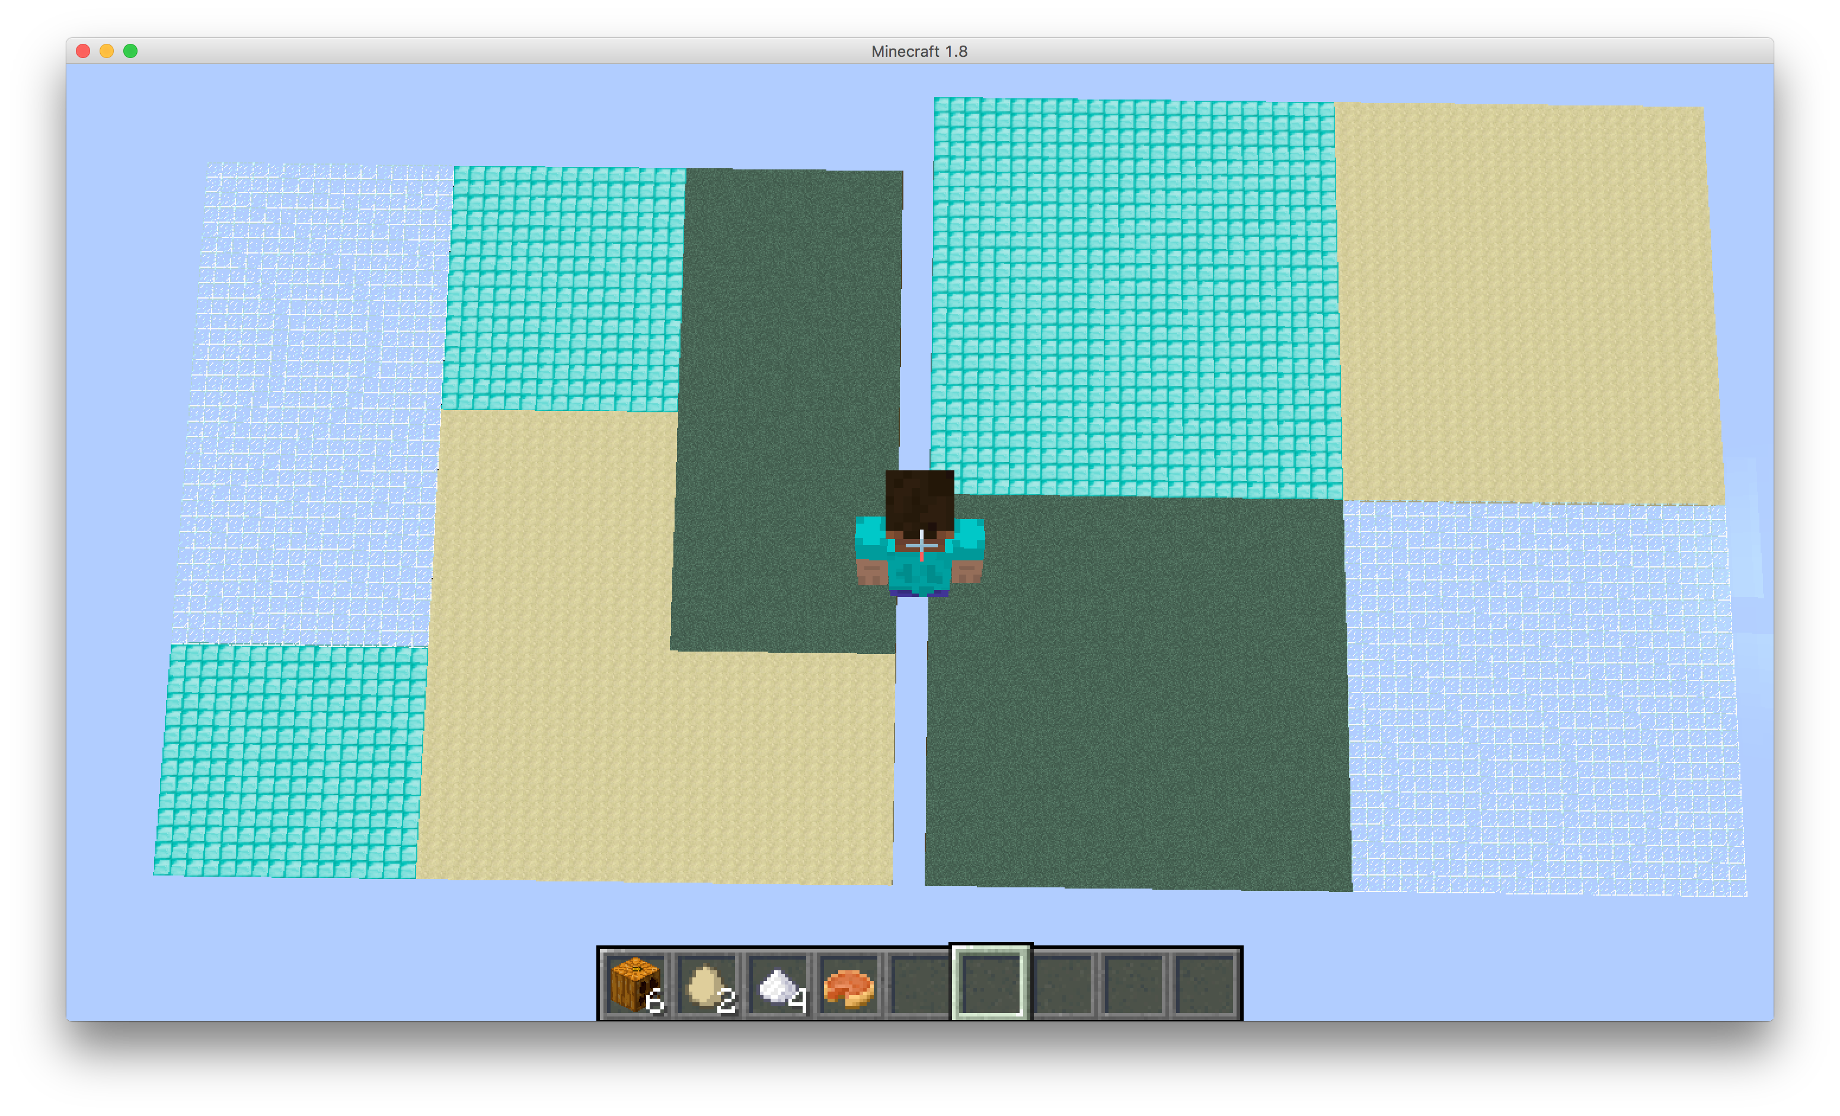
This is an overview of the whole map. On the left side, it is a 45*45 test map divided into 9 blocks with four types; on the right it is a 50*50 training map divided into 4 blocks with four types. Each object in recipe will be assigned to a type of block.

Slide 2
The agent is running DFS and Reinforcement learning to keep track of each collected object with the type of block where it is found.
After traversing the whole map, it will have a dictionary as
{object1:[(type1, 0.9), (type2, 0.1)…], object2:[(type1, 0.9), (type2, 0.1)…], …}
After the agent finishes training, it will teleport to the new map with the training result.
There will be objects other than things in recipe as outliers. Out agent will be able to conquer this problem.
This is a sample output of training result.
'sugar': [(u'glass', 0.9), (u'sandstone', 0.1)],
'egg': [(u'diamond_block', 1.0), (u'glass', 0.0), (u'grass', 0.0), (u'sandstone', 0.0)],
'pumpkin': [(u'sandstone', 0.8888888888888888), (u'grass', 0.1111111111111111), (u'glass', 0.0), (u'diamond_block', 0.0)]}

Slide 3
The agent takes the training result and optimizes a better way of retrieving those objects on the new map.
The agent will rank terrain with probability from the dictionary. In other word, it will go to the closest block with highest probability.
In the demo, the task to make a PUMPKIN PIE, which is made of a pumpkin, sugar, and an egg.
Therefore, the agent will first find a pumpkin on Sandstone. Since it is currently on Sandstone, it will begin a DFS in this area. Then it will look for egg on Diamond, which is on the East side of its current position. Sugar is on Glass, and the closest glass is on South. Hence, it will go south for the last piece to craft a pumpkin pie.

Slide 4
Evaluation
For a simple DFS, the worst case is to travel all blocks or travel two blocks of the same type, causing unneeded actions.
For our agent, it evaluates blocks in ranks, so it will never look back into a type of blocks that it has visited.

