Slide 1
Illustration
Ki Hyun Kim

Slide 2
z
x+y
…
x
y

Slide 3
Related meaning
Sense 1
Sense 2
Word 2
Sense 3
Word 1
Sense 4
Sense 5
Related meaning

Slide 4
entity .n.01
physical_entity .n.01
causal_agent .n.01
person .n.01
worker .n.01
employee .n.01
deliveryman .n.01
mailman .n.01
enrollee .n.01
preserver .n.03
defender .n.01
lawman .n.01
sheriff .n.01
fireman .n.04
policeman .n.01
student .n.01

Slide 5
GREEN | L1 Norm
BLUE | L2 Norm
RED | Infinity Norm

Slide 7

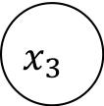
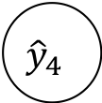
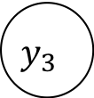
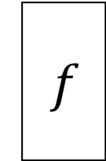


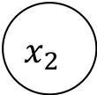
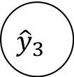
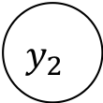
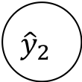

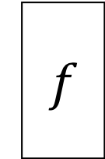



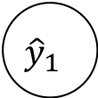
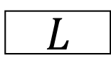


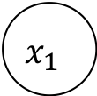

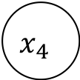

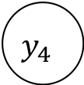
$$y_{1}$$
$$y_{2}$$
$$y_{3}$$
$$y_{4}$$
$$L$$
$${\hat{y}}_{1}$$
$${\hat{y}}_{2}$$
$${\hat{y}}_{3}$$
$${\hat{y}}_{4}$$
$$h_{1}$$
$$h_{2}$$
$$h_{3}$$
$$h_{4}$$
$$f$$
$$f$$
$$f$$
$$f$$
$$h_{0}=0$$
$$h_{1}$$
$$h_{2}$$
$$h_{3}$$
$$h_{4}$$
$$x_{1}$$
$$x_{2}$$
$$x_{3}$$
$$x_{4}$$

Slide 8
$$y_{1}$$
$$y_{2}$$
$$y_{3}$$
$$y_{4}$$
$$L$$
$${\hat{y}}_{1}$$
$${\hat{y}}_{2}$$
$${\hat{y}}_{3}$$
$${\hat{y}}_{4}$$
$$h_{1}$$
$$h_{2}$$
$$h_{3}$$
$$h_{4}$$
$$f$$
$$f$$
$$f$$
$$f$$
$$h_{0}=0$$
$$h_{1}$$
$$h_{2}$$
$$h_{3}$$
$$h_{4}$$
$$x_{1}$$
$$x_{2}$$
$$x_{3}$$
$$x_{4}$$

Slide 9
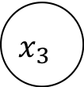
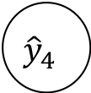
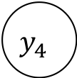
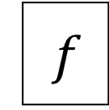
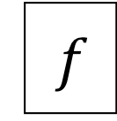


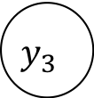


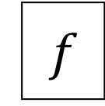



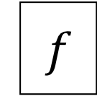


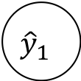



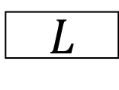

$$y_{1}$$
$$y_{2}$$
$$y_{3}$$
$$y_{4}$$
$$L$$
$${\hat{y}}_{1}$$
$${\hat{y}}_{2}$$
$${\hat{y}}_{3}$$
$${\hat{y}}_{4}$$
$$h_{1}$$
$$h_{2}$$
$$h_{3}$$
$$h_{4}$$
$$f$$
$$f$$
$$f$$
$$f$$
$$f$$
$$f$$
$$f$$
$$f$$
$$f$$
$$f$$
$$f$$
$$f$$
$$x_{1}$$
$$x_{2}$$
$$x_{3}$$
$$x_{4}$$

Slide 10
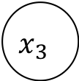



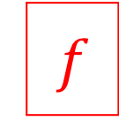
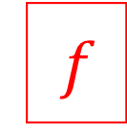
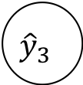
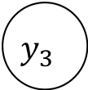




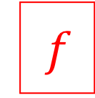


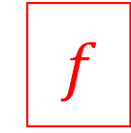




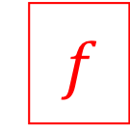
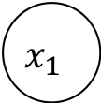
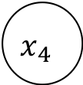


$$y_{1}$$
$$y_{2}$$
$$y_{3}$$
$$y_{4}$$
$$L$$
$${\hat{y}}_{1}$$
$${\hat{y}}_{2}$$
$${\hat{y}}_{3}$$
$${\hat{y}}_{4}$$
$$h_{1}$$
$$f$$
$$h_{2}$$
$$f$$
$$h_{3}$$
$$f$$
$$h_{4}$$
$$f$$
$$f$$
$$f$$
$$f$$
$$f$$
$$f$$
$$f$$
$$f$$
$$f$$
$$f$$
$$f$$
$$f$$
$$f$$
$$f$$
$$f$$
$$f$$
$$f$$
$$f$$
$$f$$
$$f$$
$$f$$
$$x_{1}$$
$$x_{2}$$
$$x_{3}$$
$$x_{4}$$

Slide 11








매우 긍정
…1000…
$$L$$
긍정
…
0.1
0.7
0.2
0.1
…
$$softmax$$
$$h_{1}$$
$$h_{2}$$
$$h_{3}$$
$$h_{4}$$
$$f$$
$$f$$
$$f$$
$$f$$
$$h_{0}$$
$$h_{1}$$
$$h_{2}$$
$$h_{3}$$
$$h_{4}$$
$$emb$$
$$emb$$
$$emb$$
$$emb$$
…0010…
BOS
$$나는$$
$$학교에$$
$$가는$$

Slide 12









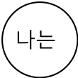

$$너는$$
$$직장에$$
$$가는$$
$$것을$$
…1000…
$$L$$
$$나는$$
$$학교에$$
$$가는$$
$$것을$$
…
0.1
0.7
0.2
0.1
…
$$softmax$$
$$softmax$$
$$softmax$$
$$softmax$$
$$h_{1}$$
$$h_{2}$$
$$h_{3}$$
$$h_{4}$$
$$f$$
$$f$$
$$f$$
$$f$$
$$h_{0}$$
$$h_{1}$$
$$h_{2}$$
$$h_{3}$$
$$h_{4}$$
$$emb$$
$$emb$$
$$emb$$
$$emb$$
…0010…
BOS
$$나는$$
$$학교에$$
$$가는$$

Slide 13














$$c_{t−1}$$
x
+
$$c_{t}$$
$$forget(σ)$$
$$f_{t}$$
$$tanh$$
$$h_{t−1}$$
$$output(σ)$$
$$o_{t}$$
x
$$h_{t}$$
$$tanh$$
$$g_{t}$$
x
$$input(σ)$$
$$i_{t}$$
$$x_{t}$$

Slide 14







x
$$reset(σ)$$
$$r_{t}$$
$$h_{t−1}$$
x
+
$$h_{t}$$
$$tanh$$
$$n_{t}$$
$$update(σ)$$
$$z_{t}$$
x
$$x_{t}$$

Slide 15
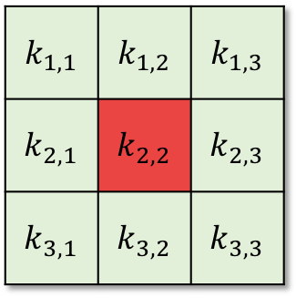
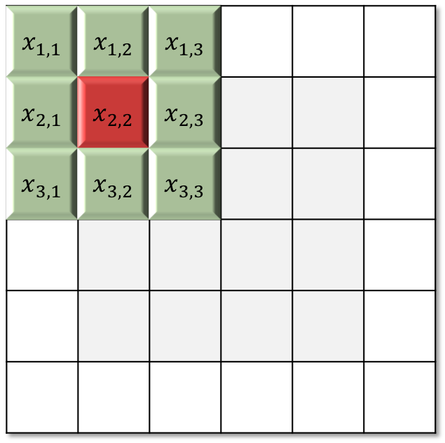
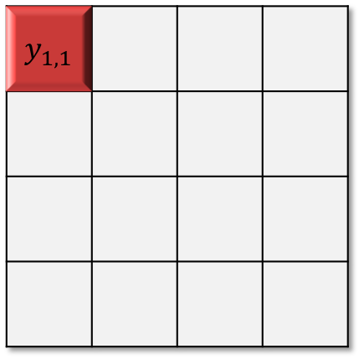
$$x_{1,1}$$ | $$x_{1,2}$$ | $$x_{1,3}$$
$$x_{2,1}$$ | $$x_{2,2}$$ | $$x_{2,3}$$
$$x_{3,1}$$ | $$x_{3,2}$$ | $$x_{3,3}$$
$$k_{1,1}$$ | $$k_{1,2}$$ | $$k_{1,3}$$
$$k_{2,1}$$ | $$k_{2,2}$$ | $$k_{2,3}$$
$$k_{3,1}$$ | $$k_{3,2}$$ | $$k_{3,3}$$
$$y_{1,1}$$

Slide 16
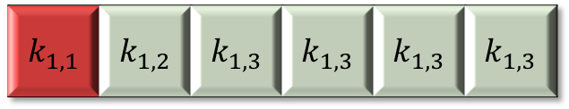
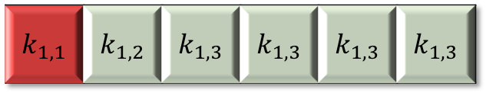

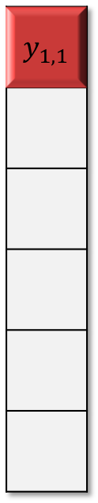
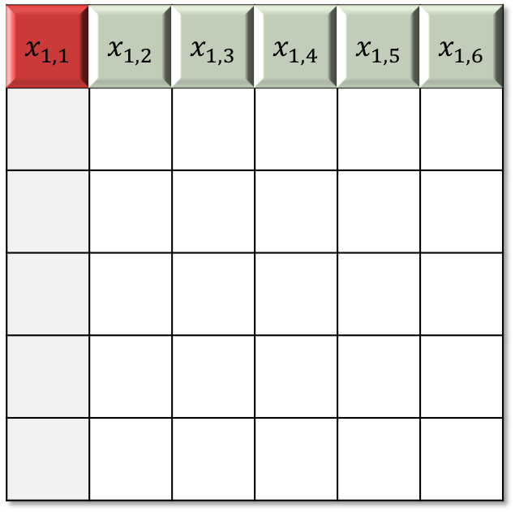

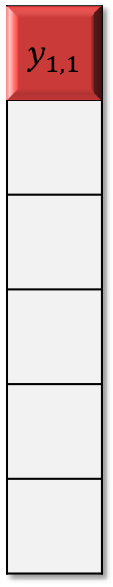

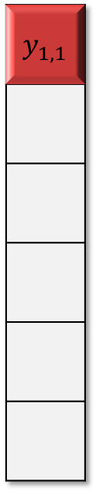
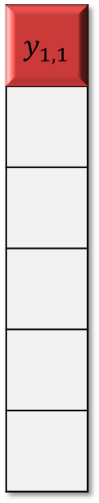

Embedding Vector Size
#filters
$$x_{1,1}$$ | $$x_{1,2}$$ | $$x_{1,3}$$ | $$x_{1,4}$$ | $$x_{1,5}$$ | $$x_{1,6}$$
$$y_{1,1}$$
$$y_{1,1}$$
$$y_{1,1}$$
$$y_{1,1}$$
#filters
$$k_{1,1}$$ | $$k_{1,2}$$ | $$k_{1,3}$$ | $$k_{1,3}$$ | $$k_{1,3}$$ | $$k_{1,3}$$
Batch Size
$$⨂$$
$$k_{1,1}$$ | $$k_{1,2}$$ | $$k_{1,3}$$ | $$k_{1,3}$$ | $$k_{1,3}$$ | $$k_{1,3}$$
$$=$$
$$k_{1,1}$$ | $$k_{1,2}$$ | $$k_{1,3}$$ | $$k_{1,3}$$ | $$k_{1,3}$$ | $$k_{1,3}$$
$$k_{1,1}$$ | $$k_{1,2}$$ | $$k_{1,3}$$ | $$k_{1,4}$$ | $$k_{1,5}$$ | $$k_{1,6}$$
Embedding Vector Size

Slide 17










$${\hat{x}}_{1}$$
$${\hat{x}}_{2}$$
$${\hat{x}}_{3}$$
$${\hat{x}}_{4}$$
$${\hat{x}}_{5}$$
softmax
softmax
softmax
softmax
softmax
rnn cell
rnn cell
rnn cell
rnn cell
rnn cell
rnn cell
rnn cell
rnn cell
rnn cell
rnn cell
embedding
embedding
embedding
embedding
embedding
$$x_{0}$$
$$x_{1}$$
$$x_{2}$$
$$x_{3}$$
$$x_{4}$$

Slide 18












Generator
$${\hat{y}}_{1}$$
$${\hat{y}}_{2}$$
$${\hat{y}}_{3}$$
$$EOS$$
softmax
softmax
softmax
softmax
Encoder
Decoder
Stacked RNN Cells
Stacked RNN Cells
Stacked RNN Cells
Stacked RNN Cells
Stacked RNN Cells
Stacked RNN Cells
Stacked RNN Cells
Stacked RNN Cells
Embedding
Embedding
Embedding
Embedding
Embedding
Embedding
Embedding
Embedding
$$x_{1}$$
$$x_{2}$$
$$x_{3}$$
$$x_{4}$$
$$BOS$$
$$y_{1}$$
$$y_{2}$$
$$y_{3}$$

Slide 19










$${\hat{y}}_{1}$$
$${\hat{y}}_{2}$$
$${\hat{y}}_{3}$$
Context vector
softmax
softmax
softmax
Attention weight
concat
concat
concat
Concatenated Encoder Output
W
Stacked RNN Cells
Stacked RNN Cells
Stacked RNN Cells
Stacked RNN Cells
Stacked RNN Cells
Stacked RNN Cells
Stacked RNN Cells
● ● ●
Embedding
Embedding
Embedding
Embedding
Embedding
Embedding
Embedding
$$x_{1}$$
$$x_{2}$$
$$x_{3}$$
$$x_{4}$$
$$BOS$$
$$y_{1}$$
$$y_{2}$$

Slide 20
$${\hat{y}}_{1}$$
$${\hat{y}}_{2}$$
$${\hat{y}}_{3}$$
Context vector
softmax
softmax
softmax
Attention weight
concat
concat
concat
Concatenated Encoder Output
W
Stacked RNN Cells
Stacked RNN Cells
Stacked RNN Cells
Stacked RNN Cells
Stacked RNN Cells
Stacked RNN Cells
Stacked RNN Cells
● ● ●
;
;
Embedding
Embedding
Embedding
Embedding
Embedding
Embedding
Embedding
$$x_{1}$$
$$x_{2}$$
$$x_{3}$$
$$x_{4}$$
$$BOS$$
$$y_{1}$$
$$y_{2}$$

Slide 21
학교에
Context
Vector
Linear Transform
0.2
0.8
I | love | to | go | to | school | .
나는
학교에

Slide 22
school
school
school
school
school
school
school
school
I
I
I
I
I
I
I
I
love
love
love
love
love
love
love
love
you
you
you
you
you
you
you
you
BOS
to
to
to
to
to
to
to
to
go
go
go
go
go
go
go
go
eat
eat
eat
eat
eat
eat
eat
eat
EOS
EOS
EOS
EOS
EOS
EOS
EOS
EOS

Slide 23
I | …
<EOS> | …
school | …
go | .3
love | .2
you | …
. | …
to | …
I | …
<EOS> | …
school | …
go | …
love | …
you | …
. | …
to | …
I | …
<EOS> | …
school | .3
go | .4
love | …
you | …
. | …
to | …
I | …
<EOS> | …
school | .2
go | …
love | …
you | …
. | .1
to | .6
I | …
<EOS> | …
school | .2
go | …
love | …
you | …
. | …
to | …
I | …
<EOS> | …
school | …
go | …
love | …
you | …
. | .4
to | …
I | .4
<EOS> | …
school | …
go | .3
love | …
you | .2
. | …
to | …
I | …
<EOS> | …
school | …
go | …
love | .3
you | …
. | …
to | …
I | …
<EOS> | …
school | .2
go | .2
love | …
you | …
. | …
to | .5
I | …
<EOS> | …
school | …
go | …
love | …
you | …
. | …
to | …
I | …
<EOS> | …
school | …
go | …
love | …
you | …
. | …
to | …
I | …
<EOS> | …
school | …
go | …
love | …
you | …
. | .5
to | …
I | …
<EOS> | .6
school | …
go | …
love | …
you | …
. | …
to | …
<BOS>
I | …
<EOS> | …
school | …
go | …
love | …
you | …
. | …
to | …
I | …
<EOS> | …
school | …
go | …
love | …
you | …
. | …
to | …
I | …
<EOS> | …
school | .8
go | …
love | …
you | …
. | …
to | …
I | …
<EOS> | …
school | …
go | …
love | …
you | …
. | …
to | …
I | …
<EOS>
school | …
go | …
love | …
you | …
. | …
to | …
I
<EOS>
school
go
love
you
.
to

Slide 24
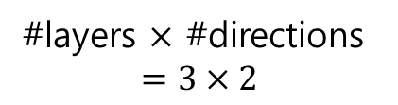

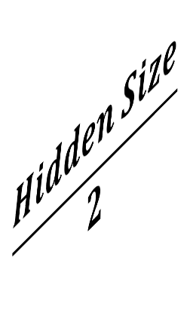
$$\frac{Hidden Size}{2}$$
Backward
Forward
Hidden Size
Layer 3
Forward Backward
#layers $×$ #directions
$$=3×2$$
Layer 2
Layer 3
#layers $=3$
Layer 2
Layer 1
Layer 1
Batch Size
Batch Size

Slide 25
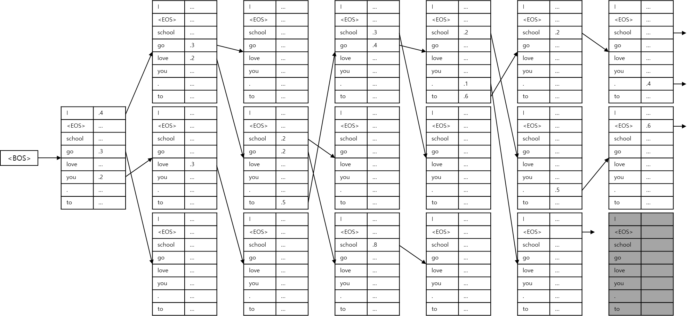
Batch Size
or
# Samples
Time-Step
Beam Size

Slide 26
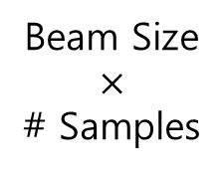
1-word
Word Vector Dim
Beam Size
Beam Size
$$×$$
# Samples
Get Batch
Time-Step
Beam Size
Sequence-to-Sequence
Batch Size
or
# Samples
Translated Fabricated Mini-batch
Separation
and
Collecting

Slide 27
Linear

Slide 28
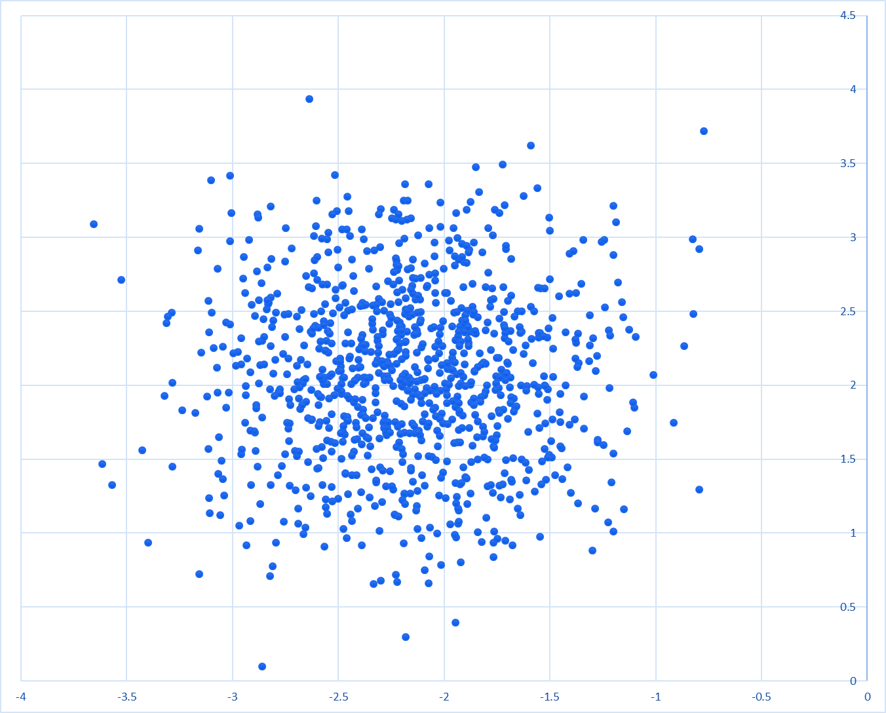
I love to go to school.

Slide 29




$$σ$$
$$2d$$
$$k$$
$$d$$

Slide 30
0.1
State
C
0.3
0.3
0.2
0.6
0.6
State
A
State
B
0.2
0.3
0.4

Slide 31













$$0.4|x$$
State
C
$$0.4|x$$
$$0.1|y$$
$$0.1|x$$
$$0.2|x$$
$$0.1|x$$
$$0.3|y$$
State
A
State
B
$$0.8|x$$
$$0.7|y$$
$$0.5|x$$
$$0.3|y$$
$$0.5|x$$
$$0.6|y$$

