Slide 1
Natural Language Processing with PyTorch Architecture
Ki Hyun Kim

Slide 2










$${\hat{x}}_{1}$$
$${\hat{x}}_{2}$$
$${\hat{x}}_{3}$$
$${\hat{x}}_{4}$$
$${\hat{x}}_{5}$$
softmax
softmax
softmax
softmax
softmax
rnn cell
rnn cell
rnn cell
rnn cell
rnn cell
rnn cell
rnn cell
rnn cell
rnn cell
rnn cell
embedding
embedding
embedding
embedding
embedding
$$x_{0}$$
$$x_{1}$$
$$x_{2}$$
$$x_{3}$$
$$x_{4}$$

Slide 3












Generator
$${\hat{y}}_{0}$$
$${\hat{y}}_{1}$$
$${\hat{y}}_{2}$$
$$EOS$$
softmax
softmax
softmax
softmax
Encoder
Decoder
Stacked RNN Cells
Stacked RNN Cells
Stacked RNN Cells
Stacked RNN Cells
Stacked RNN Cells
Stacked RNN Cells
Stacked RNN Cells
Stacked RNN Cells
Embedding
Embedding
Embedding
Embedding
Embedding
Embedding
Embedding
Embedding
$$x_{0}$$
$$x_{1}$$
$$x_{2}$$
$$x_{3}$$
$$BOS$$
$$y_{0}$$
$$y_{1}$$
$$y_{2}$$

Slide 4










$${\hat{y}}_{0}$$
$${\hat{y}}_{1}$$
$${\hat{y}}_{2}$$
Context vector
softmax
softmax
softmax
Attention weight
concat
concat
concat
Concatenated Encoder Output
W
Stacked RNN Cells
Stacked RNN Cells
Stacked RNN Cells
Stacked RNN Cells
Stacked RNN Cells
Stacked RNN Cells
Stacked RNN Cells
● ● ●
Embedding
Embedding
Embedding
Embedding
Embedding
Embedding
Embedding
$$x_{0}$$
$$x_{1}$$
$$x_{2}$$
$$x_{3}$$
$$BOS$$
$$y_{0}$$
$$y_{1}$$

Slide 5
$${\hat{y}}_{0}$$
$${\hat{y}}_{1}$$
$${\hat{y}}_{2}$$
Context vector
softmax
softmax
softmax
Attention weight
concat
concat
concat
Concatenated Encoder Output
W
Stacked RNN Cells
Stacked RNN Cells
Stacked RNN Cells
Stacked RNN Cells
Stacked RNN Cells
Stacked RNN Cells
Stacked RNN Cells
● ● ●
;
;
Embedding
Embedding
Embedding
Embedding
Embedding
Embedding
Embedding
$$x_{0}$$
$$x_{1}$$
$$x_{2}$$
$$x_{3}$$
$$BOS$$
$$y_{0}$$
$$y_{1}$$

Slide 6
학교에
Context
Vector
Linear Transform
0.2
0.8
I | love | to | go | to | school | .
나는
학교에

Slide 7
school
school
school
school
school
school
school
school
I
I
I
I
I
I
I
I
love
love
love
love
love
love
love
love
you
you
you
you
you
you
you
you
BOF
to
to
to
to
to
to
to
to
go
go
go
go
go
go
go
go
eat
eat
eat
eat
eat
eat
eat
eat
EOF
EOF
EOF
EOF
EOF
EOF
EOF
EOF

Slide 8
Linear

Slide 9
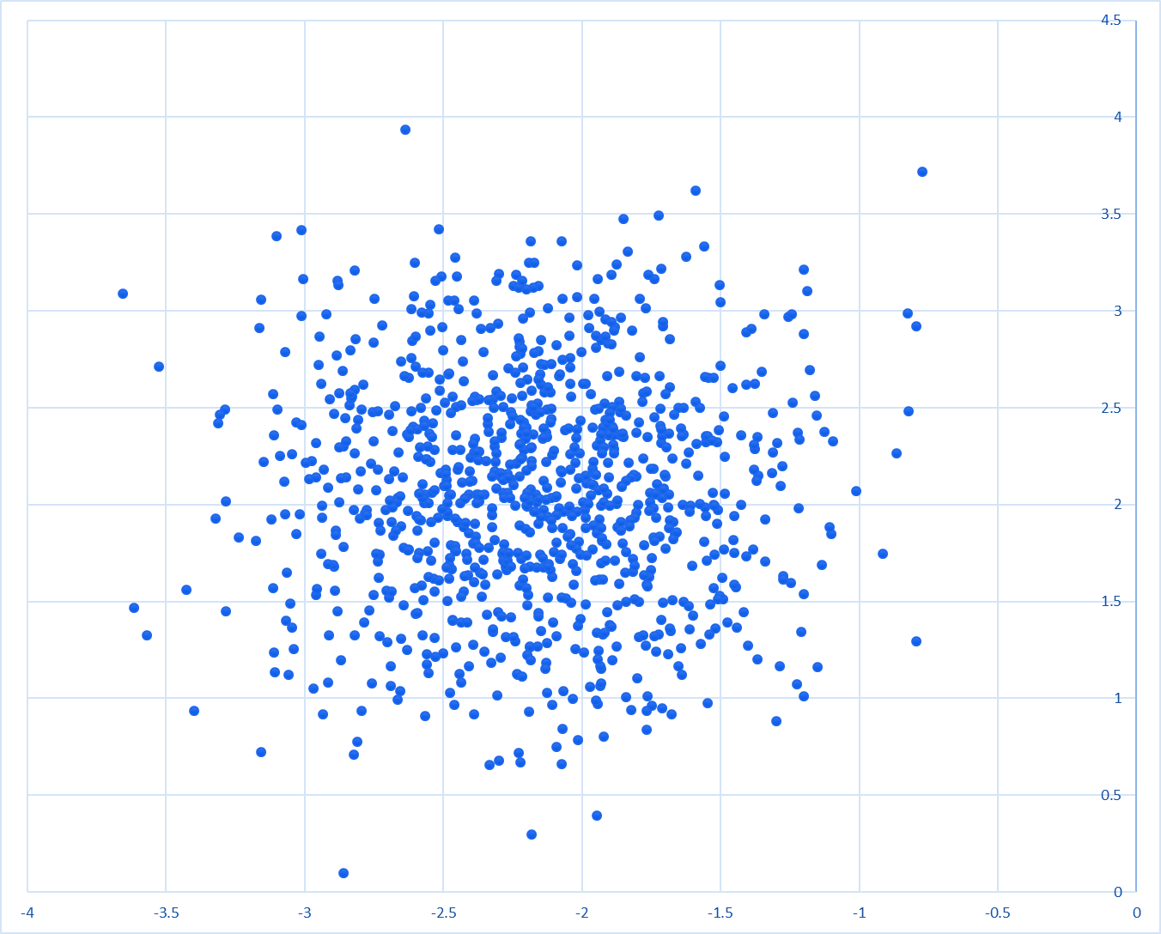
I love to go to school.

Slide 10
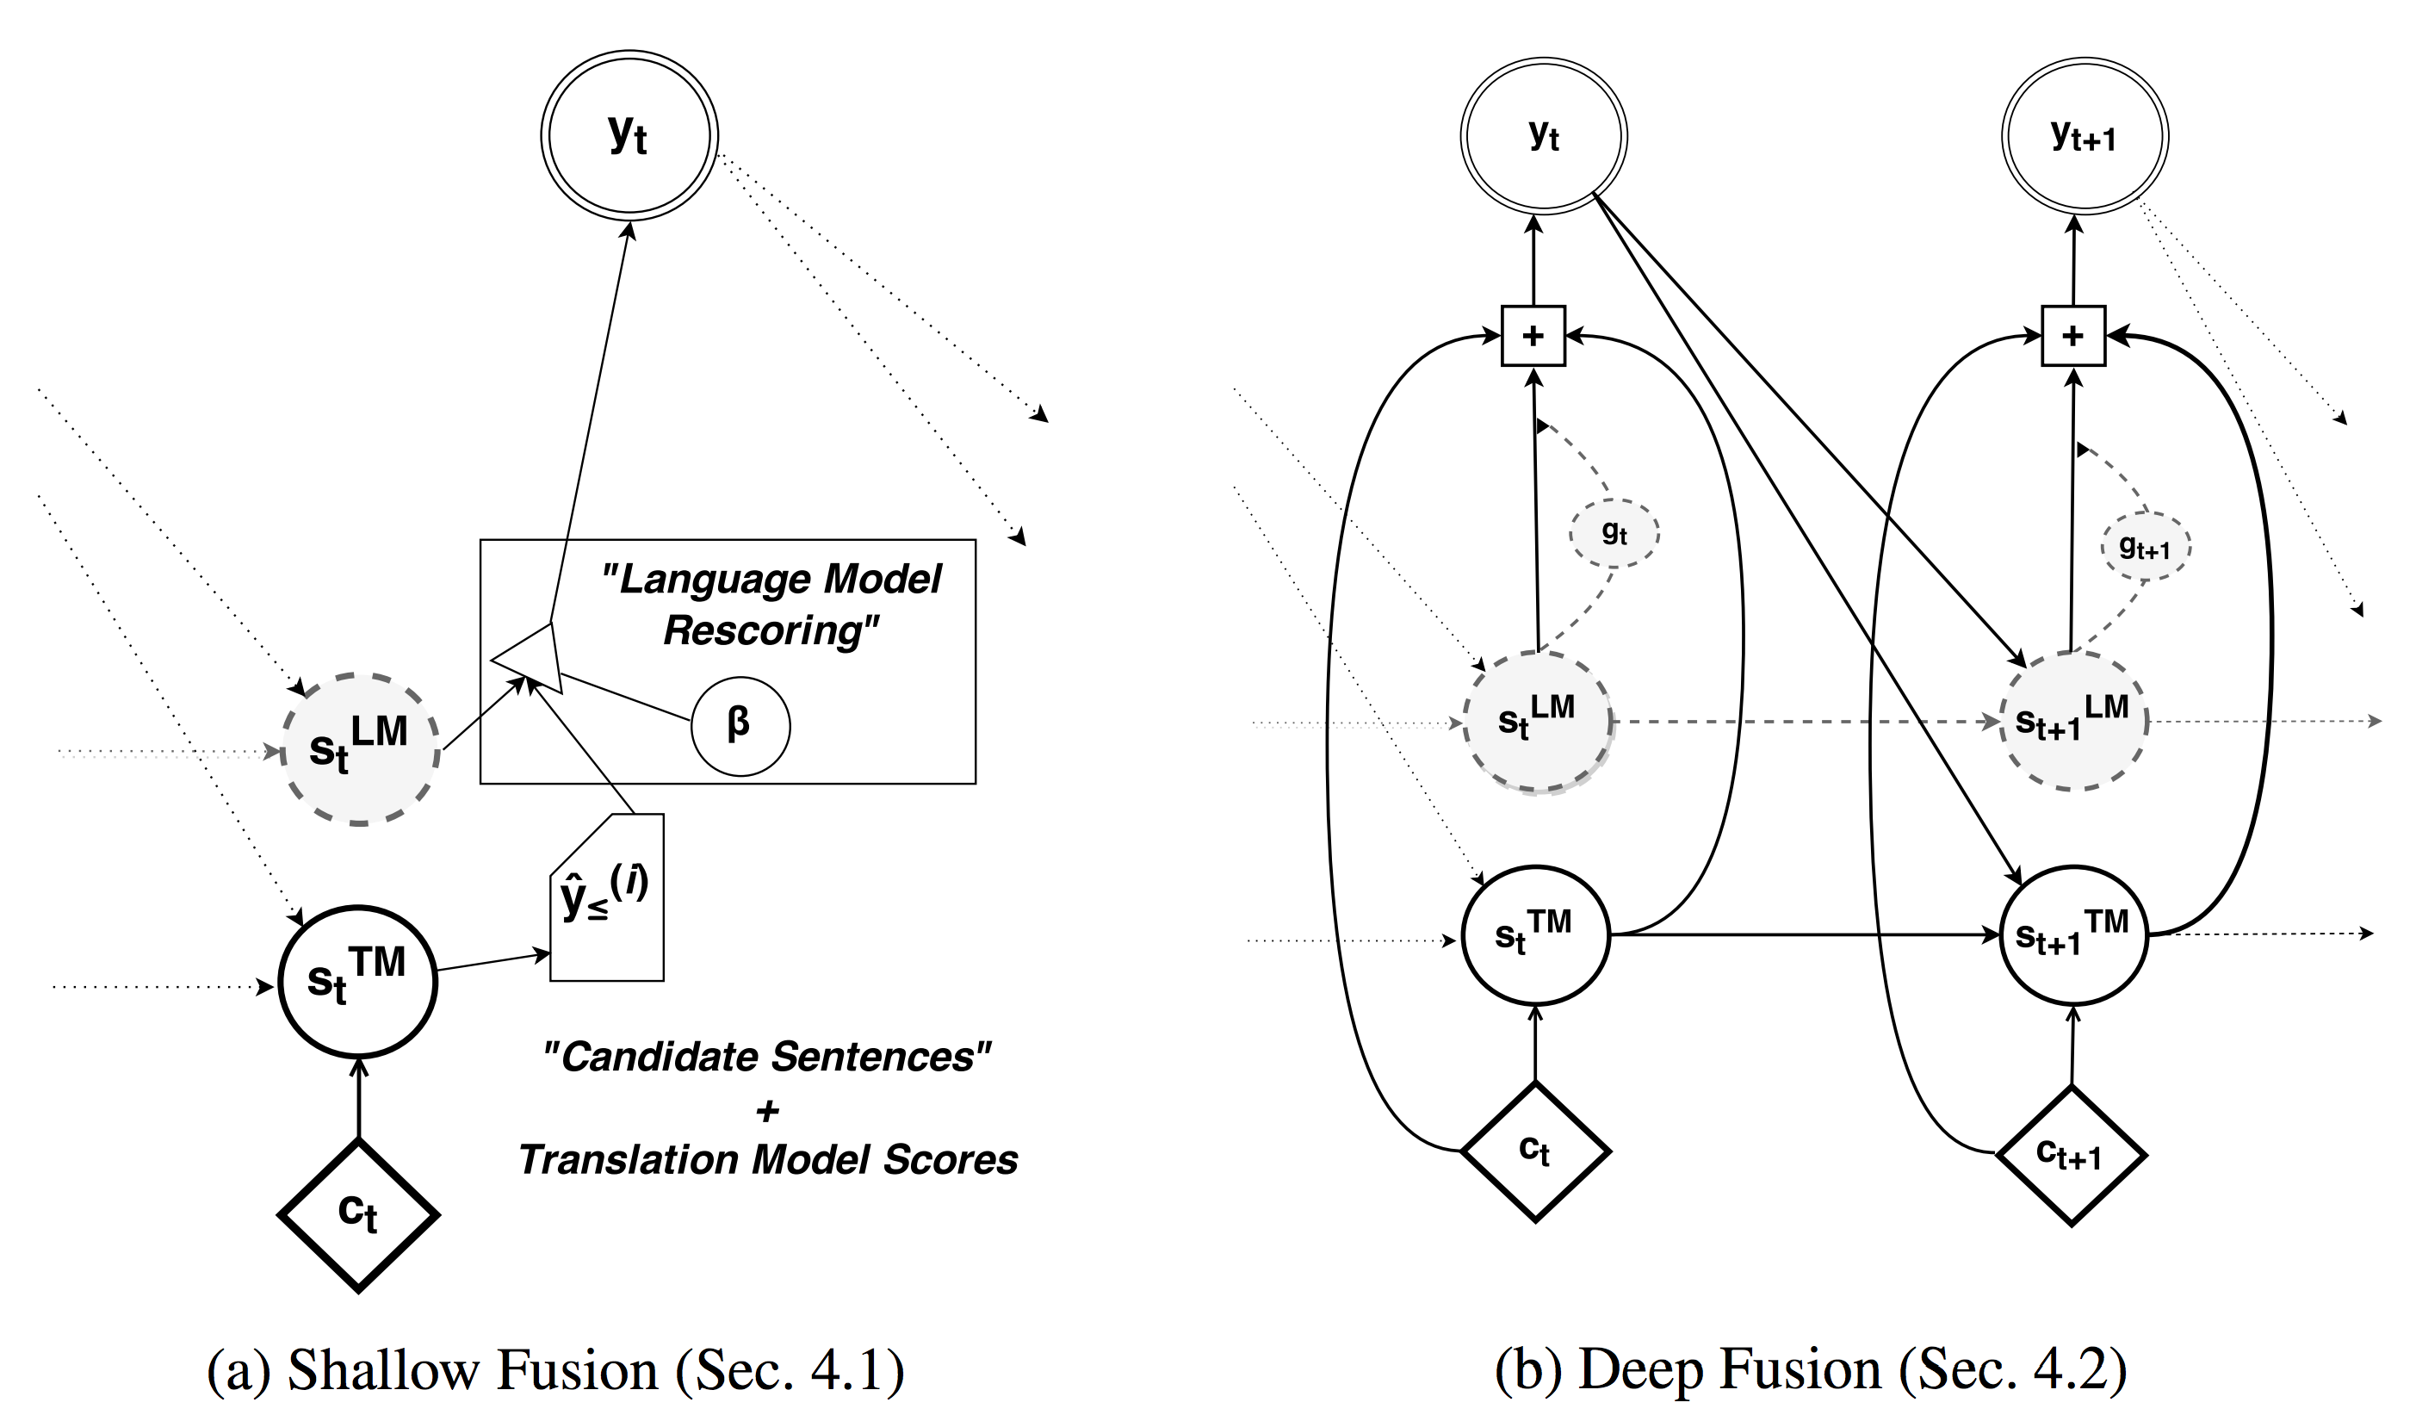

Slide 11
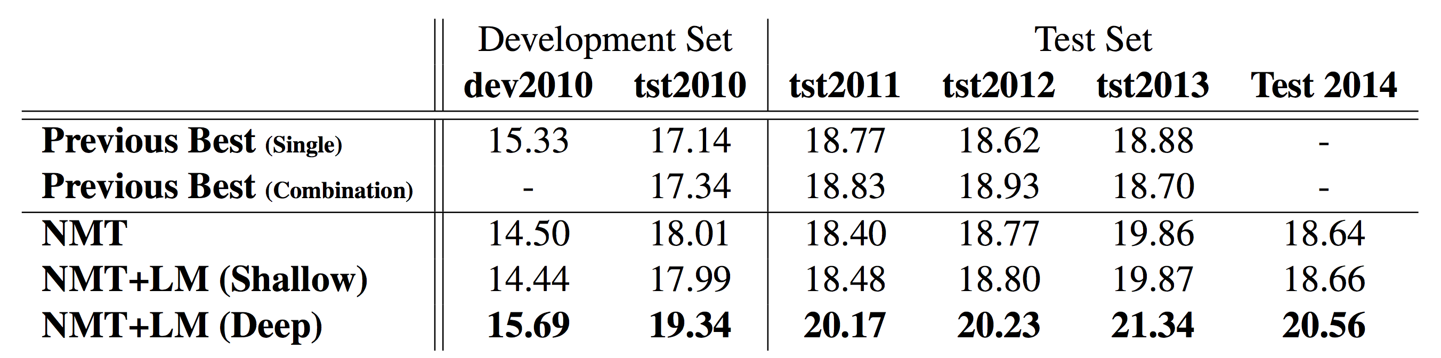

Slide 12
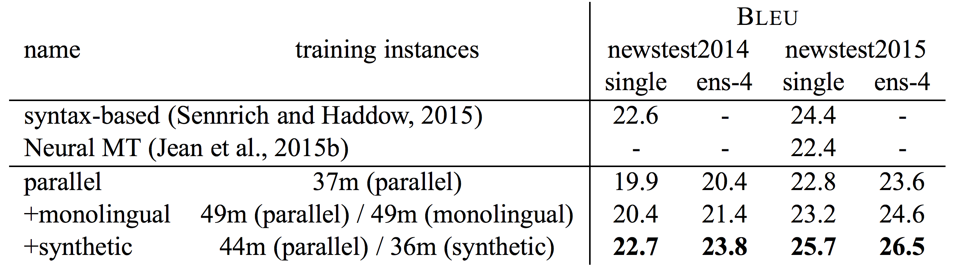

Slide 13
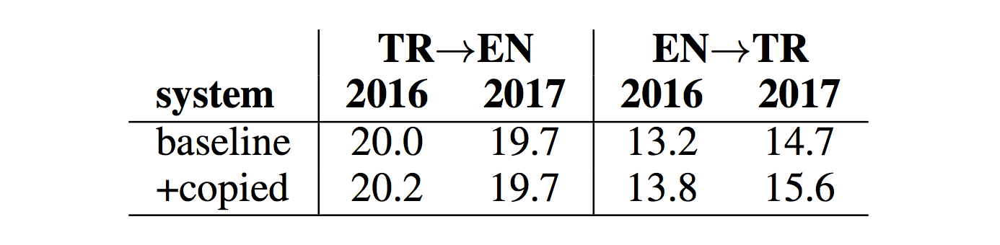

Slide 14
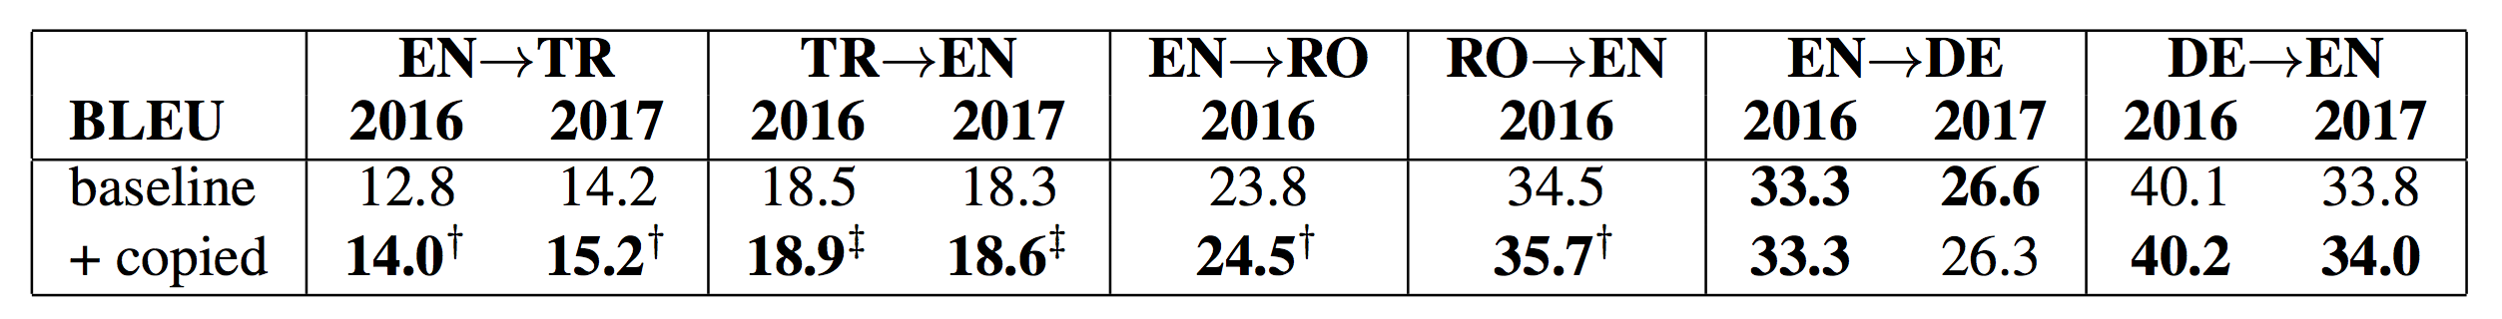

Slide 15
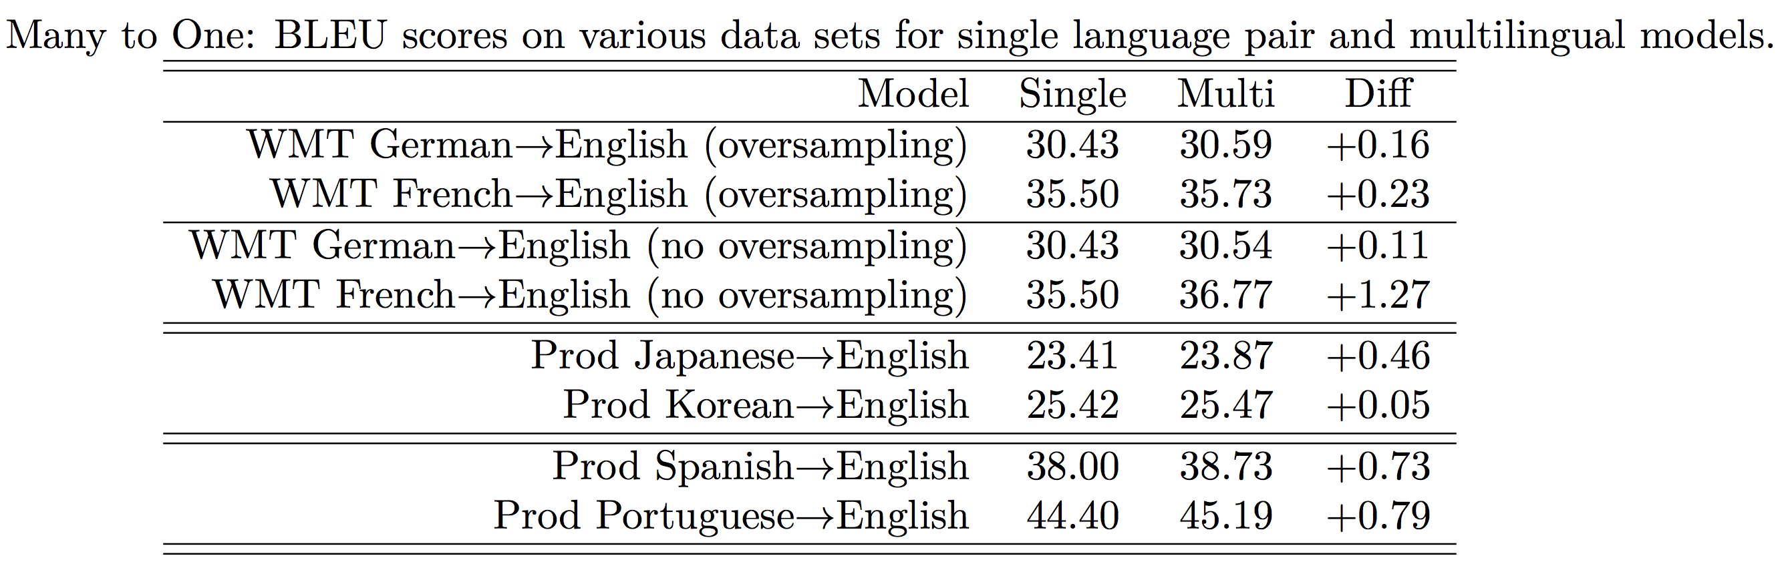

Slide 16
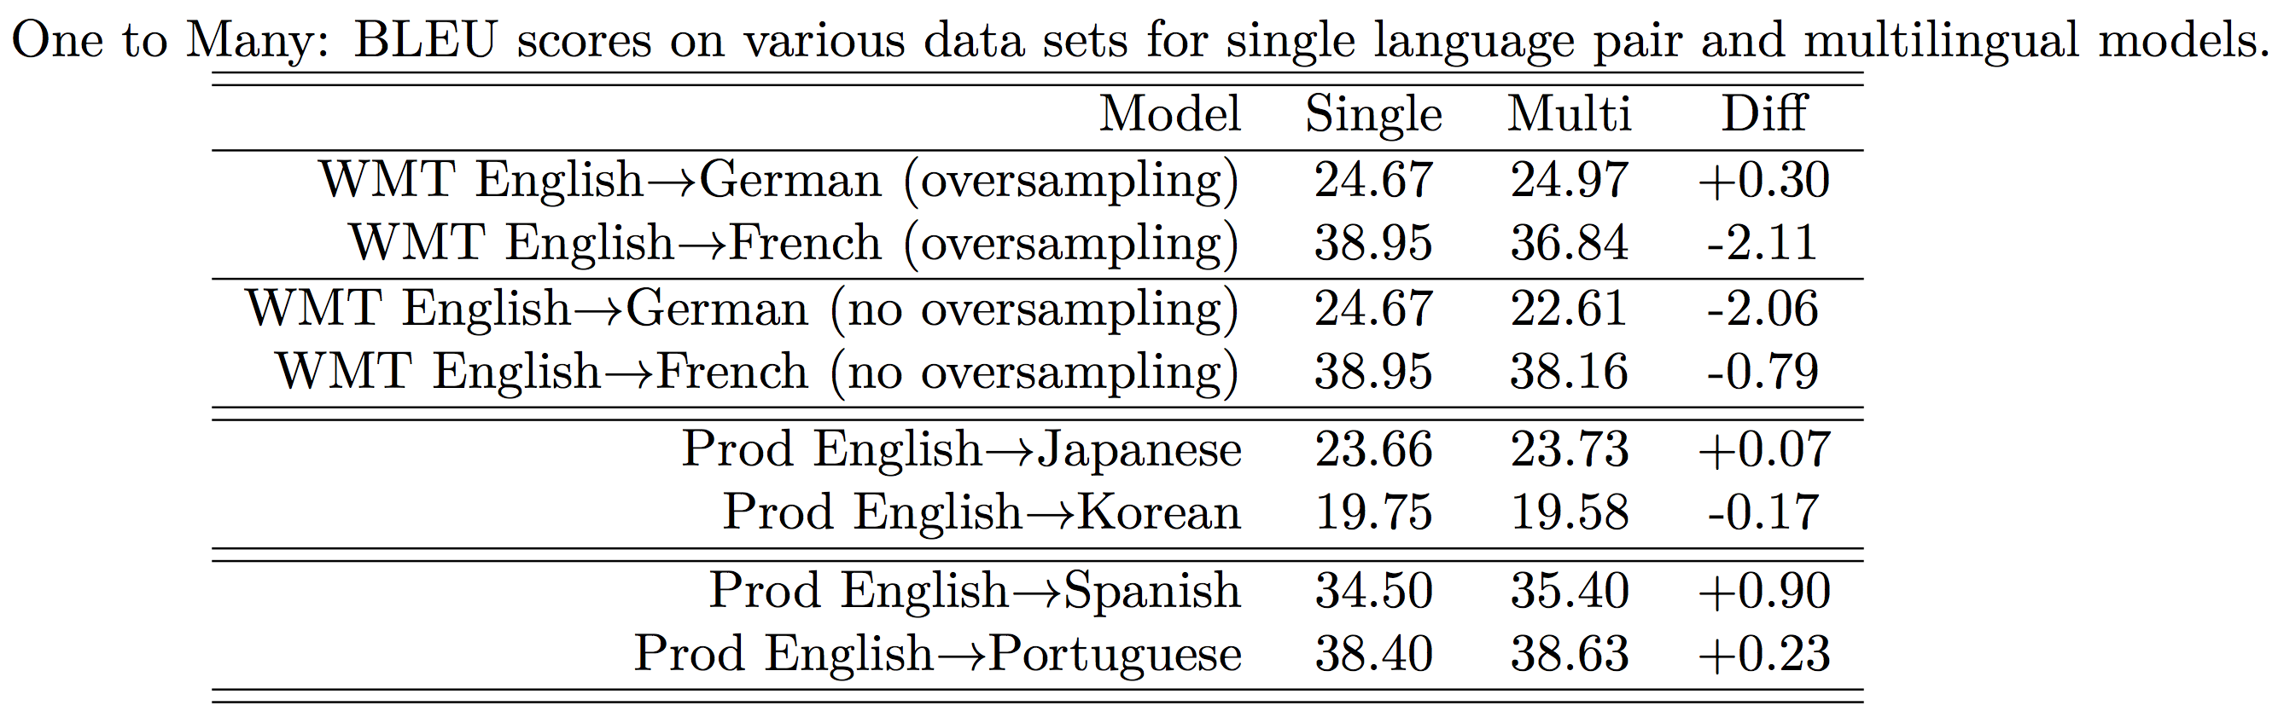

Slide 17
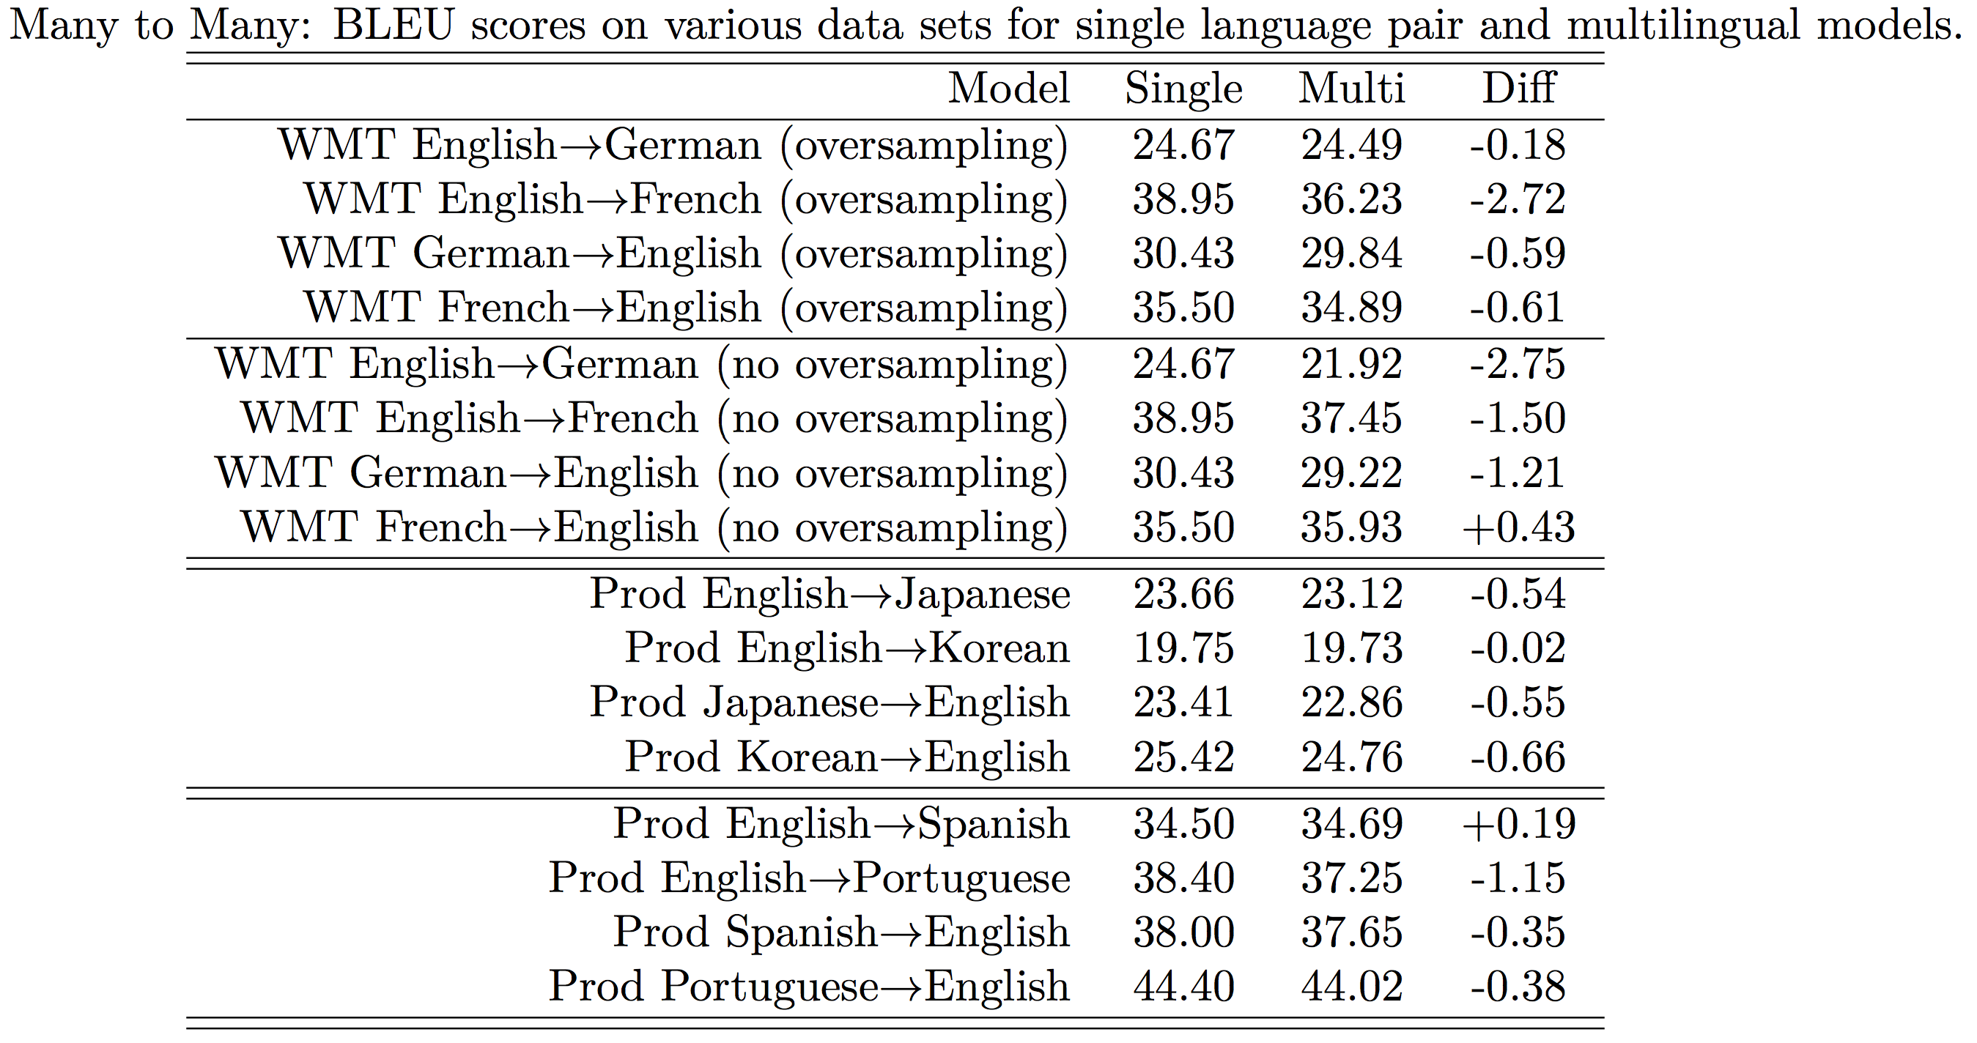

Slide 18
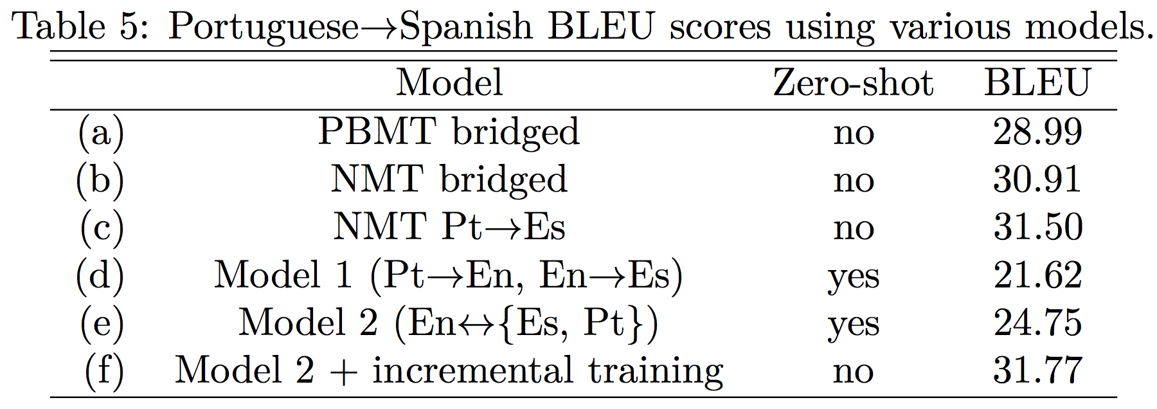

Slide 19
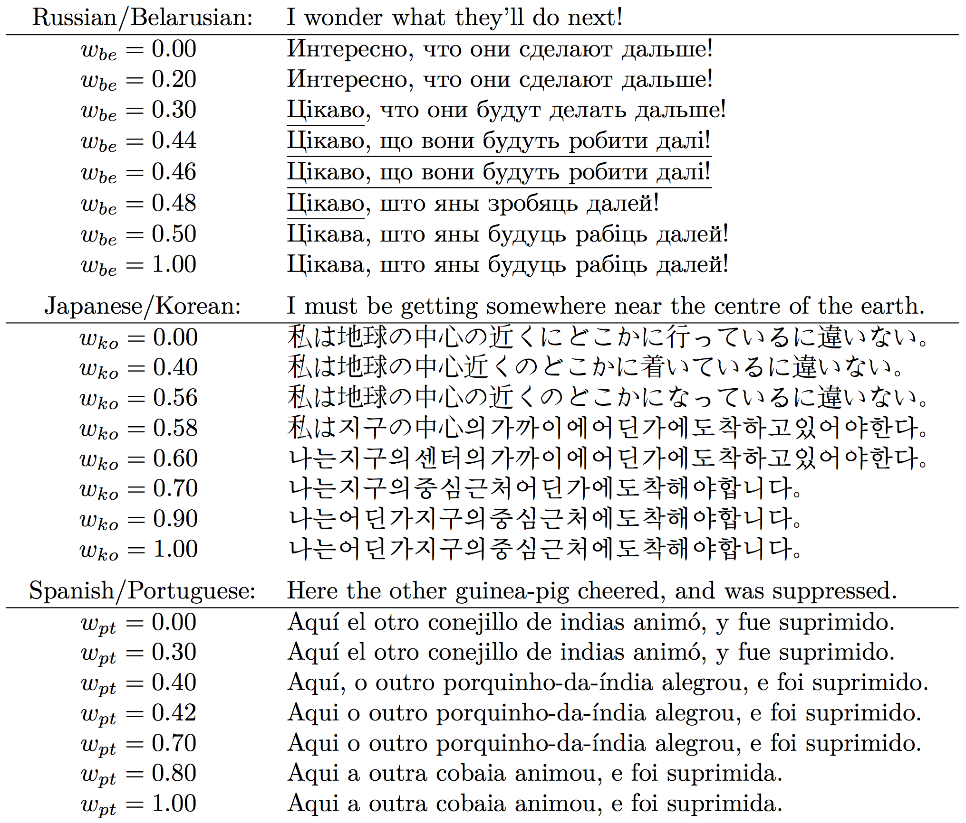

Slide 20
