Slide 1
Intrinsically Motivated Goal Exploration Processes with Automatic Curriculum Learning
Group 2: Jonas Jakob, Leon Wagner, Kunpeng Xiao

Slide 2
Table of contents
Introduction
Theory
Implementation Paper
Our Approach
Results of our Approach (so far)

Slide 3
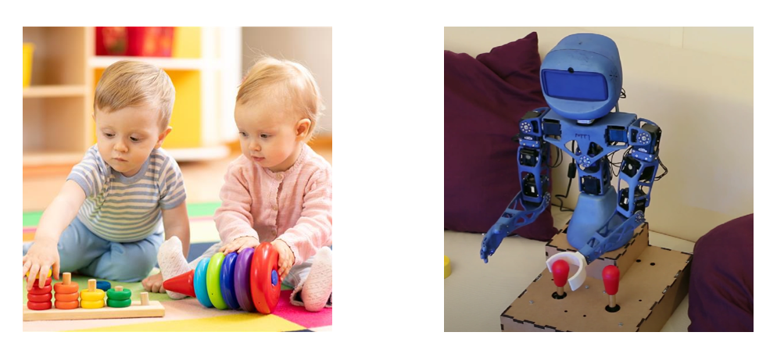
Introduction
Notes:
Background and Context:
Human developmental learning relies on intrinsically motivated exploration.
Machines lack autonomous learning capabilities akin to human infants.
Existing models fail to autonomously generate and pursue diverse learning goals.
Research Gap:
There's a significant gap in replicating human-like autonomous learning in AI systems.
Research Objective or Purpose:
Introduce Intrinsically Motivated Goal Exploration Processes (IMGEP) for autonomous learning.
Develop algorithms that can self-generate goals, explore efficiently, and leverage acquired information.
Significance and Contribution:
Contributes to developmental artificial intelligence.
Facilitates efficient acquisition of high-dimensional motor skills in robotics.
Implications for robotics, neuroscience, and psychology.
Scope and Structure:
Formalization of IMGEP.
Introduction of AMB algorithmic architecture.
Experimental evidence demonstrating efficacy.
Terminology and Definitions:
Define autotelic learning, intrinsically motivated exploration, and developmental trajectory.
Methodological Approach:
Brief introduction to IMGEP architecture and key components.
Expected Outcomes or Implications:
IMGEP expected to autonomously generate learning curricula and discover diverse skills.
Potential to advance artificial intelligence and inform the development of autonomous learning systems.

Slide 4
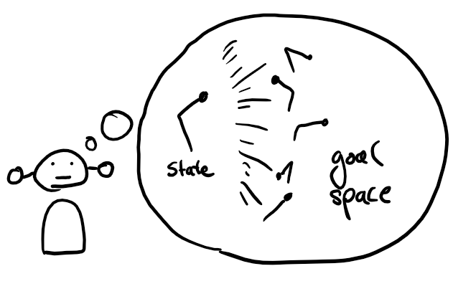
Assumptions
agent executes continuous actions in continuous states of an environment
policies considered as time-bounded rollouts through the dynamics of the environment
corresponding behavioral trajectories (to the policies)
agent can construct goal space
goal space is representing the fitness functions to reach certain goals with certain experiments
agent can compute the fitness function for any goal in the goal-space
given a state, possible actions and a goal space, agent explores by sampling goals, searching for good solutions, learning goal-parameterized policy to reach any goal from any state

Slide 5
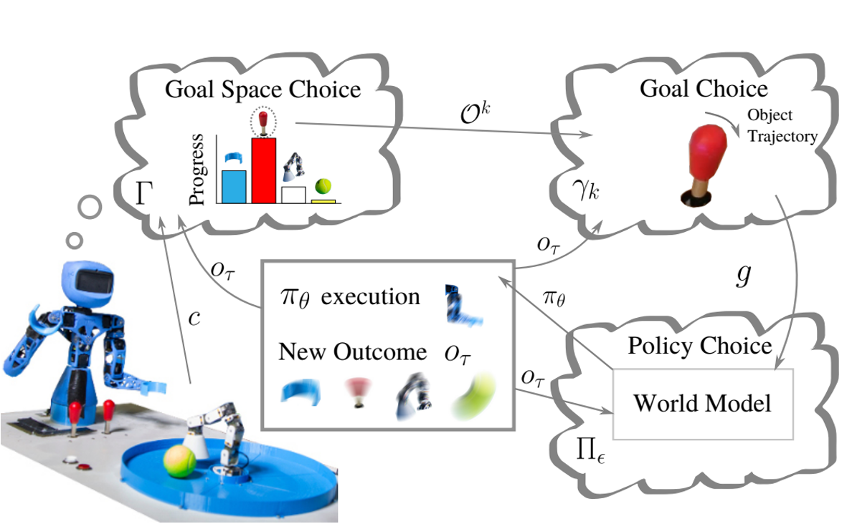
Algorithm - important aspects
goal-parameterized policy Π is based on the population of solutions
object-centered modular goal construction
goal space G constructed in modular manner starting from set of objects
implementation of stepping-stone preserving mutations
particular instantiation of modular population-based IMGEP
AMB (Active Model Babbling)
RMB (Random Model Babbling)
Notes:
AMB - learning progress based, with stepping stone preservation
RMB - randomly choosing goals from the goal space, with stepping stone preservation

Slide 6
All intrinsic Algorithms
AMB (Active Model Babbling): Curious explorer, sets goals for specific tools and learns from progress. Think: Child playing with toolbox, figuring out each tool's purpose. → developed by the authors
RMB (Random Model Babbling): Random player, tries different actions without a plan. Think: Toddler grabbing random toys, making noise and exploring without focus.
FRGB (Flat Random Goal Babbling): Overwhelmed planner, considers everything at once, leading to inefficiency. Think: Child trying to play with all toys simultaneously, getting tangled up.
SGS (Single Goal Space): Fixated learner, explores only one goal or object, ignoring the rest. Think: Child fixated on one toy, refusing to play with anything else.
FC (Fixed Curriculum): Step-by-step follower, explores goals in a predetermined order, potentially missing new discoveries. Think: Child following instructions to build something, not exploring other possibilities.

Slide 7
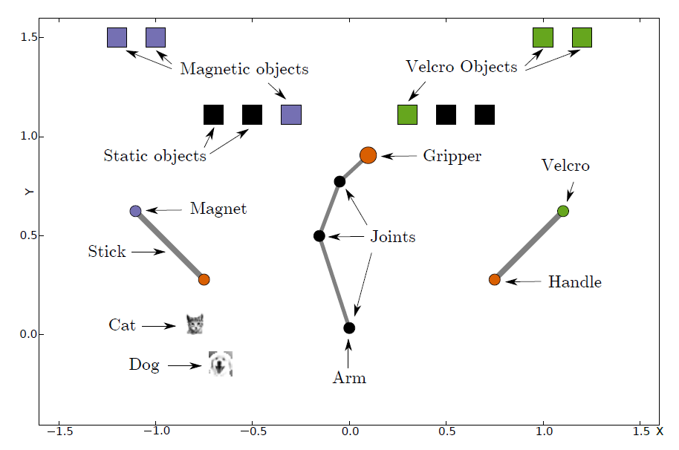
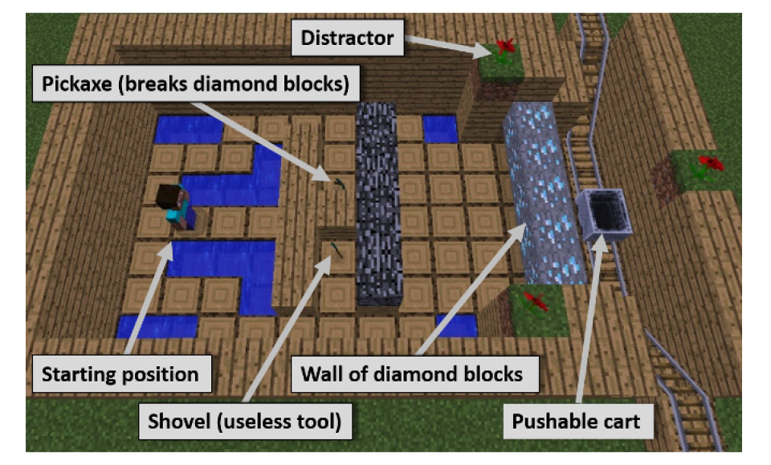
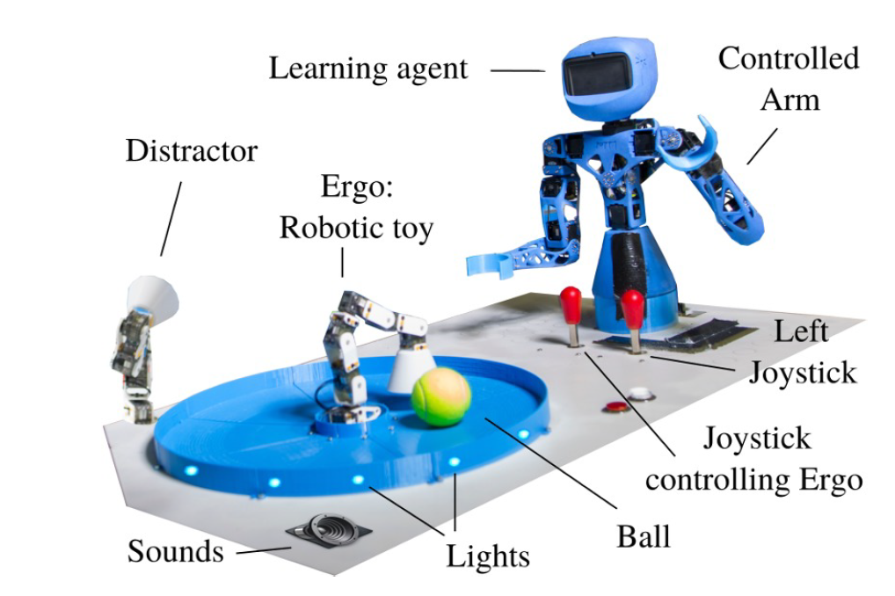
Implementation Paper
Agents using a modular representation of goals (AMB) explored tool and toy spaces better than those with a flat representation in the 2D simulated environment. Modular approaches significantly outperformed flat approaches in the Minecraft Mountain Cart and Robotic environments as well.

Slide 8
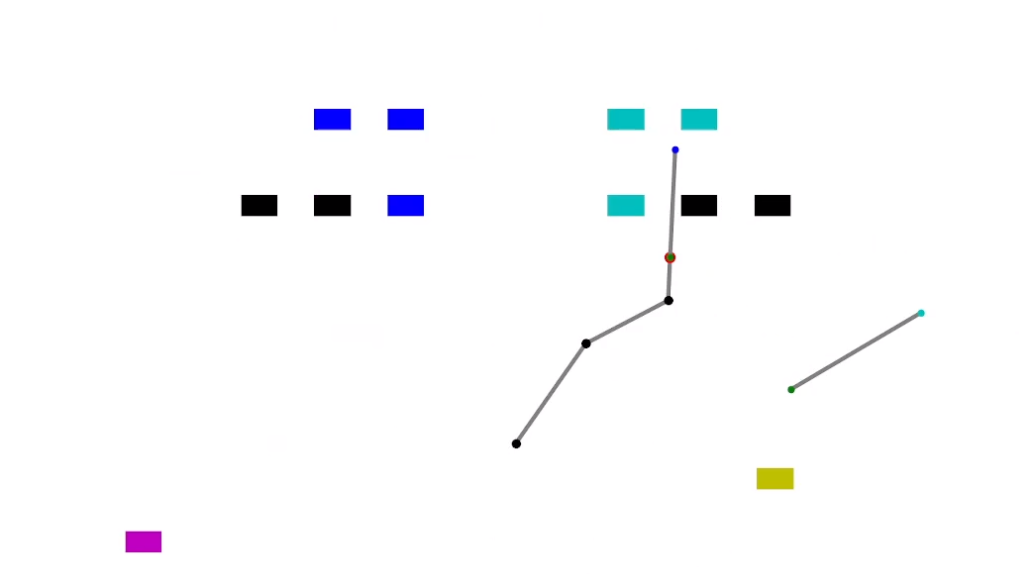
Our Approach
reimplemented the “2D Simulated Tool-Use Environment” for further investigation of the paper.
verification of the authors results
play with parameters and enhance visualization

Slide 9

LIVE presentation

Slide 10
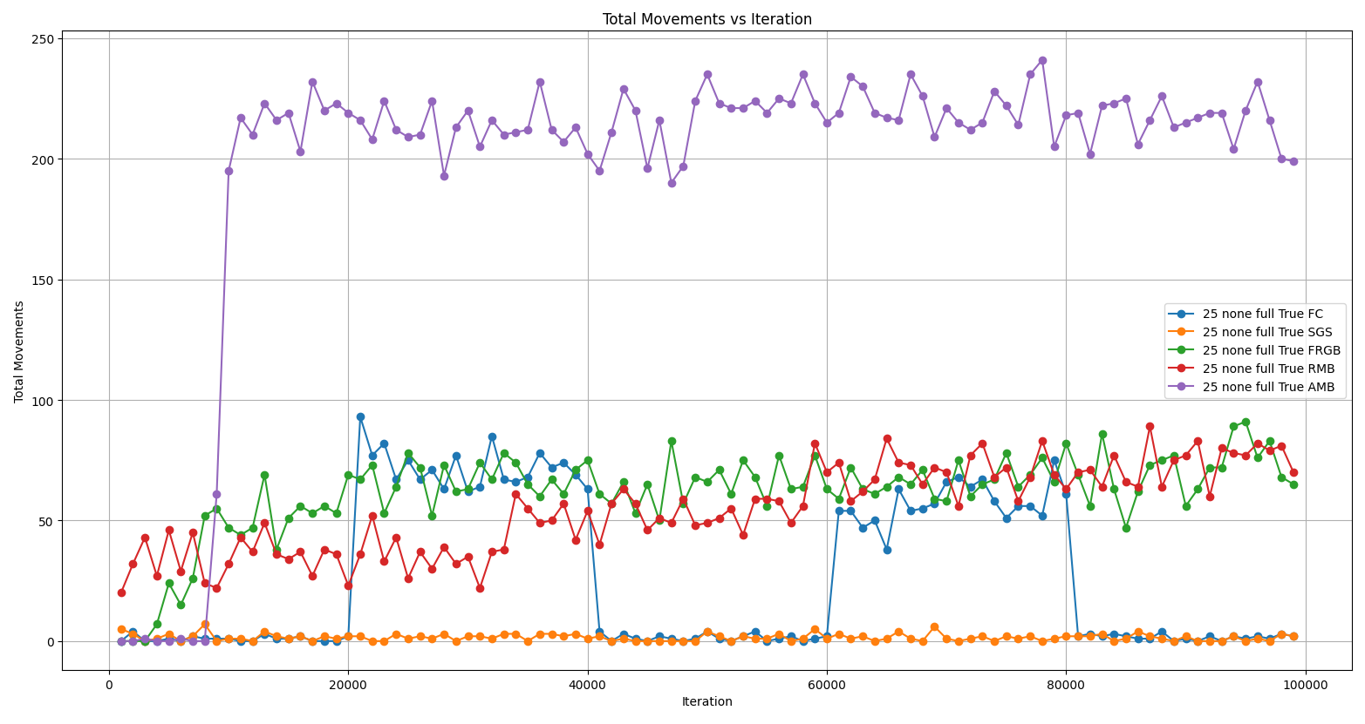
Results (no distractions)

Slide 11
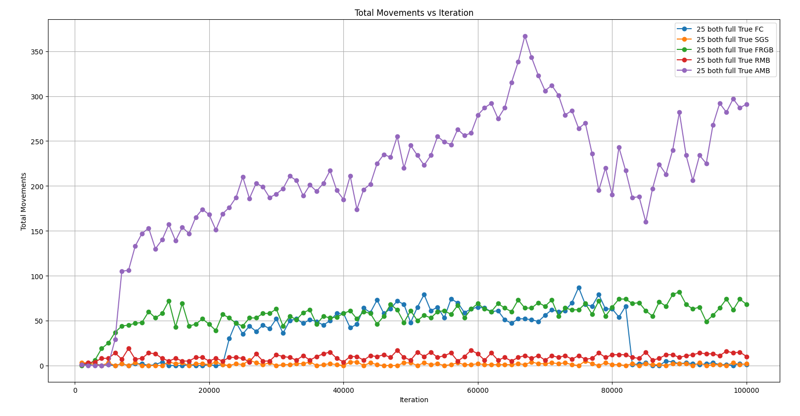
Results (both distractions)

Slide 12
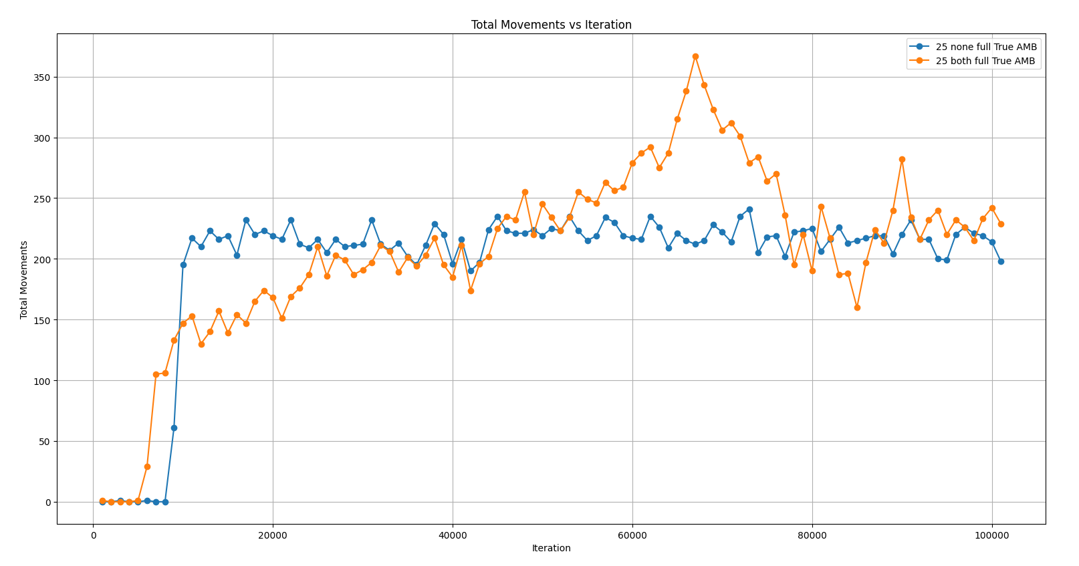
Comparison AMB

Slide 13
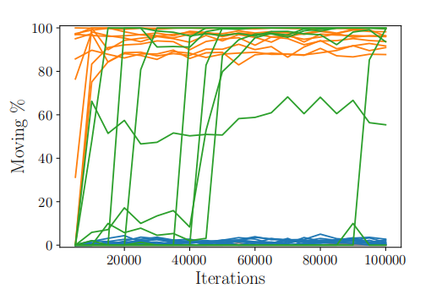
Portions of Movement

Slide 14
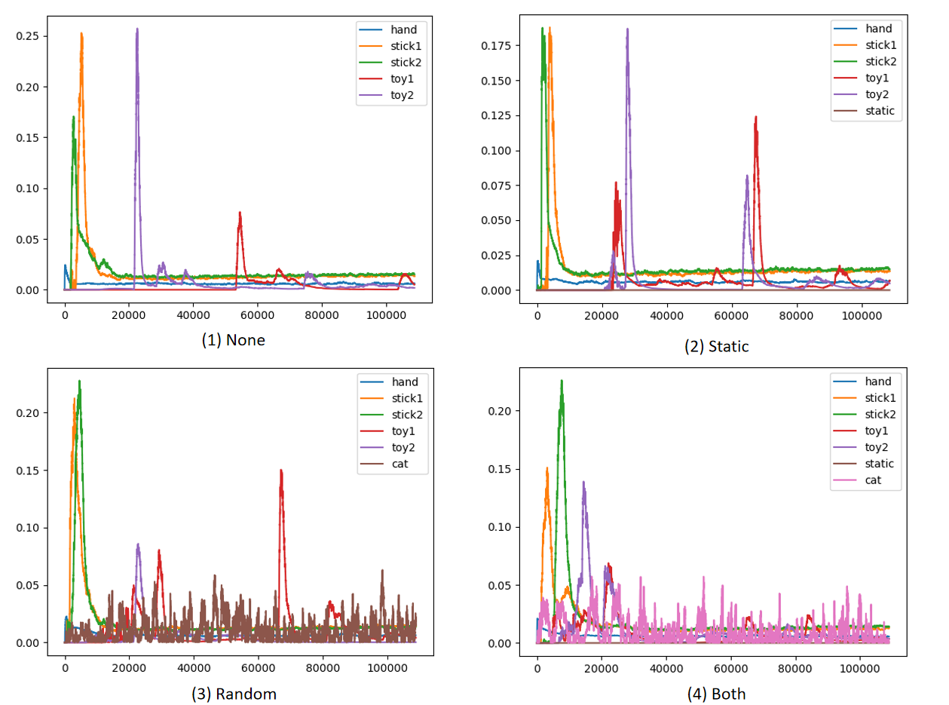
Different Distractors

Slide 15
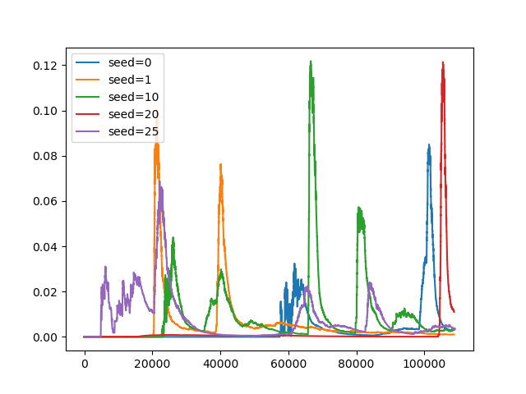
Discussion about Seeds

Slide 16
Questions?

