Slide 1
Presentation on
Multimeter, Oscilloscope and Signal Generator
Presented by: Leon Hossen
ID:12012032
Department of Physics,
Begum Rokeya University, Rangpur
Date: April 17,2025

Slide 2
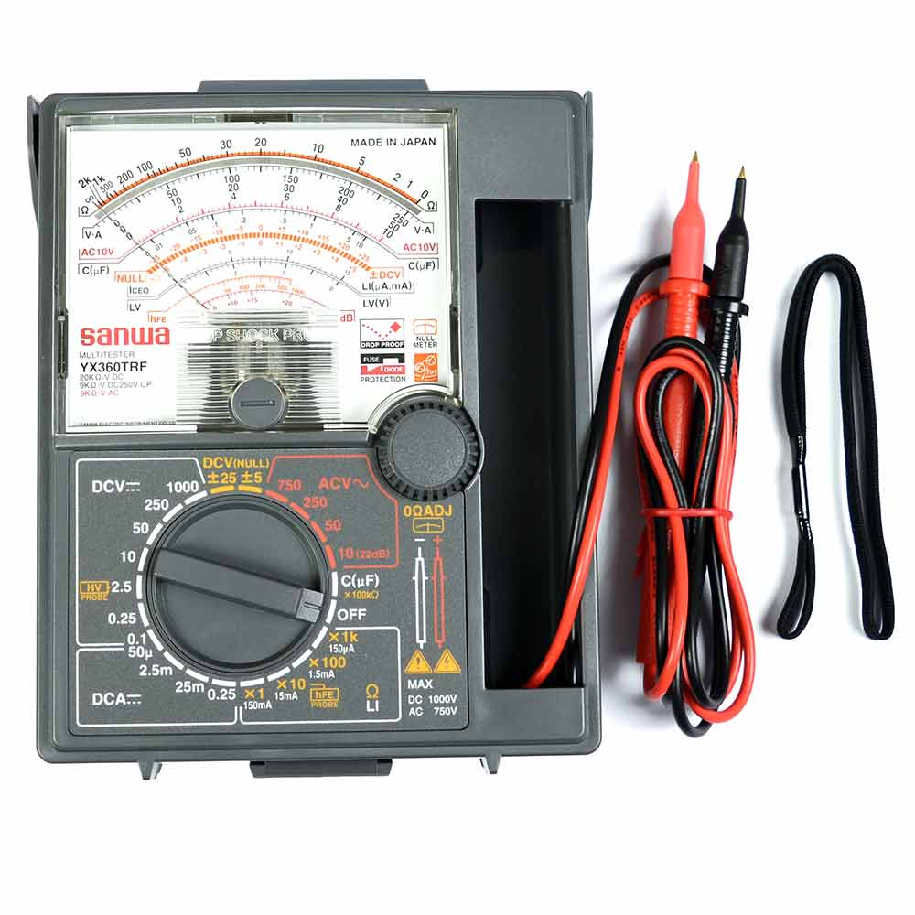
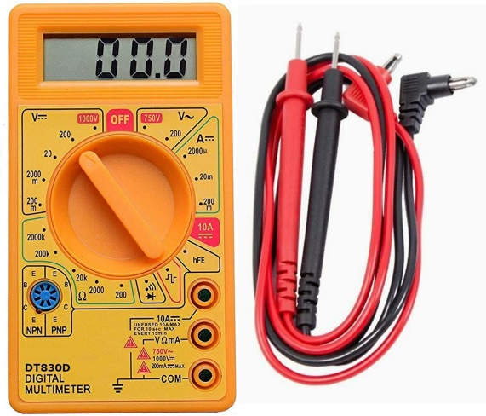
MULTIMETER
Multimeter: A multimeter is a measuring instrument that can measure multiple electrical properties. A typical multimeter can measure voltage, resistance and current, in which can be used as a voltmeter, ohmmeter and ammeter.
Types of multimeter:
Analog Multimeter
Digital Multimeter

Slide 3
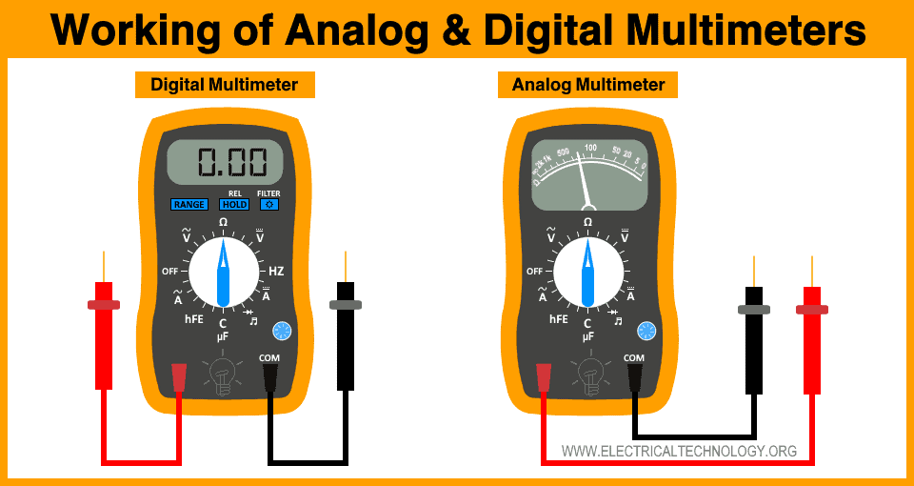
Functions of a Multimeter:
Measuring voltage (AC/DC)
Measuring current (AC/DC)
Measuring resistance
Continuity test
Diode testing (in some models)
Some multimeter can measure capacitance, temperature and frequency
How to Use a Multimeter:
Set the correct mode (voltage , current etc.)
Connect probes correctly
Read the value from the display

Slide 4
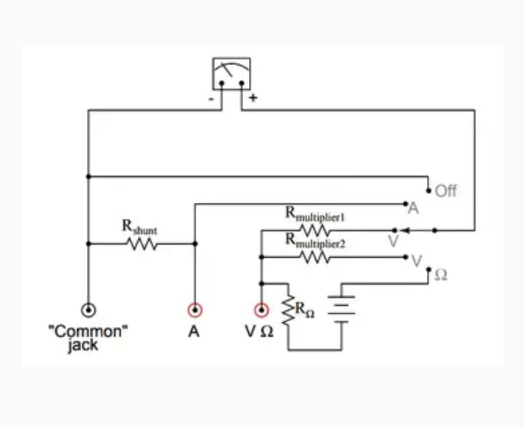
Circuit of a Multimeter:

Slide 5
Advantage of Digital Multimeter:
High accuracy
Easy to read display
Multiple functions in one device
Portable and affordable
Applications of Multimeter:
Electronics repairing
Circuit testing
Household electrical maintenance
Education and experiments
Conclusion:
Multimeter is a versatile and essential tool
Helps in diagnosing and fixing electrical problems
Simple to use in powerful function

Slide 6
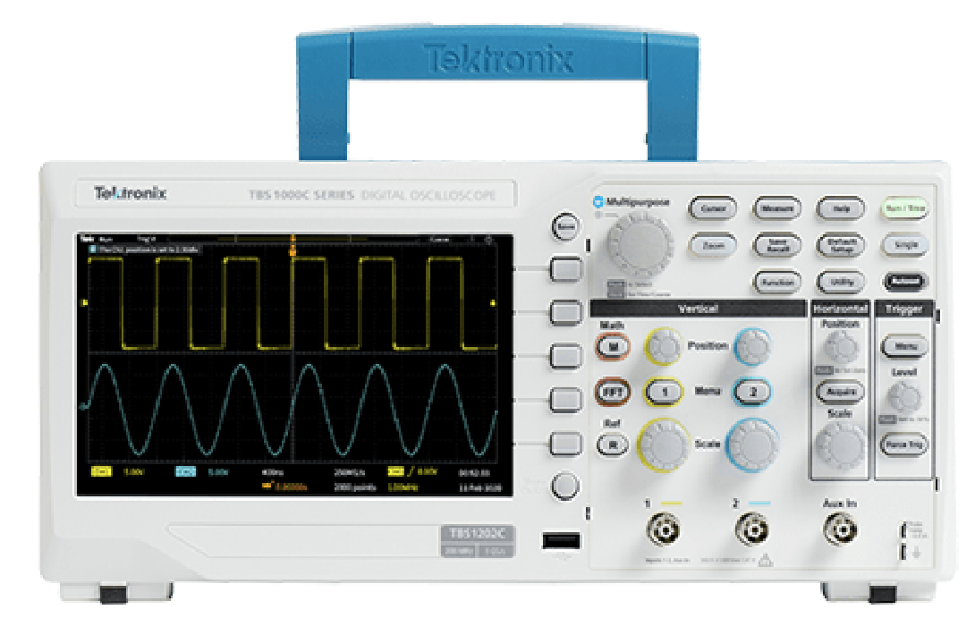
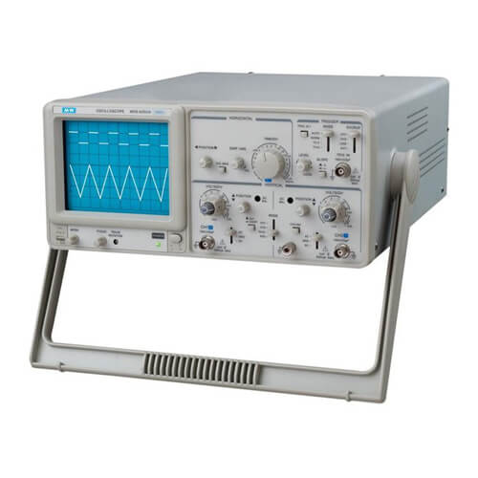
Oscilloscope
Oscilloscope: An oscilloscope is an electronic test instrument that displays the waveform of electrical signals. It shows how voltage varies with time.
Types of Oscilloscopes:
Analog Oscilloscope
Digital Oscilloscope

Slide 7
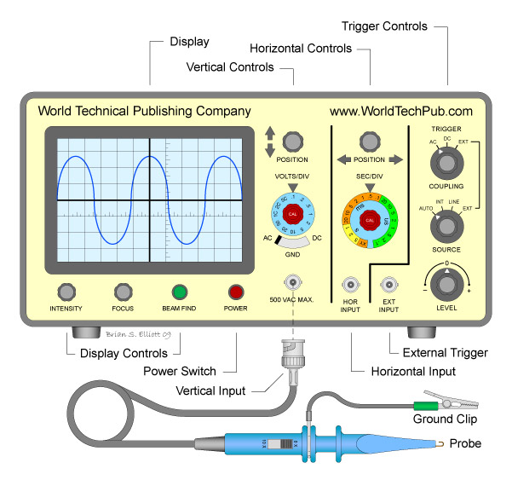
Main Parts of an Oscilloscope:
Display screen
Time/Div knob
Volt/Div knob
Trigger control
Input channels and probes
How an Oscilloscope Works:
Converts voltage signals into visual waveforms
X-axis represents time
Y-axis represents voltage
Can measure frequency, amplitude, rise time etc.

Slide 8
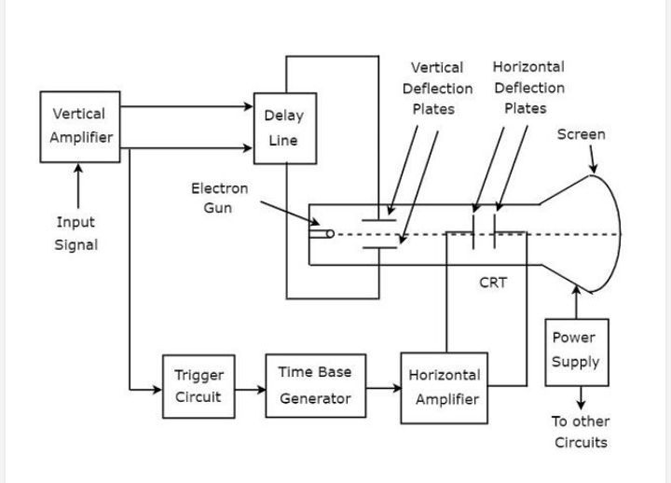
Block Diagram of an Oscilloscope:

Slide 9
Applications of Oscilloscopes:
Observing waveforms in circuits
Measuring signal properties
Debugging electronic devices
Testing audio signals
Used in medical fields(like ECG)
Conclusion:
Oscilloscopes are powerful diagnostic tools
Help visualize electrical signals
Essentials for designing, testing and troubleshooting electronic circuits
Essentials for engineers, technicians and students

Slide 10
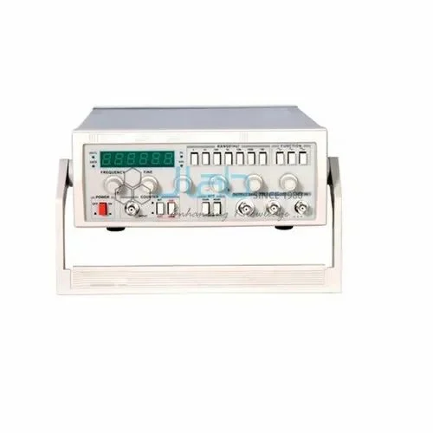
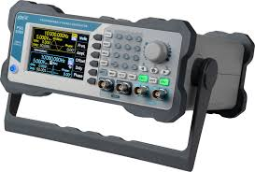
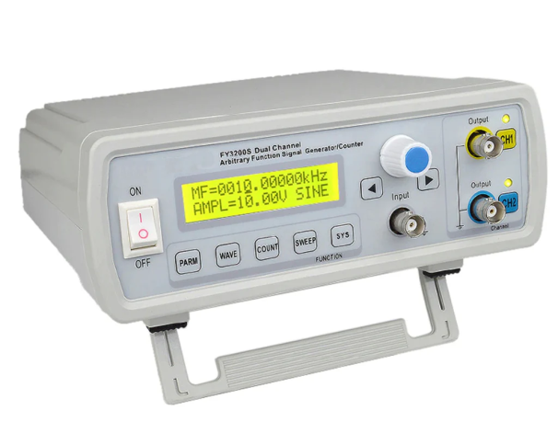
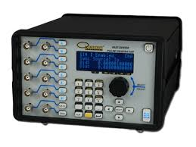
Signal Generator
Signal Generator: A signal generator is an electronic device that produces repeating or non-repeating electronic signals in either the analog or digital domain.
Types of Signal Generator:
Function generator
RF signal generator
Audio signal generator
Pulse generator etc.

Slide 11
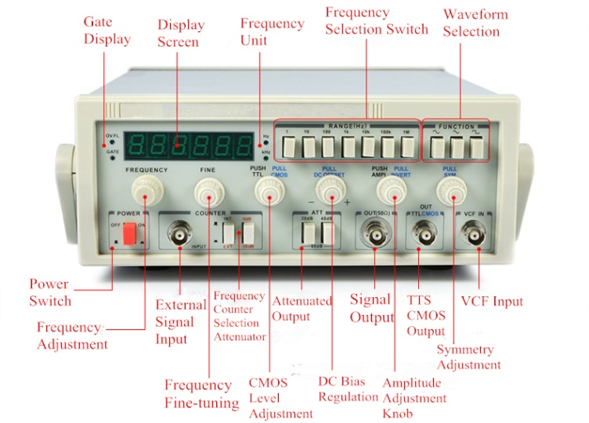
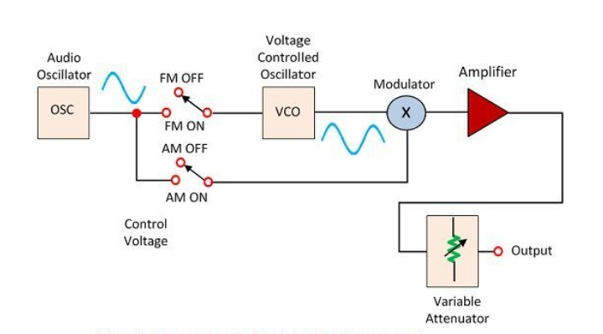
Main Components of Signal Generator:
Frequency control
Amplitude control
Waveform selector
Output terminology
Block Diagram of a Signal Generator:

Slide 12
How a Signal Generator Work:
Generates signals using internal oscillators
User selects frequency, amplitude and waveform
Signal is sent to an external circuit or device
Applications of Signal Generators:
Testing and designing circuit
Troubleshooting amplifiers or receivers
Education and experiments
Medical devices(like ultrasound)
Conclusion:
Signal generators are essentials for testing and simulation
Versatile and valuable tools in electronics lab
Widely used in industries and education

Slide 13


Slide 14
Thank you for your time and attention!!!

