Slide 1
NovaVest Research Summary Assistant v1
A governed AI-assisted financial research summary workflow
Team
Course
Focus
Riza Cepni Zhengliang (Leon) Xiang
AI Design & Deployment Risks Final Project
Governance, controls, evidence, and release decisions
Core system idea
Input
Draft support
Governed release
Public company disclosures such as filings and earnings transcripts.
The system creates a first draft, but not a final released output.
Controls and human review decide approved, revise, escalate, reject, or pending review.
NovaVest Research Summary Assistant v1 · ME575 Final Project

Slide 2
1. Problem, scope, and system definition
2
Why this project matters and what is inside the project boundary
Why this matters
What we built
AI can help analysts draft faster, but speed alone is not enough in finance-related work.
A summary can miss material risk disclosures, use stale source information, or include weak claims.
Without traceability and review, users may trust an output too quickly.
So we chose one narrow workflow instead of trying to build a broad finance platform.
An internal AI-assisted financial research summary workflow.
Main input: public company disclosures.
Main output: a first-draft summary plus control results and release status.
Not a public chatbot, not a trading bot, and not an autonomous investment platform.
NovaVest Research Summary Assistant v1 · ME575 Final Project

Slide 3
2. Governance risks and mandatory controls
3
The governance design was built around a few specific failure modes
Main governance risks
Frozen control set used in the prototype
Unsupported claims
Missing categories
Control | Main role
C1.1 | Source-grounding check
C1.2 | Reviewer claim verification
C2.1 | Risk-factor coverage check
C3.1 | Source freshness validation
C4.2 | Analyst sign-off before release
C5.1 | Evidence-pack capture
C6.1 | Escalation and release routing
The draft may say something that is not clearly grounded in the source.
The draft may omit a material disclosed risk category.
Stale sources
Weak accountability
Older disclosures may no longer reflect the current situation.
Without sign-offs and evidence, users may not know who reviewed what.
NovaVest Research Summary Assistant v1 · ME575 Final Project

Slide 4
3. Three Lines of Defense and tiering journey
4
How the project moved from owner assessment to official tiering and audit review
LoD1
LoD2
LoD3
First-line registration
Second-line MRM tiering
Third-line audit
System registered. Owner risk narrative, mitigations, and open questions completed. Initial result: Tier 2 / score 15.
Independent MRM challenge completed. Official result changed to Tier 1 / score 28. Required controls and executive summary generated.
Audit confirmed documentation completeness and tier reproducibility. It also found several required controls still in progress.
Key takeaway
The owner’s first-line result did not remain the final answer. Independent second-line review raised the model to Tier 1, and the third-line audit confirmed that higher-governance treatment was appropriate.
NovaVest Research Summary Assistant v1 · ME575 Final Project

Slide 5
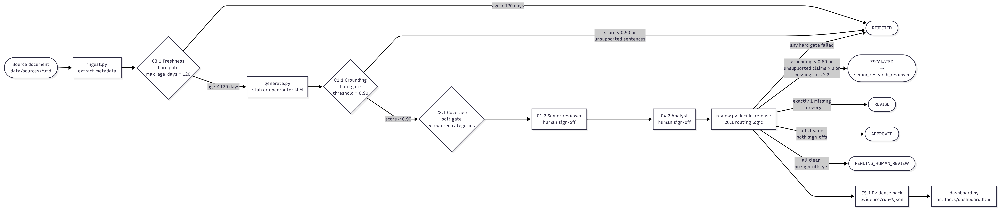
4. Implemented workflow diagram
5
Rendered from the original README workflow logic in the repository
Workflow diagram rendered from repository README mermaid flow

Slide 6
5. Frozen sample cases and release logic
6
Three controlled examples keep the project focused and reproducible
Case | Expected outcome | Why
Microsoft | APPROVED | Fresh source, grounded draft, all required categories covered, and both sign-offs completed.
Apple | REVISE | The draft is mostly usable, but exactly one important risk category is missing.
Nvidia | ESCALATED | Multiple material categories are missing, so the case is too serious for normal revision.
Decision rules
APPROVED: no hard fails, no missing categories, and both sign-offs complete.
REVISE: exactly one important required category is missing.
ESCALATED: multiple material categories are missing, or another serious issue is unresolved.
REJECTED: a hard gate fails, such as stale source input or major grounding failure.
PENDING_HUMAN_REVIEW: automated checks pass but sign-offs are not complete yet.
Why we froze the cases
They help us demonstrate governance behavior clearly without making the project too broad for the course timeline.
Two Modes
stub (deterministic, no API key, guaranteed frozen outcomes) and openrouter (MiniMax M2.5 via OpenRouter, with an LLM semantic judge to handle paraphrases).
NovaVest Research Summary Assistant v1 · ME575 Final Project

Slide 7
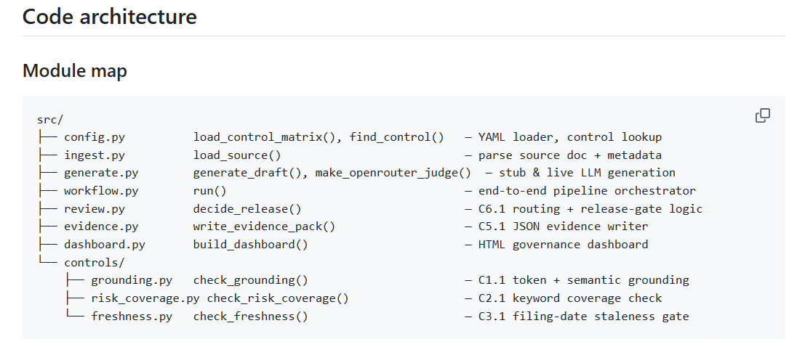
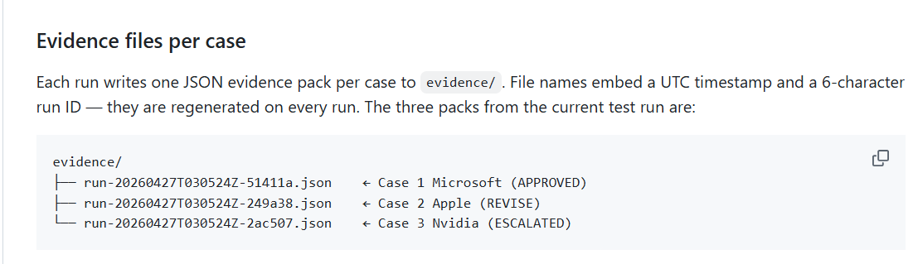
6. Repository structure and evidence package
7
How the implementation is organized and what artifacts it produces
Main repo pieces
Evidence pack contents
data/sources: frozen input files for Microsoft, Apple, and Nvidia.
src/workflow.py: end-to-end pipeline orchestration.
src/controls: freshness, grounding, and risk-coverage checks.
src/review.py: release routing and final decision logic.
artifacts/dashboard.html: HTML dashboard output.
evidence/run-*.json: one evidence pack per run.
Run ID and timestamp.
Source-document metadata.
Generated draft output.
Control-by-control results.
Reviewer and sign-off information.
Final release status and escalation details if needed.
NovaVest Research Summary Assistant v1 · ME575 Final Project

Slide 8
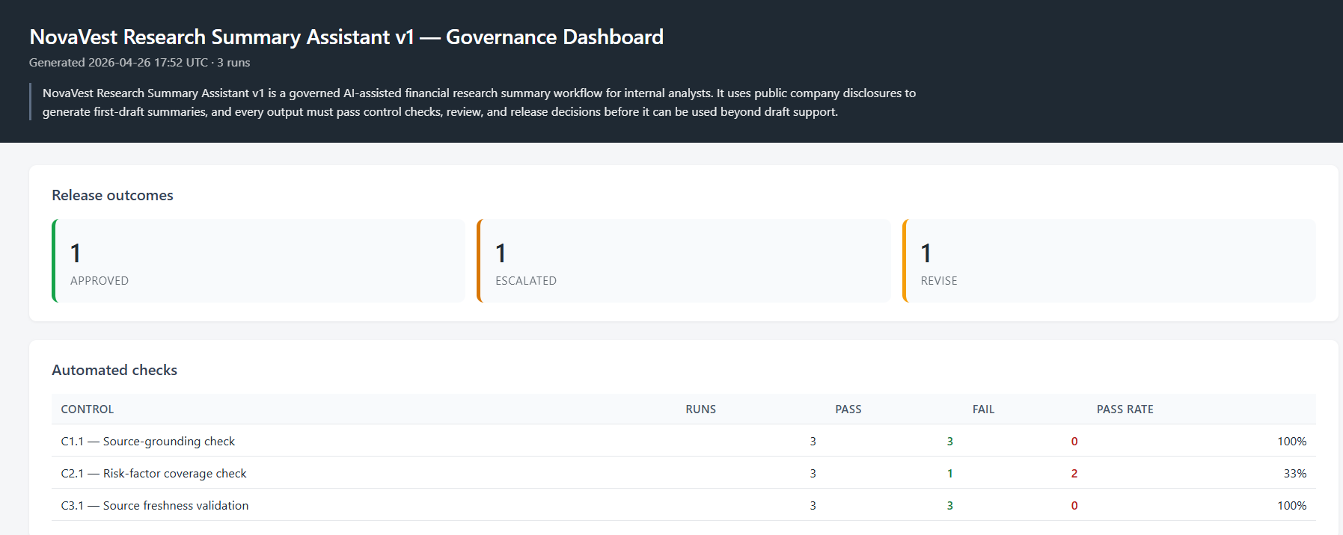
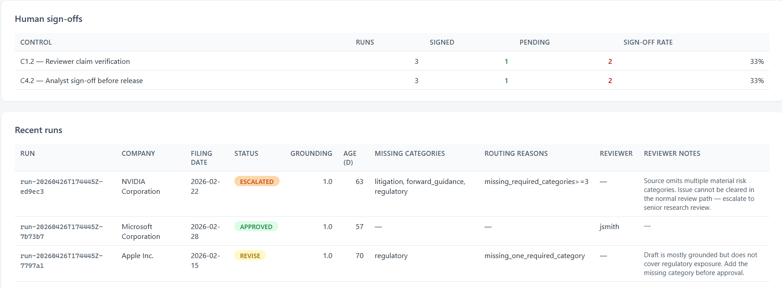
7. Dashboard and LoD3 audit interpretation
8
Implementation view plus audit interpretation
HTML governance dashboard sample
LoD3 audit highlights
Documentation
Complete for the reviewed model.
Tiering reproducibility
Official Tier 1 and audit-recomputed Tier 1 matched, with score 28.
Control gaps
Several required controls remained in progress at prototype stage.
Overall reading
The governance path is sound, but the prototype still needs follow-up work before enterprise use.
NovaVest Research Summary Assistant v1 · ME575 Final Project

Slide 9
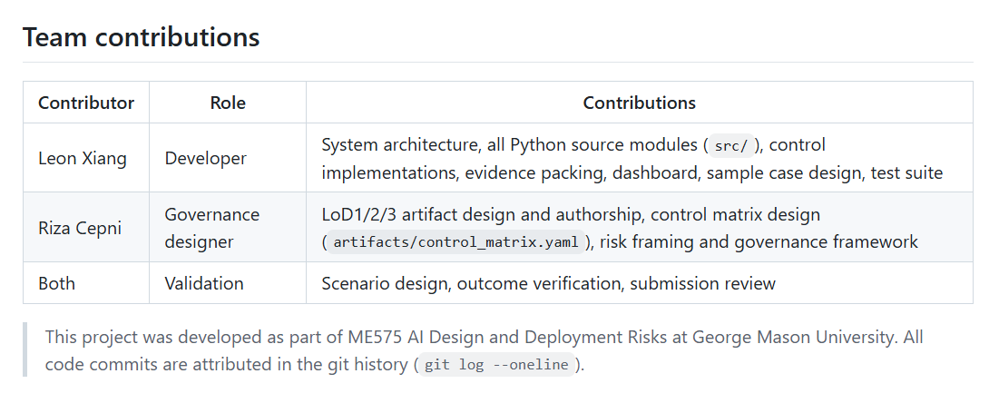
8. Contribution split
9
Included to make individual contributions clear
Riza focus
Leon focus
Joint work
Governance framing and project scope
LoD1, LoD2, and LoD3 interpretation
Tiering narrative, controls, and governance report
Sample-case governance logic and presentation flow
Repository implementation and pipeline coding
Workflow logic, control modules, and release routing
Evidence-pack generation and dashboard build
Repository packaging and workflow visualization
Final project direction and frozen sample cases
Aligned wording and system definition
Review of outputs and final presentation
Shared explanation of governance + implementation
NovaVest Research Summary Assistant v1 · ME575 Final Project

Slide 10
9. Final takeaways and next steps
10
Project conclusion
Main takeaways
Next steps
A narrow use case made the project more realistic and easier to implement well within the course timeline.
The three lines of defense gave us a clear governance story from owner view to official tiering and audit review.
The repo shows a working prototype with frozen cases, release logic, evidence packs, and a dashboard.
The audit view helped us be honest about what is complete and what is still in progress.
Expand monitoring and evidence automation.
Make sign-off workflow and committee approval more formal.
Add more cases, stronger testing, and fuller validation documentation.
Closing message
The main result is not only the draft summary tool itself. The main result is the governed workflow around it — with controls, evidence, and a clear release path.
NovaVest Research Summary Assistant v1 · ME575 Final Project

