Slide 1
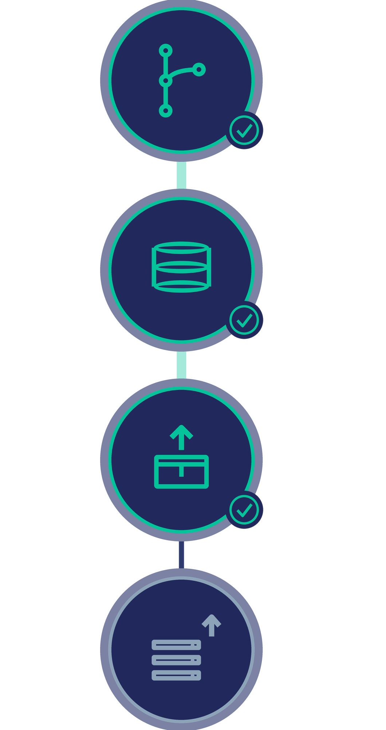
C270 DEVOPS ESSENTIALS · HPONE DEPAR
CI/CD Pipeline
for NextStep
Every commit tested.
Every merge packaged.
2
pipelines
7
jobs
17
tests
2
images
GitHub Actions · Docker · GHCR · PostgreSQL
Notes:
SLIDE 1 (about 40 seconds). My part of the project this phase was the CI/CD pipeline. The diagram on the right is the flow: a commit comes in, it gets tested, it gets packaged into a Docker image, and the last step, releasing it to a server, is greyed out because that is the part still waiting. Two pipelines, seven jobs, seventeen tests, two container images — all of it runs by itself on GitHub Actions.

Slide 2

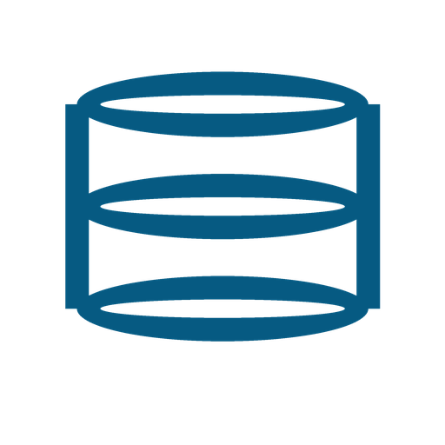




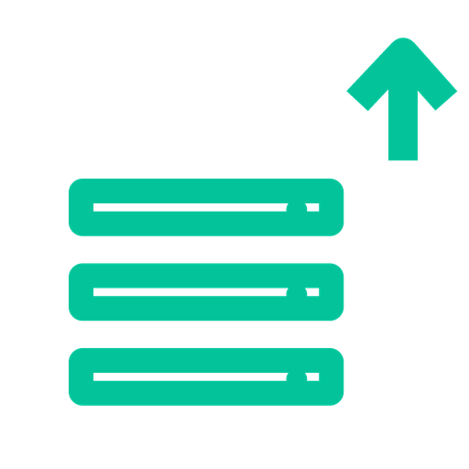
HOW IT WORKS
Seven automated jobs, no manual steps
Two pipelines: one verifies the code, one ships it.
CI — on every push
Quality
Tests
Build
Image
no secrets committed
real PostgreSQL, 17 tests
production build
both containers
CD — on every merge into main
Gate
Publish
Release
CI must pass first
images to GHCR, tagged
approval required
A failing test turns the pull request red — it cannot be merged.
Notes:
SLIDE 2 (about 60 seconds). Top row is CI, and it runs on every single push. Quality checks that no secrets got committed. Tests spin up a real PostgreSQL database and run seventeen tests. Build compiles the production frontend. Image builds both containers. Bottom row is CD, on every merge into main. The gate re-runs all of CI first, publish pushes both images to GitHub's registry tagged with the commit, and release is behind an approval click. The line at the bottom is the point: a failing test turns the pull request red, so broken code cannot be merged.

Slide 3
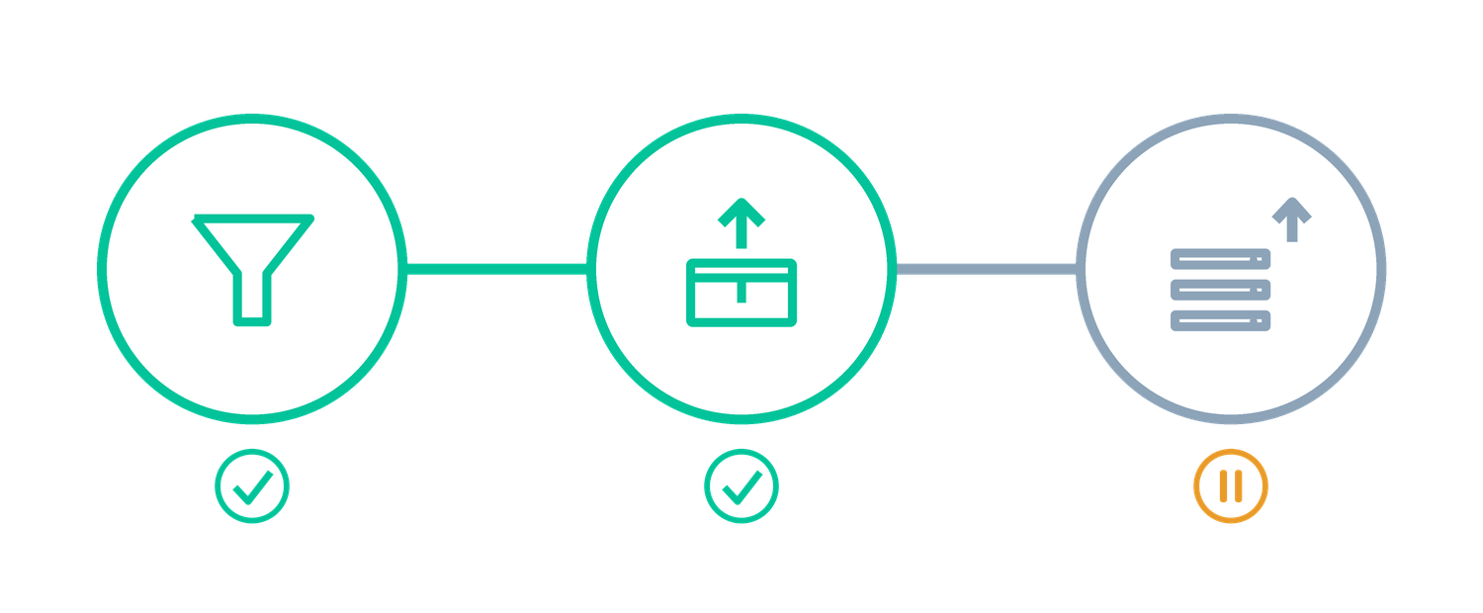


WHERE IT STANDS
Live today — except the last step
Two of the three release jobs already run on every merge.
CI runs on every push
Tests run on a real database
Images published on every merge
Gate
Publish
Deploy
In one sentence
“CI and continuous delivery are running. Deployment is switched off behind an approval gate until we have a server.”
Deploy is waiting on a server
Notes:
SLIDE 3 (about 40 seconds). Three things are live: CI on every push, tests against a real database, and images published on every merge. The fourth is honest — we have no server yet, so the deploy job detects that and skips instead of failing. The diagram shows it: two green, one paused. Finish on the sentence in the box, which is also the answer if you are asked whether we have CI/CD.

