Slide 1
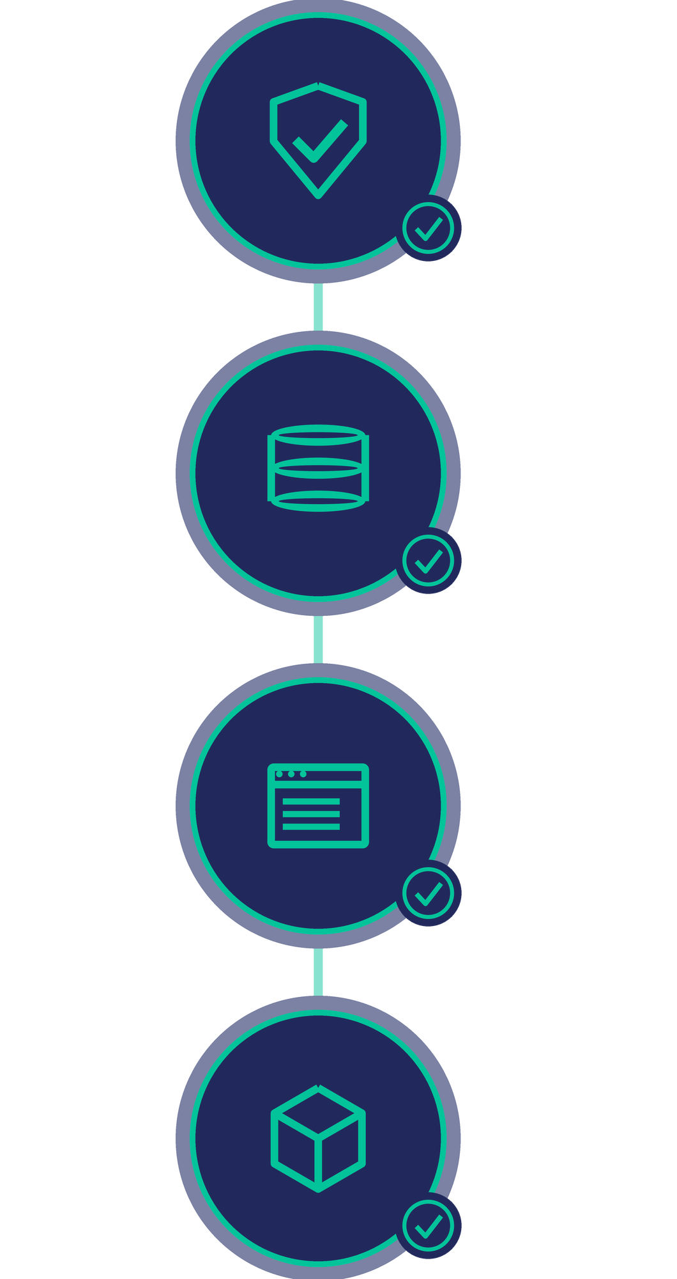
C270 DEVOPS ESSENTIALS · HPONE DEPAR
CI Pipeline
for NextStep
Every push is tested.
Nobody has to remember.
1
pipeline
4
stages
17
tests
0
manual steps
GitHub Actions · Docker · PostgreSQL · Node.js
Notes:
SLIDE 1 (about 35 seconds). My part of this project was the CI pipeline — continuous integration. The picture on the right is the four checks it runs. One pipeline, four stages, seventeen tests, and zero manual steps: once the code is pushed, GitHub Actions does all of it by itself. Before this, testing was manual, and the API tests were being skipped because they need a database with data in it.

Slide 2

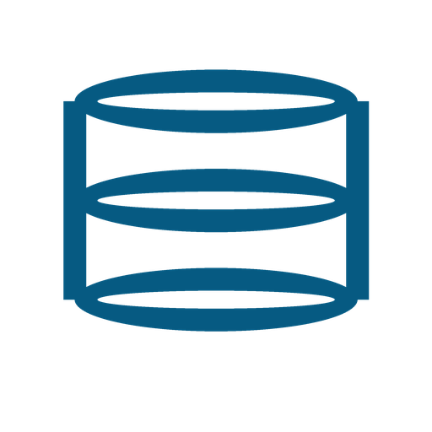




HOW IT WORKS
Four checks run on every push
I push code. GitHub runs all four by itself. I don't do anything.
1 Quality
2 Tests
3 Build
4 Package
No passwords or secret files in the repo.
Starts a real database, runs 17 tests, then checks the app actually starts.
Builds the frontend the same way as the real thing.
Builds both Docker containers.
All four pass → safe to merge
One fails → the PR turns red
Turn on branch protection and GitHub then refuses the merge — so broken code cannot reach the main branch.
Notes:
SLIDE 2 (about 55 seconds). Four checks, in this order. Quality makes sure no passwords or .env files got committed. Tests is the main one: it starts a real PostgreSQL database, creates the tables, loads the seed data, runs seventeen tests, and then starts the server and checks the health endpoint replies — because tests passing does not prove the app actually starts. Build compiles the frontend the production way. Package builds both Docker containers, which no test can check. Then the two boxes at the bottom: if all four pass, the code is safe to merge. If one fails, GitHub blocks the merge. That is the whole point.

Slide 3

WHERE IT STANDS
It is running now
Green on GitHub today. One thing I would still add.
17 / 17
tests pass, on every single push
The pipeline is green right now — I can open the Actions tab and show you.
Runs on every push and pull request
Tests run on a real PostgreSQL database
Checks that the app actually starts
In one sentence
“Continuous integration is working. Every push is tested automatically on a real database, and a failing test marks the pull request red so it is not merged.”
Deployment is the next phase — not part of my task.
Both Docker containers build
Next: add frontend tests
Notes:
SLIDE 3 (about 30 seconds). It is live: it runs on every push, the tests use a real database, it checks the app boots, and both containers build. Seventeen out of seventeen tests pass, and it is green right now — offer to show the Actions tab. The one thing I would add next is tests for the frontend; right now only the backend is tested. Deployment is the next phase and was not part of my task.

