Slide 1
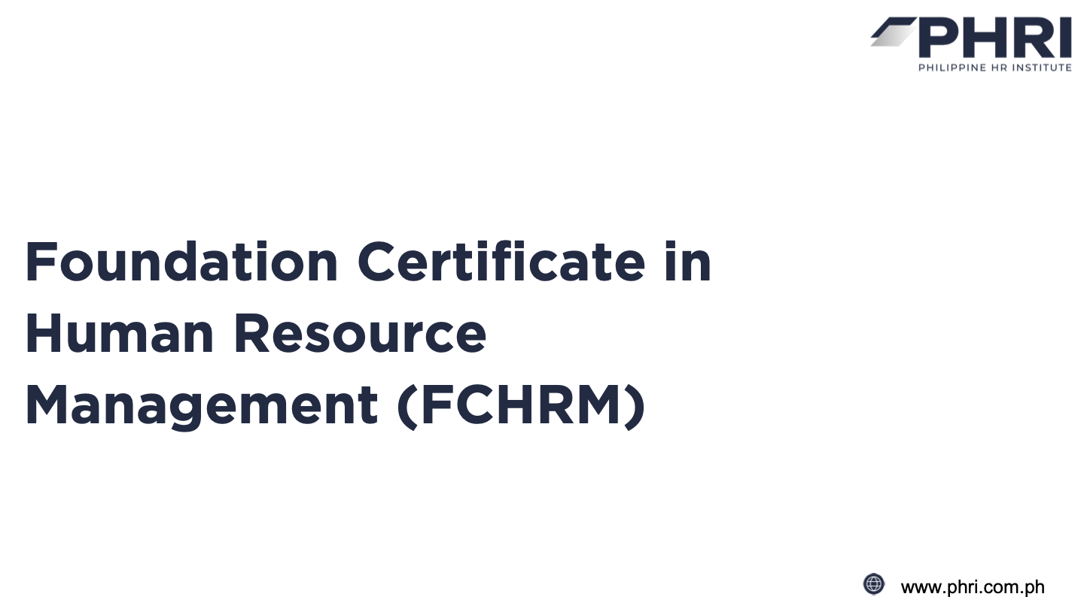

Slide 2


Learning Session 3:
Learning & Development
www.phri.com.ph

Slide 3
Learning Objectives
  Explain the strategic role of Learning & Development (L&D) within modern organizations
  Identify key L&D theories and frameworks to organizational contexts
  Learn basic L&D concepts that organizations follow to create learning ecosystems, effective Individual and Organizational development plans, and effective context-wise frameworks.
  Articulate how L&D integrates with other HR functions
  Know basic L&D principles within the Philippine context

Slide 4



Strategic role of L&D in Organizations
The business case for L&D
Foundational Principles
Learning Design
Learning Interventions
L&D in the Philippines
SESSION OVERVIEW

Slide 5

The Strategic Role of Learning & Development in Organizations
Definition and Scope of L&D
Learning and Development (L&D) encompasses all formal and informal activities designed to improve the knowledge, skills, and abilities of individuals and groups within an organization. It includes:
  Training programs (instructor-led, online, blended)
  Coaching and mentoring
  On-the-job learning experiences
  Knowledge management systems
  Career development initiatives
  Leadership development programs
  Performance support tools

Slide 6
The Business Case for L&D
Effective L&D functions deliver significant value to organizations through:
  Improved Performance
  Adaptability and Innovation
  Talent Attraction and Retention
  Succession Planning
  Risk Mitigation

Slide 7
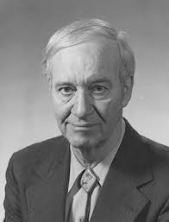





Foundational principles of L&D
Foundational Learning Theories and Frameworks
The 70-20-10 Model
Adult Learning Principles (Andragogy)
Malcolm Knowles - Pedagogy vs. Andragogy
Developed by Morgan McCall, Robert Eichinger, and Michael Lombardo at the Center for Creative Leadership.
  Need to know the reason for learning
  Are self-directed
  Bring prior experience
  Have readiness to learn
  Are problem-centered
  Respond to internal motivators
  70% - EXPERIENCE
  20% - EXPOSURE
  10% - EDUCATION
This model emphasizes that most professional development occurs through experiential learning rather than formal training events.
Application in L&D Practice:
Begin training by explaining
the relevance and practical benefits
Include problem-solving
activities and case studies
Focus on application
rather than theory alone
Create opportunities for
learners to share experiences
Allow flexibility in learning
paths and self-directed options

Slide 8

Experiential Learning Cycle
Concrete
Experience
Reflective Observation
David Kolb's Experiential Learning Cycle describes learning as a four-stage process:
  Concrete Experience
  Reflective Observation
  Abstract Conceptualization
  Active Experimentation
Active Experimentation
Abstract Conceptualization

Slide 9



Learning Styles and Multiple Intelligences
While recent research has questioned the empirical basis for rigid learning style classifications, understanding learning preferences can still help create more inclusive learning experiences:
Visual learners prefer diagrams, charts, and visual demonstrations
Auditory learners learn best through verbal instructions and discussions
Kinesthetic learners prefer hands-on activities and physical engagement

Slide 10
Learning Design
The ADDIE Model
The ADDIE Model provides learning professionals with a structured approach to creating effective educational interventions by identifying needs, crafting appropriate solutions, developing materials, delivering the training, and measuring outcomes to ensure continuous improvement.
Analysis
Design
Development
Implementation
Evaluation
While ADDIE is often depicted as linear, modern applications treat it as an iterative process with feedback loops between phases.

Slide 11

Training Needs Analysis
Training Needs Analysis (TNA) is the critical first step in the learning design process, identifying performance gaps that can be addressed through learning interventions.
1
Define the business problem or opportunity
4
Determine if gaps are due to knowledge/skill deficits or other factors
Basic Process of Training Needs Analysis
2
Identify affected roles and required performance standards
5
Establish learning objectives that address the gaps
3
Assess and identify current knowledge, skills, and performance levels and gaps between current and required states
6
Prioritize learning needs based on business impact

Slide 12
Common Learning Methods
Instructor-Led Training
eLearning
Blended Learning
On-the-job Training
Coaching/Mentoring
Effective L&D professionals select learning methods based on:
  Learning objectives
  Content complexity
  Audience characteristics
  Available resources
  Organizational context

Slide 13
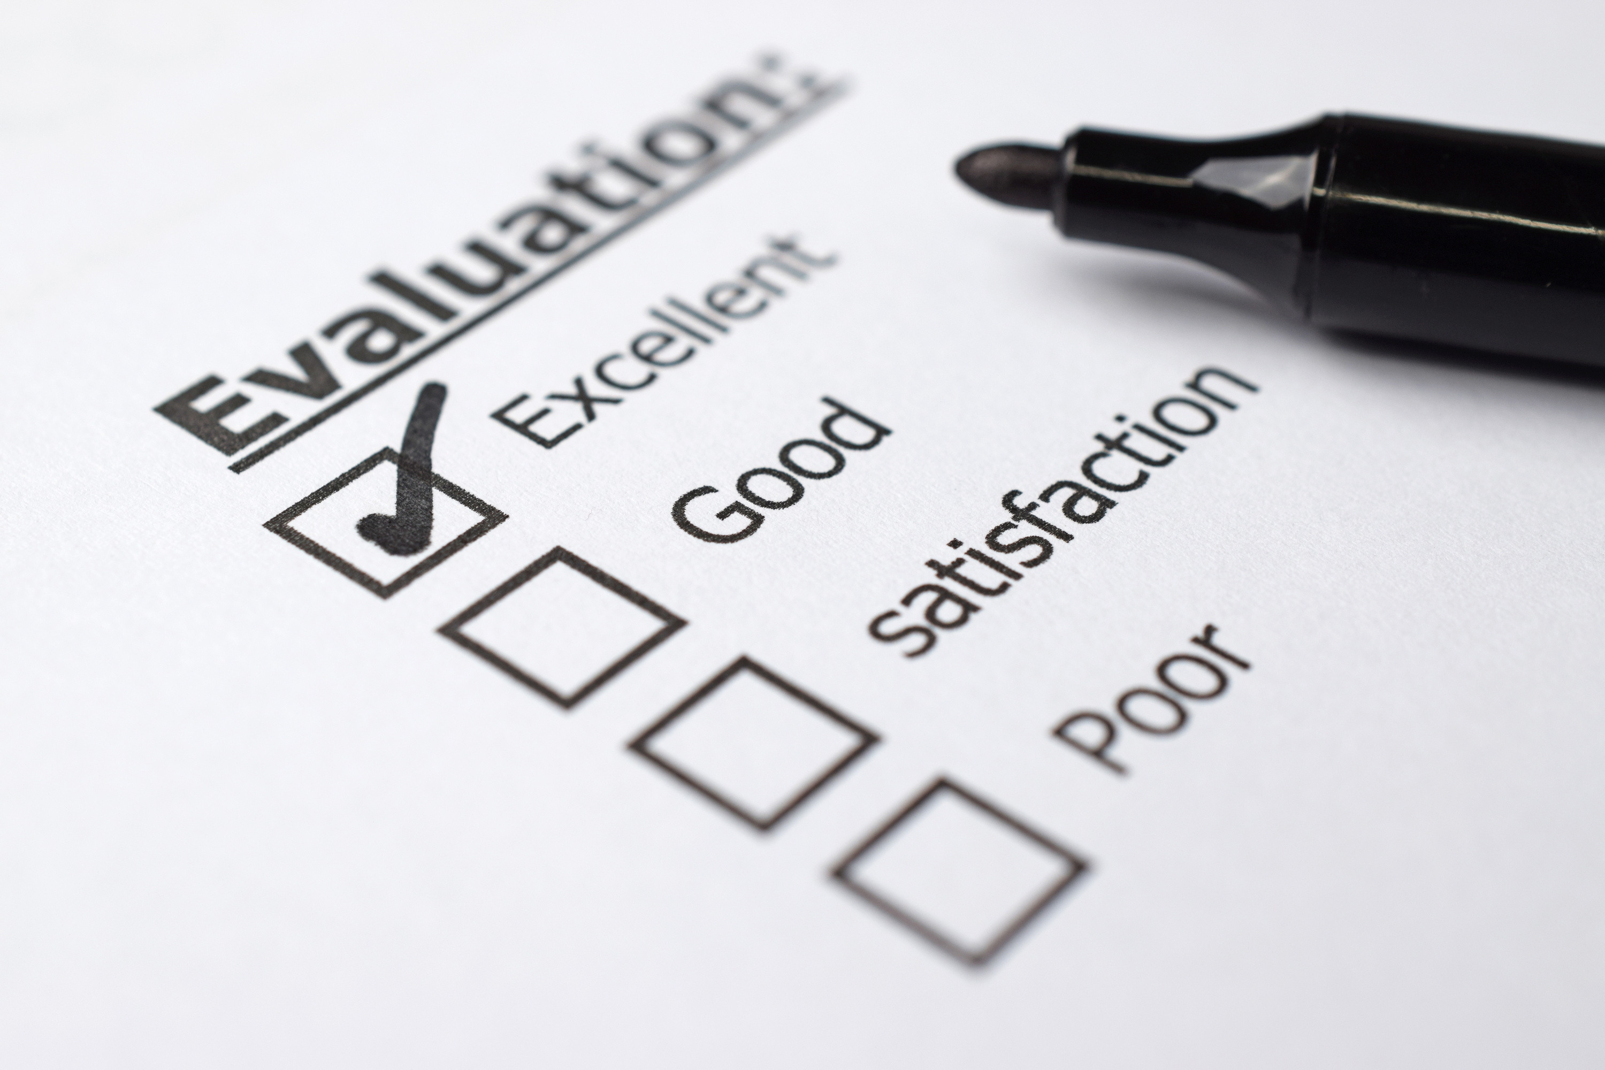
Evaluation
Kirkpatrick's Four Levels of Evaluation
The Kirkpatrick Evaluation Model is a four-level framework for assessing the effectiveness of training programs by measuring reaction, learning, behavior change, and business results. It provides L&D professionals with a comprehensive approach to determine not only participant satisfaction but also knowledge acquisition, on-the-job application, and ultimate impact on organizational performance metrics.
Levels of Evaluation
Level 1: Reaction
Level 2: Learning
Level 3: Behavior
Level 4: Results
www.phri.com.ph

Slide 14
Learning Interventions
  Coaching and mentoring - Personalized learning interventions that facilitate professional growth through guided relationships between experienced practitioners and developing individuals.
  On-the-job learning - Learning approach of mastering through repetition and consistency. Derived from 70-20-10 model.
  eLearning and Digital Solutions - At own pace of learner, implemented with the aid of digital tools and applications.
  Traditional Classroom Training - Instructor-led educational sessions conducted in physical learning environments that facilitate direct interaction, immediate feedback, and collaborative learning experiences among participants.
  Action Learning - Developmental approach where individuals work on real organizational challenges in small groups, combining problem-solving with reflection to simultaneously address business issues and build leadership capabilities.

Slide 15




L&D in the Philippines
Learning Practices in Philippine Organizations
Common approaches and trends in organizational learning in the Philippines include:
Formal Learning Emphasis:
  Strong tradition of classroom training
  High value placed on certificates and credentials
  Growing but still developing digital learning adoption
Knowledge Sharing Approaches:
  Storytelling traditions support narrative-based learning
  Communities of practice often follow social groupings
  Mentoring relationships based on strong interpersonal bonds
L&D Function Structure:
  Often positioned under HR in organizational structure
  Increasing development of dedicated L&D departments
  Growing strategic importance but often limited resources
Industry Variations:
  BPO sector emphasizing technical and soft skills training
  Manufacturing focusing on compliance and technical training
  Financial services emphasizing regulatory and product training
  Hospitality focusing on service excellence training

Slide 16





Strategic L&D Opportunities in the Philippine Context
Several strategic opportunities exist for advancing L&D practice in Philippine organizations:
UPSKILLING FOR DIGITAL TRANSFORMATION
LEADERSHIP DEVELOPMENT
  Developing digital literacy across workforce segments
  Building specialized technical capabilities
  Creating change readiness for technological evolution
  Building locally relevant leadership models
  Developing adaptive leadership capabilities
  Creating Filipino leadership development approaches
WORKFORCE READINESS
SME CAPABILITY BUILDING
  Bridging education-employment gaps
  Building workplace readiness in
  new graduates
  Creating industry-education partnerships
  Developing cost-effective L&D approaches for smaller organizations
  Building entrepreneurial capabilities
  Creating resource-sharing learning models

Slide 18
Learning Session 4:
Organizational Development
www.phri.com.ph

Slide 19
Learning Objectives
This topic introduces HR professionals to the essential concepts of Organizational Development and how these principles support organizational effectiveness, change management, and strategic human capital initiatives.
  Understand Organizational Development (OD) fundamentals and its strategic role in HR
  Recognize key OD frameworks applicable to workplace challenges
  Identify appropriate OD interventions for common organizational needs
  Connect OD principles with core HR functions and processes
  Appreciate how OD approaches can be adapted to Philippine workplace contexts
Upon completion, participants will recognize organizational development opportunities within their workplace and understand how OD perspectives enhance HR's ability to contribute to sustainable business success.

Slide 20
Understanding OD
OD Models and Frameworks
OD and other HR Functions
OD in the Philippines
SESSION OVERVIEW

Slide 21


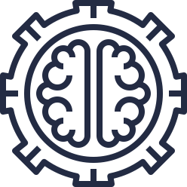

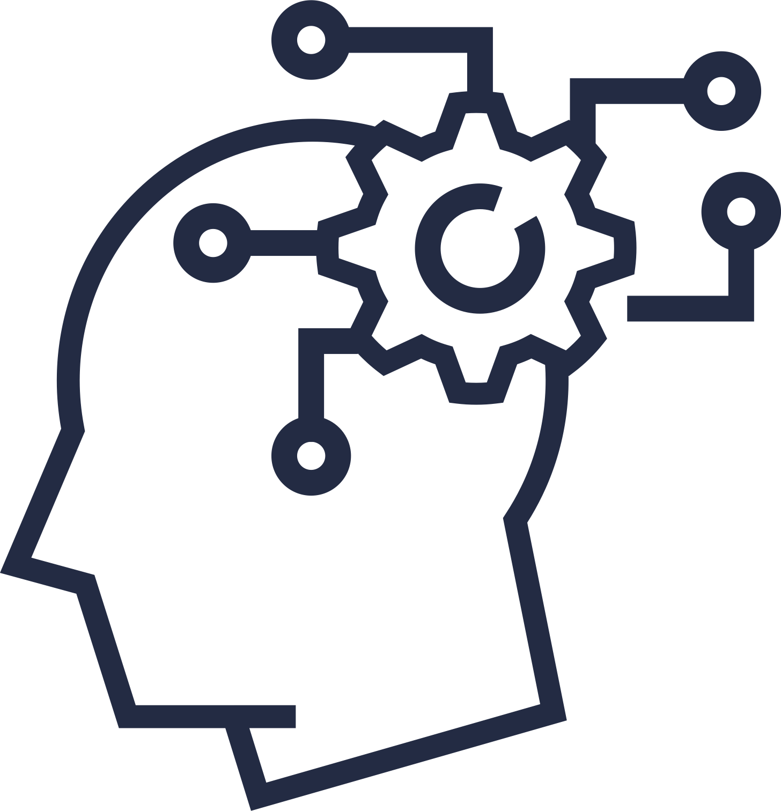


Understanding OD: Core Values and Principles
The practice of OD is guided by several key values that distinguish it from mechanistic approaches to organizational change:
Respect for people
Systems thinking
Participation and inclusion
Data-based decision making
Authenticity and openness
Continuous learning
These values shape how OD practitioners approach their work and influence the kinds of interventions they design. For HR professionals, these values provide ethical guardrails for organizational change efforts.

Slide 22

OD Models and Frameworks
Systems Thinking: The Foundation of OD
Before exploring specific models, it's important to understand the systems perspective that underlies all OD work. Systems thinking represents a fundamental shift from linear cause-and-effect reasoning to understanding organizations as complex webs of interdependent elements.
Interconnected Parts
Feedback Loops
Organization
Characteristics
Multiple Subsystems
Emergent
Properties
External Environment Interaction
Systems thinking helps HR professionals avoid the common pitfall of implementing changes that solve one problem while inadvertently creating others elsewhere in the organization. It encourages holistic diagnosis that considers multiple perspectives and levels of analysis.

Slide 23



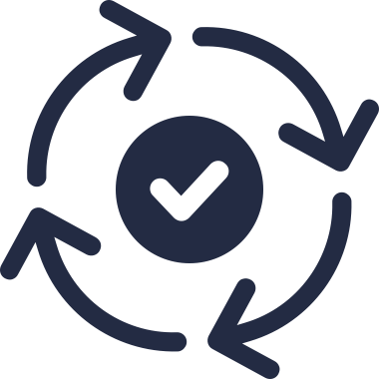
Lewin's Change Model: Understanding the Change Process
Kurt Lewin's three-stage model remains one of the most influential frameworks for understanding organizational change.
Unfreezing
Moving/Changing
Refreezing

Slide 24
Connecting OD with other HR functions
OD and Recruitment/Selection
The people you bring into an organization significantly impact its capabilities and culture. OD principles can enhance recruitment and selection by:
  Aligning selection criteria with organizational values and strategic capabilities
  Designing hiring processes that assess cultural fit alongside technical skills
  Creating onboarding experiences that effectively socialize new hires into organizational culture
  Using selection data to identify organizational patterns and development needs
OD and Performance Management
Performance management systems significantly influence organizational behavior and results. OD approaches improve performance management by:
  Ensuring performance criteria align with organizational strategy and values
  Designing feedback processes that promote development rather than just evaluation
  Creating performance conversations that enhance rather than undermine engagement
  Building manager capabilities to have effective performance discussions

Slide 25
Connecting OD with other HR functions
OD and Learning & Development
Learning and development functions naturally complement OD initiatives. The connection
works in both directions:
  OD assessments identify learning needs at individual, team, and organizational levels
  Learning initiatives build capabilities needed for organizational change
  OD principles improve learning design through greater participation and application
  Learning evaluation connects to broader organizational impact
OD and Compensation/Benefits
Reward systems powerfully influence behavior and can either support or undermine change efforts. OD perspectives enhance compensation and benefits by:
  Ensuring reward systems reinforce desired behaviors and culture
  Aligning incentives with strategic priorities
  Creating compensation approaches that support collaboration rather than just individual achievement
  Designing benefits that reflect organizational values and employee needs

Slide 26

OD in Philippine Context
Adapting OD Approaches for Philippine Organizations
Organizational Development approaches require thoughtful adaptation to align with the distinct cultural dynamics present in Philippine organizations, where relationship orientation, hierarchical structures, and a blend of Eastern and Western influences shape workplace interactions. Successful OD practitioners recognize that effective transformation must honor the value placed on personal relationships, face-preservation, and community harmony characteristic of Filipino work environments.
Successful OD practitioners in the Philippines adapt global best practices to local realities:
  Communication Approaches
  Leadership Development
  Change Management
  Work Design
Contemporary OD Challenges in Philippine Organizations
Philippine organizations face unique organizational development challenges as they navigate the intersection of traditional cultural values, rapid technological change, and increasing global integration in an evolving business landscape.
  Digital Transformation
  Multigenerational Workforce
  Global Integration
  Pandemic-Accelerated Changes
Addressing these contemporary challenges requires OD professionals to develop contextually relevant approaches that honor Filipino cultural strengths while facilitating necessary organizational evolution.

Slide 27




Contact
Information
About PHRI
Address
The Philippine Human Resource Institute (PHRI) is the premier professional organization dedicated to advancing HR excellence in the Philippines. Composed by seasoned HR Professionals, PHRI provides world-class training programs, certifications, and networking opportunities that help individuals and organizations thrive in today's dynamic business environment.
PHRI: Empowering HR Professionals, Driving Workforce Innovation
Level 24 Philippine Stock Exchange Tower, 5th Avenue Corner 28th Street, Bonifacio Global City - Taguig City 1634 Metro Manila
Phone
Mobile: +63 992 6241983 | Landline: (02) 8596-3726
Email
secretariat@phri.com.ph
Website
www.phri.com.ph

