Slide 1
What’s Required in
Knowledge Technologies
– A Practical View
Reid Smith
Vice President, Knowledge Management
Notes:
© 2001 Schlumberger Limited
What’s Required in Knowledge Technologies – A Practical View
Reid Smith is responsible for leading the effort to improve organizational performance through processes and technology to capture, share, and apply the overall experience and know-how of people in the company. Learn about the requirements for knowledge technologies from a practicing knowledge manager.
For additional information, see:
R. G. Smith and A. Farquhar. The Road Ahead for Knowledge Management: An AI Perspective. AI Magazine, 21(4):17-40, Winter 2000.

Slide 2
Knowledge Management
… Improving organizational capability
Create a new working environment where knowledge and experience can easily be shared
Enable information and knowledge to emerge and flow to the right people at the right time so they can act more efficiently and effectively
Notes:
The focus of knowledge management is improving
organizational capability.
To realize this capability, we need to create a new
working environment where knowledge and
experience can easily be shared.
Knowledge Management is the term used for
processes, technology and organizational alignment
that help information and knowledge emerge and
flow to the right people at the right time so they
can act more efficiently and effectively.
The key issues issues revolve around people, processes, technology and content.

Slide 3
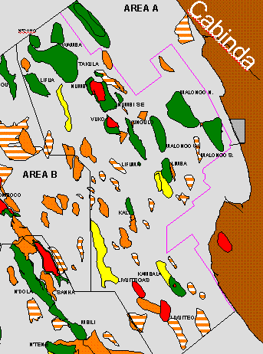
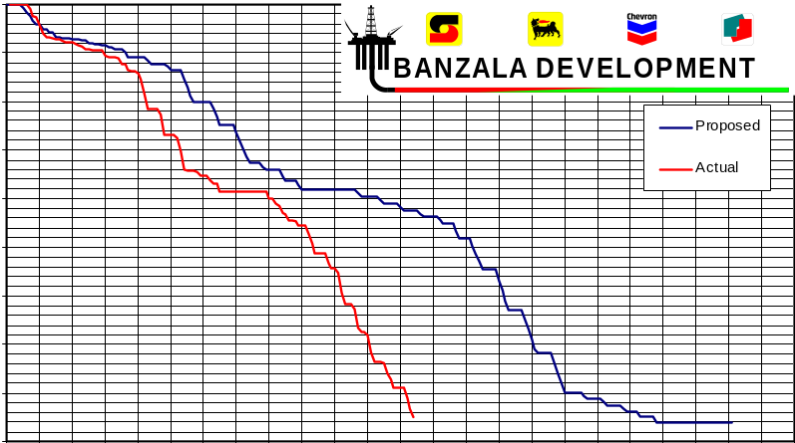
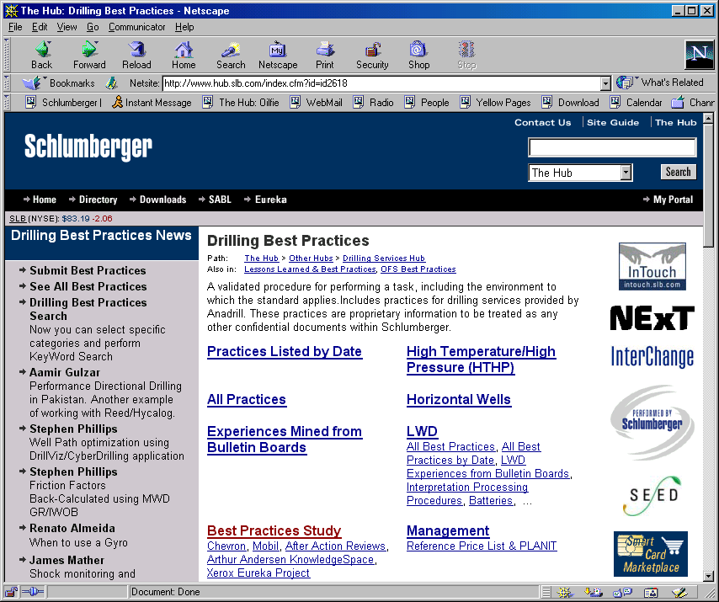
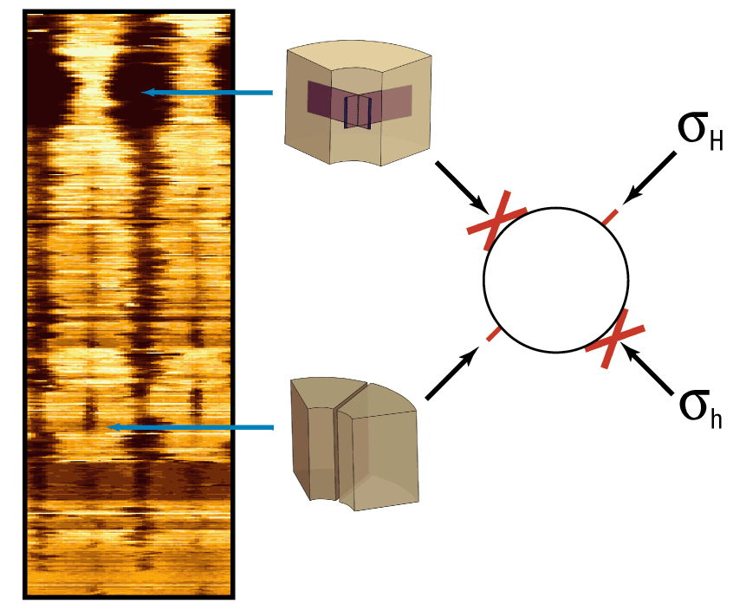
Apply everywhere what you learn anywhere
Notes:
Banzala - A Drilling & Measurements Knowledge
Management Example
The Banzala field was discovered in 1982 and is a
shallow oil reservoir offshore Angola. During the
drilling of one of the exploration wells in the field, a
blowout occurred and a Jack up rig was lost. The
blowout resulted in a charged shallow sand layer to
almost fracture pressure thus creating a safety hazard
while drilling. In the development phase, KM was used
successfully during the design, execution and
evaluation phases on subsequent wells.
It is an example of leveraging the knowledge of the entire organization … being able to “apply everywhere what you learn anywhere.”

Slide 4
Apply everywhere what you learn anywhere
Connecting
People to
Information
People to
Business
Make better decisions
Make faster decisions
Do more with less
Speed up learning
Improve motivation
People to
People
People to
Communities
Collaborating
Notes:
To apply everywhere what you learn anywhere, the
key elements are connecting and collaborating.
Connecting People to Information and Connecting People to People.
Enabling People to focus on Business objectives.
Enabling People to collaborate with others in Communities of Practice.
If you can do these things, then, as an organization, you will be able to … make better and faster decisions, improve productivity by doing more with less, speed up organizational learning, and improve employee motivation.

Slide 5

Knowledge Technologies
– Present and Future
Notes:
In the remainder of this presentation, we look forward
at the road ahead for knowledge management—how
the “knowledge technologies” might evolve over the
next decade or so.
Our approach is to present a “technology road map”
that highlights computational technology on the
critical path to reach a new era in organizational
performance.
The road-map method has been popularized by
Motorola (Willyard and McClees 1987) as an orderly
process for developing a picture of future technology
together with a projection of its evolution over time.
It was originally intended as a practical tool to
encourage business managers to give proper
attention to their technological future. It also provides a means of communicating to engineers and marketing personnel which technologies will be requiring development and application for future products.
The process starts by stating a clear overall target, based on product market, competitive or technology trends. Armed with such a target, developing the road map is an iterative brainstorming process, often involving people from a variety of functions (for example, research and development, manufacturing, marketing, business). The fact that road-map time frames tend to extend well beyond conventional business and product planning horizons adds to the challenge. Another benefit of the process is that it forces the participants to be explicit about their assumptions—to make clear the problems that must be solved to reach the target, the order in which they will be solved, and the expected interim results.
The process has been adopted by the U.S. semiconductor industry overall. It has been used to provide a common vision, a framework to guide research and development for all sectors of the U.S. semiconductor technology base—industry, universities, and government organizations (SIA 1994). The overall target was established by extending historic trends for dynamic random-access memory (DRAM) bit count by a factor of 4 every 3 years until 2010, implying a 64-gigabyte chip in 2010. From this follow the requirements for supporting technology to enable such devices to be designed, manufactured, and tested.
In the upstream exploration and development sector of the oil and gas industry, a simply stated target is to double economic hydrocarbon recovery from the current typical levels of 30 to 40 percent to 60 percent and beyond (Smith and Maitland 1998).
For knowledge management, such a crisp target is elusive. However, if we can make stories like the Banzala story “normal” in an organization—make them such every day occurrences that they would not merit special attention—we argue that a new era in organizational capability will have been reached. We call it the era of the “knowledge-powered enterprise.”
In this new era, knowledge management happens in the background—in real time. It is done by everyone as part of the day-to-day job, embedded in the workflow. People are easily able to obtain the data, information, and knowledge they need to do their jobs. They interact effectively with their colleagues—anywhere, any time, and by any means. They are supported by a new generation of business and technical applications that contain integrated decision support, simulation, and data-mining technology.
In addition, the enterprise fosters knowledge creation and innovation by continuous learning to replenish and renew its stocks of knowledge. Not only has the enterprise achieved substantial improvements in efficiency, productivity, and service quality, it has reinvented itself as a provider of products and services that are only possible because it is able to leverage the collective knowledge of its people.

Slide 6



First Wave KM
  Technology
    Portals, Collaboration,
    Document Management,
    Little Integration
  Process
    Best Practices, Validation
  People
    Communities of Practice
Notes:
This slide shows the current state—first-wave
knowledge management.
People: The people focus is on the creation, support
and nurture of Communities of Practice (Brown and
Gray 1995), which is a group of people who share a
common area of expertise and/or who search for
solutions to common problems.
Process: The process focus is on the capture,
validation, integration, and dissemination of best
practices. These represent the ready-at-hand
knowledge of the community—its shared common
sense. They include recipes and examples that detail
the community's understanding of the best way to
accomplish a task or solve a problem.
Technology: The technology focus is on the portal,
backed up by Document Management and Content
Management systems. Access to the intranet is assumed.
First-wave knowledge management processes in CoPs typically require assistance by support staff. This might include journalists who capture and report news or highlight people who have participated in best-practice activities. Librarians can help employees codify and disseminate information. Knowledge champions can animate the knowledge management processes and validate best practices. An alternative that can work in some CoPs is self-service knowledge management. In this scenario, CoP members are expected to find what they need by themselves as well as publish and evaluate information themselves.
A portal is an application that gives users a single gateway to the information and applications they
need to do their jobs. It draws together on the desktop all the important information from both inside
and outside a company—everything that is needed to make a business decision and take action. Microsoft uses the term digital dashboard.
The word portal was first applied to knowledge management in 1998, following the observed success
of internet sites such as Yahoo! in enabling users to find information (Shilakes and Tylman 1998). Building an intranet portal is now a standard first step in knowledge management.
Today, a portal provides unified access to all the organization’s information, both unstructured and structured. The unstructured information is mostly web pages and documents, including product plans and marketing brochures. The structured information is usually stored in databases. In the case of Schlumberger, the structured data include reservoir data, semiconductor test data, and simulation data of one sort or another.
Portals deliver information to the desktop by way of a “thin client,” usually a web browser. They typically offer two
ways to find information, following the original internet portals:
Search: This can be full text and context specific; indexing of structured and unstructured data from file systems, web servers, e-mail, and so on.
Browsing through a hierarchy of categories: Creation and maintenance of a common vocabulary and one or more
category hierarchies (ontologies) are key tasks associated with portal construction.
At Schlumberger, we have found that information seekers are evenly divided between finding information by
searching and finding it by browsing. In a recent survey of over 1000 people, 10% claimed to find information by browsing, 23% mostly by browsing, 37% by both searching and browsing, 20% mostly by searching, and 10% by searching. The symmetry of the distribution is striking, as is the divergence of preferences, which shows how crucial it is to design portals that support distinct information-seeking paradigms.
The design, construction, and maintenance of the category structures used to organize information in knowledge management systems is an area where knowledge technology could help substantially. The task is similar to that of building large-scale knowledge bases or ontologies. Projects such as ontolingua (Farquhar, Fikes, and Rice 1997) have begun to develop tools and methodologies for distributed collaborative ontology construction. This sort of approach is critical for knowledge management, in which communities of practice are often geographically distributed.
In addition, there is considerable leverage to be had by using the ontology explicitly as a guide to search, allowing the user to search in the “semantic neighborhood” of a concept (Clark, 2000).

Slide 7
Enterprise Information Portal
All important information from both inside and outside the company delivered to the desktop
  unstructured & structured data
  thin client → web browser
  Search & Browsing
Services
    Presentation – Visualization • Subscription – Notification
    Collaboration • Personalization
    Publishing & Distribution • Data Feeds
    Data Feeds • Security
Trends
    Finding → Doing • Multi-Purpose Information
Notes:
Increasingly, portals are also expected to provide services
such as the following:
Presentation-visualization: This includes web display, data
visualization, abstract information visualization, and
presentation in context. The web pages displayed by a
portal are often generated dynamically to match the task of
the user.
Subscription-notification: It is usually possible to subscribe
to a series of channels. Agents learn an individual’s
interests, actively go through news feeds, select the
relevant news, and “push” it to the user by e-mail.
Collaboration: This includes threaded discussions, chat
room sessions, and video interactions. This technology is
established, although the interfaces for integrating existing
collaboration tools into portals are not yet well established.
Technology that supports synchronous interaction (for
example, chat, video) is, of course, more useful in regional communities, where the members work in roughly the same time zone.
Personalization: Presentation of information is customized for individual users; agents filter information. LDAP authentication is sometimes used to reduce the number of separate user names and passwords needed by people.
Publishing and distribution: A document management subsystem is a vital component of a portal solution. The support for publishing is primitive in most current portals, which place a greater focus on access than on publishing. We expect to see more emphasis on publishing in the near term.
Data feeds: News, stocks, weather, and so on, are standard. However, a number of company- or task-specific real-time data feeds are of interest (for example, flow and temperature data from producing oil wells).
Security: High-end portals must support fine-grained authorization and access control, which becomes increasingly important as an organization accesses, stores, and organizes more of its knowledge using the portal. For example, employees, customers, and suppliers require access to overlapping information packages but must be prevented from accessing information to which they are not entitled. Similarly, within the organization, some information is for managers only; some is restricted to the members of a project team; and so on.
Integration: Today there is relatively little integration between portals and data management systems, back-end databases, or ERP systems.
Over time, intranet portals can be expected to follow another trend that has occurred in their internet ancestors. They will become places to do something as well as places to find something. That is, they will offer a variety of application services. Indeed application service providers (ASPs) have already begun to integrate portals with the applications they offer on demand over the internet.
A major cost of knowledge management comes from the tasks of generating, collecting, organizing, and storing information. A major risk comes from using information of poor quality—out of date or inaccurate. By reusing information for multiple tasks and multiple audiences, the cost and risk can be reduced. For example, both employees and customers can use technical information about a company’s products and services.
Using the same information for multiple purposes and audiences provides substantial benefits. It enables amortization of the cost of knowledge management and information technology support. It improves quality because more people review, access, and use each piece of information. It can also have substantial benefits for a company because the employees are used to seeing the same information organized in the same way as their customers—they are on the same page as the customers.
Of course, sharing is more subtle than showing the same information to everyone in the same way. Each audience might need a different view of the underlying information—a view that is filtered, organized, and presented in a slightly different way. For example, a good practice might be appropriate to show to engineers with the experience to evaluate its applicability for their activities and understand the context in which it should be used, but the same information might not be appropriate for trainees or customers. Similarly, although a company’s products and services should be presented to customers at the top of the list of information categories, perhaps information about customers should be at the top of the list for employees. As an example, the Schlumberger hub uses a common ontology for employees and customers. We have developed and deployed technology to allow customers and employees in internet, intranet, and extranet settings to use shared information that is filtered, organized, and presented through custom views.

Slide 8
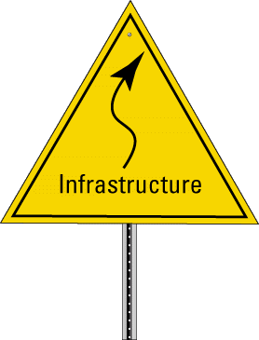
Infrastructure
  e-business
  XML
  Wireless Devices
Notes:
As we proceed along the timeline from today, we arrive at
the first near-term way point. It highlights some
infrastructure developments in progress.
e-business: It is not just about selling products online, as
e-commerce was originally defined. It covers all aspects of
relationships with customers, suppliers, and partners (for
example, sales, marketing, technical support, news,
tracking and reporting progress, linking customers and
employees). It also includes service; infrastructure; and
multiparty, multidirectional (business-to-business)
transactions (Karlenzig 2000).
Knowledge management projects lead naturally to
e-business projects over time. Why?
First, the benefits that an organization reaps from
knowledge management activities (for example, improved
practices, access to up-to-date technical information) will
also be beneficial to the organization’s customers, suppliers, and partners.
Second, the portals and other knowledge management systems that ensure employees have access to critical information can provide a similar service to customers, suppliers, and partners—the requirements are almost identical. In the previous subsection, we noted how portal technology, common to the Schlumberger public knowledge hub and its internal counterpart, is a first step in this direction.
Third, much of the knowledge that companies are trying to reuse is generated beyond the bounds of the single enterprise. It is generated by the so-called “extended enterprise” (customers, suppliers, partners, and alliance members) and beyond (Dawson 2000). It is essential to have access to this external knowledge.
Some organizations use their knowledge as a competitive differentiator, some sell it directly, and others offer services and technology to enable their customers to improve their own knowledge management. Three other possibilities for direct exploitation of knowledge management are customer-specific (extranet) portals, industry portals, and online industry product catalogs.
The customer-specific (extranet) portal provides direct information and support for products and services that are required to support an organization’s relationship with a specific customer.
For example, the Schlumberger coiled-tubing drilling (CTD) library is an extranet portal set up to support BP/Schlumberger CTD work. It is available globally to personnel from the two companies. The trend in applications such as this is clearly moving from finding to doing. We expect direct access to services, such as data management or seismic data analysis services, to become widespread.
The industry portal draws traffic and revenue by providing a variety of things to see and do. Such portals exist to serve many industries (for example, plastics, metals, medical). We expect this trend to continue (along with consolidation in the number of portals that serve any particular industry). An example of an industry portal that serves the energy industry is IndigoPool.com. In addition to news and information, it provides an online oil and gas asset-trading service, complete with the data management and economic simulation tools necessary to evaluate the fit of the assets with a potential buyer’s portfolio.
xml: The extensible markup language is used today in the catalogs of B2B industry portals. We referred earlier to some weakness in publishing and editing in today’s portals. Knowledge management involves a continuous content update process. We anticipate that xml will play a significant role, as it has already started to do in some of the e-business offerings.
Wireless devices: By 2002, it is expected that web-enabled wireless device shipments will surpass PC shipments. By 2005, it is expected that there will be 2 billion wireless internet devices. One effect of this explosion will be that people will expect to have the information they need to do their jobs not only anywhere, any time, but also delivered by any means to the device(s) of their choice. There is interesting work to be done to develop general methods for intelligently selecting-synthesizing the appropriate information to be delivered to different device types.
In addition, means by which wireless devices can communicate with intelligence, that is, with awareness of the contextual environment, are needed. Developing these means in the near term is a good agenda item for the technical community (du Castel 2000).

Slide 9
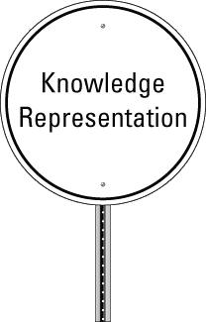
Knowledge Representation
  Transparent Interfaces
  Workflow Capture
  Expertise
  Incomplete, Ephemeral Knowledge
  Integration
  Standards
Notes:
Knowledge representation is clearly important to
knowledge management. The challenge is to put
knowledge representation tools in the hands of the
people who have the knowledge.
Accomplishing this means addressing issues that
are well known to people who have been working
on large-scale knowledge bases, methodologies
for ontology construction, and so on
(Pease et al. 2000).
Transparent interfaces: The interfaces to knowledge
representation tools will have to be transparent. Busy
people with “regular day jobs” are the front-line
knowledge management practitioners. These are the
people who build knowledge hubs. By and large, they
are not computer specialists. This means that the tools
must be extremely quick and easy to use, even on an occasional basis, and that the tools must be embedded in a user’s normal workflow. The activity cannot be seen as an optional extra. We believe that there is exciting work to be done by the knowledge representation community to enable those who have the knowledge to use knowledge representation tools.
Workflow capture: Knowledge management applications frequently revolve around workflows defined for particular tasks (for example, drilling a horizontal oil well). The workflow is typically a graph of steps, loops, decision points, and so on, associated with performing the task. Representations and tools for capturing workflows (Lee et al. 1998) will be valuable, especially if they integrate well with other information (for example, best practices, training material, financial applications) and with other applications.
Expertise: When a CoP member has a problem to solve and is unable to find a solution, the next step is to find an expert—a person who can help. Today, this is done by keyword or full-text intranet search—some sort of structured search—for example, in an LDAP directory or a database of people profiles. We believe that a knowledge representation approach has the potential to produce more effective techniques for matching those who have problems with the experts who can help.
Incomplete, ephemeral knowledge: The knowledge of an organization is often messy, ephemeral, and incomplete. It might not be accurate, and it is rarely neatly packaged. As an example, each time a new product is introduced, the field community must learn a new set of best practices. We believe an interesting challenge for the knowledge representation community is to develop technology and methods to deal with this type of knowledge, representing the dynamics of changing knowledge (Heflin, 2000). In addition, improved methods and tools are required to assist the CoP in following its knowledge management process. On an ongoing basis, it must keep up with what's new, what's working, what doesn't work, what should be retired, and so on.
Integration: For the knowledge representation community to have an impact on the future of knowledge management, it is important that the tools and ontologies are plug-and-play compatible with the other knowledge management technologies. Key among these are portal and search engine technologies. Although there have been some efforts to provide standard application programming interfaces (APIs) to support knowledge base interoperation (Chaudhri et al. 1998), these have not provided practical integration with existing technologies.
Standards: By standards, we mean for representation as well as standard ontologies. xml is important here. Of course, xml and related protocols and standards will evolve on their own, whether the knowledge technology community gets involved with it or not. However, the knowledge representation community is well placed to drive the evolution—as it has in emerging standards such as the resource description framework (rdf) (Brickley 2000), (Decker 2000).

Slide 10
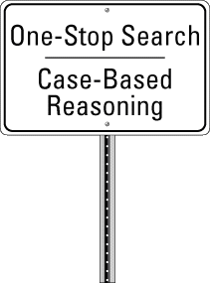
One-Stop Search /
Case-Based Reasoning
  Speed, Precision, Recall
  Natural Language
  Integration / Interaction
  Multilanguage
  Multiple Media
Notes:
One-stop search: Today, one uses full-text search
with a web browser, database search for structured
data (for example, seismic data), Find on a local PC,
and so on. Each of these searches requires the user
to learn a different interface. Furthermore, one must
know which system to search to find the desired
information.
We envision a one-stop shop for search with a single
interface, one search box if you will. We suggest that
the portal approach be applied to one of the major
components of any portal, the search engine itself.
Note: Northern Light’s Search page offers an early
glimpse. Meta Search Engines (e.g., Copernic,
metacrawler) are also relevant here.
There are at least three challenges: First, the search
portal must understand a user’s query well enough to direct it to the appropriate index, database, or file system. Second, the interface differences of the various subsystems must be hidden from the user. Finally, the search portal must retain the power of the previously separate search systems and deliver it to the user.
Case-based reasoning (CBR): CBR appears in figure 9 because it shares many common elements with search (for example, indexing, information classification, and extraction). We expect case bases to be included in the repositories accessible by a search portal (for example, the project archive given in the example earlier).
Speed, precision, recall: We assume that the search engine companies will be hard at work to make substantial progress on speed, precision, and recall.
Natural language: There are many opportunities to make a difference here. Among these is evolving the ideas used in “Ask Jeeves” or Dell's version, “Ask Dudley.” This is an area where there is interesting work to be done and where successful approaches will continue to be adopted quickly in commercial applications.
Integration-interaction: We are thinking about integration with other applications and systems. By interaction, we mean changing the concept of search so that the search engine doesn’t simply return information; it bundles that information with an application so that the user can interact with it (for example, update a three-dimensional model or run a simulation). This starts to happen in the comparison shopping systems of today. We expect that this is going to be an exciting area over the coming years.
Multilanguage: Support for multiple languages is obviously important for organizations that have diverse customers and employees around the world. We expect much improved approaches to multiple language search to be developed. We also look forward to improvements to support multiple-language authoring and content maintenance.
Multimedia: Today, most knowledge hubs are text oriented. This is not by desire; it is apparent that much of the knowledge of an organization is not captured in text but in other media. However, the technology to support indexing and searching of images, sound files, and video is immature. We include multiple media on this slide to emphasize that the knowledge management practitioner community is anxious to use new technology in this area if and when the knowledge technology community can deliver it.

Slide 11

JIT Knowledge Delivery
  Agents
  Help Wizards
  e-learning
Notes:
Just-in-time knowledge delivery means that the
knowledge needed to perform a task is delivered
when it is needed and in the context in which it will
be used (figure 10).
Agents: We expect significant advances in this
technology. Agents will find and bring to our attention
(for example, by push) the things that we didn’t know
we needed to know. Today, agents exist to monitor
news feeds and other real-time data streams and
return only the items indicated by a user’s profile.
Over time, these agents are going to get much
smarter about finding and summarizing the relevant
information. We expect they will be able to
personalize the summaries for individual users. This
means that two individuals might receive different
summaries of the same source document, depending on their profiles. We also expect advances to be made in the ability of agents to select and synthesize information for display on wireless devices. Finally, we expect that it will be standard for users to solve large problems by contracting with a number of agents. Each “entrepreneur” agent will act independently, bidding for the work and delivering a piece of the overall solution.
Help wizards: Online assistance in the context of solving a problem, integrated with the workflow, will become the norm for applications. As an example, in oil-well–drilling planning software today, it is possible at each step in the process to view training material to assist in making decisions. We expect technology to be developed that will allow these training materials to be turned into active help wizards. Imagine having access to active, multimedia best practices, explained by the experts themselves, when you most need help.
e-learning: Just-in-time knowledge delivery means learning anywhere, any time, on demand, and in context. Another way to put it is “just in time, just enough, just for me.”
Today, self-learning is enabled by online CoP knowledge (for example, best practices) and interactive computer-based training materials. Asynchronous distance learning is also used, wherein a remote instructor is available by e-mail. Finally, synchronous distance learning is carried out, wherein a course is offered by net broadcast, and the instructor is available during the session. There is a good deal of work to be done, and a receptive knowledge management community is ready to apply it quickly if it is robust and can be integrated with the other knowledge management systems. A simple example would be a “training wizard” that observes the browsing and searching done by a user on the knowledge hub and makes inferences about the training courses that may be of interest.

Slide 12

Knowledge Powered Enterprise
  Real-Time Knowledge Management
    – Everyone Contributes
    – KM Embedded in Workflow
    Seamless Information Space
    Integrated Simulation / Decision Support
    Data Mining / Knowledge Discovery
Notes:
Farther forward, beyond the first chicane, the next
visible road sign is "knowledge-powered enterprise."
In such an organization, knowledge management is
“organic” (Shevlin et al. 1997). It happens
everywhere—in the background, in real time.
Everyone contributes. Knowledge management
process and behavior are embedded in the workflow
as part of the normal day-to-day job. Knowledge
management functions are embedded in core
business applications and employee productivity
tools.
Knowledge management specialists may still be
present to assist, for example, librarians. However,
the specialists will be part of a small team that
operates across the company.
There are three important components from a technological point of view:
Seamless information space: Everyone has rapid access to the information needed to do his/her job. The portal concept will be extended across the organization. CoP members will not need to know that the information is stored in a particular application, which is on that server. It will not matter. They will get the information they need when they want it, where they want it, and how they want it delivered.
Data mining and knowledge discovery: Today, most enterprises are still at the stage of trying to capture the data in an organized fashion, let alone trying to mine it to influence business decisions. However, we expect three threads to come together: First there will be continued evolution of data management technology. Second, powerful new data-mining and knowledge-discovery technology will be developed. Third, these two types of technology will be coupled with portal technology to deliver the information needed to perform a task just in time for it to be of use (Mitchell 1999).
Integrated simulation and decision support: Imagine you are offered the opportunity to invest, say in an operation that promises to improve the producdtion of an existing oil well. You are given the necessary geoscience data (e.g., well logs, seismic data) and the models that have been created (e.g., reservoir model). You are asked to decide whether to invest in the well … now!
Vignette 3 dealt with an oil company well engineer talking to a potential investor. The investor was able to compute the likely effect of a particular oil well operation, drilling a sidetrack, from a geoscience point of view. He then used those results to compute the rate of return and risk associated with the proposed investment. This kind of combined geoscience, economics, and risk simulation can be accomplished today, but it is not commonplace, nor does it happen in real time.
By including integrated simulation and decision support in this slide, we do not mean to suggest that the knowledge technology community will introduce the necessary technology. Indeed, in a company like Schlumberger, a sizable fraction of the entire research and development budget is devoted to building the tools that can be used by our clients to solve problems such as the one in the vignette. However, we do believe that the knowledge technology community can make a useful contribution to the design of these tools. It is important to ensure that they can be coupled in useful ways to the seamless information space by means of the intranet portal (including its case bases, best practices, and other information) and with the data-mining and knowledge discovery systems.

Slide 13
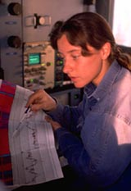

Decisions … in Real Time
    OilCo Well Engineer: We're planning to sidetrack well B23 in the Fifties field and are hoping you’ll buy in. For $10 million you can become a full 1-percent partner. A 96-hour shut-in test ended a few minutes ago. It indicates additional reserves of 750,000 barrels of oil and an initial sand-free production rate of 4,300 barrels per day…. We could do this tomorrow.
    Investor, consulting his Knowledge Hub: I see that a sidetrack can double my rate of return, with a payback time of 30 days for 1-percent interest.… Count me in.
Notes:
The Right Information, to the Right People, at the Right Time
It’s not enough to have the right information delivered to the right people at the right time. They must also have the tools to apply that information. In this vignette, the investor has the simulation and decision support tools necessary to integrate the geoscience, production, and economic data delivered by the well engineer. He/she is able to determine the potential payback and risk and make a decision—in real time.

Slide 14
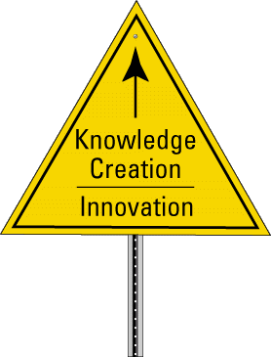
Knowledge Creation / Innovation
  Continuous Learning
Notes:
In the knowledge-powered enterprise, knowledge
sharing and application are standard. As a result,
the enterprise has substantially improved its
performance and reduced its costs.
The new focus is the end game for knowledge
management—fostering knowledge creation and
innovation by continuous learning to replenish and
renew its stocks of knowledge. Data-mining and
knowledge-discovery tools play an important
supporting role.
The new challenge for knowledge management will
be reinventing the organization as a provider of
products and services that are only possible
because it is able to leverage the collective
knowledge of its people.
While we cannot yet imagine the complete set of technology packages will be required to enable this new state, we are confident that knowledge technology will play a role. As a simple example, observing what CoP members are searching for—but not finding—could be used to infer areas where the knowledge stocks are weak and new research projects and/or alliances are required. This intelligence would be valuable to the knowledge champions in the Example: Drilling Best Practices section and to the line management.

Slide 15
JIT Knowledge Delivery
  Agents
  Help Wizards
  e-learning
First Wave KM
  Technology
    Portals, Collaboration,
    Document Management,
    Little Integration
  Process
    Best Practices, Validation
  People
    Communities of Practice
One-Stop Search /
Case-Based Reasoning
  Speed, Precision, Recall
  Natural Language
  Integration / Interaction
  Multilanguage
  Multimedia
Knowledge Powered Enterprise
  Real-Time Knowledge Management
    Everyone Contributes
    KM Embedded in Workflow
  Seamless Information Space
  Integrated Simulation / Decision Support
  Data Mining / Knowledge Discovery
Knowledge Representation
  Transparent Interfaces
  Workflow Capture
  Expertise
  Incomplete, Ephemeral Knowledge
  Integration
  Standards
Infrastructure
  e-business
  XML
  Wireless Devices
Knowledge Creation / Innovation
  Continuous Learning
Today
Long Term
Notes:
Here is the overall road map on a single slide. Today
is shown on the left end of the timeline, the Long Term
is shown on the right. Arrows indicate connections
between the technology way points.
-----
We attempted to summarize existing practice in
knowledge management and suggest possible
scenarios for the way that the enabling technology
and engineering might evolve over the next decade
or so. We have done this by presenting a technology
road map and vignette future scenarios for
technology that has the potential to enable a new era
in organizational performance. It is envisaged that the
enterprise of the future will be knowledge powered.
Proactive, real-time knowledge management will
become the norm.
Such a summary must inevitably be incomplete and selective, but it is hoped that the major targets have been identified and that ways in which the knowledge technology community, in particular, can contribute to shaping the future of knowledge management are clear.
Meeting the challenges described here is beyond the scope of any single organization. It will require synthesis of the work of many contributors—in industry, academia, and government. Hopefully, this presentation will stimulate further dialog and collaboration among these groups to develop a technical agenda that turns the vision of the knowledge-powered organization into a reality.

Slide 16

Notes:
Finally, let's remember that driving down the road
ahead is not a leisurely experience—it is a race
—and the competitors are lined up on the grid.

Slide 17
The End

