Slide 1
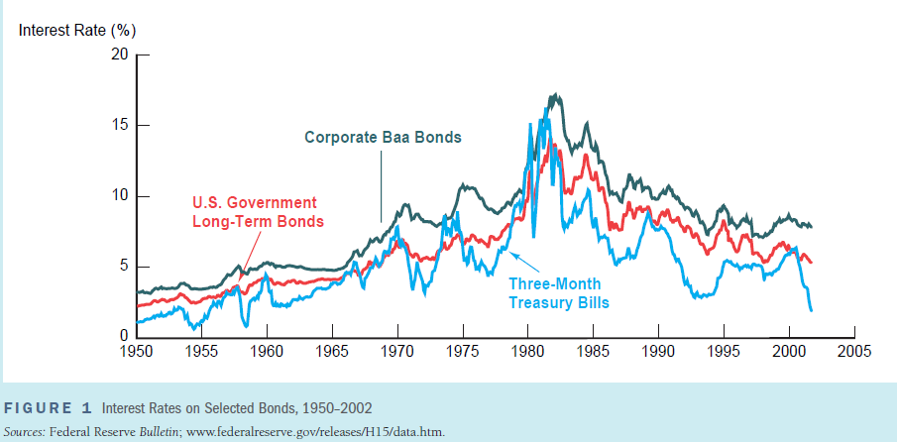
FIGURE 1 Interest Rates on Selected Bonds, 1950–2002
Notes:
FIGURE 1 Interest Rates on Selected Bonds, 1950–2002
Sources: Federal Reserve Bulletin; www.federalreserve.gov/releases/H15/data.htm.

Slide 2
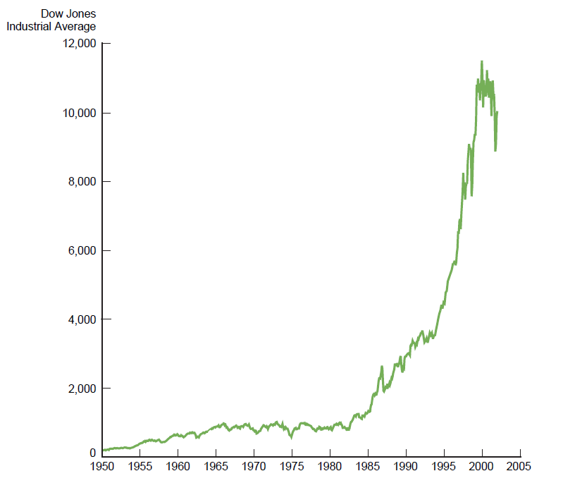
FIGURE 2 Stock Prices as Measured by the Dow Jones Industrial Average, 1950–2002

Slide 3
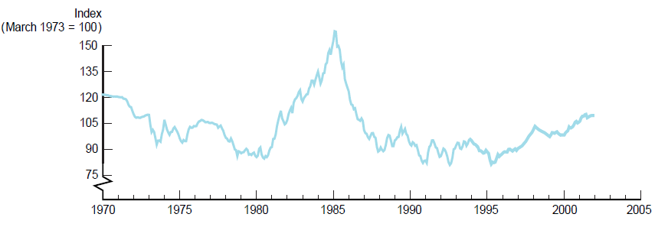
FIGURE 3 Exchange Rate of the U.S. Dollar, 1970–2002

Slide 4
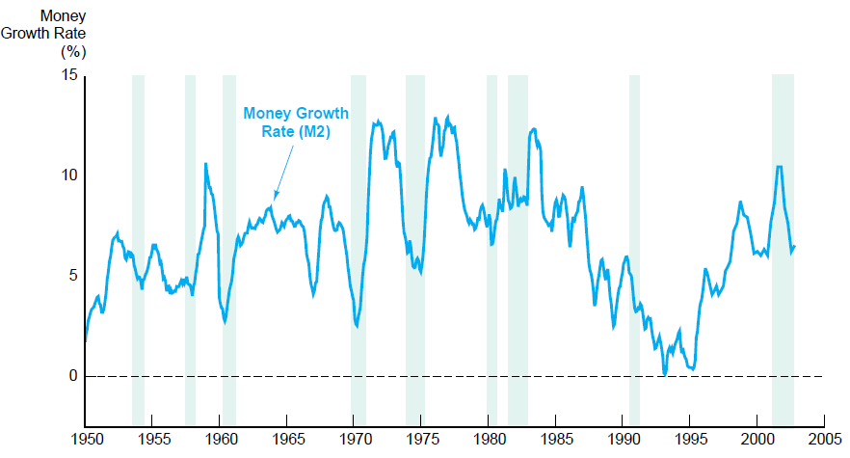
FIGURE 4 Money Growth (M2 Annual Rate) and the Business Cycle in the United States, 1950–2002
Notes:
FIGURE 4 Money Growth (M2 Annual Rate) and the Business Cycle in the United States, 1950–2002
Note: Shaded areas represent recessions.
Source: Federal Reserve Bulletin, p. A4, Table 1.10; www.federalreserve.gov/releases/h6/hist/h6hist1.txt.

Slide 5
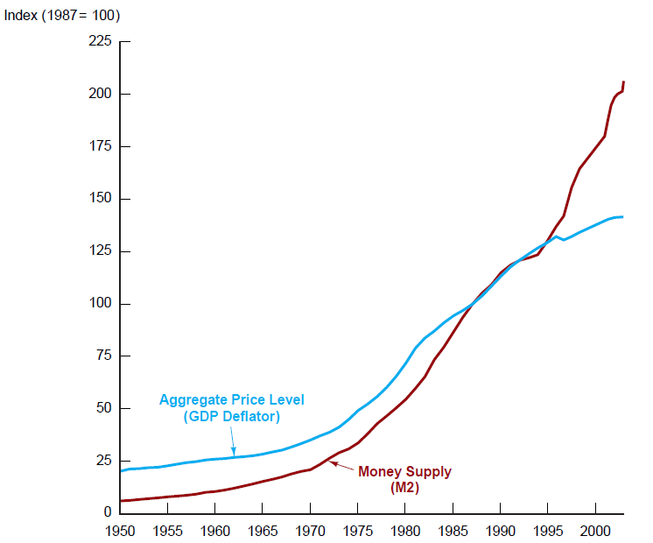
FIGURE 5 Aggregate Price Level and the Money Supply in the United States, 1950–2002
Notes:
Sources: www.stls.frb.org/fred/data/gdp/gdpdef; www.federalreserve.gov/releases/h6/hist/h6hist10.txt.

Slide 6
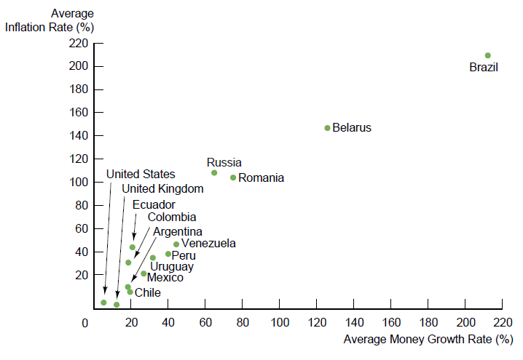
FIGURE 6 Average Inflation Rate Versus Average Rate of Money Growth for Selected Countries, 1992–2002
Notes:
Source: International Financial Statistics.

Slide 7
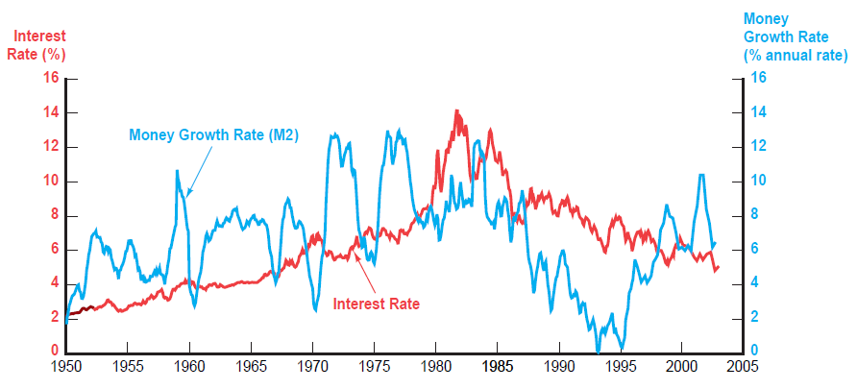
FIGURE 7 Money Growth (M2 Annual Rate) and Interest Rates (Long-Term U.S. Treasury Bonds), 1950–2002
Notes:
Sources: Federal Reserve Bulletin, p. A4, Table 1.10; www.federalreserve.gov/releases/h6/hist/h6hist1.txt.

Slide 8
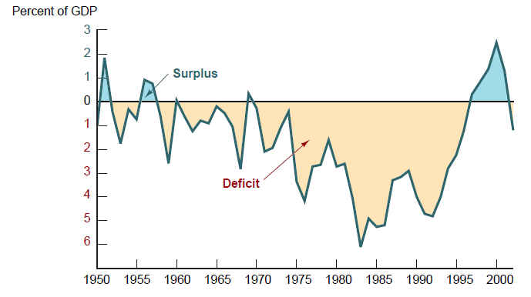
FIGURE 8 Government Budget Surplus or Deficit as a Percentage of Gross Domestic Product, 1950–2002
Notes:
Source: http://w3.access.gpo.gov/usbudget/fy2003/spreadsheets.html.

