Slide 1

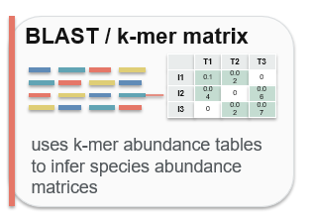
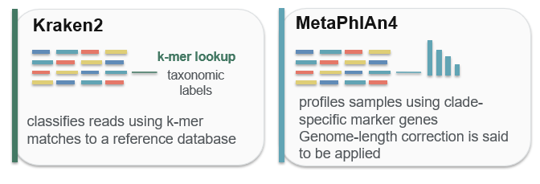
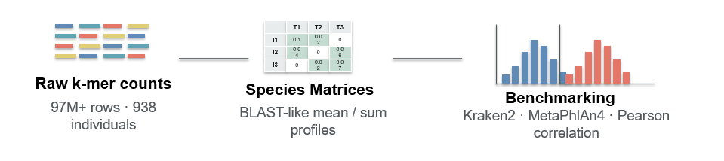
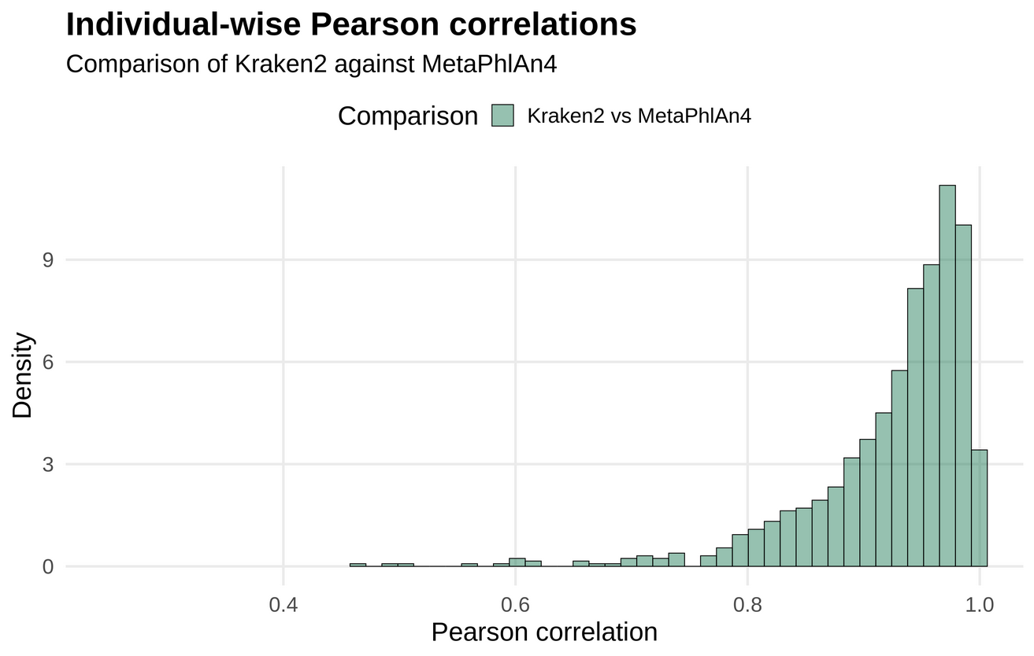
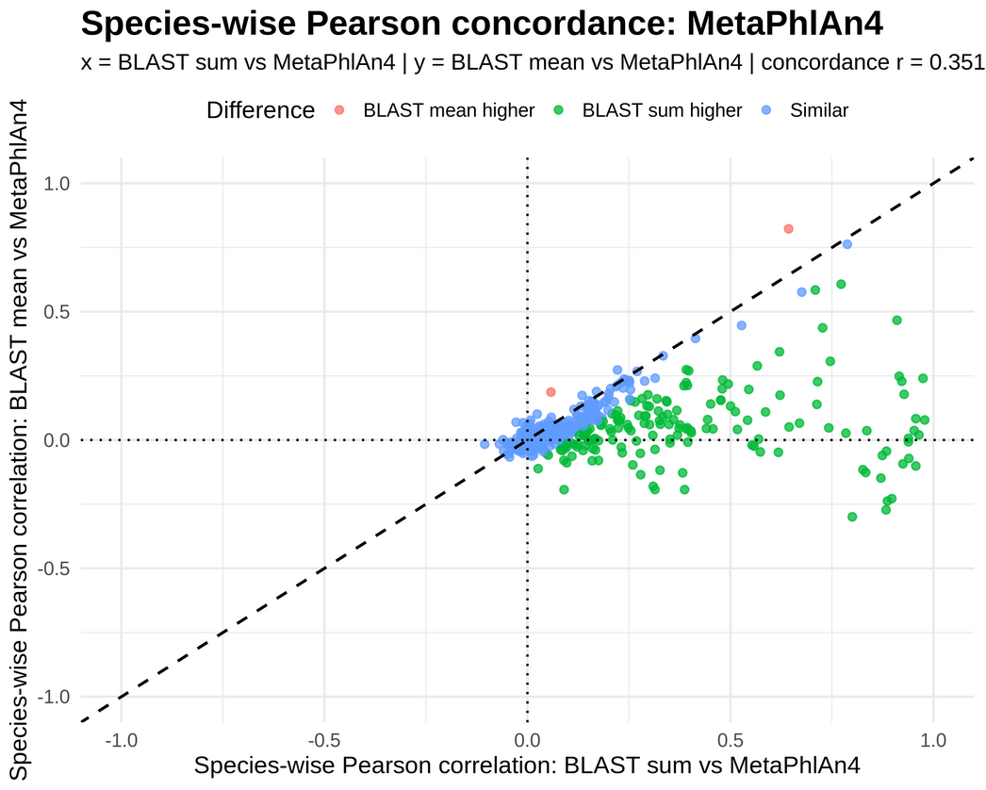
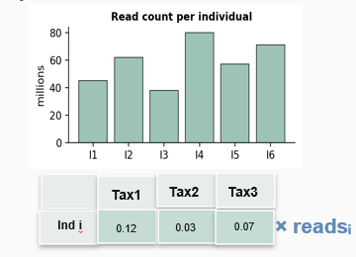
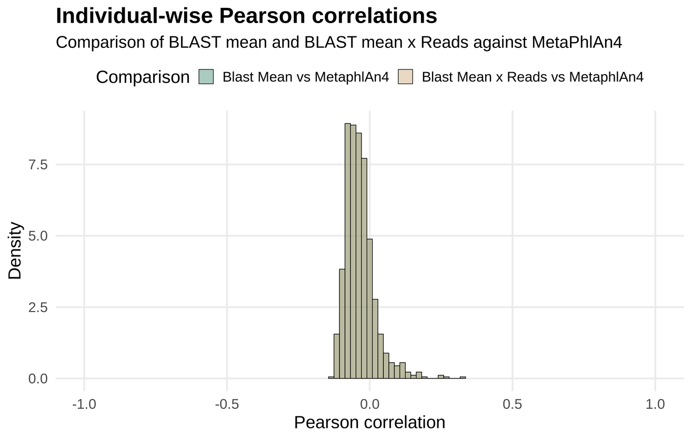
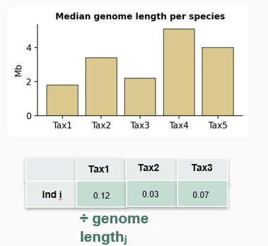
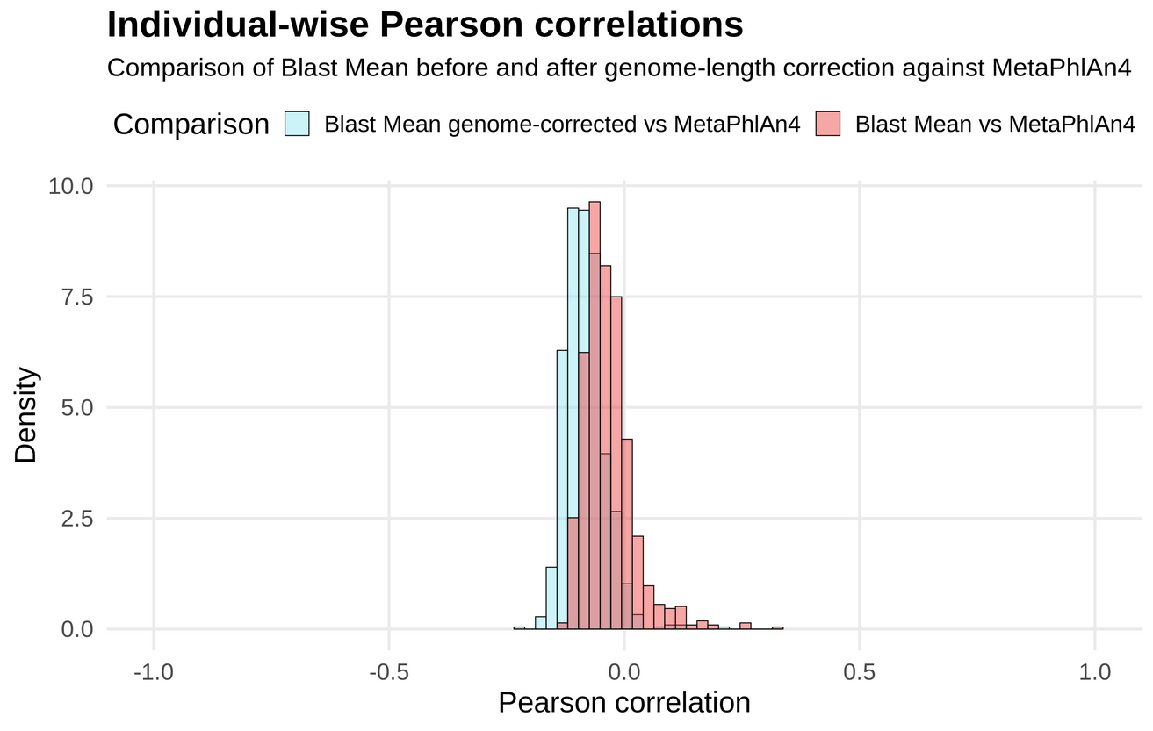
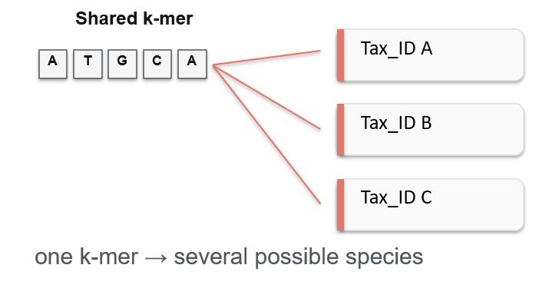
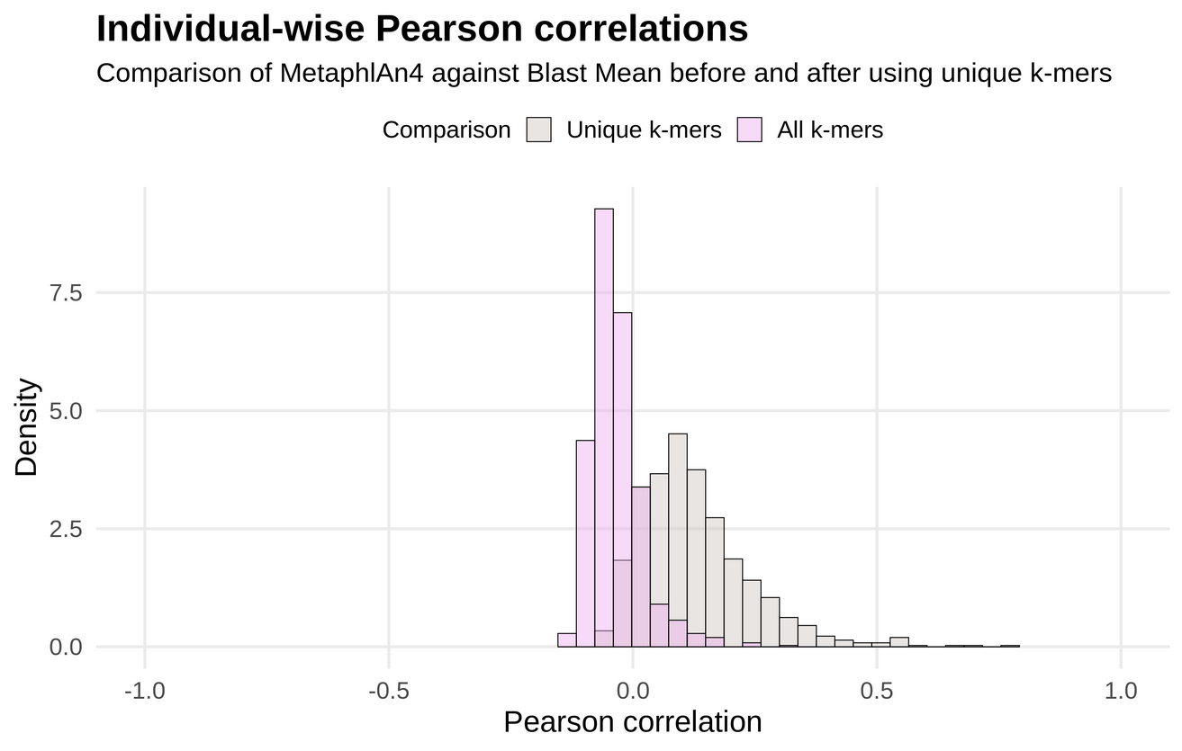
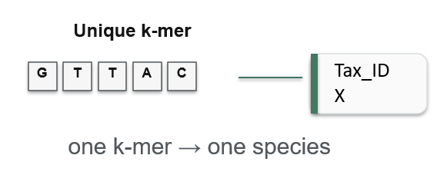
Predicting Psychiatric Illness Risk from Brain Structure
Aspasia Lavazou, Raphael Malak, Hugues Aschard
Institut Pasteur, Department of Computational Biology, Statistical Genetics Laboratory, Paris, France
INTRODUCTION
METHODS
Metagenomic profiling characterizes the gut microbiome by estimating bacterial species and their abundances. Taxonomic classifiers such as Kraken2 and MetaPhlAn4 assign sequencing reads to known taxa, while taxonomy-free MWAS approaches use k-mers, short DNA words capturing single nucleotide polymorphisms, insertion or deletion events and gene presence–absence. Here, we investigate whether k-mer-based profiles can reproduce species abundance patterns obtained from established classifiers.
K-MER PROFILING
97M+ k-mer abundances from 938 gut microbiome samples were mapped to species-level taxonomic IDs using BLAST against NCBI GenBank. Species abundance matrices were reconstructed using sum and mean-based aggregation strategies.
OBJECTIVE
REFERENCE COMPARISON
To evaluate whether species abundance profiles reconstructed from k-mer data agree with taxonomic profiles generated by established classifiers like Kraken2 and MetaphlAn4.
RESULTS
Benchmark agreement
Read-count correction
1
2
Each individual row was multiplied by its read count.
Pearson Correlation between Kraken2 and MetaphlAn4
Kraken2 and MetaphlAn4 show high agreement across the 938 samples.
Correcting by number of reads doesn’t improve the agreement.
j
j
Genome-length correction
Unique k-mers
3
Each species column was divided by its median genome length.
4
Genome-length scaling worsens the agreement.
Keeping only unique k-mers improves the agreement.
j
j
CONCLUSIONS
NEXT STEPS
Kraken2 and MetaphlAn4 show high mutual agreement that is not reproducible even after number of reads and genome length corrections of the Blast matrices.
Use of new data sets that would serve as the ground truth, to compare the three methods more accurately.
Reducing taxonomic ambiguity by keeping only unique k-mers improves agreement between our state-of-the-art method and the established taxonomic classifiers.
Application of new corrections to our k-mer based method in order to produce more applicable results.

Slide 2



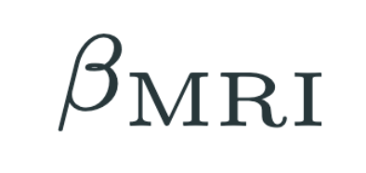

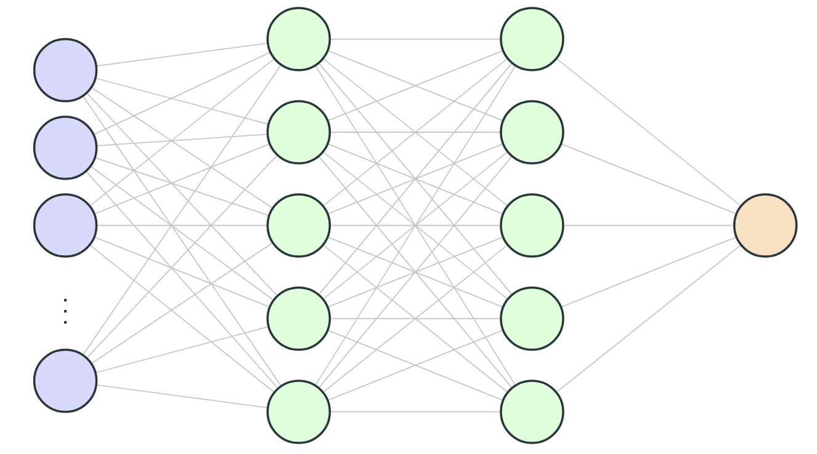
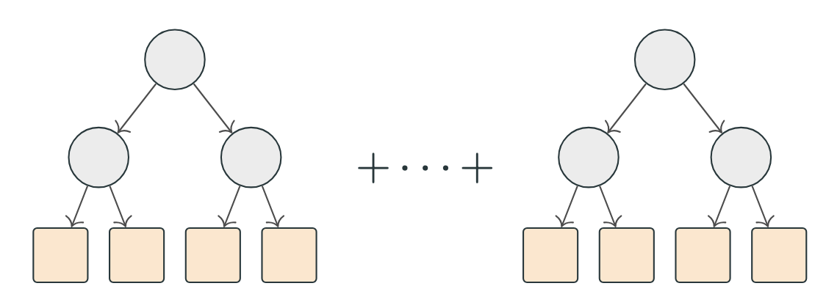
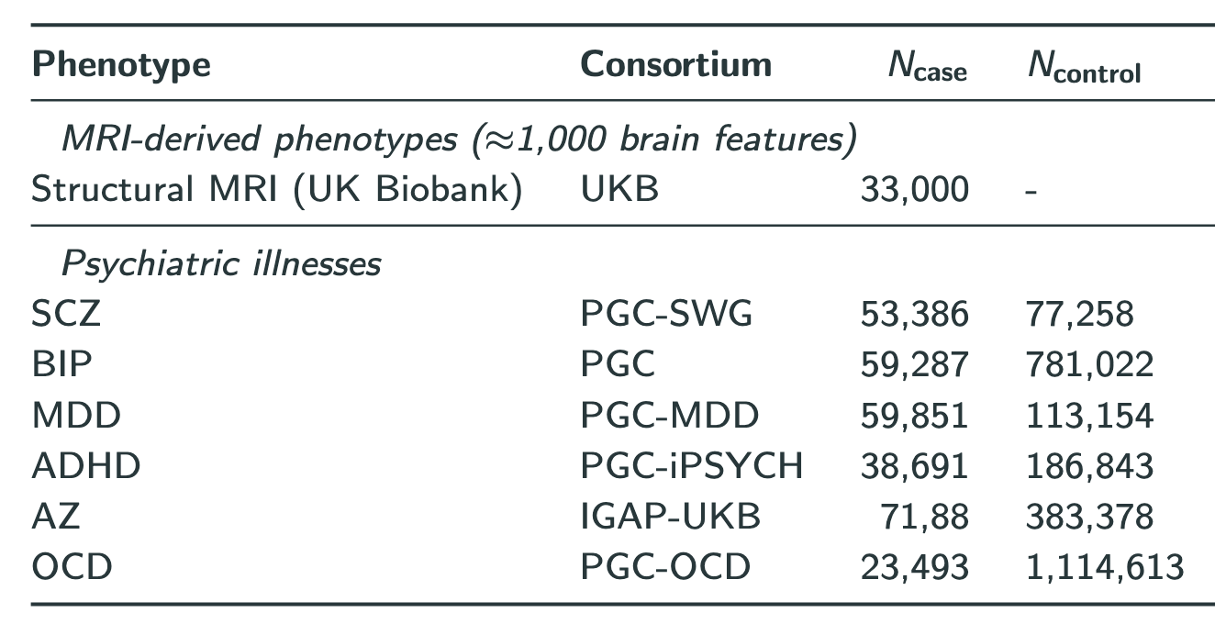
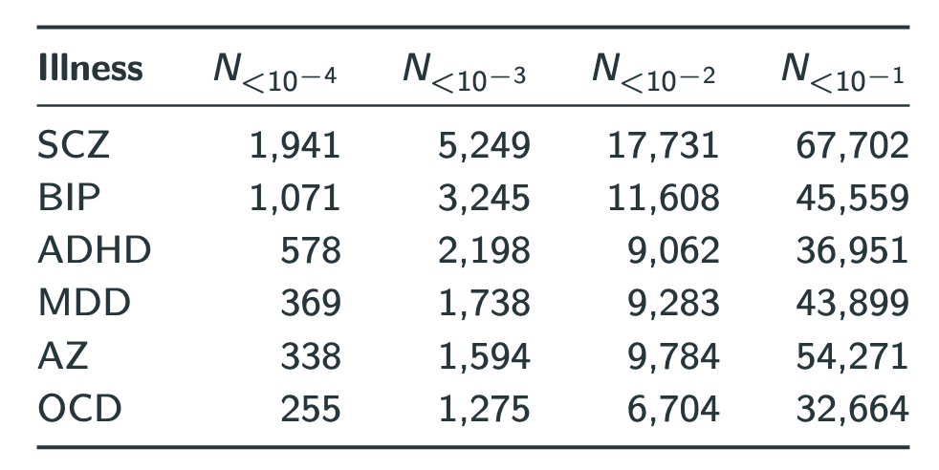
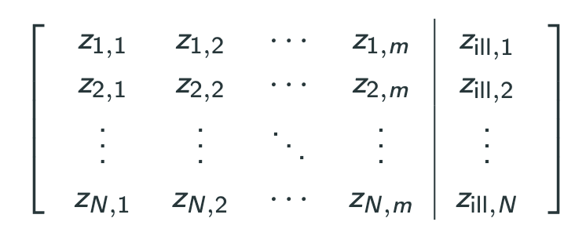
An explainable Machine Learning framework for identifying genetically informed neuroimaging phenotypes in neuropsychiatric disorders
Leon Ackermann^{1,2}, Simeon Tsang¹, Antoine Auvergne¹, Roberto Toro¹, Leo Henches¹, Daniel Racoceanu^{2,3}, Hugues Aschard¹.
¹Institut Pasteur, Université Paris Cité, Department of Computational Biology, Paris, France,
²Sorbonne Université, Faculty of Sciences and Engineering, Paris, France,
³Paris Brain Institute (ICM), Aramis Lab, Faculty of Health Sciences, Paris, France.
Single Nucleotide Polymorphism
.
.
.
Psychiatric Illness Risk
Brain Structure
DATA
EXPERIMENTS
No Filter on Brain Structure significance
Filter on Brain Structure significance
Questions
No Filter on psychiatric risk significance
EXPERIMENT 1
Baseline with all data
Worst performance
EXPERIMENT 3
Increase of signal in brain structure
Does more signal in brain structure lead to better performance?
Filter on psychiatric risk significance
EXPERIMENT 2
Increase of signal in psychiatric risk
EXPERIMENT 4
Most signal available
Does more signal in psychiatric risk lead to better performance?

