Slide 1
Hospital Database
Team Members: Zack Rosa, Branden Dao, and Leon Chen

Slide 3
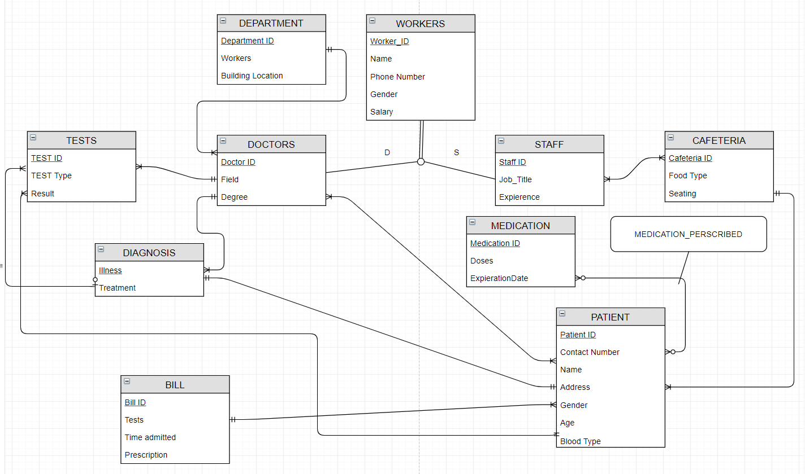
ERD

Slide 4
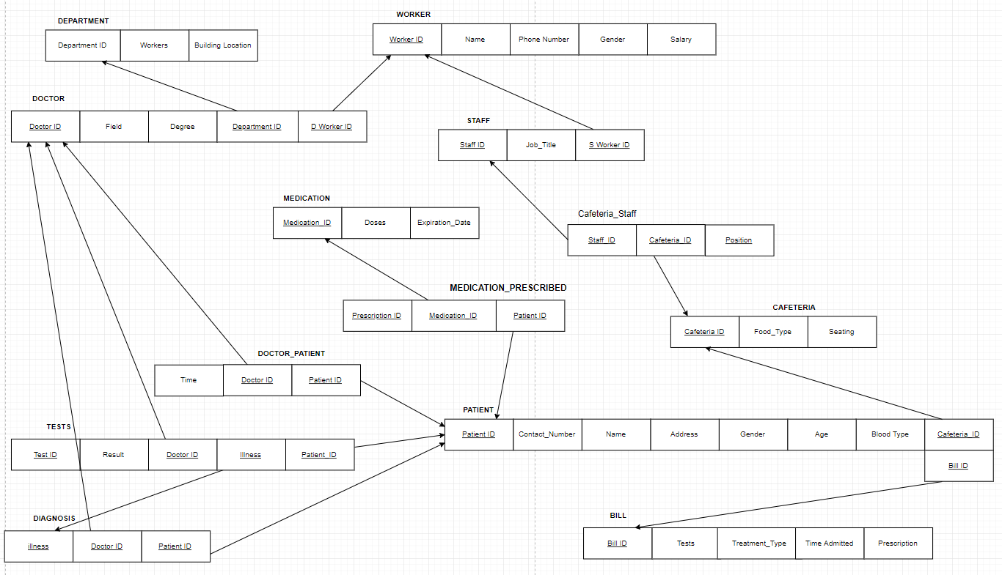
Relational Model (EERD)

Slide 5
Sample DDL (Not Tested!)
DROP TABLE IF EXISTS WORKER;
DROP TABLE IF EXISTS DEPARTMENT;
# Checked
CREATE TABLE DEPARTMENT (
Department_ID varchar(15) NOT NULL,
Workers INT,
Building_Location VARCHAR(15),
CONSTRAINT Department_PK PRIMARY KEY (Department_ID)
);
# Checked
CREATE TABLE WORKER (
Worker_ID INT NOT NULL,
fname VARCHAR(10),
lname VARCHAR(10),
Gender CHAR(1),
telephone VARCHAR(14),
Salary INT,
CONSTRAINT Worker_PK PRIMARY KEY (Worker_ID)
);
INSERT INTO Department VALUES (' ICU ', ' 20 ', ' Dobson ');
INSERT INTO Department VALUES (' Pediatric ', ' 26 ', ' Wheeler ');
INSERT INTO Department VALUES (' ER ', ' 32 ', ' Dobson ');
INSERT INTO Department VALUES (' Burn Center ', ' 15 ', ' Campbell ');
INSERT INTO Department VALUES (' Pharmacy ', ' 8 ', ' Wheeler ');
INSERT INTO Worker VALUES (' 119275 ', ' Henry ', ' Fuller ', ' M ', ' (978)123-1234 ', ' 127000 ');
INSERT INTO Worker VALUES (' 122842 ', ' Zack ', ' Futa ', ' M ', ' (123)436-1236 ', ' 122000 ');
INSERT INTO Worker VALUES (' 197531 ', ' Cam ', ' Ryder ', ' M ', ' (543)753-1327 ', ' 72000 ');
INSERT INTO Worker VALUES (' 128575 ', ' Janet ', ' Grosmen ', ' F ', ' (617)355-7684 ', ' 150000 ');
INSERT INTO Worker VALUES (' 124865 ', ' Michelle ', ' Haverhill ', ' F ', ' (631)125-1235 ', ' 125000 ');
INSERT INTO Worker VALUES (' 118467 ', ' Oliver ', ' Mansman ', ' M ', ' (934)126-6421 ', ' 49000 ');
INSERT INTO Worker VALUES (' 195538 ', ' Lisa ', ' Perez ', ' F ', ' (682)165-8523 ', ' 64000 ');

Slide 6




4 Simple Queries (Lecture 6)
SELECT fname, lname
FROM worker Output = Female Workers
WHERE gender = ‘F’
SELECT Salary
FROM worker Output = Salaries of workers between 70000 and 180000
WHERE Salary BETWEEN 70000 AND 180000 (in decreasing order)
ORDER BY Salary DESC
SELECT Doses
FROM medication Output = the number of doses
WHERE Doses is NOT null
SELECT Address
FROM patient Output = Address of patient who live at Vancouver Way
WHERE Address LIKE '%Vancouver Way%'

Slide 7

3 Intermediate Queries (Lecture 7)
SELECT sum(Salary)
FROM worker Output = the sum of all the workers combined

Slide 8
3 Advanced Queries (Lecture 8)

