Slide 1
Identifying Potential Locations to Establish an Armenian Restaurant in São Paulo, Brazil
IBM Data Science Professional Certificate
Applied Data Science Capstone

Slide 2
INTRODUCTION
The key objective of this project is to help a group of investors to identify potential locations in São Paulo, Brazil, in order to establish an Armenian restaurant, targeting its efforts not only to Armenian-origin residents but also to other market segments with long-lasting historical relationships with Armenians.
Our particular interest will be in neighbourhoods where there is already a strong gastronomic tradition, but that does not include an existing Armenian restaurant or other restaurants known for their Greek and Arab traditions.

Slide 3
THE BUSINESS PROBLEM
São Paulo is a cosmopolitan city where restaurants of all types and origins abound. Our particular interest will be in neighbourhoods where there is already a gastronomic tradition, but that does not include other Greek and Arab-food restaurants, the latter including the Syrian and Lebanese cuisine.
Data science-based techniques will be employed to generate potential and promissing neighbourhoods candidates. Advantages of each areas will then be clearly expressed so that best possible final location can be chosen by the stakeholders.

Slide 4
DATA
Based upon the stated business-problem, data sources will be needed to extract/generate the required information:
Geolocation coordinates of candidate areas will be generated, and
The number of restaurants and their type and location in every neighborhood will be obtained using available resources of Foursquare API.

Slide 5
METHODOLOGY
The methodology in this project will consist in the following steps:
Import all needed libraries;
Retrieve the geolocation coordinates of all boroughs and neighbourhoods that comprise the municipality of São Paulo;
Visualize those neighbourhoods through folium maps;
Adopting the "Elbow method" and the k-means classifier, explore the characteristics of those neighbourhoods in order to identify distinct clusters that might be attractive to host an Armenian restaurant;
Through queries to Foursquare API, list all categories of restaurants aiming at identifying potential competing restaurants and their geolocations;
Determine the gastronomic activity of each neighbourhood, selecting those that are more active and presenting low competition levels;
Finally, suggest to the group of investors the potential neighbourhood candidates.

Slide 6
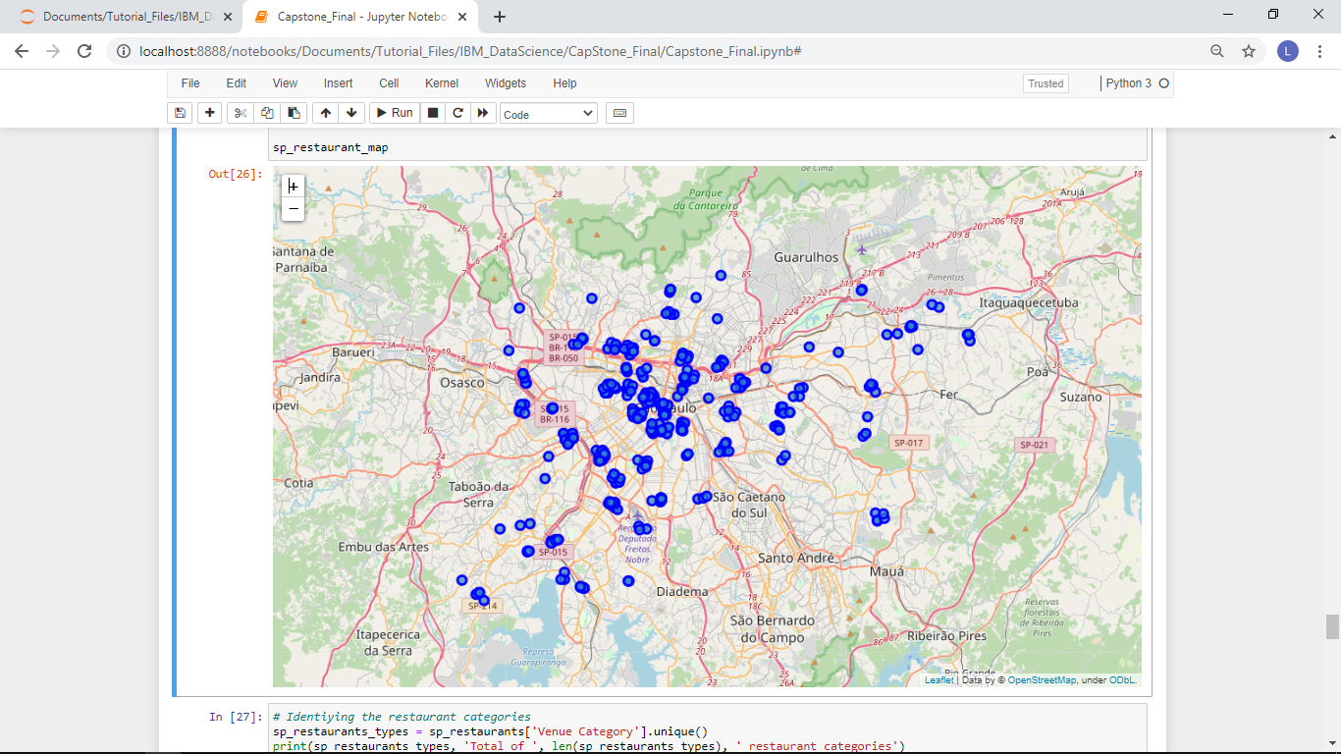
ANALYSIS: Geolocation of Restaurants in São Paulo

Slide 7
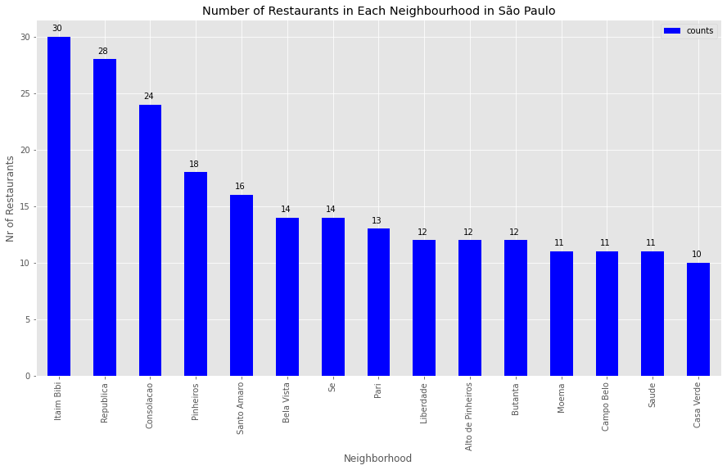
ANALYSIS: Gastronomic Activity in Selected Neighbourhoods

Slide 8
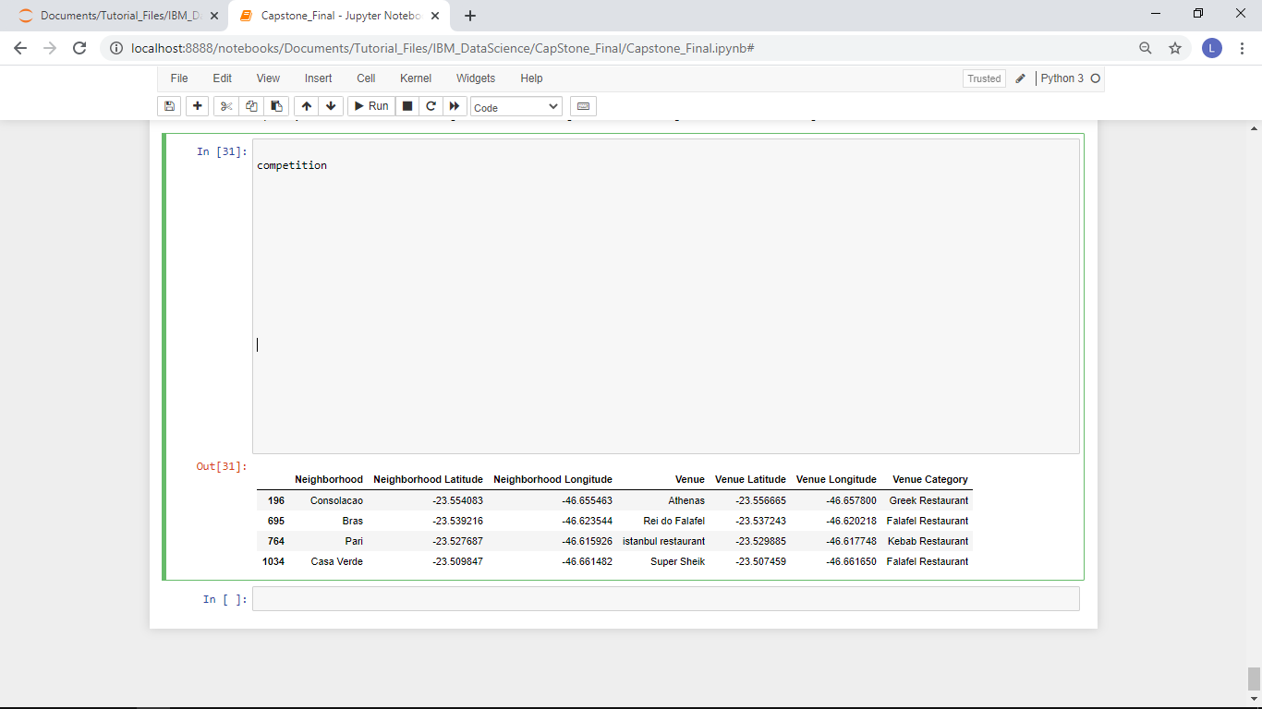
ANALYSIS: Potential Competitors

Slide 9
RESULTS AND DISCUSSION
From the above mentioned analytical procedures, the following observations emerge:
São Paulo is a pretty much an homogeneous city with a "huge" cluster comprising by the bulk of its neighbourhoods. The distinct clusters are two neighbourhoods at the low-income outskirts of the city and, therefore, not eligible for potential candidates for hosting an Armenian restaurant;
The 458 restaurants delivered by the queries to the Foursquare API can be grouped into 44 distinct categories that do not include the "Armenian" and "Arab" as well, but include two other categories that indirectly compete with the Armenian cuisine: "Falafel" (2 individuals) and "Kebab" (1 individual);
Those 3 restaurants mentioned in the preceding comment are in popular neighbourhoods, somewhat far from the gastronomic epicentre frequented by middle and high income class consumers;
The strongest potential competitor is a Greek restaurant located within the Sao Paulo's gastronomic belt, in the "Consolação" neighbourhood;
One strong candidate emerge as the most attractive neighbourhood, "Itaim", popularly known as the charming venue that hosts a bunch of well-known restaurants in São Paulo.

Slide 10
CONCLUSION
The key conclusion is that "Itaim" neighbourhood should be strongly recommended to the group of investors that commissioned this project.
A detailed and follow-up study should be carried out, looking in details its micro-regions that can leverage the successful launching of an Armenian restaurant in São Paulo.

