Slide 1
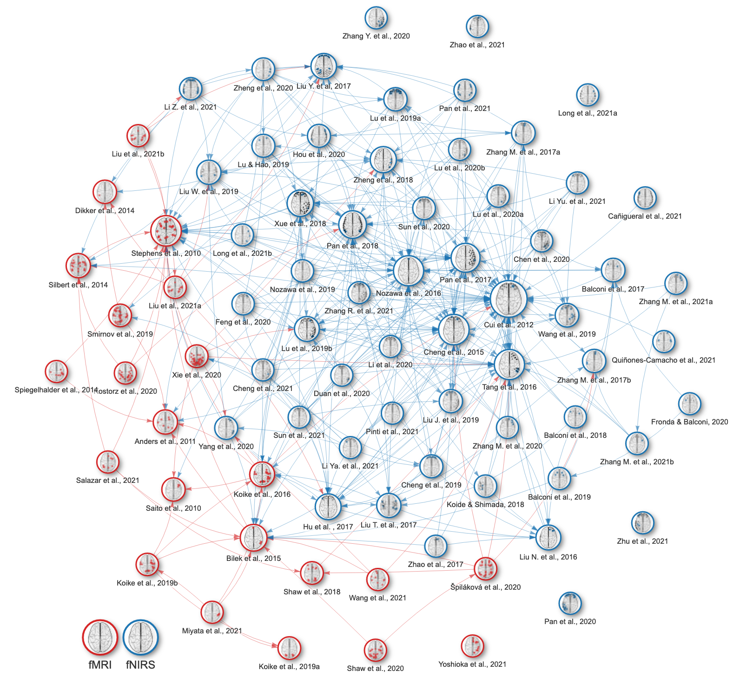
A
Records itentified
Pubmed, Scopus, arXiv, bioRxiv, medRxiv, OpenCitations (n = 2,621)
Previous literature search (n = 39)
Nam et al., 2020 (n = 64)
B
Identification
Records removed before screening
Additional duplicates (n = 149)
Records screened
(n = 2,575)
Records excluded
(n = 2,393)
Reports sought for retrievel
(n = 182)
Reports not retrieved
(n = 0)
Screening
Reports assessed for eligibility
(n = 182)
Reports excluded
Not healthy / <18 / >65 y (n = 13)
No article / preprint (n = 8)
Not fMRI / fNIRS (n = 8)
No hyperscanning (n = 33)
No interaction (n = 17)
No temporal synchrony (n = 43)
Not whole-brain / channel-wise / data not available (n = 55)
Studies included
fMRI (n = 22)
fNIRS (n = 57)
Inclusion
Experiments identified
fMRI (n = 22)
fNIRS (n = 69)
Experiments analyzed
fMRI: Primary Activation Likelihood Estimation (n = 22)
fNIRS: Primary parcel-wise quantitative analysis (n = 69)
fMRI & fNIRS: Secondary joint Activation Likelihood Estimation (n = 22/60)
Analyses

