Slide 1
Data Stream Sampling
Jia Teoh
UCLA CS 240B – Prof. Zaniolo
Winter 2017

Slide 2
Why Sampling?
Computation on entire dataset not always feasible
Large data can take too long to compute
Bursty streams cannot afford to be blocked
Sampling provides approximate answers quickly
Sampling rate can be adjusted to accommodate data flow
Approximate answers often within provable error bounds

Slide 3
Outline
Why Sampling?
Sampling Background + Definitions
Review of Basic Sampling Techniques
Concise Sampling
Sampling Subsets
Sampling on Windows
Distributed Sampling

Slide 4
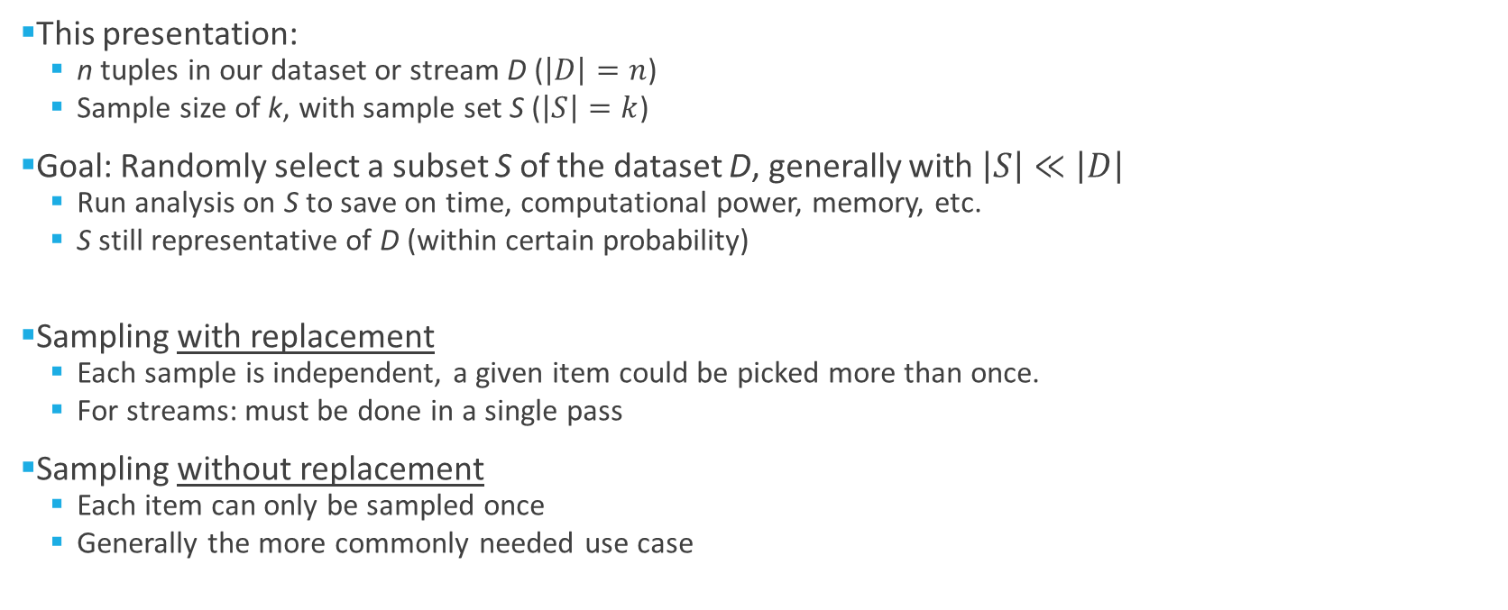
Sampling Background + Definitions
This presentation:
n tuples in our dataset or stream D ($\left|D\right|=n$)
Sample size of k, with sample set S ($\left|S\right|=k$)
Goal: Randomly select a subset S of the dataset D, generally with $\left|S\right|≪\left|D\right|$
Run analysis on S to save on time, computational power, memory, etc.
S still representative of D (within certain probability)
Sampling with replacement
Each sample is independent, a given item could be picked more than once.
For streams: must be done in a single pass
Sampling without replacement
Each item can only be sampled once
Generally the more commonly needed use case

Slide 5
Outline
Why Sampling?
Sampling Background + Definitions
Review of Basic Sampling Techniques
Concise Sampling
Sampling Subsets
Sampling on Windows
Distributed Sampling

Slide 6
Simple Random Sampling
Without replacement
Select a random (n choose k) combination
Each k-size sample has probability 1/(n choose k)
With replacement
Randomly select a number from [1, n] k times
Equivalent to k independent instances of sampling 1 item without replacement
Fairly straightforward, but requires that n is known beforehand.
Impossible for data streams!

Slide 7
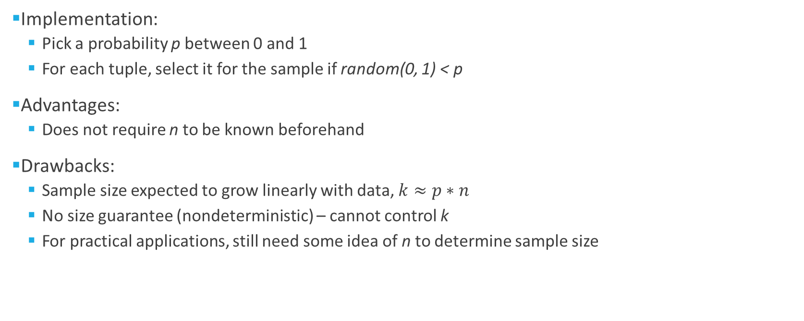
Bernoulli Sampling
Implementation:
Pick a probability p between 0 and 1
For each tuple, select it for the sample if random(0, 1) < p
Advantages:
Does not require n to be known beforehand
Drawbacks:
Sample size expected to grow linearly with data, $k≈p∗n$
No size guarantee (nondeterministic) – cannot control k
For practical applications, still need some idea of n to determine sample size

Slide 8
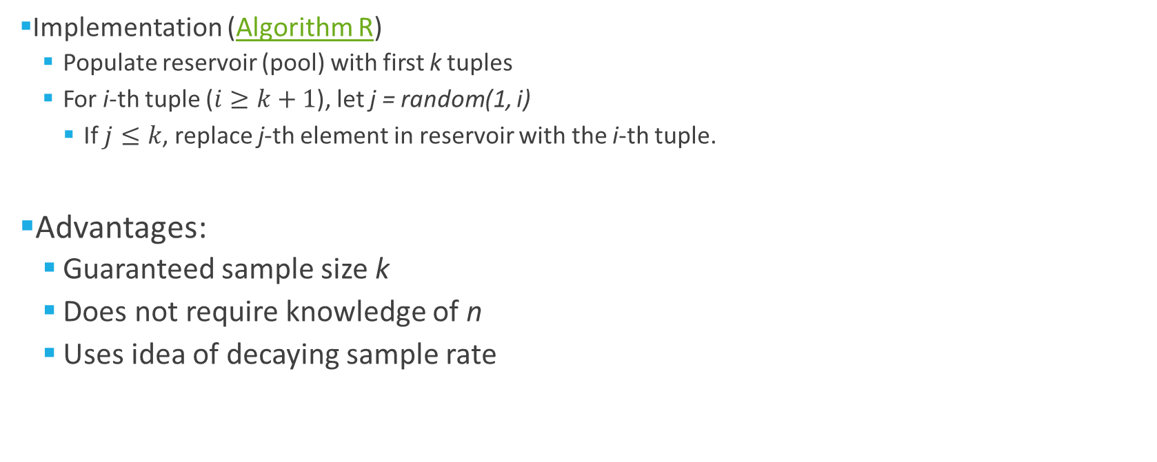
Reservoir Sampling [5]
Implementation (Algorithm R)
Populate reservoir (pool) with first k tuples
For i-th tuple ($i≥k+1$), let j = random(1, i)
If $j≤k$, replace j-th element in reservoir with the i-th tuple.
Advantages:
Guaranteed sample size k
Does not require knowledge of n
Uses idea of decaying sample rate

Slide 9
Outline
Why Sampling?
Sampling Background + Definitions
Review of Basic Sampling Techniques
Concise Sampling
Sampling Subsets
Sampling on Windows
Distributed Sampling

Slide 10
Concise Sampling [1]
Reservoir sampling works well, but not always optimal
k limited by available memory
Two considerations:
Can we more efficiently handle the case when there are a small number of distinct tuples?
Can we adaptively sample as many points as possible within available memory?
Key idea: keep track of each distinct element + its count.

Slide 11
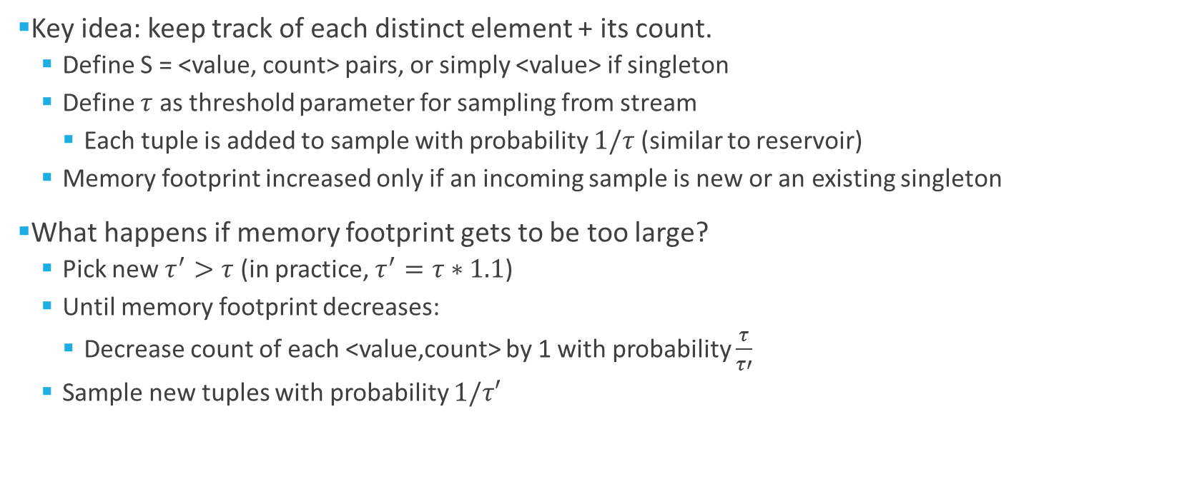
Concise Sampling [1]
Key idea: keep track of each distinct element + its count.
Define S = <value, count> pairs, or simply <value> if singleton
Define $τ$ as threshold parameter for sampling from stream
Each tuple is added to sample with probability $1/τ$ (similar to reservoir)
Memory footprint increased only if an incoming sample is new or an existing singleton
What happens if memory footprint gets to be too large?
Pick new $τ^{′}>τ$ (in practice, $τ^{′}=τ∗1.1$)
Until memory footprint decreases:
Decrease count of each <value,count> by 1 with probability $\frac{τ}{τ′}$
Sample new tuples with probability $1/τ′$

Slide 12
Outline
Why Sampling?
Sampling Background + Definitions
Review of Basic Sampling Techniques
Concise Sampling
Sampling Subsets
Sampling on Windows
Distributed Sampling

Slide 13
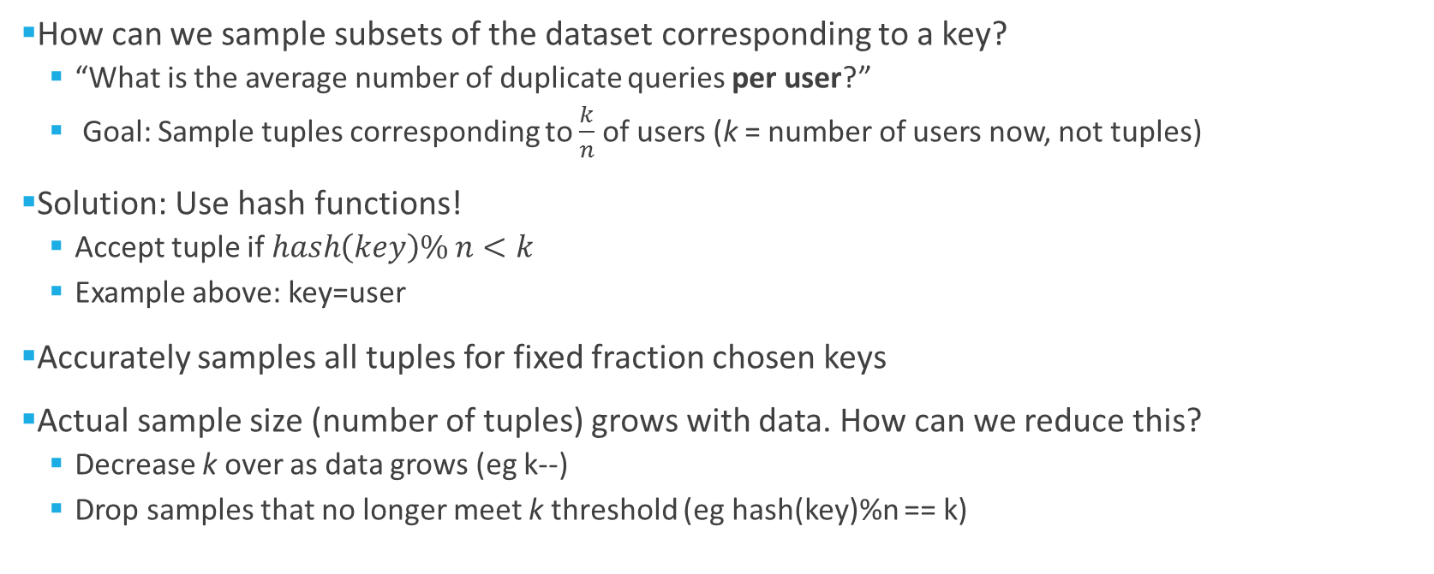
Sampling Subsets [4]
How can we sample subsets of the dataset corresponding to a key?
“What is the average number of duplicate queries per user?”
Goal: Sample tuples corresponding to $\frac{k}{n}$ of users (k = number of users now, not tuples)
Solution: Use hash functions!
Accept tuple if $hash\left(key\right)\% n<k$
Example above: key=user
Accurately samples all tuples for fixed fraction chosen keys
Actual sample size (number of tuples) grows with data. How can we reduce this?
Decrease k over as data grows (eg k--)
Drop samples that no longer meet k threshold (eg hash(key)%n == k)

Slide 14
Outline
Why Sampling?
Sampling Background + Definitions
Review of Basic Sampling Techniques
Concise Sampling
Sampling Subsets
Sampling on Windows
Distributed Sampling

Slide 15
Windows
Windows
Limit scope of data for analysis
Focus on recent data, which generally has most relevance
Two types of sliding windows:
Sequence-based (set size, varying time -> physical)
Timestamp-based (varying size, set time -> logical)
For windows, n = number of elements in the window W

Slide 16
Sampling in Windows – Naïve Approach
Periodic sampling
Use Reservoir Sampling
When a new tuple in the window causes a sampled tuple to expire, replace the expired tuple with the new one.
Drawbacks
Influenced by periodic data, is predictable
A bit more complicated to handle multiple tuples expiring at once (timestamp-based windows)

Slide 17
Chain Method
Based on Reservoir Sampling
Key addition: Chain of successors
When a tuple is added to the sample, pick its future replacement
Sequence-based: i-th tuple will have a randomly chosen replacement from window [i+1, i+w]
Timestamp-based: Assign a random ‘priority’ value to each tuple, sample consists of top K priorities.
When a tuple expires, pick next highest priority.
Memory efficient in expectation – O(k) for sequence-based, O(k log n) for timestamp-based

Slide 18

Optimal Memory Sampling on Windows [2]
Optimal memory not just in expectation, but in worst case
Data stream is divided into non-overlapping ‘buckets’
also known as ‘tumbles’, essentially sliding windows with slide length == window size
Each bucket: reservoir sampling for k samples
General idea: Sample from previous bucket + current bucket
Active Window
Previous Bucket
Current Bucket
k samples
$≤$k samples

Slide 19
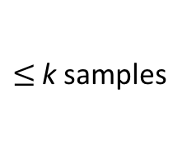
Optimal Memory Sampling on Windows [2]
General idea: Sample from previous bucket + current bucket
With replacement:
Select a sample from previous bucket
if active (not expired), return sample
Otherwise select a random sample from the current bucket
Without replacement
Select all active samples from previous bucket (j)
Select k-j random samples from current bucket
Both: Guaranteed O(k) space
What about timestamp-based windows? Similar approach, but requires O(k log n) space
Active Window
Previous Bucket
Current Bucket
k samples
$≤$k samples

Slide 20
Outline
Why Sampling?
Sampling Background + Definitions
Review of Basic Sampling Techniques
Concise Sampling
Sampling Subsets
Sampling on Windows
Distributed Sampling

Slide 21
Distributed Sampling [3]
In a distributed environment, data can come from multiple sources
network monitoring, distributed databases, etc
Need to sample from the union of these data streams
Each site only has knowledge of its own data
Latest sample no longer known at a global level (unlike single-instance case)
Similarly, total number of tuples observed across all streams is not immediately available
New cost to consider: communication between nodes
Terminology:
Site: each non-coordinator data source
Coordinator: Single node to handle sampling and communication between sites
s samples (Not k like before!)
k streams, n elements from union of streams

Slide 22
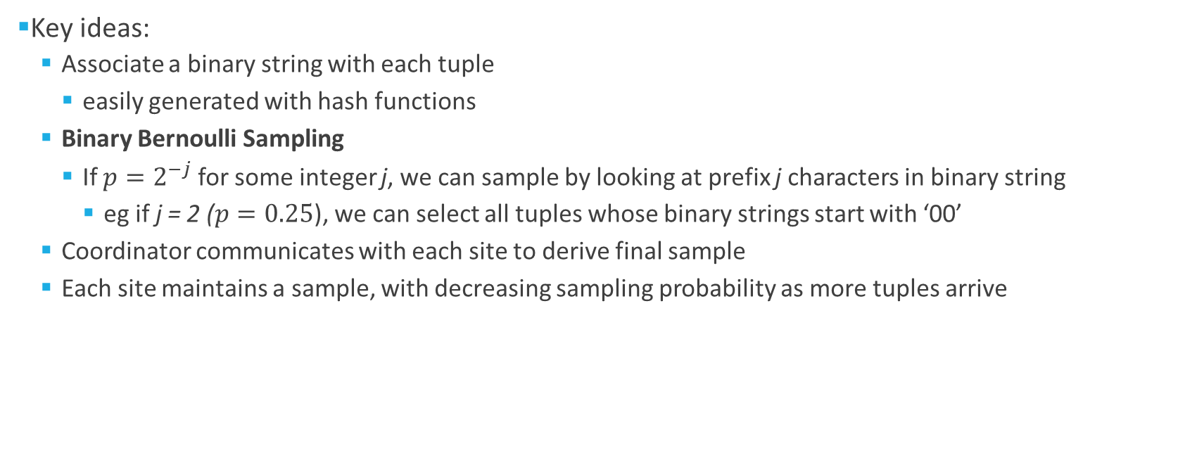
Distributed Sampling
Key ideas:
Associate a binary string with each tuple
easily generated with hash functions
Binary Bernoulli Sampling
If $p=2^{−j}$ for some integer j, we can sample by looking at prefix j characters in binary string
eg if j = 2 ($p=0.25$), we can select all tuples whose binary strings start with ‘00’
Coordinator communicates with each site to derive final sample
Each site maintains a sample, with decreasing sampling probability as more tuples arrive

Slide 23
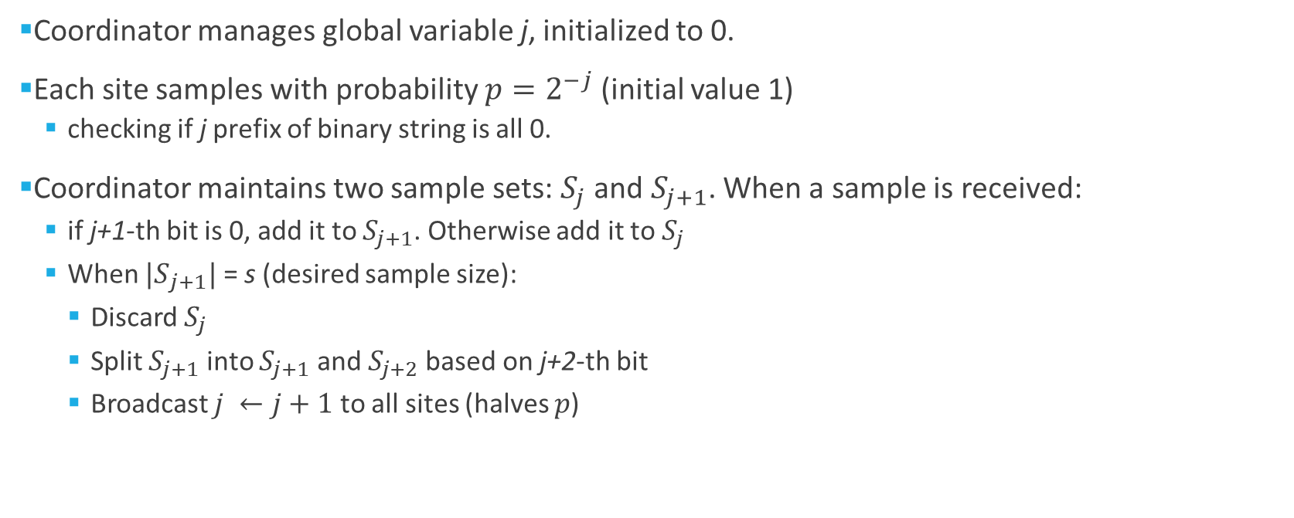
Infinite Sampling Without Replacement
Coordinator manages global variable j, initialized to 0.
Each site samples with probability $p=2^{−j}$ (initial value 1)
checking if j prefix of binary string is all 0.
Coordinator maintains two sample sets: $S_{j}$ and $S_{j+1}$. When a sample is received:
if j+1-th bit is 0, add it to $S_{j+1}$. Otherwise add it to $S_{j}$
When ${|S}_{j+1}|$ = s (desired sample size):
Discard $S_{j}$
Split $S_{j+1}$ into $S_{j+1}$ and $S_{j+2}$based on j+2-th bit
Broadcast $j ←j+1$ to all sites (halves $p$)

Slide 24
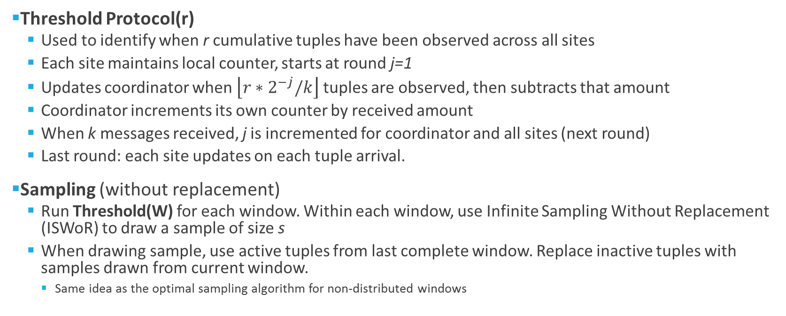
Sequence-Based Sampling
Threshold Protocol(r)
Used to identify when r cumulative tuples have been observed across all sites
Each site maintains local counter, starts at round j=1
Updates coordinator when $\left\lfloor r∗2^{−j}/k\right\rfloor$ tuples are observed, then subtracts that amount
Coordinator increments its own counter by received amount
When k messages received, j is incremented for coordinator and all sites (next round)
Last round: each site updates on each tuple arrival.
Sampling (without replacement)
Run Threshold(W) for each window. Within each window, use Infinite Sampling Without Replacement (ISWoR) to draw a sample of size s
When drawing sample, use active tuples from last complete window. Replace inactive tuples with samples drawn from current window.
Same idea as the optimal sampling algorithm for non-distributed windows

Slide 25
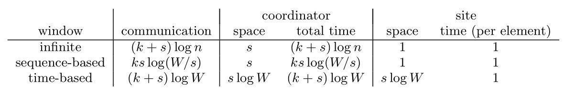
Distributed Sampling Recap
Algorithms exist for sampling on infinite and sequence-based windows.
What about sampling on timestamp-based windows?
Less communication required
More complexity required for optimal bounds
What about sampling with replacement?
General idea: Run s parallel instances of the no-replacement algorithm, with sample size 1
Small additional steps required at coordinator step
See [3] Cormode et al. “Optimal Sampling From Distributed Streams” for details

Slide 26
References
[1] Aggarwal, Charu C. Data streams: models and algorithms. Vol. 31. Springer Science
& Business Media, 2007.
[2] Braverman, Vladimir, Rafail Ostrovsky, and Carlo Zaniolo. “Optimal sampling from
sliding windows.” Proceedings of the twenty-eighth ACM SIGMOD-SIGACT-SIGART
symposium on Principles of database systems. ACM, 2009.
[3] Cormode, Graham, et al. “Optimal sampling from distributed streams.” Proceedings
of the twenty-ninth ACM SIGMOD-SIGACT-SIGART symposium on Principles of
database systems. ACM, 2010.
[4] Rajaraman, Anand, and Jeffrey David Ullman. Mining of massive datasets. Cambridge
University Press, 2011
[5] Vitter, Jeffrey S. “Random sampling with a reservoir.” ACM Transactions on Mathematical Software (TOMS) 11.1 (1985): 37-57.

