Slide 1
Huffman Encoding

Slide 2
Entropy
Entropy is a measure of information content: the number of bits actually required to store data.
Entropy is sometimes called a measure of surprise
  A highly predictable sequence contains little actual information
    Example: 11011011011011011011011011 (what’s next?)
    Example: I didn’t win the lottery this week
  A completely unpredictable sequence of n bits contains n bits of information
    Example: 01000001110110011010010000 (what’s next?)
    Example: I just won $10 million in the lottery!!!!
  Note that nothing says the information has to have any “meaning” (whatever that is)

Slide 3
Actual information content
A partially predictable sequence of n bits carries less than n bits of information
  Example #1: 111110101111111100101111101100
  Blocks of 3: 111110101111111100101111101100
  Example #2: 101111011111110111111011111100
  Unequal probabilities: p(1) = 0.75, p(0) = 0.25
  Example #3: "We, the people, in order to form a..."
  Unequal character probabilities: e and t are common, j and q are uncommon
  Example #4: {we, the, people, in, order, to, ...}
  Unequal word probabilities: the is very common

Slide 4
Fixed and variable bit widths
To encode English text, we need 26 lower case letters, 26 upper case letters, and a handful of punctuation
We can get by with 64 characters (6 bits) in all
Each character is therefore 6 bits wide
We can do better, provided:
  Some characters are more frequent than others
  Characters may be different bit widths, so that for example, e uses only one or two bits, while x uses several
  We have a way of decoding the bit stream
    Must tell where each character begins and ends

Slide 5
Example Huffman encoding
A = 0
B = 100
C = 1010
D = 1011
R = 11
ABRACADABRA = 01001101010010110100110
This is eleven letters in 23 bits
A fixed-width encoding would require 3 bits for five different letters, or 33 bits for 11 letters
Notice that the encoded bit string can be decoded!

Slide 6
Why it works
In this example, A was the most common letter
In ABRACADABRA:
  5 As code for A is 1 bit long
  2 Rs code for R is 2 bits long
  2 Bs code for B is 3 bits long
  1 C code for C is 4 bits long
  1 D code for D is 4 bits long

Slide 7
Creating a Huffman encoding
For each encoding unit (letter, in this example), associate a frequency (number of times it occurs)
  You can also use a percentage or a probability
Create a binary tree whose children are the encoding units with the smallest frequencies
  The frequency of the root is the sum of the frequencies of the leaves
Repeat this procedure until all the encoding units are in the binary tree

Slide 8

Example, step I
Assume that relative frequencies are:
  A: 40
  B: 20
  C: 10
  D: 10
  R: 20
(I chose simpler numbers than the real frequencies)
Smallest numbers are 10 and 10 (C and D), so connect those

Slide 9
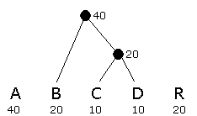
Example, step II
C and D have already been used, and the new node above them (call it C+D) has value 20
The smallest values are B, C+D, and R, all of which have value 20
  Connect any two of these; it doesn’t matter which two

Slide 10
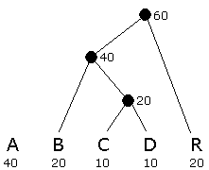
Example, step III
The smallest values is R, while A and B+C+D all have value 40
Connect R to either of the others

Slide 11
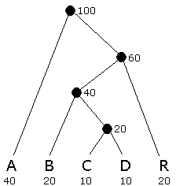
Example, step IV
Connect the final two nodes

Slide 12
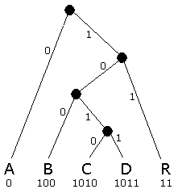
Example, step V
Assign 0 to left branches, 1 to right branches
Each encoding is a path from the root
A = 0
B = 100
C = 1010
D = 1011
R = 11
Each path terminates at a leaf
Do you see why encoded strings are decodable?

Slide 13
Unique prefix property
A = 0
B = 100
C = 1010
D = 1011
R = 11
No bit string is a prefix of any other bit string
For example, if we added E=01, then A (0) would be a prefix of E
Similarly, if we added F=10, then it would be a prefix of three other encodings (B=100, C=1010, and D=1011)
The unique prefix property holds because, in a binary tree, a leaf is not on a path to any other node

Slide 14
Practical considerations
It is not practical to create a Huffman encoding for a single short string, such as ABRACADABRA
  To decode it, you would need the code table
  If you include the code table in the entire message, the whole thing is bigger than just the ASCII message
Huffman encoding is practical if:
  The encoded string is large relative to the code table, OR
  We agree on the code table beforehand
    For example, it’s easy to find a table of letter frequencies for English (or any other alphabet-based language)

Slide 15
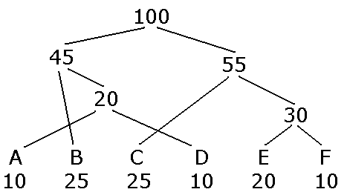
About the example
My example gave a nice, good-looking binary tree, with no lines crossing other lines
  That’s because I chose my example and numbers carefully
  If you do this for real data, you can expect your drawing will be a lot messier—that’s OK
Example:

Slide 16
Data compression
Huffman encoding is a simple example of data compression: representing data in fewer bits than it would otherwise need
A more sophisticated method is GIF (Graphics Interchange Format) compression, for .gif files
Another is JPEG (Joint Photographic Experts Group), for .jpg files
  Unlike the others, JPEG is lossy—it loses information
  Generally OK for photographs (if you don’t compress them too much), because decompression adds “fake” data very similar to the original

Slide 17
The End

