Slide 1
Main Memory Database Systems
Adina Costea

Slide 2
Introduction
Main Memory database system (MMDB)
Data resides permanently on main physical memory
Backup copy on disk
Disk Resident database system (DRDB)
Data resides on disk
Data may be cached into memory for access
Main difference is that in MMDB, the primary copy lives permanently in memory

Slide 3
Questions about MMDB
Is it reasonable to assume that the entire database fits in memory?
Yes, for some applications!
What is the difference between a MMDB and a DRDB with a very large cache?
In DRDB, even if all data fits in memory, the structures and algorithms are designed for disk access.

Slide 4
Differences in properties of main memory and disk
The access time for main memory is orders of magnitude less than for disk storage
Main memory is normally volatile, while disk storage is not
The layout of data on disk is much more critical than the layout of data in main memory

Slide 5
Impact of memory resident data
The differences in properties of main-memory and disk have important implications in:
  Concurrency control
  Commit processing
  Access methods
  Data representation
  Query processing
  Recovery
  Performance

Slide 6
Concurrency control
Access to main memory is much faster than disk access, so we can expect that transactions complete more quickly in a MM system
Lock contention may not be as important as it is when the data is disk resident

Slide 7
Commit Processing
As protection against media failure, it is necessary to have a backup copy and to keep a log of transaction activity
The need for a stable log threatens to undermine the performance advantages that can be achieved with memory resident data

Slide 8
Access Methods
The costs to be minimized by the access structures (indexes) are different

Slide 9
Data representation
Main memory databases can take advantage of efficient pointer following for data representation

Slide 10
A study of Index Structures for Main Memory Database Management Systems
Tobin J. Lehman
Michael J. Carey
VLDB 1986

Slide 11
Disk versus Main Memory
Primary goals for a disk-oriented index structure design:
  Minimize the number of disk accesses
  Minimize disk space
Primary goals of a main memory index design:
  Reduce overall computation time
  Using as little memory as possible

Slide 12
Classic index structures
Arrays:
  A: use minimal space, providing that the size is known in advance
  D: impractical for anything but a read-only environment
AVL Trees:
  Balanced binary search tree
  The tree is kept balanced by executing rotation operations when needed
  A: fast search
  D: poor storage utilization

Slide 13
Classic index structures (cont)
B trees:
  Every node contains some ordered data items and pointers
  Good storage utilization
  Searching is reasonably fast
  Updating is also fast

Slide 14
Hash-based indexing
Chained Bucket Hashing:
  Static structure, used both in memory and disk
  A: fast, if proper table size is known
  D: poor behavior in a dynamic environment
Extendible Hashing:
  Dynamic hash table that grows with data
  A hash node contain several data items and splits in two when an overflow occurs
  Directory grows in powers of two when a node overflows and has reached the max depth for a particularly directory size

Slide 15
Hash-based indexing (cont)
Linear Hashing:
  Uses a dynamic hash table
  Nodes are split in predefined linear order
  Buckets can be ordered sequentially, allowing the bucket address to be calculated from a base address
  The event that triggers a node split can be based on storage utilization
Modified Linear Hashing:
  More oriented towards main memory
  Uses a directory which grows linearly
  Chained single items nodes
  Splitting criteria is based on average length of the hash chains

Slide 16
The T tree
A binary tree with many elements kept in order in a node (evolved from AVL tree and B tree)
Intrinsec binary search nature
Good update and storage characteristics
Every tree has associated a minimum and maximum count
Internal nodes (nodes with two children) keep their occupancy in the range given by min and max count

Slide 17
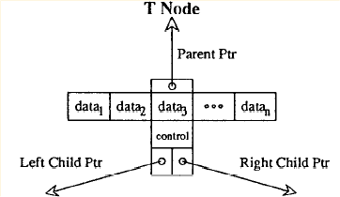
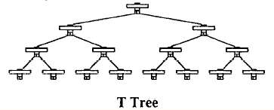
The T tree
Notes:
Proceedings of the Twelfth International Conference on Very Large Data Bases, Kyoto, August, 1986

Slide 18
Search algorithm for T tree
Similar to searching in a binary tree
Algorithm
  Start at the root of the tree
  If the search value is less than the minimum value of the node
    Then search down the left subtree
    If the search value is greater than the maximum value in the node
      Then search the right subtree
      Else search the current node
  The search fails when a node is searched and the item is not found, or when a node that bounds the search value cannot be found

Slide 19
Insert algorithm
Insert (x):
Search to locate the bounding node
If a bounding node is found:
  Let a be this node
  If value fits then insert it into a and STOP
  Else
    remove min element amin from node
    Insert x
    Go to the leaf containing greatest lower bound for a and insert amin into this leaf

Slide 20
Insert algorithm (cont)
If a bounding node is not found
  Let a be the last node on the search path
  If insert value fits then insert it into the node
  Else create a new leaf with x in it
If a new leaf was added
  For each node in the search path (from leaf to root)
    If the two subtrees heights differ by more than one, then rotate and STOP

Slide 21
Delete algorithm
(1)Search for the node that bounds the delete value; search for the delete value within this node, reporting an error and stopping if it is not found
(2)If the delete will not cause an underflow then delete the value and STOP
Else, if this is an internal node, then delete the value and ‘borrow’ the greatest lower bound
Else delete the element
(3)If the node is a half-leaf and can be merged with a leaf, do it, and go to (5)

Slide 22
Delete algorithm (cont)
(4)If the current node (a leaf) is not empty, then STOP
Else free the node and go to (5)
(5)For every node along the path from the leaf up to the root, if the two subtrees of the node differ in height by more than one, then perform a rotation operation
STOP when all nodes have been examined or a node with even balanced has been discovered

Slide 23
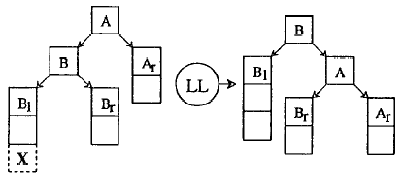
LL Rotation
Notes:
Proceedings of the Twelfth International Conference on Very Large Data Bases, Kyoto, August, 1986

Slide 24
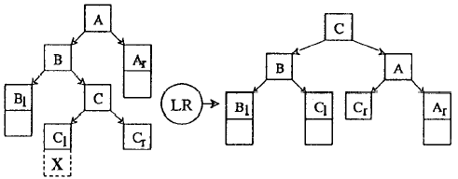
LR Rotation
Notes:
Proceedings of the Twelfth International Conference on Very Large Data Bases, Kyoto, August, 1986

Slide 25
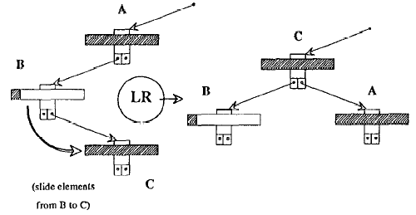
Special LR Rotation
Notes:
Proceedings of the Twelfth International Conference on Very Large Data Bases, Kyoto, August, 1986

Slide 26
Conclusions
We introduced a new main memory index structure, the T tree
For unordered data, Modified Linear Hashing should give excellent performance for exact match queries
For ordered data, the T Tree provides excellent overall performance for a mix of searches, inserts and deletes, and it does so at a relatively low cost in storage space

Slide 27
But…
Even if the T trees have more keys in each node, only the two end keys are actually used for comparison
Since for every key in node we store a pointer to the record, and most of the time the record pointers are not used, the space is ‘wasted’

Slide 28
The Architecture of the Dali Main-Memory Storage Manager
Philip Bohannon, Daniel Lieuwen,
Rajeev Rastogi, S. Seshadri,
Avi Silberschatz, S. Sudarshan

Slide 29
Introduction
Dali System is a main memory storage manager designed to provide the persistence, availability and safety guarantees typically expected from a disk-resident database, while at the same time providing very high performance
It is intended to provide the implementor of a database management system flexible tools for storage management, concurrency control and recovery, without dictating a particular storage model or precluding optimization

Slide 30
Principles in the design of Dali
Direct access to data: Dali uses a memory-mapped architecture, where the db is mapped into the virtual address space of the process, allowing the user to acquire pointers directly to information stored in the database
No inter-process communication for basic system services: all concurrency control and logging services are provided via shared memory rather than communication with a server

Slide 31
Principles in the design of Dali (cont)
Support for creation of fault-tolerant applications:
  Use of transactional paradigm
  Support for recovery from process and/or system failure
  Use of codewords and memory protection to help ensure the integrity of data stored in shared memory
Toolkit approach: for example, logging can be turned off for data which don’t need to be persistent
Support for multiple interface levels: low-level components can be exposed to the user so that critical system components can be optimized

Slide 32
Architecture of the Dali
In Dali, the database consists of:
  One or more database files: stores user data
  One system database file: stores all data related to database support
Database files opened by a process are directly mapped into the address space of that process

Slide 33
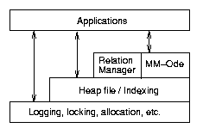
Layers of abstraction
Dali architecture is organized to support the toolkit approach and multiple interface levels

Slide 34
Storage allocation requirements
Control data should be stored separately form user data
Indirection should not exist at the lowest level
Large objects should be stored contiguously
Different recovery characteristics should be available for different regions of the database

Slide 35
Segments and chunks
Segment: contiguous page-aligned units of allocation; each database file is comprised of segments
Chunk: collection of segments
Recovery characteristics are specified on a per-chunk basis, at chunk creation
Different alocators are available within a chunk:
  The power-of-two allocator
  The inline power-of-two allocator
  The coalescing allocator

Slide 36
The Page Table and Segment Headers
Segment header – associate info about a segment/chunk with a physical pointer
  Allocated when segment is added to a chunk
  Can store additional info about data in segment
Page table – maps pages to segment headers
  Pre-allocated based on max # of pages in dbase

Slide 37
Transaction management in Dali
We will present how transaction atomicity, isolation and durability are achieved in Dali
In Dali, data is logically organized into regions
Each region has a single associated lock with exclusive and shared modes, that guards accesses and updates to the region

Slide 38
Multi-level recovery (MLR)
Provides recovery support for concurrency based on the semantics of operations
It permits the use of operation locks in place of shared/exclusive region locks
The MLR approach is to replace the low-level physical undo log records with higher-level logical undo log records containing undo descriptions at the operation level

Slide 39
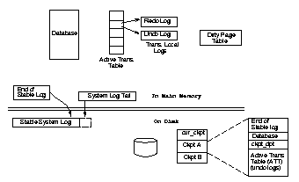
System overview - fig

Slide 40
System overview
On disk:
  Two checkpoint images of the database
  An ‘anchor’ pointing to the most recent valid checkpoint
  A single system log containing redo information, with its tail in memory

Slide 41
System overview (cont)
In memory:
  Database, mapped into the address space of each process
  The variable end_of_stable_log, which stores a pointer into the system log such that all records prior to the pointer are known to have been flushed to disk
  Active Transaction Table (ATT)
  Dirty Page Table (dpt)
  ATT and dpt are stored in system database and saved on disk with each checkpoint

Slide 42
Transaction and Operations
Transaction – a list of operations
  Each op. has a level L_{i} associate with it
  Op at level L_{i} is can consist of ops of level L_{i-1}
  L₀ are physical updates to regions
  Pre-commit – the commit record enters the system log in memory
  Commit - commit record hits the stable storage

Slide 43
Logging model
The recovery algorithm maintains separate undo and redo logs in memory, for each transaction
Each update generates physical undo and redo log records
When a transaction/operation pre-commits:
  the redo log records are appended to the system log
  the logical undo description for the operation is included in the operation commit record in the system log
  locks acquired by the transaction/operation are released

Slide 44
Logging model (cont)
The system log is flushed to disk when a transaction decides to commit
Pages updated by a redo record written to disk are marked dirty in dpt by the flushing procedure

Slide 45
Ping-Pong Checkpointing
Two copies of the database image are stored on disk and alternate checkpoints write dirty pages to alternate copies
Checkpointing procedure:
  Note the current end of stable log
  The contents of the in-memory ckpt_dpt are set to those of dpt and dpt is zeroed
  The pages that were dirty in either ckpt_dpt of the last completed checkpoint or in the current (in-memory) ckpt_dpt are written out

Slide 46
Ping-Pong Checkpointing (cont)
  Checkpoint the ATT
  Flush the log and declare the checkpoint completed by toggling cur_ckpt to point to the new checkpoint

Slide 47
Abort processing
The procedure is similar with the one existent in ARIES
When a transaction aborts, updates/operations described by log records in the transaction’s undo log are undone
New physical-redo log records are created for each physical-undo record encountered during the abort

Slide 48
Recovery
End_of_stable_log is the ‘begin recovery point’ for the respective checkpoint
Restart recovery:
  Initialize the ATT with the ATT stored in checkpoint
  Initialize the transactions undo logs with the copy from checkpoint
  Loads the database image

Slide 49
Recovery (cont)
  Sets dpt to zero
  Applies all redo log records and in the same time sets the appropriate pages in dpt to dirty and maintains the ATT consistent with the log applied so far
  The active transactions are rolled back (first all operations at L₀ that must be rolled back are rolled back, then operations at level L₁, then L₂ and so on )

Slide 50
Post-commit operations
These are operations which are guaranteed to be carried out after commit of a transaction or operation, even in case of system/process failure
A separate post-commit log is maintained for each transaction - every log record contains description of a post-commit operation to be executed
These records are appended to the system log right before the commit record for a transaction and saved on disk during checkpoint

Slide 51
Fault Tolerance
We present features for fault tolerant programming in Dali, other than those provided directly by transaction management.
Handling of process death : we assume that the process did not corrupt any system control structures
Protection from application errors: prevent updates which are not correctly logged from becoming reflected in the permanent database

Slide 52
Detecting Process Death
The process known as the cleanup server is responsible for cleanup of a dead process
When a process connects to the Dali, information about the process are stored in the Active Process Table in system database
When a process terminates normally, it is deregistered from the table
The cleanup process periodically goes through the table and checks if each registered process is still alive

Slide 53
Low level cleanup
The cleanup process determines (by looking in the Active Process Table) what low-level latches were held by the crashing process
For every latch hold by the process, it is called a cleanup function associated with the latch
If the function cannot repair the structure, a full system crash is simulated
Otherwise, go on to the next phase

Slide 54
Cleaning Up Transactions
The cleanup server spawns a new process, called a cleanup agent, to take care of any transaction still running on behalf of the dead process
The cleanup agent:
  Scans the transaction table
  Aborts any in-progress transaction owned by the dead process
  Executes any post-commit actions which has not been executed for a committed transaction

Slide 55
Memory protection
Application can map a database file in a special protected mode (using mprotect system call )
Before a page is updated, when an undo log record for the update is generated, the page is in put in un-protected mode (using munprotect system call)
At the end of transaction, all unprotected pages are re-protected
Notes: - erroneous writes are detected immediately
- system calls are expensive

Slide 56
Codewords
codeword = logical parity word associated with the data
When data is updated ‘correctly’, the codeword is updated accordingly
Before writing a page to disk, its contents is verified against the codeword for that page
If a mismatch is found, a system crash is simulated and the database is recovered from the last checkpoint
Notes: - lower overhead is incurred during normal updates
- erroneous writes are not detected immediately

Slide 57
Concurrency control
The concurrency control facilities available in Dali include
  Latches (low-level locks for mutual exclusion)
  Locks

Slide 58
Latch implementation
Latches in Dali are implemented using the atomic instructions supplied by the underlying architecture
Issues taken into consideration:
Regardless of the type of atomic instructions available, the fact that a process holds or may hold a latch must be observable by the cleanup server
If the target architecture provides only test-and-set or register-memory-swap as atomic instructions, then extra care must be taken to determine in the process did in fact own the latch

Slide 59
Locking System
Locking is usually used as the mechanism for concurrency control at the level of a transaction
Lock requests are made on a lock header structure which stores a pointer to a list of locks that have been requested by transactions
If the lock request does not conflict with the existing locks, then the lock is granted
Otherwise, the requested lock is added to the list of locks for the lock header, and is granted when the conflicting locks are released

Slide 60
Collections and Indexing
The storage allocator provides a low-level interface for allocating and freeing data items
Dali also provides a higher level interface for grouping related data items, performing scans and associative accessing data items

Slide 61
Heap file
Abstraction for handling a large number of fixed-length data items
The length (itemsize) of the objects in the heap file, is specified at creation of heap file
The heap file supports inserts, deletes, item locking and unordered scan of items

Slide 62
Indexes
Extendible Hash
  Dali includes a variant of Extendible hashing as described in Lehman and Carey
  The decision to double the directory size is based on an approximation of occupancy rather than on the local overflow of a bucket
T Trees

Slide 63
Higher Level Interfaces
Two database management systems built on Dali:
  Dali Relational Manager
  Main Memory –ODE Object Oriented Database

