Slide 1


ELM2018
Benchmarking Hardware Accelerating techniques for Extreme Learning Machine
Northeastern University
Liang Li, Guoren Wang, Gang Wu, and Ql Zhang
Notes:
Hello, everyone! I am one of the database group member in Northeastern University. My today’s presentation topic is “Benchmarking Hardware Accelerating techniques for Extreme Learning Machine”

Slide 2


Outline
1
Preliminary
2
ELM on several device
Experiments
3
4
Conclusions
Notes:
I will introduce the work from 4 aspects. First, we give some background about elm algorithm.
Next, implement elm on several computing device, include mult-core cpu, gpu ,fpga
Next is experiments, and some conclusions

Slide 3
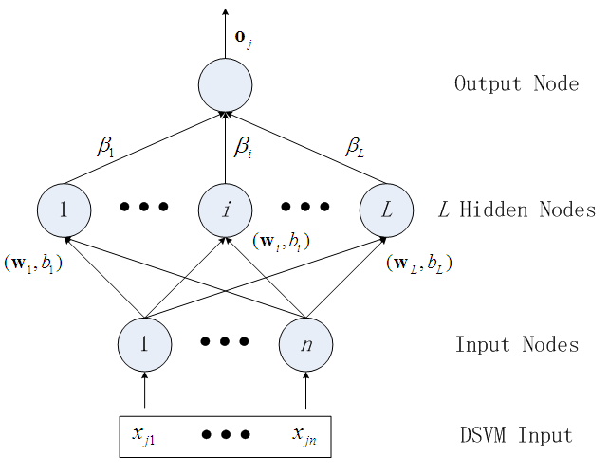
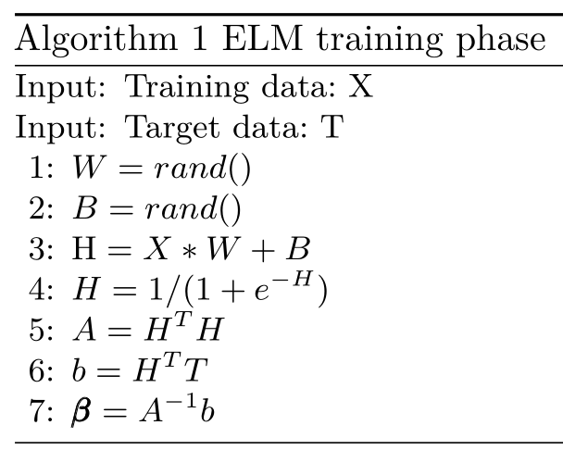
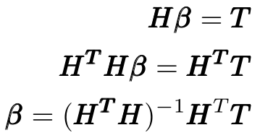
1. Preliminary
ELM
Notes:
As we know , ELM is one of the leading trends for fast learning. The parameters of hidden layers of ELM are randomly established and need not be tuned, thus the training of hidden nodes can be established before the inputs are acquired.
Elm training phase include 7 steps in all. Most of the time spend on step 3 to step6

Slide 4
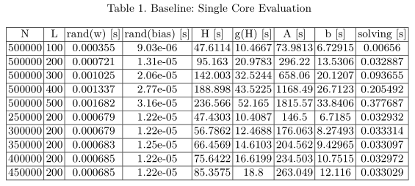
1. Preliminary
Performance of Training with Single-Core
Most of the time consumes on matrix multiplication
97.5% with large dataset
Notes:
First of all, we implement a elm on single core as a baseline.
We evaluate the seven step time-cost on several dataset size.
The result shows the most of the time spends on matrix multiplication
On large dataset , it spend 97.5% on multiplication

Slide 5
1. Preliminary
Hardware Accelerating techniques
Multi-core CPU
SIMD instructions
GPU Computing
FPGA Computing
Notes:
To speedup the elm training processing, we implement elm training algorithm on several computing device, include multicore, simd, gpu, fpga

Slide 6

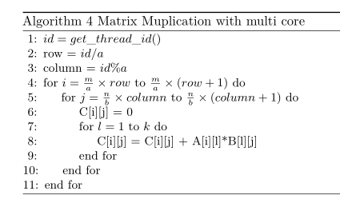
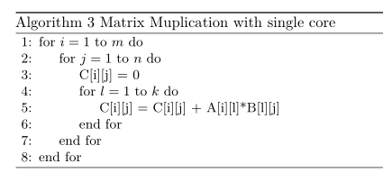
2. Accelerating with multi-core (#1)
Thread-level parallelism
https://github.com/bombehub/ELM_exp
Notes:
First is thread level parallelism
Assume A multiply by B equals C,
we divide C to several submatrix, using each thread to computing a submatrix.
For example, first thread to computing c11, another thread computing Ca1

Slide 7
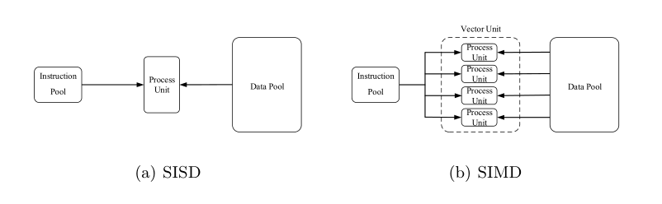
2. Accelerating with SIMD (#2)
Instruction-level parallelism
Suitable for Vector Processing
Notes:
Next ,we use the instruction level parallelism techniques to accelerating elm.
As shows in the figure, simd is a set of cpu instructions, and is very suitable for vector processing.

Slide 8
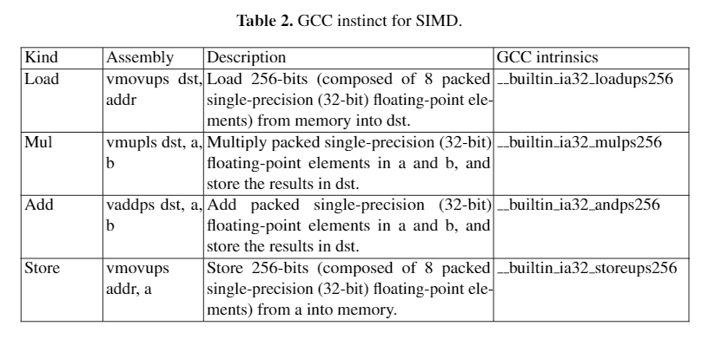
2. Accelerating with SIMD (#2)
Instruction-level parallelism
Notes:
GCC compiler has several built-in instinct for SIMD.

Slide 9
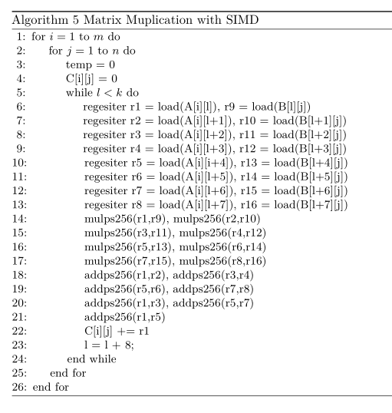
2. Accelerating with SIMD (#2)
Instruction-level parallelism
Notes:
We can bulk load several data to cpu register, computing the result in batch.

Slide 10
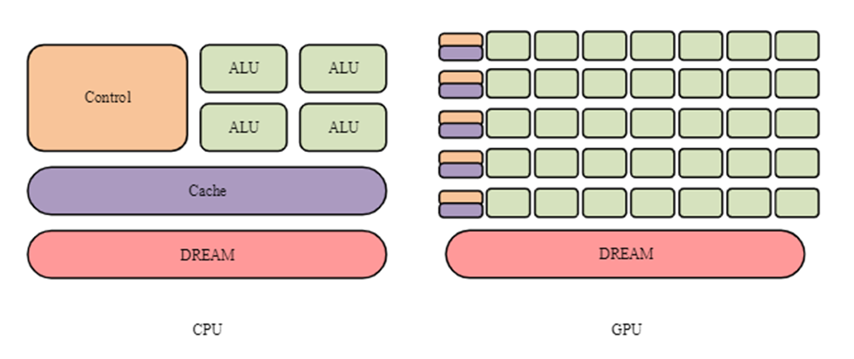
2. Accelerating with GPU-card (#3)
Thousand of lightweight “cores”
Suitable for Batch Processing
Notes:
We can also use gpu card to accelerate the processing
As we know, gpu can be regard as having thousands of lightweight cores.

Slide 11
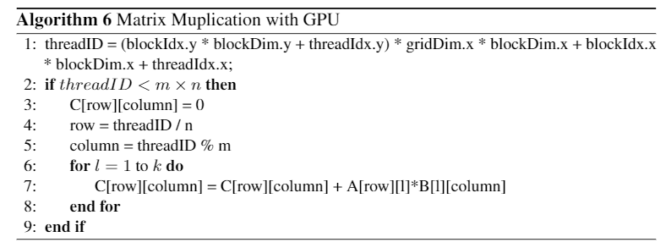
2. Accelerating with GPU-card (#3)
CUDA programming
https://github.com/bombehub/ELM_GPU.git
Notes:
Programing with gpu, we need use the cuda programing toolkits.
The full implementation detail can be found in this github links.

Slide 12
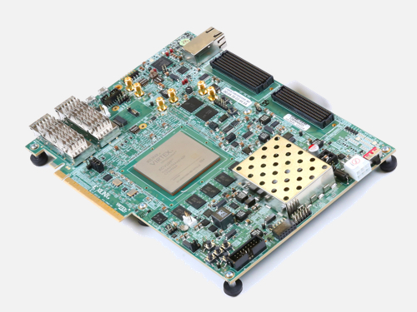
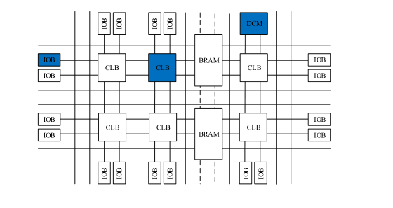
2. Accelerating with FPGA-card (#4)
Instruction pipeline
Suitable for stream processing
Notes:
We next implement elm on fpga

Slide 13
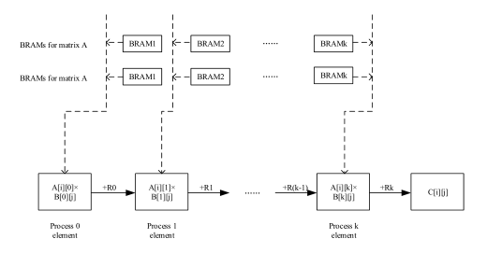
2. Accelerating with FPGA-card (#4)
Instruction pipeline
Similar to SIMD, but very complicate to programming
Notes:
FPGA mainly use pipeline to speedup
The logical is similar to SIMD
Unfortunetely, It is unfriendly to user

Slide 14
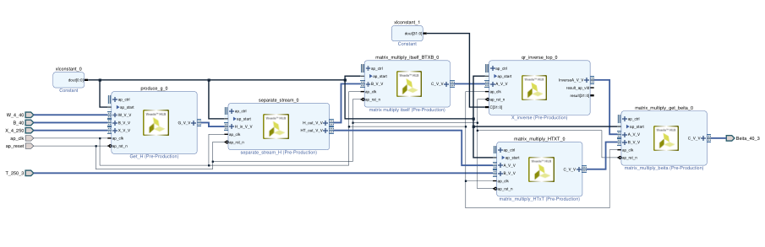
2. Accelerating with FPGA-card (#4)
Instruction pipeline

Slide 15
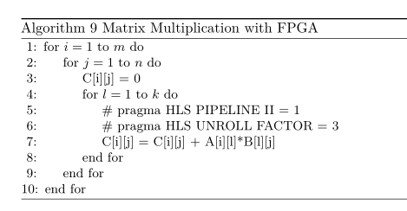
2. Accelerating with FPGA-card (#4)
Instruction pipeline

Slide 16
3. Experiments
Device
Intel Xeon E7-4820 v4 CPUs(40cores, 80threads)
Intel(R) Core(TM) i7 6500U CPU
NVIDIA GeForce 940MX
VCU118 FPGA
Notes:
3 group experiments device

Slide 17
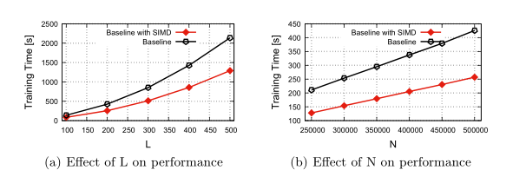
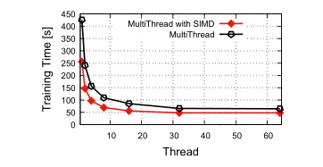
3. Experiments
CPU results
baseline
Speedup = 9X

Slide 18
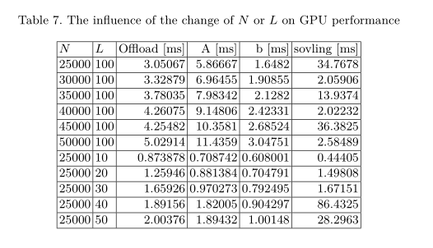
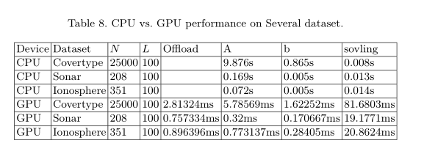
3. Experiments
GPU results
Speedup: Hundred to Thousand of times
Notes:
Note that gpu has a extra offloading cost, since gpu memory is connect with a pci-e bus.

Slide 19
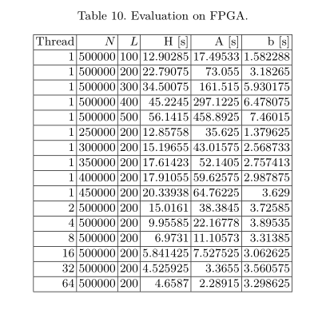
3. Experiments
FPGA results
Speedup = 3-5x

Slide 20
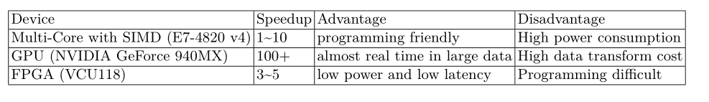
3. Summary
Performance Summary
Notes:
Speedup for cpu is about 1-to 10 times,
Gpu is up to 100 times
Fpga is only 3-5 times.

Slide 21
4. Conclusion
We fully implement the single-core version of ELM algorithm, and evaluate the time cost of each step in detail. The result shows that the main time cost of ELM is matrix multiplication, i.e., In CoverType dataset, Matrix multiplication accounts for roughly 97.5% of the time.
Based on the problem of excessive cost of matrix multiplication, we design the optimized version of ELM algorithm on Multi-Core CPU, GPU and FPGA, respectively.
We implement and open the source code of the above algorithms. Experiment results of the experiments show that the new hardware is very suitable for accelerating ELM algorithm. Specifically, in our experiments, the Multi-Core CPU (64 threads) combined with SIMD technology can get about 9× speedup. GPU can get about 100× speedup, and FPGA can get 4× of speedup (Sec. 4).

Slide 22
https://github.com/bombehub
liliang@stumail.neu.edn.cn
Thank you!
Notes:
The author did not come to Macau. If you have some detail questions, fill free to contact the author. Thank You!

