Slide 1
面向更新密集型内存计算的 轻量异步一致性快照算法
李梁

Slide 2
大纲
问题
4个经典算法
Hourglass和piggyback算法
实验
一致性讨论和评审意见

Slide 3
Motivation
持久性（ACID）
记录日志，进行恢复
Checkpoint的作用：加快日志恢复时间
内存数据库需要周期性的备份 in-memory snapshot，生成检查点数据
不同于磁盘数据库，内存数据库执行检查点的开销很大
Update-intensive
股票数据，游戏用户坐标数据
假设每1W条更新日志，执行一次检查点备份
快速恢复
负载越高，检查点操作需要越频繁的执行
算法目标：执行频繁检查点（内存数据备份到外存）
对检查点操作要求很高，必须是“轻量的”

Slide 4
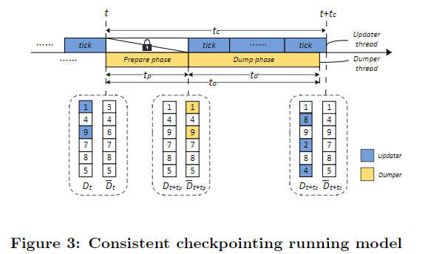
抽象模型
线性表/数据段，代表数据库。重点是遍历的特性，而不是上层的逻辑结构，SQL or NoSQL 物理上看，都是线性表。
前台updaters线程，后台dumper线程
假设请求快照的时刻，刚好
数据库处于一致性的状态

Slide 5
一致 or 非一致
一致。1，便于恢复；2，并且可以用于OLAP或者long running的事务中。
非一致。1，恢复不便；2，不适合持久性要求不高的场景。
串行 or 并行
在并发下会出现很多锁竞争，尤其是update intensive
而串行没有锁开销 ，吞吐量在in memory下反而更好
串行下，做快照，问题相对简单，我们在串行下讨论算法。
单机 or 分布式
Performing frequent lightweight consistent checkpoint for single-thread processing in-memory systems.
paper争议最大的点
Notes:
长事务，比如说是join操作。
串行的问题稍后讲解。

Slide 6
Problem
Backup memory data to disk
程序重启、断电，数据丢失
限制条件
Snapshot：某一个时刻的内存中Read-only数据镜像。（忽略一致性）
Naïve snapshot（NS）

Slide 7
Contribution
快照算法分类
相对于ns，cou(fork)，zz，pp四个算法。提出了两个改进算法hourglass和piggyback。实验评估了算法的实用性和性能
集成两个算法到redis系统，提高了redis本身的备份性能，采用ycsb测试基准, 展示了原型系统的持久化性能。

Slide 8
快照案例1
key-value型内存数据库Redis，RDB镜像文件的生成方式
save 同步调用rdbsave()
bgsave 先同步fork子进程；然后子进程异步调用rdbsave()，父进程继续处理读写请求
Fork() 原理

Slide 9
redis
a
b
c
d
a
b
c
d
redis-fork (read only)
页表
物理内存
a
b
c
d
OS内核

Slide 10
redis
A
b
c
d
a
b
c
d
redis-fork (read only)
页表
物理内存
A
a
b
c
d
OS内核

Slide 11
redis
a
b
c
d
a
b
c
d
redis-fork (read only)
页表
物理内存
a
b
c
d
OS内核

Slide 12
redis
A
b
c
d
a
b
c
d
redis-fork (read only)
页表
物理内存
A
a
b
c
d
OS内核
Unavailable time ~ copy(页表) ~ O(n)

Slide 13
快照案例2
Hybrid in-memory system： oltp+olap
内存数据库Hyper，OLTP fork快照数据用于OLAP
SAP HANA
或者用于复杂查询
join

Slide 14
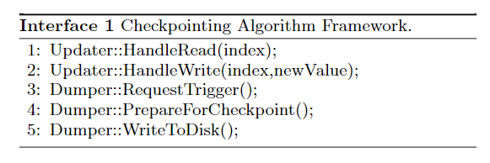
算法要求
naïve snapshot，fork
尽可能快的生成（只读）快照，并且读写不能破坏快照数据
Reading. 任何时刻都能读取到最新的数据项
Updating. 需要备份的快照数据，不能在没持久化之前，就被前台的写操作所覆盖了。
Consistency. It should materialize a full and consistent snapshot of the whole application data state. Fuzzy-like checkpointing algorithms are not considered here, because the checkpoint is not in the consistent state, which will cause additional overhead when recovering

Slide 15
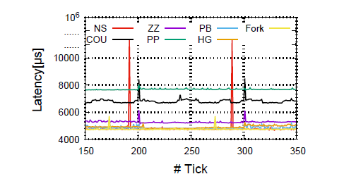
理想性能
快速快照
低延时
高吞吐
内存少

Slide 16
问题
4个经典算法
Hourglass和piggyback算法
实验
一致性讨论和评审意见

Slide 17
Naive Snapshot
Beginning of checkpoint period
_{Data}
Data_{copy}
Notes:
NS’s IDEA IS VERY SIMPLE: TAKE A COPY OF THE STATE AT THE BEGINNING OF THE CHECKPOINT PERIOD (PREPARE)
THEN LET THE ASYNCHRONOUS WRITER FLUSH THAT COPY TO DISK.

Slide 18
Naive Snapshot: Latency
Expected Latency Profile
Unavailable time ~ copy(n) ~ O(n)
Notes:
THE MAIN MEMORY PERFORMANCE OF NS HAS FREQUENT LATENCY SPIKES THAT OCCUR
WHEN THE ALGORITHM PAUSES THE APPLICATION TO COPY THE WHOLE STATE.

Slide 19
Copy On Update
Beginning of checkpoint period
AS
AS_{shadow}
dirty
Notes:
Go very fast through this algorithm
CLASSIC COPY-ON-WRITE METHOD THAT KEEPS A SHADOW STATE AND DIRTY BITS TO INDICATE BLOCKS THAT HAVE BEEN UPDATED.

Slide 20
Copy On Update
Updates during first checkpoint period
42
Old Value
43
Old Value
AS
AS_{shadow}
dirty
Notes:
WHENEVER UPDATES OCCUR DURING A CHECKPOINT PERIOD, WE COPY THE OLD VALUES
(AS OF BEGINNING OF CHECKPOINT) TO SHADOW AND SET THE DIRTY BITS.

Slide 21
Copy On Update
End of checkpoint period
42
Old Value
43
Old Value
PrepareforCheckpoint（）
Copy-dirty（）
AS
AS_{shadow}
dirty
Notes:
AT THE END OF THE CHECKPOINT PERIOD, WE CAN CLEAR THE DIRTY BITS.

Slide 22
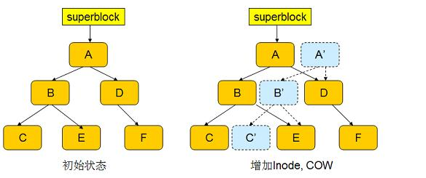
COU/COW 应用
Fork 函数
磁盘快照（ Windows的还原精灵软件， vmware快照）

Slide 23
Vldb 2009：evaluation
NS和COU都具有实用性
NS适合high workload，但会导致阻塞
COU不适合high workload，尤其是update intensive的场景。前台的写操作必须和后台的备份线程，互斥

Slide 24
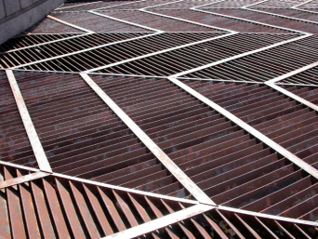
Wait-Free Zigzag
Initialization
AS₀
AS₁
MR
MW
Notes:
START WITH TWO COPIES OF THE STATE AND TWO BIT ARRAYS: MUTATOR READ AND MUTATOR WRITE.

Slide 25
Wait-Free Zigzag
Updates during a checkpoint period
42
43
AS₀
AS₁
MR
MW
Notes:
WHENEVER UPDATES COME, THEY ARE APPLIED TO THE COPY FLAGGED BY THE MUTATOR WRITE ARRAY.
THEN WE CHANGE MUTATOR READ TO THE SAME VALUE AS MUTATOR WRITE – REDIRECT NEXT READS.
NOTE THAT THE NEGATION OF MUTATOR WRITE IS NEVER TOUCHED,
SO THIS IS WHAT THE ASYNC WRITER FLUSHES.
FINALLY THE CURRENT STATE IS ZIGZAGED BETWEEN THE TWO STATE COPIES
AS INDICATED BY THE MUTATOR READ BIT ARRAY.

Slide 26
Wait-Free Zigzag
End of checkpoint period
42
43
AS₀
AS₁
MR
MW
Notes:
AT THE END OF THE CHECKPOINT PERIOD, WHEN PREPARING FOR A NEW CHECKPOINT,
WE WANT TO PRESERVE THE CURRENT STATE → EXACTLY THE WORDS FLAGGED IN MUTATOR READ.
SO WE TAKE THE NEGATION OF MUTATOR READ AND COPY IT INTO MUTATOR WRITE.

Slide 27
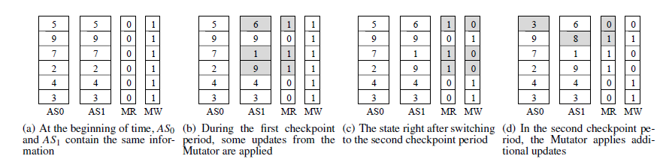
Running example

Slide 28
Wait-Free Zigzag: Latency
Expected Latency Profile
PrepareforCheckpoint（）
Mw = ~mr
Unavailable time ~ O(n)
Notes:
IN TERMS OF MAIN MEMORY LATENCY, ZIGZAG GETS TO ALMOST CONSTANT LATENCY.
THE ONLY LATENCY SPIKE INTRODUCED BY THE ALGORITHM IS IN THE TIME NEEDED TO
DO BIT ARRAY NEGATION. SO WE WANT TO OPTIMIZE THIS OPERATION IN AN IMPLEMENTATION.

Slide 29

Wait-Free Ping-Pong
Initialization
AS
BO
Odd
BE
Even
current
Notes:
WAIT-FREE PING-PONG ELIMINATES THIS FINAL SOURCE OF LATENCY BY INVESTING EXTRA MAIN MEMORY.
WE KEEP THE APPLICATION STATE PLUS TWO COPIES ODD AND EVEN, WITH THEIR BIT ARRAYS.
AT THE BEGINNING, EVEN CONTAINS A COPY OF AS.

Slide 30
Wait-Free Ping-Pong
Updates during first checkpoint period
42
42
43
43
44
44
AS
BO
Odd
BE
Even
current
Notes:
WE COLLECT UPDATES DURING THE FIRST CHECKPOINT PERIOD IN ODD,
WHILE EVEN IS FLUSHED TO DISK BY THE ASYNC WRITER.
IF OVERWRITES HAPPEN IN AS, WE ALSO OVERWRITE IN ODD.

Slide 31
Wait-Free Ping-Pong
End of checkpoint period
42
42
44
44
AS
BO
Odd
BE
Even
current
Notes:
AT THE END OF A CHECKPOINT PERIOD, WE SWITCH THE ROLES OF ODD AND EVEN.

Slide 32
Wait-Free Ping-Pong
New updates in next checkpoint period
45
45
42
42
46
46
44
44
AS
BO
Odd
BE
Even
current
Notes:
NOW, WE COLLECT UPDATES IN EVEN, WHILE THE ASYNC WRITER FLUSHES ODD.

Slide 33
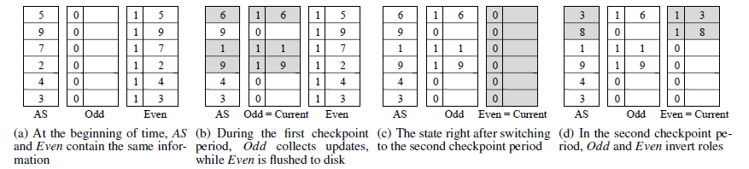
Running example

Slide 34
Wait-Free Ping-Pong: Latency
Expected Latency Profile
Unavailable time ~ O(1) ~ 0
Notes:
CONSTANT LATENCY FOR PING PONG – OUR IMPLEMENTATION GOAL IS REDUCE OVERHEAD.
WE DESIGNED A CACHE-AWARE INTERLEAVING OF THE STATE THAT GUARANTEES THAT EVERY SECOND
UPDATE FROM PING-PONG FALLS INTO THE SAME CACHE LINE.

Slide 35
缺点
Zigzag
生成快照期间需要遍历,取反，O(n)
只能适用于小数据集
Hyper olap快照, 舍弃了zz，实际性能不如fork
Pingpong
需要三份内存
每次需要写入两份数据，lantency性能不好
sigmod11两个算法，被之后的文章采纳的很少。

Slide 37
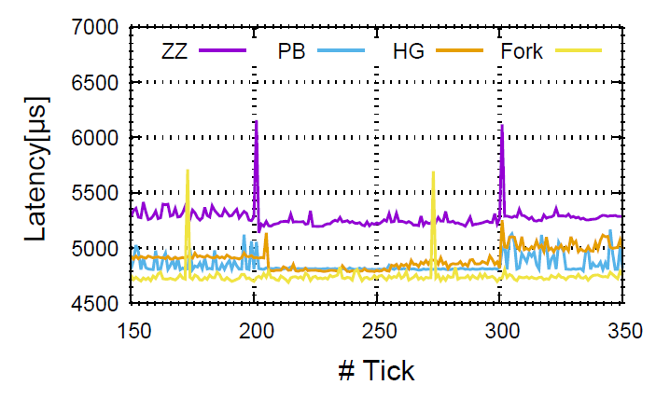

Slide 38
问题
4个经典算法
Hourglass和piggyback算法
实验
一致性讨论和评审意见

Slide 39
Hourglass：pingpong改进
23
3
3
13
14
4
4
16
6
6
17
7
7
18
8
8
5
5
online
backup
MR

Slide 40
Hourglass: Latency
Expected Latency Profile

Slide 41
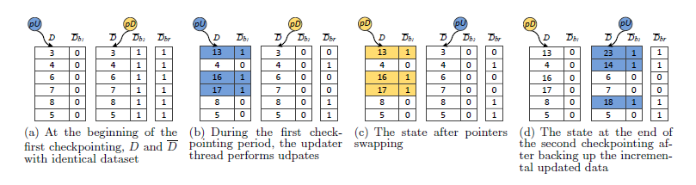
Hourglass：pingpong改进

Slide 42
与pingpong对比
只需要两份数据
每次只写一份数据
还是增量快照
不适合类似于 oltp+olap ,复杂查询的场景

Slide 43
3
13
3
3
1
3
0
4
4
4
4
0
16
6
6
1
6
0
6
7
7
7
7
1
17
0
8
8
8
8
0
5
5
5
0
5
online
backup
MR

Slide 44
23
13
3
3
1
2
14
4
4
4
4
2
0
16
16
1
6
0
6
17
17
7
7
1
0
18
8
8
8
8
2
0
5
5
5
0
5
backup
online
MR

Slide 45
Piggyback: Latency
Expected Latency Profile

Slide 46
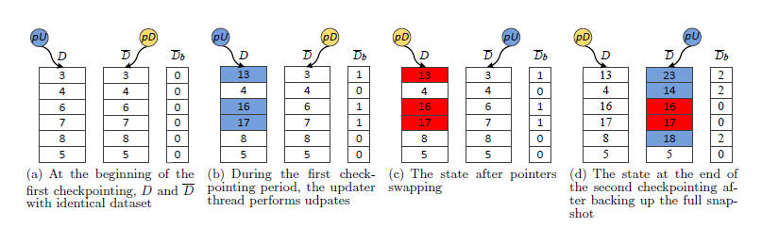
Piggyback

Slide 47
Hourglass内存中维护的是增量快照，而Piggyback维护的是full快照。
完整快照可以应用于其他很多场景。比如在OLTP数据上，直接生成用于OLAP的数据快照，这也是很多内存数据库系统的优势。

Slide 48
问题
4个经典算法
Hourglass和piggyback算法
实验
一致性讨论和评审意见

Slide 49
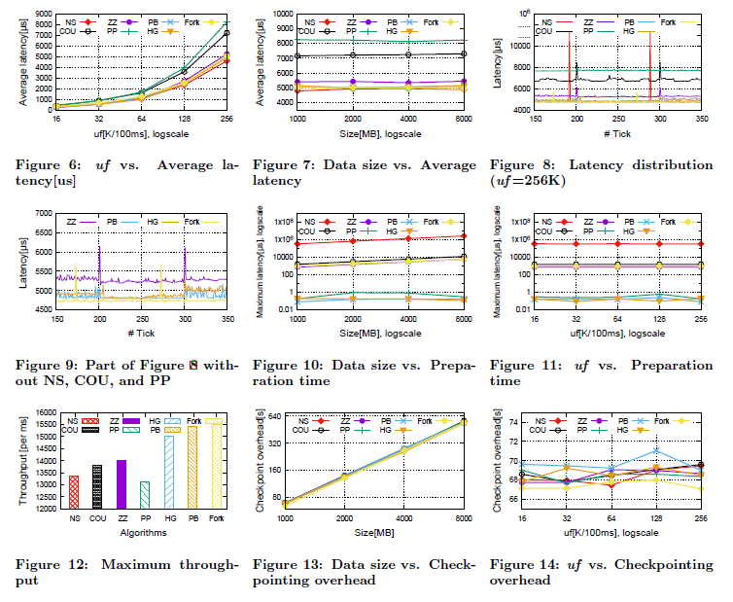

Slide 50
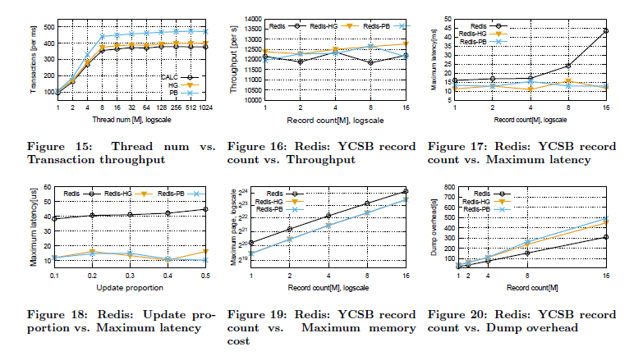

Slide 51
Redis实现原理

Slide 52
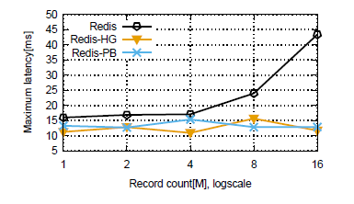
实验
57GB
Notes:
直接看论文

Slide 53
问题
4个经典算法
Hourglass和piggyback算法
实验
一致性讨论和评审意见

Slide 54
并行事务一致检查点
CALC-sigmod2016
新事务，操作新数据；旧事务，操作旧数据

Slide 55
Hourglass：一致性快照
23
3
3
13
14
4
4
16
6
6
17
7
7
18
8
8
5
5
online
backup
MR

Slide 56
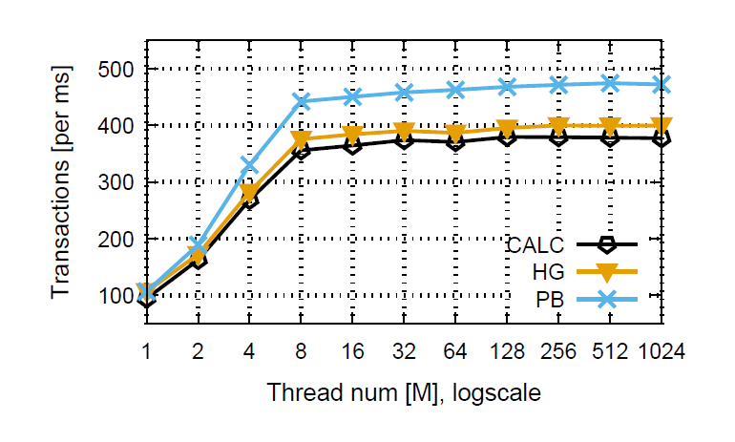

Slide 57
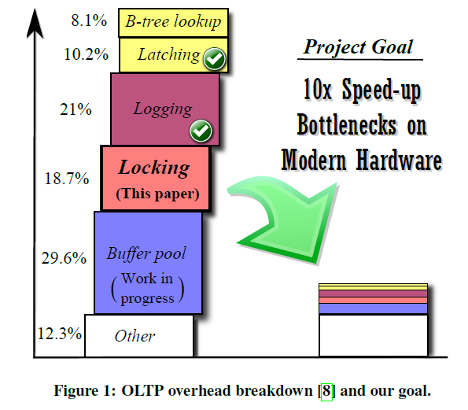
In-Memory transaction
ACID
A事务对B事务“不可见”
串行：h-store/voltdb，hyper
The end of an architecture era
事务结束时刻，执行备份
并行：VLL，ILL。。。

Slide 58
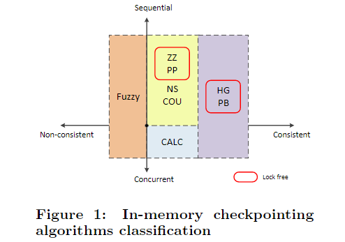

Slide 59
review
串行，并行
单机，分布式
事务模型
内存开销太大
可以内存优化
相对MVCC等提高吞吐量的手段，多出的内存开销还是可以接受的
Fuzzy和calc(sigmod2016)
我没写好
Fork可以通过 hugepage 解决
O(n)与O(1)
Hyper OLAP用fork，而舍弃zz

