Slide 1


Accelerating Hybrid Transactional/Analytical
Processing using Consistent Dual-Snapshot
Northeastern University of China
Liang Li, Gang Wu, Guoren Wang and Ye Yuan
Notes:
Hello, everyone! My name is liang li, one of the database group member in Northeastern University. My today’s presentation title is “Accelerating Hybrid Transactional/Analytical Processing using Consistent Dual-Snapshot”

Slide 2


Outline
1
Introduction
2
WHTAP
Experiments
3
4
Contributions
Notes:
I will introduce the work from 4 aspects. First, we give some background about HTAP.
Next, we will introduce our whtap architecture.
then is experiments, and some conclusions

Slide 3
Outline
1
Introduction
2
WHTAP
Experiments
3
4
Contributions
Notes:
I will introduce the work from 4 aspects. First, we give some background about HTAP.
Next, we will introduce our whtap architecture.
then is experiments, and some conclusions

Slide 4
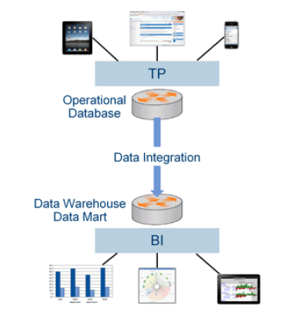
OLTP, OLAP
Online Transaction Processing
Online Analysis Processing
ETL
Extract, transform, load
Disadvantages
Need to deploy 2 systems
Development is complicate
AP side data is out of date
Source: gartner
Notes:
As we know, the traditional database processing system can be categorized with 2 type: online transaction processing and online analysis processing.
As the picture shows, the tp system is always connected with some app or website, is a kind of to customer business. The AP system is about some businesses intelligent processing task.
Generally , the data is produced from the TP side by the customers, the traditional way to transform the data from TP to AP is by using some ETL tools.
Apparently, we need to deployed 2 separate system to processing data, it always means that we need 2 group of programmer to develop the application.
Besides, compared with tp’s data, the ap system’s data is always out of date.

Slide 5
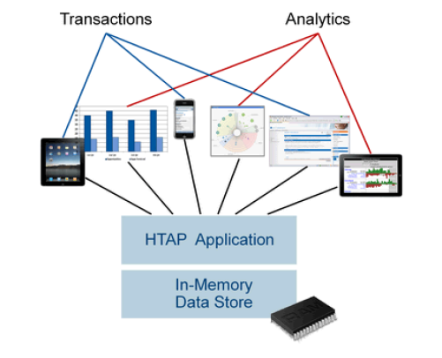
HTAP
What if we build one system
Processing TP and AP at the same time
Advantages
Uniform interface, friendly to programmers
Real-Time analytic
Less data duplication
Source: gartner
Notes:
What if we build one system can processing tp and ap at the same time.
As the picture shows, no matter it is transaction or analysis query. We can deal it with one data system.
This kind of system has 3 advantages:
First of all, it is friendly to programmers, since it has a uniform SQL interface.
The analytic can be based on the newest data.
Since based on One single system, it only needs less data duplications.

Slide 6
Goals
High Performance OLTP/OLAP
Wait-Free Latency
TP is wait-free
AP is wait-free
Freshness of data
The AP data should keep up-to-date.
Data should be transformed frequently
Notes:
As far as we know , To develop a HTAP system, we think it must meet the following requirements:
The throughput must be high.
The latency must be wait-free. In other words, No matter transactions and analytics , it can not be blocked when it is triggerd.
Data must be up to date, in other words, data should be transformed frequently from tp to ap side.

Slide 7

Analogy
OLTP side
OLAP side
High speed Road, HTAP designs
ETL “boat”
Notes:
The image is similar to what htap is, assume the right mountain is oltp, and the left motunain is olap,
To move data from TP to AP, we can use the lower speed boat, like etl,
Today , we can connect TP and AP with a high speed road, which combine TP and AP in one system.

Slide 8
Outline
1
Introduction
2
WHTAP
Experiments
3
4
Contributions
Notes:
Now, we will discuss our design, the W means wait-free.

Slide 9
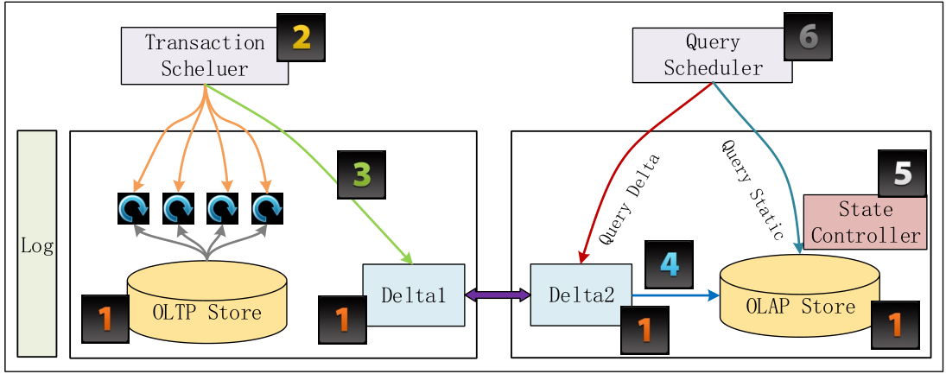
WHTAP dual-snapshot architecture
3- Record current period Delta Snapshot
4- Merge last period Delta Snapshot
The shorter the period is, the AP data is more fresher
Notes:
This page shows the top-level architecture. Our system contains 6 components in all: Foremost, the data is store into 2 storage, oltp storage, and olap storage. the extra 2 delta-snapshot used to record the period incremental data and merge the last period data to the olap storage.
The component 2, Transaction concurrency control not only need to write data into oltp storage, but also record data into the delta snapshot1, The another snapshot delta2 used to merge with olap storage. Please NOTE THAT the role of delta1 and delta2 exchange periodically,
Normally, with component 6, we can Query from olap storage directly, but during the merge phase, olap storage is not read-only, we should query delta2 first, if not find then query olap. To make the system running correctly, efficiently and wait-free, we develop a State controller execution model.
As we can see, The shorter the period is, the AP’s data is more fresher, the problem is how to ensure not to leads to performances loss and keep the system running in wait-free manner.

Slide 10
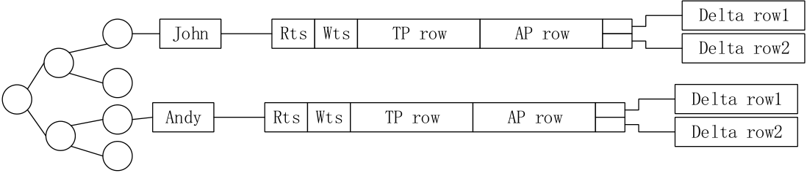
Tree-based Storage Engine
Notes:
Ap could be in row or column format

Slide 11
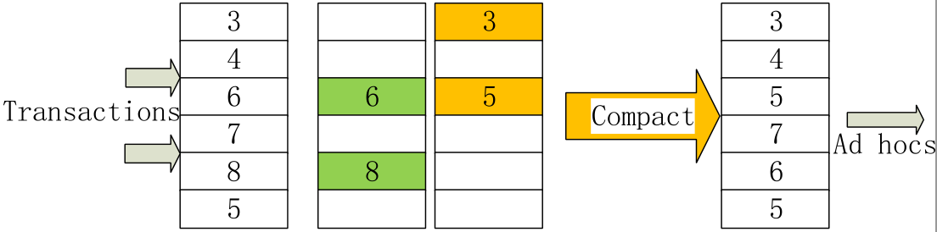
Varaint OCC + Dual Snapshot
Optimistic Concurrency Control
Read, Validate, Write Phases
Read, Validate, Double Write Phases
Lead to a little performance loss
TP
Delta1
Delta2
AP
Notes:
Our transaction execution engine is based on optimistic concurrency control
The basic optimistic concurrency control method has 3 phase, read, validate and write phase.
Our strategies has some little difference, in the write phase, we not only write data to tp storage, but also write to delta snapshot, since for a transaction most of the time is spending on the read phase, our double write only lead to some performance loss, it will be showd in the evaluation part

Slide 12
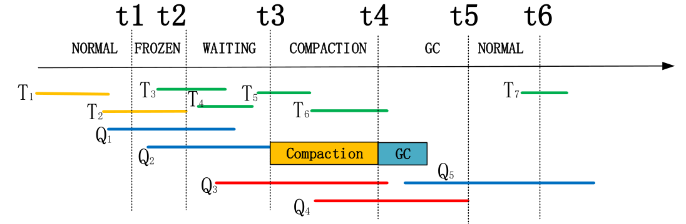
State Controller Running Example
Time
Notes:
This page we give the running example of our system. Our system has 5 phase in all. T means transactions, Q represents Query. At time point t1, we triggered the exchange role of delta1 and delta2, for example, Transaction1 and transaction 2 is recorded into delta2, Time t1 has some active transactions not committed, that means delta2 is inconsistent, to maintain consistent, transaction 3 should be recorded into delta1,
assume at time t2, the last period active transactions are all finished, Delta2 is consistent and should be merged to OLAP storage. However, On the other side, The query q1 and q2 should query OLAP data directly, the compaction work is conflict with q1 and q2, the system step into the waiting phase. therefore, we should waiting q1 and q2 finished, and then trigger the compaction phase. Query started in waiting an compaction phase should query delta2 first, it the entry not in delta, then query OLAP storage. The garbage collection phase we can recycle those useless delta snapshot .
We can see that both transaction and query can runs in wait-free manner.

Slide 13
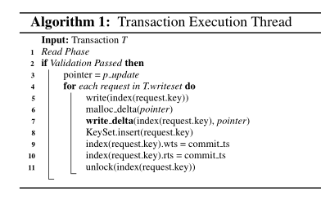
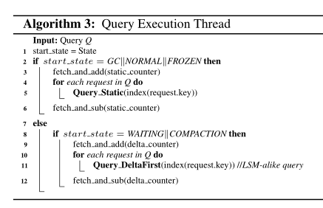
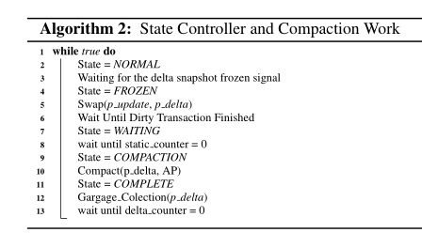

Slide 14
Outline
1
Introduction
2
WHTAP
Experiments
3
4
Contributions
Notes:
I will introduce the work from 4 aspects. First, we give some background about HTAP.
Next, we will introduce our whtap architecture.
then is experiments, and some conclusions

Slide 15
Setup
Compared systems
TicToc
SILO
HEKATON
BASIC MVCC
WHTAP
Benchmark
Based on YCSB with mixed workload.
OLTP, 16 accesses per transaction, θ = 0.9
OLAP, long-running & read-only transactions

Slide 16
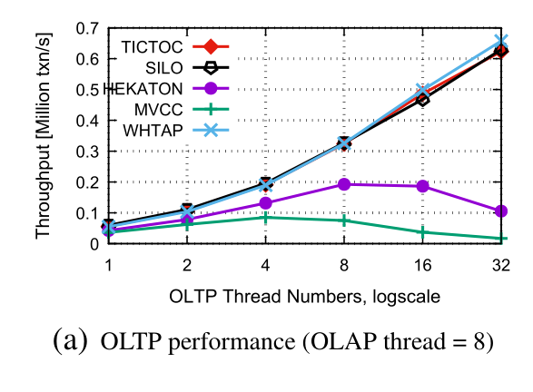
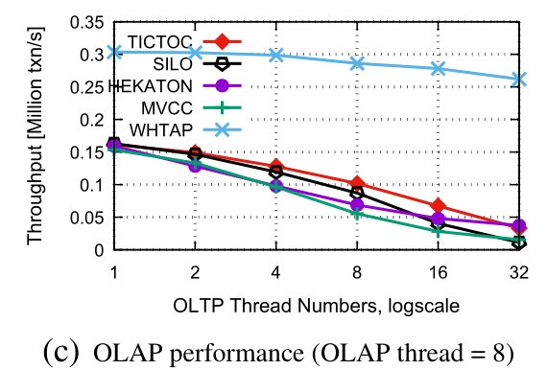
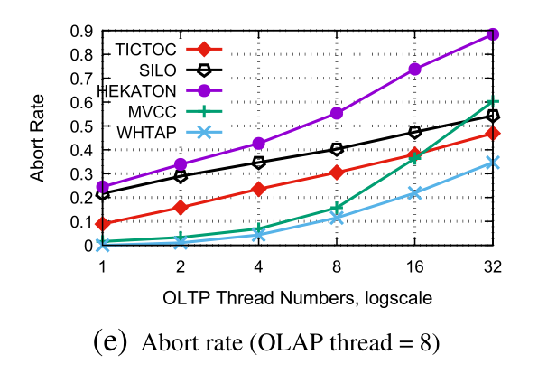
Evaluation, fixing AP’s workload

Slide 17
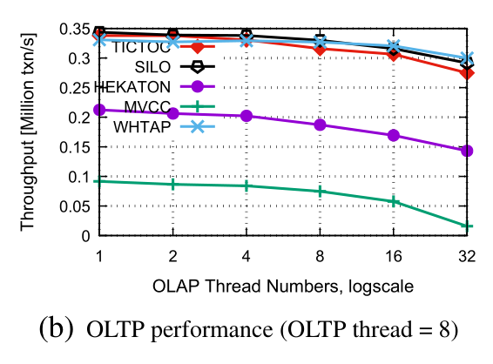
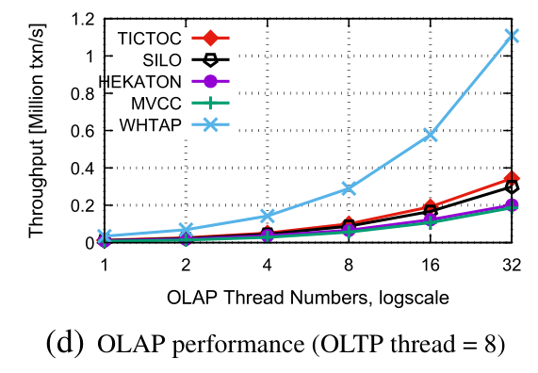
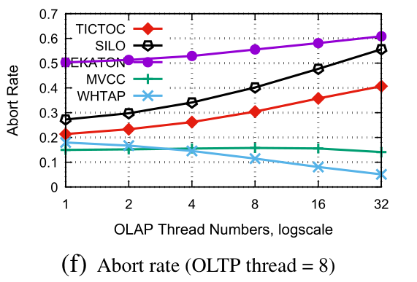
Evaluation, fixing TP’s workload

Slide 18
Outline
1
Introduction
2
WHTAP
Experiments
3
4
Contributions
Notes:
I will introduce the work from 4 aspects. First, we give some background about HTAP.
Next, we will introduce our whtap architecture.
then is experiments, and some conclusions

Slide 19
4. Contributions
We exploit a dual-snapshot structure to isolate OLTP and OLAP workloads
OCC variants Concurrency Control
LSM-like query layer
A State-Controller Execution model

Slide 20

https://github.com/bombehub
liliang@stumail.neu.edn.cn
Thank you!

