Slide 1
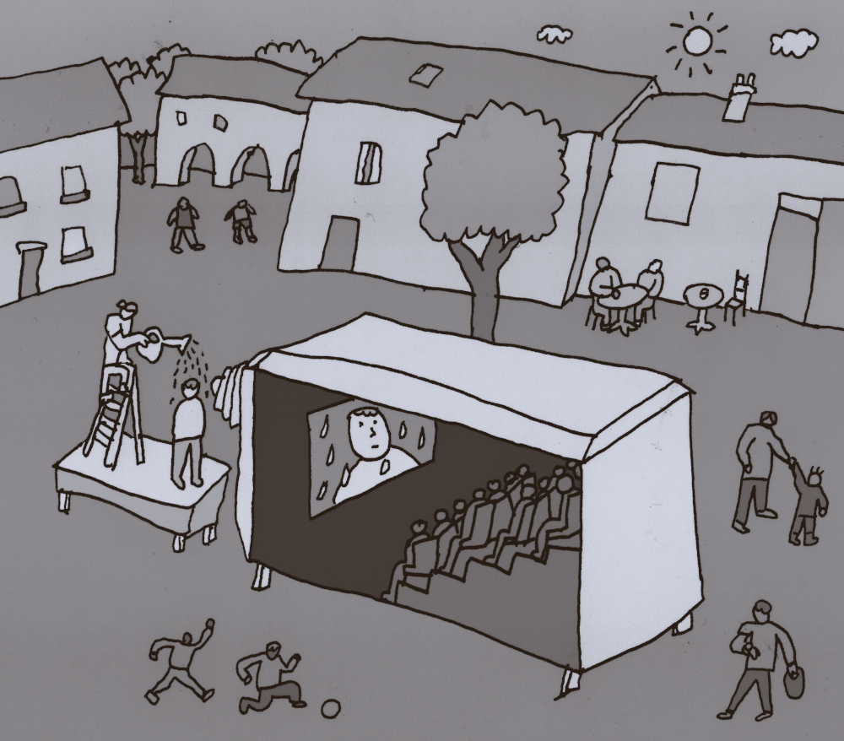
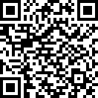
Camera Obscura
Title: Camera Obscura
Premiere: 2-3 of august 2024
Budget: 86000 €
Cast: Lucile Balézeaux
Bertrand Lenclos
Léon Lenclos
Booking: Amparo Gallur
07 68 52 29 53
cie@nokill.fr
Coproduction: MIMA
LE PARVIS
QUAI DES SAVOIRS
Residencies: LE KIWI / ARTO
LE PERISCOPE
CIRCA
SCÈNES CROISÉES DE LOZÈRE
L’ASSOCIATION DES CLOUS
Support: DRAC OCCITANIE
DGCA Commission Art de la Rue
RÉGION OCCITANIE

Slide 2

Calendar
2020-2022
Development
2022-2024
Creation
26-27 of july 2024
Show preview with le Parvis
at l’abbaye de l’Escaladieu
at Bonnemazon (65)
2-3 of august 2024
Premiere at MIMA festival
at Mirepoix (09)
14-15 of septembre 2024
At ARTO festival at Ramonville (31)
21-22 of septembre 2024
With les Scènes croisées de Lozère
at Saint-Alban-sur-Limagnole (48)

Slide 3

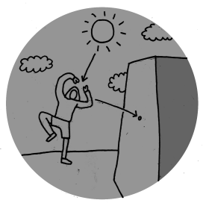
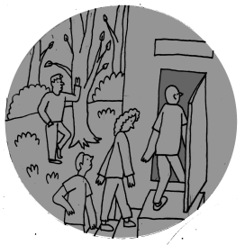
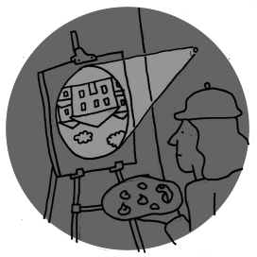
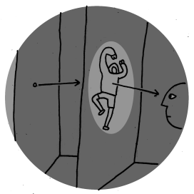

The camera obscura principle
We've built one, and invite viewers to step inside.
A super old principle
Quite « simple » in theory

Slide 4
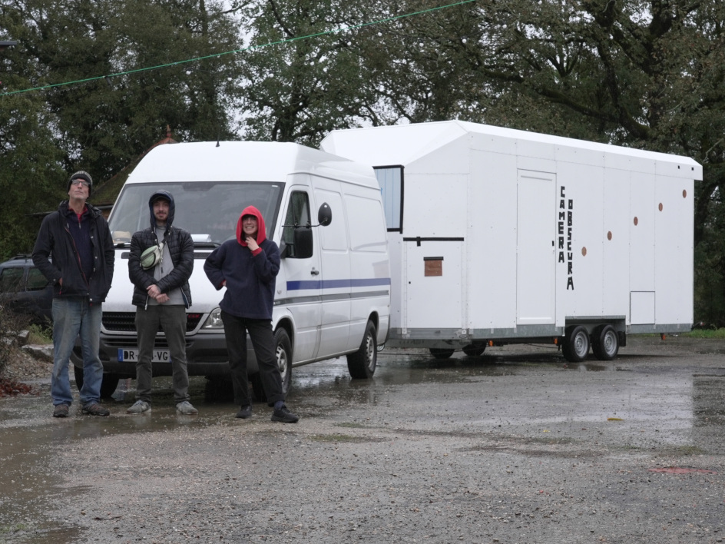
Our
camera
21 seats
30 minutes show
4 sessions a day
1 comedian inside
2 comedians outside
→
Late 2023 picture of the trailer (during construction)

Slide 5
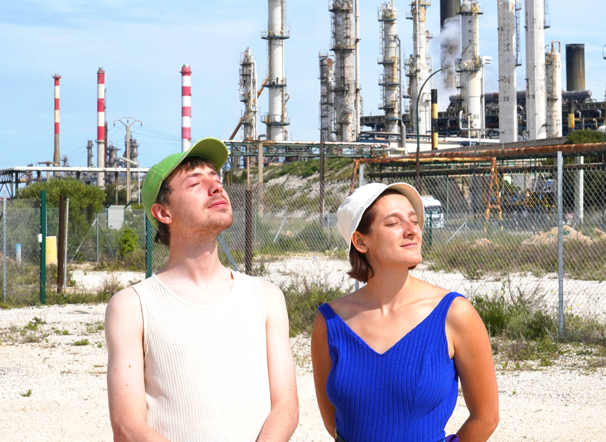
Memories
From The
Future
Is the title of the movie played in the Camera Obscura

Slide 6
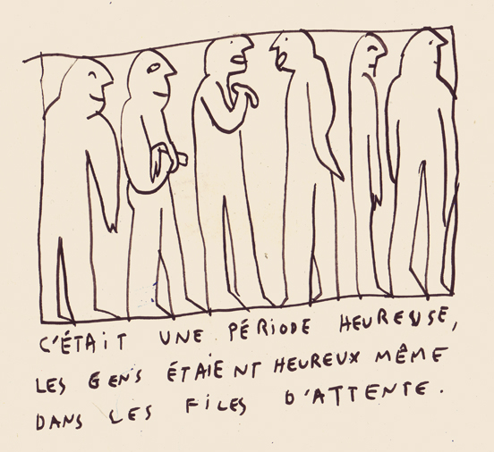
Show translation
Using subtitles :
Consistent with the cinematic form
Not limited to languages we speak
Low cost of adding a new language
It was a happy time
people were happy, even in the queues.
It was a happy time
people were happy, even in the queues.

