Slide 1
ECE449 Final Project
3080Ti
Zhongkai Shangguan
Yue Zhao
Jingwen Wang
Apr. 22 2020

Slide 2
Content
Method Description
Augmentation and Preprocessing Method
Network Architecture
Optimization Method
Number of iterations/epochs of convergence
Novelty
Results Losses and Accuracy
Summary

Slide 3
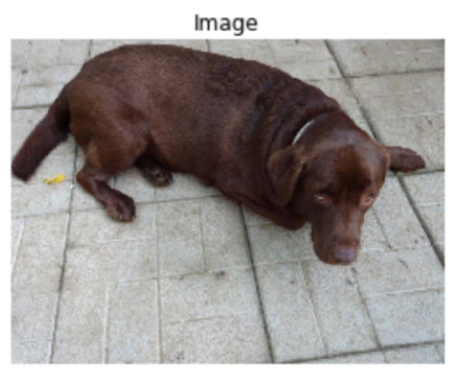
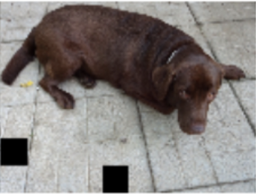
Augmentation and Preprocessing Method
•Spatial-level transforms:
Cropping
Rotation
Horizontal Flip
• Pixel-level transforms
Image contrast augmentation:
Random Gamma,
Color Saturation Changes
Brightness change Blur: Gaussian Blur, Motion Blur, and Medium Blur
Image cutout: Coarse Dropout
Notes:
such as open and closed cellular convection, but also differ in important ways.

Slide 4
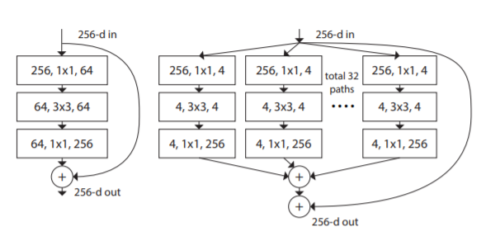
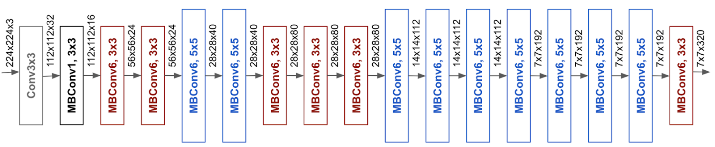
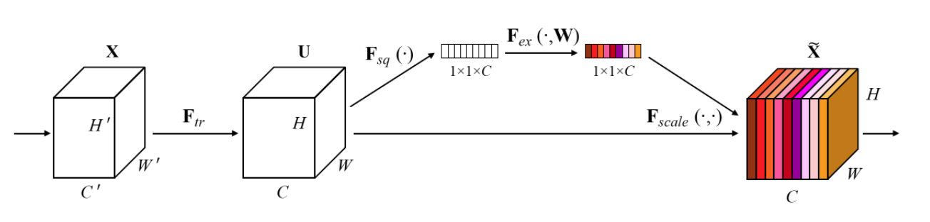
Network Architecture
We tried several networks in this case, finally decide backbone based on EfficientNet-B7 and SE-ResNeXt101, which here show better performance.
EfficientNet-B0
SE-ResNeXt101
[1] Mingxing Tan and Quoc V Le. Efficientnet: Rethinking model scaling for convolutional neural networks. arXiv preprint arXiv:1905.11946, 2019.
[2] Saining Xie, Ross Girshick, Piotr Dollár, Zhuowen Tu, and Kaiming He. Aggregated residual transformations for deep neural networks. In Proceedings of the IEEE conference on computer vision and pattern recognition, pages 1492–1500, 2017.

Slide 5
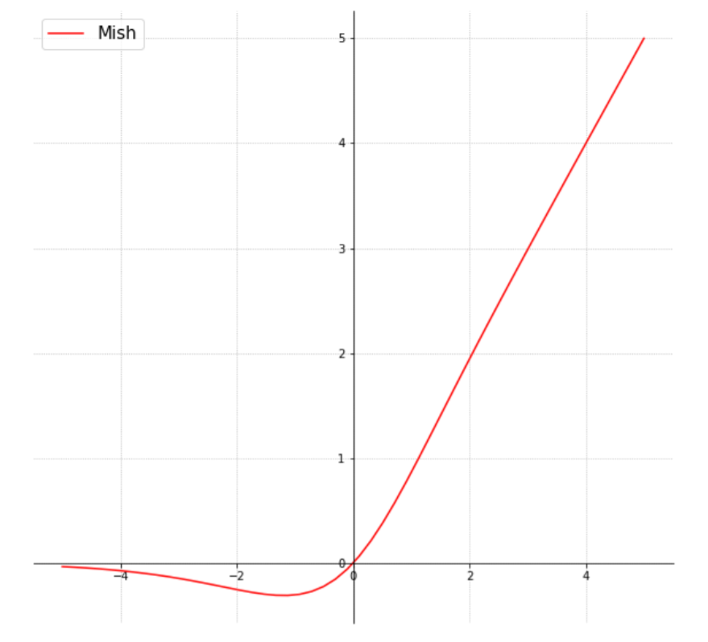
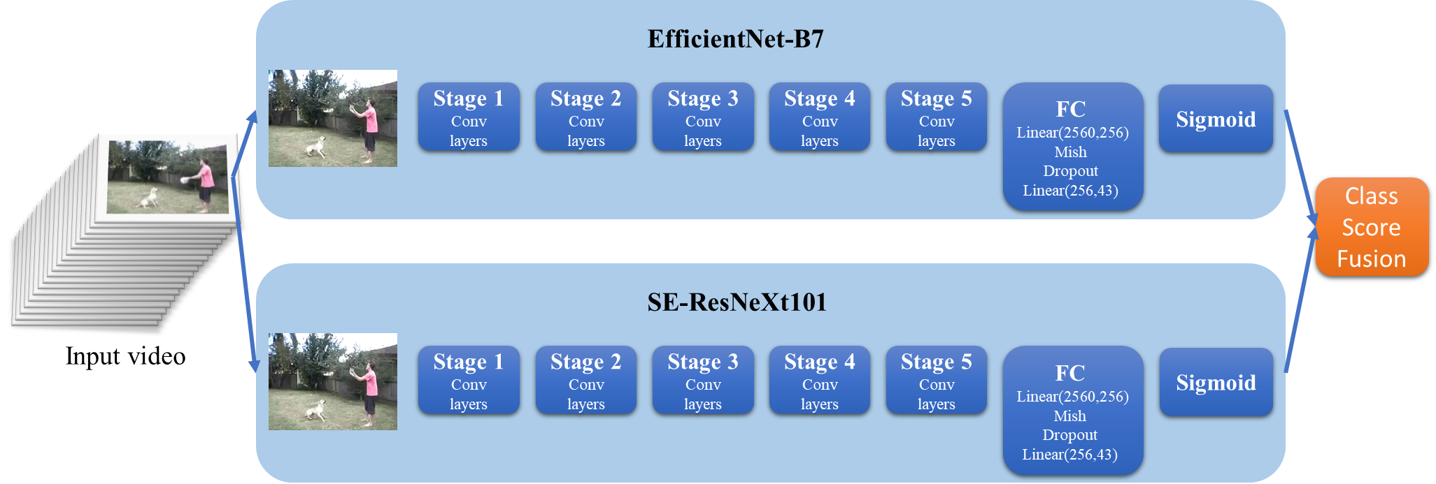
Network Architecture
We also add a FC layer (fully connected layer, also known as ‘dense layer’) and dropout layers after the end of two backbone architectures, respectively.
Activation function: Mish.
[3] Diganta Misra. Mish: A self regularized non-monotonic neural activation function. arXiv preprint arXiv:1908.08681, 2019.

Slide 6
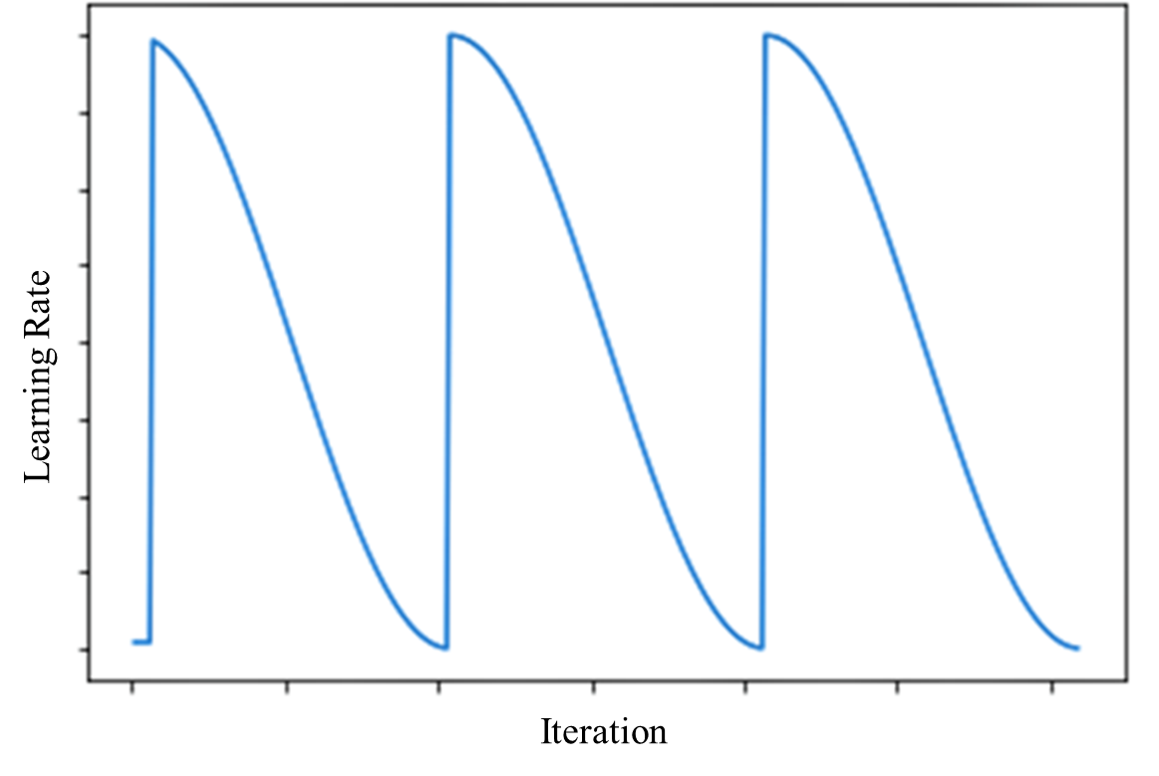
Optimization Method
Optimization Method: Stochastic gradient descent(SGD)
Learning rate scheduler: CosineAnneaingLR + MultiStepLR
Initial random seed for each epoch.
[4] Diederik P Kingma and Jimmy Ba. Adam: A method for stochastic optimization. international conference on learning representations (2015), 2015.

Slide 7
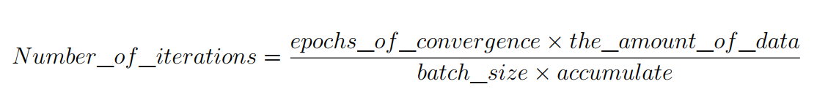
Number of iterations/epochs of convergence
For EfficientNet-B7, the model is converged roughly around 87 and the number of iteration is (87× 4752)/(24×3) = 5742.
For SE-ResNeXt101, the model is converged roughly around 44 and the number of iteration is (44× 4800)/64 = 3300.

Slide 8
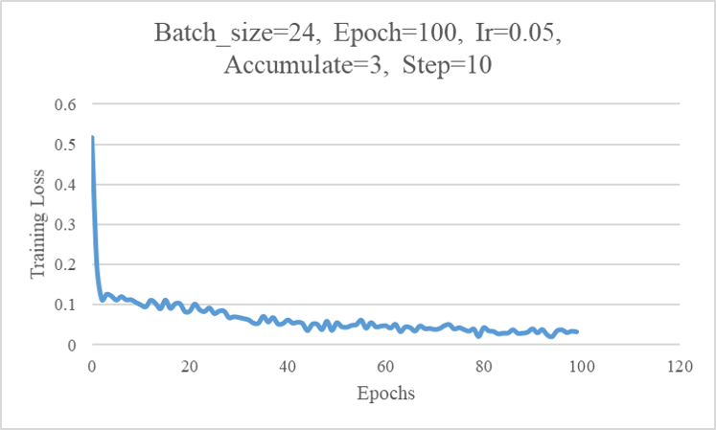
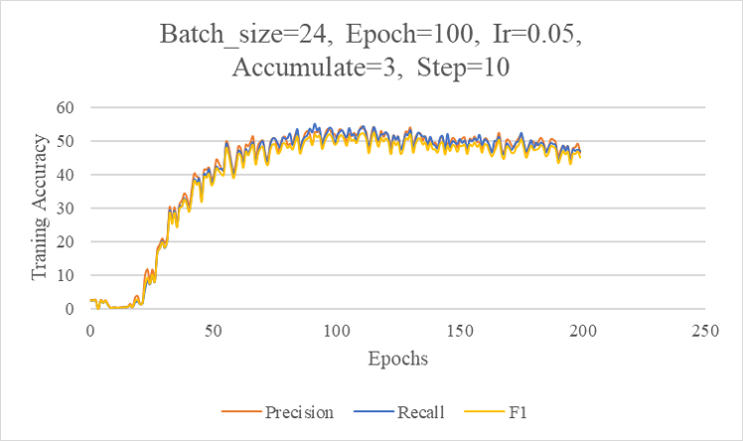
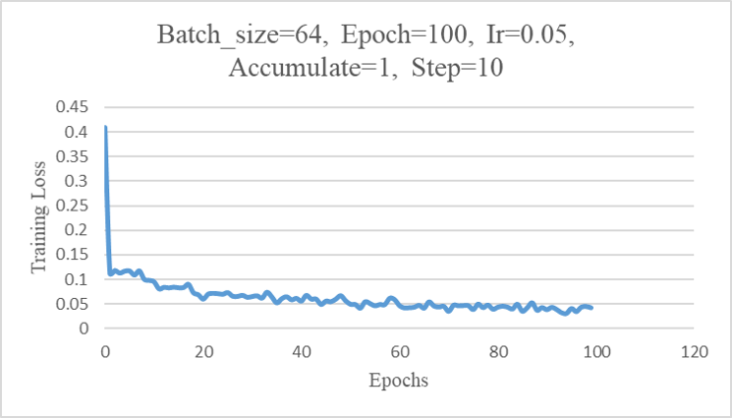
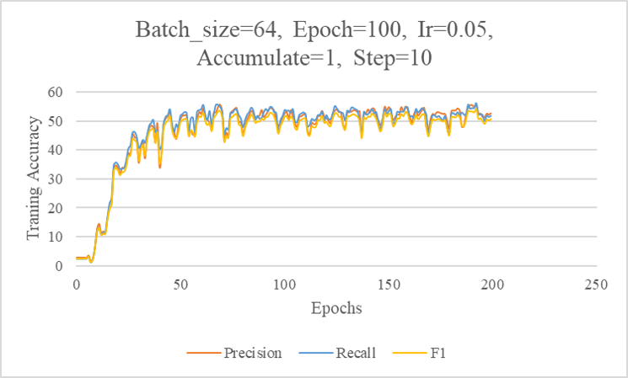
Results Losses and Accuracy
EfficientNet-B7
SE-ResNeXt101

Slide 9
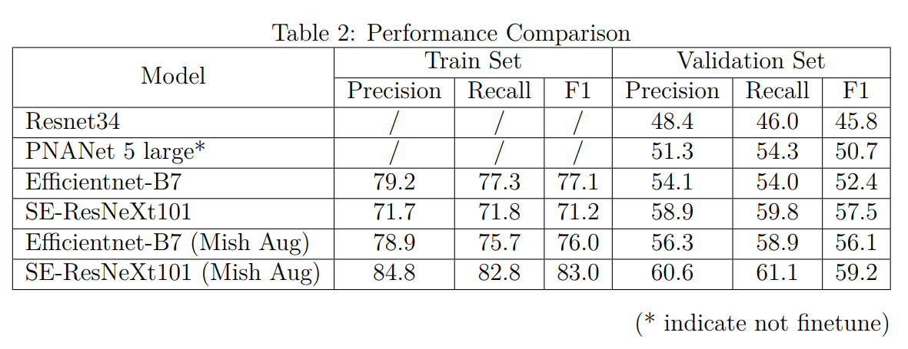
Summary
Performance
Our all results are shown in Table 2 below:

Slide 10
Things that works
Model architecture:
1. Select a proper backbone based on experience.
2. Add FC and Dropout layers and using Mish as activation method.
Data augmentation:
1. Spatial level: Rotate, Horizontal flip.
2. Pixel level: gamma transform, color and saturation change, motion blur, median blur, gaussian blur.
Smooth training process:
1. Optimizer selection, based on experiment.
2. Two stage for training using different scheduler.
3. Using accumulate to reach appropriate batch_size.

Slide 11
Things doesn’t work
Model architecture:
Too many dense layers may decrease the performance of precision and F1 score accordingly.
Data augmentation:
1. Spatial level: Vertical flip, transpose,
2. Pixel level: All sharpen methods(sharpen, CLAHE).
Training process:
1. Adam doesn’t show good performance in our case(though it should be).
2. Too big batch_size or accumulate may also not work.
3. Too big or small learning rate may cause the model can’t converge.

Slide 12
Things we could do
Model architecture:
1. Try new models and activation method.
2. Analyze why SE-ResNeXt shows better performance than Efficientnet-B7 in multi-label classification.
3. Blend models.
Data augmentation:
1. Spatial level: Large size input.
2. Pixel level: May try other image filters.
Training process:
1. Could combine two learning rate into one(CosineAnneaingLR with decay).
2. Analysis why Adam doesn’t work (code bugs?).

Slide 13

Experiment Environment:
Hardware: Two local 2080Ti (11GB).
System and Environment:
Ubuntu 16.04 & 18.04
Cuda 10.1
Python 3.7
PyTorch 1.2.0
Training Time:
Efficientnet-b7 80s per epoch.
SE-ResNext101 90s per epoch.

Slide 14
Acknowledgement:
Professor Chenliang Xu,
All TAs, especially Jing Shi.
All students who post or answer questions on Piazza.
Wish All of You Stay Safe and Healthy.
Thank you.

Slide 15
Reference
[1] Mingxing Tan and Quoc V Le. Efficientnet: Rethinking model scaling for convolutional neural networks. arXiv preprint arXiv:1905.11946, 2019. [2] Saining Xie, Ross Girshick, Piotr Dollár, Zhuowen Tu, and Kaiming He. Aggregated residual transformations for deep neural networks. In Proceedings of the IEEE conference on computer vision and pattern recognition, pages 1492–1500, 2017. [3] Diganta Misra. Mish: A self regularized non-monotonic neural activation function. arXiv preprint arXiv:1908.08681, 2019. [4] Diederik P Kingma and Jimmy Ba. Adam: A method for stochastic optimization. international conference on learning representations (2015), 2015.

Slide 16

Questions

Slide 17
Thank You!
Thank you

