Slide 1

A SAFER WAY TO TRAVEL

Slide 2
THE PROBLEM
Vehicle collisions
Potential result of injury or death
Many high-risk intersections with flawed designs
Factor out of the traveler’s control
Mistakes by pedestrian or driver has a higher chance of being fatal in these intersections
Areas where flawed design could occur:
Road width, speed limit, markings and signs, and intersection infrastructure such as dividers and shoulders

Slide 3
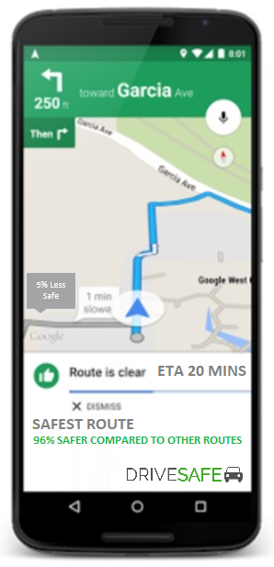
THE SOLUTION
Navigation system which focuses on safety
Mobile (Android) application
Finds safest route rather than fastest
Assigns safety weight for each route and intersection based on past collision data and factors
Routes outputted based on travel conditions and method (e.g. vehicle, foot, bicycle)

Slide 4
THE DATASET
‘Collisions’ from Seattle GIS Open Data
Dataset of collisions at each intersection in Seattle (2004-Present)
Factors obtained from dataset
Number of Collisions
Weather, road, and daylight conditions
Type of collision (pedestrian/vehicle)
Collision details (left/right turn, etc.)
Severity of collision
Severity code from 0-2
Injury/death
Data will be needed to assign safety weight to each intersection and route

Slide 5
ALGORITHMIC CHALLENGES
Searching and sorting algorithms for extracting data from dataset
Searching and sorting algorithms for finding and calculating safest route
Algorithm for calculating the weight of each intersection and route
Balance of safety and efficiency
Graph to produce route
Intersections are vertex, and the roads are edges
The safest and shortest route will plotted as polyline and polygons graph

Slide 6
iClicker
Leon So
This was an interesting project and if it was one of the projects in my team, I would have liked to implement it.
Strongly disagree
Disagree
Neither agree nor disagree
Agree
Strongly Agree

