Slide 1
Product Assignment Recommender
Jialiang Xie^{1,2}, Qimu Zheng^{1,2}, Minghui Zhou^{1,2}, Audris Mockus³
¹School of Electronics Engineering and Computer Science, Peking University
²Key Laboratory of High Confidence Software Technologies, MoE
Beijing 100871, China
³Avaya Labs Research
Basking Ridge, 233 Mt Airy Rd, NJ

Slide 2



In issue-tracking system of open source projects
Volunteers help to filter incoming issues
Check if the issue is valid
Check if the issue has necessary information filled
Determine the location/product
In Mozilla, non-developer volunteers help to assign 29% of issues
Triage
Is valid?
Has filled necessary information?
Issue
Product assigned?
Get fixed
Non-developer
Notes:
This is the background

Slide 3
Assigning issues to products is challenging
In Mozilla, over 21% of product assignments are incorrect¹
Error rate of developers: 18%
Error rate of Non-developer: 29%
¹J. Xie, M. Zhou and A. Mockus. Impact of triage: a study of Mozilla and Gnome. ESEM2013
Notes:
Problem (state the problem)

Slide 4

Product assignment is critical for fixing issue
If the issue goes to the wrong product
It may take long time until the team notices that the issue is not caused by that product
Product team may not be familiar with the other products, so the next assignment may not be accurate either
Product A
Wrong
Assignment
Long delay
Not accurate either
Product B
Issue
Product C
Notes:
Problem (clarify how severe the problem is)

Slide 5



Product Assignment Recommender - how does it work?
Learn from the past activities
Estimate the odds that a product assignment is incorrect
Put the new issues into two queues (based on threshold)
“Recommended” queue: high-accuracy assignments
“Warned” queue: low-accuracy assignments
New issue
Recommended queue
……
PAR
Warned queue
Past activities in ITS
Notes:
Introduce functionality

Slide 6

Product Assignment Recommender - what can it help?
Help developer focus their limited time on relevant issues
So that developer can concentrate on fixing real problems
Improve the accuracy of assignment
By crowd-sourcing non-developers to verify and correct low-accuracy assignment
New Issue
Fix issue
Developer
……
Verify and correct
Non-developer
Notes:
motivation

Slide 7
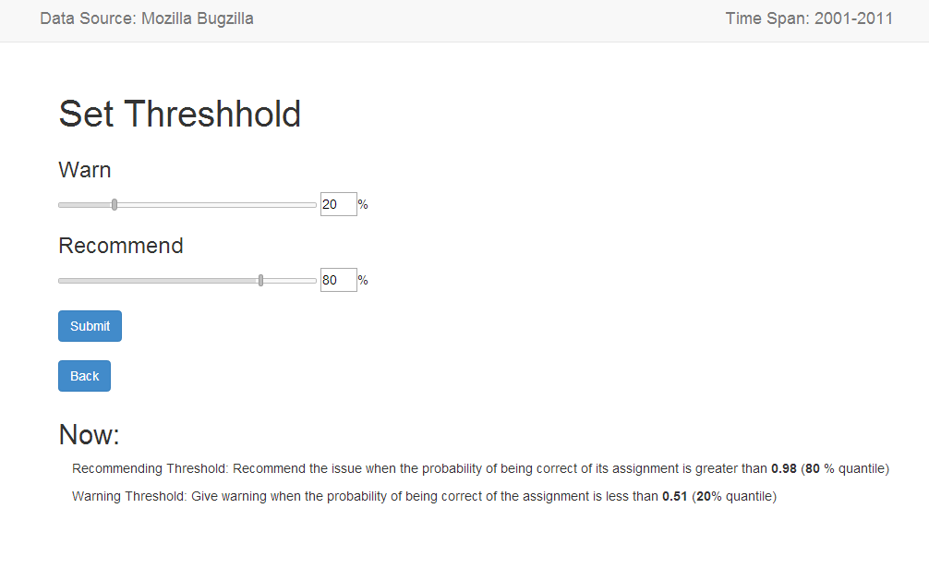
Product Assignment Recommender - how to use PAR? (1)
Training: feed PAR with historical data-set
Predicting: set accuracy threshold, get two queues of issues
Notes:
Demo show

Slide 8
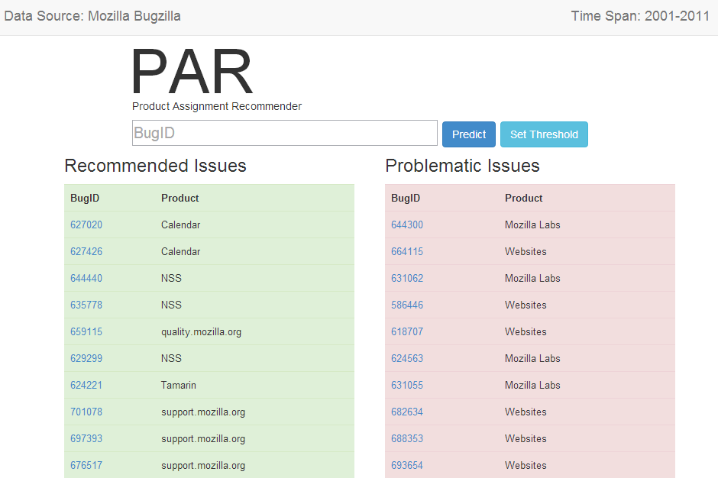
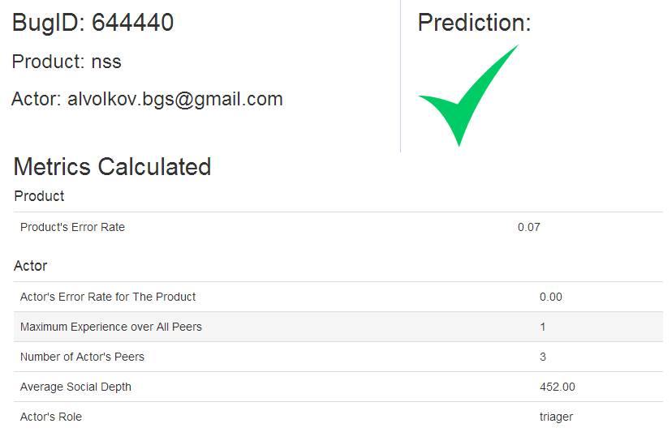
Product Assignment Recommender - how to use PAR? (2)
Developers/triagers, could:
start their work by picking issues from the queue
check the accuracy of a particular issue
Notes:
Demo show

Slide 9
Approach
Model the accuracy of product assignment
Predict the accuracy of product assignment for the new issue
Place the issue into queues according to its accuracy
Past activities in ITS
Model
Recommended queue for fixing
Predict
Place into queues
New issue
Recommended queue
for re-considering assignment
Notes:
General introduce the core idea

Slide 10
Approach
Model the accuracy of product assignment
Mozilla data set
From 2001 to 2011
102K assignments on 88K issues (15% of the original corpus)
Notes:
The model is our primary contribution

Slide 11
Approach
Model the accuracy of product assignment
Build linear regression model
Response
Accuracy of product assignment
Product’s past error rate
Product-related factor
Product indicator
Predictor
Assigner’s past error rate for a product
Assigner-related factor
Assigner’s role
Maximum experience over all peers
Interaction with peers
Number of peers
Average interaction depth
Notes:
The model is our primary contribution

Slide 12
Approach
Model the accuracy of product assignment
Product assignment model (28% deviance explained)
isProductCorrect ~ Perr + TrPErr + lnMaxSNExp + lnSNsize + lnAvgSNDep + Role + P
Predictor | Estimate | P-value | Dev expl
(Intercept) | -11.47 | 0.96
Product error rate | -1.30 | 0.00 | 14000
Assigner’s error rate on product | -3.04 | 0.00 | 7683
Assigner’s role |  |  | 831
Max experience over all peers | 0.16 | 0.00 | 757
Number of peers | -0.24 | 0.00 | 566
Average interaction depth | -0.11 | 0.00 | 41
Product indicator |  |  | 4162
Notes:
The model is our primary contribution

Slide 13
Evaluation
Use one year of history to fit the model
Predict the incorrect assignments in the next year
Choose the lowest 5% and 10% predicted probability of being correct
Prediction quartile | Precision | Recall | F₁ Score
5% | 73.65% | 20.55% | 0.31
10% | 63.89% | 33.90% | 0.42
The precision is 3.4 times higher than a random predictor

Slide 14
Conclusion
Aiming to improve the effectiveness of development process, we design PAR
Highlight problematic issues
Focus developers time on relevant issues
Future work
Model accuracy of other fields and integrate the model into PAR
Extend PAR in both commercial and open source project

Slide 15
Different Roles in Mozilla

