Slide 1
Particles: parallelizing an O(N²) N-body solver
C++/Python baselines → OpenMP, CUDA, MPI, Numba CPU and Numba CUDA
Leonardo Scappatura — Polimi PhD School, HPC course final project — July 2026
7
runnable programs
6
bitwise-identical states
543×
max GPU speed-up
113.7×
MPI, 128 ranks
1 / 19
Notes:
One-liner of the result up front: seven runnable programs—two baselines plus five parallel ports. Six produce bitwise-identical state arrays; Numba CUDA passes the course tolerance. Speedup reaches 543× on one GPU and 114× across four MPI nodes.

Slide 2
The application
2D particle-dynamics toy solver from the course repository (C++17 + Python baselines).
Particle generation: Mandelbrot field on a 1200×1000 grid (3000 iters); cells above threshold become particles → N = 2231, weight = mass.
Dynamics: all-pairs softened force — kForce·wᵢwⱼ/(r²+ε²)3/2, kForce=10⁻³, ε²=10⁻⁴.
Integrator: velocity-Verlet, 200 steps, dt=10⁻³ → O(N²)·steps ≈ 10⁹ interactions.
Output: HDF5 (/pos /vel /step /weight) + 11 printed validation quantities (sums, momenta, kinetic/potential-like energy).
2 / 19
Notes:
The force kernel is 99+% of the runtime — the whole project is about that loop. Weight doubles as mass; the numerical model, input format, and validation quantities are contractual and must not change.

Slide 3
Strategy: reproducibility first
Design invariant used in EVERY port: parallelize only the outer particle index i; keep the inner j-sum in serial order (j = 0…N−1).
Each fx[i] then accumulates in exactly the serial order → results can be bitwise identical, not just "within tolerance".
Corollaries: no fast-math anywhere; no FMA contraction (CUDA uses __dadd_rn/__dmul_rn intrinsics); no pair-symmetry tricks that create write races.
Baseline untouched: each port is a separate self-contained source file, exactly as the CMake scaffold expects.
3 / 19
Notes:
This is the thesis of the talk. Parallel ≠ nondeterministic: if you preserve the accumulation order per output element, an embarrassingly parallel outer loop reproduces serial floating point exactly. The profiler later estimates a +31% FMA optimization opportunity, which we decline to retain that reproducibility.

Slide 4
Five parallel ports + two baselines
Implementation | Source file | Key techniques
Serial baselines | src/cpp/particles.cpp + src/python/particles.py | C++ and NumPy references; same model/HDF5 schema
OpenMP | src/cpp/particles_omp.cpp | parallel for on outer loops; reductions for validation sums
CUDA | src/cpp/particles.cu | 1 thread = 1 particle; device-resident SoA; __d*_rn intrinsics; sm_80
MPI | src/cpp/particles_mpi.cpp | block decomposition of i; per-step MPI_Allgatherv of positions
Numba CPU | src/python/particles_numba.py | @njit(parallel=True) + prange, fastmath=False
Numba CUDA | src/python/particles_numba_cuda.py | @cuda.jit kernels, float64, device-resident
4 / 19
Notes:
Five optimized ports plus two serial baselines. The six-way course matrix excludes MPI and includes both baselines; MPI is validated separately against C++ serial.

Slide 5
Correctness methodology
Every implementation writes the same HDF5 datasets; the course validator compares /step /weight /pos /vel pairwise.
15-pair matrix: C++ serial, OpenMP, CUDA, Python, Numba CPU and Numba CUDA at rtol=atol=2·10⁻³.
MPI is checked separately; strict 10⁻¹² checks cover expected bitwise pairs (Numba-CUDA is informational).
Plus: 17-significant-digit comparison of the 11 printed validation quantities.
5 / 19
Notes:
Validation is dataset-level over full trajectories (11 frames × N × 2), not just final scalars—position errors would compound over 200 steps and get caught.

Slide 6
Correctness results (Leonardo A100, official input)
15/15 pairs PASS the six-way course gate; MPI passes its separate serial check.
C++ serial, OpenMP, CUDA, MPI, Python and Numba CPU: bitwise-identical /pos and /vel arrays.
CUDA = serial in all 11 validation quantities to all 17 printed digits.
MPI bitwise-identical from 1 to 128 ranks (decomposition preserves sum order).
Numba-CUDA: max relative velocity difference 1.158·10⁻³, below the 2·10⁻³ gate (position max abs 4.56·10⁻⁵).
6 / 19
Notes:
"Bitwise" validates the design invariant of S3. Numba-CUDA is the one port where NVVM gives less control over contraction; its worst relative difference, 1.158·10⁻³, is about 1.7× below the 2·10⁻³ course limit. Momentum components are catastrophic-cancellation quantities (~10⁻⁸ on 10¹¹-scale sums), so their trailing digits are not meaningful—expected and documented.

Slide 7
Case study: one FMA, one particle
On macOS (clang, default -ffp-contract), the baseline itself generates 2232 particles; Python generates 2231.
Root cause: FMA contraction in the Mandelbrot loop changes 14 of 1.2 M cells; ONE cell (i=1157, j=489) crosses the selection threshold (2900).
Fix/proof: -ffp-contract=off → C++ matches Python bitwise.
On Leonardo (gcc 12 + nvcc): all seven runnable programs agree at N = 2231.
7 / 19
Notes:
Found during local verification before touching the cluster. A single fused multiply-add changed the particle COUNT — the dataset shapes stop matching, not just values. This motivates the no-contraction discipline of S3 and shows validation must compare structure, not only tolerances. On the exam platform the issue does not arise, but the report documents it for reproducibility on other machines.

Slide 8
Benchmark setup (hardware / compilers / method)
Leonardo Booster node: Xeon Platinum 8358 (32 cores) + NVIDIA A100-SXM-64GB (108 SMs, driver 535.274.02); MPI: up to 4 nodes / 128 ranks over Dragonfly+.
Toolchain: gcc 12.2.0, CUDA 12.2 (nvcc, sm_80), cmake 3.27.9, hdf5 1.14.3, python 3.11.7, numpy 2.4.6, numba 0.65.1.
Flags: -O3 -std=c++17 (+-fopenmp); no fast-math, no -march=native.
Method: benchmark mode = HDF5 disabled (none 0); metric = "pure dynamics" time (excludes JIT warm-up & I/O); median of 3 runs; threads pinned (OMP_PROC_BIND=close, OMP_PLACES=cores).
8 / 19
Notes:
Exam deliverable #4 verbatim. Serial reference: 3.516 s for 200 steps at N=2231 = 0.283 GInteractions/s, flat across problem sizes (compute-bound, cache-resident).

Slide 9
OpenMP: what was parallelized
#pragma omp parallel for schedule(static) on: force outer loop, both Verlet half-kick loops, Mandelbrot rows (collapse(2)).
Validation reductions: reduction(+:…) incl. the O(N²) potential.
Each thread writes only its own fx[i]/fy[i] → race-free by construction, inner order untouched → bitwise result for ANY thread count.
9 / 19
Notes:
~10 pragmas on the baseline; deliberately minimal so the diff vs serial is reviewable. Bitwise at every thread count tested (1…32).

Slide 10
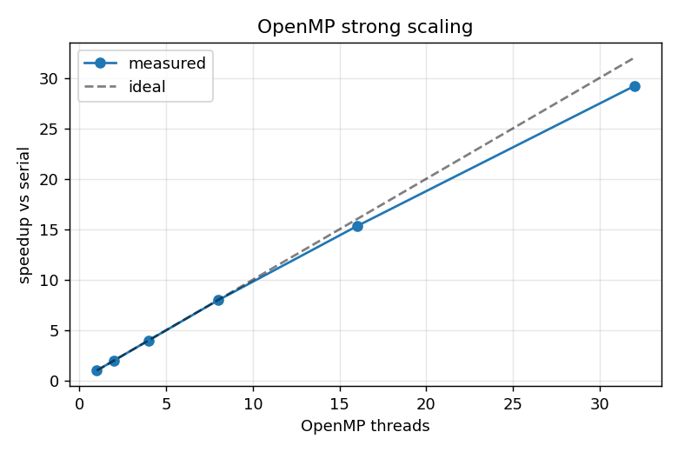
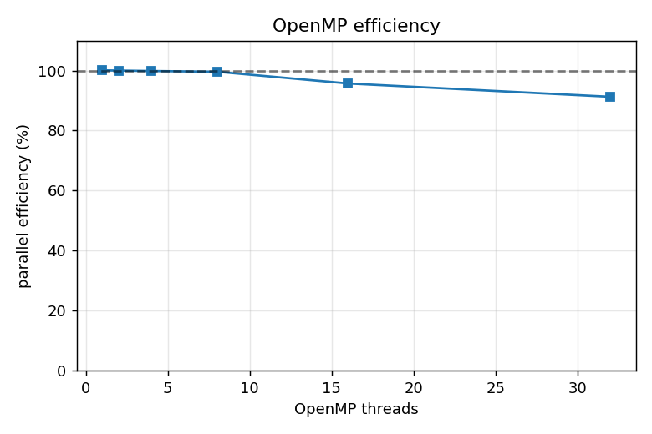
OpenMP strong scaling
Threads | Speed-up | Efficiency
2 | 2.00× | 100%
4 | 3.99× | 100%
8 | 7.97× | 100%
16 | 15.31× | 96%
32 | 29.20× | 91%
Speed-up vs threads
Parallel efficiency vs threads
10 / 19
Notes:
Near-ideal to 8 threads; 91% at the full socket. The 16/32-thread dips are memory-subsystem sharing, not algorithmic — the Amdahl fit next quantifies it.

Slide 11
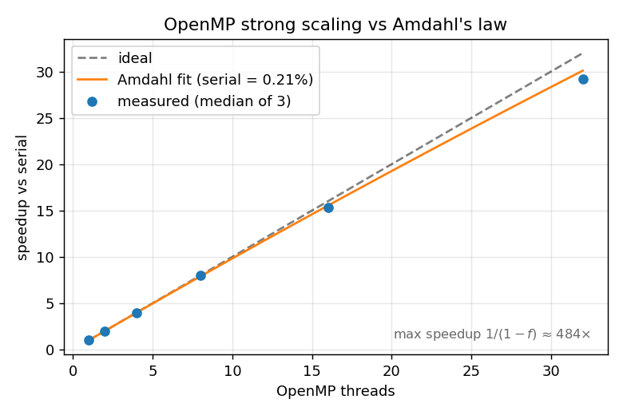
Amdahl's law fit
Least-squares fit of 1/S vs 1/p over p = 1…32.
Serial fraction ≈ 0.21% → speedup ceiling ≈ 480×.
Measured points match the model within ~3% at every p.
The 32-core node exploits only ~6% of the parallel headroom → the algorithm scales far beyond one CPU (motivates GPU + MPI).
11 / 19
Notes:
Course topic "measuring performance". The tiny serial fraction is the integrator + loop bookkeeping. Ceiling ≈480× is the Amdahl asymptote 1/(serial fraction) — the fitted intercept of the linearized model.

Slide 12
CUDA port: what was offloaded
One thread per particle i (128-thread blocks); inner j-loop in registers, serial order preserved.
Whole SoA state device-resident across all 200 steps; copies only for HDF5 frames and the final validation (9 memcpys, 0.19 ms total).
Round-to-nearest intrinsics (__dadd_rn, __dmul_rn, __drcp_rn(sqrt)) — immune to --fmad contraction by construction.
Result (S6): bitwise identical to serial on the A100.
12 / 19
Notes:
No shared-memory tiling: at these N the kernel is compute-bound with all data in L1/L2 (profiling slide), so tiling adds complexity for ~nothing — the honest engineering answer, backed by ncu data two slides ahead.

Slide 13
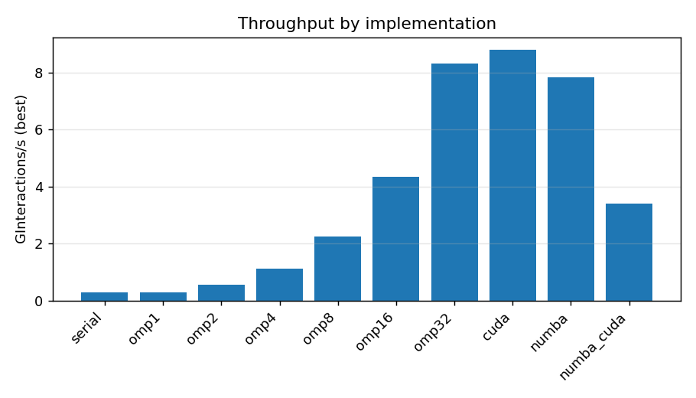
CPU vs GPU at the official size
Implementation | GInt/s | Speed-up vs serial
serial | 0.283 | 1×
OpenMP-32 | 8.31 | 29.2×
CUDA A100 | 8.80 | 31.1×
Numba CPU | 7.83 | 27.5×
Numba CUDA | 3.42 | 11.9×
At N=2231 the A100 barely beats 32 CPU cores — why?
ncu: grid = 18 blocks on 108 SMs → occupancy 6.1%, SM throughput 4.5% — the GPU is ~95% idle.
13 / 19
Notes:
Key teaching moment: the official problem is too small for the GPU. N=2231 sits almost exactly at the CPU/GPU crossover. Numba-CPU at 27.5× ≈ hand-written OpenMP is remarkable for Python; Numba-CUDA pays kernel-launch + codegen overheads at tiny N.

Slide 14
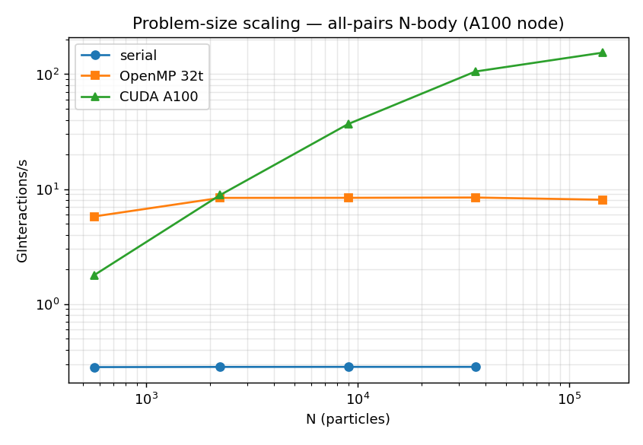
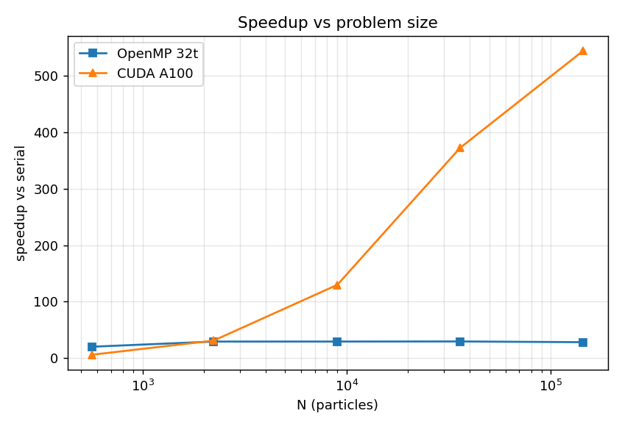
Problem-size scaling: the GPU needs work
N | serial GInt/s | OpenMP-32 | CUDA | CUDA speed-up
567 | 0.282 | 5.78 | 1.78 | 6.3×
2,231 | 0.283 | 8.37 | 8.86 | 31× ← crossover
8,996 | 0.283 | 8.39 | 36.8 | 130×
35,919 | 0.283 | 8.44 | 105.4 | 372×
143,768 | (0.283) | 8.07 | 153.9 | 543×
14 / 19
Notes:
Serial is size-independent (0.283 flat); OpenMP saturates at ~8.4 GInt/s (~29×); the A100 climbs with occupancy and is 19× faster than the full CPU socket at N=144k. XXL serial is extrapolated from the flat rate (stated in the report). Different step counts per size are fine — GInt/s is a rate.

Slide 15
GPU profiling: nsys + ncu (roofline view)
nsys: computeForcesKernel = 99.1% of GPU time; memcpy total 0.19 ms → streams/overlap would buy nothing.
ncu @ XL: SM throughput 53.5%, DRAM ≈ 0% → purely compute-bound (all particle data lives in L1/L2; effectively infinite arithmetic intensity).
Hottest pipe: FP64 at 63%; achieved ≈ 37% of A100 FP64 peak.
ncu optimizer: fusing to FMA would gain ≈ +31% — declined: non-contracted arithmetic is what makes the GPU bitwise-identical to serial.
Occupancy M → XL: 6.1% → 13.8%; waves/SM 0.02 → 0.25 (explains S13/S14).
15 / 19
Notes:
The profiler reports an estimated +31% FMA optimization opportunity; we decline it deliberately to preserve bitwise agreement. On the memory/compute roofline the kernel sits under the compute roof, far from the memory roof.

Slide 16
MPI: distributed memory across nodes
Block decomposition of the outer index; each rank computes its slice against ALL positions; per-step MPI_Allgatherv (positions only).
Preserves the inner sum order → bitwise identical to serial, 1 → 128 ranks.
Same 32-way node: MPI 27.5× (86%) vs OpenMP 29.2× (91%) — the gap IS the Allgatherv that shared memory avoids → argument for hybrid MPI+OpenMP.
Communication cost isolated: 32 ranks packed on 1 node = 27.5× vs spread over 4 nodes = 19.2× (same ranks, same N).
16 / 19
Notes:
The course's MPI day applied. The 1-node-vs-4-node pair at fixed rank count is the cleanest single number for "what does the network cost".

Slide 17
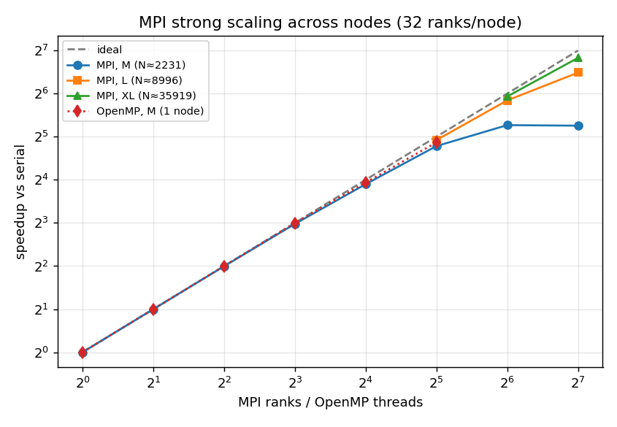
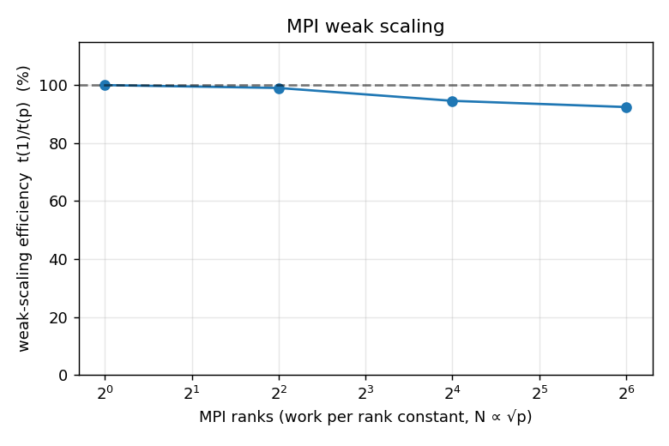
MPI scaling
Strong-scaling speed-up @ ranks
N | 32 | 64 | 128
2,231 (M) | 27.5× (1 node) | 38.6× | 38.2× — saturated
8,996 (L) | 30.3× | 57.4× | 89.7× (70%)
35,919 (XL) | — | 61.1× (95%) | 113.7× (89%)
Weak scaling (work/rank const): p=4 → 99%, p=16 → 95%, p=64 → 92%.
At N=2231, 128 ranks ≈ 17 particles/rank → communication-bound, speedup saturates.
Scaling ceiling moves with problem size — the MPI twin of the GPU occupancy story.
17 / 19
Notes:
32/64/128-rank multi-size runs used a 4-node allocation with ranks spread across nodes (Dragonfly+). Same unifying lesson as S14: performance = keeping every processing element fed, whether SMs or ranks.

Slide 18
Conclusions
Seven runnable programs: six produce bitwise-identical state arrays; Numba-CUDA passes the 2·10⁻³ course gate.
One design rule made that possible: preserve the inner sum order and refuse contraction—an estimated +31% FMA opportunity knowingly declined.
Performance: 29.2× (OpenMP, 32 cores) · 31→543× (CUDA, N-dependent) · 113.7× (MPI, 128 ranks) · Numba within 6% of hand-written OpenMP.
One lesson everywhere: speedup = work per processing element (Amdahl ceiling, GPU occupancy, MPI ranks — the same curve three times).
18 / 19
Notes:
Close with the FMA anecdote callback: correctness in parallel computing is a design choice, not luck — and it is measurable.

Slide 19
Backup: artifacts
Repo: github.com/Leonard013/polimi-phd-school → FinalProjects/Particles.
Raw evidence: logs/*.out (SLURM jobs), reports/validation.log (15-pair matrix), reports/*.csv (every measurement), reports/ncu/*.ncu-rep, reports/nsys/*.
Run: scripts/submit_pipeline.sh; validate: run_validate.sh; reports: tools/parse_*.py.
Run environment details: LEONARDO_RUN_STATUS.md.
19 / 19
Notes:
Everything in the talk is regenerable from the committed logs by tools/parse_benchmarks.py, tools/parse_scaling.py, tools/parse_mpi.py, tools/amdahl_fit.py.

