Slide 1
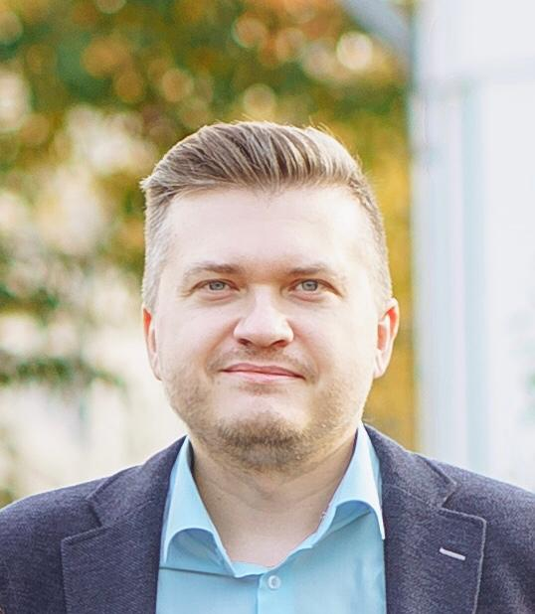
PROFILE
My ideal job is working with data. For me, it's a creative process. When I lacked Excel's capabilities to solve problems, I started looking for something different... better... more perfect… I signed up for a DATA SCIENTIST course.
I wrote 4 scripts (mini-programs) and implemented them in production in two weeks, after Python course. After I have completed the PostgreSQL course, I wrote sql-script and mined Data, that has been entered manually from paper within 6 years. Using statistical tools, I study the nature of processes, find patterns and turn weak points into points of growth.
I know how to turn raw data into useful information for making strategic decisions.
LEONARD CHEREPANOV
DATA SCIENTIST
JOB EXPERIENCE
HARD SKILLS:
BIG DATA ANALYSIS
STATISTICAL EVOLUATION
Python
pandas
numpy
seaborn
matplotlib
scipy
sklearn
etc.
PostgreSQL
CTE
views
window functions
subqueries
joins
etc.
Excel (pivot, vlookup)
JMP (Tableau, P BI analog)
JAN 2017- PRESENT
ZAO Berlin-Pharma (pharm. production
Mezym, Siofor and etc.)
Production Support Specialist
Track&Trace administrator: Werum, TraceLink
Python scripts for optimizing processes
Data mining - SQL queries
Statistical analysis SAS JMP
Certification Specialist
Collecting dossier and batch release
Statistical analysis of produced batches in SAS JMP (development and implementation of the evaluation form)
MAR 2011- JAN 2017
KALUGAPHARMACY (pharmacy retail)
CAREER
pharmacist
marketer
Head of sales department (merchandiser, Data analyst - Excel, 3D designer - SketchUp)
before
LLC PHARMASOUZ (pharmacy retail)
CJSC ERKAPHARM (pharmacy retail)
Moscow
pharmacist
+ 7 903 817 49 51 leonardcherepanov@gmail.com

Slide 2

EDUCATION
NOV 2020- PRESENT
NETOLOGY – DATA SCIENTIST
FINISHED
Data Mining
Data Analysis
Statistical Evoluation
Data Visualisation
Building a forecasting model
Postgre SQL, MongoDB
IN PROCESS
Math Analysis, Probability Theory
Data project management
Computer Vision
Neuronet
Natural Language Processing
LEONARD CHEREPANOV
before
NORTH-WEST ACADEMY OF PUBLIC
ADMINISTRATION
(Finance and credit)
PHARMACEUTICAL COLLEGE
GYMNASIUM №24 Kaluga
(with in-depth study of English)
DATA SCIENTIST
PORTFOLIO
Python Graduate Work @
SQL Graduate Work @
JMP Statistical form @
(try several times, please, if doesn’t open)
SOFT SKILLS: Communication, Collaboration, Generating Hypothesis,
Creative Thinking,
Active Learning
ABOUT ME
36 years old
ENGLISH B1-B2
HOBBIES
Minimal practice in:
Tableau, Power BI
API REST
Interested in:
Hadoop, Hive, Spark
API SOAP
Google Tag Manager
Google Analytics
Yandex.Metrica
Futsal Composing Video Editor
There are several ways to solve any problem... let's look for the optimal one.
+ 7 903 817 49 51 leonardcherepanov@gmail.com

