Slide 1
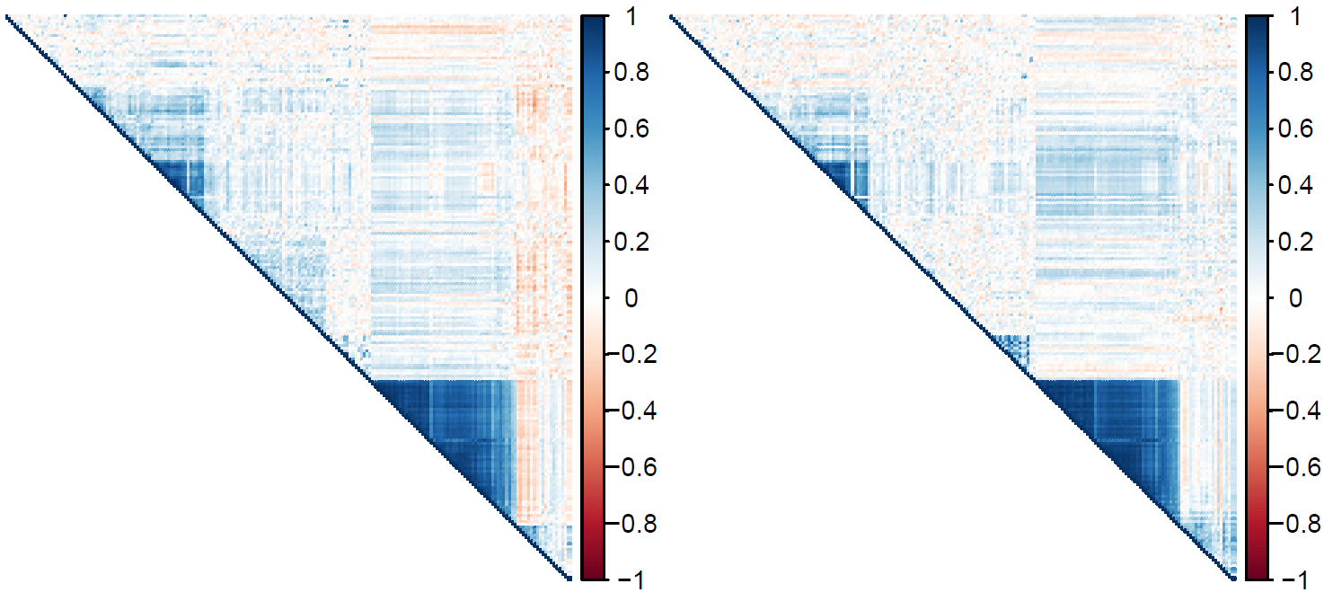
r = .75
Mothers
Children
Exon 1
Intron 1
Exon 2
Intron 2
Exon 3
Enhancer

