Slide 1
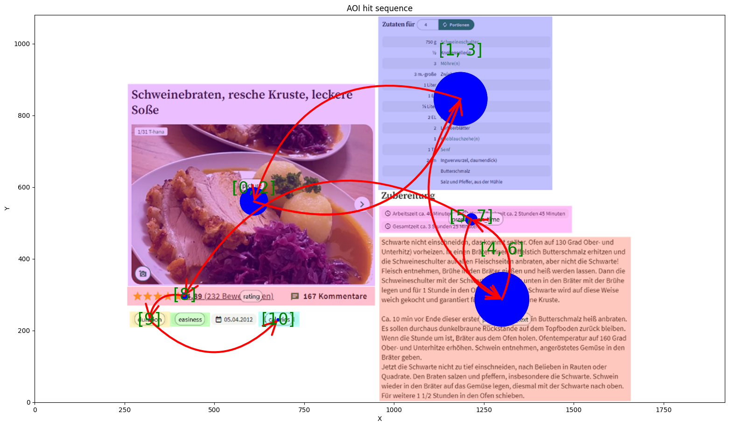
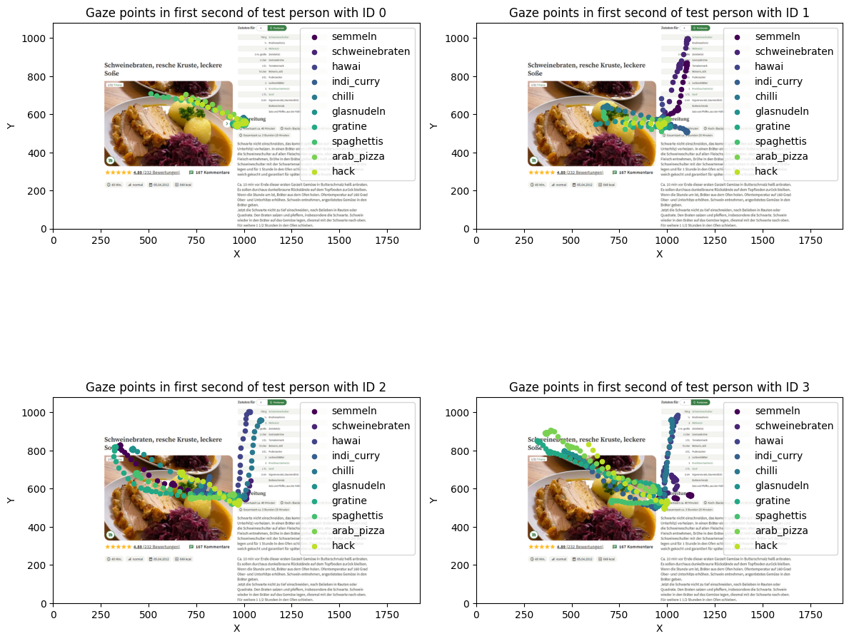
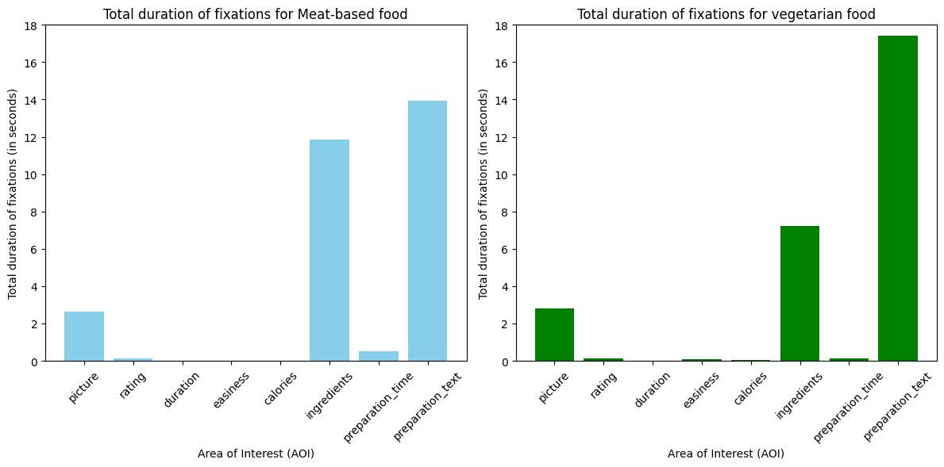
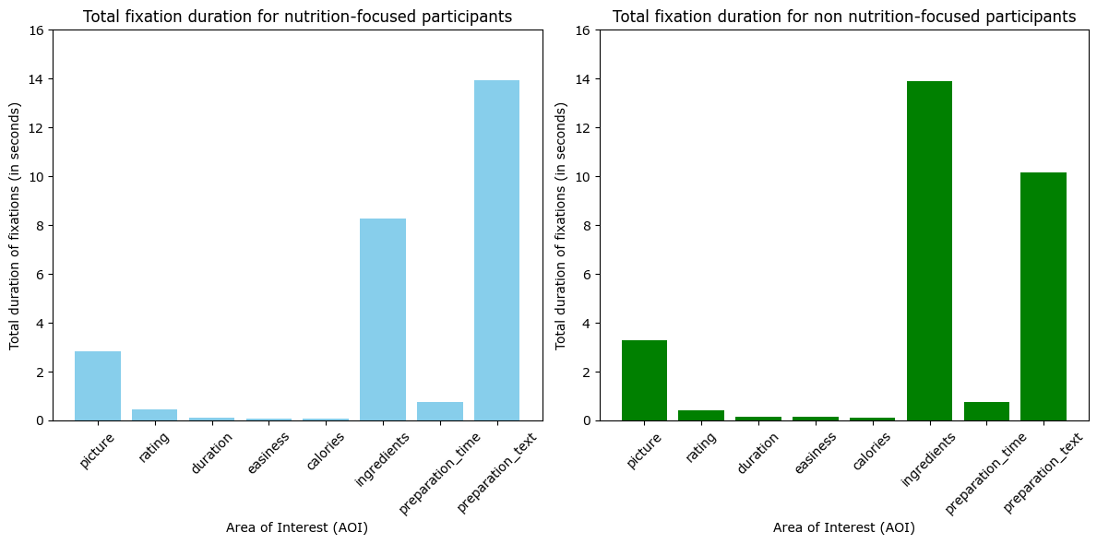
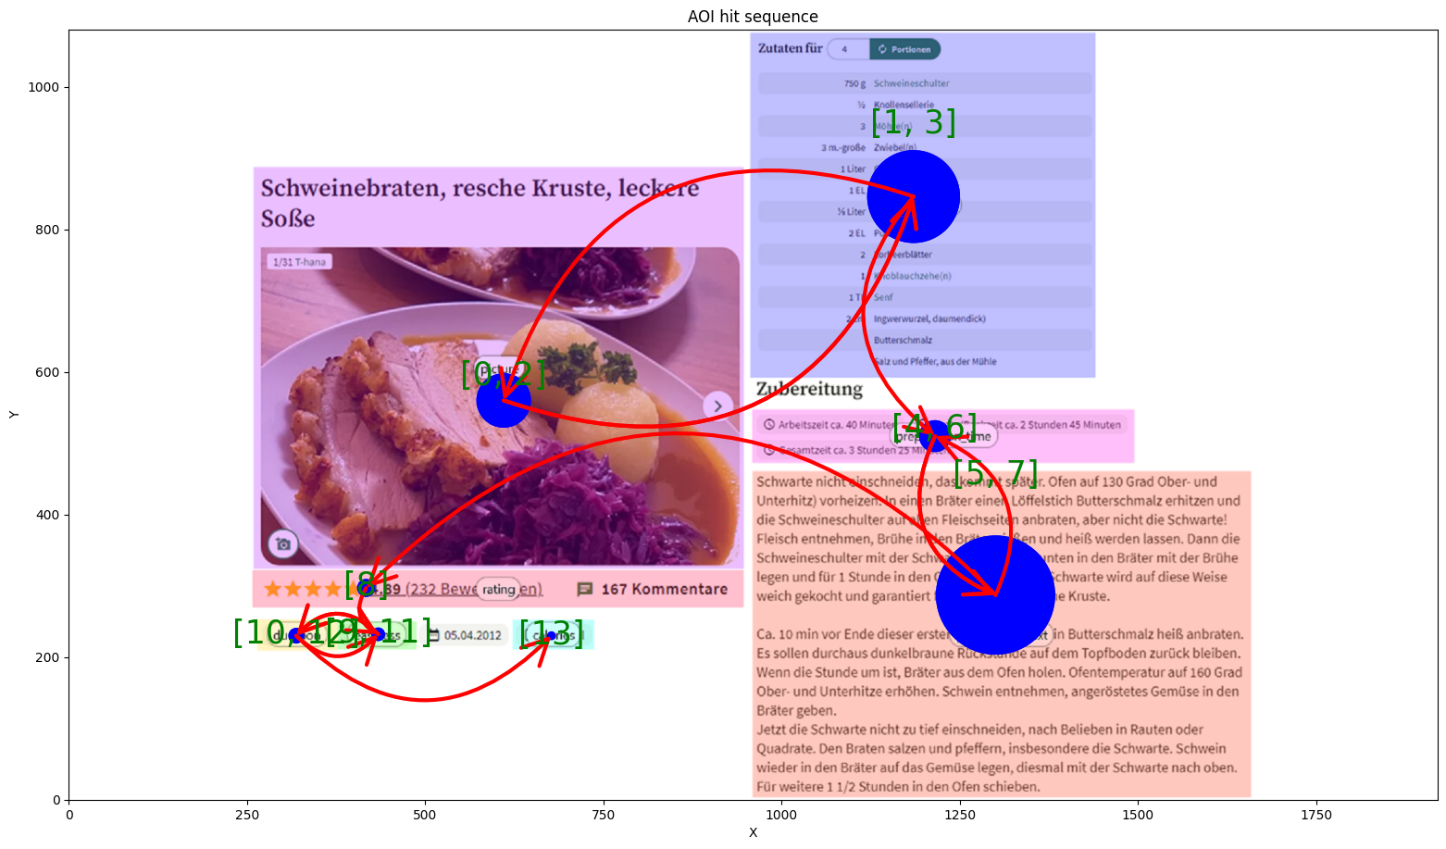
A Comprehensive Eye-Tracking Study on Reading Cooking Recipes
Leonard Kreil, Michael Graml
Motivation:
Discover how people's cooking skills, interest in healthy eating, and the way they look at recipe details are all connected. Our eye-tracking study dives into whether cooking experience influences how they read recipes, if curiosity about healthy eating affects attention to calories, and if people generally start by looking at the dish's picture.
Methodology:
Fifteen subjects engaged with 10 cooking recipes each, tracked by an eye tracker, followed by a post-session survey. Eye-tracking data was analyzed for gaze patterns, exploring correlations between cooking experience and AOI visiting sequences. The study was designed as a within subjects design.
Research Question: Does cooking experience affect how people follow the recipe steps?
Research Question: Do participants generally consider the image of a dish as the first visual anchor?
Research Question: Do vegetarians view non-vegetarian dishes differently than vegetarian dishes?
Research Question: Does the interest in healthy eating influence participants' attention to the specified calories (kcal) in cooking recipes?
skilled cook
differences in AOI fixation times
differences in AOI fixation times
less skilled cook
Hypothesis: Participants who frequently cook elaborate dishes consider elements of a cooking recipe in a different order compared to participants who rarely cook simple dishes.
Hypothesis: Within the first second, a participant always looks at the image of a cooking recipe.
Hypothesis: Vegetarian participants spend more time looking at the ingredient list of non-vegetarian dishes than those of vegetarian dishes.
Hypothesis: Nutrition-focused participants are expected to view the 'calories' AOI more than double the frequency of non Nutrition-focused participants.
Explanation: The Hypothesis is partially supported, because the overall AOI sequence shows only minor differences.
Explanation: The Hypothesis is not supported, because, in picture ID 1, the participant did not look at the image within the first second on the sheets displaying “semmeln” and “schweinebraten”.
Explanation: The Hypothesis is supported, because the vegetarian participants spend more time on the ingredient list of non-vegetarian dishes than on the ingredients list of vegetarian dishes.
Explanation: The Hypothesis is not supported, because participants interested in healthy eating did spend even less time on the “calories” AOI then the participants, who are not interested in healthy eating.
Conclusion and outlook:
The eye-tracking study explored how participants engage with cooking recipes. While cooking experience influenced the order of consideration, overall sequence differences were minor. Contrary to expectations, participants didn't consistently focus on recipe images within the first second. Vegetarians scrutinized non-vegetarian ingredients more, but interest in healthy eating didn't correlate with increased attention to calorie information. Moving forward, understanding these nuances could refine recipe design for diverse user preferences.
Code: https://gitlab.oth-regensburg.de/grm35372/set_eye_tracking_cooking_recipes

