Slide 1
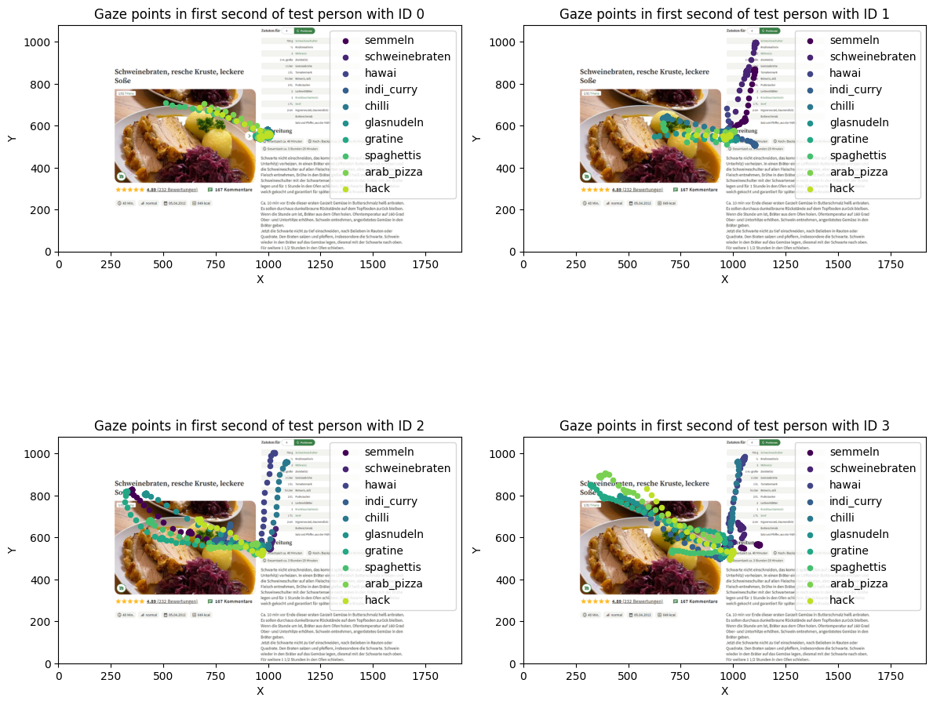
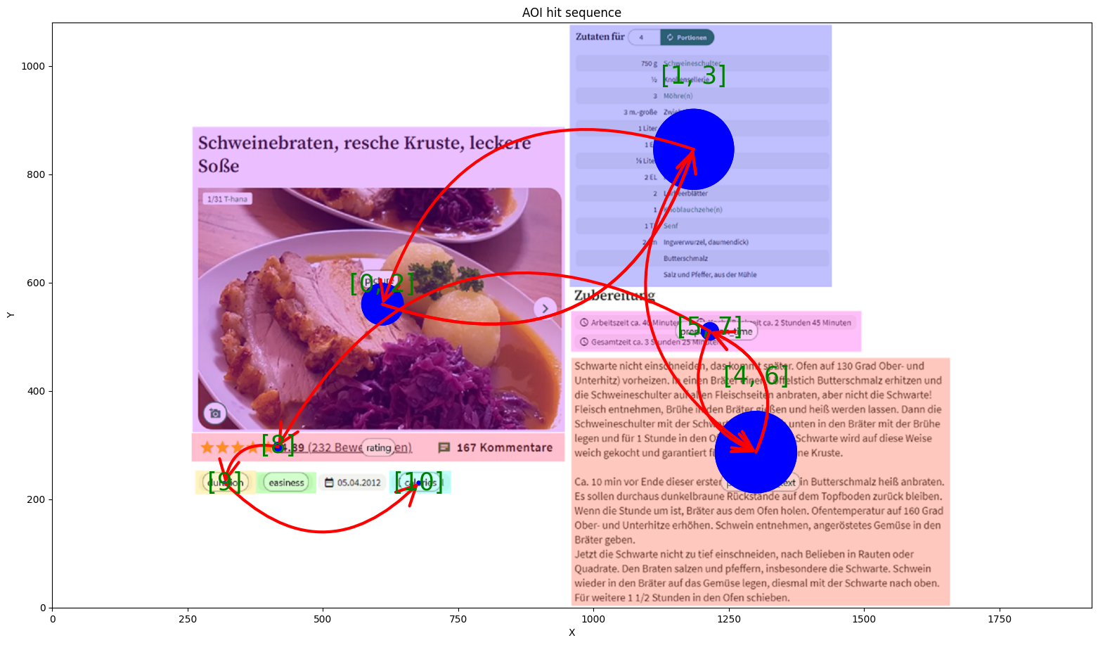
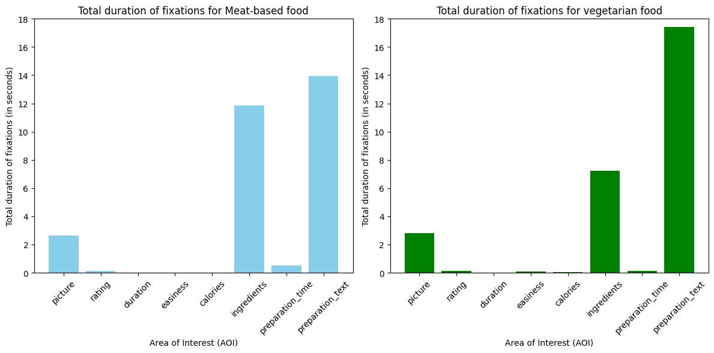
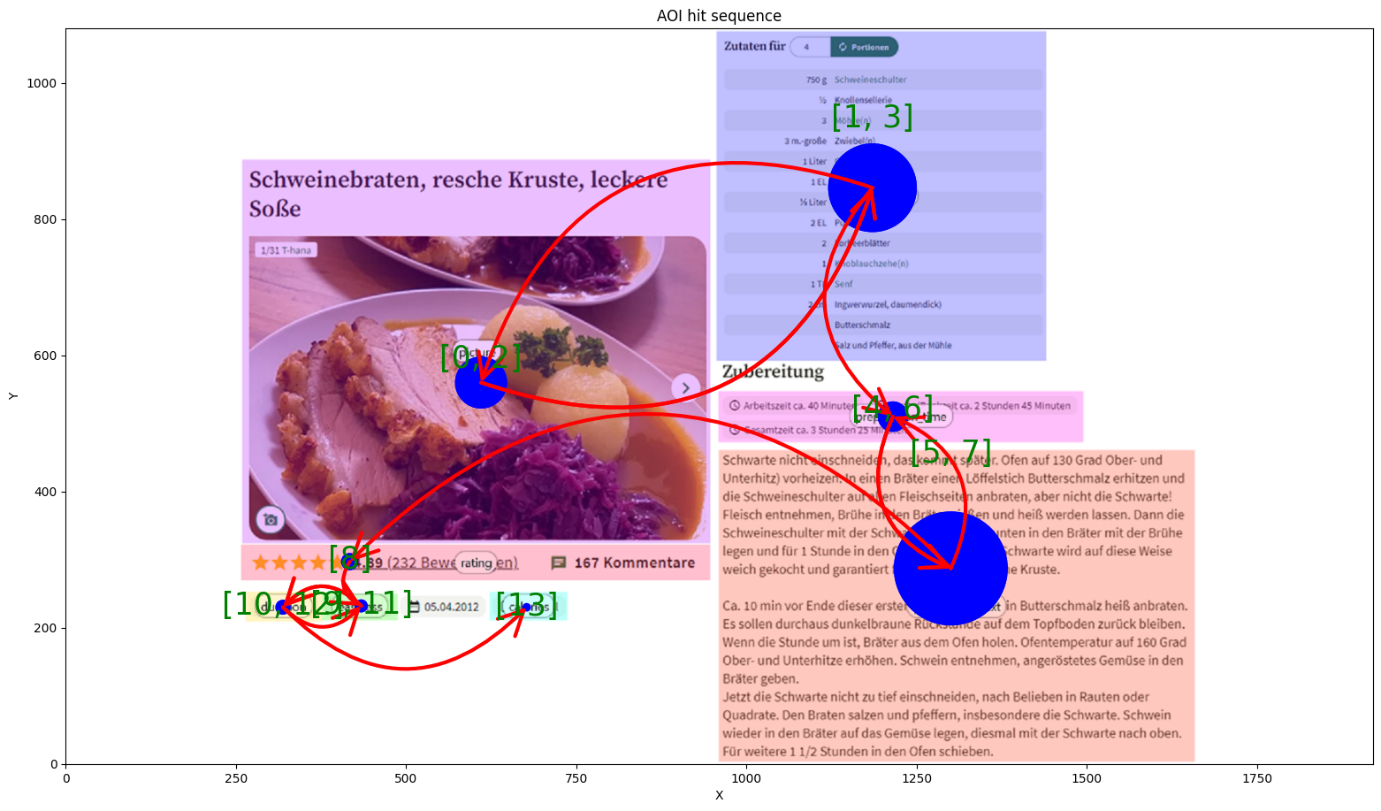
A Comprehensive Eye-Tracking Study on Reading Cooking Recipes
Leonard Kreil, Michael Graml
Motivation:
Discover how people's cooking skills, interest in healthy eating, and the way they look at recipe details are all connected. Our eye-tracking study dives into whether cooking experience influences how they read recipes, if curiosity about healthy eating affects attention to calories, and if people generally start by looking at the dish's picture.
Methodology:
Fifteen subjects engaged with 10 cooking recipes each, tracked by an eye tracker, followed by a post-session survey. Eye-tracking data was analyzed for gaze patterns, exploring correlations between cooking experience and AOI visiting sequences.
Research Question: Does cooking experience affect how people follow the recipe steps?
Research Question: Do participants generally consider the image of a dish as the first visual anchor?
Research Question: Do vegetarians view non-vegetarian dishes differently than vegetarian dishes?
skilled cook
differences in AOI fixation times
less skilled cook
Hypothesis: Participants who frequently cook elaborate dishes consider elements of a cooking recipe in a different order compared to participants who rarely cook simple dishes.
Hypothesis : Within the first second, a participant always looks at the image of a cooking recipe.
Hypothesis : Vegetarian participants exhibit different total AOI fixation times for vegetarian and non-vegetarian dishes.
Conclusion and outlook:
Cooking experience shapes how people follow recipe steps, with the dish image as the key focus. Vegetarians show distinct viewing patterns for non-vegetarian and vegetarian dishes, supporting our hypotheses. Future research could explore wider influences like cultural and nutritional factors and validate findings with larger samples. Understanding these nuances could improve cooking instructions for diverse culinary backgrounds and diets.

