Slide 1
The Mapper algorithm
Mapper is a tool used to summarize vital information about datasets in high-dimension by partial clustering and visualize the outcome in low dimension using MDS.
It is a TDA data visualization tool that reflects similarity.
Overall Aims:
the qualitative analysis,
Simplification
visualization of high dimensional data sets

Slide 2
Mapper algorithm
Input:
point cloud samples
filter functions
covering of a metric space
clustering algorithm
other parameters.
Output:
Graph (or simplicial complex) which is thought to capture aspects of the topology of the point cloud that reflect level of similarity between data records.

Slide 3
The choice of f
Projections onto Coordinate Axes
Distance from a Reference Point
Principal Component Analysis (PCA)
T-distributed Stochastic Neighbour Embedding (t-SNE) or UMAP
Density Functions
Geodesic Distance
Height Function
Eccentricity
Eigenfunctions of the Laplacian
Custom Functions

Slide 4
Choosing the Right Filter Function
Purpose of Analysis: The choice should align with what you want to discover in the data. For example, if you’re interested in clusters, a density-based filter might be appropriate.
Dimensionality: If the data is very high-dimensional, PCA, t-SNE, or UMAP might be good starting points.
Data Structure: Consider what the underlying structure of the data might be. If the data is expected to have a manifold structure, geodesic distances or eigenfunctions might be suitable.

Slide 5
Cover U
Type of the cover (open or closed intervals)
Number of intervals (resolution)
Amount of overlap between intervals
Shape and structure of intervals
Dimension of the cover (depending on filter function)
***Choice of Clustering Algorithm and Its Parameters

Slide 6
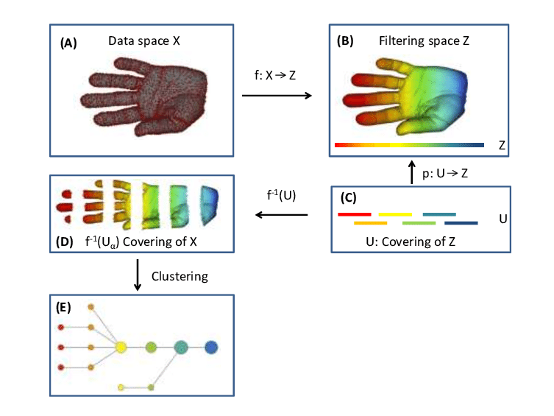

Slide 7

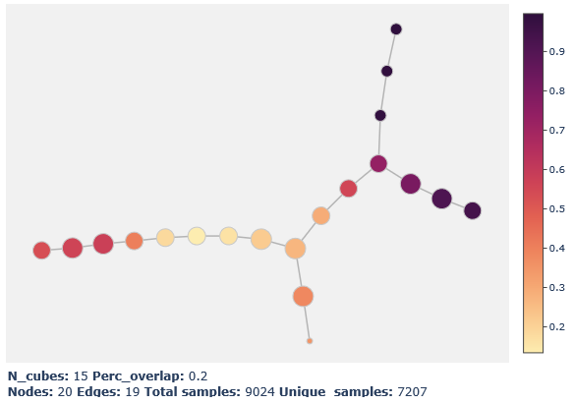
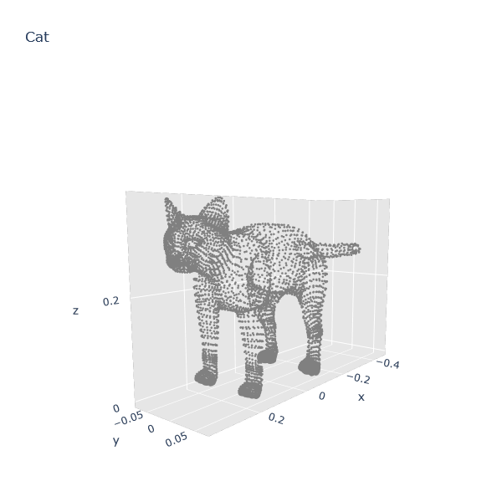
Example:
danifold.net/mapper/index.html

Slide 8
AlexNet – 1st CL (individual filters)

Slide 9
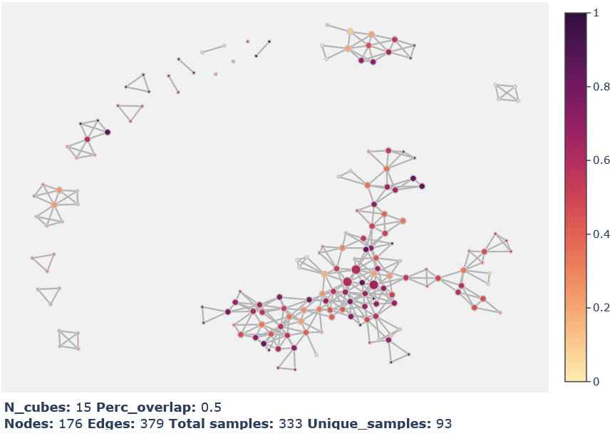
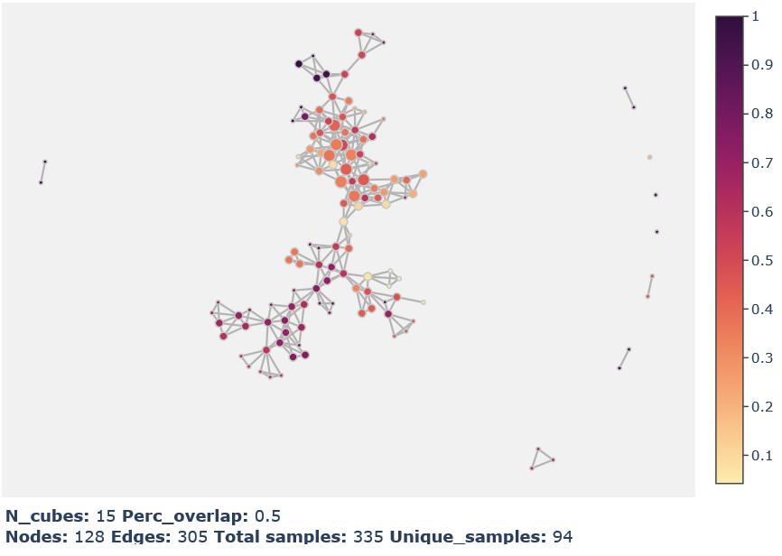
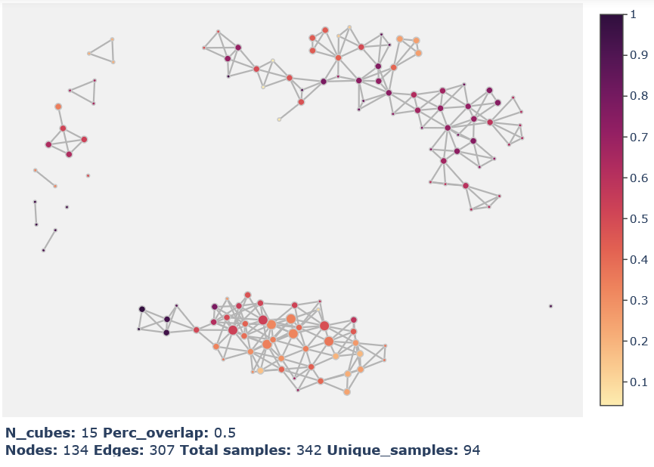
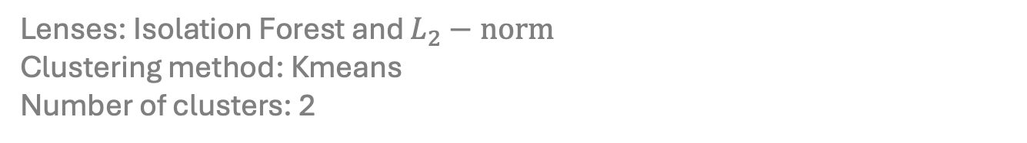
Mapper clustering of RGFs:
Lenses: Isolation Forest and $L_{2}−norm$
Clustering method: Kmeans
Number of clusters: 2
Initialized RGFs
Pretrained filters
Transfer learning filters

Slide 10
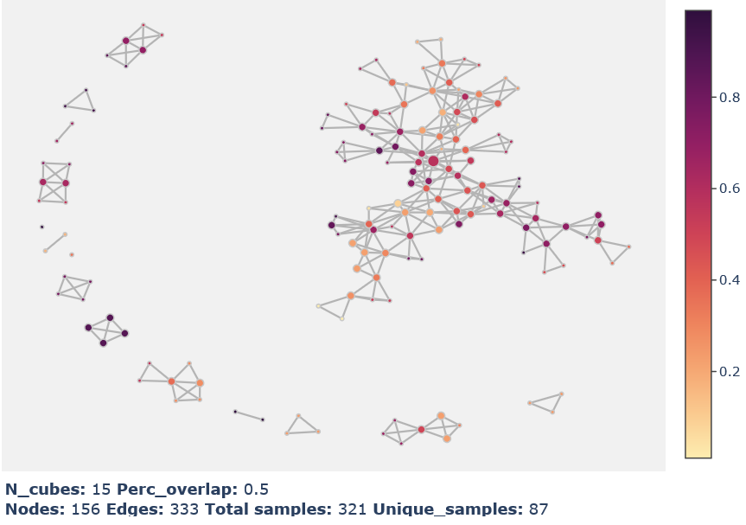
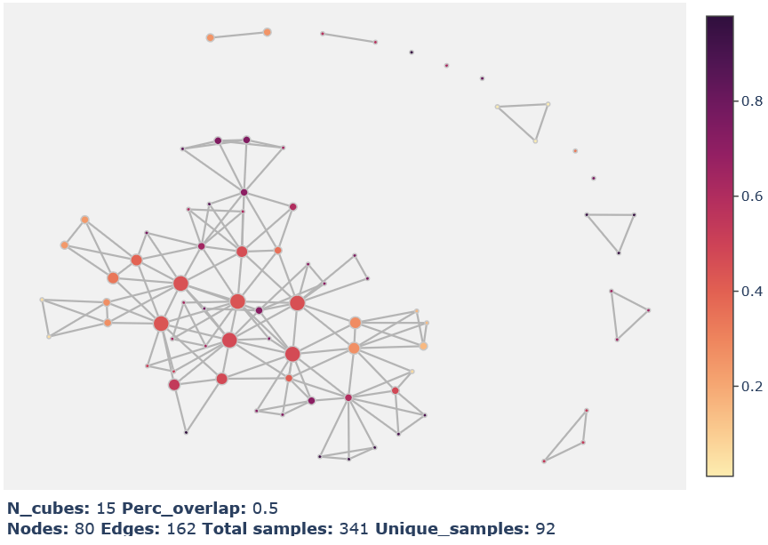
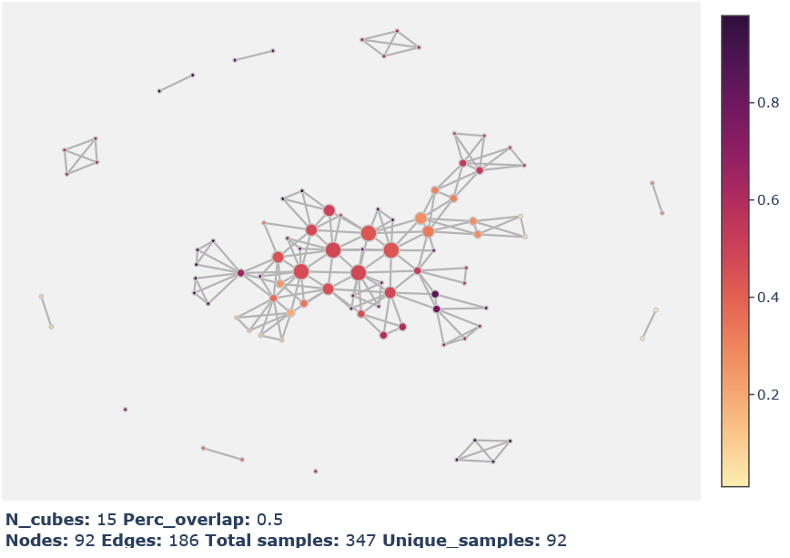
Mapper clustering of RGFs:
Lenses: PCA 1 and 2
Clustering method: Kmeans
Number of clusters: 2
Initialized RGFs
Pretrained filters
Transfer learning filters

Slide 11
Breast Cancer Wisconsin (Diagnostic) Data Set and Mapper
https://archive.ics.uci.edu/ml/datasets/Breast+Cancer+Wisconsin+(Diagnostic)

Slide 12
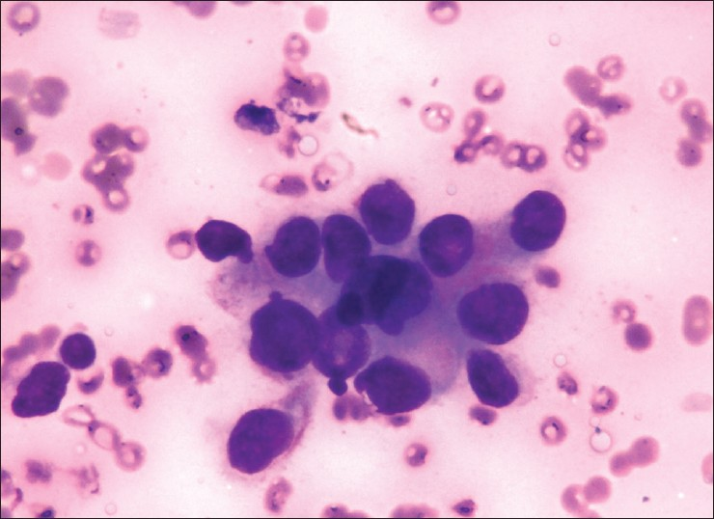
Digitized image of a fine needle aspiration (FNA) of a breast mass
Microphotograph of carcinoma breast showing pleomorphic nuclei and nuclear indentations (concave points) (Leishman stain, x400)
http://www.ijabmr.org/viewimage.asp?img=IntJAppBasicMedRes_2013_3_1_22_112237_u7.jpg

Slide 13
Attribute Information:
1) ID number
2) Diagnosis (M = malignant, B = benign)
Ten real-valued features are computed for each cell nucleus:
a) radius (mean of distances from center to points on the perimeter)
b) texture (standard deviation of gray-scale values)
c) perimeter
d) area
e) smoothness (local variation in radius lengths)
f) compactness (perimeter^2 / area - 1.0)
g) concavity (severity of concave portions of the contour)
h) concave points (number of concave portions of the contour)
i) symmetry
j) fractal dimension ("coastline approximation" - 1)

Slide 14
id
diagnosis
radius_mean
texture_mean
perimeter_mean
area_mean
smoothness_mean
compactness_mean
concavity_mean
concave points_mean
symmetry_mean
fractal_dimension_mean
radius_se
texture_se
perimeter_se
area_se
smoothness_se
compactness_se
concavity_se
concave points_se
symmetry_se
fractal_dimension_se
radius_worst
texture_worst
perimeter_worst
area_worst
smoothness_worst
compactness_worst
concavity_worst
concave points_worst
symmetry_worst
fractal_dimension_worst

Slide 15
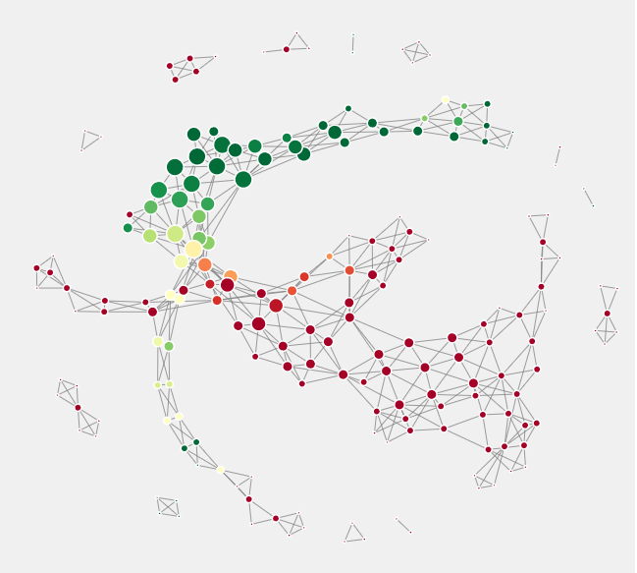
All attributes.

Slide 16
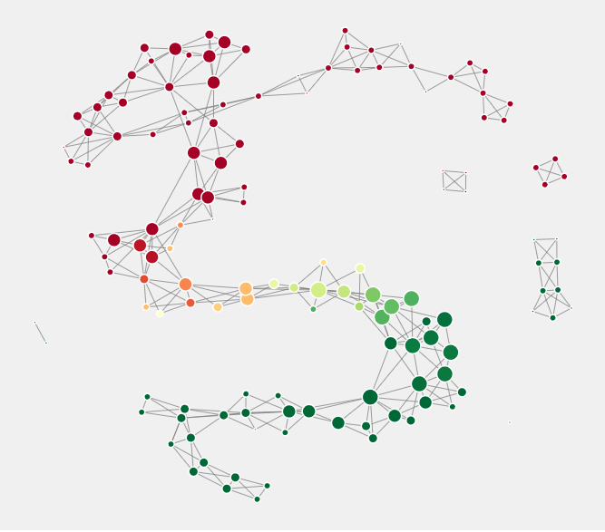
Top 1
Attribute no. : 23

Slide 17
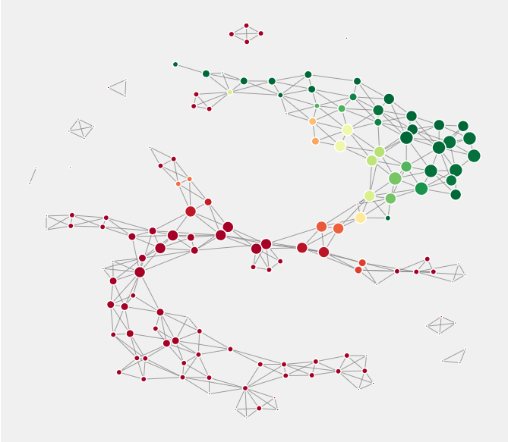
Top 5
Attribute no. : 23, 26, 25, 30, 10

Slide 18
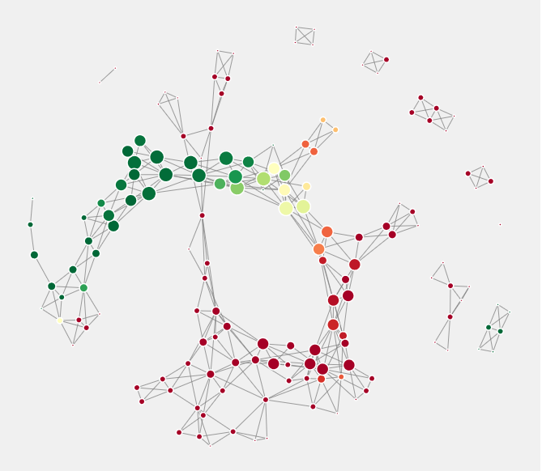
Top 10
Attribute no. : 23,26,25,30,10,6,3,5,9,16

Slide 19
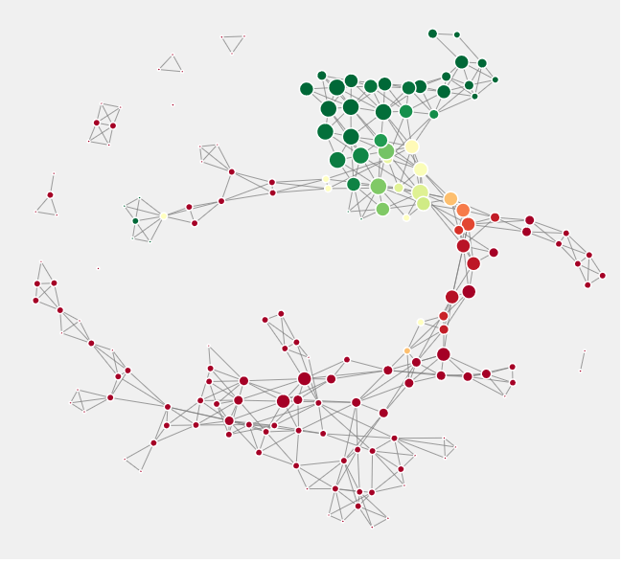
Top 15
Attribute no. : 23,26,25,30,10,6,3,5,9,16,29,13,15,28,8

Slide 20
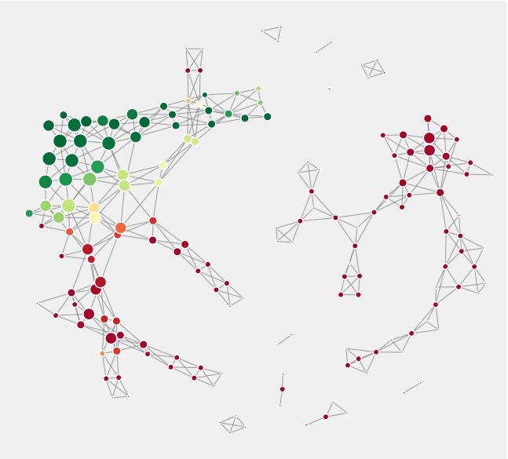
Top 20
Attribute no. : 23,26,25,30,10,6,3,5,9,16,29,13,15,28,8,4,20,31,19,24

Slide 21
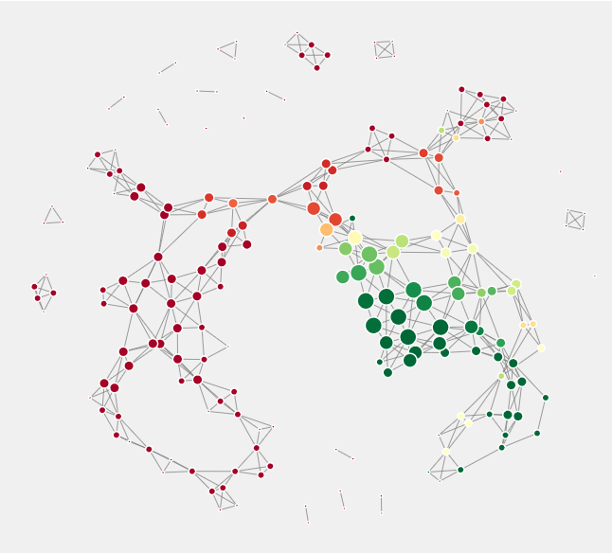
Middle 20
Attribute no. : 6,3,5,9,16,29,13,15,28,8,4,20,31,19,24,27,32,18,21,7

Slide 22
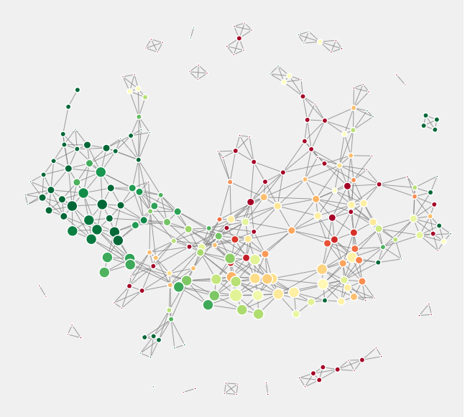
Bottom 20
Attribute no. : 29,13,15,28,8,4,20,31,19,24,27,32,18,21,7,11,22,17,14,12

Slide 23
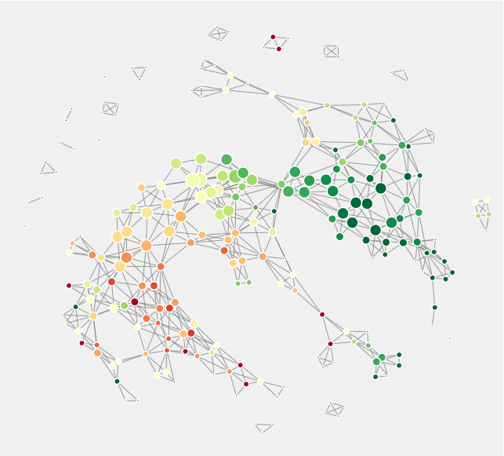
Bottom 15
Attribute no. : 4,20,31,19,24,27,32,18,21,7,11,22,17,14,12

Slide 24
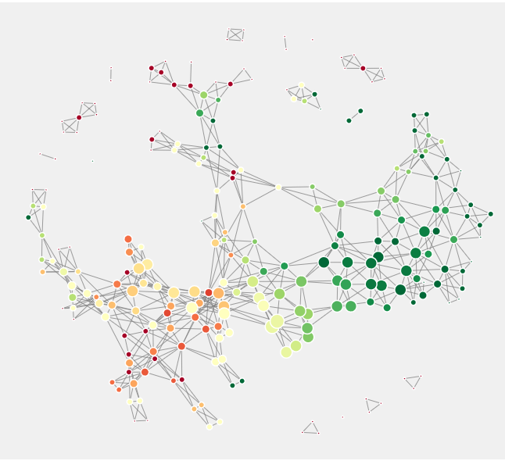
Bottom 10
Attribute no. : 4,20,31,19,24,27,32,18,21,7

Slide 25
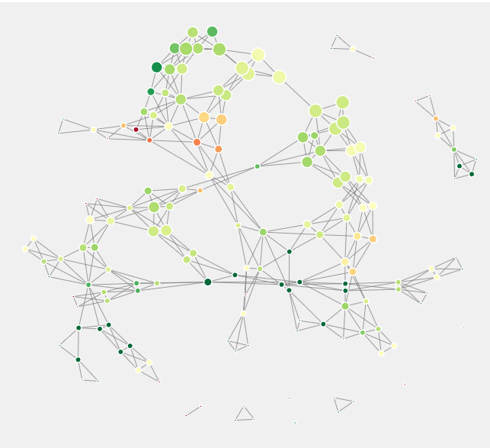
Bottom 5
Attribute no. : 11,22,17,14,12

Slide 26
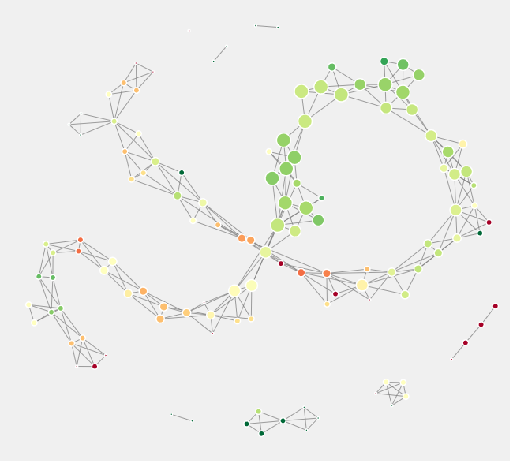
Bottom 1
Attribute no. : 12

