Slide 1
-0.6
-0.1
-0.3
0.1
-0.1
-0.3
-0.1
-0.1
0.3
0.3
0.3
1
0.1
0.6
-0.1
0.3
0.3
0.1
0.3
-0.6
0.3
-0.1
0.3
0.3
0.1
0.6
-0.6
0.6
-0.1
0.3
0.3
0.3
0.3
-0.3
0.3
-0.1
0.3
0.3
0.1
-0.1
0.1
-0.1
-0.1
0.3
0.3
0.3
0.3
0.3
0.3

Slide 2
0.3
0.3
1
0.6
0.3
0.3
0.6
0.6
0.3
0.3
0.3
0.3
0.3
0.3
0.3
0.3

Slide 3
0.3
1
0.3
0.3

Slide 4
0
0
0
0.1
0
0
0
0
0.3
0.3
0.3
1
0.1
0.6
0
0.3
0.3
0.1
0.3
0
0.3
0
0.3
0.3
0.1
0.6
0
0.6
0
0.3
0.3
0.3
0.3
0
0.3
0
0.3
0.3
0.1
0
0.1
0
0
0.3
0.3
0.3
0.3
0.3
0.3

Slide 5
0.3
0.3
1
1
0.3
0.3
0.3
0.3
1
0.3
0.3
1
0.3
1
0.3
1

Slide 6
NEU

Slide 7
0.33
0.33
0.33
1
0.11
0.33
0.33
0.11
0.33
-0.77
0.33
0.33
0.11
0.55
-0.33
0.33
0.33
0.33
0.33
-0.11
0.33
0.33
0.11
0.11
-0.11

Slide 8
0.33
0.33
0.33
1
0.11
0.33
0.33
0.11
0.33
0
0.33
0.33
0.11
0.55
0
0.33
0.33
0.33
0.33
0
0.33
0.33
0.11
0.11
0

Slide 9
1
0.11
0.33
0.33
0.55
0
0.33
0.11
0

Slide 10
1
0.11
0.33
0

Slide 11
1
1
0.11
0.11
0.33
0.33
0
0
1
0.33
0.11
1
0
1
0.33
1

Slide 12
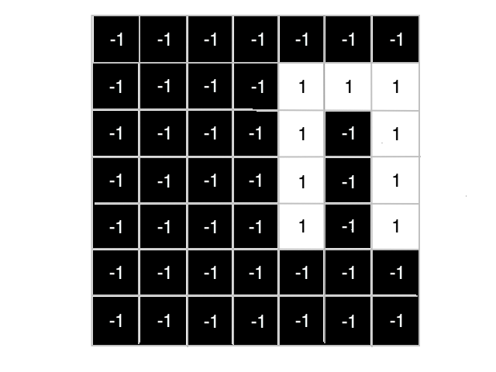
Classification
Convolution Layer
Activation Function
0
Fully Connected Layer
Pooling Layer

Slide 13
