Slide 1
Train and Deploy models with Azure AUTOML
Leonard Püttmann
Data Scientist at Kern AI

Slide 2
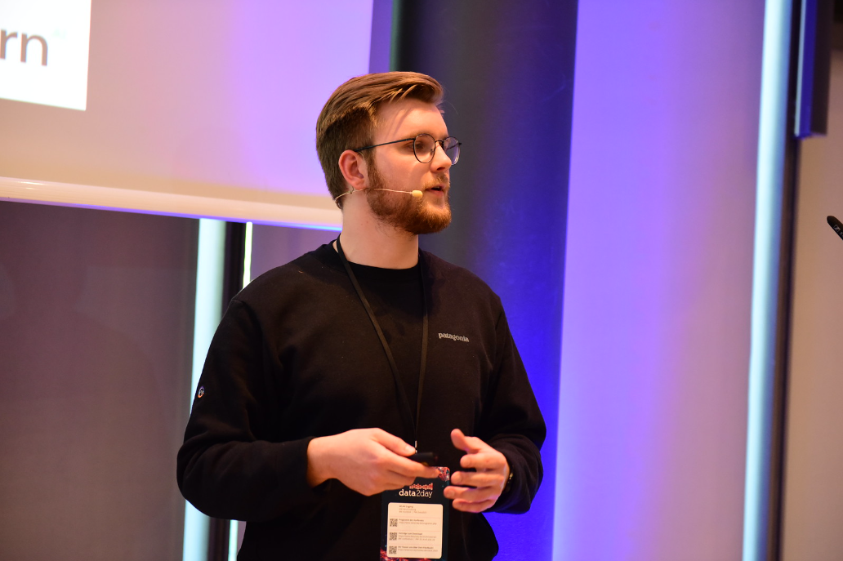





About me
Background in economics
Data Scientist at Kern AI
Mainly working with NLP, big interest in cloud computing
Leonard Püttmann
github.com/LeonardPuettmannKern

Slide 3

About me
DP-100 | Azure Data Scientist Associate certified

Slide 4
Slides & code

Slide 5
AGENDA
- What is AutoML & when to use it
- When to move AutoML to the cloud
- Azure ML basics
- Authentication & Python SDK
- Compute basics
- Training a model with AutoML for a Kaggle competition
- Inspecting the models
- Deploying & predicting with Azure (Auto)ML models

Slide 6
What is AutoMl?
And when should you use it?

Slide 7
INTRODUCTION
At Contoso, we empower organizations to foster collaborative thinking to further drive workplace innovation. By closing the loop and leveraging agile frameworks, we help business grow organically and foster a consumer-first mindset.​

Slide 8
What is AutoML
Automated machine learning is the process of automating the time-consuming, iterative tasks of machine learning model development.

Slide 9
What is AutoML
It allows data scientists, analysts, and developers to build ML models with high scale, efficiency, and productivity all while sustaining model quality.
What is automated ML? AutoML - Azure Machine Learning | Microsoft Learn

Slide 10
What is AutoML

Slide 11

What is AutoML
Professionals
Experienced developers

Slide 12
What is AutoML
Professionals
Experienced developers
Production

Slide 13
What is AutoML
Professionals
Experienced developers
Students
New developers
Production

Slide 14
What is AutoML
Professionals
Experienced developers
Students
New developers
Production
Testing/ Learning

Slide 15
Moving AutoML to the Cloud
Annual revenue growth

Slide 16
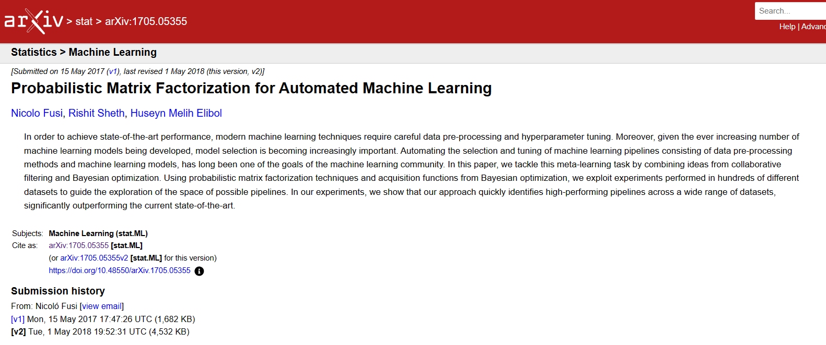
What is Azure AutoML
Highly scalable
Easy to use -> Azure ML Studio
Accurate for many use cases
[1705.05355] Probabilistic Matrix Factorization for Automated Machine Learning (arxiv.org)

Slide 17
Automl vs Hpo
Hyperparameter Optimization
Automated
Machine Learning
Improving and finding the best Hyperparameters of a single model type to improve performance
Feature engineering and transformation, finding the best type of model. Broader approach to the whole ML pipeline.

Slide 18
Title

Slide 19
Some Azure ML Basics
Authentication, Compute & more

Slide 20
Title

Slide 21
Training a Model
With Azure AutoML

Slide 22
Hands-on
Let’s switch to our Notebook and the Azure ML Studio! ☺

Slide 23
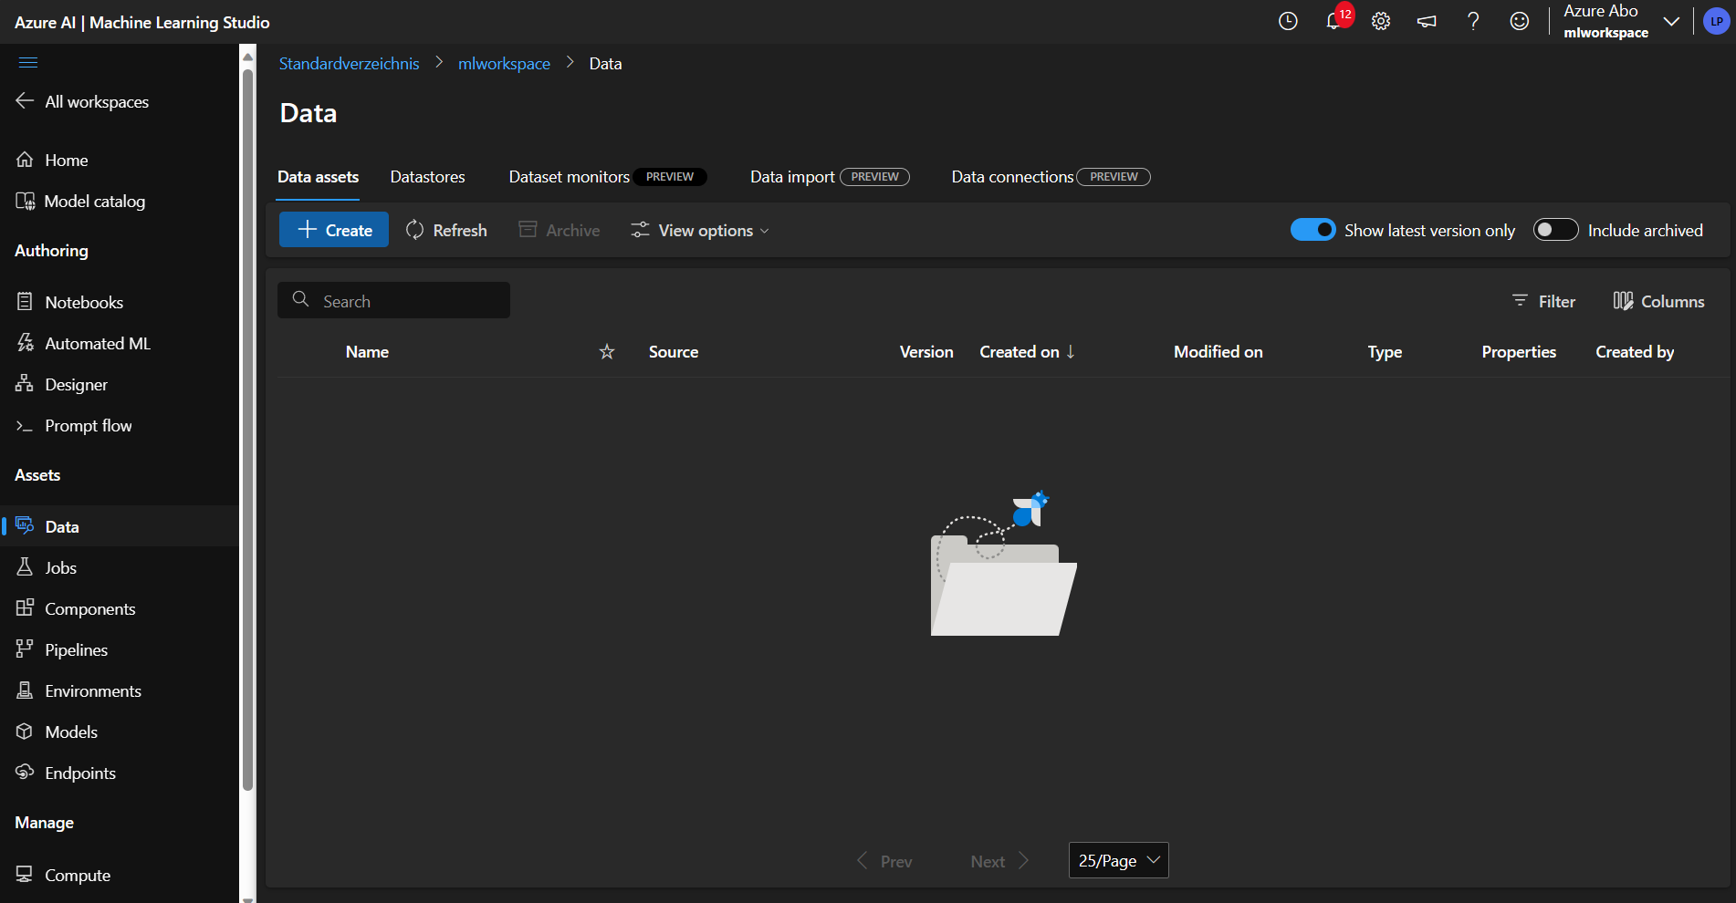
Creating a dataset

Slide 24
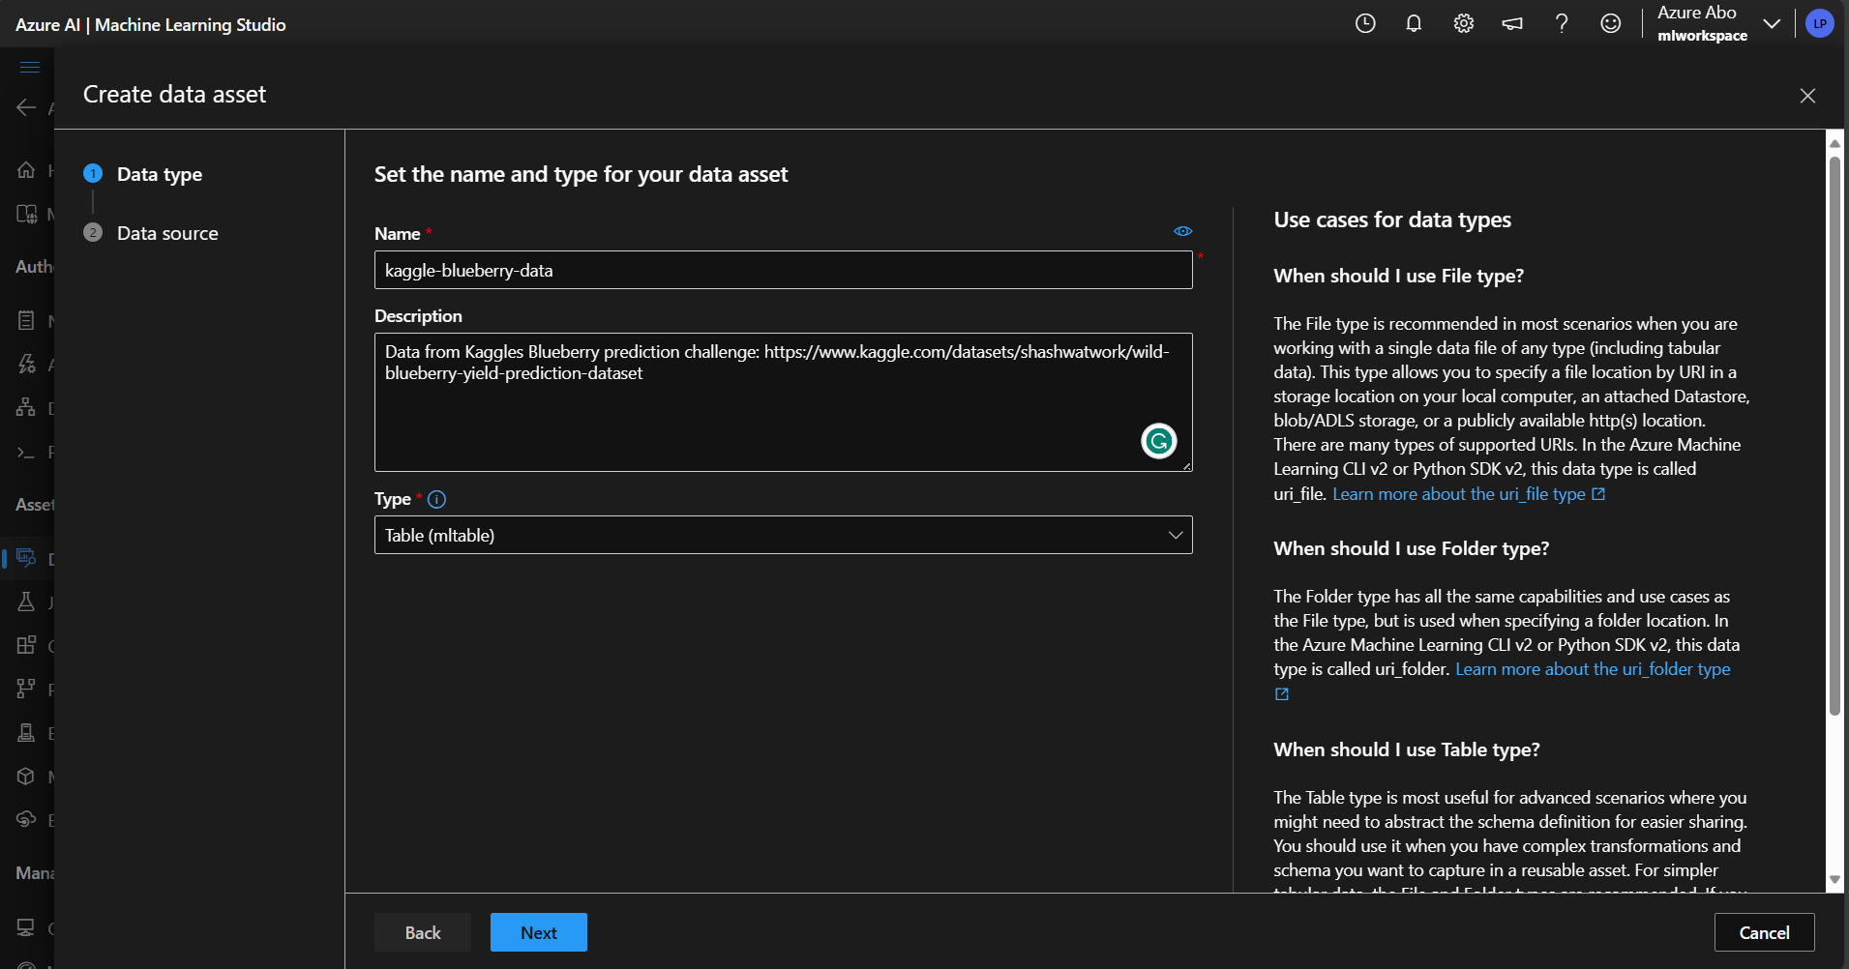
Creating a dataset

Slide 25
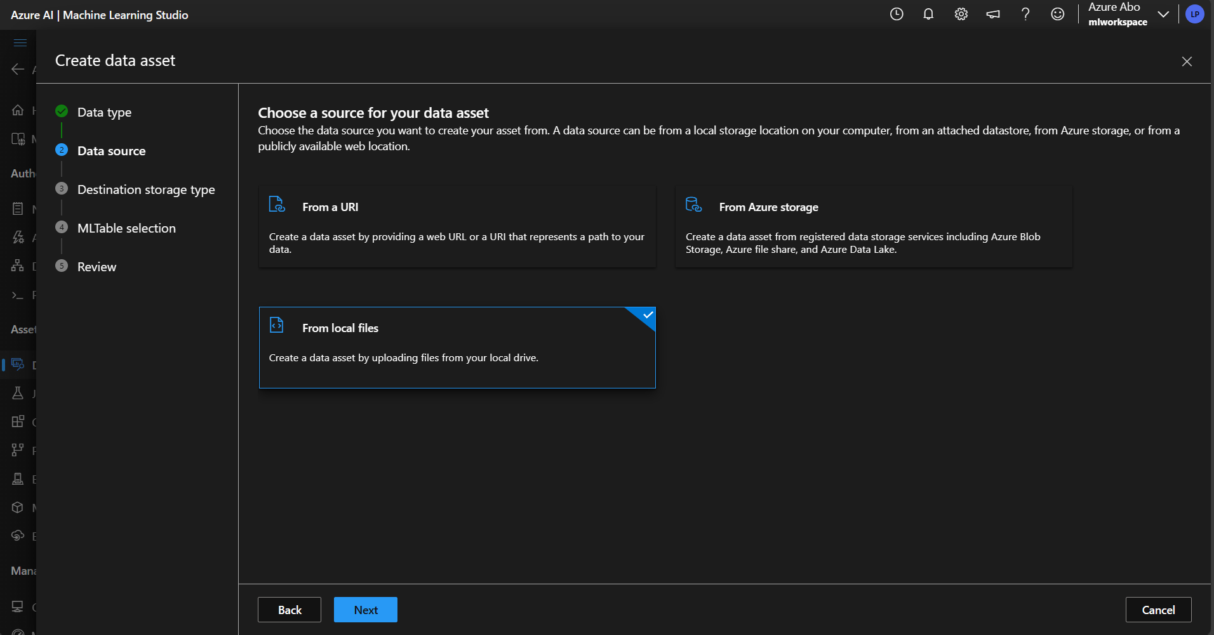
Creating a dataset

Slide 26
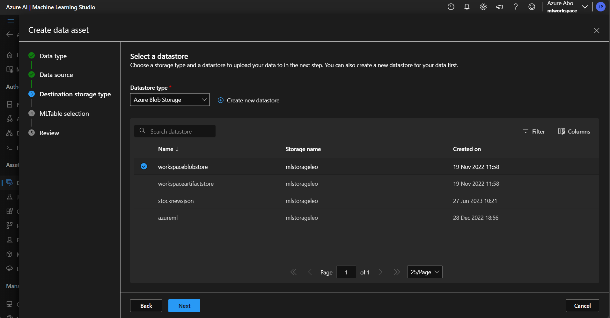
Creating a dataset

Slide 27
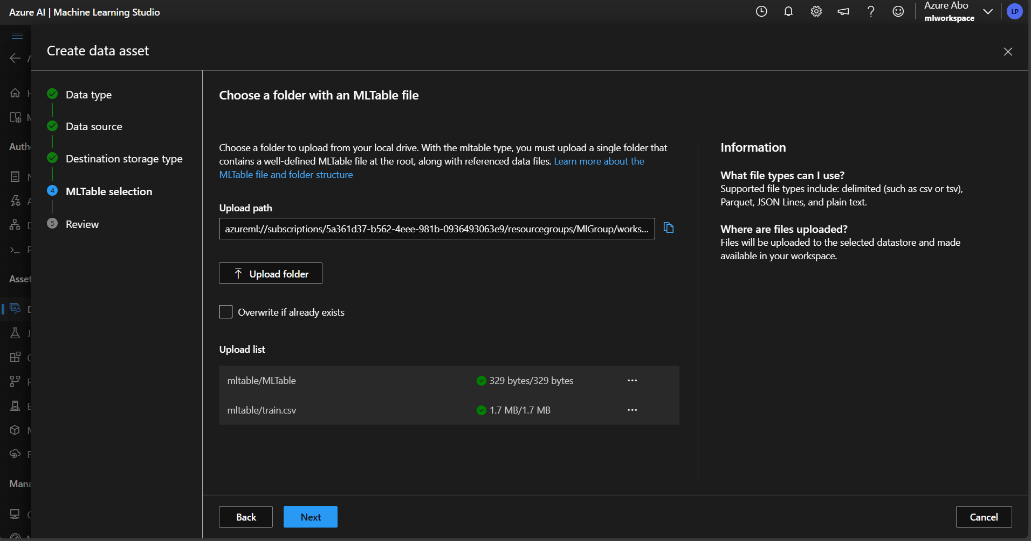
Creating a dataset

Slide 28
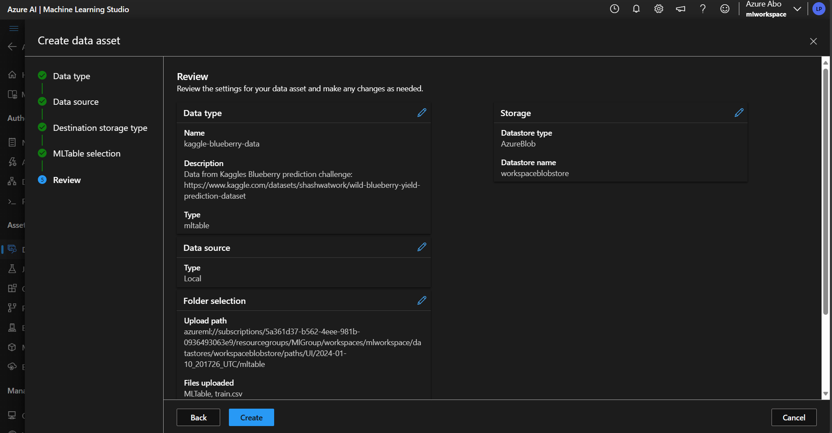
Creating a dataset

Slide 29
Hands-on

Slide 30
Hands-on

Slide 31
Hands-on

Slide 32
Hands-on

Slide 33
Hands-on

Slide 34
Hands-on

Slide 35
Hands-on

Slide 36
Some Azure ML Basics
Authentication, Compute & more

Slide 37
AREAS OF GROWTH
​ | CATEGORY 1 | CATEGORY 2 | CATEGORY 3​ | CATEGORY 4​
Q1 | 4.5​ | 2.3​ | 1.7​ | 5​.0
Q2 | 3.2​ | 5.1​ | 4.4​ | 3​.0
Q3 | 2.1​ | 1.7​ | 2.5​ | 2.8​
Q4 | 4.5​ | 2.2​ | 1.7​ | 7.0

Slide 38
BUSINESS OPPORTUNITIES ARE LIKE BUSES. THERE'S ALWAYS ANOTHER ONE COMING.​
Richard Branson

Slide 39




MEET OUR TEAM
TAKUMA HAYASHI
MIRJAM NILSSON
FLORA BERGGREN
RAJESH SANTOSHI
President
Chief Executive Officer
Chief Operations Officer
VP Marketing

Slide 40







MEET OUR TEAM
TAKUMA HAYASHI
MIRJAM NILSSON
RAJESH SANTOSHI
RAJESH SANTOSHI
President
Chief Executive Officer
Chief Operations Officer
VP Marketing
GRAHAM BARNES
ROWAN MURPHY
ELIZABETH MOORE
ROBIN KLINE
VP Product
SEO Strategist
Product Designer
Content Developer

Slide 41
PLAN FOR PRODUCT LAUNCH
Deploy strategic networks with compelling e-business needs
PLANNING
Synergize scalable e-commerce
MARKETING
Disseminate standardized metrics
DESIGN
Coordinate e-business applications
Foster holistically superior methodologies
LAUNCH
STRATEGY

Slide 42
TIMELINE
Q1
Synergize scalable e-commerce
Q2
Coordinate e-business applications
Q3
Deploy strategic networks with compelling e-business needs
Q4
Disseminate standardized metrics

Slide 43
AREAS OF FOCUS
B2B MARKET SCENARIOS
CLOUD-BASED OPPORTUNITIES
Develop winning strategies to keep ahead of the competition
​Capitalize on low-hanging fruit to identify a ballpark value
​Visualize customer directed convergence​
Iterative approaches to corporate strategy
​Establish a management framework from the inside​

Slide 44
HOW WE GET THERE
ROI
NICHE MARKETS
SUPPLY CHAINS
Envision multimedia-based expertise and cross-media growth strategies​
​Engage worldwide methodologies with web-enabled technologies​
Pursue scalable customer service through sustainable strategies​
Engage top-line web services with cutting-edge deliverables​​​
Cultivate one-to-one customer service with robust ideas​
Maximize timely deliverables for real-time schemas​

Slide 45
SUMMARY
At Contoso, we believe in giving 110%. By using our next-generation data architecture, we help organizations virtually manage agile workflows. We thrive because of our market knowledge and great team behind our product. As our CEO says, "Efficiencies will come from proactively transforming how we do business."​

Slide 46
THANK YOU
Leonard Püttmann
leonard.puettmann@kern.ai
kern.ai

