Slide 1
Train and Deploy models with Azure AUTOML
Leonard Püttmann
Data Scientist at Kern AI

Slide 2
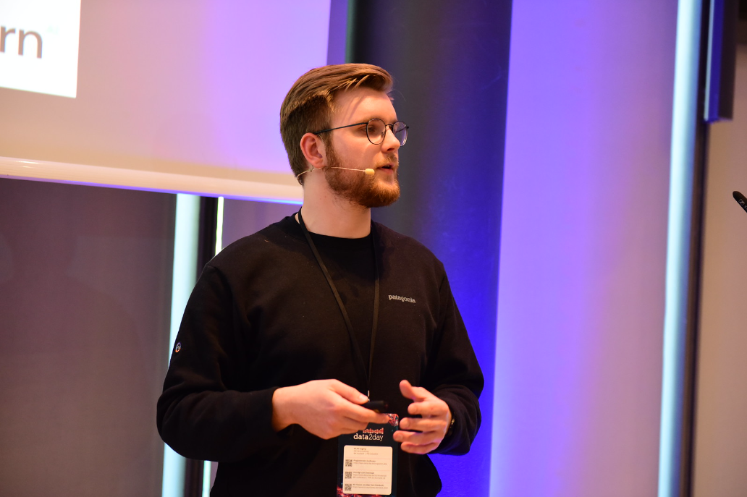





About me
Background in economics
Data Scientist at Kern AI
Mainly working with NLP, big interest in cloud computing
Leonard Püttmann
github.com/LeonardPuettmannKern

Slide 3

About me
DP-100 | Azure Data Scientist Associate certified

Slide 4
Slides & code
You can find all the code & slides on my GitHub:

Slide 5
AGENDA
- What is AutoML & when to use it
- When to move AutoML to the cloud
- Azure ML basics
- Authentication & Python SDK
- Compute basics
- Training a model with AutoML for a Kaggle competition
- Inspecting the models
- Deploying & predicting with Azure (Auto)ML models

Slide 6
What is AutoMl?
And when should you use it?

Slide 7
What is AutoML
Automated machine learning is the process of automating the time-consuming, iterative tasks of machine learning model development.

Slide 8
What is AutoML
It allows data scientists, analysts, and developers to build ML models with high scale, efficiency, and productivity all while sustaining model quality.
What is automated ML? AutoML - Azure Machine Learning | Microsoft Learn

Slide 9
What is AutoML

Slide 10

What is AutoML
Professionals
Experienced developers

Slide 11
What is AutoML
Professionals
Experienced developers
Production

Slide 12
What is AutoML
Professionals
Experienced developers
Students
New developers
Production

Slide 13
What is AutoML
Professionals
Experienced developers
Students
New developers
Production
Testing/ Learning

Slide 14
Moving AutoML to the Cloud
Annual revenue growth

Slide 15
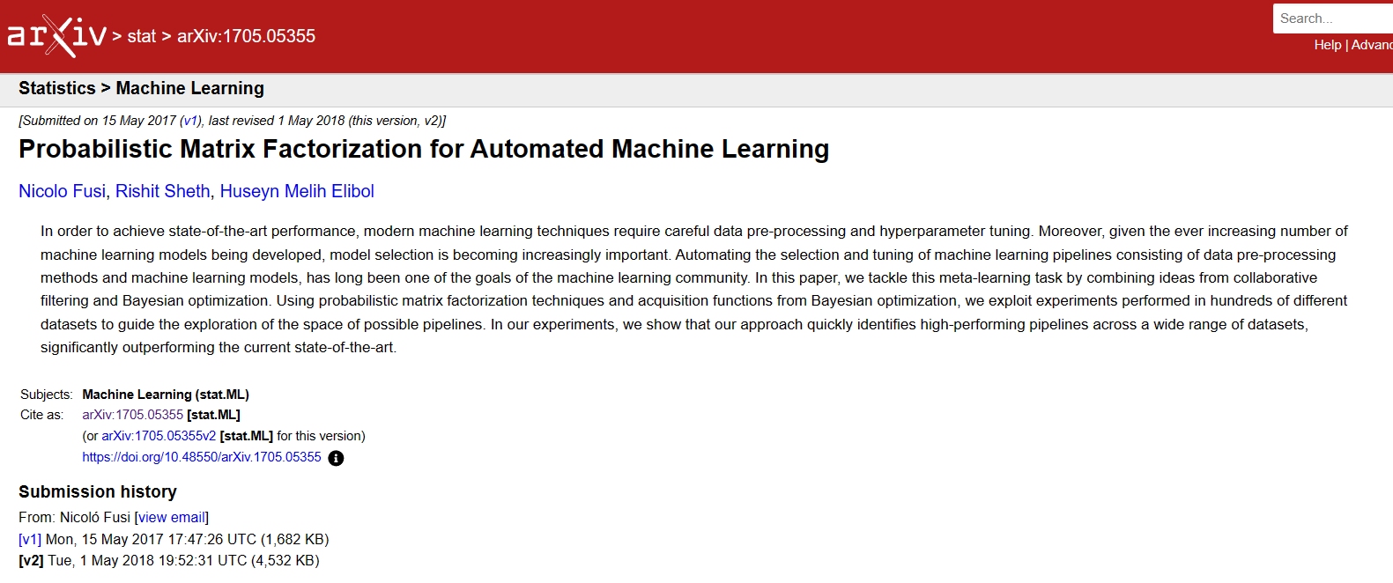
What is Azure AutoML
Highly scalable
Easy to use -> Azure ML Studio
Accurate for many use cases
[1705.05355] Probabilistic Matrix Factorization for Automated Machine Learning (arxiv.org)

Slide 16
Automl vs Hpo
Hyperparameter Optimization
Automated
Machine Learning
Improving and finding the best Hyperparameters of a single model type to improve performance
Feature engineering and transformation, finding the best type of model. Broader approach to the whole ML pipeline.

Slide 17
Title

Slide 18
Some Azure ML Basics
Authentication, Compute & more

Slide 19
Title

Slide 20
Training a Model
With Azure AutoML

Slide 21
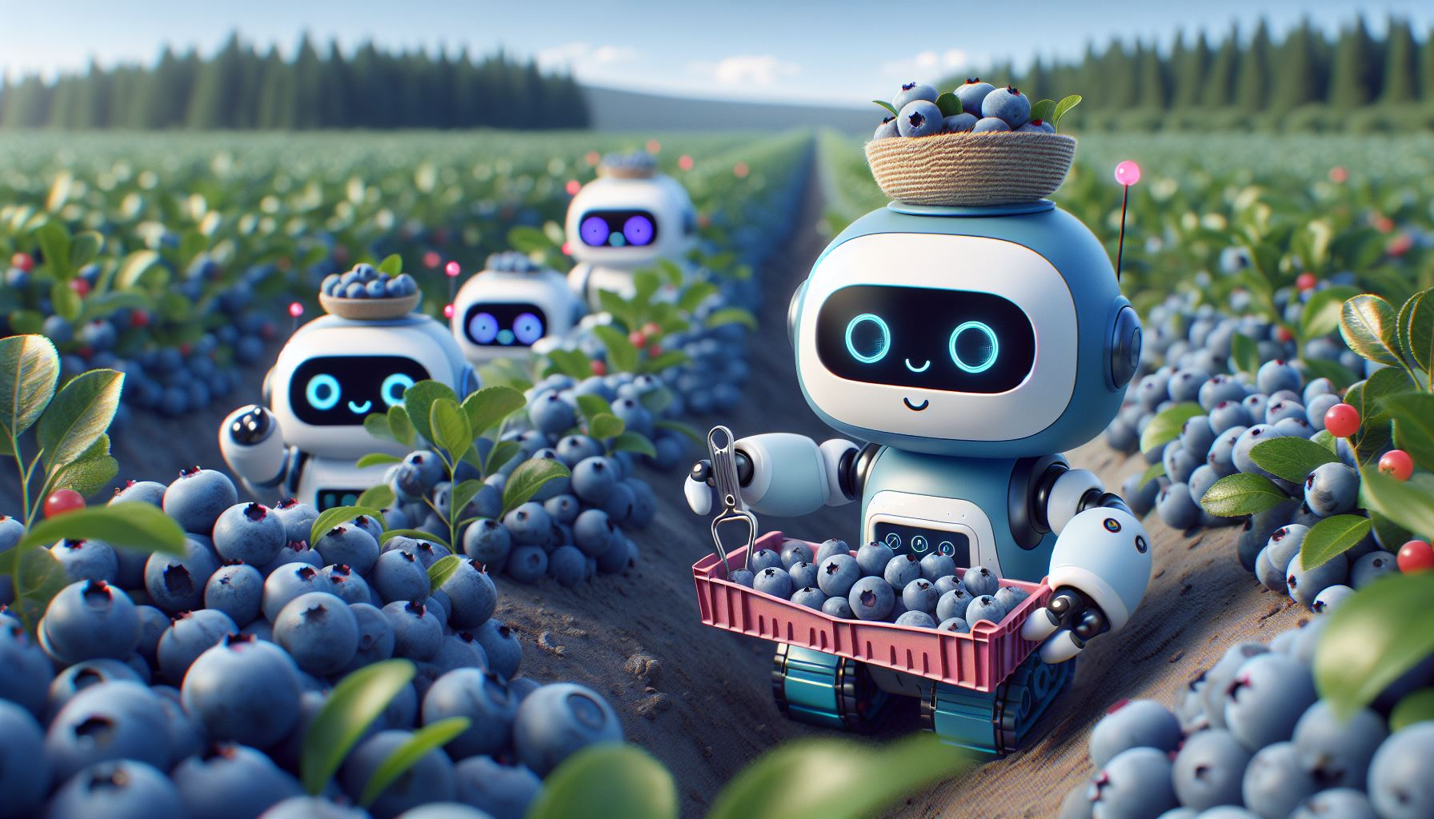
The dataset
Today we’ll use AutoML to predict the yield for a Blueberry farm based on things like rain or insect population!

Slide 22
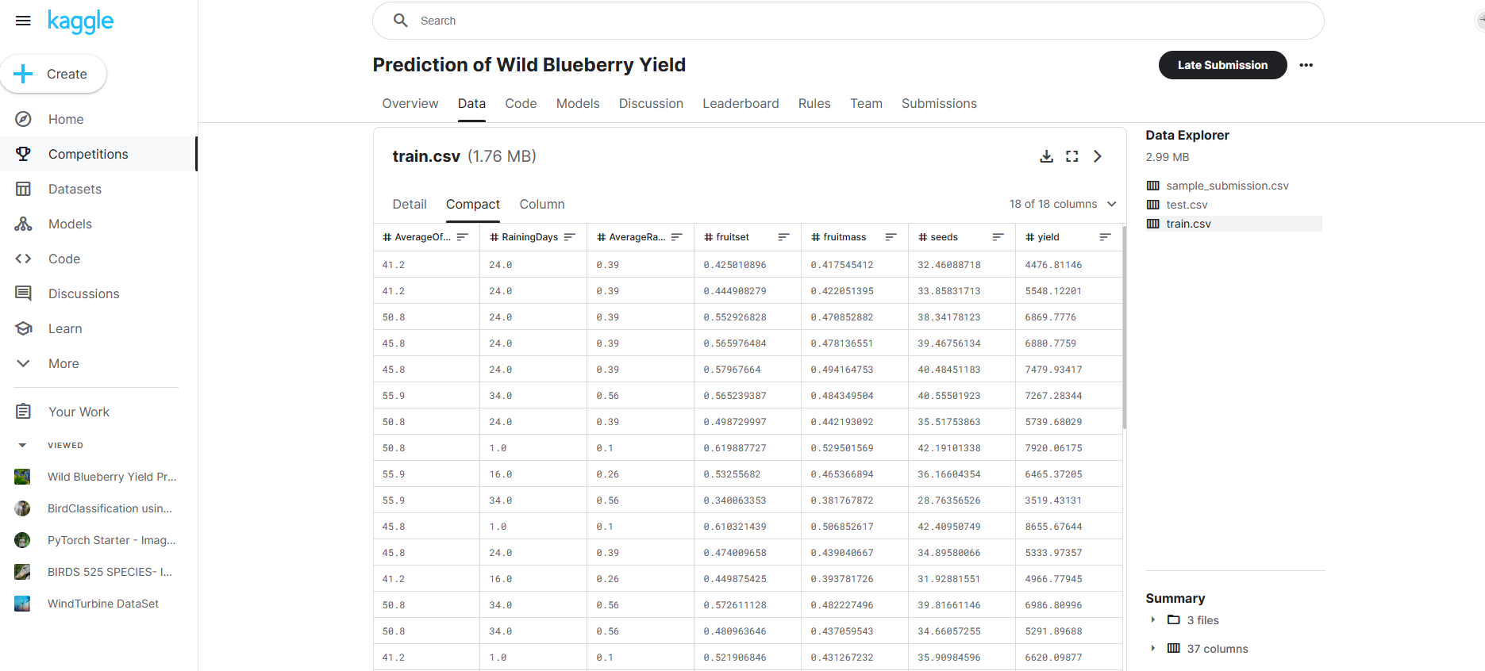
The dataset
You can find the dataset on Kaggle:
Prediction of Wild Blueberry Yield | Kaggle

Slide 23
Hands-on
Let’s switch to our Notebook and the Azure ML Studio! ☺

Slide 24
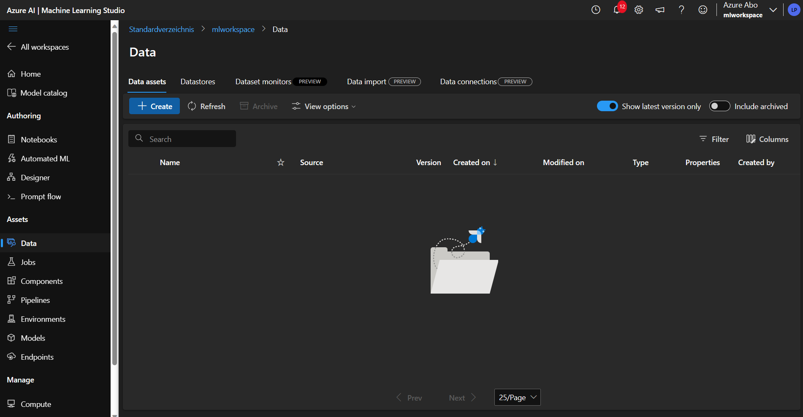
Creating a dataset

Slide 25
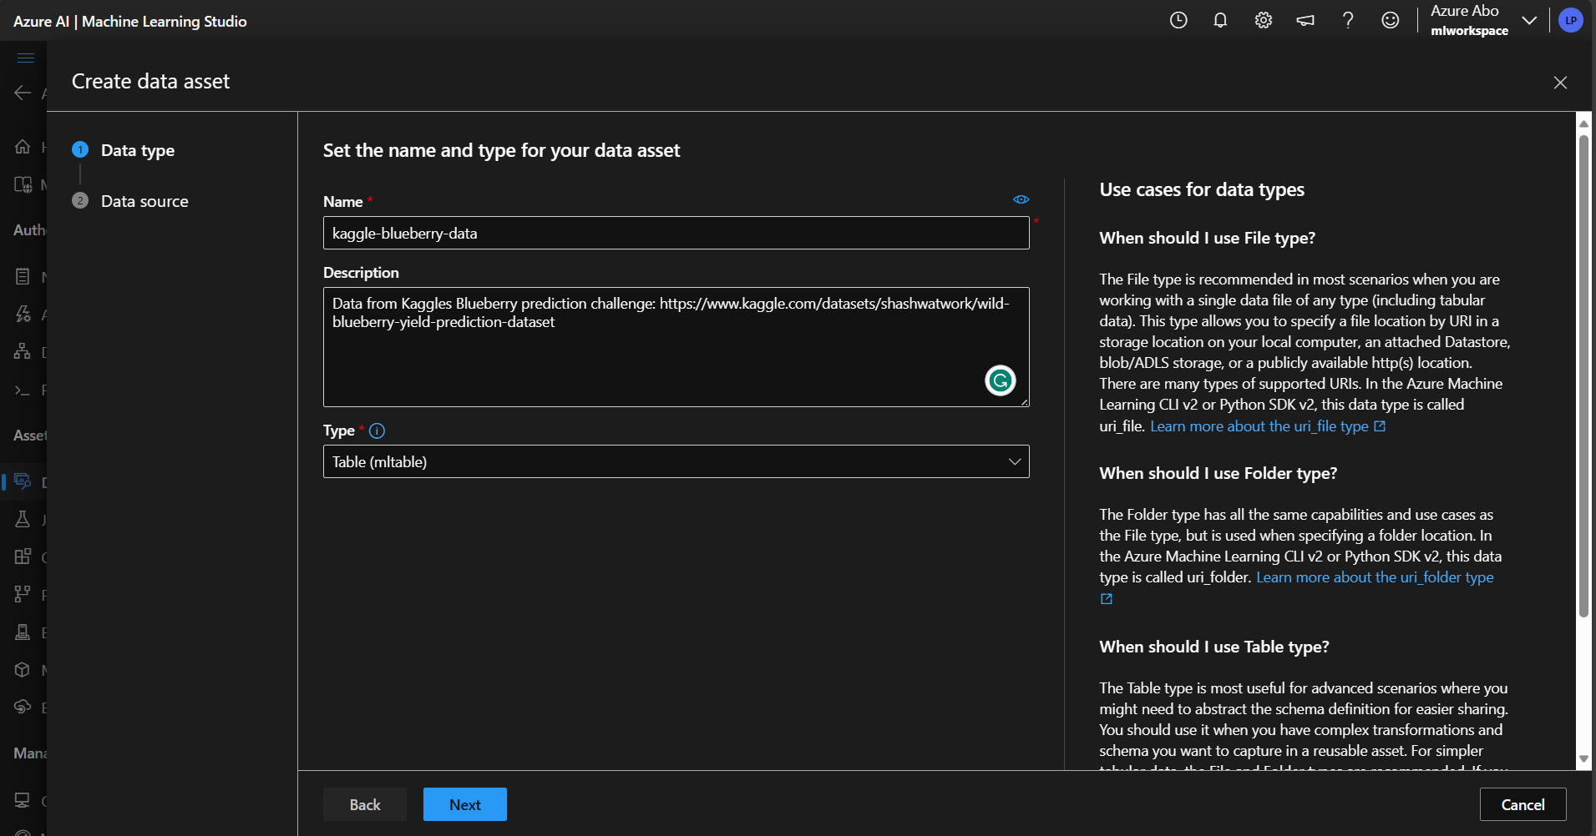
Creating a dataset

Slide 26
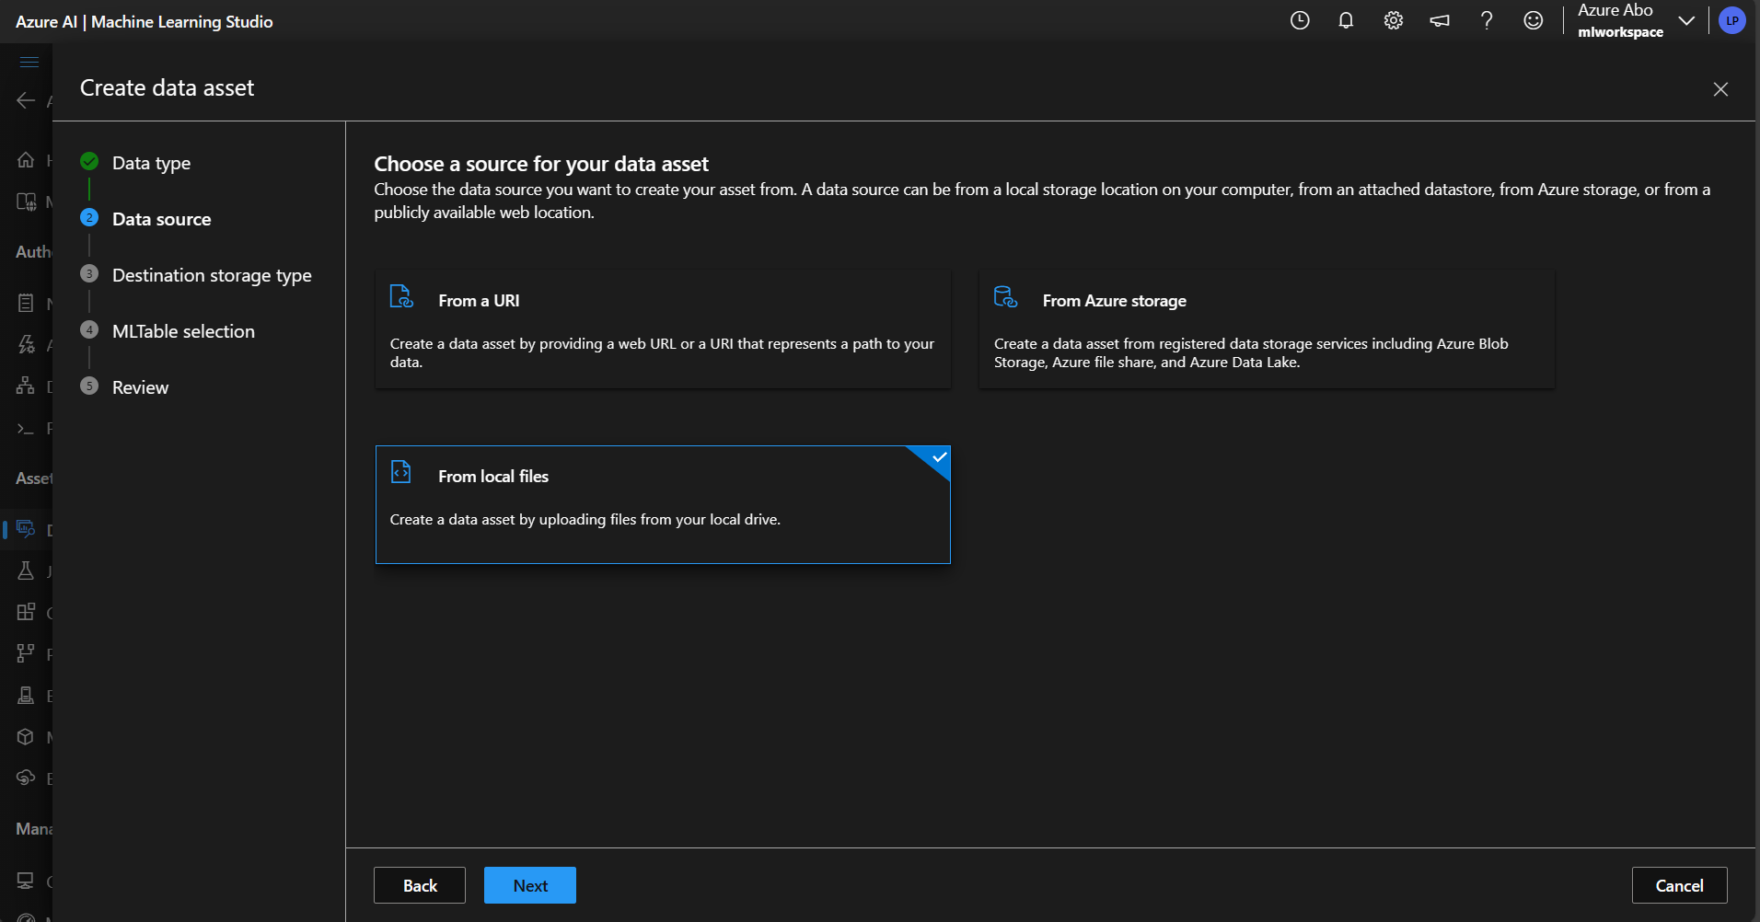
Creating a dataset

Slide 27
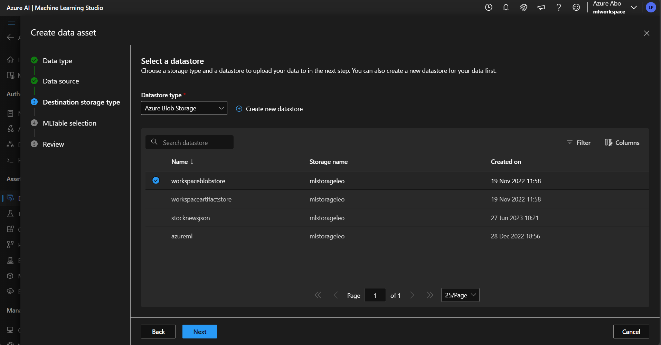
Creating a dataset

Slide 28
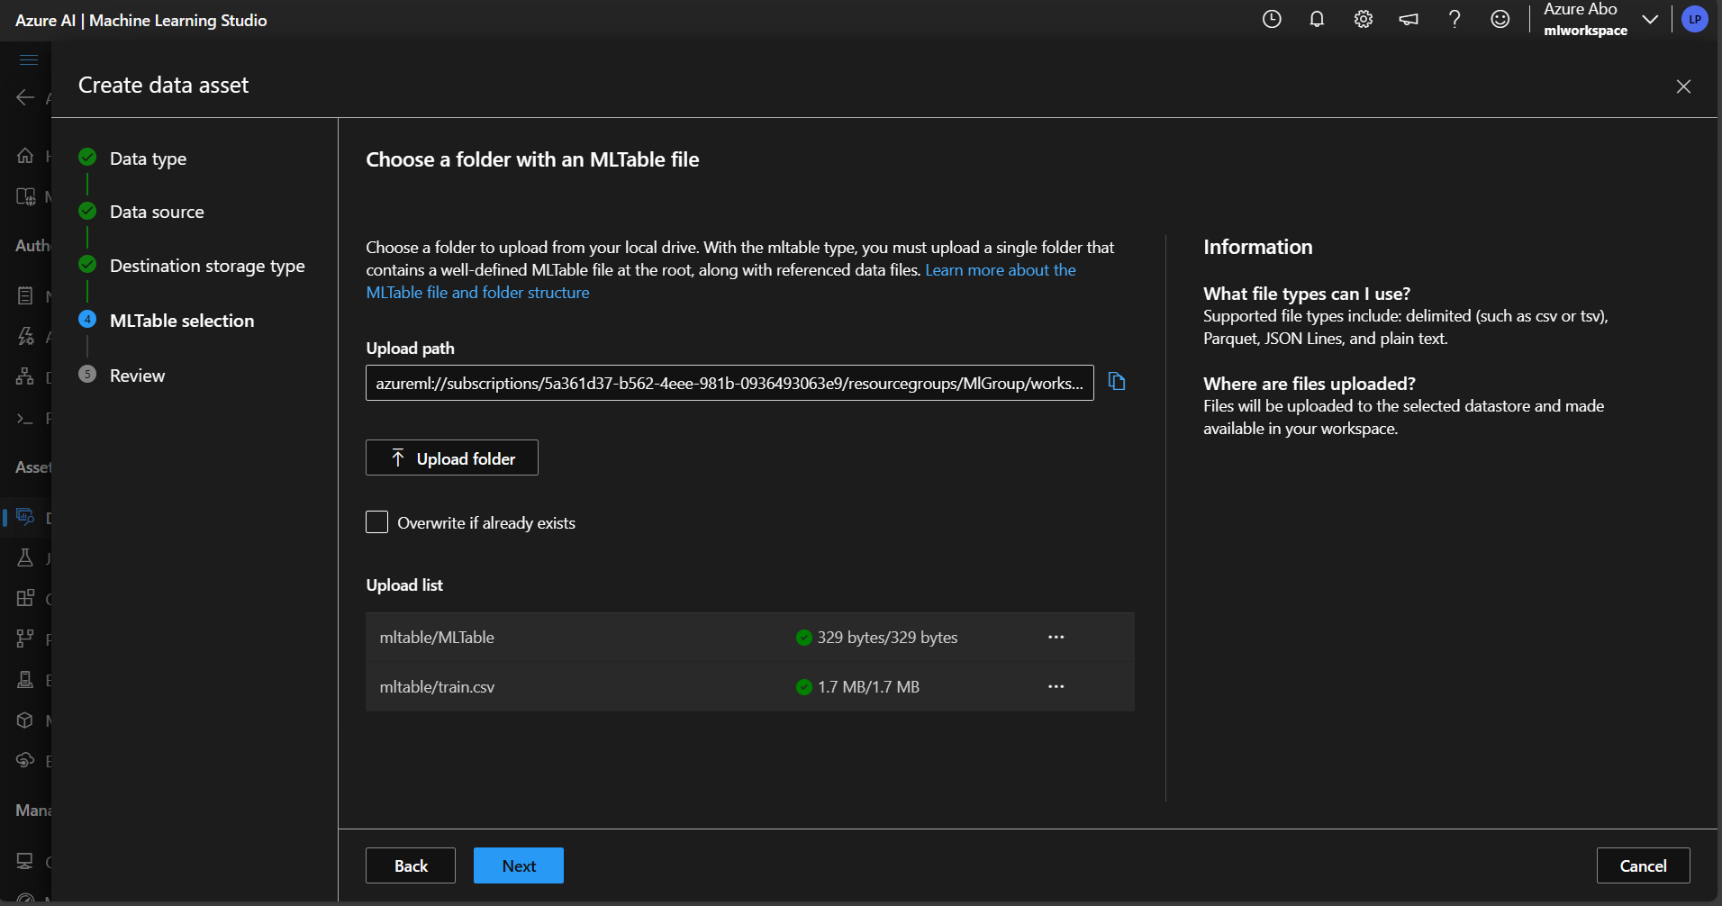
Creating a dataset

Slide 29
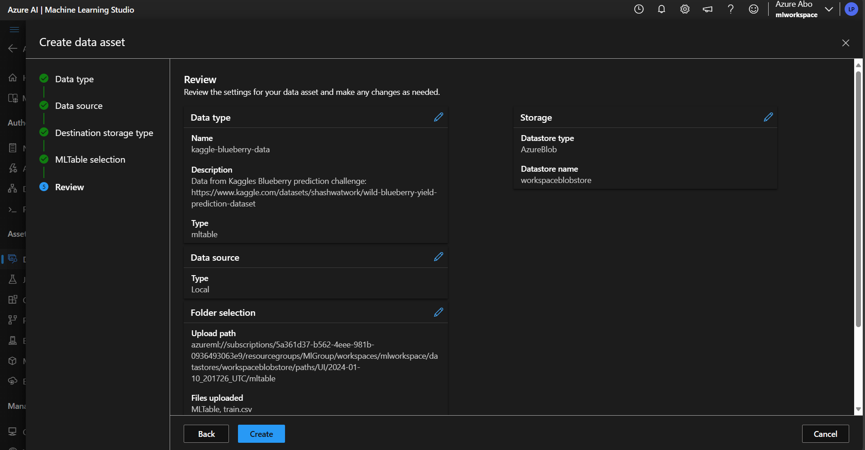
Creating a dataset

Slide 30
Hands-on

Slide 31
Hands-on

Slide 32
Hands-on

Slide 33
Hands-on

Slide 34
Hands-on

Slide 35
Hands-on

Slide 36
Hands-on

