Slide 1


AresGuard: Mission Control System
Distributed Automation Platform for Mars Habitat
Ettore Cantile 2026562
Leonardo Chiarparin 2016363
Laboratory of Advanced Programming
(Hackaton: March 2026)

Slide 2

MISSION BRIEFING
Scenario overview: Mars Habitat 2036
THE CONTEXT
THE CHALLENGE
THE OBJECTIVE
HOSTILE ENVIRONMENT
The year is 2036. You have been deployed to Mars Operations at SpaceY. The habitat's automation stack is partially destroyed and unstable. Life-support relies on manual polling of heterogeneous sensors. Without intervention, the crew faces a thermodynamic collapse.
SYSTEM FRAGMENTATION
Sensors communicate using incompatible dialects (rest.scalar, rest.chemistry). Critical data is fragmented and requires continuous manual polling. There is no unified visualization for vital signs. Automated safety protocols are offline or non-existent.
SOLUTION: ARESGUARD
Design and deploy a distributed automation platform. Ingest data from all legacy REST devices. Normalize payloads into a Unified Event Schema. Automate critical responses via a persistent Rule Engine. Visualize real-time status on a centralized Mission Control Dashboard.

Slide 3


PROJECT SCOPE & CORE ACHIEVEMENTS
2-PERSON TEAM STRATEGY
DELIVERED ARCHITECTURE
Configuration: Optimized for a 2-Developer Team
Ingestion Approach: Robust REST Polling (5s interval)
Note: Telemetry streaming omitted as per mission guidelines.
Primary Goal: Maximize system resilience and data consistency over complexity
Validation: 10 Core User Stories fully implemented
Microservices: Fully containerized stack via Docker Compose
Event-Driven: Asynchronous processing via RabbitMQ
Automation: Persistent Rule Engine (PostgreSQL) with
Upsert logic
Visualization: Real-time Dashboard with WebSocket push
IaC: Infrastructure defined strictly as Code

Slide 4
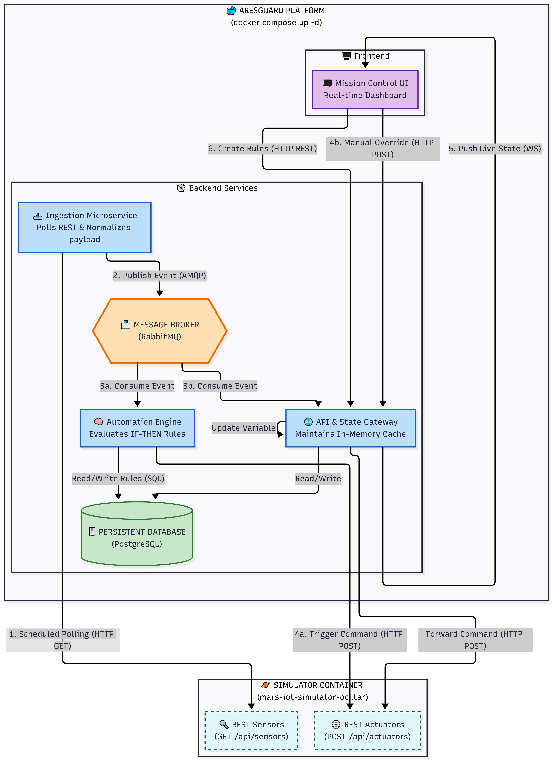
EVENT-DRIVEN ARCHITECTURE & DATA FLOW
High-Level Overview:
Decoupled Ingestion Layer: A dedicated microservice polls legacy REST sensors (5s interval), normalizing heterogeneous data into a Unified Event Schema. It publishes atomic events to RabbitMQ, ensuring data intake never blocks processing.
The "Fan-out" Backbone: The Message Broker broadcasts every event simultaneously to all consumers. This architecture decouples the "source" from the "brains," guaranteeing system resilience even if a component fails.
Persistent Automation: The Rule Engine consumes events to evaluate safety conditions dynamically. All rules are stored in PostgreSQL, ensuring critical safety protocols survive system reboots.
Real-Time Visualization: The API Gateway updates the system state in-memory and pushes live telemetry to the Dashboard via WebSockets, providing zero-latency situational awareness.

Slide 5

FROM RAW SENSORS TO UNIFIED EVENTS
The Normalization Process
Legacy Polling
The Ingestion Microservice queries the Simulator API every 5 seconds (REST GET). Target: Heterogeneous sensors with incompatible dialects (e.g., rest.scalar vs rest.chemistry).
Protocol Decoding
The service actively identifies the sensor type. Complex nested payloads (like chemistry arrays) are unpacked and flattened into individual metric readings.
Unified Schema
All data is converted into a standard JSON format:
source: ID & Protocol
payload: Value & Unit
timestamp: ISO-8601
Broker Dispatch
The sanitized, atomic event is published to RabbitMQ (ares_telemetry_stream).The ingestion process ends here, fully decoupled from the rest of the system.

Slide 6


THE NERVOUS SYSTEM: RABBITMQ BACKBONE
The Nervous System: RabbitMQ Backbone
Fire & Forget Ingestion
The Ingestion Microservice publishes normalized events to the exchange. It operates blindly, unaware of who is listening, maximizing throughput and decoupling data intake from processing logic.
Fan-out Exchange
RabbitMQ sits at the center, acting as the distribution hub. We utilize a Fan-out pattern to instantaneously broadcast every single telemetry event to multiple queues simultaneously, ensuring parallel processing.
Parallel Execution
Two distinct services consume the same message stream in parallel:
Automation Engine
API Gateway
Note: If one fails, the other continues uninterrupted.

Slide 7

THE BRAIN: PERSISTENT RULE ENGINE
AresGuard implements a deterministic logic engine that consumes telemetry in real-time to enforce safety protocols.
Dynamic Evaluation: Simple IF-THEN logic triggers actuators instantly when thresholds are breached. Syntax: IF <sensor> <operator> <value> THEN <actuator> = ON/OFF
Resilient Persistence: Rules are not just in RAM. They are stored in PostgreSQL, ensuring safety protocols survive system reboots or crashes
Smart Conflict Resolution: A database-level constraint UNIQUE(sensor, actuator, operator) prevents logic collisions. The system uses UPSERT to automatically update existing rules instead of creating duplicates

Slide 8
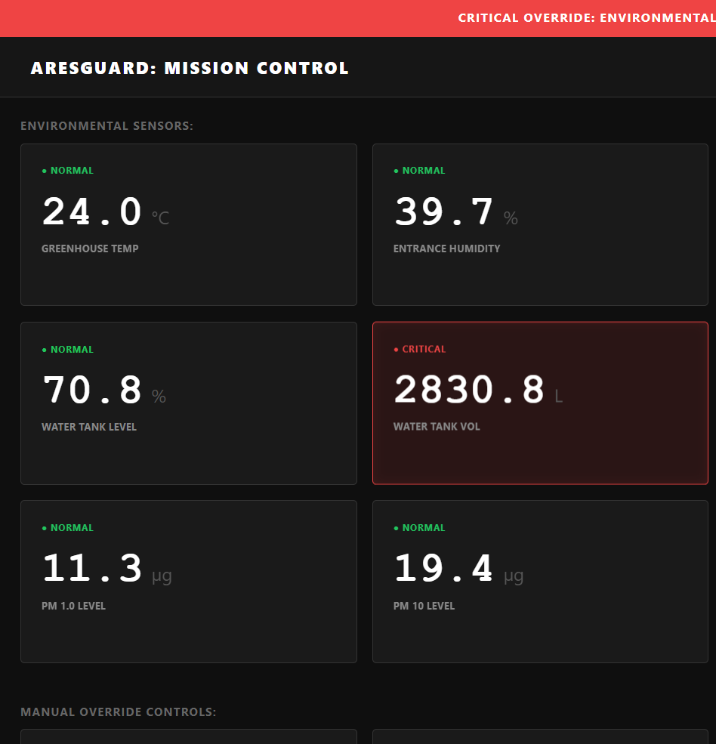
MISSION CONTROL INTERFACE
Real-Time Situational Awareness
Zero-Latency Updates
Lightweight Tech Stack
The API Gateway pushes telemetry via WebSocket (/ws) directly to the browser.
Immediate state synchronization without manual page reloads (Push vs Pull).
Pure Vanilla JS: Built with native HTML5, CSS3, and JavaScript. No heavy frameworks ensures maximum performance on constrained hardware.
Astronaut-Centric UX
Dark Mode: High-contrast UI designed for low-light habitat environments
Visual Alarms: Sensor cards flash RED instantly when safety thresholds are breached
Interactive Data: Integrated Chart.js renders historical trends on-demand for deep analysis

Slide 9
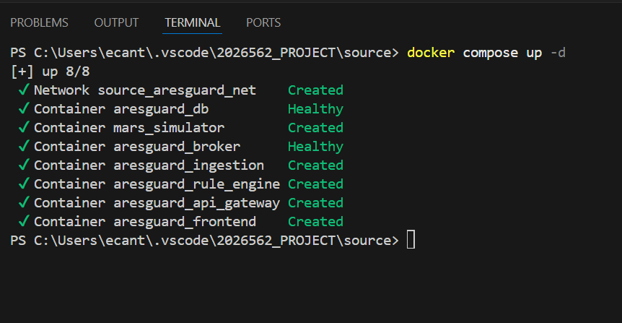
DEPLOYMENT & ORCHESTRATION
Containerized Stack
The entire mission ecosystem (Ingestion, Broker, DB, Frontend) is defined in a single docker-compose.yml file. No manual installation is required.
12 Factor Portability
We strictly use Environment Variables (os.getenv) for configuration. The system is agnostic: it runs identically on a developer laptop or a cloud server without code changes.

Slide 10



ENGINEERING CHALLENGES & SOLUTIONS
Beyond the Basic Requirements
LOGIC CONFLICTS | INPUT VALIDATION | OBSERVABILITY
The Problem: What if a user defines two contradictory rules for the same sensor (e.g., > 20 and > 25)?
The Solution: We implemented a strict Database Constraint UNIQUE(sensor, actuator, operator). The backend uses UPSERT logic: new rules automatically update existing ones instead of creating ambiguous duplicates
The Problem: Preventing "Garbage In, Garbage Out" (e.g., setting a temperature threshold of -500°C)
The Solution: The UI enforces physical limits based on sensor types before sending data to the API. Result: Invalid commands are rejected at the source, reducing backend load
The Problem: Debugging a distributed asynchronous system is difficult when events happen in milliseconds
The Solution: We built a custom "Expand View" in the dashboard log. It allows operators to inspect the full JSON payload of every automated action without cluttering the main UI

Slide 11
CONCLUSION
Project Summary & Compliance
MISSION STATUS: READY FOR LAUNCH
Architecture Compliance
Microservices: Fully containerized, decoupled architecture (Ingestion, Broker, Backend, Frontend)
Event-Driven: Asynchronous communication via RabbitMQ (Fan-out pattern)
Functional Requirements
Data Ingestion: Robust polling and normalization of legacy sensors
Automation: Persistent Rule Engine with database integrity (UNIQUE constraints)
Visualization: Real-time, zero-latency dashboard via WebSockets
Development Standards
Infrastructure as Code: Single docker-compose.yml for reproducible deployment
Clean Code: Modular Python backend and optimized Vanilla JS frontend
>> INITIATING LIVE DEMO SEQUENCE…

Slide 12
MISSION ACCOMPLISHED
Thank you for your attention!

