Slide 1
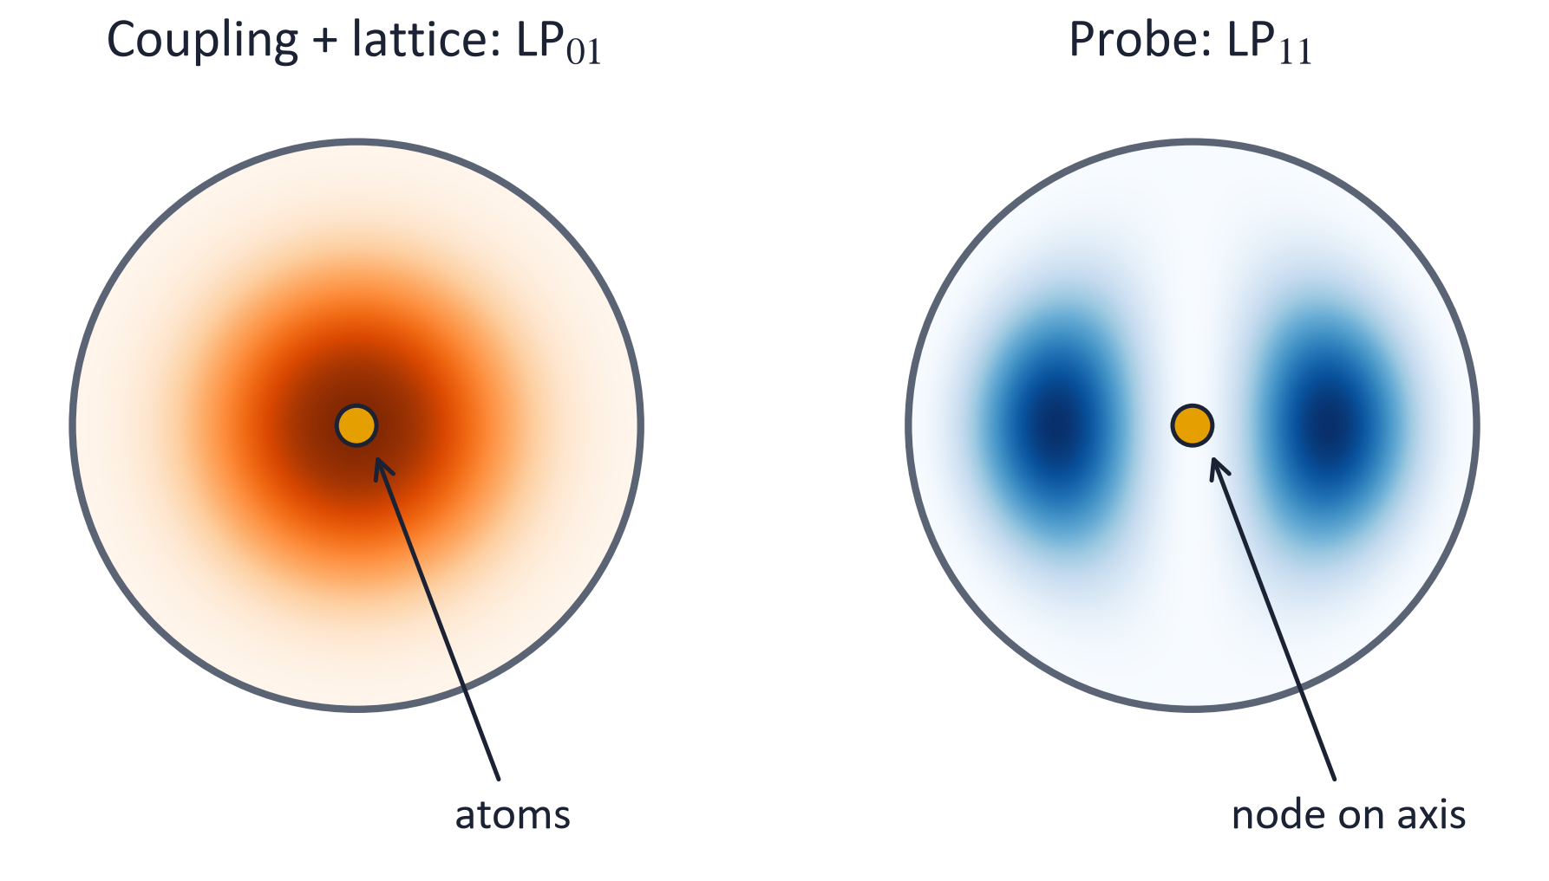
Radial ground-state cooling of atoms in a hollow-core fibre
EIT cooling with an LP₁₁ probe: what is known, and what is new
Leonardo Razzai
Notes:
The topic is cooling the radial motion of atoms trapped in a lattice inside a hollow-core fibre to the motional ground state. The key element is a probe in the LP11 mode, whose node sits exactly on the fibre axis, where the atoms are. I will first place this in the context of EIT cooling and of the closest related work, then say what is new, and then show the main results.

Slide 2
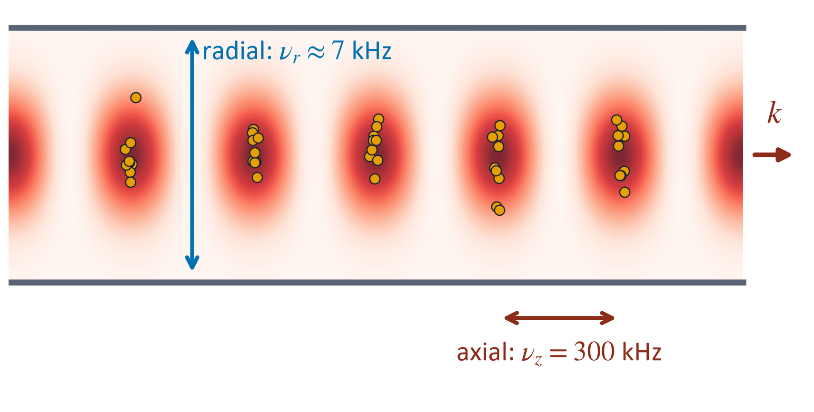
Atoms in a hollow-core fibre: the radial motion stays hot
A cm-long atomic column in a guided 1064 nm lattice: high optical depth without a cavity
Axial motion: ν_{z} = 300 kHz, ground-state cooled by Raman sideband cooling
Radial motion: ν_{r} ≈ 7 kHz for a = 15 µm, ⟨n⟩ ≈ 29 at 10 µK
Every guided beam pushes along z: LP₀₁ light alone cannot cool the radial motion
Fibre lattices: Okaba et al., Nat. Commun. 5, 4096 (2014); Leong et al., Nat. Commun. 11, 5295 (2020)
Notes:
In an LP01 lattice the axial confinement is strong and axial sideband cooling works. The radial trap is forty times softer, so a 10 microkelvin sample has about 30 radial quanta, and every guided beam carries momentum only along the axis. With both EIT beams in LP01 the radial coupling is only second order in x0 over the mode radius.

Slide 3
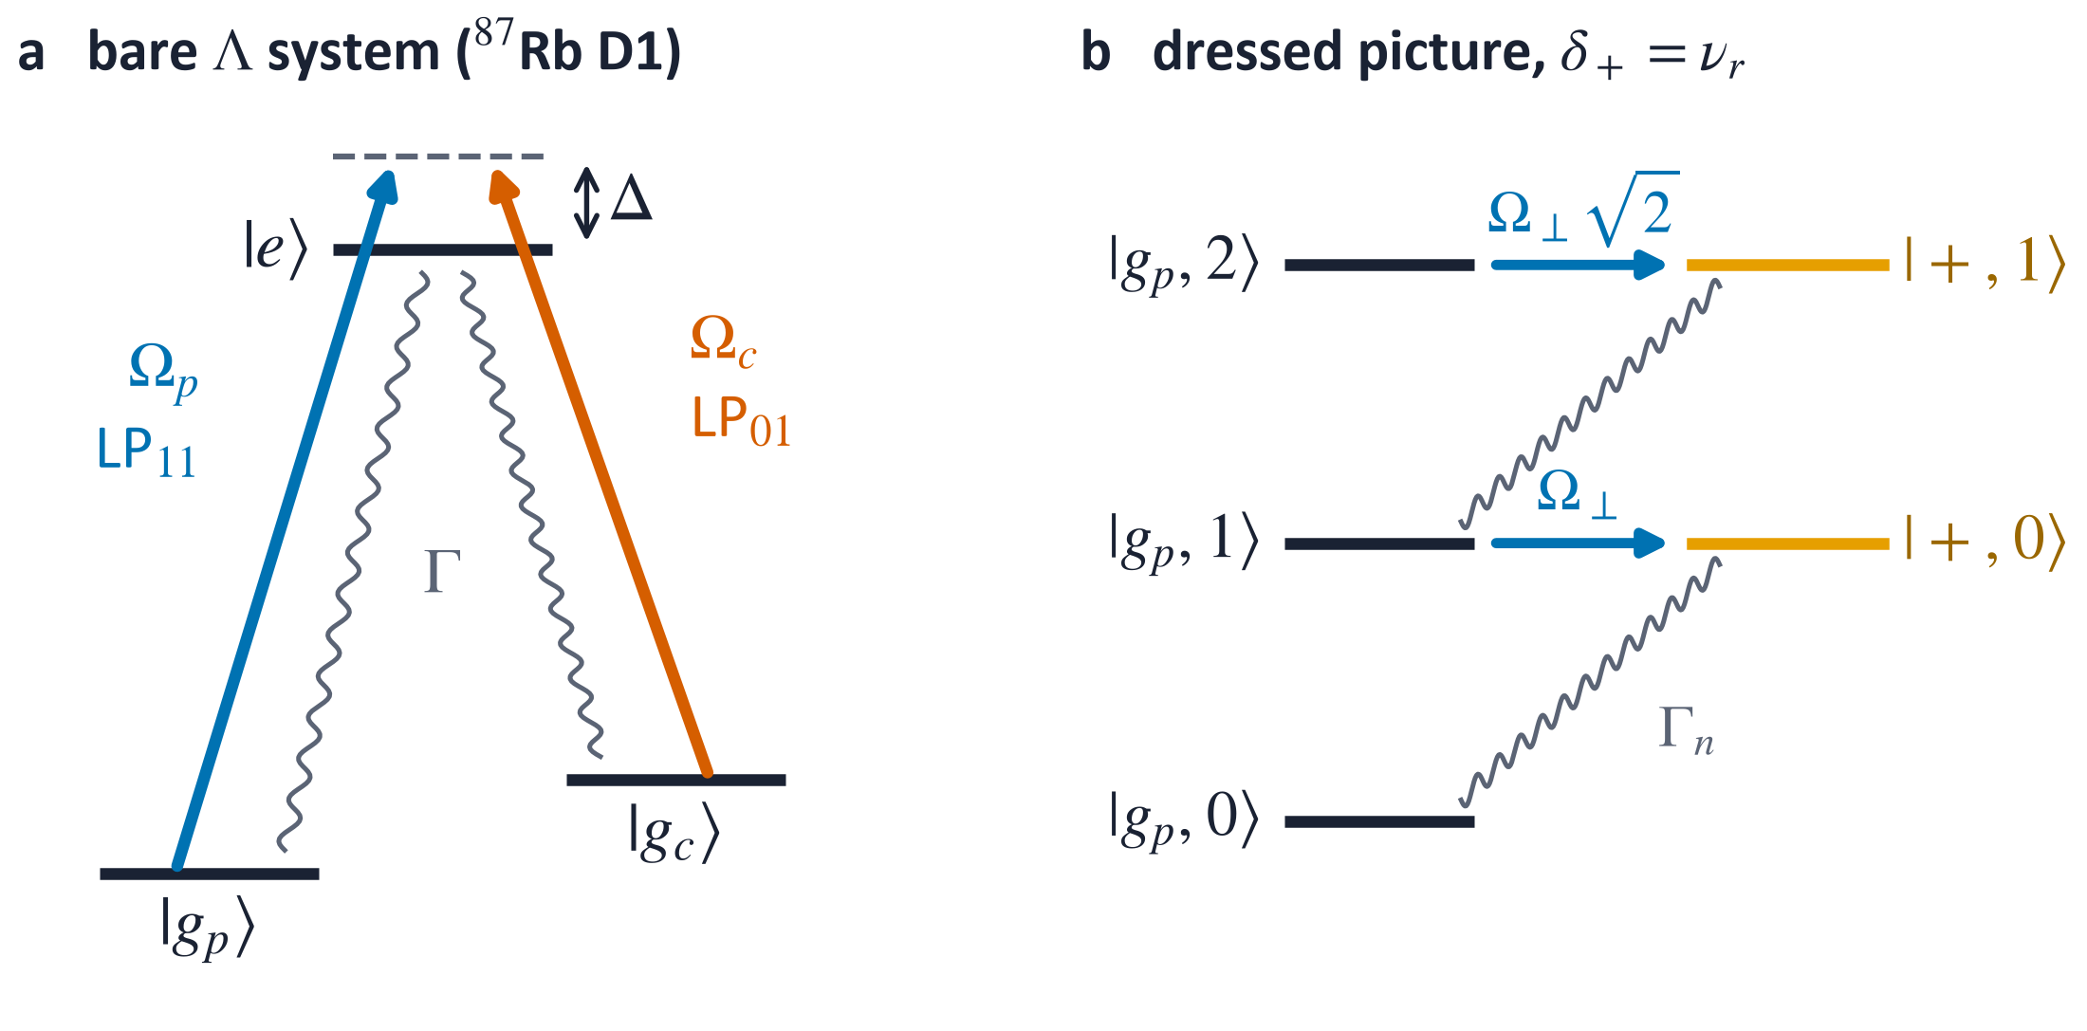
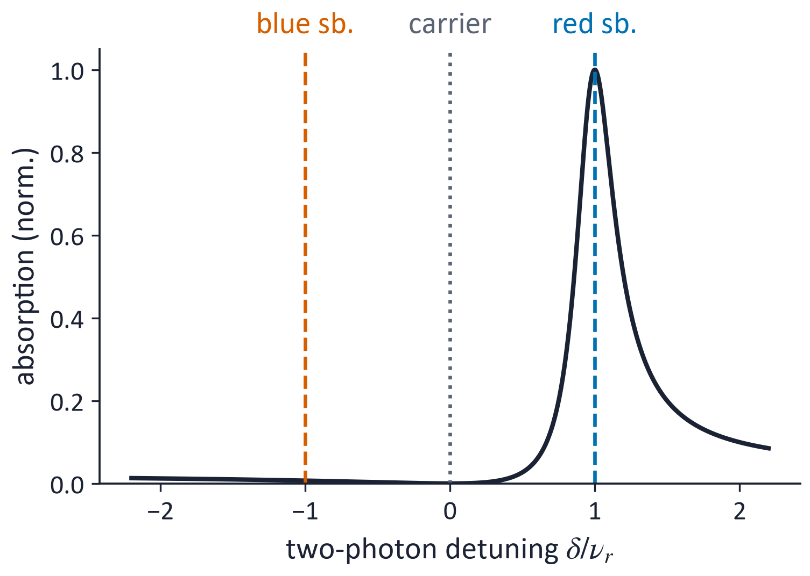
EIT cooling in one slide
A strong coupling beam dresses the Λ system: the probe absorption gets a narrow peak next to a dark-state zero
Put the narrow peak on the red sideband: absorption removes a phonon, the carrier and the blue sideband are suppressed
Established for trapped ions and ion strings; recently used to load, image and cool ⁸⁷Rb tweezer arrays
Morigi, Eschner & Keitel, PRL 85, 4458 (2000); Roos et al., PRL 85, 5547 (2000); Lechner et al., PRA 93, 053401 (2016); Qiu et al., PRX Quantum 7, 020358 (2026)
Notes:
Standard EIT cooling. The coupling beam, detuned by Delta, creates a narrow dressed resonance at the light shift delta plus. Setting delta plus equal to the trap frequency places it on the red sideband. Theory by Morigi, Eschner and Keitel, first experiment by Roos and Blatt with a calcium ion, extended to long ion strings, and recently by the Lukin and Vuletic groups to load and image rubidium atoms in tweezer arrays while cooling axial and radial motion.

Slide 4
Closest related work
Work | System | What it showed
Cirac et al. 1992 | ion at a standing-wave node | no carrier at the node: pure sideband coupling
Morigi et al.; Roos et al. 2000 | trapped ion | EIT ground-state cooling, theory and experiment
Xing & Mehta 2025 | ion in structured light (theory) | carrier-free EIT at a node; rate independent of the gradient
Xing et al. 2025 | Ca⁺ in a phase-stable standing wave | first EIT cooling at a node: n̄ ≈ 0.05, modes over 5 MHz in 150 µs
Qiu, …, Lukin, Vuletić 2026 | ⁸⁷Rb tweezer arrays | EIT loading (68 %) and imaging (99.7 %), cools axial and radial motion
Leong et al. 2020 | Rb lattice in a hollow-core fibre | axial ground state by Raman sideband cooling
Dechant et al. 2015, 2016 | Sisyphus cooling | heavy-tailed, non-Boltzmann energy distributions
Cirac et al., PRA 46, 2668 (1992); Xing & Mehta, PR Applied 24, 014034 (2025); Xing et al., arXiv:2512.10900; Dechant et al., PRL 115, 173006 (2015), PRE 94, 022151 (2016)
Notes:
The idea of a node is old: Cirac and co-workers showed in 1992 that an ion at a standing-wave node sees no carrier. Xing and Mehta worked out carrier-free EIT cooling at a node of structured light for ions in integrated photonics, and their group demonstrated it in 2025 with a calcium ion in a phase-stable standing wave. On the neutral-atom side, the Harvard-MIT groups used EIT on rubidium in tweezers. In fibres, axial ground-state cooling has been shown. Heavy-tailed distributions are known for Sisyphus cooling. So the concept of node cooling is not ours; what is new is the regime and the platform.

Slide 5
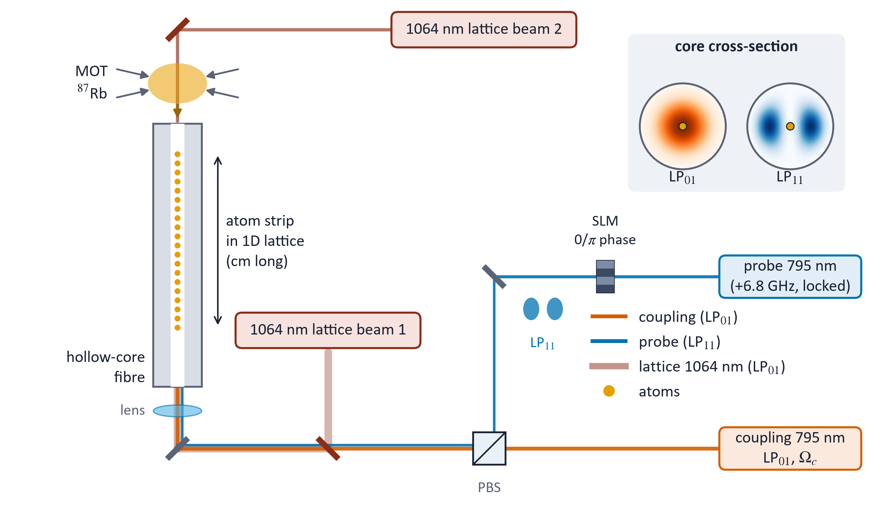
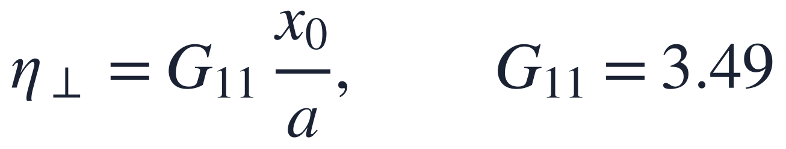
This scheme: probe in LP₁₁, atoms on its node
Lattice and coupling beam in LP₀₁, probe in LP₁₁, all guided from one end
The LP₁₁ node lies on the axis by symmetry: no carrier, only the field gradient couples to radial motion
η⊥ ≈ 0.02–0.04 is small, but without a carrier it only sets the probe power: nanowatts
Notes:
Coupling beam and lattice in LP01, the probe shaped into LP11 by an SLM or a phase plate and launched from the same end. Near the axis the LP11 field is linear in x, with slope G11 over a, so the probe couples only through its gradient, with effective Lamb-Dicke parameter eta perp equal to G11 x0 over a. This is the fibre version of the ion at a node. Being carrier-free, a small eta perp costs only probe power.

Slide 6
What is known, and what is new
Known (ions, tweezers) | New here (atoms in a hollow-core fibre)
carrier-free EIT cooling at a node | all-guided radial cooling with LP₁₁: self-aligned node, nW probe
recoil is a small correction (h ≈ 0.01) | recoil-dominated regime: h = 0.1–1 in a soft radial trap
near-thermal steady states | steady state with a power-law tail, P(n) ∝ n^{−1/h}, while P₀ > 0.95
cooling rate from ⟨n⟩ | ⟨n⟩-based rate fails; the ground-state rate W₀ is the robust measure
heavy tails in Sisyphus cooling | heavy tails in resolved-sideband cooling, from n ≈ 3
one probe cools one motional mode | both radial axes coupled by recoil: a cold 2D state needs h < 1/2
— | universal map in (ν_{r}/ω_{rec}, b_{p}); ⁸⁷Rb level and Zeeman structure; memory budget
Notes:
Left, what we take from the ion work: the node concept and the fact that the rate is set by the narrow line, not by the gradient. Right, what is specific to atoms in a fibre and new to our knowledge. The radial trap is soft, so the recoil of each scattered photon is comparable to the phonon being removed. This produces a qualitatively different steady state, with a power-law tail, it breaks the usual definition of the cooling rate, and it couples the two radial axes. We map it out with one dimensionless parameter, h.

Slide 7
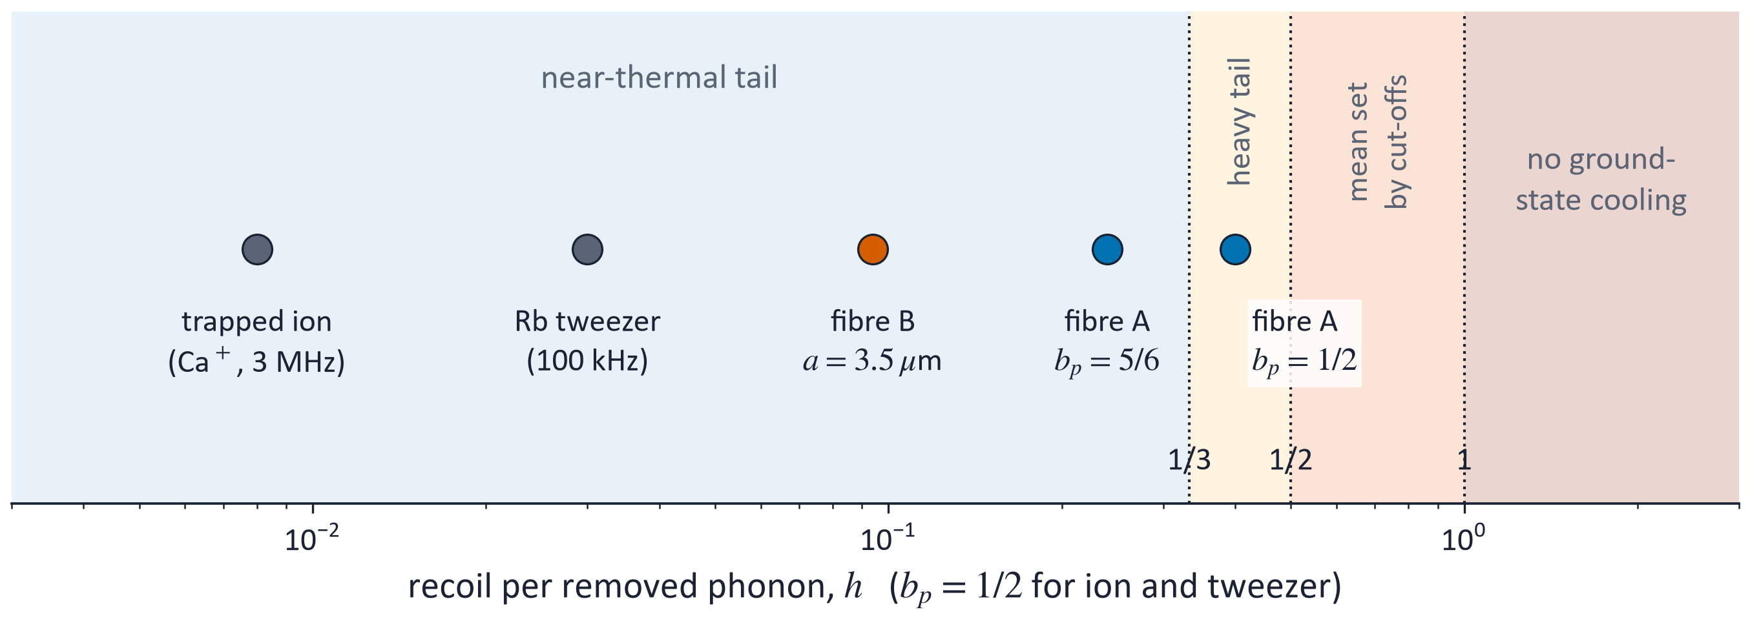
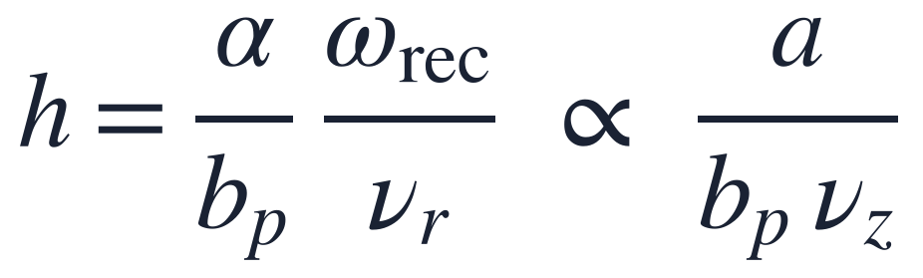
The soft trap: recoil per removed phonon, h
Fibre atoms sit 10–50× above ions and tweezers, inside the range where the steady state changes
Thresholds: h = 1/3 (variance), 1/2 (mean), 1 (ground-state cooling)
h falls with a smaller core, a deeper lattice, or a Λ that returns to the probe state (b_{p} → 1)
Notes:
h is the recoil energy fed back per removed phonon, in units of the phonon. alpha is the fraction of emission recoil along one radial axis, b_p the branching ratio back to the probe ground state, so 1 over b_p photons are scattered per cooling cycle. For a trapped ion h is about 0.01, for a rubidium tweezer about 0.03; in the fibre it is 0.1 to 0.4. Because nu_r scales as nu_z over a, h scales as a over b_p nu_z: a small core or a deep lattice helps.

Slide 8
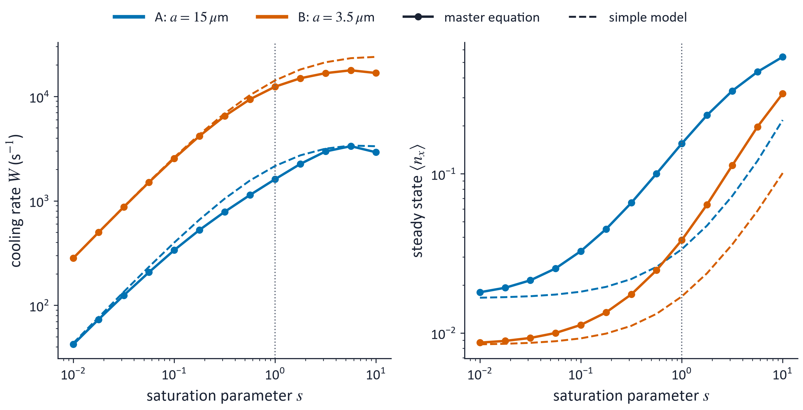
Ground-state cooling with nanowatts of probe
Case A, a = 15 µm, s = 1: W = 1.6×10³ s⁻¹ (ground-state rate W₀ = 2.2×10³ s⁻¹), P₀ = 0.95, 8 nW
Case B, a = 3.5 µm, s = 1: W = 1.2×10⁴ s⁻¹ (W₀ = 1.4×10⁴ s⁻¹), ⟨n⟩ = 0.04, 0.4 nW
Simple rate model: valid only at weak probe and only if it counts 1/b_{p} ≈ 2 photons per cycle; at s ≈ 1 it overestimates W by up to 40 % and underestimates ⟨n⟩ up to 5×
Converged master equation: excited state eliminated, banded coherences, up to 400 Fock states
Notes:
Symbols: master equation, converged in the number of Fock states, which needed adiabatic elimination of the excited state and a banded solver. Dashed: the standard rate model. s is the saturation of the narrow line, s = 2 times Omega_R over Gamma_n squared. The rate model fails at s near 1 because the Raman coupling splits the narrow line. W0 is the rate of the ground-state population; the rate from the mean occupation is not well defined, as the next slides show.

Slide 9
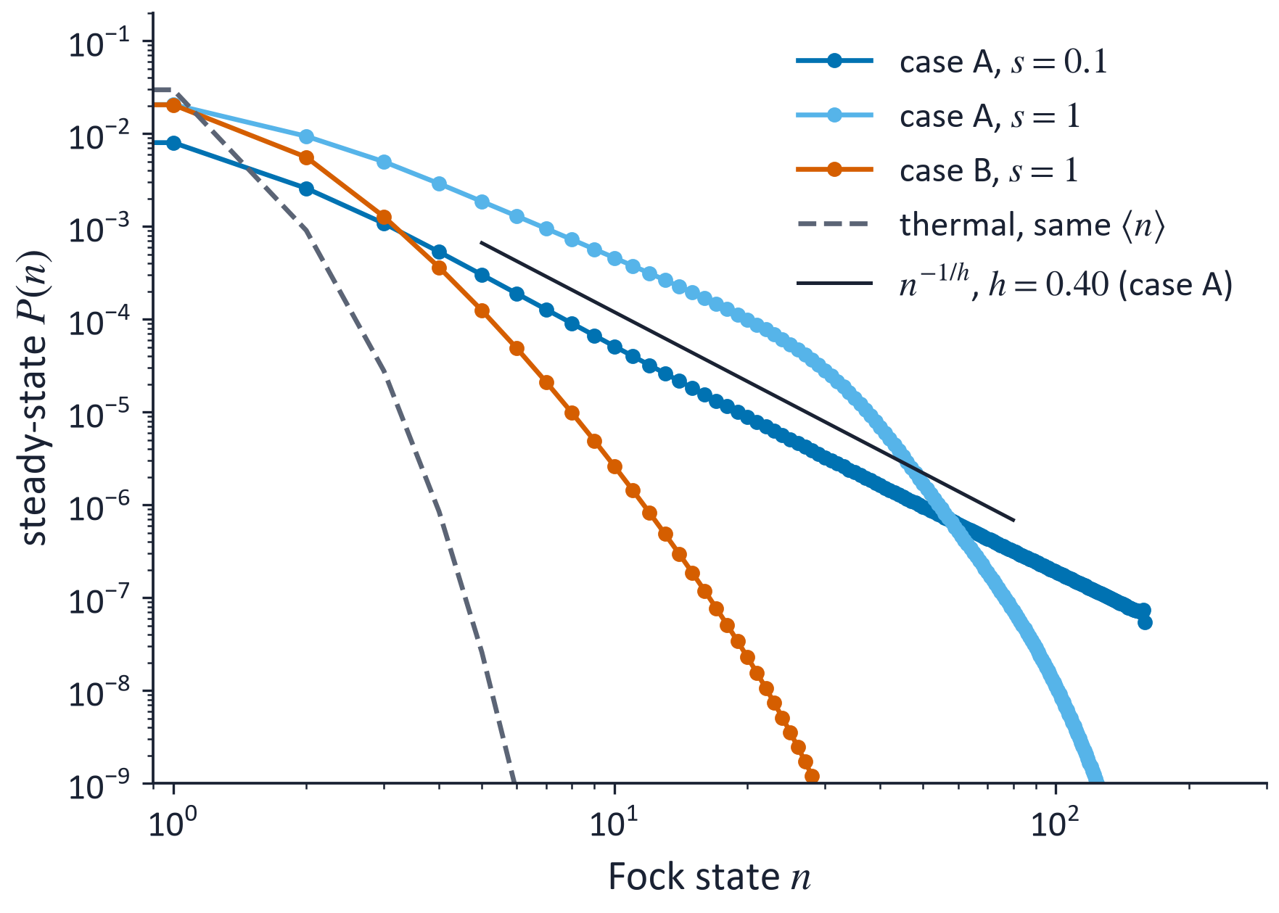
New: a heavy-tailed steady state
P(n) falls as a power law, n^{−1/h}, over two decades; the exponent follows from h alone (fit −2.34, predicted −2.48)
Case A, s = 1: P₀ = 0.95, yet 0.3 % of atoms above n = 10 carry a third of ⟨n⟩
So ⟨n⟩ and the ⟨n⟩-based rate depend on the truncation; P₀ and W₀ do not
Same law as in Sisyphus cooling, here in resolved-sideband ground-state cooling
Sisyphus analogue: Dechant, Kessler & Barkai, PRL 115, 173006 (2015)
Notes:
This is the main new physics. Each removed phonon costs about two photons, and their recoil adds energy proportional to n on average, while the removal rate saturates. The balance gives a power law with exponent minus 1 over h. A thermal state with the same mean occupation, dashed, falls off exponentially. The tail ends where the narrow line no longer resolves the sideband. In practice the ground-state population is high, but the mean is carried by a few hot atoms, so it converges only with hundreds of Fock states.

Slide 10
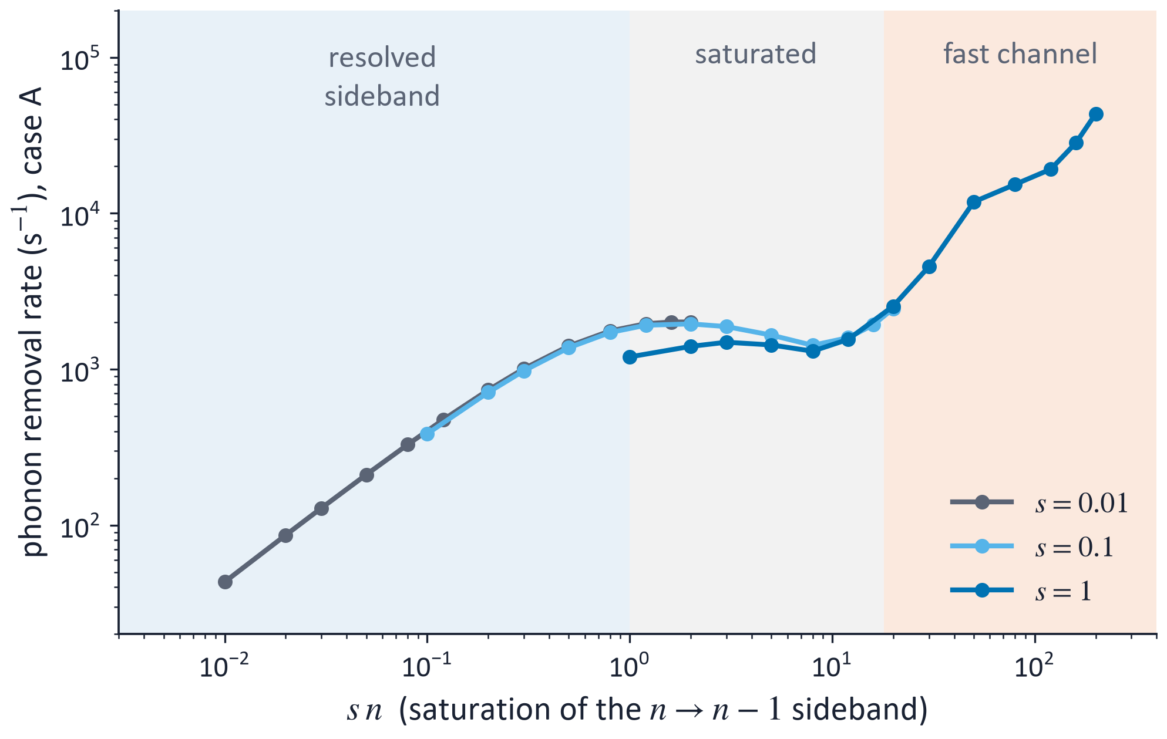
New: three cooling regimes on one curve
The phonon-removal rate depends on s and n only through s·n
R ∝ n, then a saturated plateau, then a fast channel above s·n ≈ 2(ν_{r}/Γ_{n})² ≈ 18
The plateau makes hot atoms cool linearly in time, not exponentially
Fast channel: drift grows 17× from n = 20 to 200 while diffusion grows 1.8×; Sisyphus-like reading still to be tested
Notes:
Drift of the mean occupation from Fock states, master equation, case A. Curves for different s collapse onto one curve against s times n, the saturation of the n to n minus 1 sideband. At large s n the Raman splitting exceeds the trap frequency and a much faster channel opens; our working hypothesis is dark-state following over the smooth mode profile, a Sisyphus-like mechanism. The sign-of-detuning test is still to be done.

Slide 11
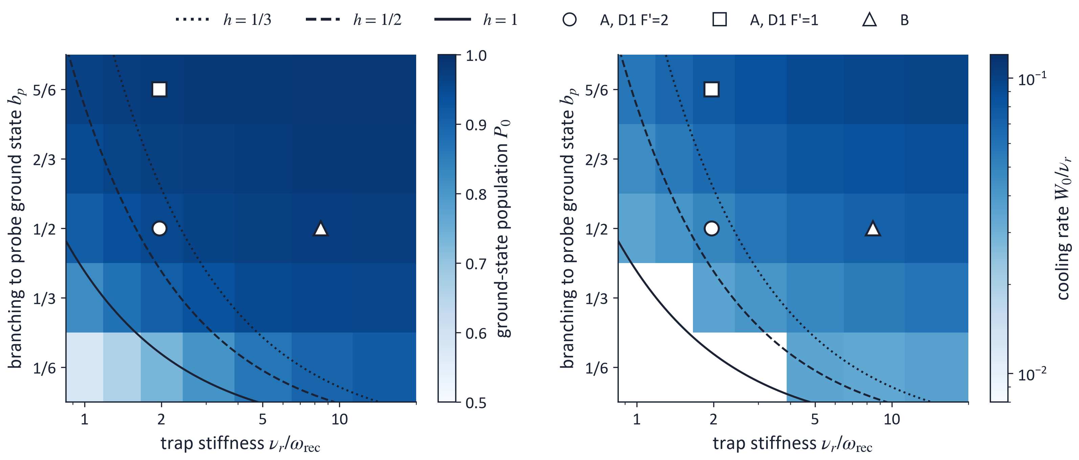
New: one cooling map for any atom and trap
Only ν_{r}/ω_{rec}, b_{p}, Δ/Γ and s matter; Γ/ν_{r} and x₀/a change results by < 0.3 %
h = 1/3 separates clean ground states from heavy tails; Δ = 3Γ, s = 1 shown
For ⁸⁷Rb, D1 F′=1 with the probe on F=2 (b_{p} = 5/6): P₀ = 0.975 and 1.5× the rate of D1 F′=2
Notes:
Converged master-equation map in the plane of trap stiffness in recoil units and branching ratio. Left, ground-state population; right, the ground-state rate in units of nu_r, shown only where the state is cold. Lines of constant h follow the colour contours. The open symbols are the configurations we considered for rubidium. Ions and tweezers would sit far to the right; we plan to add them as points.

Slide 12
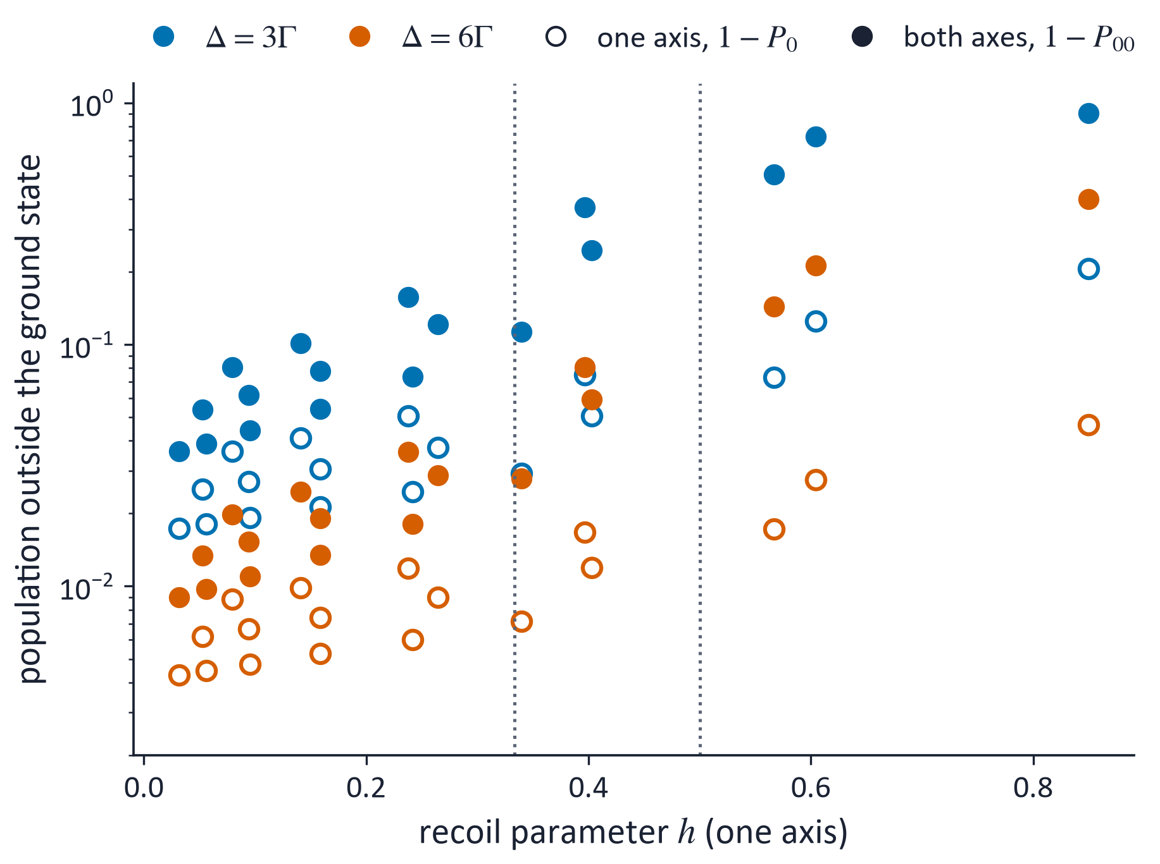
New: both radial axes
One probe pattern cools one motional mode; recoil heats both axes
The second axis doubles the effective recoil: a cold 2D state needs h < 1/2
Case A, Δ = 3Γ: P₀₀ = 0.76 with b_{p} = 1/2, 0.93 with b_{p} = 5/6; 0.98 at Δ = 6Γ
Since h ∝ a/ν_{z}, a deeper lattice relaxes the limit
Rate chain on P(n_{x}, n_{y}), checked against the exact 2D master equation (0.927 vs 0.931)
Notes:
Open symbols: one axis; filled: both axes, cooled by alternating the LP11 orientation. Below h of one third the second axis costs a factor of about two in the excited population; above one half the two-dimensional ground state is lost at three Gamma. A larger detuning helps. A single scalar vortex beam does not cool both modes; a vector mode might, which is still open.

Slide 13
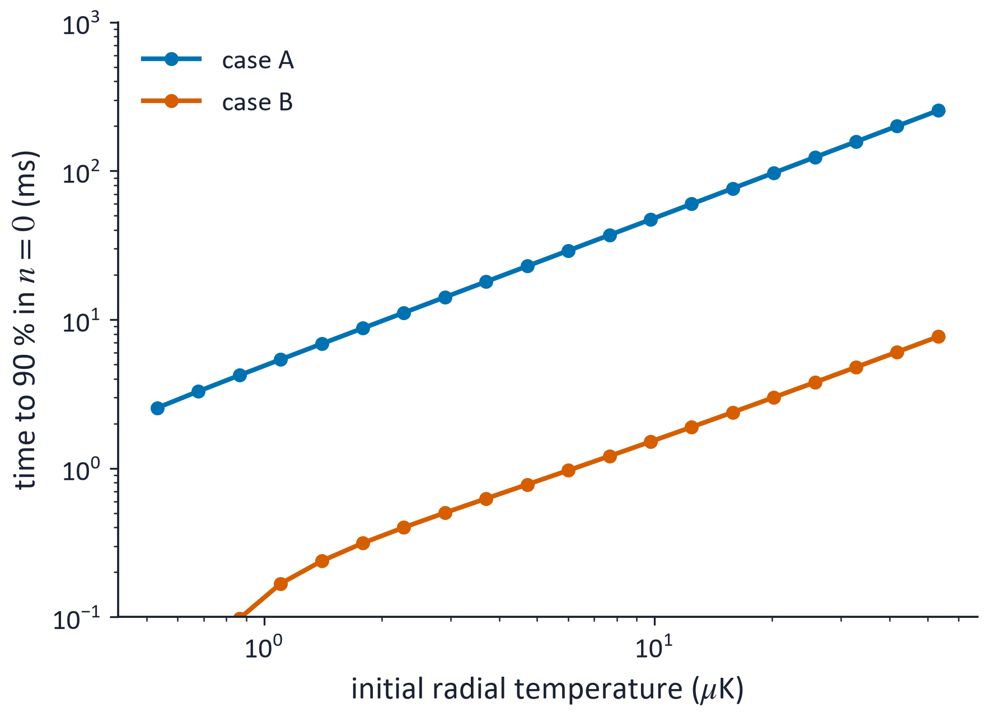
Cooling from 10 µK: time grows with temperature
Above n̄ ≈ 3 the sideband saturates: the cooling time grows linearly with the initial temperature
90 % in n = 0: 2.6–255 ms in case A, below 8 ms in case B, for 0.5–53 µK
From 10 µK: 97.5 % in n = 0 after 150 ms (A); ⟨n⟩ = 0.04 after 2.4 ms (B)
The rate model is conservative: the master equation is about 2× faster from n̄ = 30
Notes:
Calibrated rate model with the full trap depth in Fock space. The time to reach 90 percent in the ground state grows linearly with temperature because the phonon removal rate per atom is constant in the plateau. The small core is about thirty times faster. A master-equation check from thirty quanta gives 21 milliseconds against 47 from the rate model in case A, so these times are upper bounds.

Slide 14
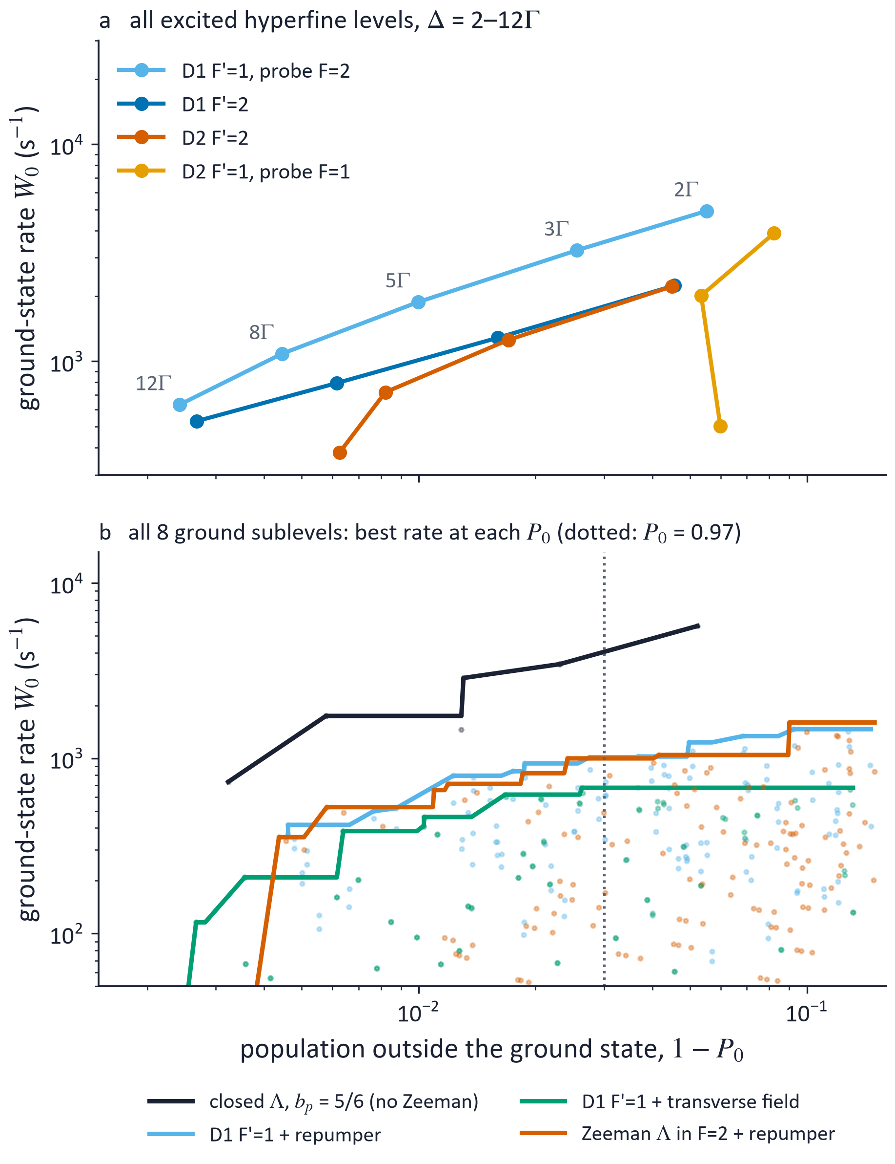
⁸⁷Rb: which transition, and what the Zeeman structure costs
Λ configuration (case A, Δ = 3Γ, s = 1) | W₀ (s⁻¹) | P₀
D1 F′=2, b_{p} = 1/2 | 2.2×10³ | 0.953
D1 F′=1, probe on F=2, b_{p} = 5/6 | 3.2–3.6×10³ | 0.974–0.979
D2 F′=2 | 2.1–2.2×10³ | 0.94–0.955
D2 F′=1, probe on F=1 | 2.0–4.2×10³ (sign) | fails above 8Γ
All excited hyperfine levels: D1 is robust (within 1 %); D2 F′=1 depends on the sign of the interference
All 8 ground sublevels: a fixed polarisation leaves dark states, so population must be remixed; a weak repumper or a Zeeman Λ inside F=2 (as in Qiu et al.) cools at about 1/3 of the closed-Λ rate, W₀ ≈ 10³ s⁻¹ at P₀ ≥ 0.97
Open: Zeeman structure with both axes, and the real polarisation of the fibre modes
Notes:
Figure a: ground-state rate against the population left outside the ground state, as the detuning goes from 2 to 12 Gamma; up and left is better. Figure b: with all Zeeman sublevels, the best rate reachable at each ground-state population for each remixing scheme, against the closed lambda. First the excited hyperfine levels. On D1 the second excited level is 814 MHz away and changes nothing; on D2 the levels are close and the F'=1 configuration depends on the interference sign. D1 F'=1 with the probe on F=2 is the best option, because five sixths of the decays return to the probe state. With all Zeeman sublevels, any fixed polarisation leaves dark states independent of motion; remixing by a repumper costs about a factor of three in rate. The Zeeman lambda used by Qiu and co-workers in tweezers performs about the same.

Slide 15
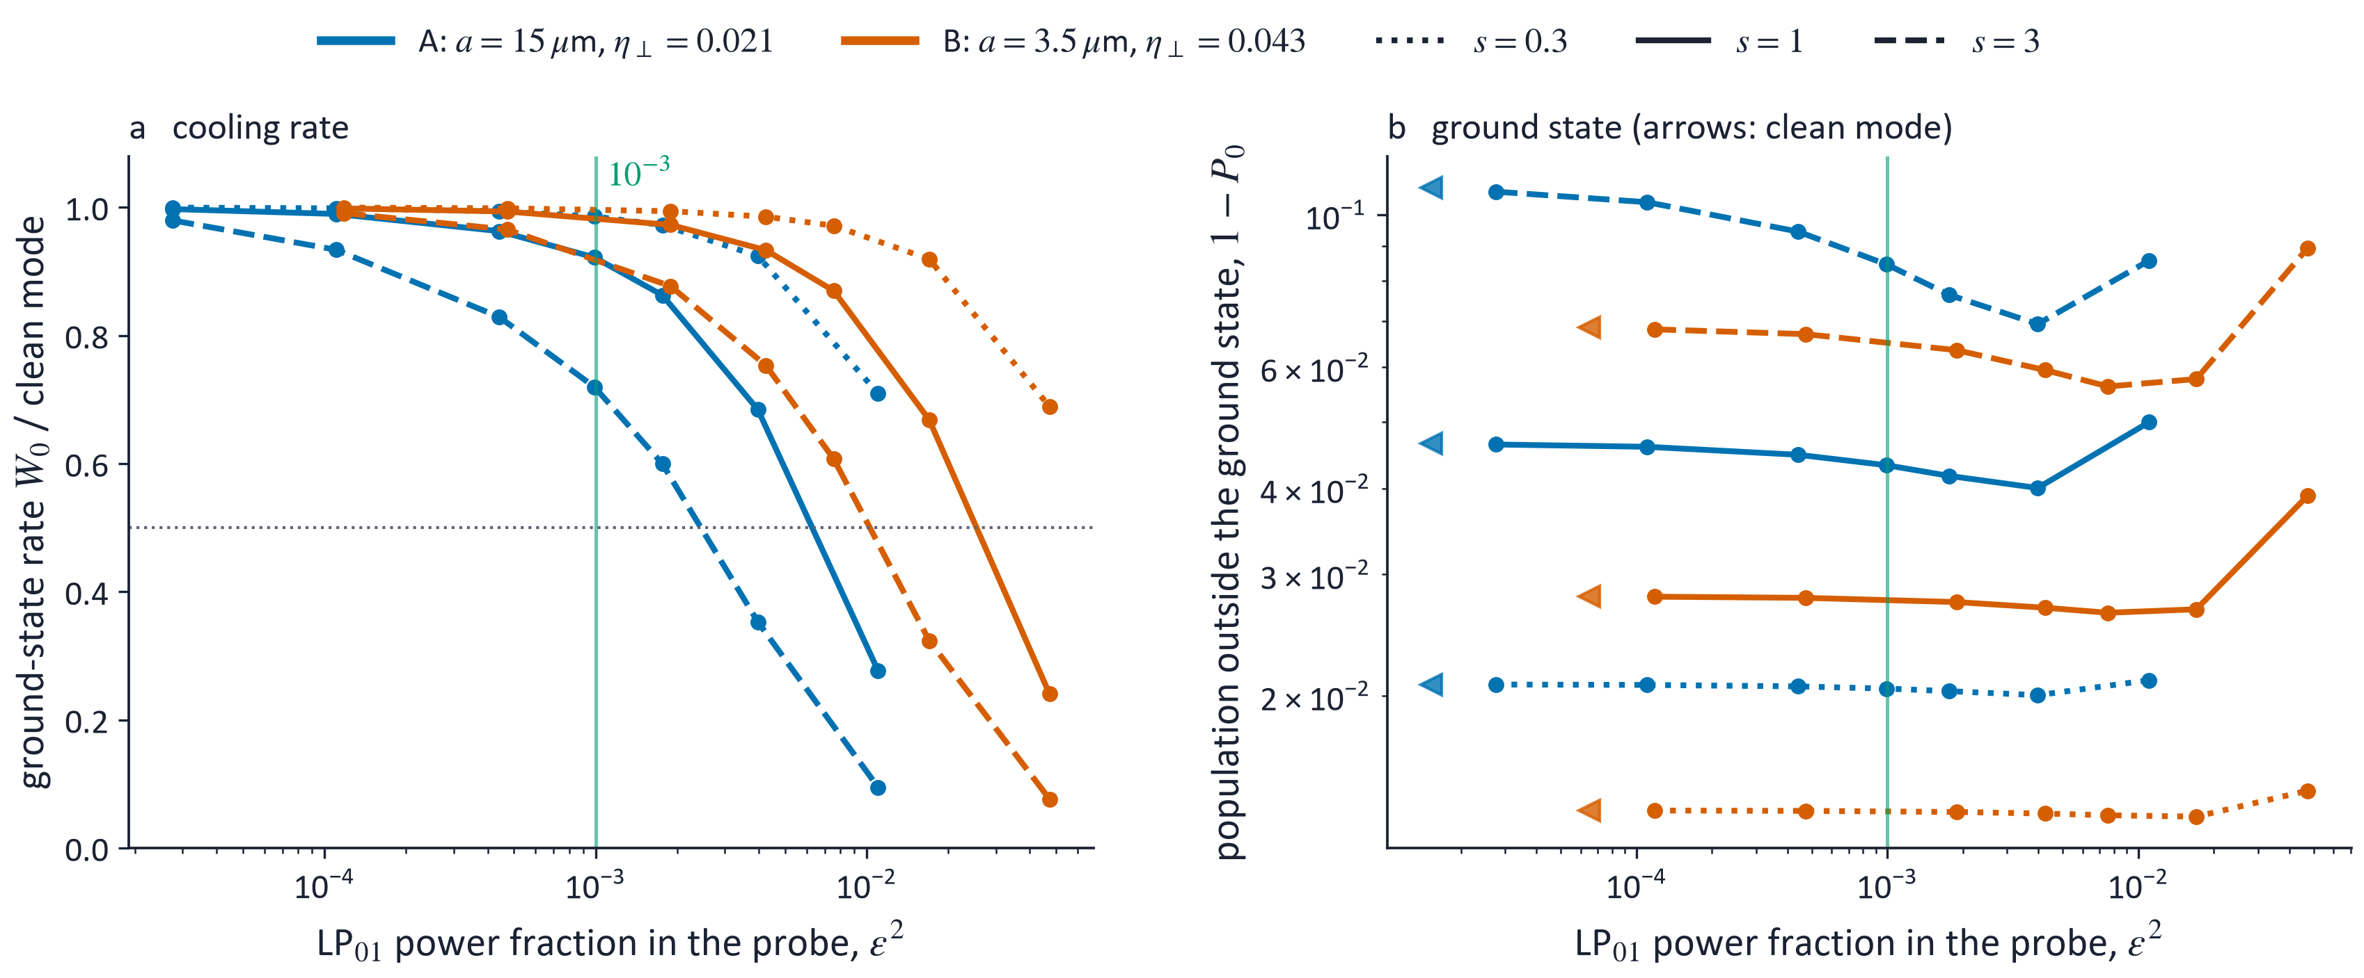
Mode purity: how clean must the LP₁₁ probe be?
An LP₀₁ admixture ε moves the node and adds a carrier; P₀ is unchanged up to ε ≈ 3 η⊥ and drops beyond
The ground-state rate halves at ε ≈ 3.6 η⊥ for s = 1 and 2.2 η⊥ for s = 3, nearly the same in both fibres; a larger η⊥ (small core) tolerates more power
LP₀₁ power below 10⁻³ keeps ≥ 90 % of the rate at s ≤ 1 in case A; the ⟨n⟩-based rate looks more fragile (halves at 1.4 η⊥, s = 3) because ⟨n⟩ sits in the hot tail
Notes:
Converged master equation at fixed saturation, both fibres. Horizontal axis: the LP01 power fraction in the probe, epsilon squared, which is what a mode measurement gives. Left: the ground-state rate relative to a clean mode. Right: the population outside the ground state, with the clean-mode value marked by arrows. A small admixture is equivalent to displacing the node, so the ground state is hardly affected; the rate suffers first, and more at high saturation, where the carrier is driven harder. An earlier estimate, rate halving at 1.3 eta perp, used the rate from the mean occupation at the rate-optimal s near 3; in case A that rate is dominated by the tail and exaggerates the sensitivity.

Slide 16
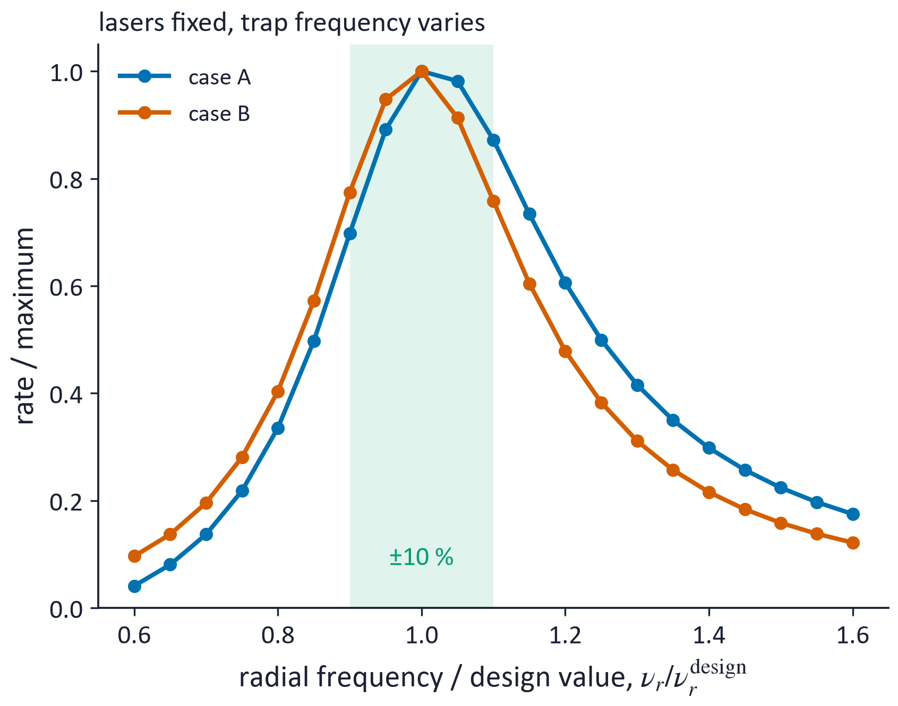
Practical requirements
Requirement | Value | Reason
Probe mode purity | LP₀₁ power < 10⁻³ | keeps ≥ 90 % of the rate at s ≤ 1 (case A); see previous slide
Trap centring | offset below ≈ x₀ (0.1 µm in case A) | acts as ε = η⊥ x_{s}/x₀: ≤ 5 % rate loss at s = 1
Radial frequency uniformity | ± 10 % along the column | keeps W above 70 % of its maximum
Probe power | 0.4–8 nW | set by s, not by the small gradient
Mode order | LP₁₁ or LP₁₂ | same rate at equal s; a higher mode only lowers the power
Notes:
Figure: lasers set for the design trap frequency while the actual one varies, as it would along a lossy fibre. Mode purity is the critical experimental requirement, as for ions: a small LP01 admixture restores a carrier. The simple estimate of the tolerance is a factor two too optimistic. A displaced trap is equivalent to an admixture. The trap frequency must be uniform along the column to within ten percent, which sets the tolerable lattice-beam loss.

Slide 17
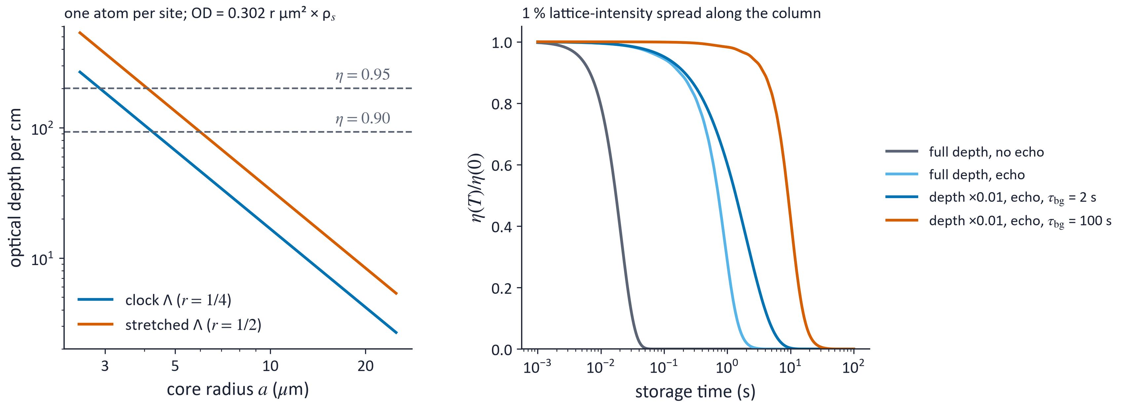
Application: a spin-wave memory in the fibre
Optical depth is the bottleneck: OD = 0.302 r µm² × ρ_{s}; 90 % efficiency needs ρ_{s} ≈ 1200 µm⁻² on the clock Λ: a ≲ 4 µm for a 1 cm column at one atom per site, or several atoms per site
Storage: cool deep, store shallow, with an echo: 2–11 s, limited by vacuum, then by lattice heating
Ground state buys shallow traps, uniform coupling and 60× fewer motional jumps; an echo alone removes static thermal dephasing
Notes:
Theory only. Left: optical depth per centimetre of column for one atom per site, as a function of core radius; rho_s is the number of atoms per square micrometre of mode area. A 15 micrometre core gives only 7 to 15 per centimetre on a usable lambda scheme, so efficient storage needs a small core, a longer column or several atoms per site. Right: storage model with lattice scattering and a one percent intensity spread along the column. Lowering the lattice a hundred times after cooling and using an echo gives seconds, limited by the background gas inside the fibre, which is the least certain input. The radial ground state is not mainly a coherence-time gain; it allows shallow traps and uniform coupling.

Slide 18
Summary
All-guided radial ground-state cooling: an LP₁₁ probe puts the atoms at a node; 10³–10⁴ s⁻¹ with nanowatts
Recoil-dominated regime: the steady state has a power-law tail, n^{−1/h}; P₀ and W₀, not ⟨n⟩, measure the cooling
One map for any atom and trap: h < 1/3 for a clean state, h < 1/2 for both radial axes, h ∝ a/(b_{p} ν_{z})
⁸⁷Rb: D1 F′=1 with the probe on F=2; the Zeeman structure costs about 3× in rate
Memory: small cores for optical depth; seconds of storage after lowering the lattice
Next: optimal saturation ramp from thermal states, real fibre-mode polarisation, Zeeman structure with both axes, memory simulations.
Notes:
Take-home messages. The concept of node cooling comes from ions; what is new is the platform, all beams guided in a hollow-core fibre, and the regime, where recoil is comparable to the trap quantum and changes the nature of the steady state. Next steps are listed at the bottom.

