Slide 1
Input Geography
Geo Data:
Geographical Bounds
Airports
Flight Manifests
User Workflow
Dataflow
Input Simulation
Sim Data:
Simulation Suite
Simulated Objects
Object Paths
MySQL
Database
Input Settings
Pre-execution Preview Plot
User Settings:
Simulated Objects
Object Paths
Execute Algorithm
Core Algorithm
Algorithm 3-D Visualization
View Results
Recorded Path Alteration Maps
Parameter and Performance History

Slide 2
MySQL
Database
Simulation:
Generates flight path contact with simulated objects
Initial path and contact event
C.
Resulting best-performing path
Assess contact event and generate alteration planes
F.
D.
Determine best-performing parameters
Generate mutated children paths alongside parent (previous generation’s best performing)
E.
Fly a batch of valid paths from parameters

Slide 3
MySQL
Database
Simulation:
Generates flight path contact with simulated objects
Initial path and contact event
Resulting best-performing path
Assess contact event and generate alteration planes
Determine best-performing parameters
Generate mutated children paths alongside parent (previous generation’s best performing)
Fly a batch of valid paths from parameters

Slide 4


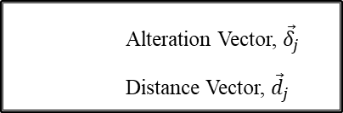

Alteration Vector, ${\vec{δ}}_{j}$
Distance Vector, ${\vec{d}}_{j}$
Sim Object Path
Last seen location, ${\vec{o}}_{e}$
Flight Path
Flight node, ${\vec{n}}_{j}$
Location of first contact, ${\vec{o}}_{s}$

Slide 5




Alteration Vector, ${\vec{δ}}_{j}$
Distance Vector, ${\vec{d}}_{j}$
Sim Object Path
Last seen location, ${\vec{o}}_{e}$
Flight Path
Flight node, ${\vec{n}}_{j}$
Location of first contact, ${\vec{o}}_{s}$

Slide 6
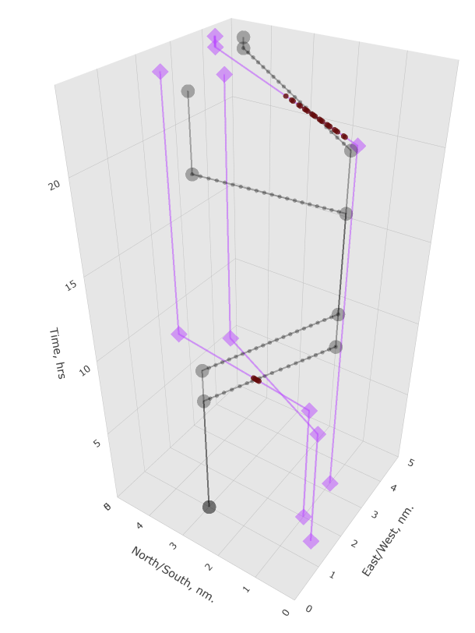
Flight Path
Sim Object Path
Contacted Nodes

Slide 7





$$t$$
$$t=t_{1},j=j_{max}=5$$
Cruise Portion of Flight
$$x$$
$$t=t_{0}, j=0$$
$$y$$

Slide 8


$$t$$
$${\vec{o}}_{s}$$
$${\vec{o}}_{e}$$
Contact Event
$$x$$
$$y$$

Slide 9
$$t$$
$$t=t_{1},j=j_{max}=5$$
CRUISE PORTION OF FLIGHT
$$x$$
$$t=t_{0}, j=0$$
$$y$$

Slide 10
$$t$$
$${\vec{o}}_{s}$$
$${\vec{o}}_{e}$$
CONTACT EVENT
$$x$$
$$y$$

Slide 11


$$t$$
Travelling at $v_{min}$
Travelling at $v_{max}$
$$x$$
$$y$$

Slide 12
Settings
Geography used
Simulation used
Fleet parameters
Algorithm parameters
Geo
Geography description
Associated airports
Sim
Available Simulation Suites
Associated target objects
Ports
All available airports
Associated flights
Sim Objects
All available target objects
Associated sim path points
Sight Schedule
Drone sight range as a function of time
Entries
All flight paths
Sim Points
All simulated path points

Slide 13









Contacted
Uncontacted
$$t$$
$$k=6$$
$$t_{4},t_{5}$$
Total Flight Time
$$t_{2},t_{3}$$
$$t_{1}$$
$$t_{min}$$
$$t_{2, 3}>t_{min}>t_{1,4,5}$$
$$k=0$$
$$x$$

Slide 14
Simulation:
Generates flight path contact with simulated objects
MySQL
Database
Core Algorithm
Batch of Shaping Parameters
Proposed Flights
Valid Flights
Select parameter set from best-performing flight
Differentiable Extension
Assess best-performing path
Minimize Path Length while maintaining contact
Optimized parameters
Output shortened path with equivalent contact performance

Slide 15
Simulation:
Generates flight path contact with simulated objects
MySQL
Database
Core Algorithm
Batch of Shaping Parameters
Proposed Flights
Valid Flights
Select parameter set from best-performing flight
Differentiable Extension
Assess best-performing path
Minimize Path Length while maintaining contact
Optimized parameters
Output shortened path with equivalent contact performance

Slide 16
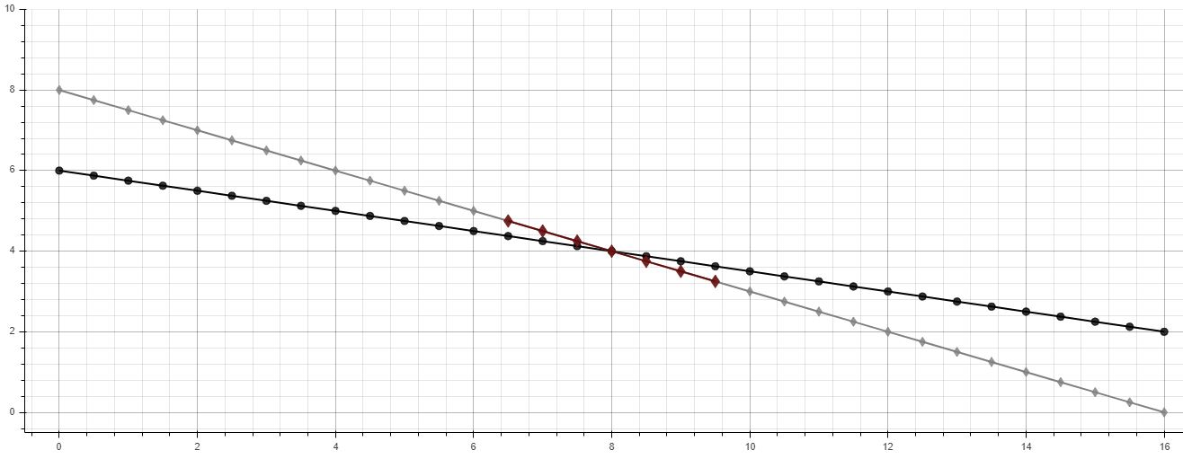








$$x_{B}$$
$${\vec{o}}_{e}$$
$t$, hrs
$$x_{A}$$
$${\vec{n}}_{j}$$
$${\vec{n}}_{j−1}$$
$${\vec{o}}_{s}$$
$x$-distance, nm

Slide 17
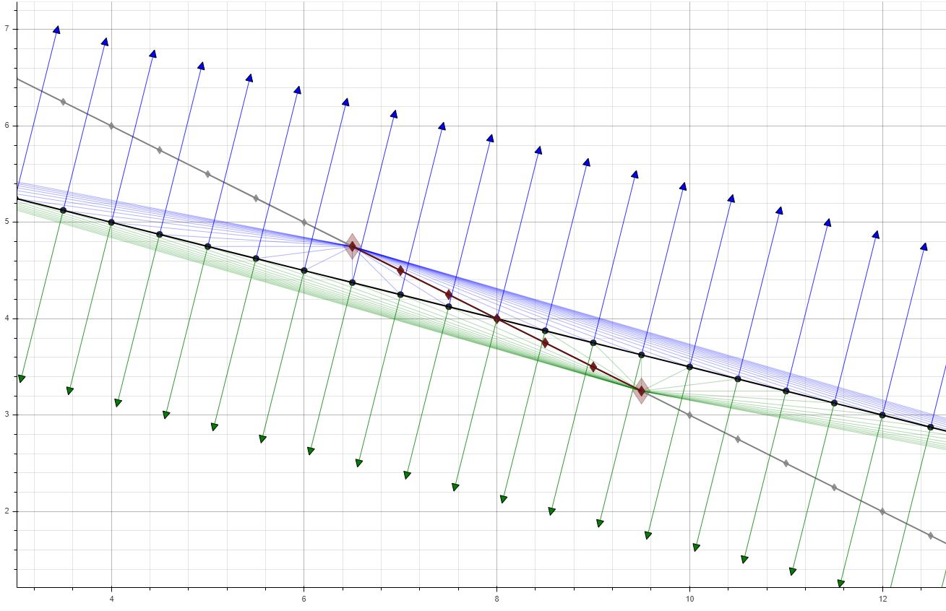


$t$, hrs
$x$-distance, nm

Slide 18
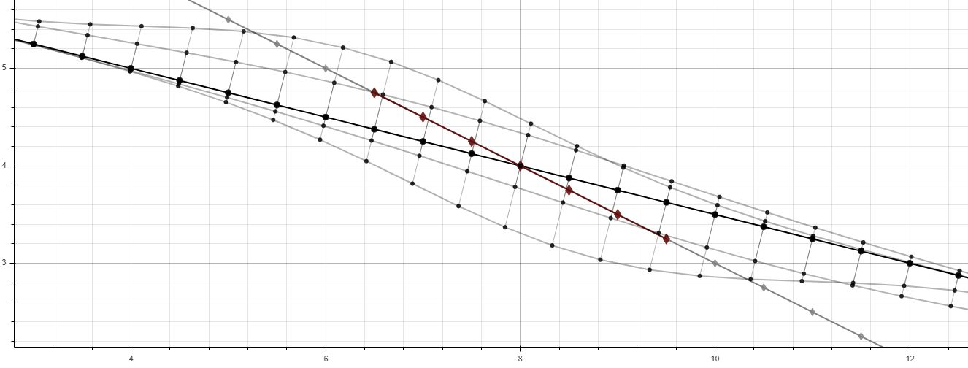



Exceeds $v_{max}$
$t$, hrs
Invalid paths (outside of flight envelope)
Exceeds $v_{max}$
$x$-distance, nm

Slide 19
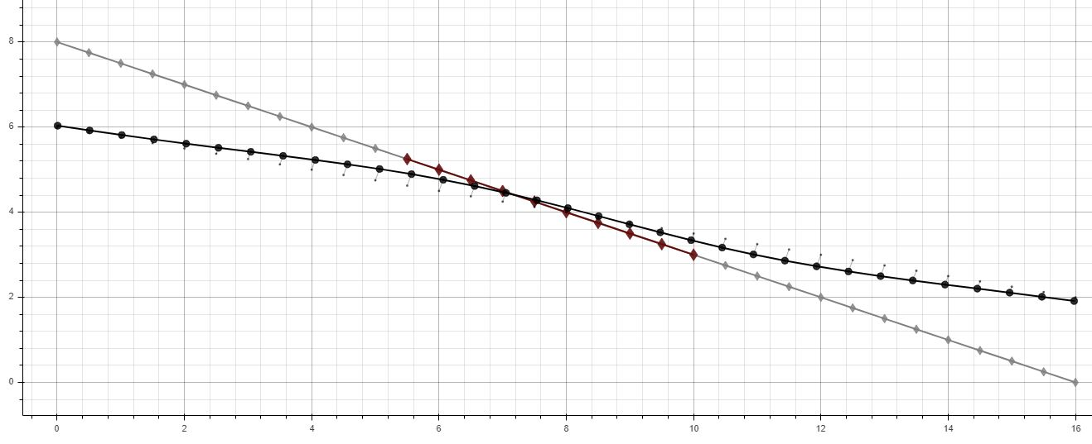






$$x_{B}$$
$${\vec{o}}_{e}′$$
$$x_{A}$$
${\vec{n}}_{j}$’
$${\vec{n}}_{j−1}′$$
$t$, hrs
$${\vec{o}}_{s}′$$
$x$-distance, nm

Slide 20
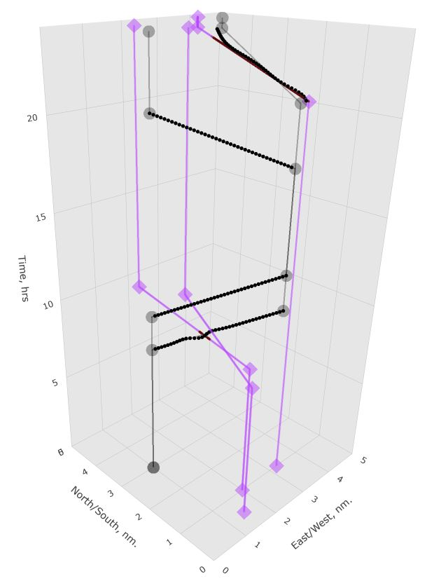
Original Flight Path
Altered Flight
Sim Object Path
Contact Region

Slide 21
Original Flight Path
Altered Flight
Sim Object Path
Contact Region

Slide 22
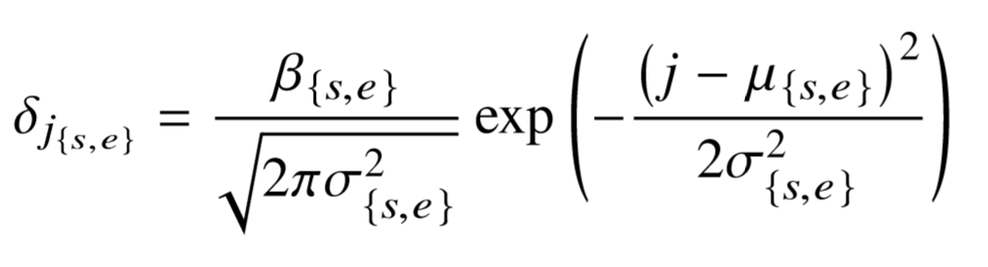
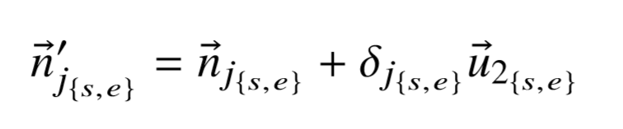




$$x_{B}$$
$${\vec{o}}_{e}$$
$t$, hrs
$$x_{A}$$
$${\vec{n}}_{j}$$
$${\vec{n}}_{j−1}$$
$${\vec{o}}_{s}$$
$x$-distance, nm

Slide 23
$t$, hrs
Children derived from original parent path
$x$-distance, nm

Slide 24


$$x_{B}$$
$${\vec{o}}_{e}′$$
$$x_{A}$$
${\vec{n}}_{j}$’
$${\vec{n}}_{j−1}′$$
$t$, hrs
$${\vec{o}}_{s}′$$
$x$-distance, nm

