Slide 1

ATOMS-02: UAS Traffic Management I
Using Genetic Algorithm to
Modify Scheduled Flights
to Track Regular Traffic
Leonardo Piñero
17 June 2019

Slide 2


➤ BACKGROUND ➤ METHODOLOGY ➤ RESULTS
Motivation
Existing Solutions take a Probabilistic Approach
The methodology is presented intends to contribute a novel heuristic solution based on regular geometry for predictable, but unknown, targets
$$v_{max}$$
$$v_{min}$$
TARGET’S POSSIBLE VELOCITIES FOR CURRENT TIME FRAME
POSSIBLE LOCATIONS AT NEXT TIME FRAME
PROBABILITY MAP INFORMS TRACKING

Slide 3
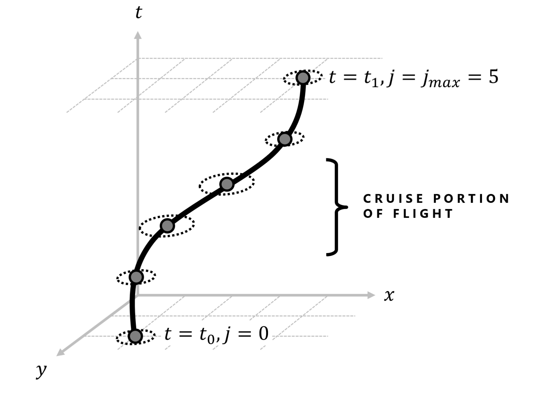
➤ BACKGROUND ➤ METHODOLOGY ➤ RESULTS
Motivation
Existing Solutions take a Probabilistic Approach
The methodology is presented intends to contribute a novel heuristic solution based on regular geometry for predictable, but unknown, targets
Geometric Approach to Search-and-Track Problem
The genetic algorithm is guided by imagining regular target paths as 3-dimensional line segments to mold into

Slide 4
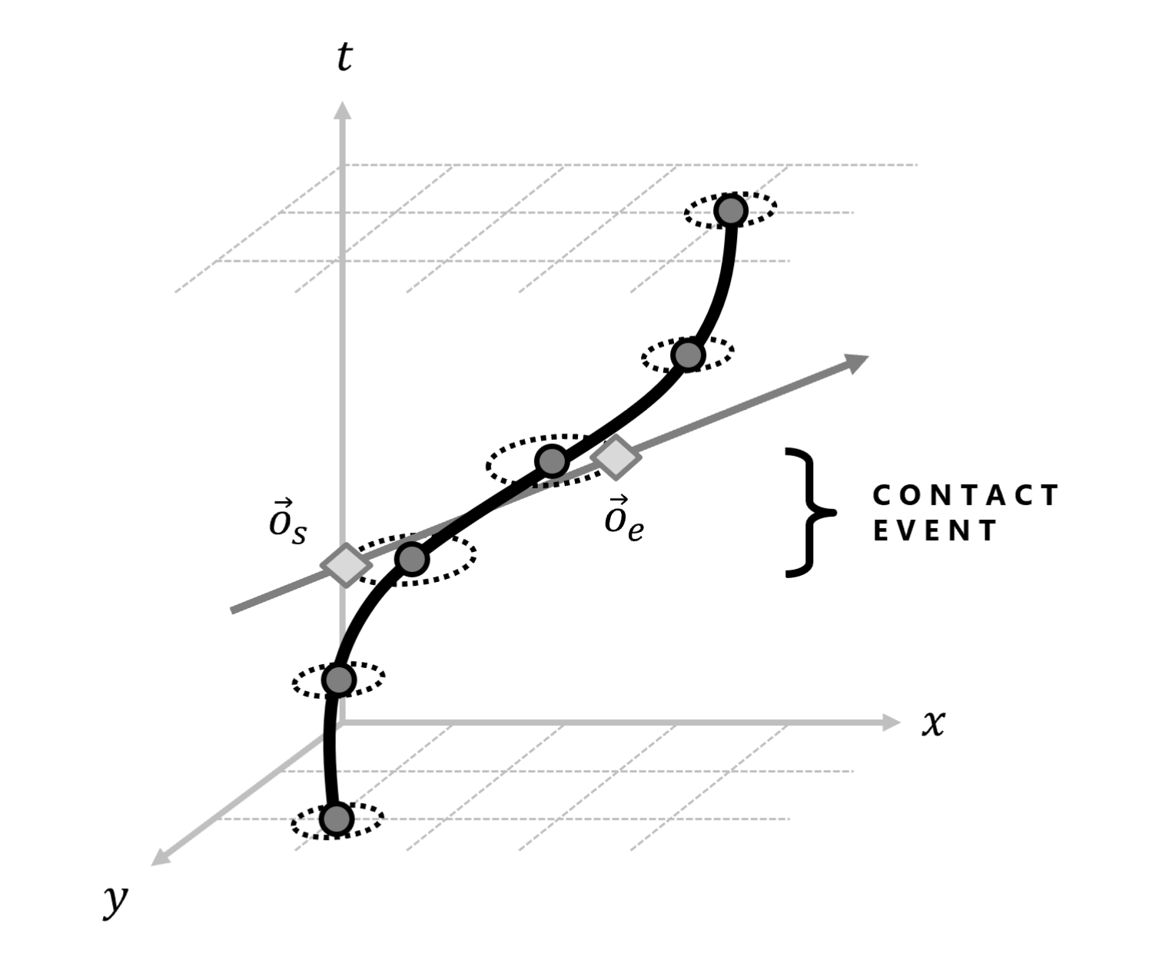
➤ BACKGROUND ➤ METHODOLOGY ➤ RESULTS
Motivation
Existing Solutions take a Probabilistic Approach
The methodology is presented intends to contribute a novel heuristic solution based on regular geometry for predictable, but unknown, targets
Geometric Approach to Search-and-Track Problem
The genetic algorithm is guided by imagining regular target paths as 3-dimensional line segments to mold into

Slide 5
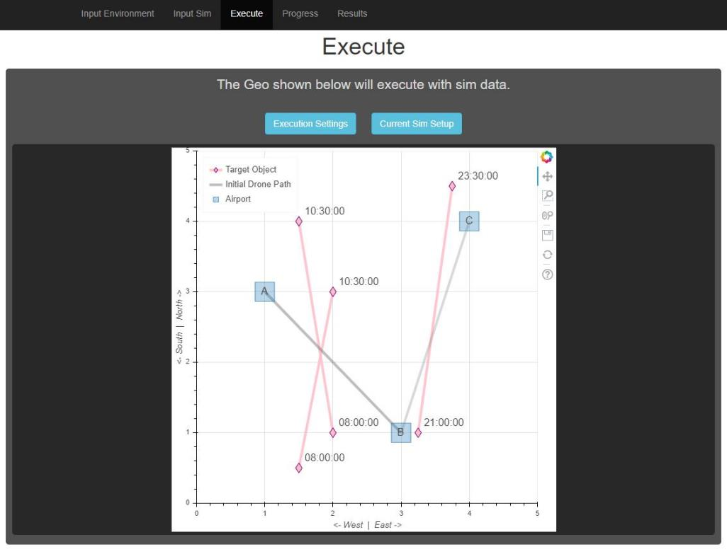
➤ BACKGROUND ➤ METHODOLOGY ➤ RESULTS
Motivation
Existing Solutions take a Probabilistic Approach
The methodology is presented intends to contribute a novel heuristic solution based on regular geometry for predictable, but unknown, targets
Geometric Approach to Search-and-Track Problem
The genetic algorithm is guided by imagining regular target paths as 3-dimensional line segments to mold into
Create Open-Source Guidance Software for Managing UAV Fleets
The user interface developed allows the user to utilize the genetic algorithm to increase tracking performance for a fleet

Slide 6
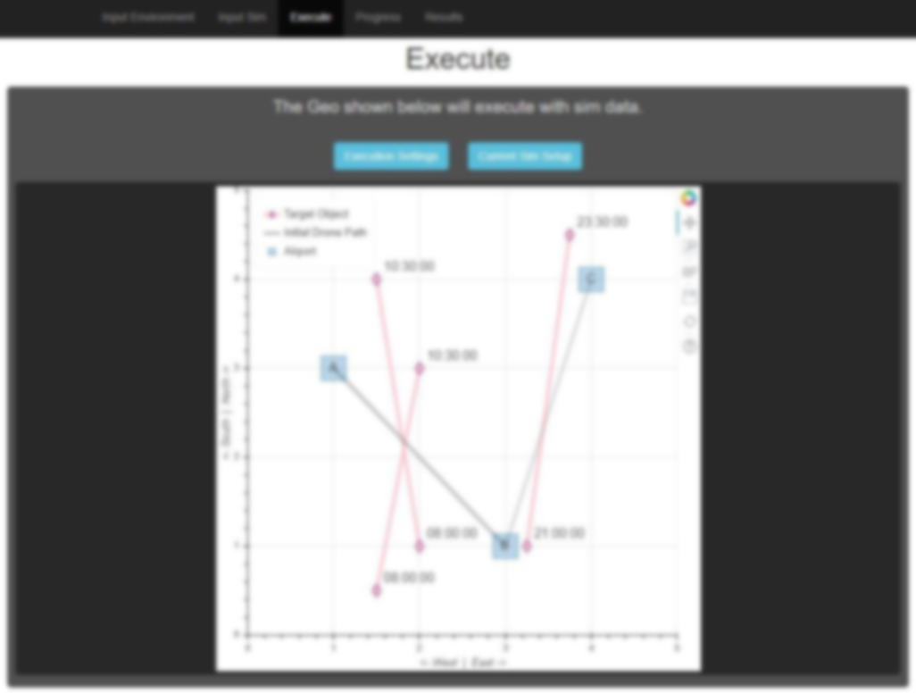
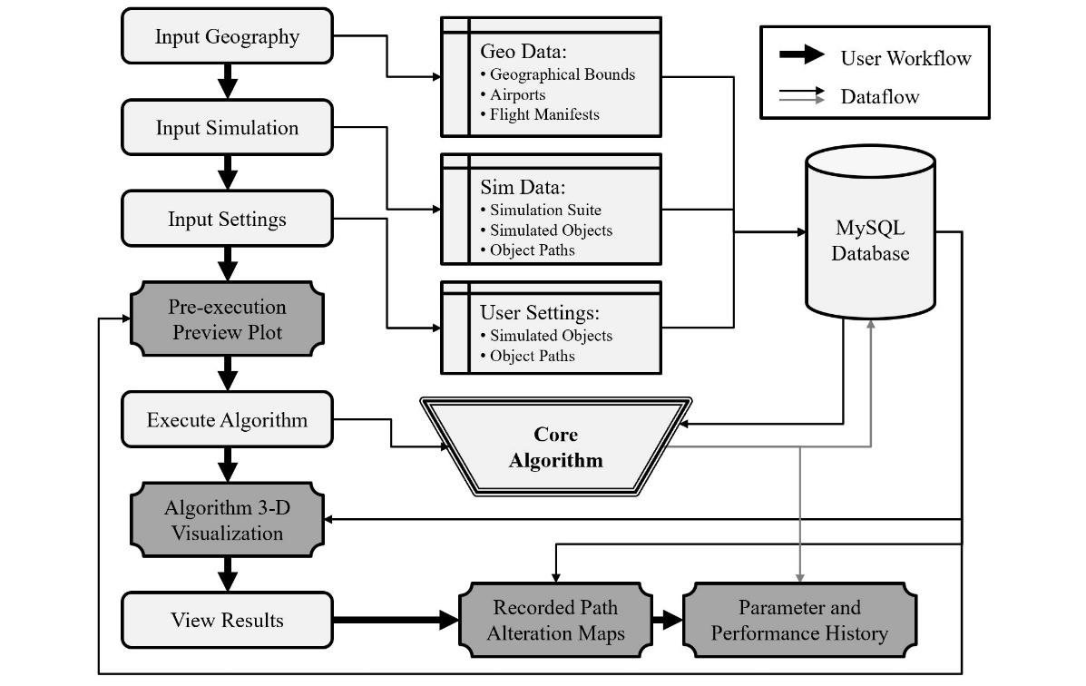
➤ BACKGROUND ➤ METHODOLOGY ➤ RESULTS
Motivation
Existing Solutions take a Probabilistic Approach
The methodology is presented intends to contribute a novel heuristic solution based on regular geometry for predictable, but unknown, targets
Geometric Approach to Search-and-Track Problem
The genetic algorithm is guided by imagining regular target paths as 3-dimensional line segments to mold into
Create Open-Source Guidance Software for Managing UAV Fleets
The user interface developed allows the user to utilize the genetic algorithm to increase tracking performance for a fleet

Slide 9
➤ BACKGROUND ➤ METHODOLOGY ➤ RESULTS
Motivation
Geometric Approach to Search-and-Track Problem
The genetic algorithm is guided by imagining regular target paths as 3-dimensional line segments to mold into
Create Guidance Software for Managing UAV Fleets
The user interface developed iteratively modifies individual path legs to increase tracking performance for a fleet
Many Existing Solutions take a Probabilistic Approach
The methodology is presented to contribute a novel heuristic solution based on geometry

Slide 10
➤ BACKGROUND ➤ METHODOLOGY ➤ RESULTS
Applications
Google Maps Traffic Validation
Existing traffic is estimated by Android users’ location

Slide 11
➤ BACKGROUND ➤ METHODOLOGY ➤ RESULTS
Problem Statement
Deviating existing fleet operations to better track patterns in traffic
NORTH
TARGET OBJECT PATH
UAV SCHEDULED PATH
(UNALTERED)
WEST
EAST
SOUTH

Slide 12
➤ BACKGROUND ➤ METHODOLOGY ➤ RESULTS
Problem Statement
Deviating existing fleet operations to better track patterns in traffic
NORTH
TARGET OBJECT PATH
UAV SCHEDULED PATH
(ALTERED)
WEST
EAST
SOUTH

Slide 13
MOTIVATION
Applications
Alternative
Write Something
Refers to a good or service being offered by a company. Ideally, a product should meet a certain consumer demand.
Refers to a good or service being offered by a company. Ideally, a product should meet a certain consumer demand.
Solution
Your Title
Refers to a good or service being offered by a company. Ideally, a product should meet a certain consumer demand.
Refers to a good or service being offered by a company. Ideally, a product should meet a certain consumer demand.

Slide 14
MOTIVATION
Applications
Alternative
Write Something
Refers to a good or service being offered by a company. Ideally, a product should meet a certain consumer demand.
Refers to a good or service being offered by a company. Ideally, a product should meet a certain consumer demand.
Solution
Your Title
Refers to a good or service being offered by a company. Ideally, a product should meet a certain consumer demand.
Refers to a good or service being offered by a company. Ideally, a product should meet a certain consumer demand.

Slide 15
WRITE SOMETHING HERE
SERVICES
Title One
Title Two
Title Three
Title Four
Marketers must link the price to the real and perceived value of the product,
Marketers must link the price to the real and perceived value of the product,
Marketers must link the price to the real and perceived value of the product,
Marketers must link the price to the real and perceived value of the product,

Slide 16
WRITE SOMETHING HERE
STATICS
Title One
Title Two
Title Three
Title Four
Marketers must link the price to the real.
Marketers must link the price to the real.
Marketers must link the price to the real.
Marketers must link the price to the real.

Slide 17


WRITE SOMETHING HERE
PRODUCTS
Title One
Refers to a good or service being offered by a company. Ideally, a product should meet a certain consumer demand.
Title Two
Refers to a good or service being offered by a company. Ideally, a product should meet a certain consumer demand.
Title Three
Refers to a good or service being offered by a company. Ideally, a product should meet a certain consumer demand.

Slide 18
WRITE SOMETHING HERE
ANALYSIS
60%
75%
Project
Project
Marketers must link the price to the real and perceived value of the product.
Marketers must link the price to the real and perceived value of the product.
20%
90%
Project
Project
Marketers must link the price to the real and perceived value of the product.
Marketers must link the price to the real and perceived value of the product.

