Slide 1
Input Environment
Geo Data:
Geographical Bounds
Airports
Flight Manifests
User Workflow
Dataflow
Input Simulated Objects
Sim Data:
Simulation Suite
Simulated Objects
Object Paths
MySQL
Database
Input Settings and Preview
Pre-execution Preview Plot
User Settings:
Simulated Objects
Object Paths
Execute Algorithm
Core Algorithm
Generates Results
Uses Path Data
Algorithm 3-D Visualization
View Results
Iteration History Plots

Slide 2
MySQL
Database
Simulation:
Generates flight path contact with simulated objects
Initial path
Newly altered path
Assess properties of contacted points
Compute the resulting cost from previous path alteration
Tuned path alteration
Update tuning parameter vector

Slide 3


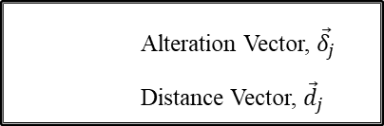

Alteration Vector, ${\vec{δ}}_{j}$
Distance Vector, ${\vec{d}}_{j}$
Sim Object Path
Last seen location, ${\vec{o}}_{e}$
Flight Path
Flight node, ${\vec{n}}_{j}$
Location of first contact, ${\vec{o}}_{s}$

Slide 4
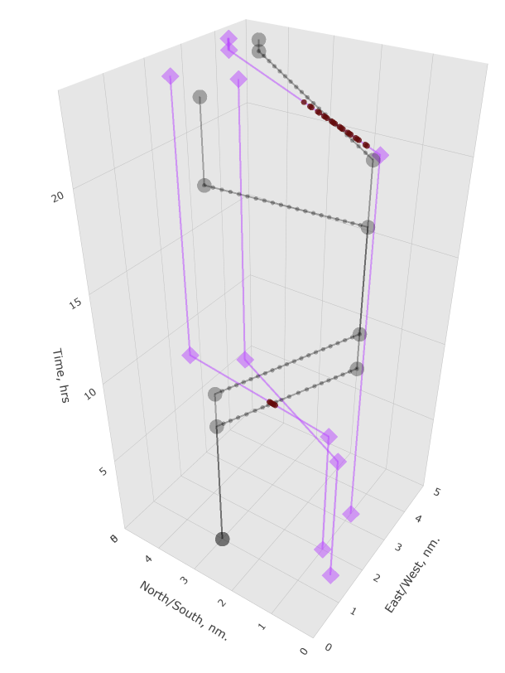
Flight Path
Sim Object Path
Contacted Nodes

Slide 5





$$t$$
$$t=t_{1},j=j_{max}=5$$
Cruise Portion of Flight
$$x$$
$$t=t_{0}, j=0$$
$$y$$

Slide 6


$$t$$
$${\vec{o}}_{s}$$
$${\vec{o}}_{e}$$
Contact Event
$$x$$
$$y$$

Slide 7


$$t$$
Travelling at $v_{min}$
Travelling at $v_{max}$
$$x$$
$$y$$

