Slide 1
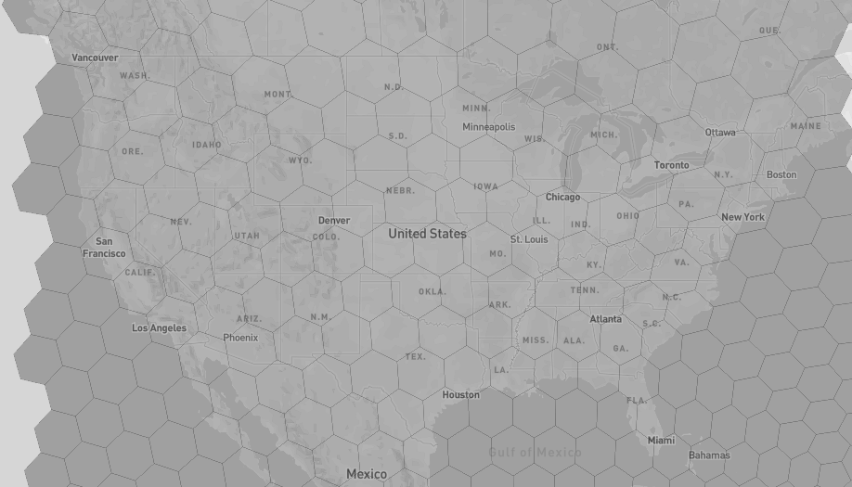
50, -126
50, -85
49, -68
44, -66
44, -81
37, -126
30, -106
31, -78
31, -118
28, -94
28, -84
24, -79
25, -97
24, -83

