Slide 1
Shared Memory Consistency Models: A Tutorial
Sarita V. Adve
Rice University
Kourosh Gharachorloo
Digital Equipment Corporation
Published In: Computer (Volume: 29, Issue 12)
Digital Object identifier: 10.1109/2.546611
Presented By: Terence Henriod

Slide 2
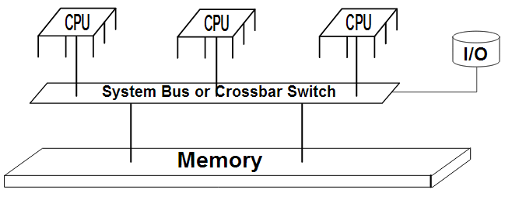
What is Shared Memory?
Memory that can be accessed by multiple processors/programs
Intent is to provide inter-process communication or a reduction in duplication of data
http://en.wikipedia.org/wiki/File:Shared_memory.svg

Slide 3
What’s the Problem?
Things like caches, buffers, multiple readers and writers, optimizations etc.
These can result in the use of invalid data in a program, disrupting proper execution if left unhandled

Slide 4
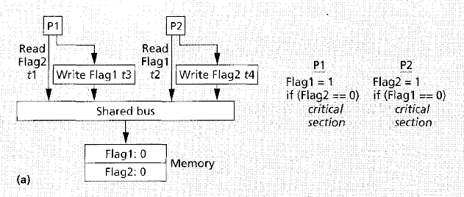
Case: Reads bypassing writes
Because the writes are put in a buffer so that the process can move on to other instructions, if a read instruction occurs shortly after the write did, bad data will be read

Slide 5
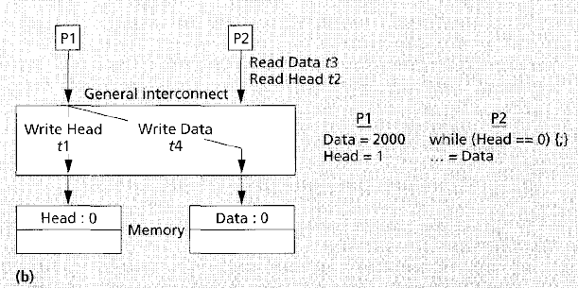
Case: Overlapping writes
Assume the figure depicts a non-bus network. Thus, a write to the Head variable may traverse the network faster than the write to Data, even though the write to Data instruction occurred first. If this occurs, P2 will think it is reading a current value for Data, when there is no such guarantee without a memory consistency model.

Slide 6
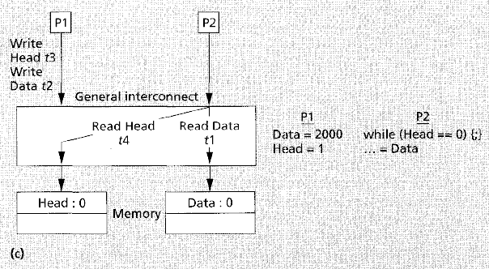
Case: Non-blocking reads
Again, this is a non-bus system. A different temporal order is depicted, but the ideal sequence of actions might be:
P1: Data = 2000 -> P1: Head = 1 -> P2: read Head -> P2: read Data
In this example, P1 is writing to Head in order to prevent P2 from reading Data. However, since the reads are non-blocking, P2 moves on (BAD).

Slide 7
Sequential Consistency
The most commonly assumed model in multiprocessor systems
Maintain program order among operations on a single processor
Maintain a single sequential order among all operations
…“if the result of any execution is the same as if the operations of all the processors were executed in some sequential order, and the operations of each individual processor appear in this sequence in the order specified by its program.”

Slide 8
Memory consistency models have the potential to affect performance, programmability, and portability
Because a strict memory consistency model would disallow many uniprocessor hardware and compiler optimizations, relaxed consistency models have also been created
Note: we are discussing sequential consistency vs. relaxed sequential consistency, not the actual model of strict consistency.

Slide 9
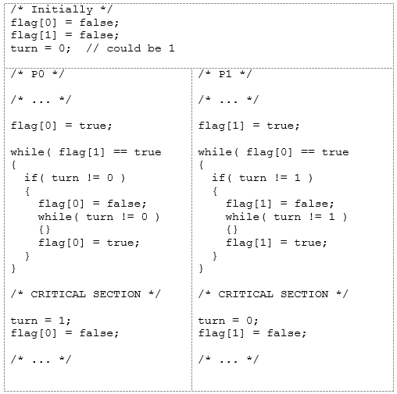
Dekker’s Algorithm (to illustrate program order):

Slide 10
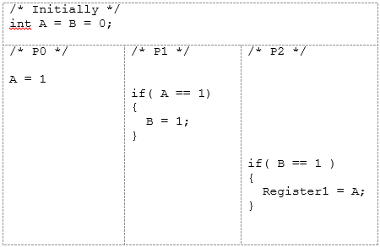
To illustrate memory operation atomicity:

Slide 11
Implementing Sequential Consistency

Slide 12
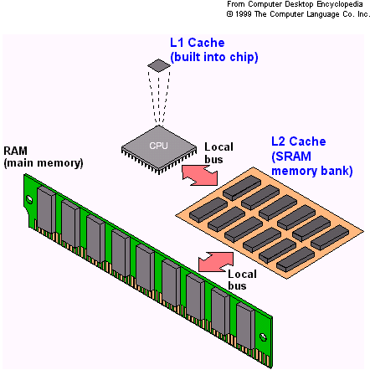
Cache Coherence Protocol
Synonym: Cache Consistency
A procedure to propagate new data
Two methods:
Data invalidation (more common)
Update policy
http://xiongz-hft.blogspot.com/2012/01/improve-cache-performance-with-high.html

Slide 13
Detecting Write Completion
In non-cache systems, it’s acceptable to move on after completion of a write
This would be too early in a caching system
Writes must be seen at ALL locations by ALL processors
Requires the writing processor to receive acknowledgement by all other processors
Maintaining Write Atomicity
Enforce writes to the same memory location to be serial
Directory based monitoring is a good way to handle this because invalidations come from a single, immediate source
Disallow reads from a memory location until all processors have acknowledged a previous write

Slide 14
Compiler Optimizations
Generally have to be disallowed
Code re-ordering
Register allocation
Pipelining, loop-blocking
Left to the programmer to disable
ex.: volatile
This applies to parallel code, compilers can appropriately handle sequential code

Slide 15
Proposed Sequential Consistency Optimization Techniques
Hardware techniques
1. Write ownership prefetching
2. “Read rollback”
Dramatically improve performance of sequential consistency
Compiler Techniques
Detect when re-ordering is OK
Algorithm is exponential; a polynomial one has been proposed

Slide 16
Relaxed Models
Can be described in two ways:
“How they relax the program order requirement.”
This allows write operations to occur concurrently as long as the addresses written to are different (similar to sequential consistency optimizations for non-caching systems)
“How they relax the write atomicity requirement.”
This allows one processor to read what another processor has written (only used in caching systems)
Typically offer memory fencing/barrier instructions to override relaxations

Slide 17
Ways to Relax
Write → Read order
Write → Write order
Read → Read or Write order
Read other processors’ writes early
Read own write early
Safety Nets (allow us to un-relax)

Slide 18
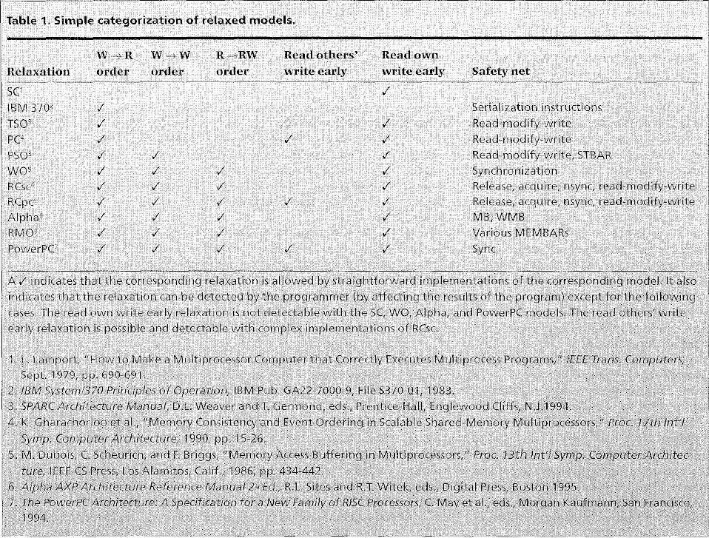

Slide 19
Weak Ordering
Memory operations between synchronization operations are allowed to be re-ordered
Release Consistency
Like WO, but with more types of synchronization operations that are either acquire or release operations
Alpha, RMO, PowerPC
Use fence instructions to produce synchronization and maintain program order

Slide 20
Programmer-Centric Models
Provide a higher level of abstraction to ease the burden of the programmer, perhaps at the cost of performance
This helps with issues such as forcing the programmer to know the system specific semantics and portability

Slide 21
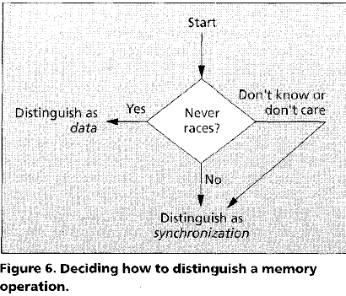
Model should provide a mechanism to allow the programmer to identify which operations involve data that will not result in races

Slide 22
Distinguishing memory operations:
Language level
doall loops
Special constructs that designate blocks of a program as “synchronization”
Hardware level
Use unused opcode bits to create special intructions
Distinguish different memory pages, virtual or physical, to create synchronization

Slide 23
References
Information (just links)
10.1109/2.546611 (The article discussed)
http://en.wikipedia.org/wiki/Cache_coherence
Images (again, just links)
http://en.wikipedia.org/wiki/File:Shared_memory.svg
http://xiongz-hft.blogspot.com/2012/01/improve-cache-performance-with-high.html
All grayscale images came from the article

