Slide 1
Attempting to Improve APSP on the GPU
Terence Henriod

Slide 2
Intro
Graphs are an abstraction of binary relationships between entities and the cost or weights of those relationships
Sometimes we want to know the best way to navigate between one entity and another

Slide 3
Sometimes we are interested in optimizing cost or reward of traversal, such as in the case of a road map or a probabilistic model
Maybe we want to know the best places to start from in order to disperse something (related to the largest clique problem)
No matter what, we want to find our answer FAST

Slide 4
My Results In Short...
I failed to improve upon the APSP algorithm in a significant way
I have found ways that don’t work or only work in non-target cases → maybe I have pruned the “search tree” of ways to improve
I attempted the important things that I proposed and added some others

Slide 5
My Ideas for Improvement
Solve subtrees of the recursion tree on separate, concurrent GPUs
Increase the β parameter to shorten the recursion tree
Increase the number of threads used in one of the existing kernels
Decrease the number of threads used (I’ll explain)
Use shared memory to execute some of the kernels concurrently
Try to improve on Volkov’s SGEMM
Choose a different project (just kidding)

Slide 6
Solving Subtrees Independently
This failed due to my own oversight
Could’ve seen this by studying the math/regular expressions more closely; could’ve tried reordering the operations sooner rather than writing code to re-arrange it
In short: impossible, one subtree is dependent on the solution of the other.

Slide 7
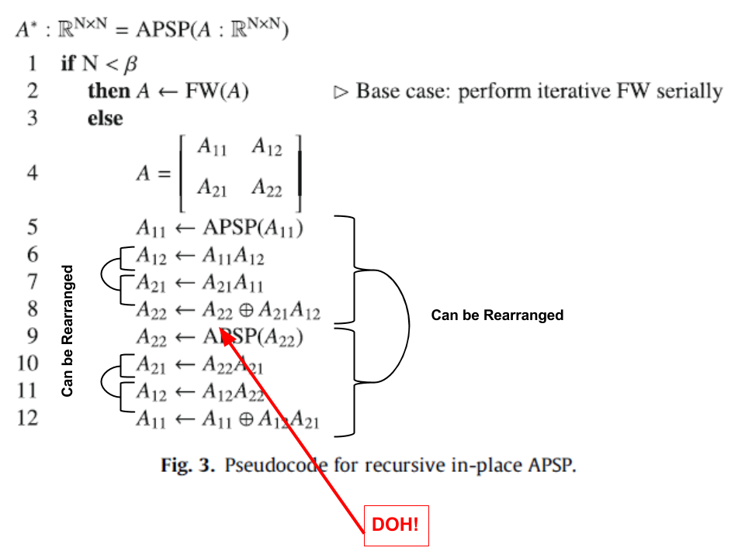

Slide 8
Increase the β Parameter
Reduce recursion depth, reduce kernel launches, and maybe eliminate the need for a 3rd kernel!
The kernels used:
if (block_width < β) → “sequential” multiply
else if (block_width < 64) → “regular” multiply
else → “Volkov” multiply

Slide 9
Increase the β Parameter /
Increase the Number of Threads Used
Attempt to reduce the number of kernel launches/have a faster kernel
It’s not very effective…
Anecdotally: slightly better on a mobile GPU (but that wasn’t the goal…)
Actually a little worse than the 16 originally used on a 480

Slide 10
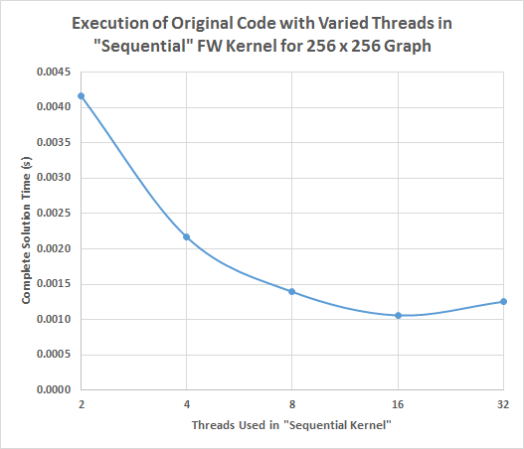
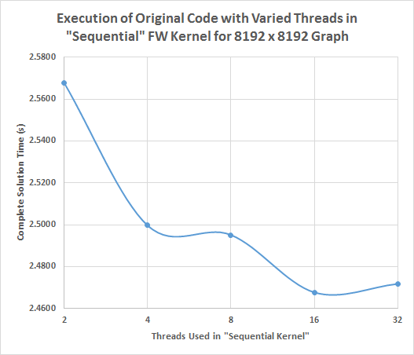

Slide 11
Increase the β Parameter/Use Fewer Threads
Again, attempt to reduce the number of kernel launches, also reduce global memory accesses, and give threads more work
Not always correct - lost correctness above 8 threads
Achieved speedup on smaller inputs/vs. smaller numbers of threads (but that’s not the goal…)

Slide 12
The strategy:
Fetch memory into shared memory to reduce global memory accesses
Have threads do more work by having each thread compute results for 4 or 16 elements of the result rather than 1 (exploit Instruction Level Parallelism; see Volkov’s work http://www.cs.berkeley.edu/~volkov/volkov10-GTC.pdf)
Should be correct since in the original algorithm, each thread assessed one pair of neighbors independently at a time; I am simply simulating a larger number of threads doing the same thing

Slide 13
Assumed values for example analysis:
4 x 4 thread block → 4 x 4 small block, 8 x 8 large block
600 cycles (~150 GB/s) per global memory access
6 (~1.7 TB/s) for shared memory accesses
reads/writes considered similar for simplicity (I know they are different)
Original Method Memory Access
each thread (4^2 threads) performs 2 reads and 1 write 4 times → 4^2 * (2 + 1) * 4 = 192 global accesses per call
4 small blocks in a big block
4 small blocks * 192 global accesses * 600 cycles = 460800 total cycles
My method
each thread performs 4 global memory reads (start) and 4 writes (end)
each thread (4^2 threads) performs 8 shared memory reads and 4 writes 8 times → 4^2 * (8 + 4) * 8 = 1536 shared memory accesses
1 big block * (1536 * 6 + 8 * 600) = 14016 total cycles
14016 << 460800

Slide 14
In Big-Oh
Original
4 tiles * (t^2 * (2gr + 1 gw) * 4)
= 32 * t^2 * gr + 16 t^2 * gw
= O(28800 * t^2)
Mine: 1 tile * (t^2 * (4gr + 4gw + 8sr + 4sw))
= 4*t^2*gr + 4*t^2*gw + 8*t^2*sr + 4*t^2*sw
= O(4860 * t^2)
***If we stick to our 600 cycles for global and 6 cycles for shared assumption

Slide 15
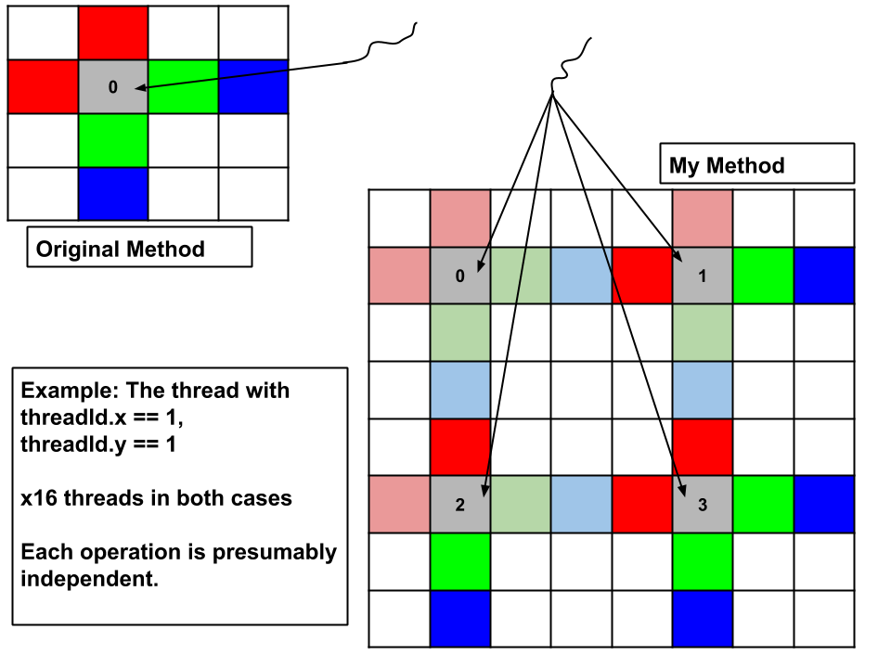

Slide 16
Could it be that allocating a small array in registers in the “regular” multiplies is better than dynamically allocating shared memory in the “sequential” multiply?

Slide 17
Didn’t Try: Execute Some Kernels Independently
Without any machines with integrated GPUs available, this seemed like a lost cause
With physically unified memory, using “pinned memory” techniques or true Unified Memory (UM) might have produced some improvement
As it stands, the hit from accessing non-UM multiple times from a discrete GPU probably would have been detrimental

Slide 18
Didn’t Try: Improve Volkov’s SGEMM
Volkov is a wiz at SGEMM - likely little room for improvement
There seems to be intricate hand tuning involved - low probability of improving it anyway

Slide 19
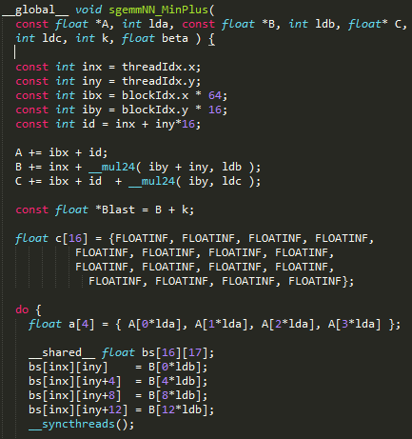
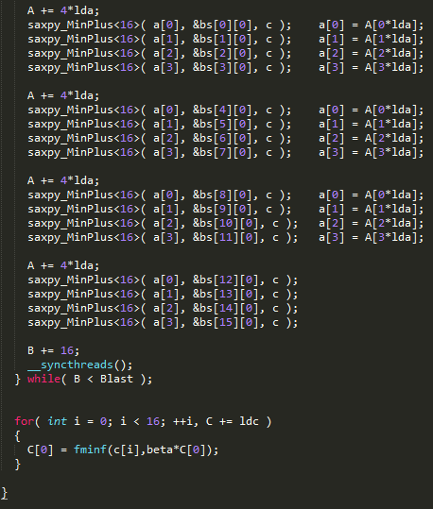

Slide 20
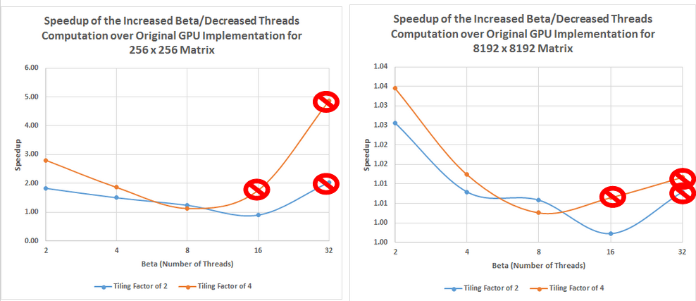

Slide 21
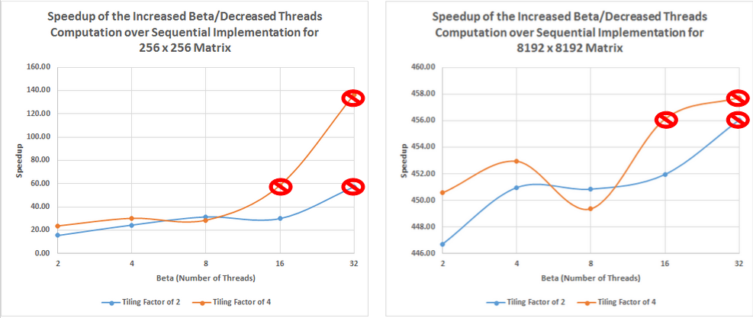

Slide 22
The Hardware
CPU
Intel Core i7-4790
15.6 GiB RAM
8 MB cache
3.60 GHz
GPU
GeForce GTX 480
15 SM; 448 Cores
1280 MB RAM
786 kB L2 cache
1.4 GHz

Slide 23
If I had another month...
I’d allow myself a week to try and fix the increased β/fewer threads approach
Spend 2 days (at most) trying the dual GPU with shared memory for concurrent kernels approach
Add blocks to the “normal” multiply kernel
Try out concurrent kernel launches where possible
Tuning or improving Volkov’s SGEMM

Slide 24
Thank You
Questions?

