Slide 1


Football Player Valuation Forecasting
and Talent Scouting
Big Data Computing
Leonardo Berti
Marco Guarino
Notes:
‹#›

Slide 2
Dataset description
The starting dataset was downloaded from kaggle. It represents the database of the football site "transfermarkt". It is made up of 8 .csv tables.
appearances.csv (1.170.381 rows): all appearances for all players in clubs;
club_games.csv (123.097 rows): all club games in the dataset
clubs.csv (412 rows): all clubs in leagues (competitions)
competitions.csv (43 rows): all competitions in the dataset (a game is played in a competitions;
game_events.csv (559.854 rows): the events in a game;
games.csv (61.459 rows): all games in the dataset
player_valuation.csv (421.565 rows): evolution of market values of players;
players.csv (21.097 rows): all players in the dataset;
Notes:
descrizione tabelle (kaggle)

Slide 3
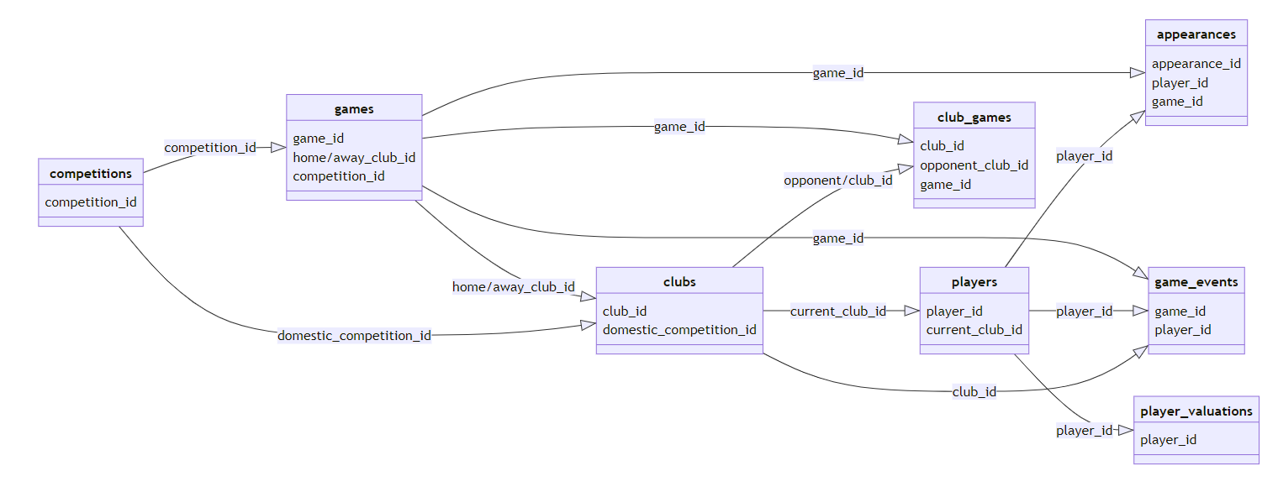
Dataset schema
Notes:
descrizione tabelle (kaggle)

Slide 4
Features extraction
The goal of this section is to create a single dataset that can be used in subsequent steps.
Through the tables described in the previous slides, a dataset is created in which the key of each row is represented by the columns "player_id", which uniquely represents a player, and "date_v", which represents the date on which the market value of " player_id" is updated. Then for each player there are as many rows as there are update dates (date_v) associated with him.
The features that have been extracted and calculated from the tables represent useful informations as appearances, assists, goals, winning rate and many others. In particular the statistics relate to the year preceding the date of "date_v".
Notes:
descrizione pre processing e creazione “dataset.csv”

Slide 5
Feature extraction and final dataset
Before saving the dataset (dataset.csv) with the new features obtained, the management of the zero-value and null-value is carried out.
The dataset obtained has this schema.
player_id: uniquely identifies the player;
date_v: update date of market_value of player_id;
market_value: market value associated to (player_id, date_v);
personal informations: features such as age, place of birth and others;
player stats: features that describe the performance of the player in the previous year with respect to date_v;
Notes:
descrizione pre processing e creazione “dataset.csv”

Slide 6
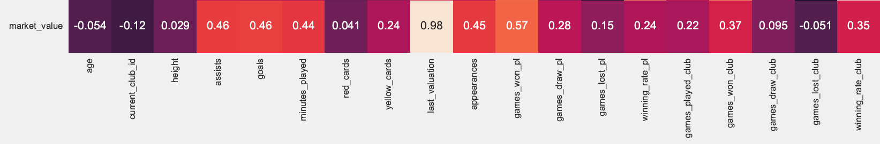
Data Analysis
Correlation vector of market value with the other features

Slide 7
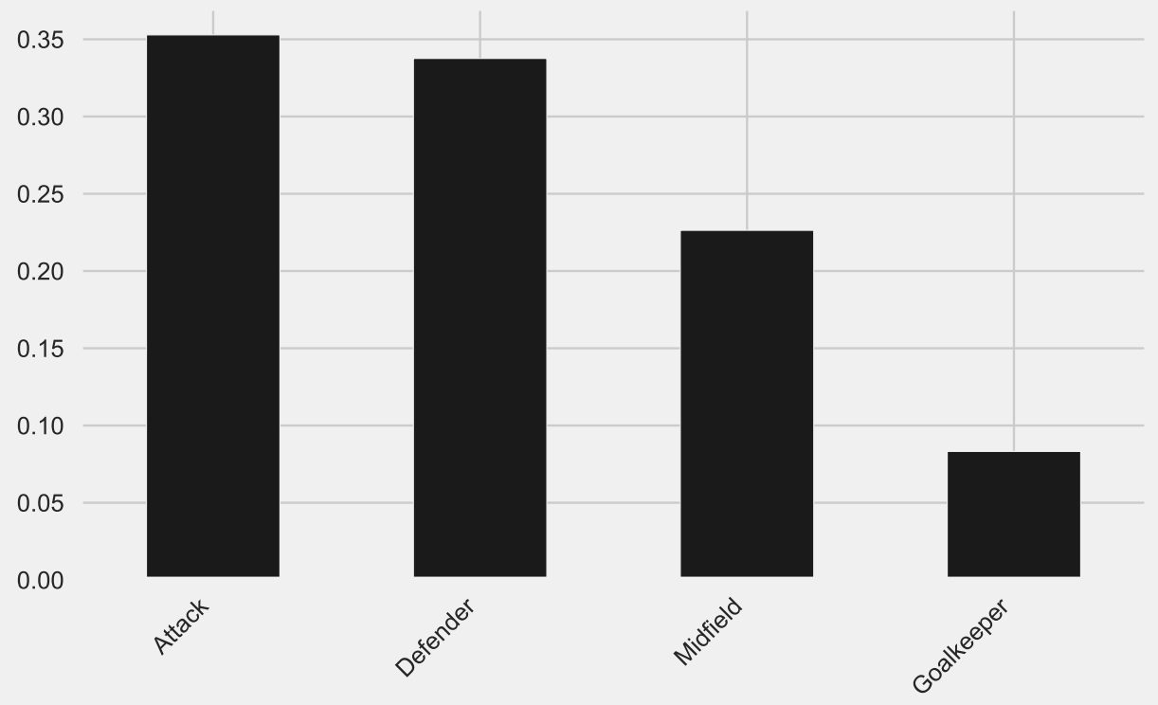
Bias towards the strickers

Slide 8
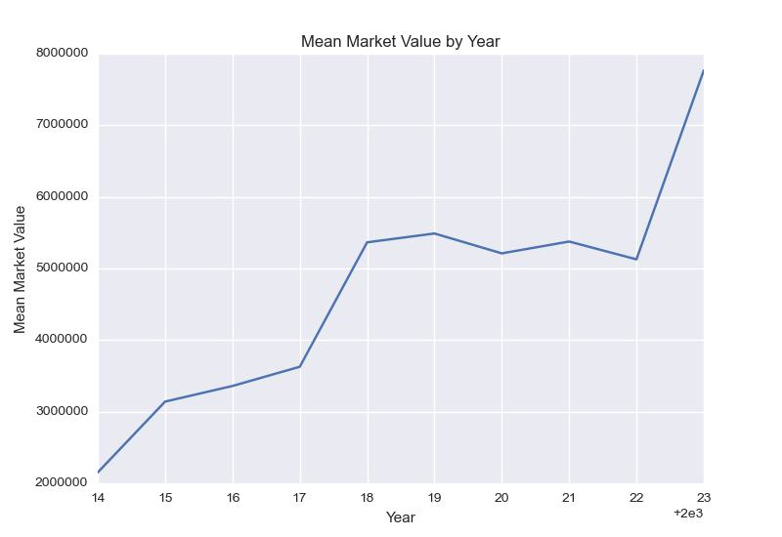

Slide 9
Forecasting player valuation: Task 1
For every couple (player_id, date_v) we want to forecast the market valuation.
To tackle this problem we developed some machine learning and deep learning models:
Multivariate Linear Regression
Multilayer Perceptron (MLP)
Long-Short Term Memory (LSTM)
Random Forest
Bagging of Decision Trees
Gradient Boosting Regressor
Notes:
descrizione primo task (lista metodi)

Slide 10
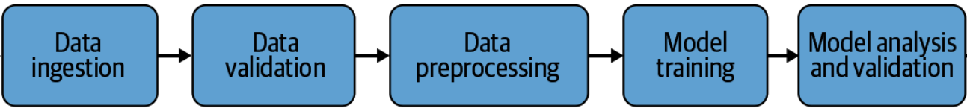
Machine Learning pipeline
Notes:
Obviously we developed all the machine learning pipeline, the data ingestion and validation part has already been explained. In a second I will explain the pre-processing part. The final dataset, ready to train the model, was of 140k elements, we divided it in train, validation and test set. With a split of 70%, 10%, 20%. We run an hyperparameters search using WANDB, a famous tool that helps you track your experiments and do hyperparameters optimization through an interactive dashboard. The hp search consist of 20 runs, divided in 10 using bayesian search and 10 using grid search. For the classical models the hp tuned are: learning rate, optimizers, batch size and dropout. For the ensemble: number of DTs, max features chosen for each split, max depth. To choose the best hyperparameters we select the best performing on the validation set, so we avoid overfitting. ANd obviously to evaluate the models we used the perform on the test set.

Slide 11
Data Pre-Processing
Numerical Continuous Features -> We apply zscore to every column except for age, last_valuation, market_value. Instead we apply min-max scaling to age because with zscore the values would be all Nan. We rescale market_value (labels) and last_valuation through dividing to the maximum/20 (1e+7)
Categorical Features (citizenship, competitions, clubs…) -> first we map them to their index in the vocabulary then for the classical models we use a nn.Embedding layer, that is a lookup table that stores embeddings of a fixed dictionary and size.
Notes:
WE only rescale the valuation to have more meaningful results, in fact in this way, after the testing we can take the MSE multiply it by the scaling factor and have an idea of the average error in euro.

Slide 12
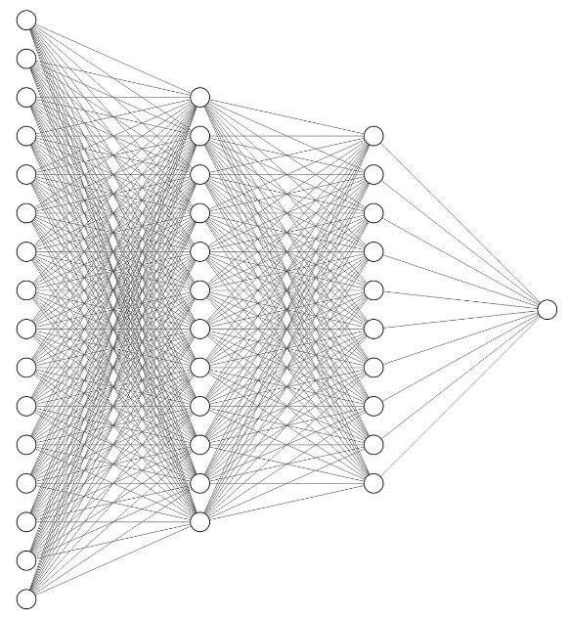
Multilayer Perceptron
Notes:
After the 6 embedding layer the input size is 44, Our MLP has 3 hidden layer (176, 64, 16), As activation function we used RELU, between the layers there is a batch normalization layer.

Slide 13
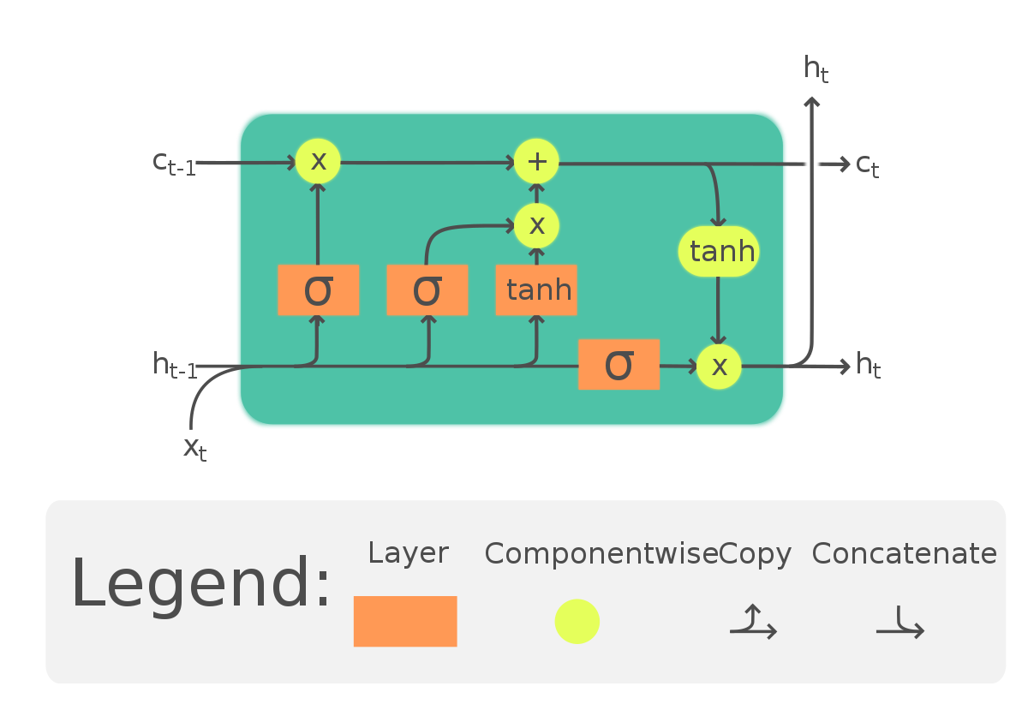
Long Short Term Memory (LSTM)
LSTM is a recurrent neural network. Three different types of information are held within an LSTM layer:
input data (x_{t})
short-term memory o hidden state (h_{t-1})
long-term memory o cell state (c_{t-1})
‹#›

Slide 14
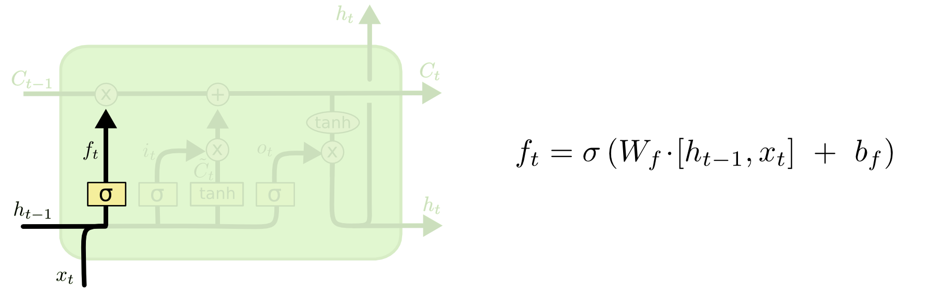
Forget gate
‹#›
Notes:
The first step is deciding what information to throw away from the cell state. This decision is made by a sigmoid layer and applied through point multiplication per point, this gate takes the name of forget gate. The layer takes as input ht−1 e xt and returns a number between zero and one for each element in the cell state Ct−1. A one represents complete retention of information while one zero represents elimination. bf is the bias vector while Wf is the matrix containing the weights on the arcs, these are the parameters "learned" by the model.

Slide 15
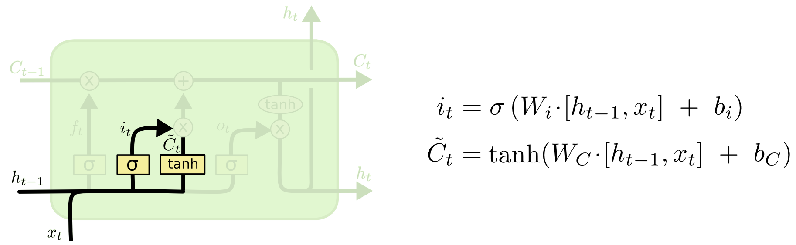
Input gate
‹#›
Notes:
The next step is to decide what new information we will store in the cell stay. The step consists of two parts:
1. A sigmoid layer called the input gate layer decides what values will come updated.
2. A tanh layer creates a vector of new candidate Ct values, that could be added to the state.

Slide 16
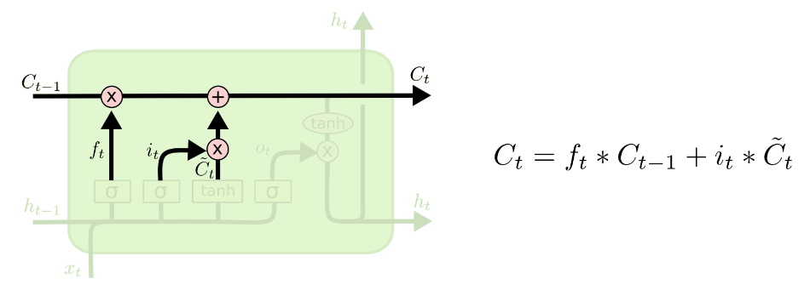
Updating cell state
Notes:
At this point it's time to update the old cell state Ct−1, into the new one cell state CT. The previous steps have already decided what to do, now we just have to execute. We multiply the old state by ft, eliminating the information which we decided to forget first. Then we add it ∗ ̃Ct, which represent the new candidate values.

Slide 17
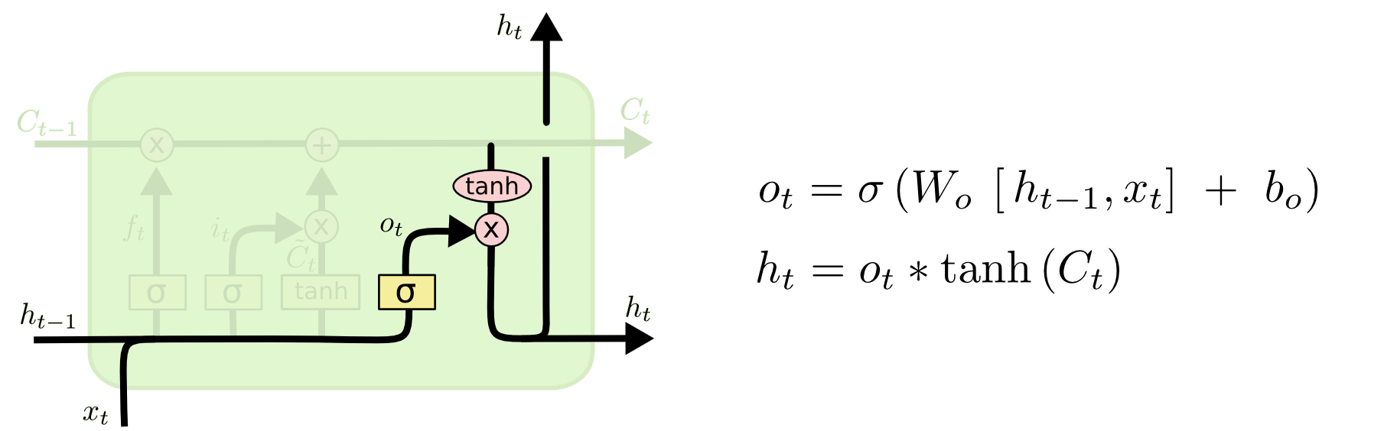
Output gate
‹#›
Notes:
Finally we have to decide what to return in output. This output will be based on the new cell state, but it will be a filtered version. First, let's do a sigmoid layer that decides which parts of the cell state will be output. At this point we apply the tanh function to the cell state (to ensure that the values are between -1 and 1) and we multiply it by the output of the sigmoid layer, in order to give in output only the informations decided. All of this is called the output gate.

Slide 18
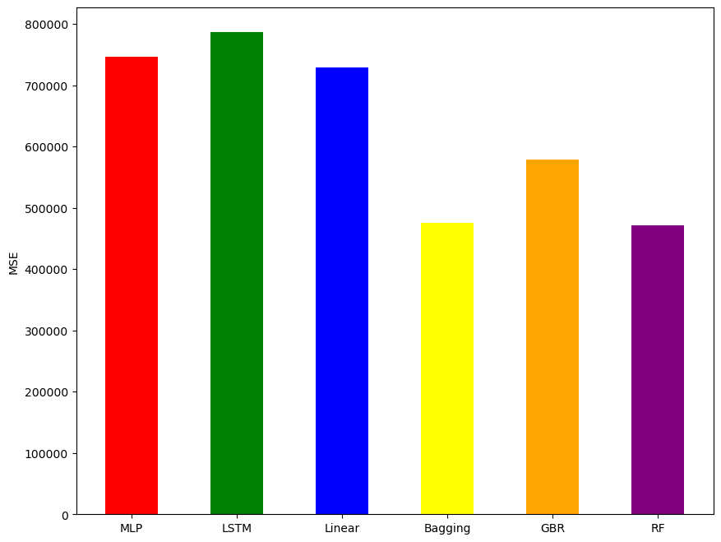
MSE

Slide 19
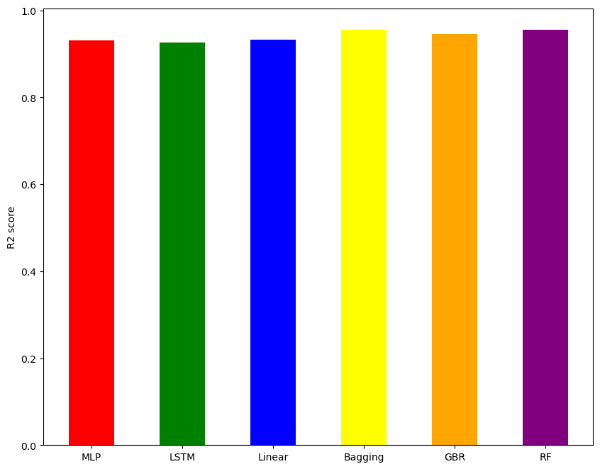
R2 score

Slide 20
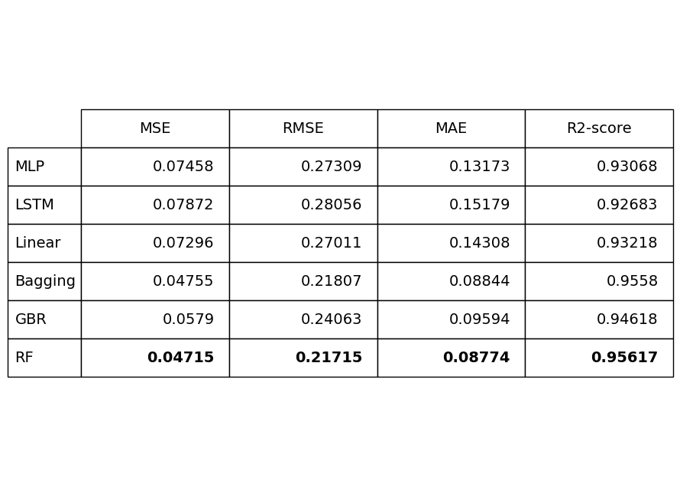
Results
Results overview
Notes:
risultati (piu slides per descrivere i risultati dei modelli, con il confronto)

Slide 21
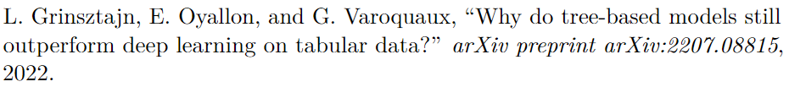
Why do tree-based models outperform deep learning and machine learning?
Tree-based models can handle uninformative features better than deep learning models, because they can split on the most informative features and ignore the rest.
Tree-based models can preserve the distribution of the data better than deep learning models, because they do not apply nonlinear transformations that can distort the data distribution.
Tree-based models can learn irregular functions better than deep learning models.

Slide 22
Task 2 description and pipeline
The goal of task 2 is talent scouting. In particular, through the use of k-means, the algorithm takes as input a footballer aged over 25 and returns in output a set of footballers aged less or equal than 25 similar to the player given in input.
Here are the steps that will be performed:
Union between final dataset obtained in the previous phase and fifa 23 dataset;
pre-processing and feature engineering;
principal component analysis application;
k-means applications;
scouting algorithm 1 application;
scouting algorithm 2 application.
Notes:
descrizione task2

Slide 23
Fifa dataset
The Fifa dataset was obtained from kaggle; (link)
It is composed by a table .csv. It contains all the Fifa versions, and for each Fifa version contains all updates.
We have extracted only the instances related to version 23 and update 1.
The feature of the table represents:
- personal information;
- physical information;
- stats related to Fifa gameplay such as speed, dribbling, skill moves
and many other.
- the total number of features is 110.
Notes:
descrizione fifa dataset

Slide 24
Task 2 dataset
Transfermarkt dataset (8 csv files)
Dataset for task 1
Dataset for task 2
Fifa dataset (1 csv files)
Fifa 23 dataset
Notes:
descrizione task2

Slide 25
Task 2 dataset
The dataset used for task 2 was obtained by merging the previously obtained dataset and the Fifa 23 dataset.
In the merging phase, the challenge was to understand how to merge the two datasets, in particular how to match fifa players with the other dataset.
The choice fell on basing the union on the nationality - date of birth pair.
FIFA DATASET
nationality | date of birth
DATASET
nationality | date of birth
NEW DATASET
nationality | date of birth
Notes:
descrizione task2

Slide 26
Task 2 dataset schema
The dataset created for the task 2 contains one row for each player. This row is one with the date closest to 2022-06-15.
The dataset obtained after the removal of unnecessary features and the correction of null value and zero value has this schema:
player_id: it identifies the player;
date_v: update date of the market value (closest to 2022-06-15);
personal and physical information: such as age, height and others;
market_value: the market value associated with date_v;
features that represent the fifa stats.
Notes:
descrizione task2

Slide 27
Standardization and encoding
Before applying pca and k-means it was necessary to apply feature standardization and categorical feature encoding.
Standardization formula stand_value = (value - mean) / std_dev
Encoding approach one-hot encoding
Notes:
standardization and encoding

Slide 28
Dataset splitting
For our task, the dataset is split in two subdatasets
Dataset with players aged 25 or younger
Dataset with players over the age of 25
pca and k-means
pca and k-means
Notes:
dataset split

Slide 29
PCA: principal component analysis
The PCA method is used to decrement the number of features;
The explained variance method is used to determine the number of components for PCA;
The explained variance method is used for each of the two datasets;
PCA is performed on the two datasets with a number of components decided by the explained variance method.
Notes:
pca

Slide 30
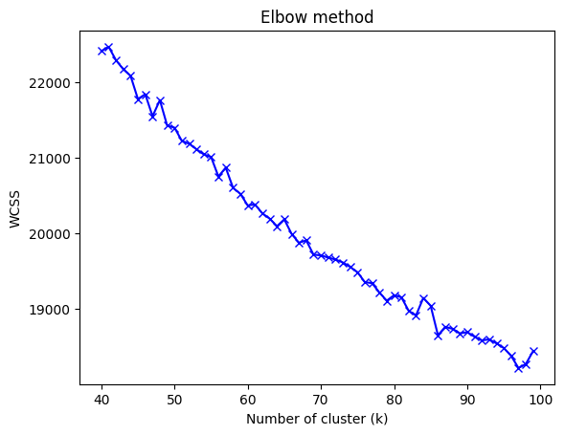
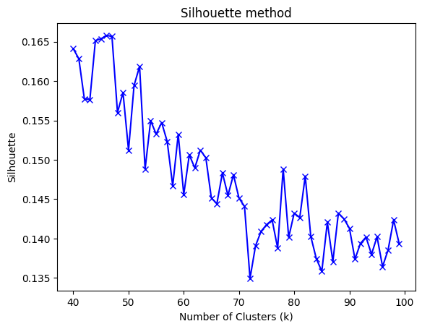
K-means
K-means is the clustering algorithm chosen to create clusters of the similar players;
The method used to decide the number of clusters can be the elbow method or the silhouette method;
The metric used to measure the clustering performance is silhouette;
Notes:
k-means

Slide 31
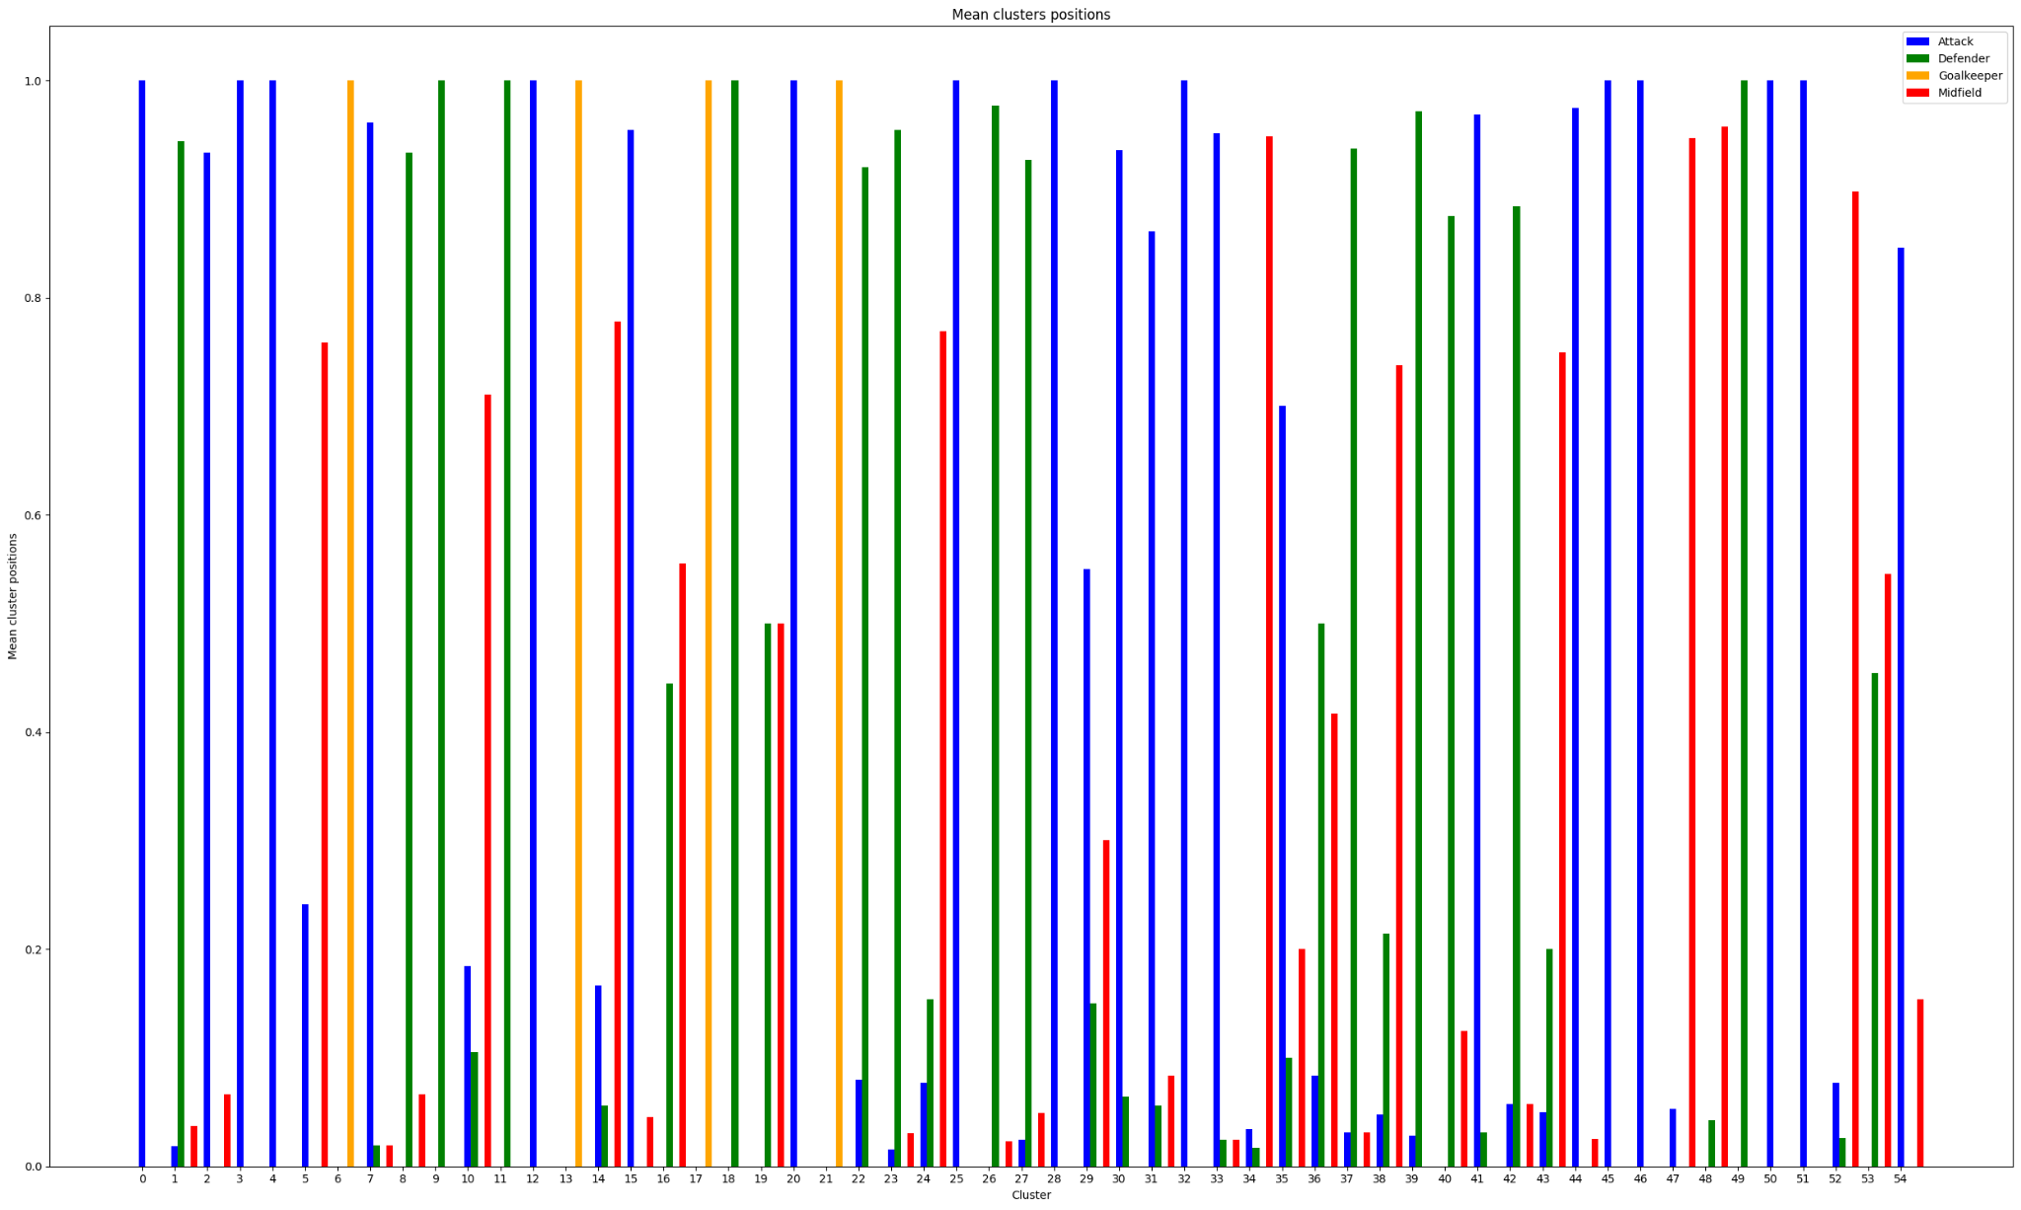
K-means result: percentage positions
Notes:
k-means

Slide 32
First scouting algorithm
Input: player with age > 25;
For each cluster (of the df with age <= 25) based on the elements that compose it, the mean, or mode, is calculated for each feature;
Cosine similarity is used to identify the most similar cluster; cosine_similarity(v1,v2) = dot_product(v1, v2) / (norm(v1) * norm(v2))
Output: the cluster most similar to the player given in input;
Strength: it always return a cluster;
Weakness: it returns the cluster most similar in feature values.
Notes:
algoritmo scouting 1

Slide 33
Second scouting algorithm (1)
Input: player with age > 25, min_value, max_value;
For each cluster perform a filter with the following controls: - check if the cluster has the same position, sub position and preferred foot as the input player;
- check if the cluster has a height that does not differ by more than 10 cm from the input player;
- check if the cluster has a market value between min_value e max value;
- check if the cluster has a skill moves value that does not differ by more than 2 points from the player.
Sort the numerical features of the player and of the clusters in descending order by values;
Output: the cluster(s) that have the same first x features as those of the input player;
Notes:
algoritmo scouting 1

Slide 34
Second scouting algorithm (2)
Strength: the search is not based on the values of the features, but on the strengths (higher qualities) shared through cluster and player.
Weakness:
we have to set some parameters;
it can return a cluster, more of one cluster, but it can also return no clusters.
Notes:
algoritmo scouting 1

Slide 35

THANKS FOR YOUR ATTENTION
Notes:
‹#›

