Slide 1

Gamma-ray burst classification
Caridi Leonardo (578938)
Università di Pisa
l.caridi@studenti.unipi.it
Github repository

Slide 2
Gamma-ray burst classification
Caridi Leonardo (578938)
Università di Pisa
l.caridi@studenti.unipi.it
Github repository

Slide 3
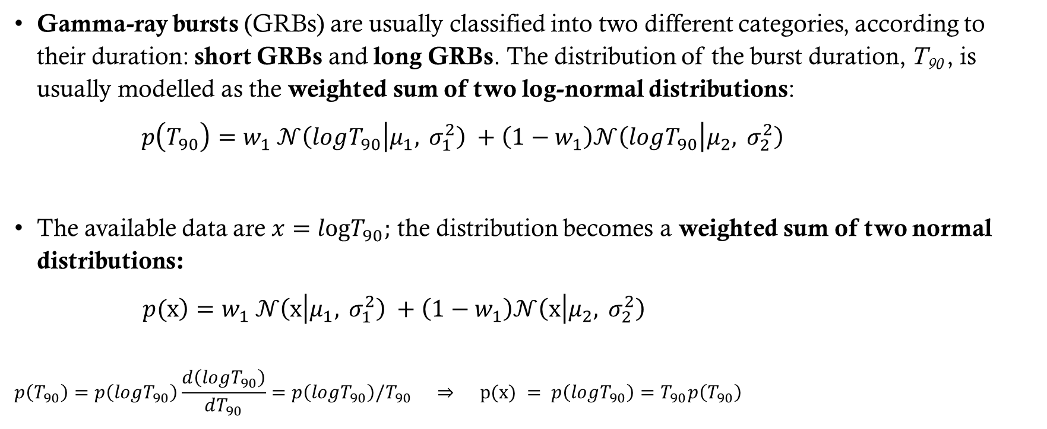
T₉₀ distribution
Gamma-ray bursts (GRBs) are usually classified into two different categories, according to their duration: short GRBs and long GRBs. The distribution of the burst duration, T₉₀ , is usually modelled as the weighted sum of two log-normal distributions:
$p\left.\left(T_{90}\right.\right)=w_{1} 𝒩\left(logT_{90} | μ_{1}, σ_{1}^{2}\right) +\left(1−w_{1}\right)𝒩\left(logT_{90} | μ_{2}, σ_{2}^{2}\right)$
The available data are $x=logT_{90};$ the distribution becomes a weighted sum of two normal distributions:
$p\left.(x\right)=w_{1} 𝒩\left(x | μ_{1}, σ_{1}^{2}\right) +\left(1−w_{1}\right)𝒩\left(x | μ_{2}, σ_{2}^{2}\right)$
$$p\left(T_{90}\right)=p\left(logT_{90}\right)\frac{d\left(logT_{90}\right)}{dT_{90}}=p\left(logT_{90}\right)/T_{90} ⇒ p(x) = p\left(logT_{90}\right)=T_{90}p\left(T_{90}\right)$$

Slide 4
Problem 1A – parameter estimation
Problem 1a: estimate the distribution parameters while ignoring measurement uncertainties.

Slide 5
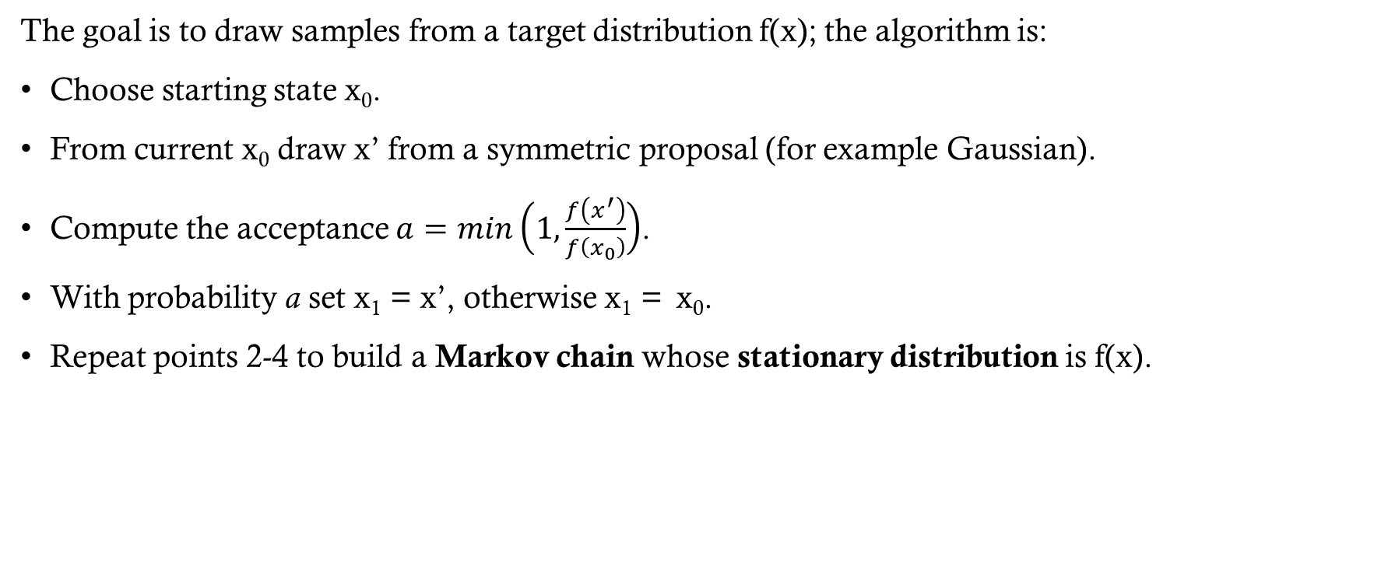
Metropolis algorithm
The goal is to draw samples from a target distribution f(x); the algorithm is:
Choose starting state x₀.
From current x₀ draw x’ from a symmetric proposal (for example Gaussian).
Compute the acceptance $a=min\left(1,\frac{f\left(x^{′}\right)}{f\left(x_{0}\right)}\right)$.
With probability a set x₁ = x’, otherwise x₁ = x₀.
Repeat points 2-4 to build a Markov chain whose stationary distribution is f(x).
Sequence of random states where each
new state depends only on the current one
Probability distribution that remains unchanged
as the chain evolves (after burnin)
Notes:
Nel quarto punto il codice consiste nell’estrazione di un valore u da una distribuzione uniforme U(0,1). Se u<a allora viene accettato, questo vuol dire che la probabilità di accettazione aumenta con l’aumentare di a.

Slide 6
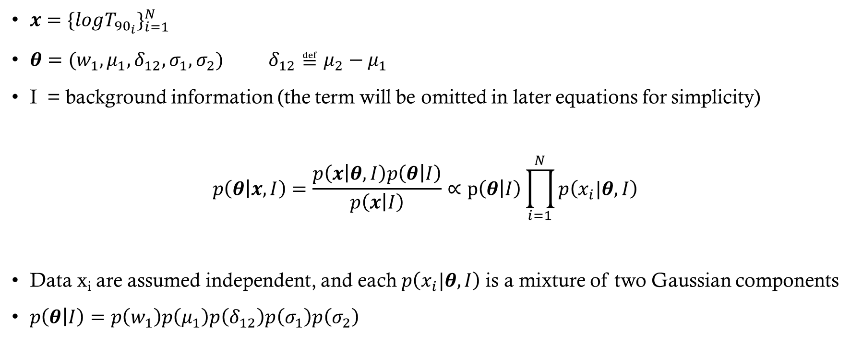
Bayes theorem
$x=\{log{T_{{90}_{i}}\}}_{i=1}^{N}$
$θ=(w_{1},μ_{1},δ_{12},σ_{1},σ_{2}) δ_{12}≝μ_{2}−μ_{1}$
I = background information (the term will be omitted in later equations for simplicity)
$$p\left(θ | x,I\right)=\frac{p\left(x | θ,I\right)p\left(θ | I\right)}{p\left(x | I\right)}∝p\left(θ | I\right)\prod_{i=1}^{N}{p\left(x_{i}|θ,I\right)}$$
Data x_{i} are assumed independent, and each $p\left(x_{i}|θ,I\right)$is a mixture of two Gaussian components
$p\left(θ | I\right)=p\left(w_{1}\right)p\left(μ_{1}\right)p\left(δ_{12}\right)p\left(σ_{1}\right)p\left(σ_{2}\right)$

Slide 7
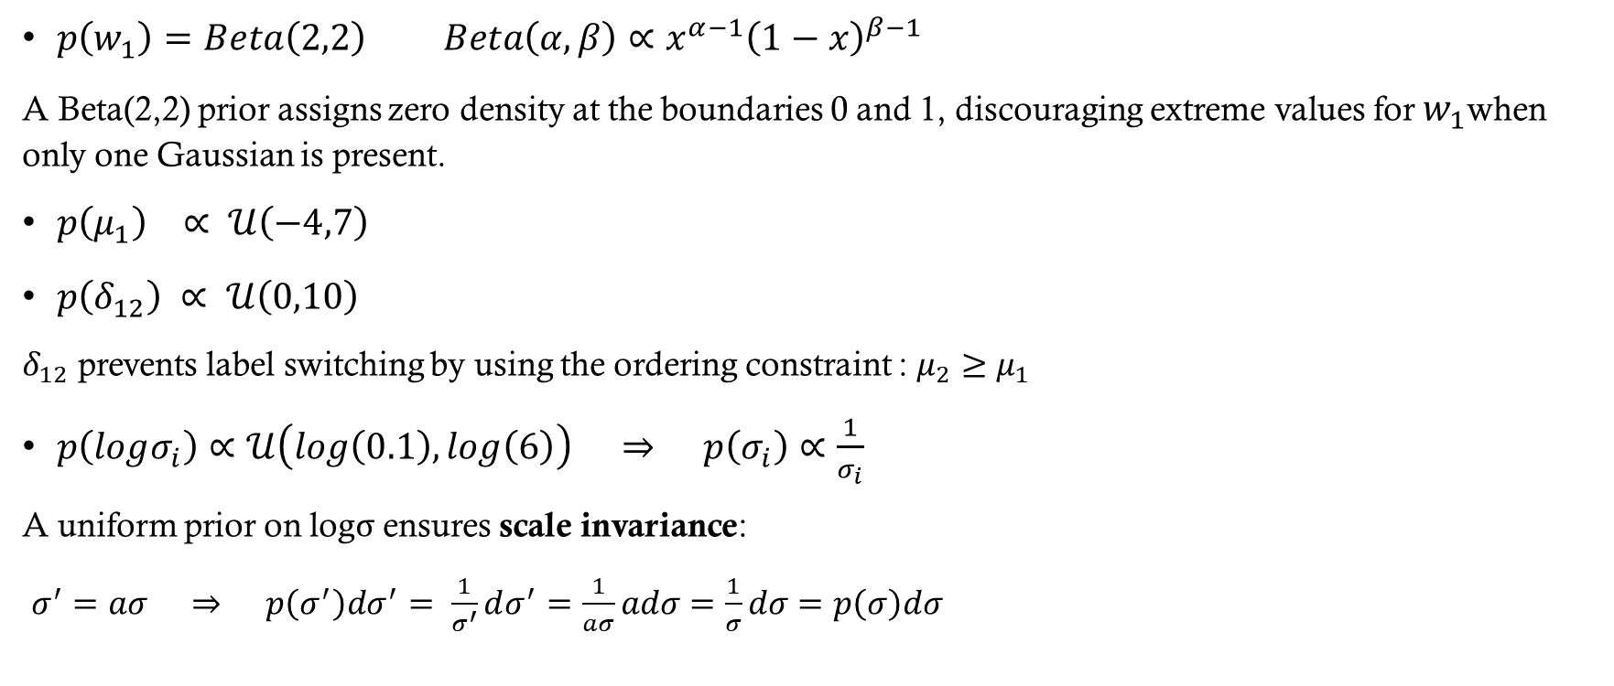
Prior
$p\left(w_{1}\right)=Beta\left(2,2\right) Beta\left(α,β\right)∝x^{α−1}{\left(1−x\right)}^{β−1}$
A Beta(2,2) prior assigns zero density at the boundaries 0 and 1, discouraging extreme values for $w_{1}$when only one Gaussian is present.
$p\left(μ_{1}\right) ∝ 𝒰\left(−4,7\right)$
$p\left(δ_{12}\right) ∝ 𝒰\left(0,10\right)$
$δ_{12}$ prevents label switching by using the ordering constraint : $μ_{2}≥μ_{1}$
$p\left(logσ_{i}\right)∝𝒰\left(log\left(0.1\right),log\left(6\right)\right) ⇒ p\left(σ_{i}\right)∝\frac{1}{σ_{i}}$
A uniform prior on logσ ensures scale invariance:
$σ^{′}=aσ ⇒ p\left(σ^{′}\right)dσ^{′}= \frac{1}{σ^{′}}dσ^{′}=\frac{1}{aσ}adσ=\frac{1}{σ}dσ=p\left(σ\right)dσ$

Slide 8
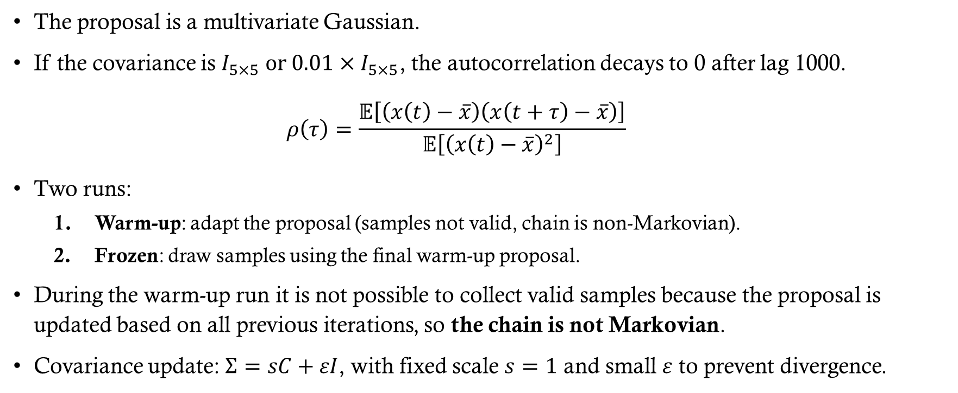
Adaptive proposal
The proposal is a multivariate Gaussian.
If the covariance is $I_{5×5} or 0.01×I_{5×5}$, the autocorrelation decays to 0 after lag 1000.
$$ρ\left(τ\right)=\frac{𝔼\left[\left(x\left(t\right)−\overline{x}\right)\left(x\left(t+τ\right)−\overline{x}\right)\right]}{𝔼\left[{\left(x\left(t\right)−\overline{x}\right)}^{2}\right]}$$
Two runs:
Warm-up: adapt the proposal (samples not valid, chain is non-Markovian).
Frozen: draw samples using the final warm-up proposal.
During the warm-up run it is not possible to collect valid samples because the proposal is updated based on all previous iterations, so the chain is not Markovian.
Covariance update: $Σ=sC+εI$, with fixed scale $s=1$ and small $ε$ to prevent divergence.
Notes:
E’ stata provata anche la matrice con valori sulla diagonale pari a 0.01, perché l’acceptance ratio era molto piccolo. Questo corrisponde ad un passo della catena che tende ad essere troppo grande rispetto alla parte principale della postirior, diminuendo il valori sulla diagonali si riduce il passo. Però non risolve il problema dell’autocorrelazione e l’acceptance ratio rimane basso.

Slide 9
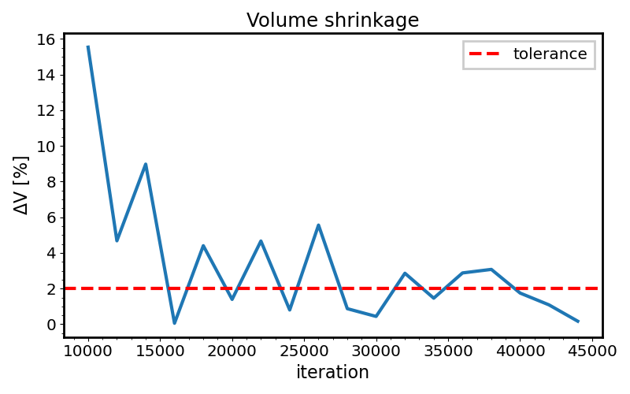

Adaptive covariance tuning (Warm-UP)
With $Σ =0.01×I_{5×5}$, start a Metropolis algorithm.
Every adapt_interval steps (2000), compute:
$Σ_{\text{new}}=\text{Cov}\left({\text{samples}}_{\text{burnin}\text{:}}\right)+εI$
and set $Σ= Σ_{\text{new}}$.
Stopping criterion: adaptation stops early if all conditions are met:
Minimum number of iterations (min_adapt=10000) has passed.
Log-determinant change is small: $|Δlogdet(Σ)| < tol_logdet=2×{10}^{−2}$
This small change persists for several consecutive checks (consecutive_stable=3) to avoid transient fluctuations.
Notes:
Utilizzo il log determinante perché viene calcolato con la somma degli autovalori. Invece il determinante normale utilizza il prodotto; se uno degli autovalori è piccolo posso avere underflow

Slide 10
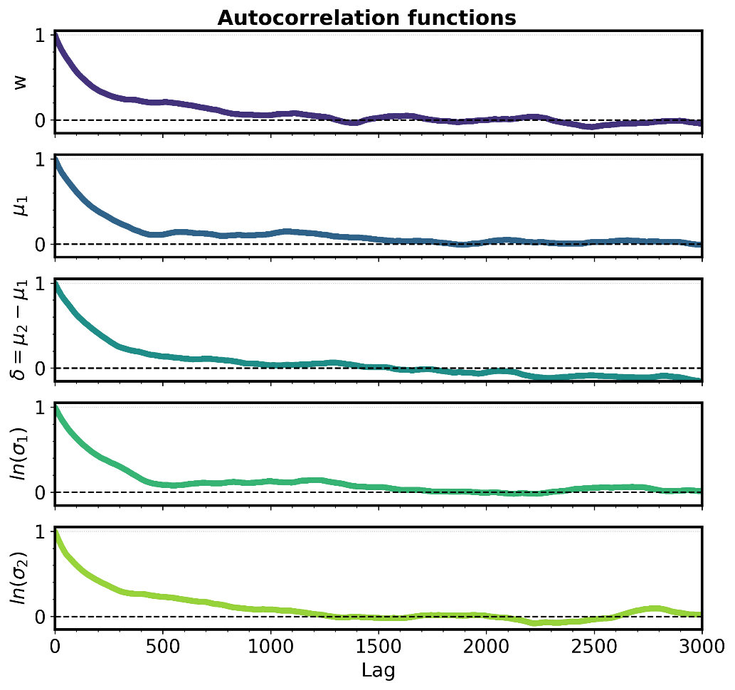
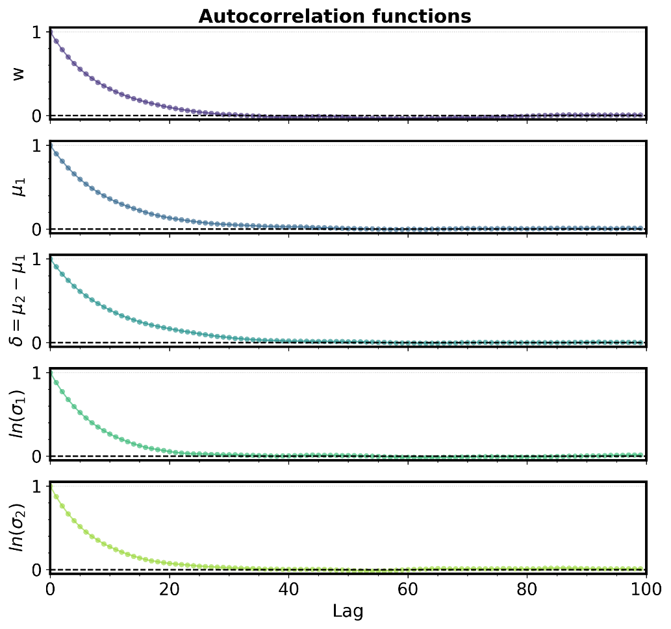
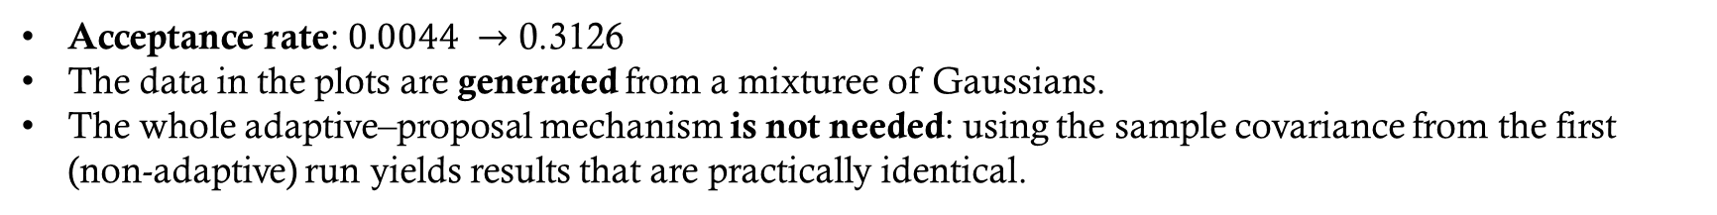
Acceptance rate: $0.0044 →\text{0.3126}$
The data in the plots are generated from a mixturee of Gaussians.
The whole adaptive–proposal mechanism is not needed: using the sample covariance from the first (non-adaptive) run yields results that are practically identical.

Slide 11
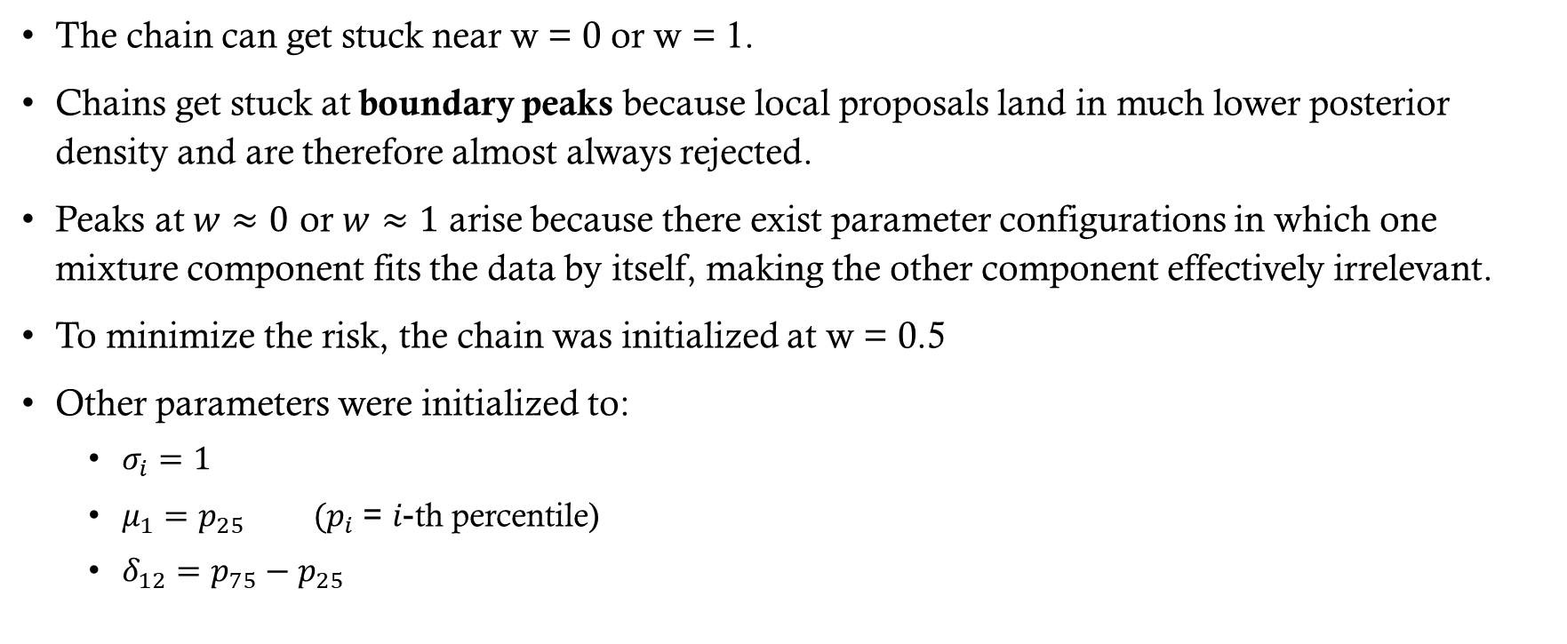
Initial State
The chain can get stuck near w = 0 or w = 1.
Chains get stuck at boundary peaks because local proposals land in much lower posterior density and are therefore almost always rejected.
Peaks at $w≈0$ or $w≈1$ arise because there exist parameter configurations in which one mixture component fits the data by itself, making the other component effectively irrelevant.
To minimize the risk, the chain was initialized at w = 0.5
Other parameters were initialized to:
$σ_{i}=1$
$μ_{1}=p_{25} (p_{i}$ = $i$-th percentile)
$δ_{12}=p_{75}−p_{25}$

Slide 12
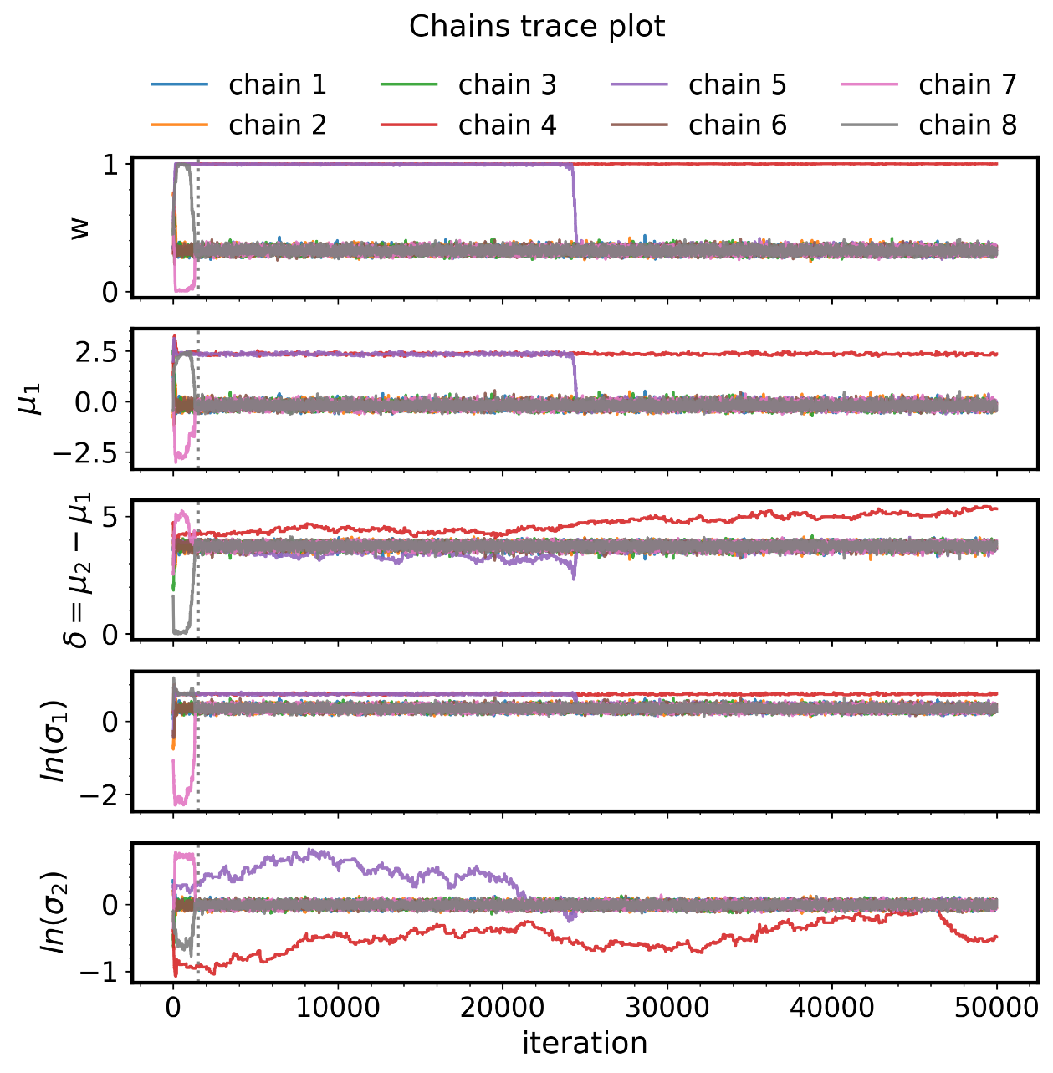
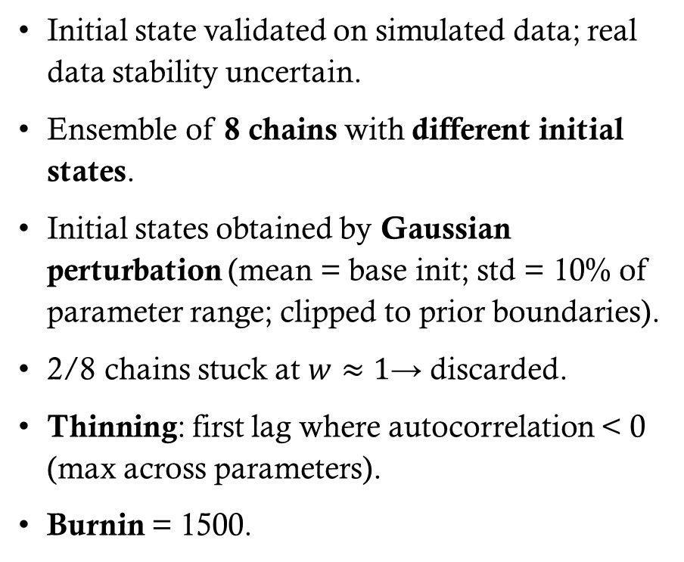
ENSEMBLE
Initial state validated on simulated data; real data stability uncertain.
Ensemble of 8 chains with different initial states.
Initial states obtained by Gaussian perturbation (mean = base init; std = 10% of parameter range; clipped to prior boundaries).
2/8 chains stuck at $w≈1$→ discarded.
Thinning: first lag where autocorrelation < 0 (max across parameters).
Burnin = 1500.
Notes:
Le 6 catene salvate sono state concatenate dopo il thinning, quando posso assumere che i samples sono indipendenti tra di loro.

Slide 13
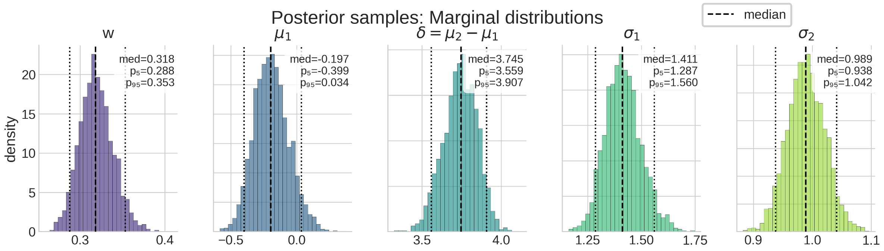
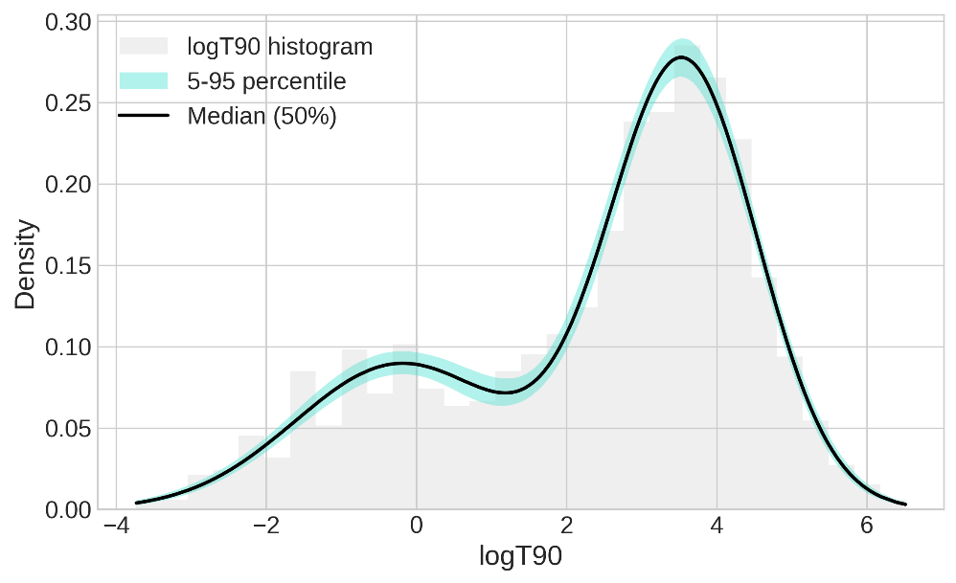
Mean acceptace rate = 0.269
#samples = 2975
Notes:
La figura inferiore è sono i modelli creati dai samples nello spazio dei dati. Cioè per ogni samples è stato creato un modello (una matrice in cui ogni righa è un modello e le colonne indicano i valori dei dati: per esempio da -4 a 7). Per estrarre la fascia ho calcolato il 5, 50 e 95 percentile di ogni colonna.

Slide 14
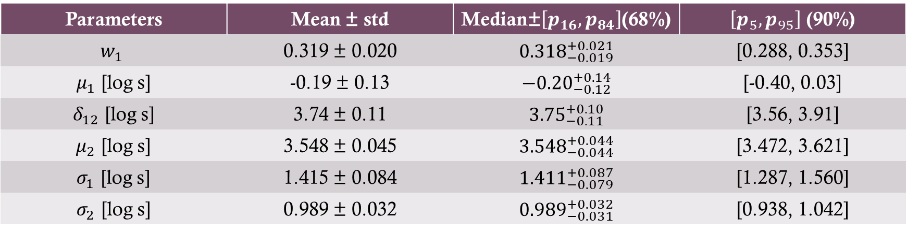
Parameter values
Parameters | Mean ± std | Median±$\left[p_{16},p_{84}\right]$(68%) | $\left[p_{5},p_{95}\right]$ (90%)
$$w_{1}$$ | 0.319 ± 0.020 | $${0.318}_{−0.019}^{+0.021}$$ | [0.288, 0.353]
$μ_{1}$ [log s] | -0.19 ± 0.13 | $${−0.20}_{−0.12}^{+0.14}$$ | [-0.40, 0.03]
$δ_{12}$ [log s] | 3.74 ± 0.11 | $${3.75}_{−0.11}^{+0.10}$$ | [3.56, 3.91]
$μ_{2}$ [log s] | 3.548 ± 0.045 | $${3.548}_{−0.044}^{+0.044}$$ | [3.472, 3.621]
$σ_{1}$ [log s] | 1.415 ± 0.084 | $${1.411}_{−0.079}^{+0.087}$$ | [1.287, 1.560]
$σ_{2}$ [log s] | 0.989 ± 0.032 | $${0.989}_{−0.031}^{+0.032}$$ | [0.938, 1.042]

Slide 15
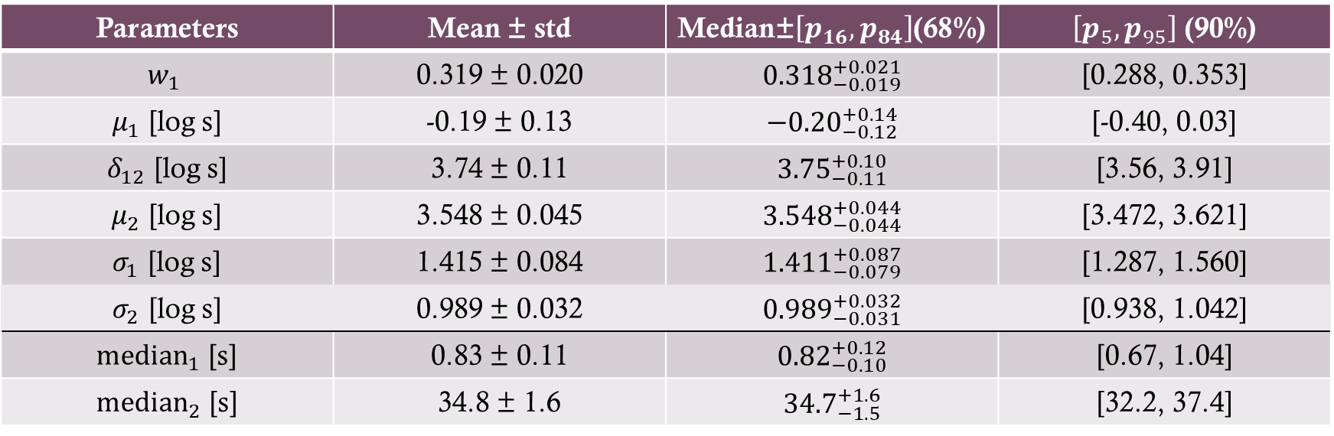
Parameter values
Parameters | Mean ± std | Median±$\left[p_{16},p_{84}\right]$(68%) | $\left[p_{5},p_{95}\right]$ (90%)
$$w_{1}$$ | 0.319 ± 0.020 | $${0.318}_{−0.019}^{+0.021}$$ | [0.288, 0.353]
$μ_{1}$ [log s] | -0.19 ± 0.13 | $${−0.20}_{−0.12}^{+0.14}$$ | [-0.40, 0.03]
$δ_{12}$ [log s] | 3.74 ± 0.11 | $${3.75}_{−0.11}^{+0.10}$$ | [3.56, 3.91]
$μ_{2}$ [log s] | 3.548 ± 0.045 | $${3.548}_{−0.044}^{+0.044}$$ | [3.472, 3.621]
$σ_{1}$ [log s] | 1.415 ± 0.084 | $${1.411}_{−0.079}^{+0.087}$$ | [1.287, 1.560]
$σ_{2}$ [log s] | 0.989 ± 0.032 | $${0.989}_{−0.031}^{+0.032}$$ | [0.938, 1.042]
${\text{median}}_{1}$ [s] | 0.83 ± 0.11 | $${0.82}_{−0.10}^{+0.12}$$ | [0.67, 1.04]
${median}_{2}$ [s] | 34.8 ± 1.6 | $${34.7}_{−1.5}^{+1.6}$$ | [32.2, 37.4]
$$P\left(x≤median_{x}\right)=P\left(log\left(x\right)≤log\left(median_{x}\right)\right)=0.5 ⇒ log\left(median_{x}\right)=median_{log\left(x\right)}$$
$$median_{log\left(x\right)}=μ_{log\left(x\right)} ⇒ median_{x}=e^{μ_{log\left(x\right)}}$$

Slide 16
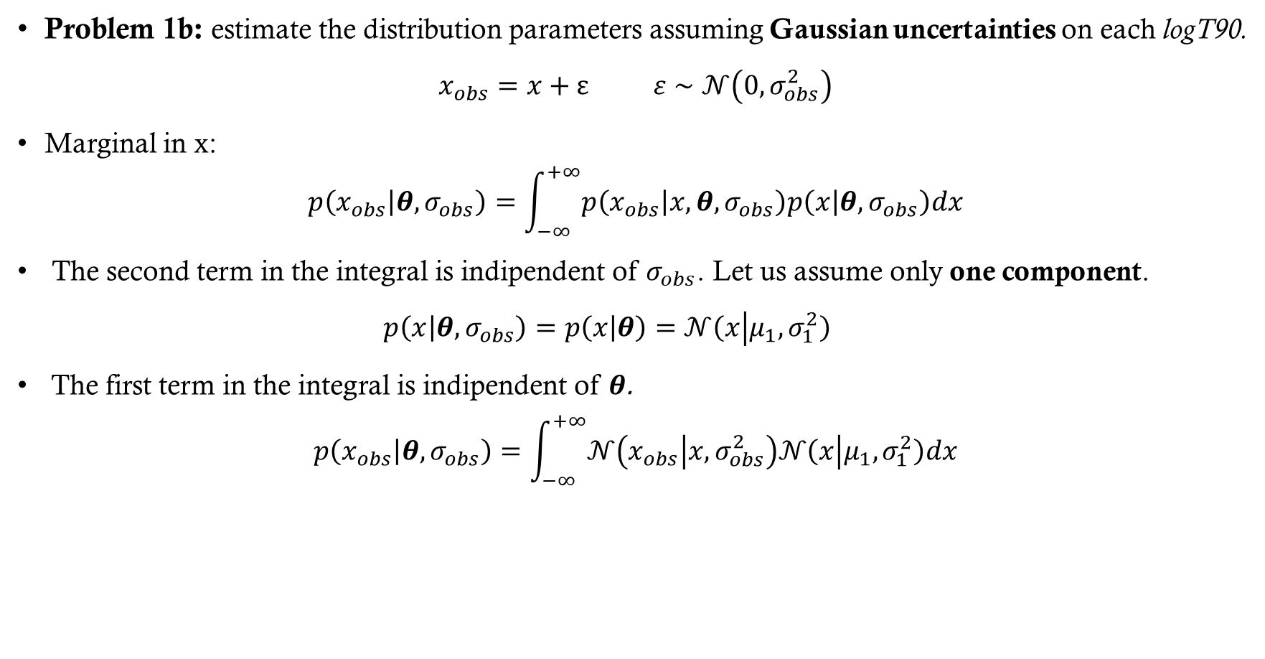
Problem 1b - Gaussian uncertainties
Problem 1b: estimate the distribution parameters assuming Gaussian uncertainties on each logT90.
$$x_{obs}=x+ε ε∼𝒩\left(0,σ_{obs}^{2}\right)$$
Marginal in x:
$$p\left(x_{obs} | θ,σ_{obs}\right)=\int_{−∞}^{+∞}{p\left(x_{obs} | x,θ,σ_{obs}\right)p\left(x | θ,σ_{obs}\right)dx}$$
The second term in the integral is indipendent of $σ_{obs}$. Let us assume only one component.
$$p\left(x | θ,σ_{obs}\right)=p\left(x | θ\right)=𝒩\left(x | μ_{1},σ_{1}^{2}\right)$$
The first term in the integral is indipendent of $θ$.
$$p\left(x_{obs} | θ,σ_{obs}\right)=\int_{−∞}^{+∞}{𝒩\left(x_{obs} | x,σ_{obs}^{2}\right)𝒩\left(x | μ_{1},σ_{1}^{2}\right)dx}$$
Notes:
$p\left(x_{obs} | θ,σ_{obs}\right)$ è la nuova distribuzione che vogliamo calcolare (non è la likelihood, per averla devo moltiplicare tutte le distribuzioni al variare degli $x_{obs}$, i quali sono assunti indipendenti).
Secondo punto: è una marginalizzazione.
Terzo punto: x è indipendente da sigma_obs, il risultato è la mistura di gaussiana già nota nel problema 1°
Quarto punto: metto insieme il primo e terzo punto (il primo punto mi dice che x_obs è generato da una gaussiana con centro x e std sigma_obs

Slide 17

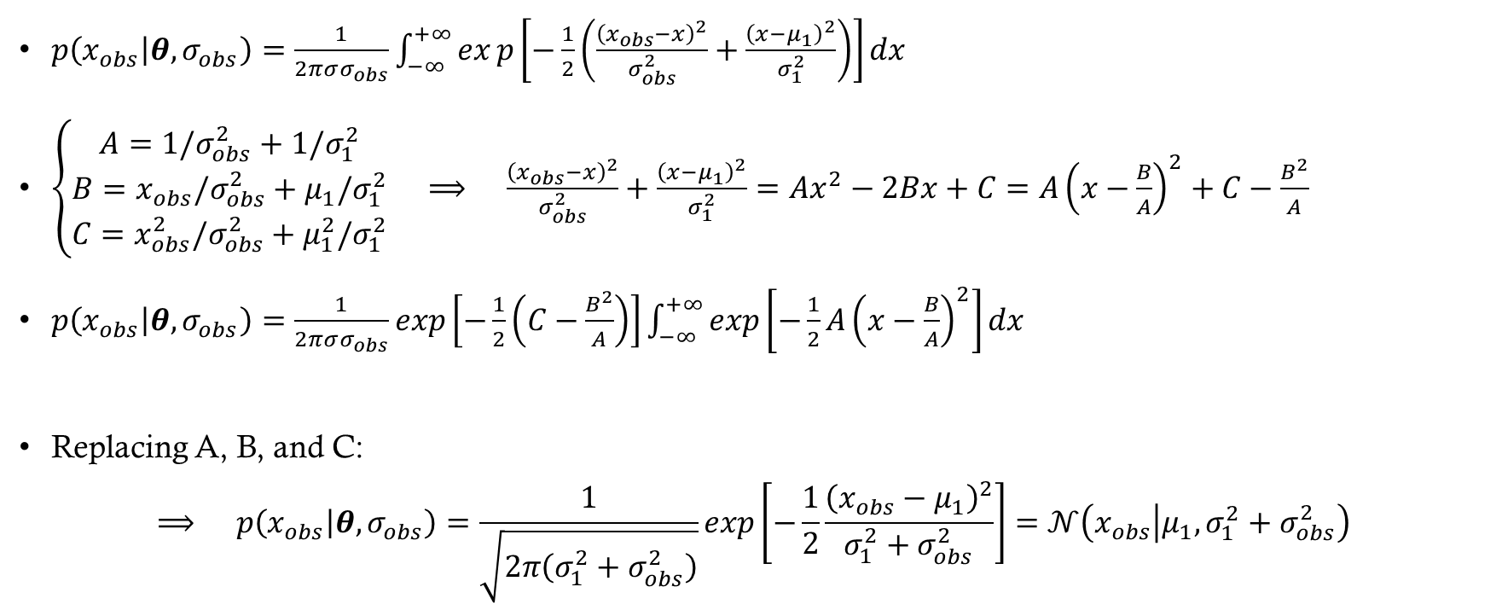
Method 1: completing the square
$p\left(x_{obs} | θ,σ_{obs}\right)=\frac{1}{2πσσ_{obs}}\int_{−∞}^{+∞}{exp\left[−\frac{1}{2}\left(\frac{{\left(x_{obs}−x\right)}^{2}}{σ_{obs}^{2}}+\frac{{\left(x−μ_{1}\right)}^{2}}{σ_{1}^{2}}\right)\right]dx}$
$\left\{\begin{aligned}A=1/σ_{obs}^{2}+1/σ_{1}^{2} \\ B=x_{obs}/σ_{obs}^{2}+μ_{1}/σ_{1}^{2} \\ C=x_{obs}^{2}/σ_{obs}^{2}+μ_{1}^{2}/σ_{1}^{2}\end{aligned}\right. ⟹ \frac{{\left(x_{obs}−x\right)}^{2}}{σ_{obs}^{2}}+\frac{{\left(x−μ_{1}\right)}^{2}}{σ_{1}^{2}}=Ax^{2}−2Bx+C=A{\left(x−\frac{B}{A}\right)}^{2}+C−\frac{B^{2}}{A}$
$p\left(x_{obs} | θ,σ_{obs}\right)=\frac{1}{2πσσ_{obs}}exp\left[−\frac{1}{2}\left(C−\frac{B^{2}}{A}\right)\right]\int_{−∞}^{+∞}{exp\left[−\frac{1}{2}A{\left(x−\frac{B}{A}\right)}^{2}\right]dx}$
Replacing A, B, and C:
$$⟹ p\left(x_{obs} | θ,σ_{obs}\right)=\frac{1}{\sqrt{2π\left(σ_{1}^{2}+σ_{obs}^{2}\right)}}exp\left[−\frac{1}{2}\frac{{\left(x_{obs}−μ_{1}\right)}^{2}}{σ_{1}^{2}+σ_{obs}^{2}}\right]=𝒩\left(x_{obs} | μ_{1},σ_{1}^{2}+σ_{obs}^{2}\right)$$
$$=\sqrt{2π/A}$$

Slide 18
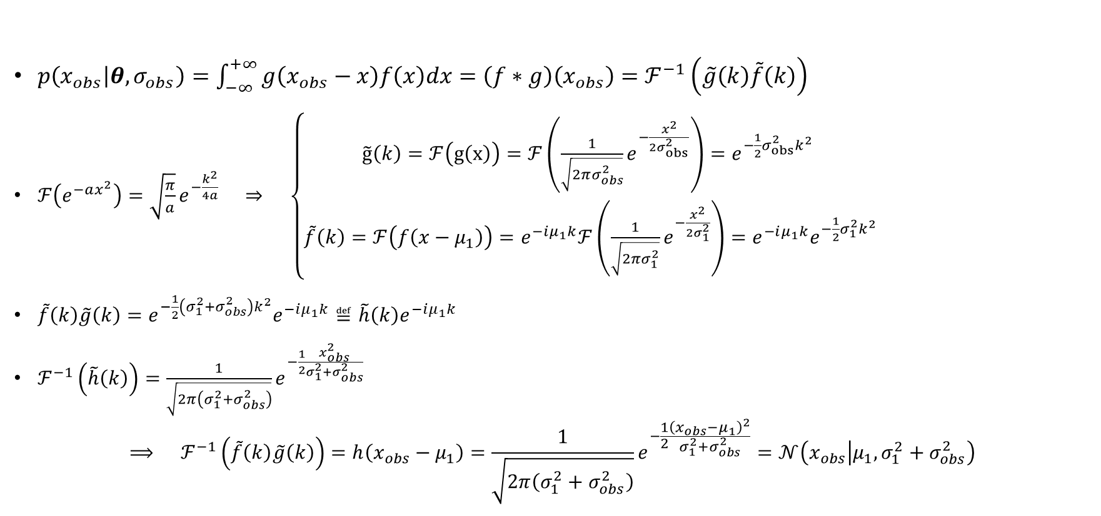
Method 2: Fourier Trasform
$p\left(x_{obs} | θ,σ_{obs}\right)=\int_{−∞}^{+∞}{g\left(x_{obs}−x\right)f\left(x\right)dx}=\left(f∗g\right)\left(x_{obs}\right)=ℱ^{−1}\left(\tilde{g}\left(k\right)\tilde{f}\left(k\right)\right)$
$ℱ\left(e^{−ax^{2}}\right)=\sqrt{\frac{π}{a}}e^{−\frac{k^{2}}{4a}} ⇒ \left\{\begin{aligned}\tilde{g}\left(k\right)=ℱ\left(g\left(x\right)\right)=ℱ\left(\frac{1}{\sqrt{2πσ_{obs}^{2}}}e^{−\frac{x^{2}}{2σ_{obs}^{2}}}\right)=e^{−\frac{1}{2}σ_{obs}^{2}k^{2}} \\ \tilde{f}\left(k\right)=ℱ\left(f\left(x−μ_{1}\right)\right)=e^{−iμ_{1}k}ℱ\left(\frac{1}{\sqrt{2πσ_{1}^{2}}}e^{−\frac{x^{2}}{2σ_{1}^{2}}}\right)=e^{−iμ_{1}k}e^{−\frac{1}{2}σ_{1}^{2}k^{2}}\end{aligned}\right.$
$\tilde{f}\left(k\right)\tilde{g}\left(k\right)=e^{−\frac{1}{2}\left(σ_{1}^{2}+σ_{obs}^{2}\right)k^{2}}e^{−iμ_{1}k}≝\tilde{h}\left(k\right)e^{−iμ_{1}k}$
$ℱ^{−1}\left(\tilde{h}\left(k\right)\right)=\frac{1}{\sqrt{2π\left(σ_{1}^{2}+σ_{obs}^{2}\right)}}e^{−\frac{1}{2}\frac{x_{obs}^{2}}{σ_{1}^{2}+σ_{obs}^{2}}}$
$$⟹ ℱ^{−1}\left(\tilde{f}\left(k\right)\tilde{g}\left(k\right)\right)=h\left(x_{obs}−μ_{1}\right)=\frac{1}{\sqrt{2π\left(σ_{1}^{2}+σ_{obs}^{2}\right)}}e^{−\frac{1}{2}\frac{{\left(x_{obs}−μ_{1}\right)}^{2}}{σ_{1}^{2}+σ_{obs}^{2}}}=𝒩\left(x_{obs} | μ_{1},σ_{1}^{2}+σ_{obs}^{2}\right)$$

Slide 19
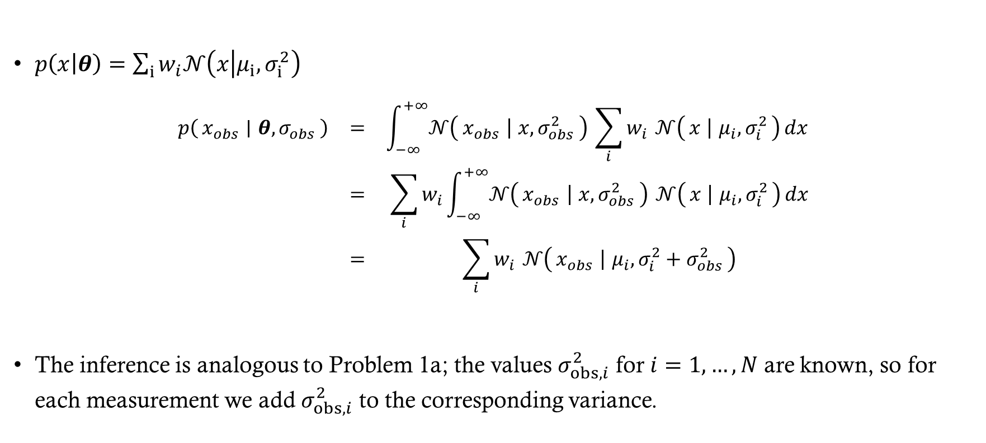
Gaussian mixture generalization
$p\left(x | θ\right)=\sum_{i}{w_{i}𝒩\left(x | μ_{i},σ_{i}^{2}\right)}$
$$\begin{matrix}p\left(x_{obs} ∣ θ,σ_{obs}\right) & = & \int_{−∞}^{+∞}{𝒩\left(x_{obs} ∣ x,σ_{obs}^{2}\right)} \sum_{i}{w_{i}} 𝒩\left(x ∣ μ_{i},σ_{i}^{2}\right) dx \\ & = & \sum_{i}{w_{i}\int_{−∞}^{+∞}{𝒩\left(x_{obs} ∣ x,σ_{obs}^{2}\right)}} 𝒩\left(x ∣ μ_{i},σ_{i}^{2}\right) dx \\ & = & \sum_{i}{w_{i}} 𝒩\left(x_{obs} ∣ μ_{i},σ_{i}^{2}+σ_{obs}^{2}\right)\end{matrix}$$
The inference is analogous to Problem 1a; the values $σ_{obs,i}^{2}$ for $i=1,…,N$ are known, so for each measurement we add $σ_{obs,i}^{2}$ to the corresponding variance.

Slide 20
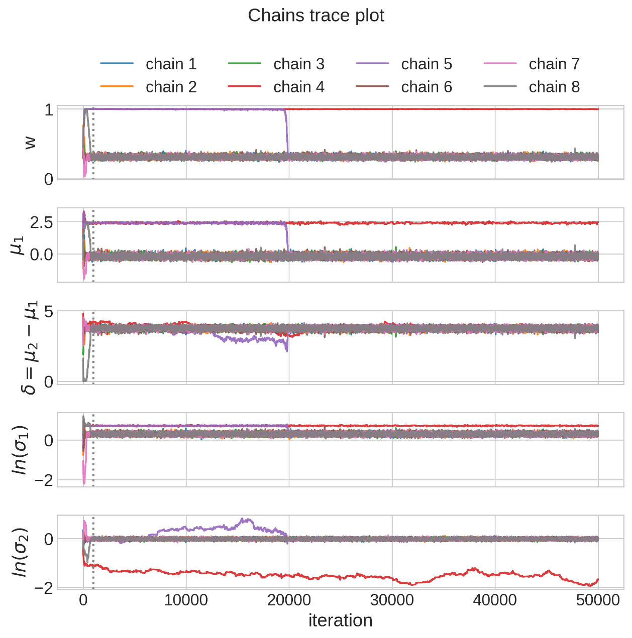
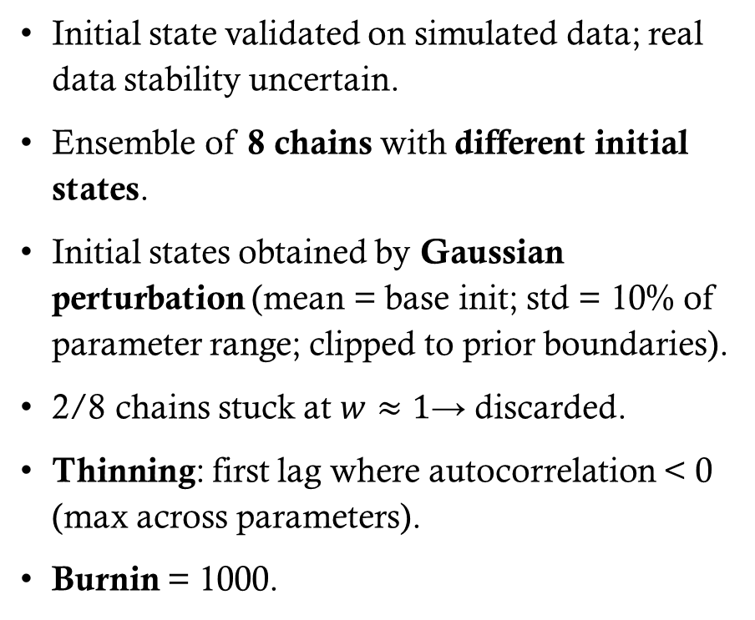
ENSEMBLE - uncertainties
Initial state validated on simulated data; real data stability uncertain.
Ensemble of 8 chains with different initial states.
Initial states obtained by Gaussian perturbation (mean = base init; std = 10% of parameter range; clipped to prior boundaries).
2/8 chains stuck at $w≈1$→ discarded.
Thinning: first lag where autocorrelation < 0 (max across parameters).
Burnin = 1000.

Slide 21
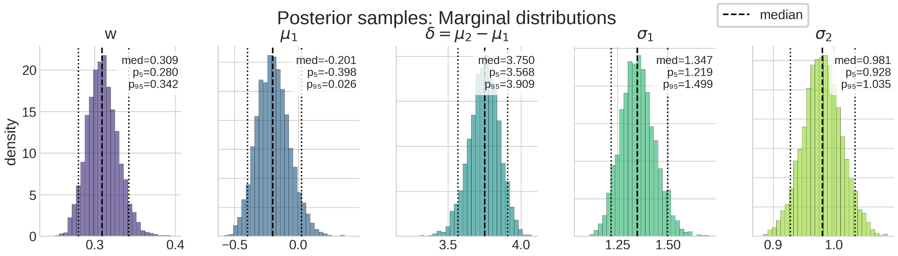
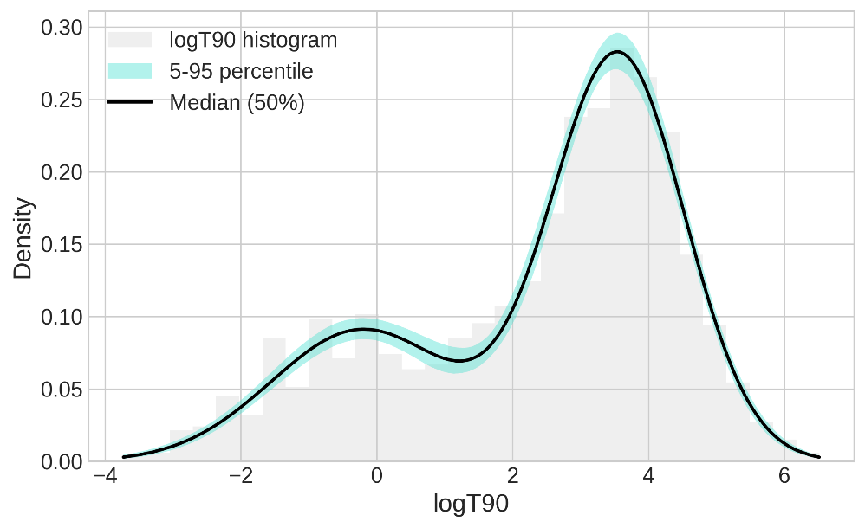
Mean acceptace rate = 0.268
#samples = 4349

Slide 22
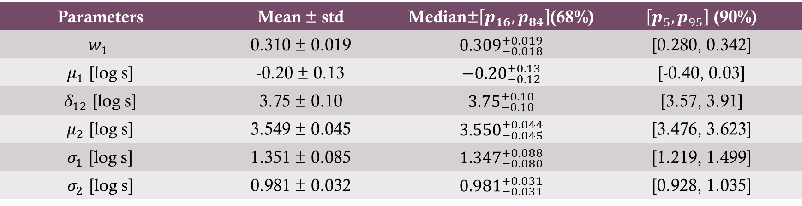
Parameter values - uncertainties
Parameters | Mean ± std | Median±$\left[p_{16},p_{84}\right]$(68%) | $\left[p_{5},p_{95}\right]$ (90%)
$$w_{1}$$ | 0.310 ± 0.019 | $${0.309}_{−0.018}^{+0.019}$$ | [0.280, 0.342]
$μ_{1}$ [log s] | -0.20 ± 0.13 | $${−0.20}_{−0.12}^{+0.13}$$ | [-0.40, 0.03]
$δ_{12}$ [log s] | 3.75 ± 0.10 | $${3.75}_{−0.10}^{+0.10}$$ | [3.57, 3.91]
$μ_{2}$ [log s] | 3.549 ± 0.045 | $${3.550}_{−0.045}^{+0.044}$$ | [3.476, 3.623]
$σ_{1}$ [log s] | 1.351 ± 0.085 | $${1.347}_{−0.080}^{+0.088}$$ | [1.219, 1.499]
$σ_{2}$ [log s] | 0.981 ± 0.032 | $${0.981}_{−0.031}^{+0.031}$$ | [0.928, 1.035]
Parameter estimates obtained when neglecting the uncertainty in $x$ are compatible with those obtained after including that uncertainty.

Slide 23
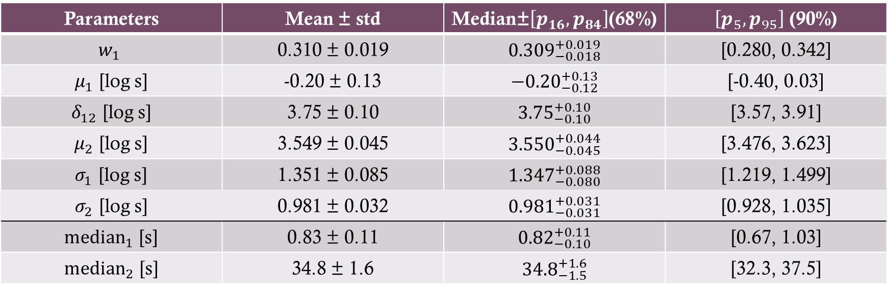
Parameter values - uncertainties
Parameters | Mean ± std | Median±$\left[p_{16},p_{84}\right]$(68%) | $\left[p_{5},p_{95}\right]$ (90%)
$$w_{1}$$ | 0.310 ± 0.019 | $${0.309}_{−0.018}^{+0.019}$$ | [0.280, 0.342]
$μ_{1}$ [log s] | -0.20 ± 0.13 | $${−0.20}_{−0.12}^{+0.13}$$ | [-0.40, 0.03]
$δ_{12}$ [log s] | 3.75 ± 0.10 | $${3.75}_{−0.10}^{+0.10}$$ | [3.57, 3.91]
$μ_{2}$ [log s] | 3.549 ± 0.045 | $${3.550}_{−0.045}^{+0.044}$$ | [3.476, 3.623]
$σ_{1}$ [log s] | 1.351 ± 0.085 | $${1.347}_{−0.080}^{+0.088}$$ | [1.219, 1.499]
$σ_{2}$ [log s] | 0.981 ± 0.032 | $${0.981}_{−0.031}^{+0.031}$$ | [0.928, 1.035]
${\text{median}}_{1}$ [s] | 0.83 ± 0.11 | $${0.82}_{−0.10}^{+0.11}$$ | [0.67, 1.03]
${median}_{2}$ [s] | 34.8 ± 1.6 | $${34.8}_{−1.5}^{+1.6}$$ | [32.3, 37.5]
Parameter estimates obtained when neglecting the uncertainty in $x$ are compatible with those obtained after including that uncertainty.

Slide 24
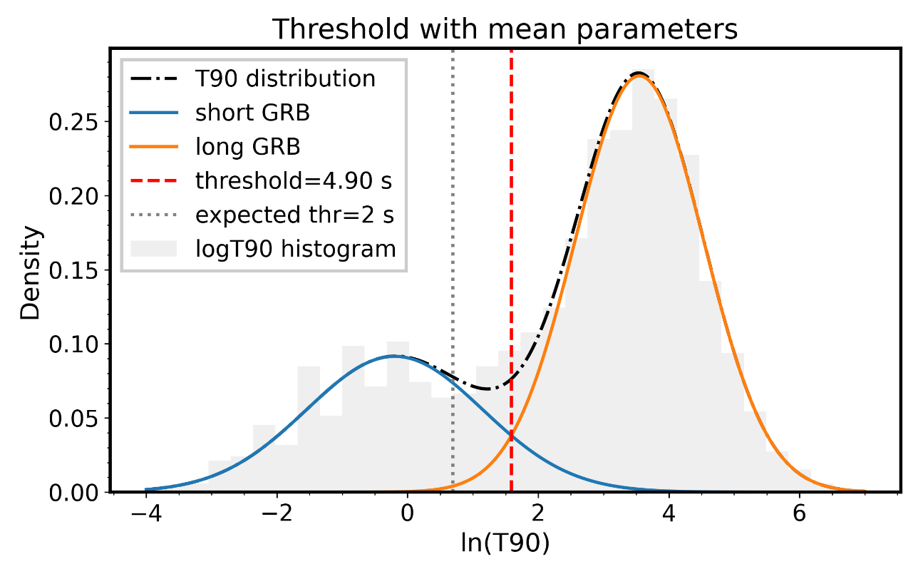
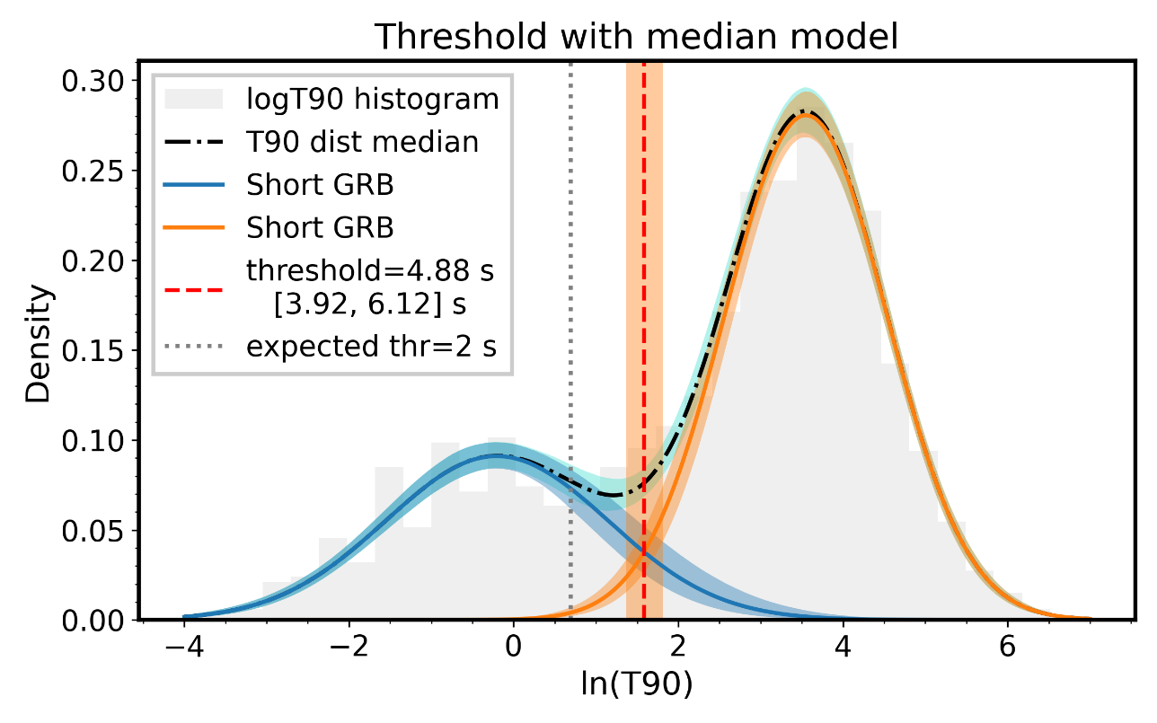
Problem 2 and 3 - classification
Problem 2: compute the probability of GRB170817A (T₉₀ = 2.0 s) of being a short GRB or a long GRB.
Problem 3: determine the threshold value for T90 to discriminate between short and long GRBs.
Notes:
Immagine a sinistra: distribuzioni create con i parametri medi, la threshold corrisponde al punto di contatto tra le due distribuzioni (quando la loro differenza cambia segno)
Immagine a destra: distribuzioni create con i percentili dei modelli (il modello medio NON corriponde al modello creato con i paramenti medi). Le bande contengono il 90% della probabilità di avere il modello, è stato possibile trovare una banda per la threshold utilizzando l’intersezione delle bande.
Il calcolo della threshold è solo una stima, il secondo caso contiene più informazione, ma avere una threshold non definita non è molto utile, per esempio se ho un valore all’interno della banda come viene classificato?
La linea a 2s contiene la threshold usata in letteratura, come si vede nelle figure non è compatibile con nessuna delle due threshold stimate (non è neanche all’interno della banda). Questa threshold è stata calcolata per la prima volta in un articolo del 1993 ("Identification of two classes of gamma-ray burts") nel quale utilizzando circa 200 GRB presi da BATSE hanno calcolato la threshold eseguendo un fit parabolico tra i due picchi.

Slide 25
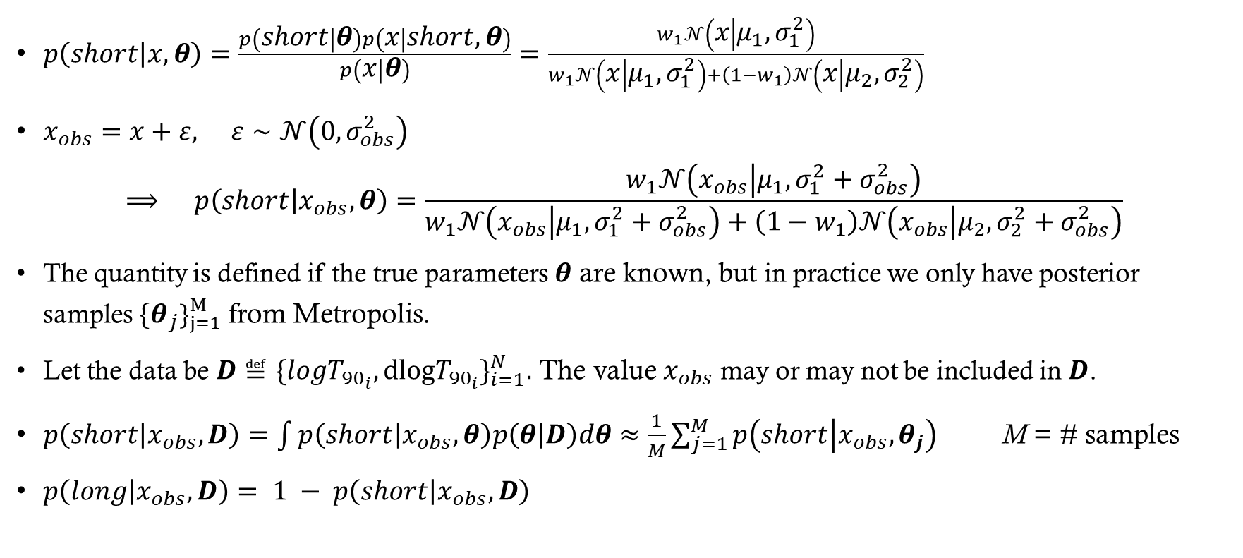
Short GRB Probability distribution
$p\left(short | x,θ\right)=\frac{p\left(short | θ\right)p\left(x | short,θ\right)}{p\left(x | θ\right)}=\frac{w_{1}𝒩\left(x | μ_{1},σ_{1}^{2}\right)}{w_{1}𝒩\left(x | μ_{1},σ_{1}^{2}\right)+\left(1−w_{1}\right)𝒩\left(x | μ_{2},σ_{2}^{2}\right)}$
$x_{obs}=x+ε, ε∼𝒩\left(0,σ_{obs}^{2}\right)$
$$⟹ p\left(short | x_{obs},θ\right)=\frac{w_{1}𝒩\left(x_{obs} | μ_{1},σ_{1}^{2}+σ_{obs}^{2}\right)}{w_{1}𝒩\left(x_{obs} | μ_{1},σ_{1}^{2}+σ_{obs}^{2}\right)+\left(1−w_{1}\right)𝒩\left(x_{obs} | μ_{2},σ_{2}^{2}+σ_{obs}^{2}\right)}$$
The quantity is defined if the true parameters $θ$ are known, but in practice we only have posterior samples ${\{θ}_{j}\}_{j=1}^{M}$ from Metropolis.
Let the data be $D≝\{log{T_{{90}_{i}}, dlogT_{{90}_{i}}\}}_{i=1}^{N}.$ The value $x_{obs}$ may or may not be included in $D$.
$p\left(short | x_{obs},D\right)=\int{p\left(short | x_{obs},θ\right)p\left(θ | D\right)dθ}≈\frac{1}{M}\sum_{j=1}^{M}{p\left(short | x_{obs},θ_{j}\right)}$ M = # samples
$p\left(long | x_{obs},D\right)= 1 − p\left(short | x_{obs},D\right)$
Notes:
x_obs è diverso da prima: nelle slides precedenti era uno dei dati disponibili, apparteneva a D. Invece adesso può essere un valore esterno, il quale può non avere un’incertezza (in questo caso basta imporre sigma_obs=0).
- Nel quarto punto (Montecarlo) ho utilizzato il fatto che $θ$ è indipendente da $x_{obs}$, in quanto i parametri $θ$ vengono estratti utilizzando solo $D.$ $⇒p\left(θ | x_{obs},D\right)=p\left(θ | D\right)$.

Slide 26
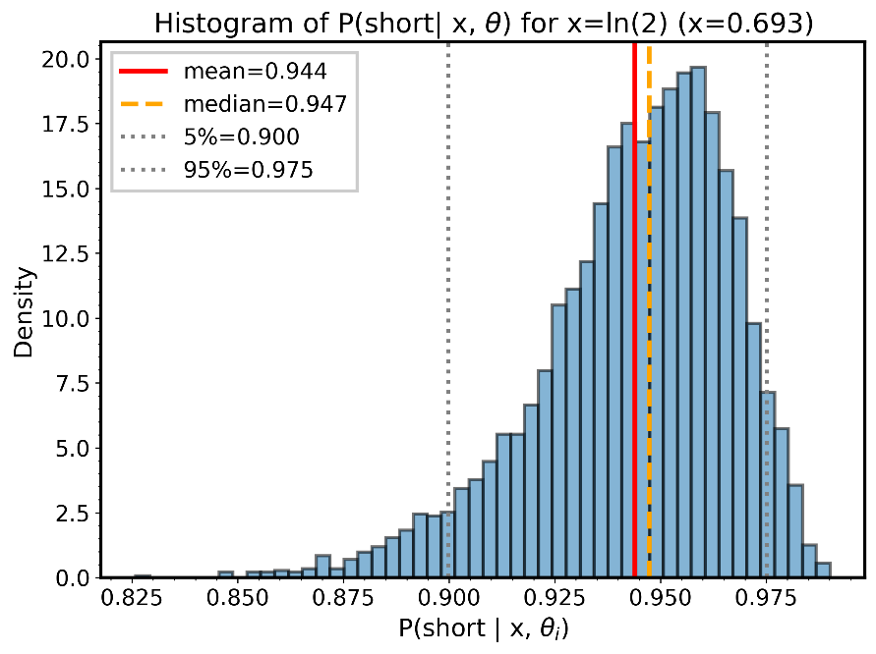
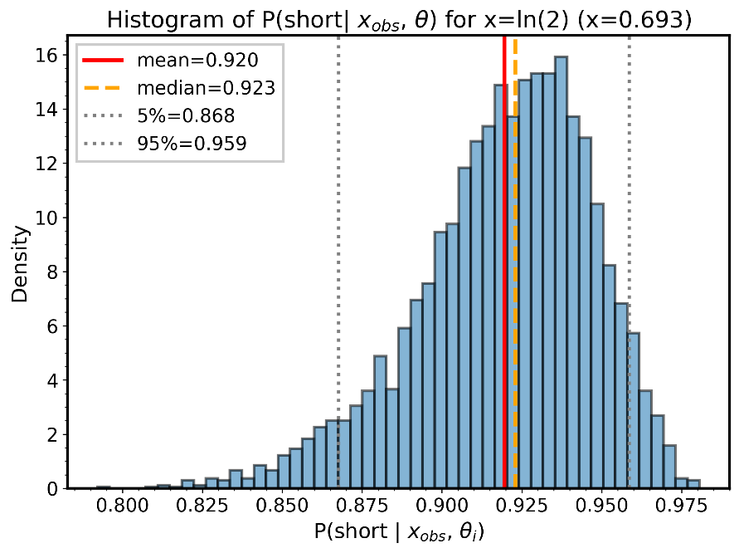
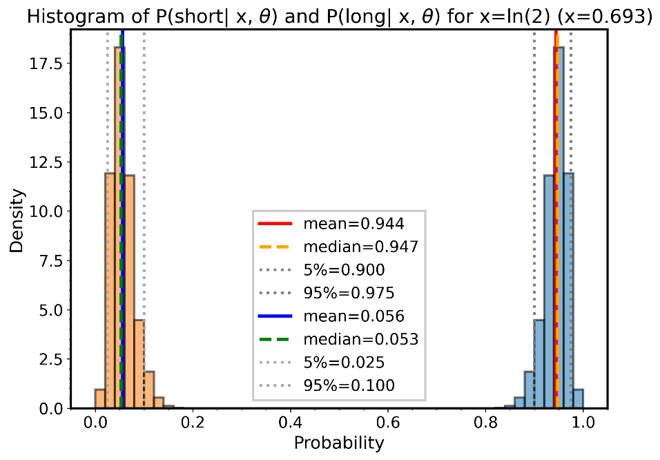
Distributions of GRB170817A
Notes:
I plot rappresentano la distribuzione di probabilità della probabilità di essere uno short (o long) GRB .
Immagine in alto a sinistra è la distribuzione per GRB170817A senza un errore di misura. Invece in alto a Destra è stato stimato grossolanamente l’errore di misura prendendo dlogT90 corrispondente al valore di logT90 più vicino a ln(2).
In basso sono rappresentate nello stesso plot le distribuzioni per la probabilità di essere short e quella di essere long. Come si nota la probabilità di essere short (circa 94%) è molto Maggiore a quella di essere long (circa 6%), quindi GRB170817A viene classificato come short. Inoltre il plot mostra che la threshold a 2s, usata in letteratura, non è affidabile, essendo gli short GRB molto più probabili. Per essere una threshold la media della distribuzione deve essere 0.5 e le due distribuzioni, short e long, devono essere sovrapposte

Slide 27
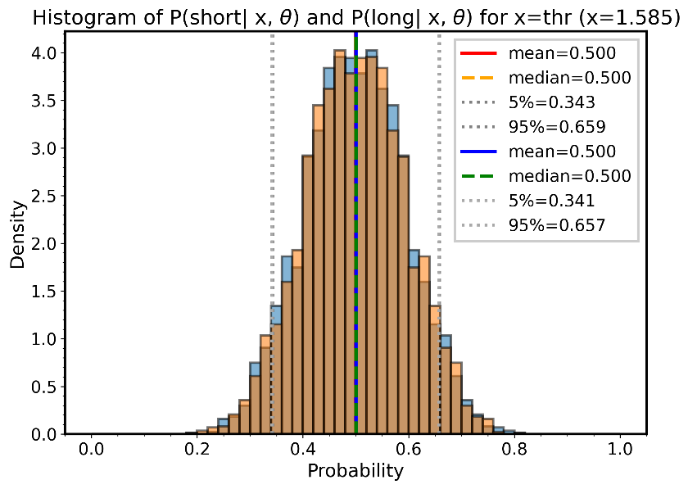
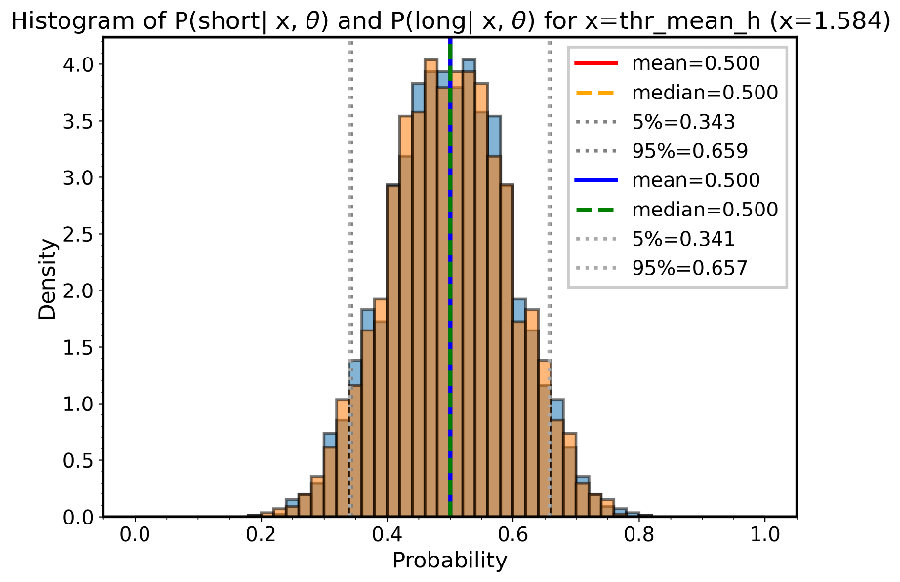
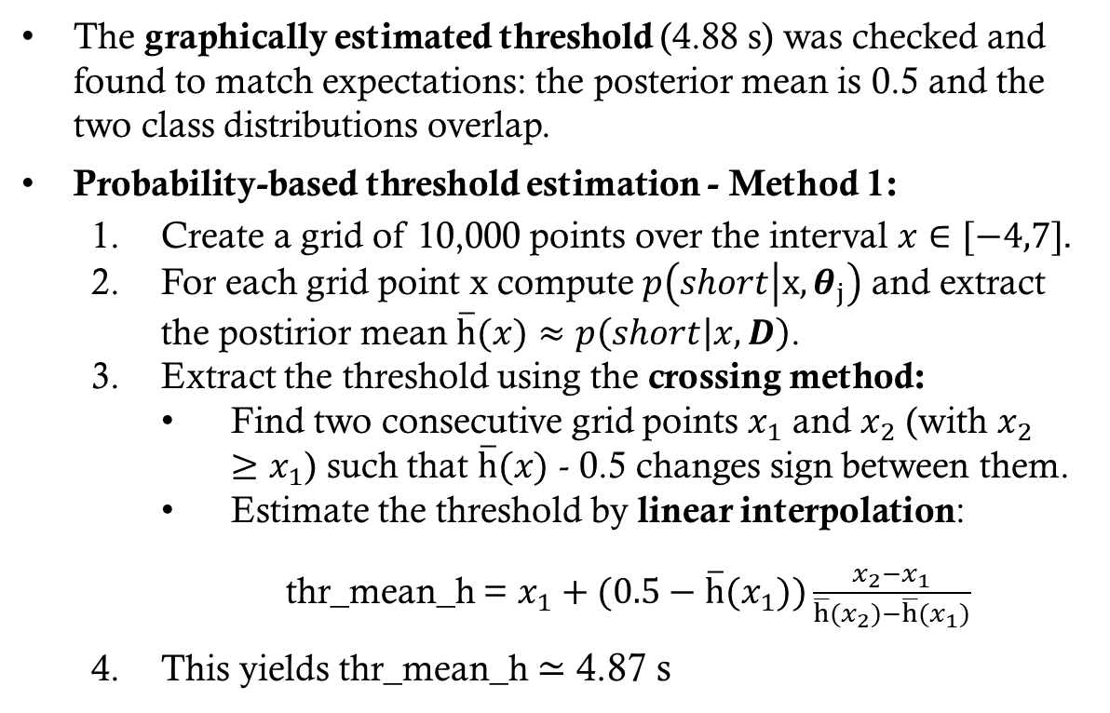
Estimate Threshold
The graphically estimated threshold (4.88 s) was checked and found to match expectations: the posterior mean is 0.5 and the two class distributions overlap.
Probability-based threshold estimation - Method 1:
Create a grid of 10,000 points over the interval $x∈[−4,7]$.
For each grid point x compute $p\left(short | x,θ_{j}\right)$ and extract the postirior mean $\overline{h}\text{(}x)≈p\left(short | x,D\right)$.
Extract the threshold using the crossing method:
Find two consecutive grid points $x_{1}$ and $x_{2}$ (with $x_{2}$ $≥x_{1}$) such that $\overline{h}\text{(}x)$ - 0.5 changes sign between them.
Estimate the threshold by linear interpolation:
thr_mean_h = $x_{1}+(0.5−\overline{h}\text{(}x_{1}))\frac{x_{2}−x_{1}}{\overline{h}{(x}_{2})−\overline{h}{(x}_{1})}$
This yields thr_mean_h ≃ 4.87 s
Notes:
La media di h è sui sample theta, cioè ricavo il risultato del Monte Carlo scritto due slides fa.

Slide 28
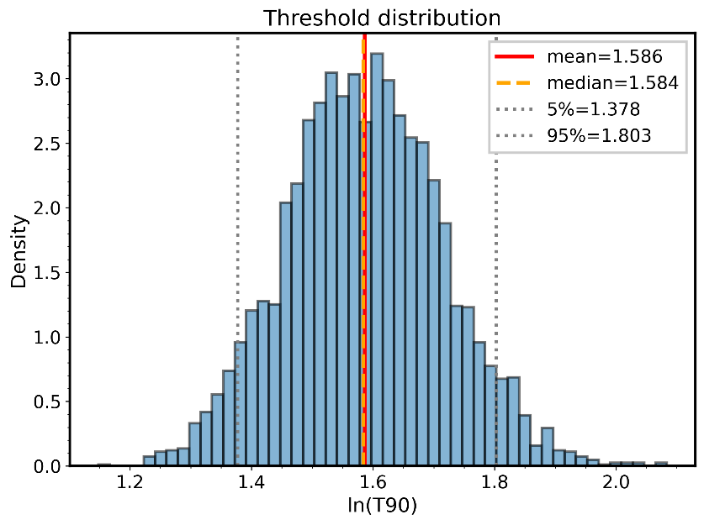
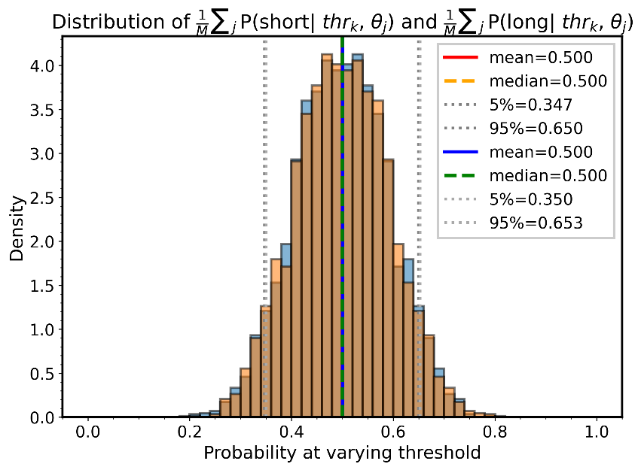
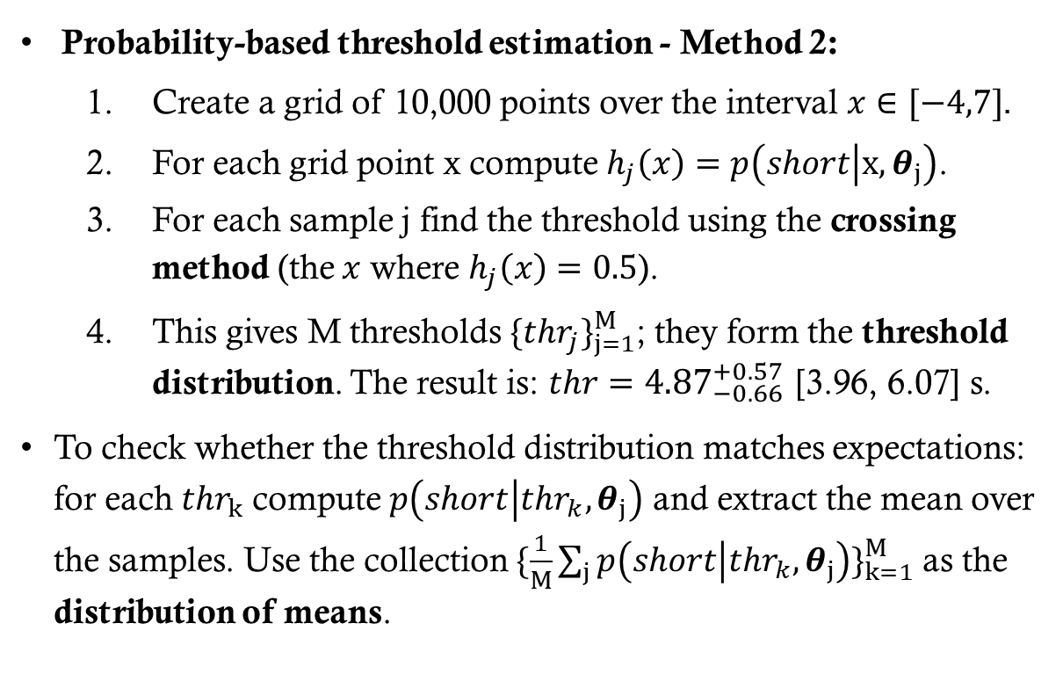
Threshold distribution
Probability-based threshold estimation - Method 2:
Create a grid of 10,000 points over the interval $x∈[−4,7]$.
For each grid point x compute $h_{j}\left(x\right)=p\left(short | x,θ_{j}\right)$.
For each sample j find the threshold using the crossing method (the $x$ where $h_{j}\left(x\right)=0.5$).
This gives M thresholds $\{thr_{j}\}_{j=1}^{M}$; they form the threshold distribution. The result is: $thr={4.87}_{−0.66}^{+0.57}$ [3.96, 6.07] s.
To check whether the threshold distribution matches expectations: for each $thr_{k}$ compute $p\left(short | thr_{k},θ_{j}\right)$ and extract the mean over the samples. Use the collection $\{\frac{1}{M}\sum_{j}{p\left(short | thr_{k},θ_{j}\right)}\}_{k=1}^{M}$ as the distribution of means.
Notes:
h è una matrice, il valore h_j(x) corrisponde alla p(short|x,theta_j) con j e x fissi.
Fissato solo il sample j, h_j(x) diventa una funzione di x (vettore)
Diversamente da prima dove h era preso come media e quindi bar h era un vettore in funzione di x.
Il valore di thr è scritto come mediana +- 68 percentile, e nella parentesi è contenuto il 90% della probabilità [5, 95] percentile

Slide 29
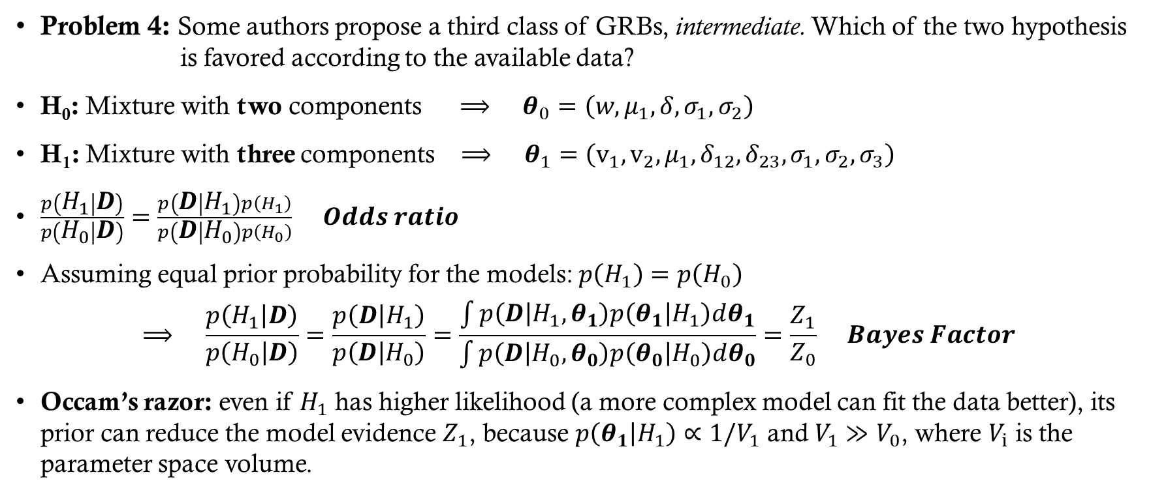
Problem 4 – model selection
Problem 4: Some authors propose a third class of GRBs, intermediate. Which of the two hypothesis is favored according to the available data?
H₀: Mixture with two components$⟹ θ_{0}=\left(w,μ_{1},δ,σ_{1},σ_{2}\right)$
H₁: Mixture with three components$⟹ θ_{1}=\left(v_{1},v_{2},μ_{1},δ_{12},δ_{23},σ_{1},σ_{2},σ_{3}\right)$
$\frac{p\left(H_{1} | D\right)}{p\left(H_{0} | D\right)}=\frac{p\left(D | H_{1}\right)p\left(H_{1}\right)}{p\left(D | H_{0}\right)p\left(H_{0}\right)} Odds ratio$
Assuming equal prior probability for the models: $p\left(H_{1}\right)=p\left(H_{0}\right)$
$$⟹ \frac{p\left(H_{1} | D\right)}{p\left(H_{0} | D\right)}=\frac{p\left(D | H_{1}\right)}{p\left(D | H_{0}\right)}=\frac{\int{p\left(D | H_{1},θ_{1}\right)p\left(θ_{1} | H_{1}\right)dθ_{1}}}{\int{p\left(D | H_{0},θ_{0}\right)p\left(θ_{0} | H_{0}\right)dθ_{0}}}=\frac{Z_{1}}{Z_{0}} Bayes Factor$$
Occam’s razor: even if $H_{1}$ has higher likelihood (a more complex model can fit the data better), its prior can reduce the model evidence $Z_{1}$, because $p\left(θ_{1} | H_{1}\right)∝1/V_{1}$ and $V_{1}≫V_{0}$, where $V_{i}$ is the parameter space volume.
Notes:
Con l’Occam’s razor voglio sottolineare che:
nell’istogramma del logT90 è possibile vedere un picco tra i due picchi principali, questo è dovuto ad un modello più complesso (tre componenti) oppure no? Supponendo che la likelihood di H1 sia maggiore in quanto riesce a fittare il picco centrale, questo guadagno riesce a compensare la perdita di evidenza dovuta a passare da uno spazio in 5D a uno in 8D? Se Bayes Factor è positivo la risposta è Sì, se è negativo è No (Spoiler: è negativo)

Slide 30
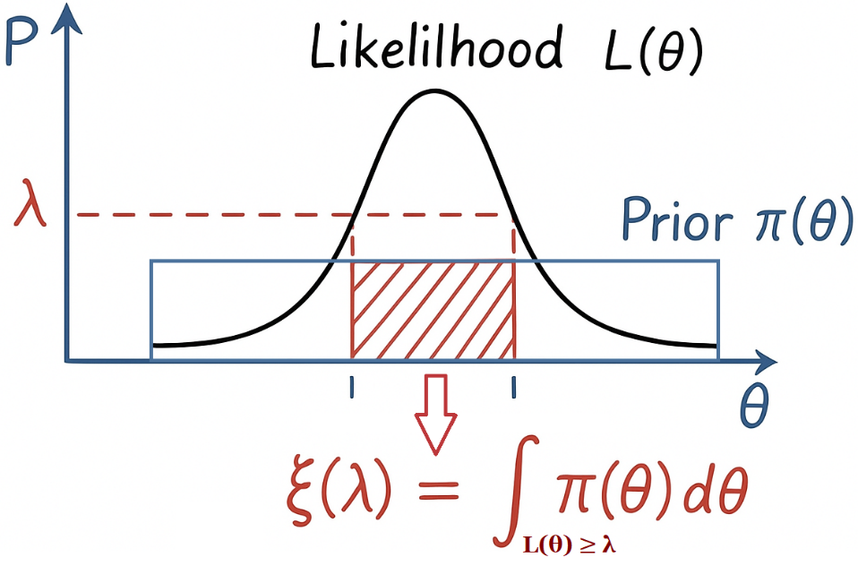
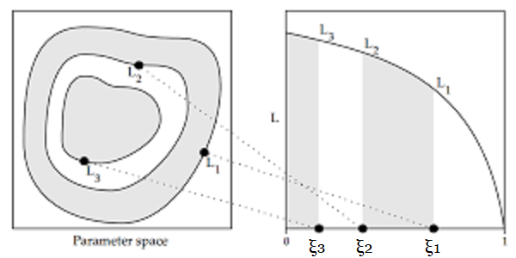
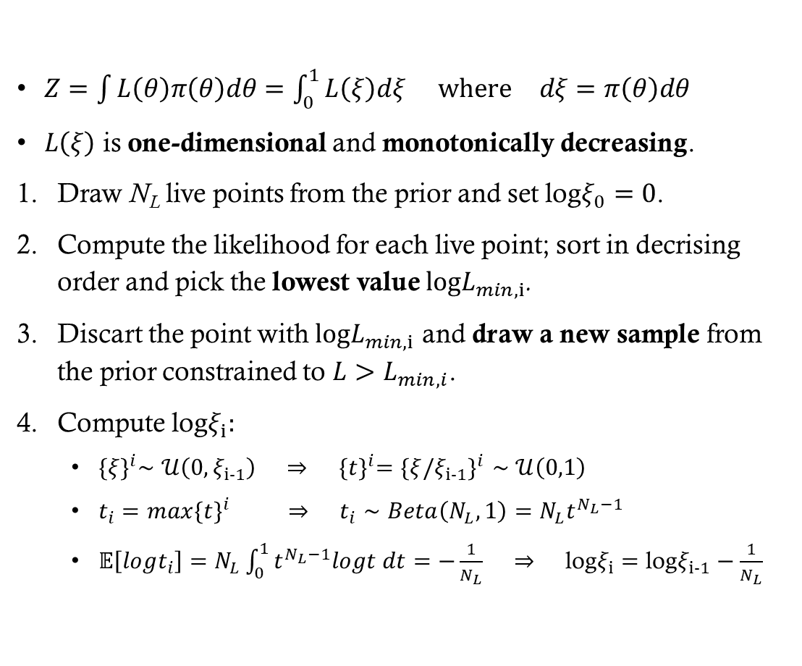
Nested sampling (1/2)
$Z=\int{L\left(θ\right)π\left(θ\right)dθ}=\int_{0}^{1}{L\left(ξ\right)dξ} \text{where} dξ=π\left(θ\right)dθ$
$L\left(ξ\right)$ is one-dimensional and monotonically decreasing.
Draw N_{L} live points from the prior and set log$ξ_{0}=0$.
Compute the likelihood for each live point; sort in decrising order and pick the lowest value $logL_{min,i}$.
Discart the point with $logL_{min,i}$ and draw a new sample from the prior constrained to $L>L_{min,i}$.
Compute log$ξ_{i}:$
${\{ξ\}}^{i}∼𝒰\left(0,ξ_{i−1}\right) ⇒ {\{t\}}^{i}=\{ξ/{ξ_{i−1}\}}^{i}∼𝒰\left(0,1\right)$
$t_{i}=max\{{t\}}^{i} ⇒ t_{i}∼Beta\left(N_{L},1\right)=N_{L}t^{N_{L}−1}$
$𝔼\left[logt_{i}\right]=N_{L}\int_{0}^{1}{t^{N_{L}−1}logt dt}=−\frac{1}{N_{L}} ⇒ \text{log}ξ_{i}=\text{log}ξ_{i−1}−\frac{1}{N_{L}}$
Notes:
-Se ξ = 0, vuol dire che λ = L_max (il valore di λ è tangente alla cima della gaussiana e quindi non viene proiettata nessuna area).
-Se ξ = 1, vuol dire che λ = 0 (oppure λ = L_min), cioè tutta la likelihood è sopra λ (nell’immagine λ è ai piedi della gaussiana e quindi viene presa tutta l’area della prior).
-Essendo L(ξ) monodimensionale l’integrale per ricavare Z diventa semplice da calcolare, precedentemente era un integrale sullo sapzio dei parametri (nel nostro caso 5D e 8D).
-{ξ}^i indica l’insieme di tutti gli ξ all’iterazione i, mentre ξ_i-1 indica il valore estratto all’iterazione i-1
-t indica la frazione di contarzione della prior mass ξ (è una normalizzazione ottenuta dai ξ per avere sempre l’intervallo tra 0 e 1) -N_L a moltiplicare nella Beta(N_L, 1) è la costante di normalizzazione ottenuta integrando t^N-1 nell’intervallo (0,1) e ponendo il risultato uguale a 1.
-ξ_i = ξ_i-1*t_i => logξ_i = logξ_i-1 + logt_i
- In realtà non è stata usata esattamente l’equazione sopra perché viene usato il valore di aspettazione di t_i, quindi il calcolo non è esatto

Slide 31
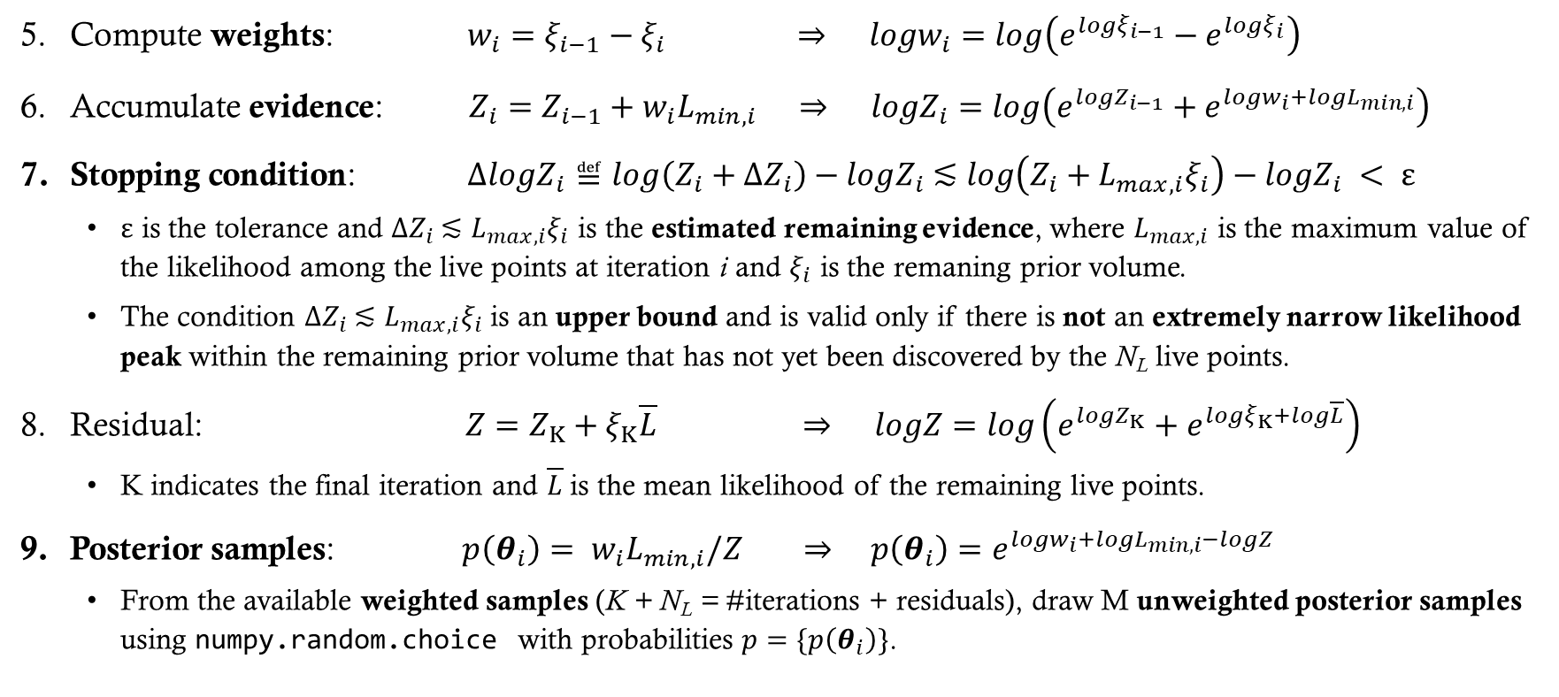
Nested sampling (2/2)
Compute weights: $w_{i}=ξ_{i−1}−ξ_{i} ⇒ logw_{i}=log\left(e^{logξ_{i−1}}−e^{logξ_{i}}\right)$
Accumulate evidence: $Z_{i}=Z_{i−1}+w_{i}L_{min,i} ⇒ logZ_{i}=log\left(e^{logZ_{i−1}}+e^{logw_{i}+logL_{min,i}}\right)$
Stopping condition: $ΔlogZ_{i}≝log\left(Z_{i}+ΔZ_{i}\right)−logZ_{i} \text{≲} log\left(Z_{i}+L_{max,i}ξ_{i}\right)−logZ_{i} < ε$
$ε$ is the tolerance and $ΔZ_{i} \text{≲} L_{max,i}ξ_{i}$ is the estimated remaining evidence, where $L_{max,i}$ is the maximum value of the likelihood among the live points at iteration i and $ξ_{i}$ is the remaning prior volume.
The condition $ΔZ_{i} \text{≲} L_{max,i}ξ_{i}$ is an upper bound and is valid only if there is not an extremely narrow likelihood peak within the remaining prior volume that has not yet been discovered by the N_{L} live points.
Residual: $Z=Z_{K}+ξ_{K}\overline{L} ⇒ logZ=log\left(e^{logZ_{K}}+e^{logξ_{K}+log\overline{L}}\right)$
K indicates the final iteration and $\overline{L}$ is the mean likelihood of the remaining live points.
Posterior samples: $p\left(θ_{i}\right)= w_{i}L_{min,i}/Z ⇒ p\left(θ_{i}\right)=e^{logw_{i}+logL_{min,i}−logZ}$
From the available weighted samples (K + N_{L} = #iterations + residuals), draw M unweighted posterior samples using numpy.random.choice with probabilities $p=\{p\left(θ_{i}\right)\}$.
Notes:
-Calcolo Z come somma di Riemann, dove L_min,i è l’altezza del rettangolo e w_i è la base del rettagolo.
-Lmax*ξi sta approssimando il rimanente Z con un rettangolo con base pari alla prior mass rimanente e altezza uguale alla likelihood massima tra i live points, quindi è un upper bound di ΔZ (se si assume che non sono presenti picchi nella likelihood non identificati).
Dopo che la condizione di stop è stata raggiunta, invece di buttare la prior mass rimanente, approssimo i valori rimanenti con un rettangolo di base uguale alla prior mass rimanente ed altezza pari alla likelihhod media sui live points rimanenti.
w_i dei residuals corrispondono a ξ_K/N_L, cioè sto dividendo il rettangolo finale in parti uguali
choise deve avere replace=True

Slide 32
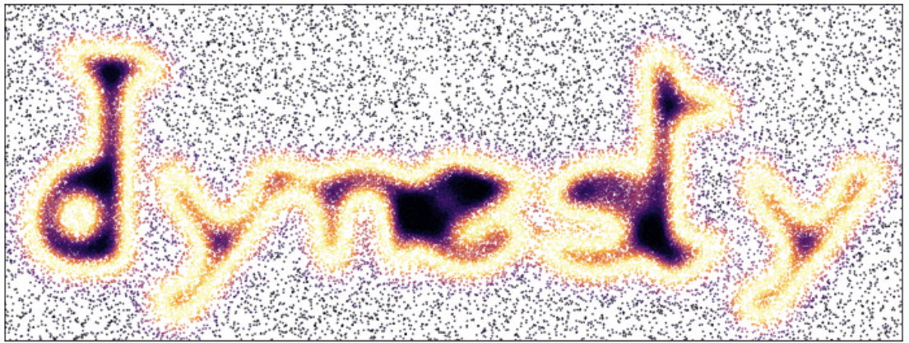

Library: Dynesty
Class: NestedSampler
#Live points $⇒N_{L}=1200$
Tolerance $⇒ε={10}^{−2}$
Bound $⇒$ Multiple ellipsoids (‘multi’)
Sample $⇒$ Random walk (‘rwalk’)

Slide 33
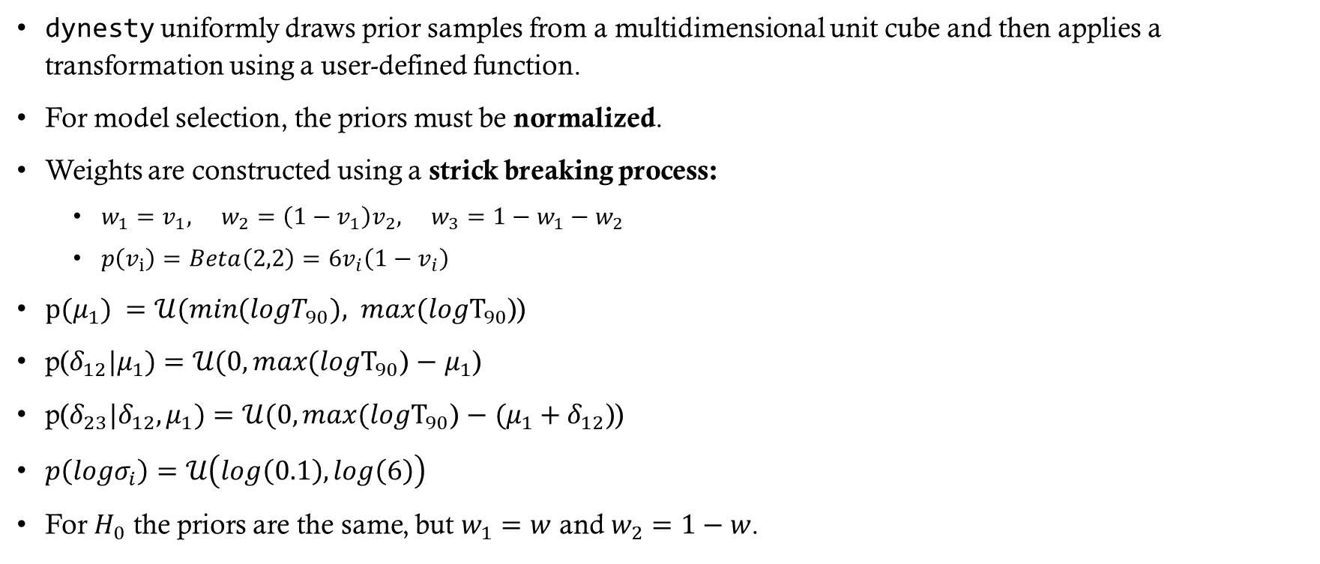
Prior
dynesty uniformly draws prior samples from a multidimensional unit cube and then applies a transformation using a user-defined function.
For model selection, the priors must be normalized.
Weights are constructed using a strick breaking process:
$w_{1}=v_{1}, w_{2}=\left(1−v_{1}\right)v_{2}, w_{3}=1−w_{1}−w_{2}$
$p\left(v_{i}\right)=Beta\left(2,2\right)=6v_{i}\left(1−v_{i}\right)$
${p(μ}_{1}) =𝒰(min(logT_{90}), max(logT_{90}$))
p($δ_{12}|μ_{1})=𝒰(0,max(logT_{90}\text{)} \text{−} μ_{1}\text{)}$
p($δ_{23}|δ_{12},μ_{1})=𝒰(0,max(logT_{90}\text{) }\text{− }{(μ}_{1} + δ_{12}\text{)}$)
$p\left(logσ_{i}\right)=𝒰\left(log\left(0.1\right),log\left(6\right)\right)$
For $H_{0}$ the priors are the same, but $w_{1}=w$ and $w_{2}=1−w$.
Notes:
In realtà v1 e v2 non vengono estratti direttamente dalla Beta(2,2), ma vengono prima estratti uniformemente da un cubo unitario e successivamente viene applicata la ppf della beta function (point probability function) per trasformare la distribuzione uniforme in Beta(2,2). La ppf è la funzione inversa della CDF (cumulante); preso un punto in (0,1) restituisce il valore corrispondnete di probabilità.
Preso un valore u estratto uniformemente da un intervallo unitario, se voglio una variabile estratta sempre in modo unitario ma con intervallo diverso [a,b] basta applicare a+u*(b-a)
Se invece devo trasformare in una distribuzione diversa da quella unitaria basta usare la ppf (fornita da scipy)

Slide 34
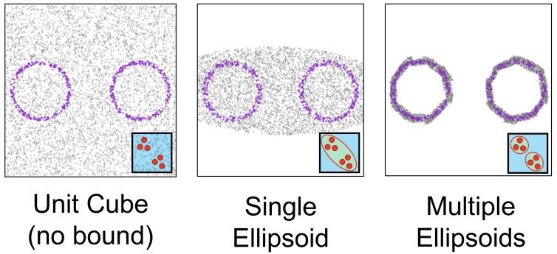
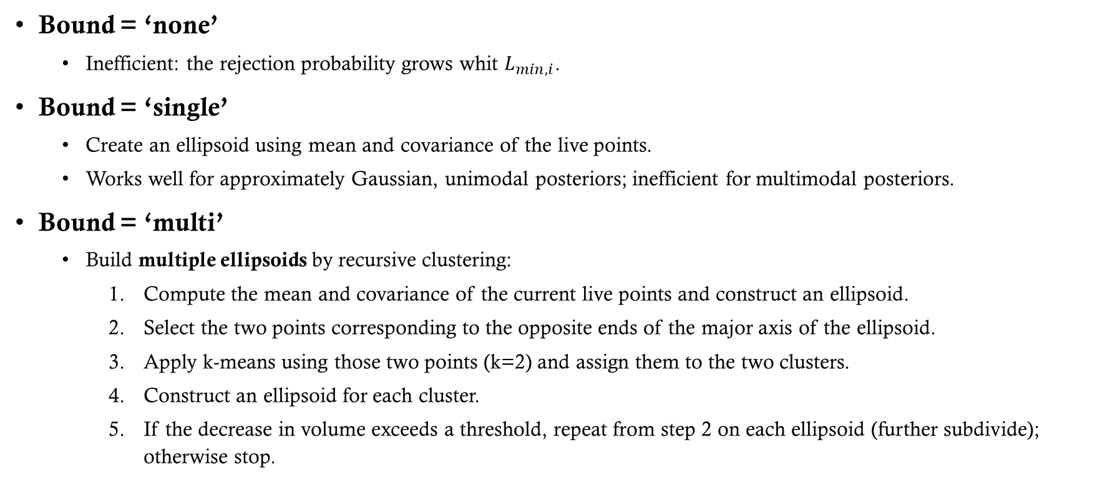
bound
Bound = ‘none’
Inefficient: the rejection probability grows whit $L_{min,i}$.
Bound = ‘single’
Create an ellipsoid using mean and covariance of the live points.
Works well for approximately Gaussian, unimodal posteriors; inefficient for multimodal posteriors.
Bound = ‘multi’
Build multiple ellipsoids by recursive clustering:
Compute the mean and covariance of the current live points and construct an ellipsoid.
Select the two points corresponding to the opposite ends of the major axis of the ellipsoid.
Apply k-means using those two points (k=2) and assign them to the two clusters.
Construct an ellipsoid for each cluster.
If the decrease in volume exceeds a threshold, repeat from step 2 on each ellipsoid (further subdivide); otherwise stop.
Notes:
Bound indica lo spazio dove posso estrarre i live points (devo estrarre un live points ad ogni iterazione)
L’ellisse viene moltiplicata per un fattore di default 1.25, in modo da essere sicuri di includere tutti i live points
K-means:
Parto da k centri iniziali (preferibilmente ben distanziati)
Per ogni punti calcolo la distanza dai k centri ed assegno il punto al centro più vicino (una volta assegnati tutti i punti ottengo k cluster)
Sostituisci k centri con la media dei cluster
Calcola la SSE (sum square error) come la somma delle distanze euclidee dei punti rispetto ai centri più vicini
Se la variazione di SSE è sotto una certa soglia interrompe l’algoritmo; altrimenti riparto dal punto 2 con i nuovi centri
Nell’immagine in viola sono rappresentati i live points, invece in grigio sono rappresentati dei possibili draws

Slide 35
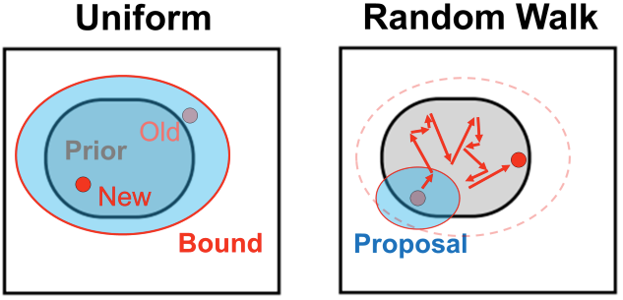

SaMple
Sample = ‘unif’
Rejection sampling inside the bound.
Sample = ‘rwalk’
The proposal is a uniform ellipsoid centered on the point to be replaced and with the same size as the bound. If bound = ‘multi’, randomly pick one of the ellipsoids that intersect the point.
The number of chain steps per iteration is set by the parameter walks (default walks = 25).
The bound is updated after $round\left(0.15×walks\right)×N_{L}$ likelihood calls:
$N_{L}=1200, walks=25 ⇒ round\left(0.15×walks\right)×N_{L}=4500$ likelihood calls ($180$iterations)
The proposal scale is adapted each iteration:
$$s_{i+1}=s_{i}×exp\left(\frac{ratio−target}{d×target}\right) ⇒ log(s_{i+1})=log(s_{i})+η\left(ratio−target\right),$$
where $η=1/\left(d×target\right),$ $ratio$is the acceptance ratio in that iteration, $target$(default is 0.5) is the desired acceptance ratio, and $d$ is the parameter dimension.
Notes:
rejection sampling è eseguito in base alla condizione L_i > L_min,i
Ogni iterazione ha 25 chiamate di likelihood (una chiamata per ogni passo) => 4500/25 = 180
Visto che i bound si aggiornano e la forma della proposal dipende dai bound, la proposal è variabile, ma la variazione è molto lenta perché avviene ogni 180 iterazioni, quindi non rischio di avere una catena non makaroviana (come invece succede in MH adaptive senza warm-up)
La forma in logaritmo della scala della proposal sembra un gradient descend con learning rate $η$ fisso
non prendi il punto 25 se quel punto non soddisfa il vincolo di likelihood, il campionatore prende l’ultimo punto del walk che soddisfa il vincolo (cioè l’ultimo punto accettato valido). Se durante tutto il walk non si trova nessun punto valido allora si ripete l’iterazione con nuovi 25 passi e aggiornando la scala della proposal come in slide
ratio > target: vuol dire che sto accettando troppo, quindi la proposal è troppo piccola -> $s_{i+1}>s_{i}$
ratio < target: vuol dire che sto rifiutando troppo, quindi la proposal è troppo grande -> $s_{i+1}<s_{i}$

Slide 36




RESULTS
Data generated from 2 components
Data generated from 3 components
The evidences $Z_{i}$ were computed 5 times for each hypothesis.
Validation on simulated data:
Data generated from 2 components:
$$logBF = −2.63 ± 0.19 < 0 ⇒ p\left(H_{0} | D\right)>p\left(H_{1} | D\right)$$
Data generated from 3 components:
$$logBF = 6.07 ± 0.18 > 0 ⇒ p\left(H_{0} | D\right)<p\left(H_{1} | D\right)$$
On real data:
$$logBF = −1.75 ±0.12< 0 ⇒ p\left(H_{0} | D\right)>p\left(H_{1} | D\right)$$
Notes:
Per creare i plot è stato prima effettuato un merge tra le 5 runs (in modo da tenere conto di tutti i parametri disponibili), succesivamente sono estratti M=4349 samples con estrazione pesata
Il merge è stato effettuato dalla funzione interna di dynesty
L’errore su Z ha due componenti: -- una dovuta all’approssimazione di riemann (stiamo approssimando l’aria di una funzione continua L(ξ) con una somma di rettangoli). All’aumentare di live points i rettangoli aumentano e l’approssimazione è più accurata
-- l’altra è dovuta al calcolo di t_i in quanto viene usato il valore di aspettazione da una distribuzione casuale, il valore diventa più accurato con l’aumentare dei live points
-- Inoltre c’è un terzo errore dovuto alla causualità della scelta dei live points (la loro posizione è estratta randomicamente dalla prior). Questo errore può essere tenuto conto costruendo un ensemble di Z ed estraendo media e std

Slide 37




Corner plot - Model $H_{0}$
(Metropolis posterior means in red)
Corner plot – Model $H_{1}$

Slide 38

Problem 5 - clustering
Problem 5: Another possibility is to classify GRBs in soft and hard, according to the hardness ratio:
$$HR = \frac{F_{50−100 keV}}{F_{20−50 keV}}$$
where F is the measured flux in a certain energy interval. Study the bimodal distribution in the log(T90) - log(HR) space.
Gibbs sampling
Collapsed Gibbs sampling
Non-parametric collapsed Gibbs sampling
Multidimensional generalization
Only logT₉₀ (1D)

Slide 39


Gibbs sampling
A Markov Chain Monte Carlo (MCMC) method to draw samples from a joint posterior by iteratively sampling each variable from its conditional distribution given the current values of the others.
Assignments: $z=\left(z_{1},…,z_{N}\right), z_{i}∈\{1,…,K\} K\begin{aligned}=\#\text{\#}\text{Gaussian} \text{components}\end{aligned}$
Parameters: weights $w=\left(w_{1},…,w_{K}\right), \text{gaussian} \text{param}eters θ=\left(μ,σ^{2}\right)=\left({{\{μ}_{k}\}}_{k=1}^{K},{\{σ_{k}^{2}\}}_{k=1}^{K}\right)$
Principle:
$$p\left(γ_{j} | γ_{¬j},x\right)=p\left(γ_{j},γ_{¬j} | x\right)/p\left(γ_{¬j}|x\right)∝p\left(γ_{j},γ_{¬j} | x\right)=p\left(γ | x\right)$$
For each $γ_{j}$ compute the posterior discarting all the pieces that depends only on $γ_{¬j}$.
$$p\left(γ | x\right) =p\left(θ,w,z | x\right)∝p\left(x | θ,w,z\right)p\left(z | w\right)p\left(w\right)p\left(θ\right)=$$
$$=\left(\prod_{i=1}^{N}{p\left(x_{i} | z_{i},θ\right)}\right)\left(\prod_{i=1}^{N}{w_{z_{i}}}\right)p\left(w\right)p\left(θ\right)=p\left(θ\right)p\left(w\right)\prod_{i=1}^{N}{w_{z_{i}}𝒩\left(x_{i} | μ_{z_{i}},σ_{z_{i}}^{2}\right)}$$
Notes:
Il Gibbs sampling consiste nell’aggiornare un parametro alla volta mentre tendo fissi tutti i restanti parametri. Una volta aggiornati tutti i parametri ho un nuovo sample (mi muovo parallelamente agli assi dello spazio dei parametri).
Per estrarre il valore da aggiornare tenendo fissi gli altri devo calcolare $p\left(γ_{j} | γ_{¬j},x\right)$, il quale è proporzionale alla postirior (mostrato nella slides)
$γ=(θ,w,z)$, il pedice $¬$j indica tutti i valori tranne j
Il calcolo delle condizionali consiste nel selezionare il parametro j da aggiornare e calcolare la posterior rimuovendo tutti i termini che dipendono non dal parametro j. Posso rimuovere tutti i valori non dipendenti da j perché vengono tenuti fissi, quindi essendo delle costanti vengono eliminati dalla normalizzazione.

Slide 40

Gibbs sampling algorithm
Initialize $θ^{\left(0\right)}$, $w^{\left(0\right)}$ and $z^{\left(0\right)}$.
For iterations $t = 1,2,…, M:$
For each i: draw $z_{i}^{\left(t\right)}∼p\left(z_{i} | x_{i},w^{\left(t−1\right)},θ^{\left(t−1\right)}\right)$.
Draw $w^{\left(t\right)}∼p\left(w | z^{\left(t\right)}\right).$
For each k: draw $\left(μ_{k}^{\left(t\right)},σ_{k}^{2\left(t\right)}\right)∼p\left(μ_{k},σ_{k}^{2} | x_{k}\right) \text{where} x_{k}=\{x_{i}: z_{i}^{\left(t\right)}=k\}$
Remove burn-in and apply thinning.
Notes:
-Sia $w$ che ($μ_{k},σ_{k}^{2}$) vengono aggiornati in blocco
Il valore $z^{\left(t\right)}$ è il vettore ottenuto dopo aver calcolato tutti i $z_{i}^{\left(t\right)}$
Gli $x_{k}$ sono tutti i punti che appartengono alla componente k (vengono selezionati da $z_{i}^{\left(t\right)})$
Nelle varie condizionali riportate sono stati già levati i parametri che non ifluiscono con il parametro selezionato, per esempio z$¬i$ non influisce con z_i

Slide 41

Conditional probabilities (1/2)
For each k: $p\left(z_{i}=k | x_{i},w,θ\right)=\frac{w_{k}𝒩\left(x_{i} | μ_{k},σ_{k}^{2}\right)}{\sum_{h=1}^{K}{w_{h}𝒩\left(x_{i} | μ_{h},σ_{h}^{2}\right)}}$
Draw one component with numpy.random.choice using probabilities $p=\{p{\left(z_{i}=k | x_{i},w,θ\right)\}}_{k=1}^{K}$.
$p\left(w | z\right)∝p\left(z | w\right)p\left(w\right) =\left(\prod_{i=1}^{N}{w_{z_{i}}}\right)Dir\left(w | α/K\right)$ $∝$ $\left(\prod_{k=1}^{K}{w_{k}^{n_{k}}}w_{k}^{α/K − 1}\right)$ $∝$ $Dir\left(w | α/K+n_{k}\right)$
$n_{k}$ is the number of points assigned to component $k$.
The prior is a Dirichlet distribution with hyperparameter $α/K$ for all components: $p\left(w\right)→p\left(w|α\right)$.
$Prior: p(θ_{k})=p(μ_{k}\text{)}\text{p}\text{(}σ_{k}^{2}\text{) }∝1/σ_{k}^{2} \text{where} p\left(μ_{k}\right)∝1, p\left(log{(σ}_{k}^{2})\right)∝ 1 ⇒$ $\text{p}\text{(}σ_{k}^{2}\text{) }∝1/σ_{k}^{2}$
$p\left(μ_{k},σ_{k}^{2} | x_{k}\right)∝p\left(μ_{k}\right)p\left(σ_{k}^{2}\right)p\left(x_{k} | μ_{k},σ_{k}^{2}\right)=$
$$=\frac{1}{σ_{k}^{2}}\prod_{i=1}^{n_{k}}{\frac{1}{\sqrt{2πσ_{k}^{2}}}exp\left(−\frac{1}{2}\frac{{\left(x_{k,i}−μ_{k}\right)}^{2}}{σ_{k}^{2}}\right)}∝{\left(σ^{2}\right)}^{−\left(\frac{n_{k}}{2}+1\right)}exp\left(−\frac{1}{2σ_{k}^{2}}\sum_{i=1}^{n_{k}}{{\left(x_{k,i}−μ_{k}\right)}^{2}}\right)$$
Notes:
$p\left(z_{i}=k | x_{i},w,θ\right)$ corrisponde a $p\left(short | x,θ\right)$ calcolato precedentemente dove k=short
Quando scrivo «Draw one component» si intende per ogni i, non una componente complessiva per tutti gli i. Il calcolo va iterato per tutti gli i; in pratica sto calcolando una matrice NxK.
Come prior dei pesi è stata scelta la Dirichlet essendo un prior coniugata alla multinomiale ( $p\left(z | w\right)$ è proporzionale ad una multinomiale)
Il valore di $α$ non è importante in questo caso perché è uguale per tutte le categorie

Slide 42

Conditional probabilities (2/2)
Marginalize over $μ_{k}$ to obtain a distribution only in $σ_{k}^{2}$.
$\begin{matrix}p\left(σ_{k}^{2} | x_{k}\right) & = & \int_{−∞}^{+∞}{p\left(μ_{k},σ_{k}^{2} | x_{k}\right)dμ_{k}}∝{\left(σ^{2}\right)}^{−\left(\frac{n_{k}}{2}+1\right)}e^{−\frac{S_{k}}{2σ_{k}^{2}} } \int_{−∞}^{+∞}{exp\left(−\frac{n_{k}}{2σ_{k}^{2}}{\left({\overline{x}}_{k}−μ_{k}\right)}^{2}\right)dμ_{k}}∝ \\ & ∝ & {\left(σ_{k}^{2}\right)}^{−\left(\frac{n_{k}}{2}+1\right)}e^{−\frac{S_{k}}{2σ_{k}^{2}}}{\left(σ_{k}^{2}\right)}^{\frac{1}{2}}={\left(σ_{k}^{2}\right)}^{−\left(\frac{n_{k}−1}{2}+1\right)}e^{−\frac{S_{k}}{2σ_{k}^{2}}}∝Inv−Gamma(σ_{k}^{2}|α_{k}=\frac{n_{k}−1}{2}, β_{k}=\frac{S_{k}}{2}).\end{matrix}$
The relation used is $\sum_{i}{{\left(x_{k,i}−μ_{k}\right)}^{2}}=S_{k}+n_{k}{\left({\overline{x}}_{k}−μ_{k}\right)}^{2}$, where ${\overline{x}}_{k}=\left(\sum_{i}{x_{k,i}}\right)/n_{k}$ and $S_{k}=\sum_{i}{{\left(x_{k,i}−{\overline{x}}_{k}\right)}^{2}}$.
Once $σ_{k}^{2}$ is sampled, sample $μ_{k}$ from its conditional distribution:
$p\left(μ_{k} | σ_{k}^{2},x_{k}\right)∝exp\left(−\frac{n_{k}}{2σ_{k}^{2}}{\left({\overline{x}}_{k}−μ_{k}\right)}^{2}\right)∝𝒩\left(μ_{k} | {\overline{x}}_{k},σ_{k}^{2}/n_{k}\right)$
$$⇒p\left(μ_{k},σ_{k}^{2} | x_{k}\right)∝p\left(μ_{k} | σ_{k}^{2},x_{k}\right)p\left(σ_{k}^{2} | x_{k}\right)=𝒩\left(μ_{k} | {\overline{x}}_{k},σ_{k}^{2}/n_{k}\right)×Inv−Gamma\left(σ_{k}^{2} | α_{k}=\frac{n_{k}−1}{2},β_{k}=\frac{S_{k}}{2}\right).$$
This result requires $α>0 ⇒n_{k}>1$, otherwise Inv-Gamma normalization diverges.
Notes:
-Inv-Gamma$(x|α,β)∝x^{−\left(α+1\right)}e^{−β/x}$
-Per ottenere $p\left(μ_{k} | σ_{k}^{2},x_{k}\right)$ si fanno gli stessi passaggi di $p\left(σ_{k}^{2} | x_{k}\right)$ ma senza l’integrale, successivamente si levano tutti i pezzi non dipendenti da $μ_{k}$
- La media campionaria ${\overline{x}}_{k}$ non è in generale uguale alla media della gaussiana $μ_{k}$, l’uguaglianza è vera solo nel caso ideale in cui i campioni nella componenete k sono distribuiti perfettamente come la gaussiana centrata in k, il quale è il risultato stazionario che vogliamo raggiungere

Slide 43

Results
(Metropolis posterior means in red)

Slide 44

Collapsed gibbs sampling
If we are interested only in the assignment (clustering) of the data, we can marginalize out all model parameters and compute the conditional distribution of $z$given the data.
$\begin{matrix}p\left(z_{i}=k | z_{¬i},x,α\right) & = & \frac{p\left(z_{i}=k,x_{i} | z_{¬i},x_{¬i},α\right)}{p\left(x_{i} | z_{¬i},x_{¬i},α\right)}∝p\left(z_{i}=k,x_{i} | z_{¬i},x_{¬i},α\right)= \\ & = & p\left(x_{i} | z_{i}=k,z_{¬i},x_{¬i},α\right)p\left(z_{i}=k | z_{¬i},x_{¬i},α\right)\end{matrix}$
$p\left(z_{i}=k | z_{¬i},x_{¬i},α\right)=\int{p\left(z_{i}=k | w,z_{¬i},x_{¬i},α\right)p\left(w | z_{¬i},x_{¬i},α\right)dw}=p\left(z_{i}=k | z_{¬i},α\right)$
$\begin{matrix}p\left(x_{i} | z_{i}=k,z_{¬i},x_{¬i},α\right) & = & \iint{p\left(x_{i} | μ_{k},σ_{k}^{2},z_{i}=k,z_{¬i},x_{¬i},α\right)p\left(μ_{k},σ_{k}^{2} | z_{i}=k,z_{¬i},x_{¬i},α\right)dμ_{k}dσ_{k}^{2}}\text{=} \\ & = & p\left(x_{i} | z_{i}=k,x_{¬i}\right)=p\left(x_{i} | \{x_{j}: z_{j}=k,j≠i\}\right)\end{matrix}$
$$⇒p\left(z_{i}=k | z_{¬i},x,α\right)∝p\left(z_{i}=k | z_{¬i},α\right)p\left(x_{i} | \{x_{j}: z_{j}=k,j≠i\}\right)$$
Notes:
-$\{x_{j}: z_{j}=k,j≠i\}$ sono tutti gli x_j che appartengono alla componente k, tranne il punto i.
- La barra sui valori vuol dire che non influisce sul calcolo del risultato; per esempio $z_{i}=k$ è indipendente da $z_{¬i}$, quindi lo barro $z_{¬i}$.

Slide 45

Marginalize over the weights
$p\left(z_{i}=k | z_{¬i}, α\right)→$ Probability that point i belongs to cluster $k$ given the assignments of all other points.
The Dirichlet normalizing constant is: $B\left(α\right)=\int{\prod_{j=1}^{K}{w_{j}^{α_{j}−1}}}dw=\frac{\prod_{j=1}^{K}{Γ\left(α_{j}\right)}}{Γ\left(\sum_{j=1}^{K}{α_{j}}\right)}$
$p\left(z | α\right)=\int{p\left(z | w\right)p\left(w | α\right)dw}=\frac{1}{B\left(α/K\right)}\int{\prod_{j=1}^{K}{w_{j}^{\frac{α}{K}+n_{j}−1}}}dw=\frac{B\left(α/K+n\right)}{B\left(α/K\right)}$, where $n=\left(n_{1},…,n_{K}\right)$
$p\left(z_{i}=k | z_{¬i},α\right)=\frac{p\left(z | α\right)}{p\left(z_{¬i} | α\right)}=\frac{B\left(α/K+n\right)}{B\left(α/K+n_{¬i}\right)}$
where $n_{j¬i}$ is the number of points in component j excluding point i (if point i is not in component j: $n_{j¬i}=n_{j}$)
$$⇒p\left(z_{i}=k | z_{¬i},α\right)=\frac{B\left(α/K+n\right)}{B\left(α/K+n_{¬i}\right)}=\frac{Γ\left(α/K+n_{k}\right)}{Γ\left(α/K+n_{k¬i}\right)}=\frac{n_{k¬i}+α/K}{N−1+α}$$
The probability that $z_{i}=k$ is proportional to the number of points in components $k$ ($n_{k¬i}$).
Notes:
Il calcolo di $p\left(z | α\right)$ è analogo al precedente calcolo di $p\left(w | z\right)$, però adesso stiamo usando gli ugauli e non il proporzionale quindi devo esplicitare la normalizzazione
La $Γ(x)$ ha le stessa proprietà del fattoriale: $Γ(x+1)=x⋅Γ(x)$
I passaggi che sono stati saltati nell’ultima formula consistono nell’usare la formula di $B\left(α\right)$, la proprietà della $Γ(x)$ scritta sopra e il fatto che il punto i appartiene alla componente k.

Slide 46




Marginalize over $μ_{k} and σ_{k}^{2}$ (1/3)
$p\left(x_{i} | \{x_{j}: z_{j}=k,j≠i\}\right)=p\left(x_{i} | x_{k¬i}\right) \text{where} x_{k¬i}≝\{x_{j}: z_{j}=k,j≠i\}$.
$p\left(x_{i} | x_{k¬i}\right)=\iint{p\left(x_{i} | μ_{k},σ_{k}^{2}\right)p\left(μ_{k},σ_{k}^{2} | x_{k¬i}\right)dμ_{k}}dσ_{k}^{2}$
$p\left(μ_{k},σ_{k}^{2} | x_{k¬i}\right)∝p(x_{k¬i}|μ_{k},σ_{k}^{2})p\left(μ_{k},σ_{k}^{2}\right) \text{where} p(x_{k¬i}|μ_{k},σ_{k}^{2})=\prod_{j=1}^{n_{k¬i}}{𝒩\left(x_{k¬i,j} | μ_{k},σ_{k}^{2}\right)}$
If we want to create new clusters ($n_{k}=0$), we must change the prior on $μ_{k} and σ_{k}^{2}$.
$p\left(μ_{k},σ_{k}^{2}\right)=p\left(μ_{k} | σ_{k}\right)p\left(σ_{k}\right)=𝒩\left(μ_{k} | μ_{0},σ_{k}^{2}/κ_{0}\right)⋅\text{Inv}\text{−}\text{Gamma}\left(σ_{k}^{2} | α_{0},β_{0}\right)≝\text{NIG}\left(μ_{k},σ_{k}^{2} | μ_{0},κ_{0},α_{0},β_{0}\right)$
$μ_{0}=\left(max\left(x\right)+min\left(x\right)\right)/2→$ middle range.
$κ_{0}=0.01 →$ small value to increase the prior variance (uninformative prior).
$α_{0}=2, β_{0}=4 →$ to have good probability in $σ_{k}^{2}∈\left[1,4\right]$.
$$α_{0}=2$$
$$β_{0}=4$$
Notes:
-L’intervallo $σ_{k}^{2}∈\left[1,4\right]$ contiene i risultati ottenuti dal metropolis $σ_{1}^{2}≈1$, $σ_{2}^{2}≈2$.

Slide 47


Marginalize over $μ_{k} and σ_{k}^{2}$ (2/3)
$\text{NIG}\left(μ_{k},σ_{k}^{2} | μ_{0},κ_{0},α_{0},β_{0}\right)$ is a conjugate prior of $p(x_{k¬i}|μ_{k},σ_{k}^{2})$.
$⇒p\left(μ_{k},σ_{k}^{2} | x_{k¬i}\right)∝\left(\prod_{j=1}^{n_{k¬i}}{𝒩\left(x_{k¬i,j} | μ_{k},σ_{k}^{2}\right)}\right)⋅\text{NIG}\left(μ_{k},σ_{k}^{2} | μ_{0},κ_{0},α_{0},β_{0}\right) \text{= }\text{NIG}\left(μ_{k},σ_{k}^{2} | μ_{n},κ_{n},α_{n},β_{n}\right)$
$\left\{\begin{aligned}α_{n}=α_{0}+\frac{n_{k¬i}}{2} , β_{n}=β_{0}+\frac{S_{k¬i}}{2}+\frac{κ_{0}n_{k¬i}}{2κ_{n}}{\left({\overline{x}}_{k¬i}−μ_{0}\right)}^{2} \\ κ_{n}=κ_{0}+n_{k¬i}, μ_{n}=\frac{κ_{0}μ_{0}+n_{k¬i}{\overline{x}}_{k¬i}}{κ_{0}+n_{k¬i}}\end{aligned}\right.$
$p\left(x_{i} | μ_{k},σ_{k}^{2}\right)=$ $𝒩\left(x_{i} | μ_{k},σ_{k}^{2}\right), p\left(μ_{k},σ_{k}^{2} | x_{k¬i}\right)=𝒩\left(μ_{k} | μ_{n},σ_{k}^{2}/κ_{n}\right)⋅\text{Inv}\text{−}\text{Gamma}\left(σ_{k}^{2} | α_{n},β_{n}\right)$
Let's put the pieces together, isolate the components dependent on $μ_{k}$, and apply the convolution of two Gaussians (solution problem 1b: sum of variances).
$\begin{matrix}⇒p\left(x_{i} | x_{k¬i}\right) & = & ∫\left(∫𝒩\left(x_{i} | μ_{k},σ_{k}^{2}\right)⋅𝒩\left(μ_{k} | μ_{n},σ_{k}^{2}/κ_{n}\right)dμ_{k}\right) \text{Inv}\text{−}\text{Gamma}\left(σ_{k}^{2} | α_{n},β_{n}\right)dσ_{k}^{2}= \\ & = & ∫𝒩\left(x_{i} | μ_{n},σ_{k}^{2}(1+1/κ_{n})\right)⋅\text{Inv}\text{−}\text{Gamma}\left(σ_{k}^{2} | α_{n},β_{n}\right)dσ_{k}^{2}\end{matrix}$
Notes:
- Grazie a questa nuova prior, $α_{n}$ ha come limite inferiore $α_{0}$, quindi se $α_{0}>0⇒α_{n}>0$, quindi non diverge se $n_{k¬i}<1$.
- $μ_{n}$ è una media pesata tra la media della prior $μ_{0}$ e la media campionaria ${\overline{x}}_{k¬i}$
${\overline{x}}_{k¬i}$ e $S_{k¬i}$ non sono stati definiti perché sono analoghi al caso gibbs sampling ma escludento il punto i dalle sommatorie.
$β_{n}$ tiene sia conto delle distanze dalla media campionaria $S_{k¬i}$ che le distanze tra media campionaria e media della prior: ${\left({\overline{x}}_{k¬i}−μ_{0}\right)}^{2}$
All’aumentare dei punti nel cluster k ($n_{k¬i})$ , il valore di $κ_{n}$ aumenta, quindi la normale che definisce la probabilità di $μ_{k}$ si stringe sempre di più intorno a $μ_{n}$.
All’aumentare di $n_{k¬i}$ i valori della prior diventano sempre più trascurabili

Slide 48


Marginalize over $μ_{k} and σ_{k}^{2}$ (3/3)
The Inverse-Gamma normalizing constant is: $\int{x^{−\left(α+1\right)}}e^{−β/x}dx=Γ\left(α\right)β^{−α}$.
Let’s write explicitly the distrubition inside the integral and take out everything that does not depend on $σ_{k}^{2}$.
$\begin{matrix}p\left(x_{i} | x_{k¬i}\right) & = & \frac{β_{n}^{α_{n}}}{Γ\left(α_{n}\right)}\frac{1}{\sqrt{2π\left(1+1/κ_{n}\right)}}\int{{\left(σ_{k}^{2}\right)}^{−\left(α_{n}+1/2+1\right)}exp\left(−\frac{1}{σ_{k}^{2}}\left(β_{n}+\frac{{\left(x_{i}−μ_{n}\right)}^{2}}{2\left(1+1/κ_{n}\right)}\right)\right)dσ_{k}^{2}}= \\ & = & \frac{β_{n}^{α_{n}}}{Γ\left(α_{n}\right)}\frac{1}{\sqrt{2π\left(1+1/κ_{n}\right)}}Γ\left(α_{n}+1/2\right){\left(β_{n}+\frac{{\left(x_{i}−μ_{n}\right)}^{2}}{2\left(1+1/κ_{n}\right)}\right)}^{−\left(α_{n}+1/2\right)}\end{matrix}$
Let’s define $ν≝2α_{n}$ and $s^{2}≝\frac{β_{n}}{α_{n}}\left(1+\frac{1}{κ_{n}}\right)$:
$$⇒p\left(x_{i} | x_{k¬i}\right)=\frac{Γ\left(\frac{ν+1}{2}\right)}{Γ\left(\frac{ν}{2}\right)\sqrt{πνs^{2}}}{\left(1+\frac{{\left(x_{i}−μ_{n}\right)}^{2}}{νs^{2}}\right)}^{−\frac{ν+1}{2}}≝t_{ν}\left(x_{i} | μ_{n},s\right)$$
t-Student distribution
Notes:
- Nella prima formula è stata utilizzato il fatto che il termine dentro l’integrale è una Inverse-Gamma con:
$α=α_{n}+1/2$ e $β=β_{n}+\frac{{\left(x_{i}−μ_{n}\right)}^{2}}{2\left(1+1/κ_{n}\right)}$, quindi l’integrale è stato sostituito con la costante di normalizzazione

Slide 49

Collapsed gibbs sampling algorithm
Initialize $θ^{\left(0\right)}$, $w^{\left(0\right)}$ and $z^{\left(0\right)}$, and choose the hyperparameters $α,μ_{0},κ_{0},α_{0} \text{and}{ β}_{0}.$
For iterations $t = 1,2,…, M:$
For each i:
Remove point i from the cluster it occupied in the previous iteration $t−1$.
Draw $z_{i}^{\left(t\right)}∼p\left(z_{i}=k | z_{¬i},x,α\right)∝(n_{k¬i}+α/K)⋅t_{ν}\left(x_{i} | μ_{n},s\right)$.
Notes:
Burnin and thinning non sono necessari perché non sto estraendo i samples, ma sto usando le iterazioni per megliorare le assegnazioni. Il valore di M è fissato a 1000, è possibile inserire un stoppping criterion, per esempio usare lo stesso del K-means, cioè calcolare l’SSE (sum square error) per ogni iterazione e calcolarne la differenza, se è stotto la tolleranza fermo la procedura.
Il valore $z_{¬i}$ non ha l’indice (t), perché può essere un misto di t e t-1, dipende dall’ordine in cui sto estraendo z_i: se è l’ultimo punto allora $z_{¬i}^{\left(t\right)},$ se è il primo punto $z_{¬i}^{\left(t−1\right)}$; altrimenti è una combinazione.

Slide 50

Non-parametric Collapsed gibbs sampling
Let us assume the number of clusters $K$ is unknown, so we adopt a nonparametric model that permits an unbounded number of clusters ($K→∞$).
The only part that depends on $K$ is $p\left(z_{i}=k | z_{¬i},α\right)$.
$p\left(z_{i}=k | z_{¬i},α\right)=\lim_{K→∞}{\frac{n_{k¬i}+α/K}{N−1+α}}$
$n_{k¬i}>0 ⇒ p\left(z_{i}=k | z_{¬i},α\right)=\frac{n_{k¬i}}{N−1+α}$
$n_{k¬i}=0 ⇒ \begin{matrix}p\left(z_{i}=new | z_{¬i},α\right) & = & 1−p\left(z_{i}=old | z_{¬i},α\right)=1−\sum_{k=1}^{K^{∗}}{p\left(z_{i}=k | z_{¬i},α\right)=} \\ & = & 1−\sum_{k=1}^{K^{∗}}{\frac{n_{k¬i}}{N−1+α}}=1−\frac{N−1}{N−1+α}=\frac{α}{N−1+α}\end{matrix}$
$K^{∗}$ denotes the number of occupied clusters, each containing at least one observation.
$p\left(z_{i}=k | z_{¬i},α\right)=\frac{1}{N−1+α}⋅\left\{\begin{aligned}n_{k¬i} if{ n}_{k¬i}>0 \\ α if{ n}_{k¬i}=0 \end{aligned}\right.$ $⟹$ Chinese restaurant process
Notes:
$\sum_{k=1}^{K∗}{n_{k¬i}}= N−1$, il -1 è dovuto al fatto che stiamo rimuovendo il punto i.
I cluster più popolati hanno maggior probabilità di essere scelti
La probabilità di creare un nuovo cluster è proporzionale ad $α$

Slide 51

Nonparametric algorithm
Initialize $θ^{\left(0\right)}$, $w^{\left(0\right)}$ and $z^{\left(0\right)}$ and choose the hyperparameters: $α,μ_{0},κ_{0},α_{0} \text{and}{ β}_{0}.$
For iterations $t = 1,2,…, M:$
For each i:
Remove point i from the cluster it occupied in the previous iteration $t−1$.
If the cluster becomes empty, remove it.
For each $k=1,…,K^{∗}:$c$ompute p\left(z_{i}=k | z_{¬i},x,α\right)∝n_{k¬i}⋅t_{ν}\left(x_{i} | μ_{n},s\right)≝q_{k}$.
C$ompute p\left(z_{i}=new | z_{¬i},x,α\right)∝α⋅t_{ν}\left(x_{i} | μ_{0},s\right)≝q_{new}$.
Normalize: $p_{k}=q_{k}/\left(q_{new}+\sum_{k=1}^{K^{∗}}{q_{k}}\right)$ and $p_{new}=q_{new}/\left(q_{new}+\sum_{k=1}^{K^{∗}}{q_{k}}\right)$
Draw $z_{i}^{\left(t\right)} \text{with} \text{numpy}\text{.}\text{random}\text{.}\text{choice} \text{using} \text{probabilities} p=\left(p_{1},…,p_{K^{∗}},p_{new}\right)$
If${ z}_{i}^{\left(t\right)}=new$, create a new cluster and assign i to it; otherwise assign i to the selected existing cluster.

Slide 52

Multidimensional generalization (1/3)
The data-dependent term is $p\left(x_{i} | x_{k¬i}\right)$, where $x_{i}=\left(x_{i_{1}},…,x_{i_{d}}\right), x_{i}∈ℝ^{d}$.
$p\left(x_{i} | x_{k¬i}\right)=\iint{p\left(x_{i} | μ_{k},Σ_{k}\right)p\left(μ_{k},Σ_{k} | x_{k¬i}\right)dμ_{k}}dΣ_{k}$
Here $μ_{k} = \left(μ_{k_{1}},…,μ_{k_{d}}\right)$ and $Σ_{k}$is the $d×d$covariance matrix$.$
$p\left(μ_{k},Σ_{k} | x_{k¬i}\right)∝p\left(x_{k¬i} | μ_{k},Σ_{k}\right)p\left(μ_{k},Σ_{k}\right)$
$p(x_{k¬i}|μ_{k},Σ_{k})=\prod_{j=1}^{n_{k¬i}}{𝒩\left(x_{k¬i,j} | μ_{k},Σ_{k}\right)}$, the likelihood is a products of multivariate Gaussian.
$p\left(μ_{k},Σ_{k}\right)=p\left(μ_{k} | Σ_{k}\right)p\left(Σ_{k}\right)=𝒩\left(μ_{k} | μ_{0},Σ_{k}/κ_{0}\right)⋅\text{Inv}\text{−}\text{Wishart}\left(Σ_{k} | ν_{0},Λ_{0}\right)≝\text{NI}W\left(μ_{k},Σ_{k} | μ_{0},κ_{0},ν_{0},Λ_{0}\right)$
$\text{Inv}\text{−}\text{Wishart}\left(Σ_{k} | ν_{0},Λ_{0}\right)$ is the multivariate analogue of the Inv-Gamma $\left(σ_{k}^{2} | α_{0},β_{0}\right)$.
If $d=1 ⇒{ ν}_{0}=2α_{0}, \text{and}{ Λ}_{0}=2β_{0}$. For consistency, we choose${ ν}_{0}=4, \text{and}{ Λ}_{0}=8⋅I_{d×d}$.
$κ_{0}=0.01 →$ small value to increase the prior covariance (uninformative prior).
$μ_{0}={\left\{\left(max\left(x_{i_{h}}\right)+min\left(x_{i_{h}}\right)\right)/2\right\}}_{h=1}^{d}→$ middle range.

Slide 53

Multidimensional generalization (2/3)
$\text{NI}W\left(μ_{k},Σ_{k} | μ_{0},κ_{0},ν_{0},Λ_{0}\right)$ is a conjugate prior of $p(x_{k¬i}|μ_{k},Σ_{k})$.
$⇒p\left(μ_{k},Σ_{k} | x_{k¬i}\right)∝\left(\prod_{j=1}^{n_{k¬i}}{𝒩\left(x_{k¬i,j} | μ_{k},Σ_{k}\right)}\right)⋅\text{NI}W\left(μ_{k},Σ_{k} | μ_{0},κ_{0},ν_{0},Λ_{0}\right) \text{= }\text{NI}W\left(μ_{k},Σ_{k} | μ_{n},κ_{n},ν_{n},Λ_{n}\right)$
$\left\{\begin{aligned}ν_{n}=ν_{0}+n_{k¬i} , Λ_{n}=Λ_{0}+S_{k¬i}+\frac{κ_{0}n_{k¬i}}{κ_{n}}\left({\overline{x}}_{k¬i}−μ_{0}\right){\left({\overline{x}}_{k¬i}−μ_{0}\right)}^{⊺} \\ κ_{n}=κ_{0}+n_{k¬i}, μ_{n}=\frac{κ_{0}μ_{0}+n_{k¬i}{\overline{x}}_{k¬i}}{κ_{0}+n_{k¬i}}\end{aligned}\right.$
$p\left(x_{i} | μ_{k},Σ_{k}\right)=$ $𝒩\left(x_{i} | μ_{k},Σ_{k}\right), p\left(μ_{k},Σ_{k} | x_{k¬i}\right)=𝒩\left(μ_{k} | μ_{n},Σ_{k}/κ_{n}\right)⋅\text{Inv}\text{−}\text{Wishart}\left(Σ_{k} | ν_{n},Λ_{n}\right)$
Let's put the pieces together, isolate the components dependent on $μ_{k}$, and apply the convolution of two Gaussians.
$\begin{matrix}⇒p\left(x_{i} | x_{k¬i}\right) & = & ∫\left(∫𝒩\left(x_{i} | μ_{k},Σ_{k}\right)⋅𝒩\left(μ_{k} | μ_{n},Σ_{k}/κ_{n}\right)dμ_{k}\right) \text{Inv}\text{−}\text{Wishart}\left(Σ_{k} | ν_{n},Λ_{n}\right)dΣ_{k}= \\ & = & ∫𝒩\left(x_{i} | μ_{n},Σ_{k}(1+1/κ_{n})\right)⋅\text{Inv}\text{−}\text{Wishart}\left(Σ_{k} | ν_{n},Λ_{n}\right)dΣ_{k}\end{matrix}$
Notes:
- ${\overline{x}}_{k¬i}$ e $S_{k¬i}$ non sono stati definiti perché sono analoghi al caso gibbs sampling ma escludento il punto i dalle sommatorie. Inoltre ${\overline{x}}_{k¬i}$ è un vettore, mentre $S_{k¬i}$ è una matrice, la somma del quadrato delle distanze diventa $∑_j\left({\overline{x}}_{k¬i}−x_{k¬i,j}\right){\left({\overline{x}}_{k¬i}−x_{k¬i,j}\right)}^{⊺}$.

Slide 54

Multidimensional generalization (3/3)
The Inverse-Wishart normalizing constant is: $\int{{|Σ|}^{−\left(ν+d+1\right)/2}}e^{−tr\left(ΛΣ^{−1}\right)/2}dΣ=\left(2^{νd/2}Γ_{d}\left(ν/2\right)\right)/{|Λ|}^{ν/2}.$
Let’s write explicitly the distrubition inside and define $c≝κ_{n}/\left(κ_{n}+1\right)$ and $u≝x_{i}−μ_{n}$.
$\begin{matrix} & & \begin{matrix}p\left(x_{i} | x_{k¬i}\right) & = & {\left(2π\right)}^{−\frac{d}{2}}c^{\frac{d}{2}}\frac{{\left|Λ_{n}\right|}^{ν_{n}/2}}{2^{ν_{n}d/2}Γ_{d}\left(ν_{n}/2\right)}{{∫\left|Σ_{k}\right|}^{−\frac{1}{2}}\left|Σ_{k}\right|}^{−\frac{ν_{n}+d+1}{2}}e^{−\frac{1}{2}u^{⊺}Σ_{k}^{−1}u}e^{−\frac{1}{2}tr\left(Λ_{n}Σ_{k}^{−1}\right)}dΣ_{k}= \\ & = & {\left(2π\right)}^{−\frac{d}{2}}c^{\frac{d}{2}}\frac{{\left|Λ_{n}\right|}^{ν_{n}/2}}{2^{ν_{n}d/2}Γ_{d}\left(ν_{n}/2\right)}∫{\left|Σ_{k}\right|}^{−\frac{\left(ν_{n}+1\right)+d+1}{2}}e^{−\frac{1}{2}tr\left(\left(cuu^{⊺}+Λ_{n}\right)Σ_{k}^{−1}\right)}dΣ_{k} \\ & = & π^{−\frac{d}{2}}c^{\frac{d}{2}}\frac{Γ_{d}\left(\left(ν_{n}+1\right)/2\right)}{Γ_{d}\left(ν_{n}/2\right)}{\left|Λ_{n}\right|}^{−1/2}{\left(1+cu^{⊺}Λ_{n}^{−1}u\right)}^{−\left(ν_{n}+d\right)/2}\end{matrix} \\ & & \end{matrix}$
Let’s define $ν_{t}≝ν_{n}−d+1$ and $Σ_{t}≝\frac{κ_{n}+1}{κ_{n}ν_{t}}Λ_{n}$:
$$⇒p\left(x_{i} | x_{k¬i}\right)=\frac{Γ\left(\frac{ν_{t}+1}{2}\right)}{Γ\left(\frac{ν_{t}}{2}\right){\left(πν_{t}\right)}^{d/2}{\left|Σ_{t}\right|}^{1/2}}{\left(1+\frac{1}{ν_{t}}{\left(x_{i}−μ_{n}\right)}^{⊺}Σ_{t}^{−1}\left(x_{i}−μ_{n}\right)\right)}^{−\frac{ν_{t}+d}{2}}≝t_{ν_{t}}\left(x_{i} | μ_{n},Σ_{t}\right)$$
Multivariate t-distribution
Notes:
- Nella prima formula è stata utilizzato il fatto che il termine dentro l’integrale è una Inverse-Wishart con:
$ν=ν_{n}+1$ e $Λ=cuu^{⊺}+Λ_{n}$, quindi l’integrale è stato sostituito con la costante di normalizzazione.
- L’operatore $|Σ|$ indica il determinante di $Σ$

Slide 55

Multidimensional algorithm
Initialize $θ^{\left(0\right)}$, $w^{\left(0\right)}$ and $z^{\left(0\right)}$ and choose the hyperparameters: $α,μ_{0},κ_{0},ν_{0} \text{and} Σ_{0}.$
For iterations $t = 1,2,…, M:$
For each i:
Remove point i from the cluster it occupied in the previous iteration $t−1$.
If the cluster becomes empty, remove it.
For each $k=1,…K^{∗}:$c$ompute p\left(z_{i}=k | z_{¬i},x,α\right)∝n_{k¬i}⋅t_{ν_{t}}\left(x_{i} | μ_{n},Σ_{t}\right)≝q_{k}$.
C$ompute p\left(z_{i}=new | z_{¬i},x,α\right)∝α⋅t_{ν_{t}}\left(x_{i} | μ_{0},Σ_{t}\right)≝q_{new}$.
Normalize: $p_{k}=q_{k}/\left(q_{new}+\sum_{k=1}^{K^{∗}}{q_{k}}\right)$ and $p_{new}=q_{new}/\left(q_{new}+\sum_{k=1}^{K^{∗}}{q_{k}}\right)$
Draw $z_{i}^{\left(t\right)} \text{with} \text{numpy}\text{.}\text{random}\text{.}\text{choice} \text{using} \text{probabilities} p=\left(p_{1},…,p_{K^{∗}},p_{new}\right)$
If${ z}_{i}^{\left(t\right)}=new$, create a new cluster and assign i to it; otherwise assign i to the selected existing cluster.

Slide 56







variable $α$ results.
#Iterations = 1000, #Initial clusters=2
$μ_{0}=\left[3.51, 0.212\right], { σ}_{0}=\left[1.02, 0.395\right]$
$μ_{1}=\left[−0.467, 0.566\right], { σ}_{1}=\left[1.27, 0.482\right]$
$μ_{2}=\left[−0.541, 0.465\right], σ_{2}=\left[1.68, 1.16\right]$
$μ_{0}=\left[3.50, 0.216\right], { σ}_{0}=\left[1.02, 0.399\right]$
$μ_{1}=\left[0.458, 0.480\right], { σ}_{1}=\left[2.06, 1.34\right]$
$μ_{2}=\left[−0.373, 0.547\right], σ_{2}=\left[1.27, 0.554\right]$
$μ_{0}=\left[3.53, 0.216\right], { σ}_{0}=\left[1.01, 0.38\right]$
$μ_{1}=\left[2.33, 0.075\right], { σ}_{1}=\left[1.19, 1.00\right]$
$μ_{3}=\left[−0.395, 0.544\right], σ_{3}=\left[1.28, 0.551\right]$
$μ_{5}=\left[−1.51, 1.20\right], σ_{5}=\left[1.16, 0.986\right]$
Notes:
Il label del cluster non viene resettato, quindi se nel processo viene creato il cluster 5 e successivaemnte viene rimosso il cluster 4, il precedente rimane con il label ‘5’.
Anche per valori di $α$ molto piccoli (0.01) viene creato il terzo cluster, ma questo è più classificabile come outliers invece di cluster intermedio
Il motivo della creazione del terzo cluster è probabilmente dovuto alla forma del t-student che all’aumentare dei punti appartenenti al cluster tende sempre di più verso una gaussiana concentrando la maggior parte della densità intorno al picco. Quindi, anche se la probabilità aumenta all’aumentare dei punti nel cluster, a causa delle code sempre meno pronunciate (il t-student ha code più pronunciate della gaussiana), la probabilità di appartenere al cluster diminuisce allontanandosi dal centro. Da questo si forma il terzo cluster composto da outliers, cioè punti dove la prior, anche se molto bassa perché settata uninformativa, diventa rilevante perché le code del t-student diventano trascurabili.

Slide 57





Fixed components.
#Iterations = 1000
Short GRB $→$ Hard GRB
Long GRB $→$ Soft GRB
Outliers
#Initial clusters = 2
$μ_{0}=\left[3.55, 0.228\right], { σ}_{0}=\left[0.987, 0.402\right]$
$μ_{1}=\left[−0.174, 0.495\right], { σ}_{1}=\left[1.43, 0.692\right]$
#Initial clusters = 3
$μ_{0}=\left[3.50, 0.216\right], { σ}_{0}=\left[1.02, 0.399\right]$
$μ_{1}=\left[0.458, 0.480\right], { σ}_{1}=\left[2.06, 1.34\right]$
$μ_{2}=\left[−0.373, 0.547\right], σ_{2}=\left[1.27, 0.554\right]$
Notes:
Per aver un numero di componenti fisse (come richiesto dal problema) basta fare tendere $α$ a 0. Sarebbe stato più corretto utilizzare il collapsed normale (quello con +$α/K$ al numeratore), ma al livello pratico il risultato è analogo e non conviene cambiare il codice.
Anche qui si vede che la terza componente è classificabile come outliers e non come componente intermedia.
Inoltre si osserva che gli short GRB tendono ad avere maggior HR:
Short GRB -> Hard GRB
Long GRB -> Soft GRB

Slide 58
REFERENCES
Sivia, D. S., & Skilling, J. (2006). Data analysis: A Bayesian tutorial (2nd ed.). Oxford University Press. https://global.oup.com/academic/product/data-analysis-9780198568322
Andrieu, C., & Thoms, J. (2008). A tutorial on adaptive MCMC. Statistics and Computing, 18(4), 343–373. https://people.eecs.berkeley.edu/~jordan/sail/readings/andrieu-thoms.pdf
Shahmoradi, A. (2013). A multivariate fit luminosity function and world model for long gamma-ray bursts. The Astrophysical Journal. https://arxiv.org/abs/1209.4647
Kouveliotou, C., et al. (1993). Identification of two classes of gamma-ray bursts. The Astrophysical Journal Letters, 413, L101–L104. https://ui.adsabs.harvard.edu/abs/1993ApJ...413L.101K/abstract
Speagle, J. S. (2019). dynesty: A dynamic nested sampling package for estimating Bayesian posteriors and evidences. https://arxiv.org/abs/1904.02180
Buchner, J. (2021). Nested sampling methods. https://arxiv.org/abs/2101.09675
Li, Y. (2019). A tutorial on Dirichlet process mixture modeling. https://www.ncbi.nlm.nih.gov/pmc/articles/PMC6583910/
Hopper, T. D. Notes on Dirichlet processes. https://dp.tdhopper.com/

