Slide 1
Discrete Cosine Transform
A crashcourse by Lennard Pfabe

Slide 2

$\left[1, 2, 4, 7, 8, 4, 3, 2\right]$

Slide 3
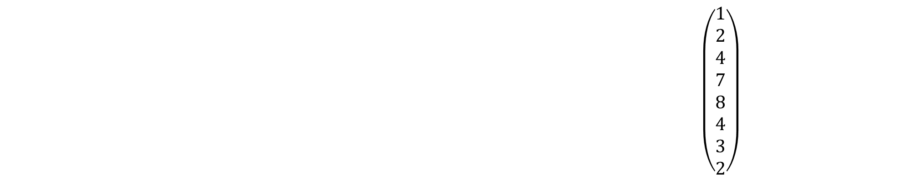
$$\begin{aligned}\left(\begin{matrix}0.353 & 0.353 & 0.353 & 0.353 & 0.353 & 0.353 & 0.353 & 0.353 \\ 0.49 & 0.451 & 0.277 & 0.097 & −0.097 & −0.277 & −0.415 & −0.49 \\ 0.461 & 0.191 & −0.191 & −0.461 & −0.461 & −0.191 & 0.191 & 0.461 \\ 0.415 & −0.097 & −0.49 & −0.277 & 0.277 & 0.49 & 0.097 & −0.415 \\ 0.353 & −0.353 & −0.353 & 0.353 & 0.353 & −0.353 & −0.353 & 0.353 \\ 0.277 & −0.49 & 0.097 & 0.415 & −0.415 & −0.097 & 0.49 & −0.277 \\ 0.191 & −0.461 & 0.461 & −0.191 & −0.191 & 0.461 & −0.461 & 0.191 \\ 0.097 & −0.277 & 0.415 & −0.49 & 0.49 & −0.415 & 0.277 & −0.097\end{matrix}\right)∙\left(\begin{matrix}1 \\ 2 \\ 4 \\ 7 \\ 8 \\ 4 \\ 3 \\ 2\end{matrix}\right)=\left(\begin{matrix}10.96 \\ −1.003 \\ −6.118 \\ −0.040 \\ 1.767 \\ −0.203 \\ −0.91 \\ 0.67\end{matrix}\right)\end{aligned}$$
$\left[1, 2, 4, 7, 8, 4, 3, 2\right]$

Slide 4
$$\begin{aligned}\left(\begin{matrix}0.353 & 0.353 & 0.353 & 0.353 & 0.353 & 0.353 & 0.353 & 0.353 \\ 0.49 & 0.451 & 0.277 & 0.097 & −0.097 & −0.277 & −0.415 & −0.49 \\ 0.461 & 0.191 & −0.191 & −0.461 & −0.461 & −0.191 & 0.191 & 0.461 \\ 0.415 & −0.097 & −0.49 & −0.277 & 0.277 & 0.49 & 0.097 & −0.415 \\ 0.353 & −0.353 & −0.353 & 0.353 & 0.353 & −0.353 & −0.353 & 0.353 \\ 0.277 & −0.49 & 0.097 & 0.415 & −0.415 & −0.097 & 0.49 & −0.277 \\ 0.191 & −0.461 & 0.461 & −0.191 & −0.191 & 0.461 & −0.461 & 0.191 \\ 0.097 & −0.277 & 0.415 & −0.49 & 0.49 & −0.415 & 0.277 & −0.097\end{matrix}\right)∙\left(\begin{matrix}1 \\ 2 \\ 4 \\ 7 \\ 8 \\ 4 \\ 3 \\ 2\end{matrix}\right)=\left(\begin{matrix}10.96 \\ −1.003 \\ −6.118 \\ −0.040 \\ 1.767 \\ −0.203 \\ −0.91 \\ 0.67\end{matrix}\right)\end{aligned}$$

Slide 5
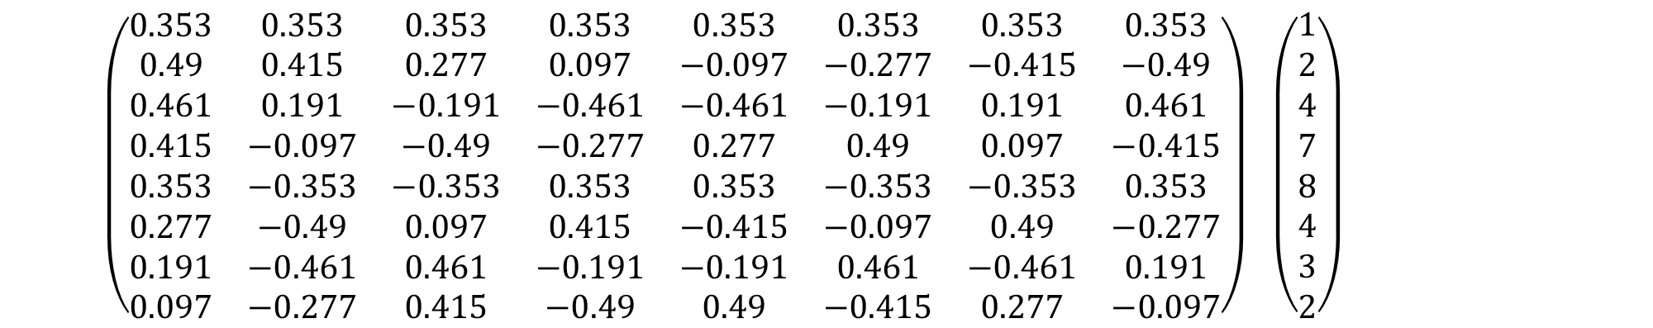
$$\begin{aligned}\left(\begin{matrix}0.353 & 0.353 & 0.353 & 0.353 & 0.353 & 0.353 & 0.353 & 0.353 \\ 0.49 & 0.415 & 0.277 & 0.097 & −0.097 & −0.277 & −0.415 & −0.49 \\ 0.461 & 0.191 & −0.191 & −0.461 & −0.461 & −0.191 & 0.191 & 0.461 \\ 0.415 & −0.097 & −0.49 & −0.277 & 0.277 & 0.49 & 0.097 & −0.415 \\ 0.353 & −0.353 & −0.353 & 0.353 & 0.353 & −0.353 & −0.353 & 0.353 \\ 0.277 & −0.49 & 0.097 & 0.415 & −0.415 & −0.097 & 0.49 & −0.277 \\ 0.191 & −0.461 & 0.461 & −0.191 & −0.191 & 0.461 & −0.461 & 0.191 \\ 0.097 & −0.277 & 0.415 & −0.49 & 0.49 & −0.415 & 0.277 & −0.097\end{matrix}\right)∙\left(\begin{matrix}1 \\ 2 \\ 4 \\ 7 \\ 8 \\ 4 \\ 3 \\ 2\end{matrix}\right)=\left(\begin{matrix}10.96 \\ −1.003 \\ −6.118 \\ −0.040 \\ 1.767 \\ −0.203 \\ −0.91 \\ 0.67\end{matrix}\right)\end{aligned}$$

Slide 6

$$\begin{aligned}\left(\begin{matrix}0.353 & 0.353 & 0.353 & 0.353 & 0.353 & 0.353 & 0.353 & 0.353 \\ 0.49 & 0.415 & 0.277 & 0.097 & −0.097 & −0.277 & −0.415 & −0.49 \\ 0.461 & 0.191 & −0.191 & −0.461 & −0.461 & −0.191 & 0.191 & 0.461 \\ 0.415 & −0.097 & −0.49 & −0.277 & 0.277 & 0.49 & 0.097 & −0.415 \\ 0.353 & −0.353 & −0.353 & 0.353 & 0.353 & −0.353 & −0.353 & 0.353 \\ 0.277 & −0.49 & 0.097 & 0.415 & −0.415 & −0.097 & 0.49 & −0.277 \\ 0.191 & −0.461 & 0.461 & −0.191 & −0.191 & 0.461 & −0.461 & 0.191 \\ 0.097 & −0.277 & 0.415 & −0.49 & 0.49 & −0.415 & 0.277 & −0.097\end{matrix}\right)∙\left(\begin{matrix}1 \\ 2 \\ 4 \\ 7 \\ 8 \\ 4 \\ 3 \\ 2\end{matrix}\right)=\left(\begin{matrix}10.96 \\ −1.003 \\ −6.118 \\ −0.040 \\ 1.767 \\ −0.203 \\ −0.91 \\ 0.67\end{matrix}\right)\end{aligned}$$

Slide 7
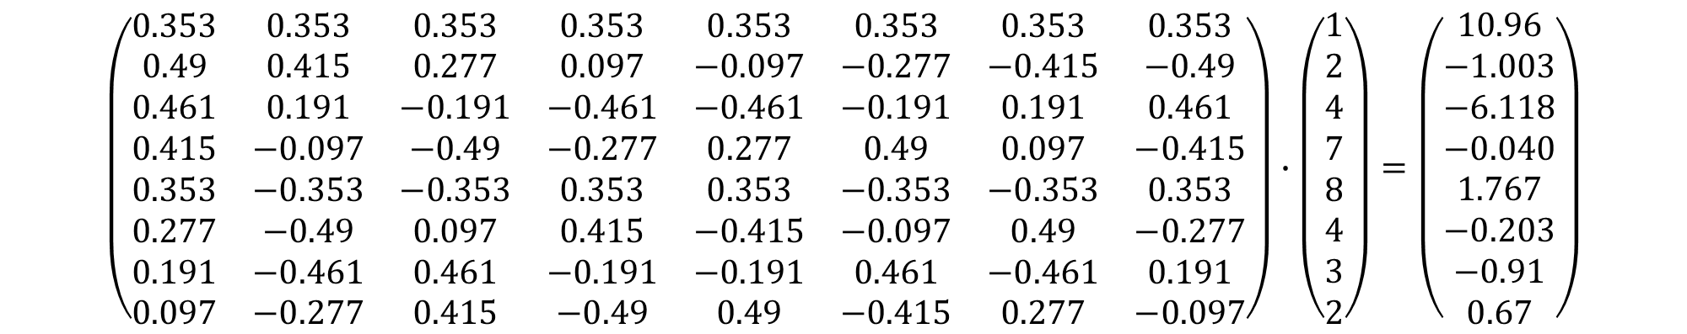
$$\begin{aligned}\left(\begin{matrix}0.353 & 0.353 & 0.353 & 0.353 & 0.353 & 0.353 & 0.353 & 0.353 \\ 0.49 & 0.415 & 0.277 & 0.097 & −0.097 & −0.277 & −0.415 & −0.49 \\ 0.461 & 0.191 & −0.191 & −0.461 & −0.461 & −0.191 & 0.191 & 0.461 \\ 0.415 & −0.097 & −0.49 & −0.277 & 0.277 & 0.49 & 0.097 & −0.415 \\ 0.353 & −0.353 & −0.353 & 0.353 & 0.353 & −0.353 & −0.353 & 0.353 \\ 0.277 & −0.49 & 0.097 & 0.415 & −0.415 & −0.097 & 0.49 & −0.277 \\ 0.191 & −0.461 & 0.461 & −0.191 & −0.191 & 0.461 & −0.461 & 0.191 \\ 0.097 & −0.277 & 0.415 & −0.49 & 0.49 & −0.415 & 0.277 & −0.097\end{matrix}\right)∙\left(\begin{matrix}1 \\ 2 \\ 4 \\ 7 \\ 8 \\ 4 \\ 3 \\ 2\end{matrix}\right)=\left(\begin{matrix}10.96 \\ −1.003 \\ −6.118 \\ −0.040 \\ 1.767 \\ −0.203 \\ −0.91 \\ 0.67\end{matrix}\right)\end{aligned}$$

Slide 8
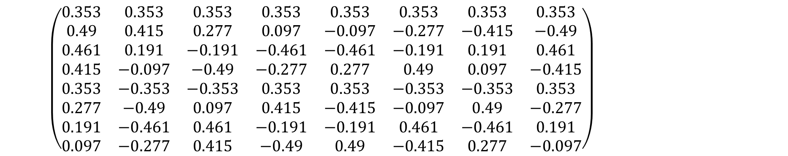
$$\begin{aligned}\left(\begin{matrix}0.353 & 0.353 & 0.353 & 0.353 & 0.353 & 0.353 & 0.353 & 0.353 \\ 0.49 & 0.415 & 0.277 & 0.097 & −0.097 & −0.277 & −0.415 & −0.49 \\ 0.461 & 0.191 & −0.191 & −0.461 & −0.461 & −0.191 & 0.191 & 0.461 \\ 0.415 & −0.097 & −0.49 & −0.277 & 0.277 & 0.49 & 0.097 & −0.415 \\ 0.353 & −0.353 & −0.353 & 0.353 & 0.353 & −0.353 & −0.353 & 0.353 \\ 0.277 & −0.49 & 0.097 & 0.415 & −0.415 & −0.097 & 0.49 & −0.277 \\ 0.191 & −0.461 & 0.461 & −0.191 & −0.191 & 0.461 & −0.461 & 0.191 \\ 0.097 & −0.277 & 0.415 & −0.49 & 0.49 & −0.415 & 0.277 & −0.097\end{matrix}\right)∙\left(\begin{matrix}1 \\ 2 \\ 4 \\ 7 \\ 8 \\ 4 \\ 3 \\ 2\end{matrix}\right)=\left(\begin{matrix}10.96 \\ −1.003 \\ −6.118 \\ −0.040 \\ 1.767 \\ −0.203 \\ −0.91 \\ 0.67\end{matrix}\right)\end{aligned}$$

Slide 9
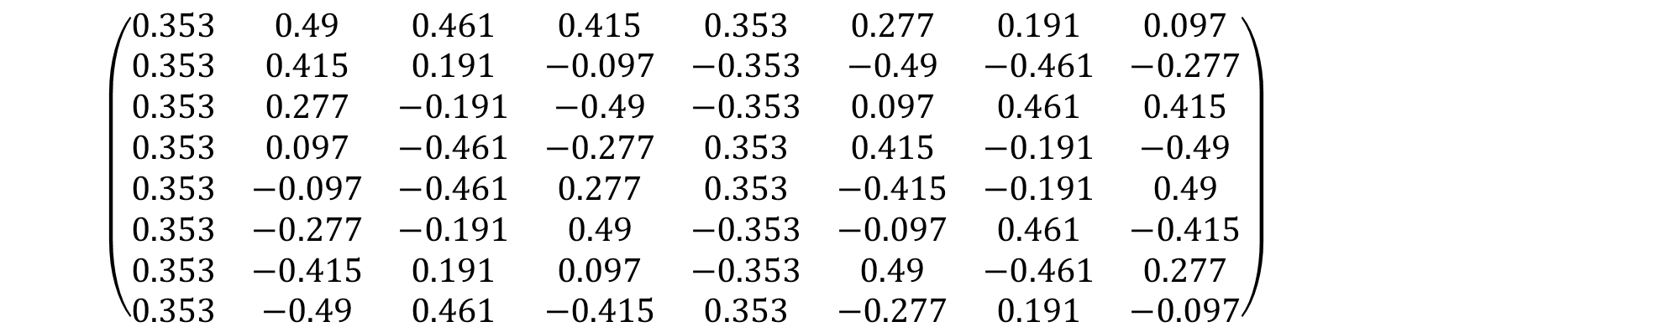
$$\left(\begin{matrix}0.353 & 0.49 & 0.461 & 0.415 & 0.353 & 0.277 & 0.191 & 0.097 \\ 0.353 & 0.415 & 0.191 & −0.097 & −0.353 & −0.49 & −0.461 & −0.277 \\ 0.353 & 0.277 & −0.191 & −0.49 & −0.353 & 0.097 & 0.461 & 0.415 \\ 0.353 & 0.097 & −0.461 & −0.277 & 0.353 & 0.415 & −0.191 & −0.49 \\ 0.353 & −0.097 & −0.461 & 0.277 & 0.353 & −0.415 & −0.191 & 0.49 \\ 0.353 & −0.277 & −0.191 & 0.49 & −0.353 & −0.097 & 0.461 & −0.415 \\ 0.353 & −0.415 & 0.191 & 0.097 & −0.353 & 0.49 & −0.461 & 0.277 \\ 0.353 & −0.49 & 0.461 & −0.415 & 0.353 & −0.277 & 0.191 & −0.097\end{matrix}\right)∙\left(\begin{matrix}10.96 \\ −1.003 \\ −6.118 \\ −0.040 \\ 1.767 \\ −0.203 \\ −0.91 \\ 0.67\end{matrix}\right)=\left(\begin{matrix}1 \\ 2 \\ 4 \\ 7 \\ 8 \\ 4 \\ 3 \\ 2\end{matrix}\right)$$

Slide 10
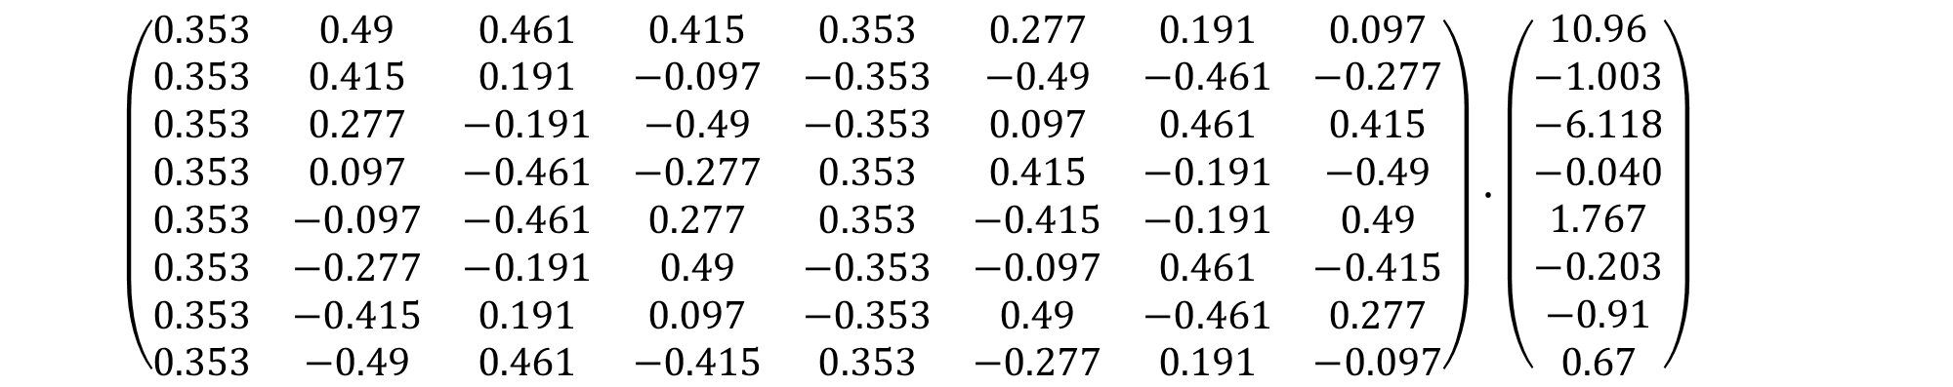
$$\left(\begin{matrix}0.353 & 0.49 & 0.461 & 0.415 & 0.353 & 0.277 & 0.191 & 0.097 \\ 0.353 & 0.415 & 0.191 & −0.097 & −0.353 & −0.49 & −0.461 & −0.277 \\ 0.353 & 0.277 & −0.191 & −0.49 & −0.353 & 0.097 & 0.461 & 0.415 \\ 0.353 & 0.097 & −0.461 & −0.277 & 0.353 & 0.415 & −0.191 & −0.49 \\ 0.353 & −0.097 & −0.461 & 0.277 & 0.353 & −0.415 & −0.191 & 0.49 \\ 0.353 & −0.277 & −0.191 & 0.49 & −0.353 & −0.097 & 0.461 & −0.415 \\ 0.353 & −0.415 & 0.191 & 0.097 & −0.353 & 0.49 & −0.461 & 0.277 \\ 0.353 & −0.49 & 0.461 & −0.415 & 0.353 & −0.277 & 0.191 & −0.097\end{matrix}\right)∙\left(\begin{matrix}10.96 \\ −1.003 \\ −6.118 \\ −0.040 \\ 1.767 \\ −0.203 \\ −0.91 \\ 0.67\end{matrix}\right)=\left(\begin{matrix}1 \\ 2 \\ 4 \\ 7 \\ 8 \\ 4 \\ 3 \\ 2\end{matrix}\right)$$

Slide 11
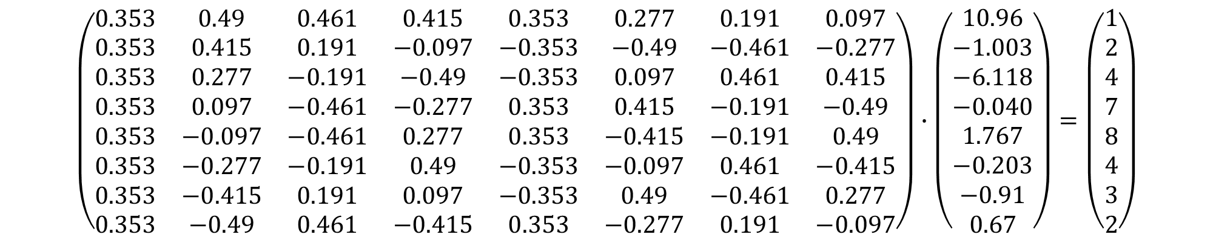
$$\left(\begin{matrix}0.353 & 0.49 & 0.461 & 0.415 & 0.353 & 0.277 & 0.191 & 0.097 \\ 0.353 & 0.415 & 0.191 & −0.097 & −0.353 & −0.49 & −0.461 & −0.277 \\ 0.353 & 0.277 & −0.191 & −0.49 & −0.353 & 0.097 & 0.461 & 0.415 \\ 0.353 & 0.097 & −0.461 & −0.277 & 0.353 & 0.415 & −0.191 & −0.49 \\ 0.353 & −0.097 & −0.461 & 0.277 & 0.353 & −0.415 & −0.191 & 0.49 \\ 0.353 & −0.277 & −0.191 & 0.49 & −0.353 & −0.097 & 0.461 & −0.415 \\ 0.353 & −0.415 & 0.191 & 0.097 & −0.353 & 0.49 & −0.461 & 0.277 \\ 0.353 & −0.49 & 0.461 & −0.415 & 0.353 & −0.277 & 0.191 & −0.097\end{matrix}\right)∙\left(\begin{matrix}10.96 \\ −1.003 \\ −6.118 \\ −0.040 \\ 1.767 \\ −0.203 \\ −0.91 \\ 0.67\end{matrix}\right)=\left(\begin{matrix}1 \\ 2 \\ 4 \\ 7 \\ 8 \\ 4 \\ 3 \\ 2\end{matrix}\right)$$

Slide 12


$$\left(\begin{matrix}0.353 & 0.49 & 0.461 & 0.415 & 0.353 & 0.277 & 0.191 & 0.097 \\ 0.353 & 0.415 & 0.191 & −0.097 & −0.353 & −0.49 & −0.461 & −0.277 \\ 0.353 & 0.277 & −0.191 & −0.49 & −0.353 & 0.097 & 0.461 & 0.415 \\ 0.353 & 0.097 & −0.461 & −0.277 & 0.353 & 0.415 & −0.191 & −0.49 \\ 0.353 & −0.097 & −0.461 & 0.277 & 0.353 & −0.415 & −0.191 & 0.49 \\ 0.353 & −0.277 & −0.191 & 0.49 & −0.353 & −0.097 & 0.461 & −0.415 \\ 0.353 & −0.415 & 0.191 & 0.097 & −0.353 & 0.49 & −0.461 & 0.277 \\ 0.353 & −0.49 & 0.461 & −0.415 & 0.353 & −0.277 & 0.191 & −0.097\end{matrix}\right)∙\left(\begin{matrix}10.96 \\ −1.003 \\ −6.118 \\ −0.040 \\ 1.767 \\ −0.203 \\ −0.91 \\ 0.67\end{matrix}\right)=\left(\begin{matrix}1 \\ 2 \\ 4 \\ 7 \\ 8 \\ 4 \\ 3 \\ 2\end{matrix}\right)$$
$$Cs=t$$
$$C^{−1}t=C^{−1}Cs=s$$

Slide 13
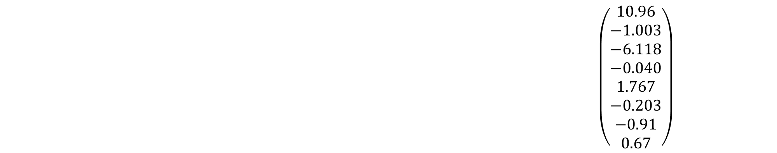
$$\left(\begin{matrix}0.353 & 0.49 & 0.461 & 0.415 & 0.353 & 0.277 & 0.191 & 0.097 \\ 0.353 & 0.451 & 0.191 & −0.097 & −0.353 & −0.49 & −0.461 & −0.277 \\ 0.353 & 0.277 & −0.191 & −0.49 & −0.353 & 0.097 & 0.461 & 0.415 \\ 0.353 & 0.097 & −0.461 & −0.277 & 0.353 & 0.415 & −0.191 & −0.49 \\ 0.353 & −0.097 & −0.461 & 0.277 & 0.353 & −0.415 & −0.191 & 0.49 \\ 0.353 & −0.277 & −0.191 & 0.49 & −0.353 & −0.097 & 0.461 & −0.415 \\ 0.353 & −0.415 & 0.191 & 0.097 & −0.353 & 0.49 & −0.461 & 0.277 \\ 0.353 & −0.49 & 0.461 & −0.415 & 0.353 & −0.277 & 0.191 & −0.097\end{matrix}\right)∙\left(\begin{matrix}10.96 \\ −1.003 \\ −6.118 \\ −0.040 \\ 1.767 \\ −0.203 \\ −0.91 \\ 0.67\end{matrix}\right)=\left(\begin{matrix}1 \\ 2 \\ 4 \\ 7 \\ 8 \\ 4 \\ 3 \\ 2\end{matrix}\right)$$

Slide 14
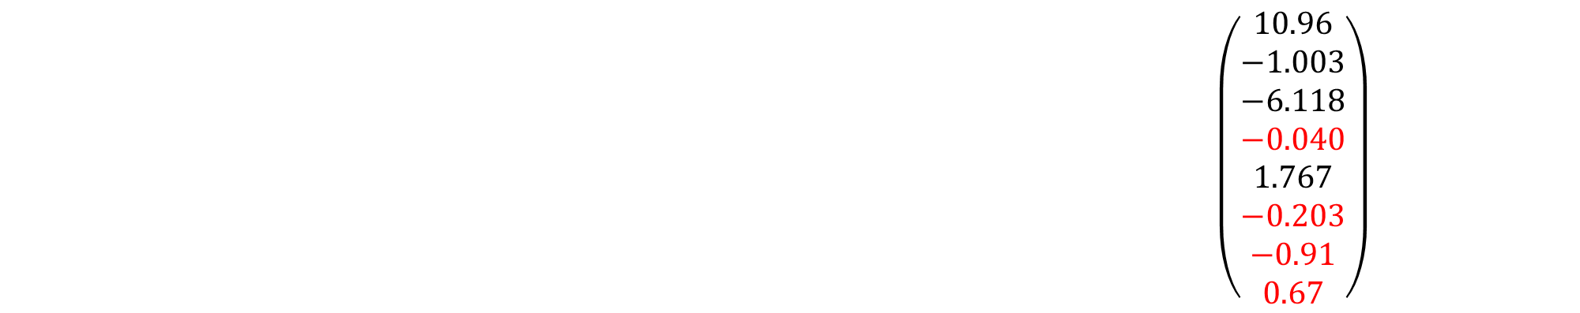
$$\left(\begin{matrix}0.353 & 0.49 & 0.461 & 0.415 & 0.353 & 0.277 & 0.191 & 0.097 \\ 0.353 & 0.451 & 0.191 & −0.097 & −0.353 & −0.49 & −0.461 & −0.277 \\ 0.353 & 0.277 & −0.191 & −0.49 & −0.353 & 0.097 & 0.461 & 0.415 \\ 0.353 & 0.097 & −0.461 & −0.277 & 0.353 & 0.415 & −0.191 & −0.49 \\ 0.353 & −0.097 & −0.461 & 0.277 & 0.353 & −0.415 & −0.191 & 0.49 \\ 0.353 & −0.277 & −0.191 & 0.49 & −0.353 & −0.097 & 0.461 & −0.415 \\ 0.353 & −0.415 & 0.191 & 0.097 & −0.353 & 0.49 & −0.461 & 0.277 \\ 0.353 & −0.49 & 0.461 & −0.415 & 0.353 & −0.277 & 0.191 & −0.097\end{matrix}\right)∙\left(\begin{matrix}10.96 \\ −1.003 \\ −6.118 \\ −0.040 \\ 1.767 \\ −0.203 \\ −0.91 \\ 0.67\end{matrix}\right)=\left(\begin{matrix}1 \\ 2 \\ 4 \\ 7 \\ 8 \\ 4 \\ 3 \\ 2\end{matrix}\right)$$

Slide 15
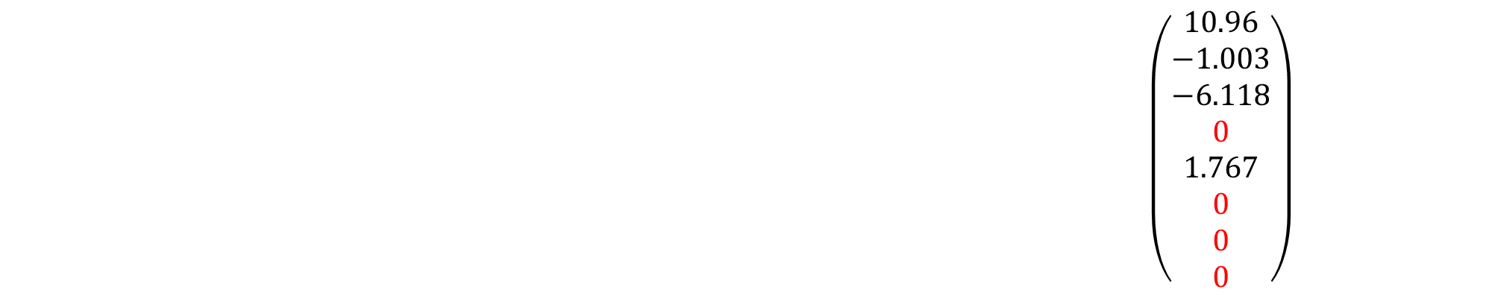
$$\left(\begin{matrix}0.353 & 0.49 & 0.461 & 0.415 & 0.353 & 0.277 & 0.191 & 0.097 \\ 0.353 & 0.451 & 0.191 & −0.097 & −0.353 & −0.49 & −0.461 & −0.277 \\ 0.353 & 0.277 & −0.191 & −0.49 & −0.353 & 0.097 & 0.461 & 0.415 \\ 0.353 & 0.097 & −0.461 & −0.277 & 0.353 & 0.415 & −0.191 & −0.49 \\ 0.353 & −0.097 & −0.461 & 0.277 & 0.353 & −0.415 & −0.191 & 0.49 \\ 0.353 & −0.277 & −0.191 & 0.49 & −0.353 & −0.097 & 0.461 & −0.415 \\ 0.353 & −0.415 & 0.191 & 0.097 & −0.353 & 0.49 & −0.461 & 0.277 \\ 0.353 & −0.49 & 0.461 & −0.415 & 0.353 & −0.277 & 0.191 & −0.097\end{matrix}\right)∙\left(\begin{matrix}10.96 \\ −1.003 \\ −6.118 \\ 0 \\ 1.767 \\ 0 \\ 0 \\ 0\end{matrix}\right)=\left(\begin{matrix}1 \\ 2 \\ 4 \\ 7 \\ 8 \\ 4 \\ 3 \\ 2\end{matrix}\right)$$

Slide 16
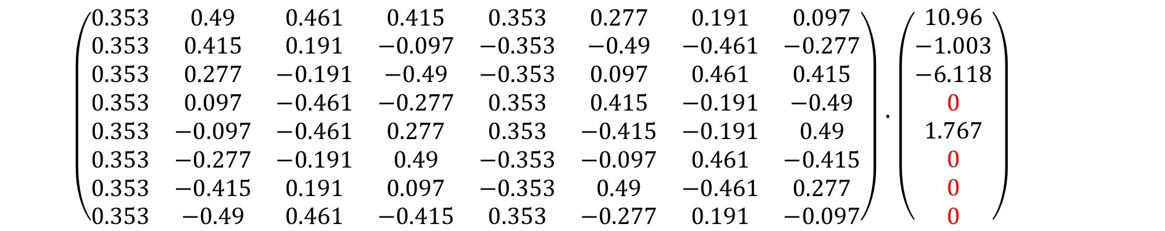
$$\left(\begin{matrix}0.353 & 0.49 & 0.461 & 0.415 & 0.353 & 0.277 & 0.191 & 0.097 \\ 0.353 & 0.415 & 0.191 & −0.097 & −0.353 & −0.49 & −0.461 & −0.277 \\ 0.353 & 0.277 & −0.191 & −0.49 & −0.353 & 0.097 & 0.461 & 0.415 \\ 0.353 & 0.097 & −0.461 & −0.277 & 0.353 & 0.415 & −0.191 & −0.49 \\ 0.353 & −0.097 & −0.461 & 0.277 & 0.353 & −0.415 & −0.191 & 0.49 \\ 0.353 & −0.277 & −0.191 & 0.49 & −0.353 & −0.097 & 0.461 & −0.415 \\ 0.353 & −0.415 & 0.191 & 0.097 & −0.353 & 0.49 & −0.461 & 0.277 \\ 0.353 & −0.49 & 0.461 & −0.415 & 0.353 & −0.277 & 0.191 & −0.097\end{matrix}\right)∙\left(\begin{matrix}10.96 \\ −1.003 \\ −6.118 \\ 0 \\ 1.767 \\ 0 \\ 0 \\ 0\end{matrix}\right)=\left(\begin{matrix}1 \\ 2 \\ 4 \\ 7 \\ 8 \\ 4 \\ 3 \\ 2\end{matrix}\right)$$

Slide 17
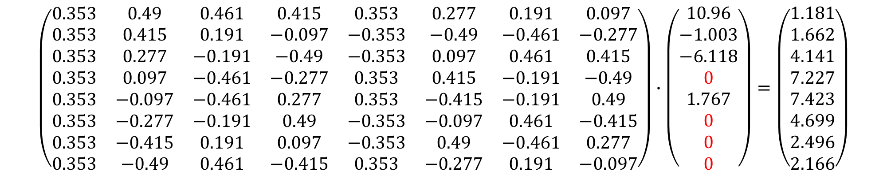
$$\left(\begin{matrix}0.353 & 0.49 & 0.461 & 0.415 & 0.353 & 0.277 & 0.191 & 0.097 \\ 0.353 & 0.415 & 0.191 & −0.097 & −0.353 & −0.49 & −0.461 & −0.277 \\ 0.353 & 0.277 & −0.191 & −0.49 & −0.353 & 0.097 & 0.461 & 0.415 \\ 0.353 & 0.097 & −0.461 & −0.277 & 0.353 & 0.415 & −0.191 & −0.49 \\ 0.353 & −0.097 & −0.461 & 0.277 & 0.353 & −0.415 & −0.191 & 0.49 \\ 0.353 & −0.277 & −0.191 & 0.49 & −0.353 & −0.097 & 0.461 & −0.415 \\ 0.353 & −0.415 & 0.191 & 0.097 & −0.353 & 0.49 & −0.461 & 0.277 \\ 0.353 & −0.49 & 0.461 & −0.415 & 0.353 & −0.277 & 0.191 & −0.097\end{matrix}\right)∙\left(\begin{matrix}10.96 \\ −1.003 \\ −6.118 \\ 0 \\ 1.767 \\ 0 \\ 0 \\ 0\end{matrix}\right)=\left(\begin{matrix}1.181 \\ 1.662 \\ 4.141 \\ 7.227 \\ 7.423 \\ 4.699 \\ 2.496 \\ 2.166\end{matrix}\right)$$

Slide 18
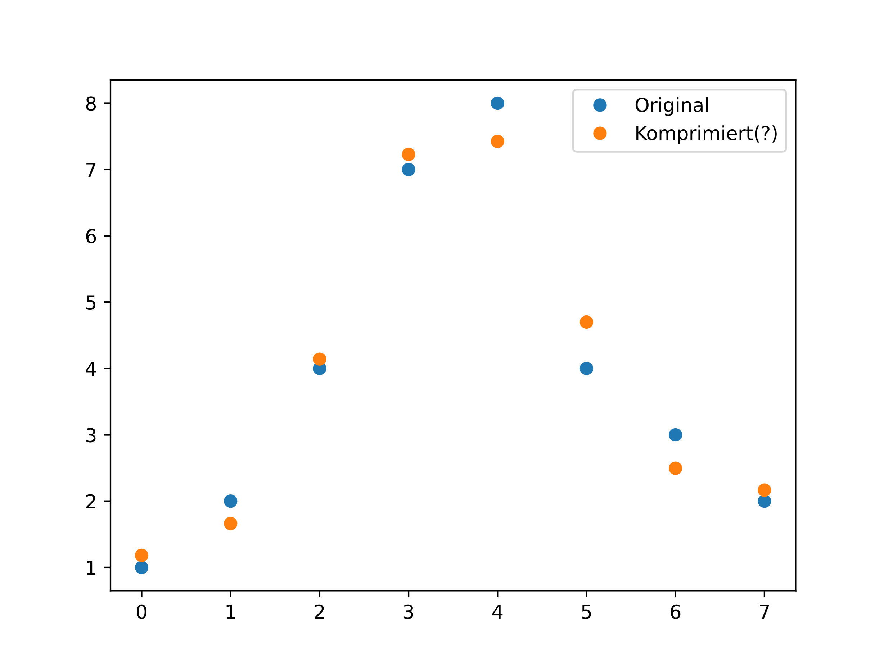
Notes:
Graph mit genauer Funktion für beide einzeichnen -> Brücke zu interpolation (koeffizienten sind t und das „halbe“ t)

Slide 19

Notes:
MSE?

Slide 20
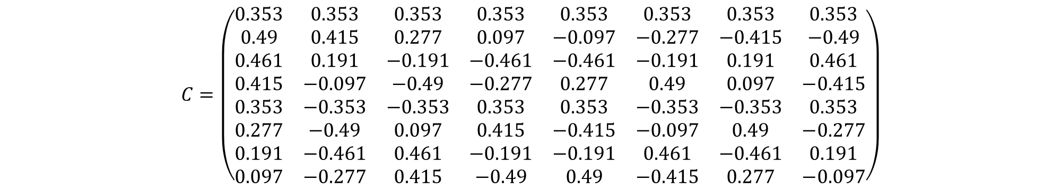
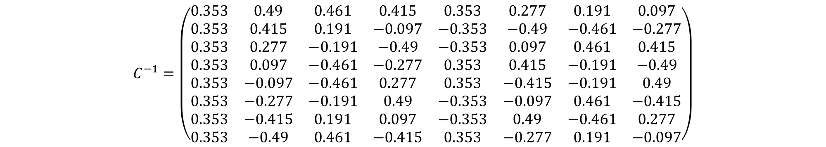
$$C=\left(\begin{matrix}0.353 & 0.353 & 0.353 & 0.353 & 0.353 & 0.353 & 0.353 & 0.353 \\ 0.49 & 0.415 & 0.277 & 0.097 & −0.097 & −0.277 & −0.415 & −0.49 \\ 0.461 & 0.191 & −0.191 & −0.461 & −0.461 & −0.191 & 0.191 & 0.461 \\ 0.415 & −0.097 & −0.49 & −0.277 & 0.277 & 0.49 & 0.097 & −0.415 \\ 0.353 & −0.353 & −0.353 & 0.353 & 0.353 & −0.353 & −0.353 & 0.353 \\ 0.277 & −0.49 & 0.097 & 0.415 & −0.415 & −0.097 & 0.49 & −0.277 \\ 0.191 & −0.461 & 0.461 & −0.191 & −0.191 & 0.461 & −0.461 & 0.191 \\ 0.097 & −0.277 & 0.415 & −0.49 & 0.49 & −0.415 & 0.277 & −0.097\end{matrix}\right)$$
$$C^{−1}=\left(\begin{matrix}0.353 & 0.49 & 0.461 & 0.415 & 0.353 & 0.277 & 0.191 & 0.097 \\ 0.353 & 0.415 & 0.191 & −0.097 & −0.353 & −0.49 & −0.461 & −0.277 \\ 0.353 & 0.277 & −0.191 & −0.49 & −0.353 & 0.097 & 0.461 & 0.415 \\ 0.353 & 0.097 & −0.461 & −0.277 & 0.353 & 0.415 & −0.191 & −0.49 \\ 0.353 & −0.097 & −0.461 & 0.277 & 0.353 & −0.415 & −0.191 & 0.49 \\ 0.353 & −0.277 & −0.191 & 0.49 & −0.353 & −0.097 & 0.461 & −0.415 \\ 0.353 & −0.415 & 0.191 & 0.097 & −0.353 & 0.49 & −0.461 & 0.277 \\ 0.353 & −0.49 & 0.461 & −0.415 & 0.353 & −0.277 & 0.191 & −0.097\end{matrix}\right)$$

Slide 21
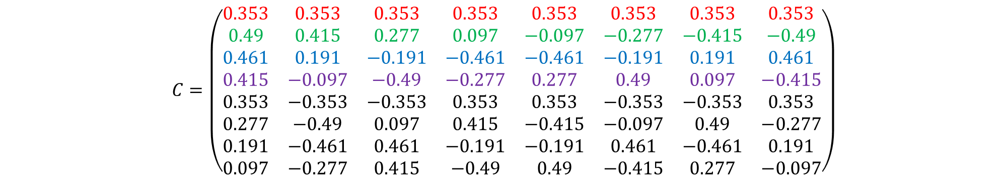
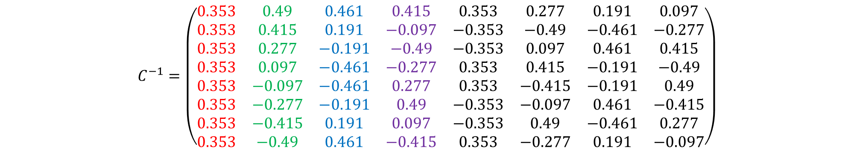
$$C=\left(\begin{matrix}0.353 & 0.353 & 0.353 & 0.353 & 0.353 & 0.353 & 0.353 & 0.353 \\ 0.49 & 0.415 & 0.277 & 0.097 & −0.097 & −0.277 & −0.415 & −0.49 \\ 0.461 & 0.191 & −0.191 & −0.461 & −0.461 & −0.191 & 0.191 & 0.461 \\ 0.415 & −0.097 & −0.49 & −0.277 & 0.277 & 0.49 & 0.097 & −0.415 \\ 0.353 & −0.353 & −0.353 & 0.353 & 0.353 & −0.353 & −0.353 & 0.353 \\ 0.277 & −0.49 & 0.097 & 0.415 & −0.415 & −0.097 & 0.49 & −0.277 \\ 0.191 & −0.461 & 0.461 & −0.191 & −0.191 & 0.461 & −0.461 & 0.191 \\ 0.097 & −0.277 & 0.415 & −0.49 & 0.49 & −0.415 & 0.277 & −0.097\end{matrix}\right)$$
$$C^{−1}=\left(\begin{matrix}0.353 & 0.49 & 0.461 & 0.415 & 0.353 & 0.277 & 0.191 & 0.097 \\ 0.353 & 0.415 & 0.191 & −0.097 & −0.353 & −0.49 & −0.461 & −0.277 \\ 0.353 & 0.277 & −0.191 & −0.49 & −0.353 & 0.097 & 0.461 & 0.415 \\ 0.353 & 0.097 & −0.461 & −0.277 & 0.353 & 0.415 & −0.191 & −0.49 \\ 0.353 & −0.097 & −0.461 & 0.277 & 0.353 & −0.415 & −0.191 & 0.49 \\ 0.353 & −0.277 & −0.191 & 0.49 & −0.353 & −0.097 & 0.461 & −0.415 \\ 0.353 & −0.415 & 0.191 & 0.097 & −0.353 & 0.49 & −0.461 & 0.277 \\ 0.353 & −0.49 & 0.461 & −0.415 & 0.353 & −0.277 & 0.191 & −0.097\end{matrix}\right)$$

Slide 22
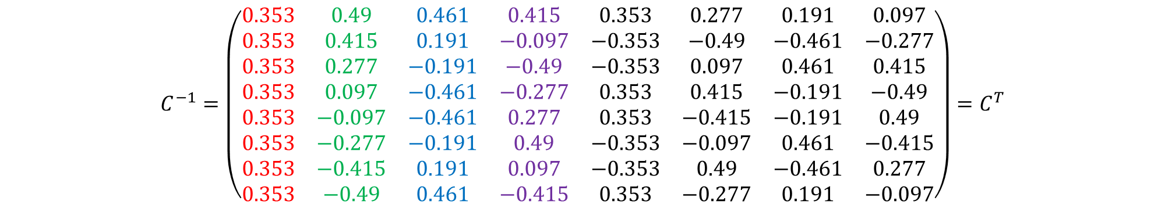
$$C=\left(\begin{matrix}0.353 & 0.353 & 0.353 & 0.353 & 0.353 & 0.353 & 0.353 & 0.353 \\ 0.49 & 0.415 & 0.277 & 0.097 & −0.097 & −0.277 & −0.415 & −0.49 \\ 0.461 & 0.191 & −0.191 & −0.461 & −0.461 & −0.191 & 0.191 & 0.461 \\ 0.415 & −0.097 & −0.49 & −0.277 & 0.277 & 0.49 & 0.097 & −0.415 \\ 0.353 & −0.353 & −0.353 & 0.353 & 0.353 & −0.353 & −0.353 & 0.353 \\ 0.277 & −0.49 & 0.097 & 0.415 & −0.415 & −0.097 & 0.49 & −0.277 \\ 0.191 & −0.461 & 0.461 & −0.191 & −0.191 & 0.461 & −0.461 & 0.191 \\ 0.097 & −0.277 & 0.415 & −0.49 & 0.49 & −0.415 & 0.277 & −0.097\end{matrix}\right)$$
$$C^{−1}=\left(\begin{matrix}0.353 & 0.49 & 0.461 & 0.415 & 0.353 & 0.277 & 0.191 & 0.097 \\ 0.353 & 0.415 & 0.191 & −0.097 & −0.353 & −0.49 & −0.461 & −0.277 \\ 0.353 & 0.277 & −0.191 & −0.49 & −0.353 & 0.097 & 0.461 & 0.415 \\ 0.353 & 0.097 & −0.461 & −0.277 & 0.353 & 0.415 & −0.191 & −0.49 \\ 0.353 & −0.097 & −0.461 & 0.277 & 0.353 & −0.415 & −0.191 & 0.49 \\ 0.353 & −0.277 & −0.191 & 0.49 & −0.353 & −0.097 & 0.461 & −0.415 \\ 0.353 & −0.415 & 0.191 & 0.097 & −0.353 & 0.49 & −0.461 & 0.277 \\ 0.353 & −0.49 & 0.461 & −0.415 & 0.353 & −0.277 & 0.191 & −0.097\end{matrix}\right)=C^{T}$$

Slide 23

$$C^{−1}=C^{T}$$
Notes:
Berechnungstechnisch extrem Vorteilhaft

Slide 24
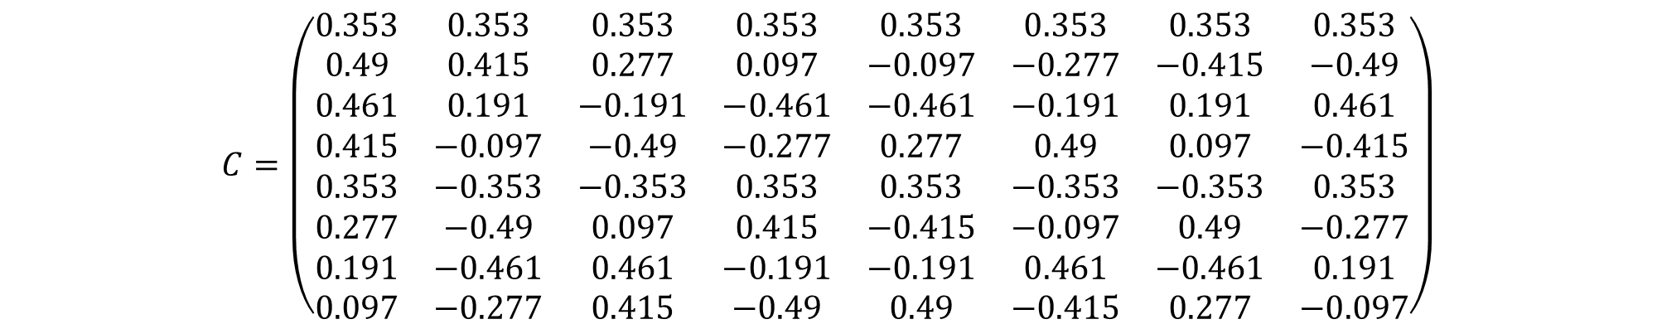
$$C=\left(\begin{matrix}0.353 & 0.353 & 0.353 & 0.353 & 0.353 & 0.353 & 0.353 & 0.353 \\ 0.49 & 0.415 & 0.277 & 0.097 & −0.097 & −0.277 & −0.415 & −0.49 \\ 0.461 & 0.191 & −0.191 & −0.461 & −0.461 & −0.191 & 0.191 & 0.461 \\ 0.415 & −0.097 & −0.49 & −0.277 & 0.277 & 0.49 & 0.097 & −0.415 \\ 0.353 & −0.353 & −0.353 & 0.353 & 0.353 & −0.353 & −0.353 & 0.353 \\ 0.277 & −0.49 & 0.097 & 0.415 & −0.415 & −0.097 & 0.49 & −0.277 \\ 0.191 & −0.461 & 0.461 & −0.191 & −0.191 & 0.461 & −0.461 & 0.191 \\ 0.097 & −0.277 & 0.415 & −0.49 & 0.49 & −0.415 & 0.277 & −0.097\end{matrix}\right)$$

Slide 25
01234567890123456789012345678901234567890123456789012345678901234567890123456789012345678901234567890
$$C=\left(\begin{matrix}0.353 & 0.353 & 0.353 & 0.353 & 0.353 & 0.353 & 0.353 & 0.353 \\ 0.49 & 0.415 & 0.277 & 0.097 & −0.097 & −0.277 & −0.415 & −0.49 \\ 0.461 & 0.191 & −0.191 & −0.461 & −0.461 & −0.191 & 0.191 & 0.461 \\ 0.415 & −0.097 & −0.49 & −0.277 & 0.277 & 0.49 & 0.097 & −0.415 \\ 0.353 & −0.353 & −0.353 & 0.353 & 0.353 & −0.353 & −0.353 & 0.353 \\ 0.277 & −0.49 & 0.097 & 0.415 & −0.415 & −0.097 & 0.49 & −0.277 \\ 0.191 & −0.461 & 0.461 & −0.191 & −0.191 & 0.461 & −0.461 & 0.191 \\ 0.097 & −0.277 & 0.415 & −0.49 & 0.49 & −0.415 & 0.277 & −0.097\end{matrix}\right)$$

Slide 26
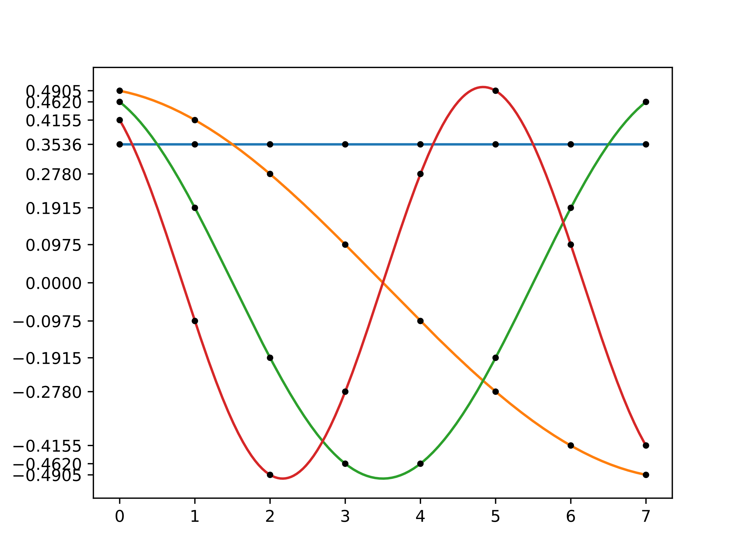
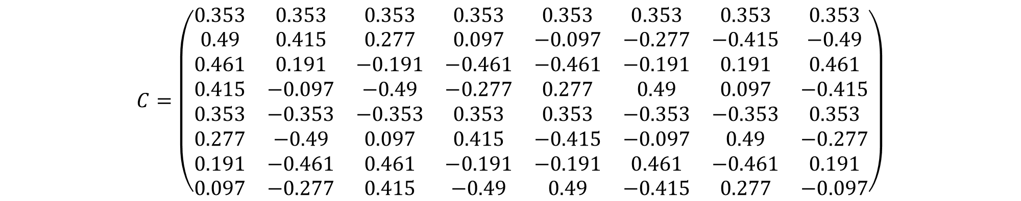
01234567890123456789012345678901234567890123456789012345678901234567890123456789012345678901234567890
$$C=\left(\begin{matrix}0.353 & 0.353 & 0.353 & 0.353 & 0.353 & 0.353 & 0.353 & 0.353 \\ 0.49 & 0.415 & 0.277 & 0.097 & −0.097 & −0.277 & −0.415 & −0.49 \\ 0.461 & 0.191 & −0.191 & −0.461 & −0.461 & −0.191 & 0.191 & 0.461 \\ 0.415 & −0.097 & −0.49 & −0.277 & 0.277 & 0.49 & 0.097 & −0.415 \\ 0.353 & −0.353 & −0.353 & 0.353 & 0.353 & −0.353 & −0.353 & 0.353 \\ 0.277 & −0.49 & 0.097 & 0.415 & −0.415 & −0.097 & 0.49 & −0.277 \\ 0.191 & −0.461 & 0.461 & −0.191 & −0.191 & 0.461 & −0.461 & 0.191 \\ 0.097 & −0.277 & 0.415 & −0.49 & 0.49 & −0.415 & 0.277 & −0.097\end{matrix}\right)$$

Slide 27
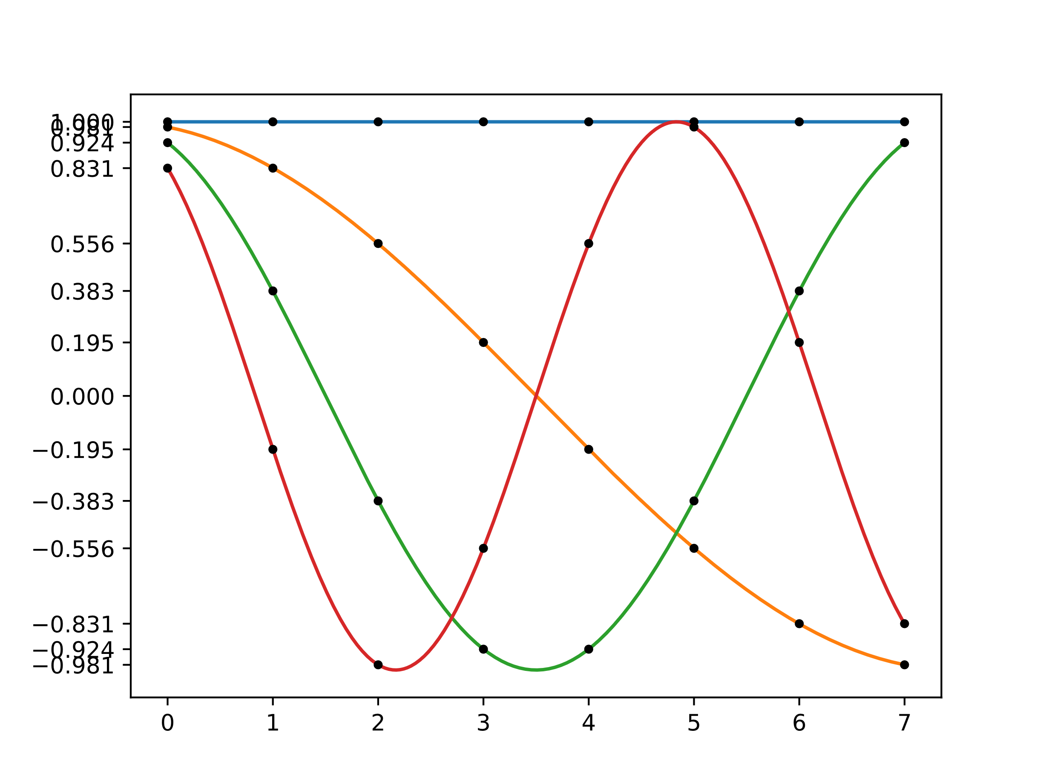

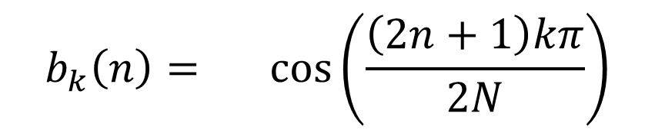
$$b_{k}\left(n\right)=α_{k}\cos\left(\frac{\left(2n+1\right)kπ}{2N}\right)$$
$$α_{0}=\sqrt{\frac{1}{N}}, α_{k}=\sqrt{\frac{2}{N}}$$

Slide 28
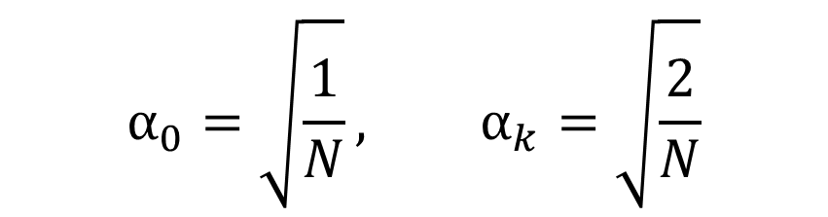
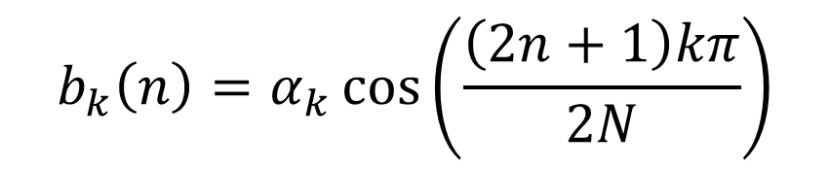
$$b_{k}\left(n\right)=α_{k}\cos\left(\frac{\left(2n+1\right)kπ}{2N}\right)$$
$$α_{0}=\sqrt{\frac{1}{N}}, α_{k}=\sqrt{\frac{2}{N}}$$

Slide 29


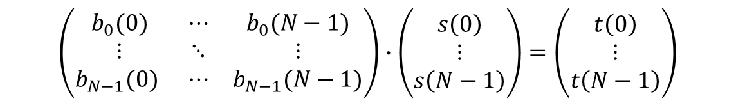

$$b_{k}\left(n\right)=α_{k}\cos\left(\frac{\left(2n+1\right)kπ}{2N}\right)$$
$$α_{0}=\sqrt{\frac{1}{N}}, α_{k}=\sqrt{\frac{2}{N}}$$
$$t(k)=\sum_{n=0}^{N−1}{s(n)∙b_{k}(n)}$$
$$\left(\begin{matrix}b_{0}(0) & ⋯ & b_{0}(N−1) \\ ⋮ & ⋱ & ⋮ \\ b_{N−1}(0) & ⋯ & b_{N−1}(N−1)\end{matrix}\right)∙\left(\begin{matrix}s\left(0\right) \\ ⋮ \\ s\left(N−1\right)\end{matrix}\right)=\left(\begin{matrix}t\left(0\right) \\ ⋮ \\ t\left(N−1\right)\end{matrix}\right)$$

Slide 30
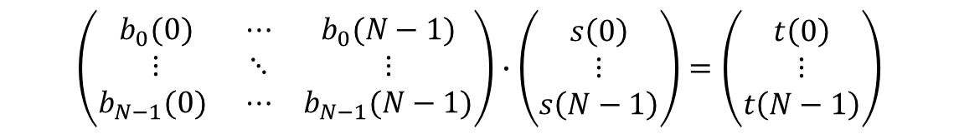

$$t(k)=\sum_{n=0}^{N−1}{s(n)∙b_{k}(n)}$$
$$\left(\begin{matrix}b_{0}(0) & ⋯ & b_{0}(N−1) \\ ⋮ & ⋱ & ⋮ \\ b_{N−1}(0) & ⋯ & b_{N−1}(N−1)\end{matrix}\right)∙\left(\begin{matrix}s\left(0\right) \\ ⋮ \\ s\left(N−1\right)\end{matrix}\right)=\left(\begin{matrix}t\left(0\right) \\ ⋮ \\ t\left(N−1\right)\end{matrix}\right)$$

Slide 31

$$t(k)=\sum_{n=0}^{N−1}{s(n)∙b_{k}(n)}$$
$$\left(\begin{matrix}b_{0}(0) & ⋯ & b_{0}(N−1) \\ ⋮ & ⋱ & ⋮ \\ b_{N−1}(0) & ⋯ & b_{N−1}(N−1)\end{matrix}\right)∙\left(\begin{matrix}s\left(0\right) \\ ⋮ \\ s\left(N−1\right)\end{matrix}\right)=\left(\begin{matrix}t\left(0\right) \\ ⋮ \\ t\left(N−1\right)\end{matrix}\right)$$
$$X_{k}=\sum_{n=0}^{N−1}{x_{n}∙α_{k}\cos\left(\frac{\left(2n+1\right)kπ}{2N}\right)}$$

Slide 32

$$t(k)=\sum_{n=0}^{N−1}{s(n)∙b_{k}(n)}$$
$$\left(\begin{matrix}b_{0}(0) & ⋯ & b_{0}(N−1) \\ ⋮ & ⋱ & ⋮ \\ b_{N−1}(0) & ⋯ & b_{N−1}(N−1)\end{matrix}\right)∙\left(\begin{matrix}s\left(0\right) \\ ⋮ \\ s\left(N−1\right)\end{matrix}\right)=\left(\begin{matrix}t\left(0\right) \\ ⋮ \\ t\left(N−1\right)\end{matrix}\right)$$
$$s(n)=\sum_{k=0}^{N−1}{t(k)∙b_{k}\left(n\right)}$$

Slide 33
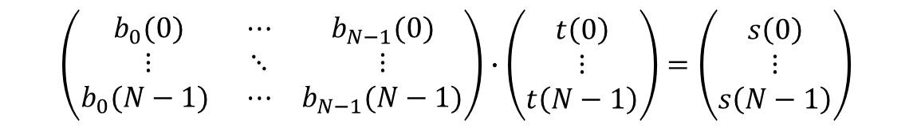

$$t(k)=\sum_{n=0}^{N−1}{s(n)∙b_{k}(n)}$$
$$\left(\begin{matrix}b_{0}(0) & ⋯ & b_{0}(N−1) \\ ⋮ & ⋱ & ⋮ \\ b_{N−1}(0) & ⋯ & b_{N−1}(N−1)\end{matrix}\right)∙\left(\begin{matrix}s\left(0\right) \\ ⋮ \\ s\left(N−1\right)\end{matrix}\right)=\left(\begin{matrix}t\left(0\right) \\ ⋮ \\ t\left(N−1\right)\end{matrix}\right)$$
$$s(n)=\sum_{k=0}^{N−1}{t(k)∙b_{k}\left(n\right)}$$
$$\left(\begin{matrix}b_{0}(0) & ⋯ & b_{N−1}(0) \\ ⋮ & ⋱ & ⋮ \\ b_{0}(N−1) & ⋯ & b_{N−1}(N−1)\end{matrix}\right)∙\left(\begin{matrix}t\left(0\right) \\ ⋮ \\ t\left(N−1\right)\end{matrix}\right)=\left(\begin{matrix}s\left(0\right) \\ ⋮ \\ s\left(N−1\right)\end{matrix}\right)$$

Slide 34

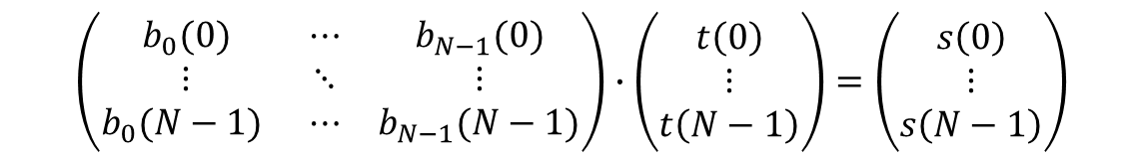
$$s(n)=\sum_{k=0}^{N−1}{t(k)∙b_{k}\left(n\right)}$$
$$\left(\begin{matrix}b_{0}(0) & ⋯ & b_{N−1}(0) \\ ⋮ & ⋱ & ⋮ \\ b_{0}(N−1) & ⋯ & b_{N−1}(N−1)\end{matrix}\right)∙\left(\begin{matrix}t\left(0\right) \\ ⋮ \\ t\left(N−1\right)\end{matrix}\right)=\left(\begin{matrix}s\left(0\right) \\ ⋮ \\ s\left(N−1\right)\end{matrix}\right)$$

Slide 35
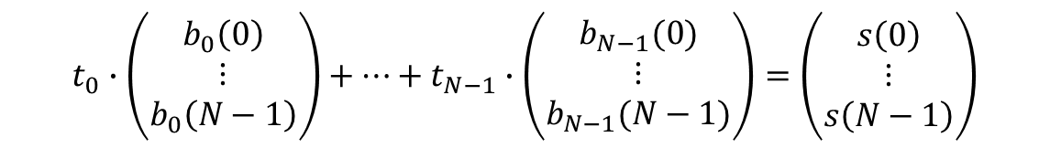

$$s(n)=\sum_{k=0}^{N−1}{t(k)∙b_{k}\left(n\right)}$$
$$\left(\begin{matrix}b_{0}(0) & ⋯ & b_{N−1}(0) \\ ⋮ & ⋱ & ⋮ \\ b_{0}(N−1) & ⋯ & b_{N−1}(N−1)\end{matrix}\right)∙\left(\begin{matrix}t\left(0\right) \\ ⋮ \\ t\left(N−1\right)\end{matrix}\right)=\left(\begin{matrix}s\left(0\right) \\ ⋮ \\ s\left(N−1\right)\end{matrix}\right)$$
$$s=\sum_{k=0}^{N−1}{t(k)∙b_{k}}$$
$$t_{0}∙\left(\begin{matrix}b_{0}\left(0\right) \\ ⋮ \\ b_{0}\left(N−1\right)\end{matrix}\right)+⋯+t_{N−1}∙\left(\begin{matrix}b_{N−1}(0) \\ ⋮ \\ b_{N−1}(N−1)\end{matrix}\right)=\left(\begin{matrix}s\left(0\right) \\ ⋮ \\ s\left(N−1\right)\end{matrix}\right)$$
Notes:
Die unwichtigsten Basisvektoren weglassen.

Slide 36
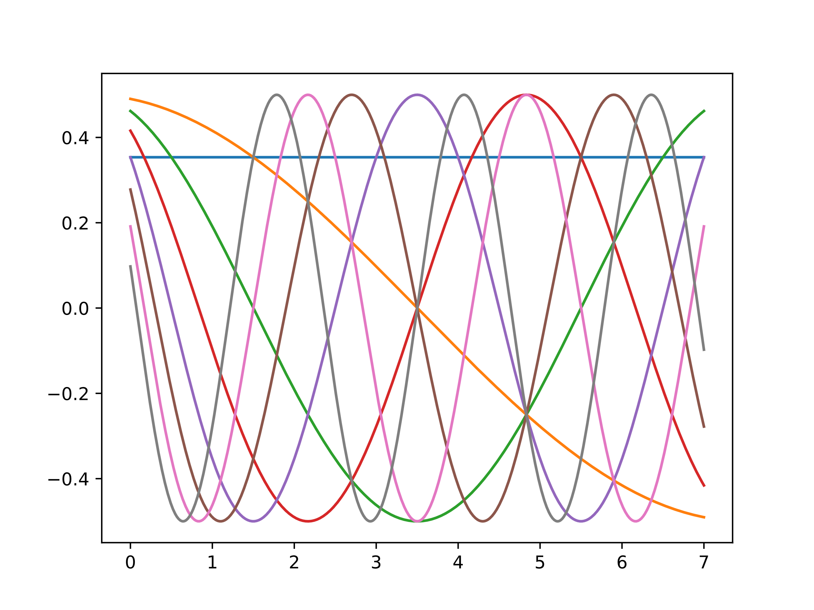

Slide 37
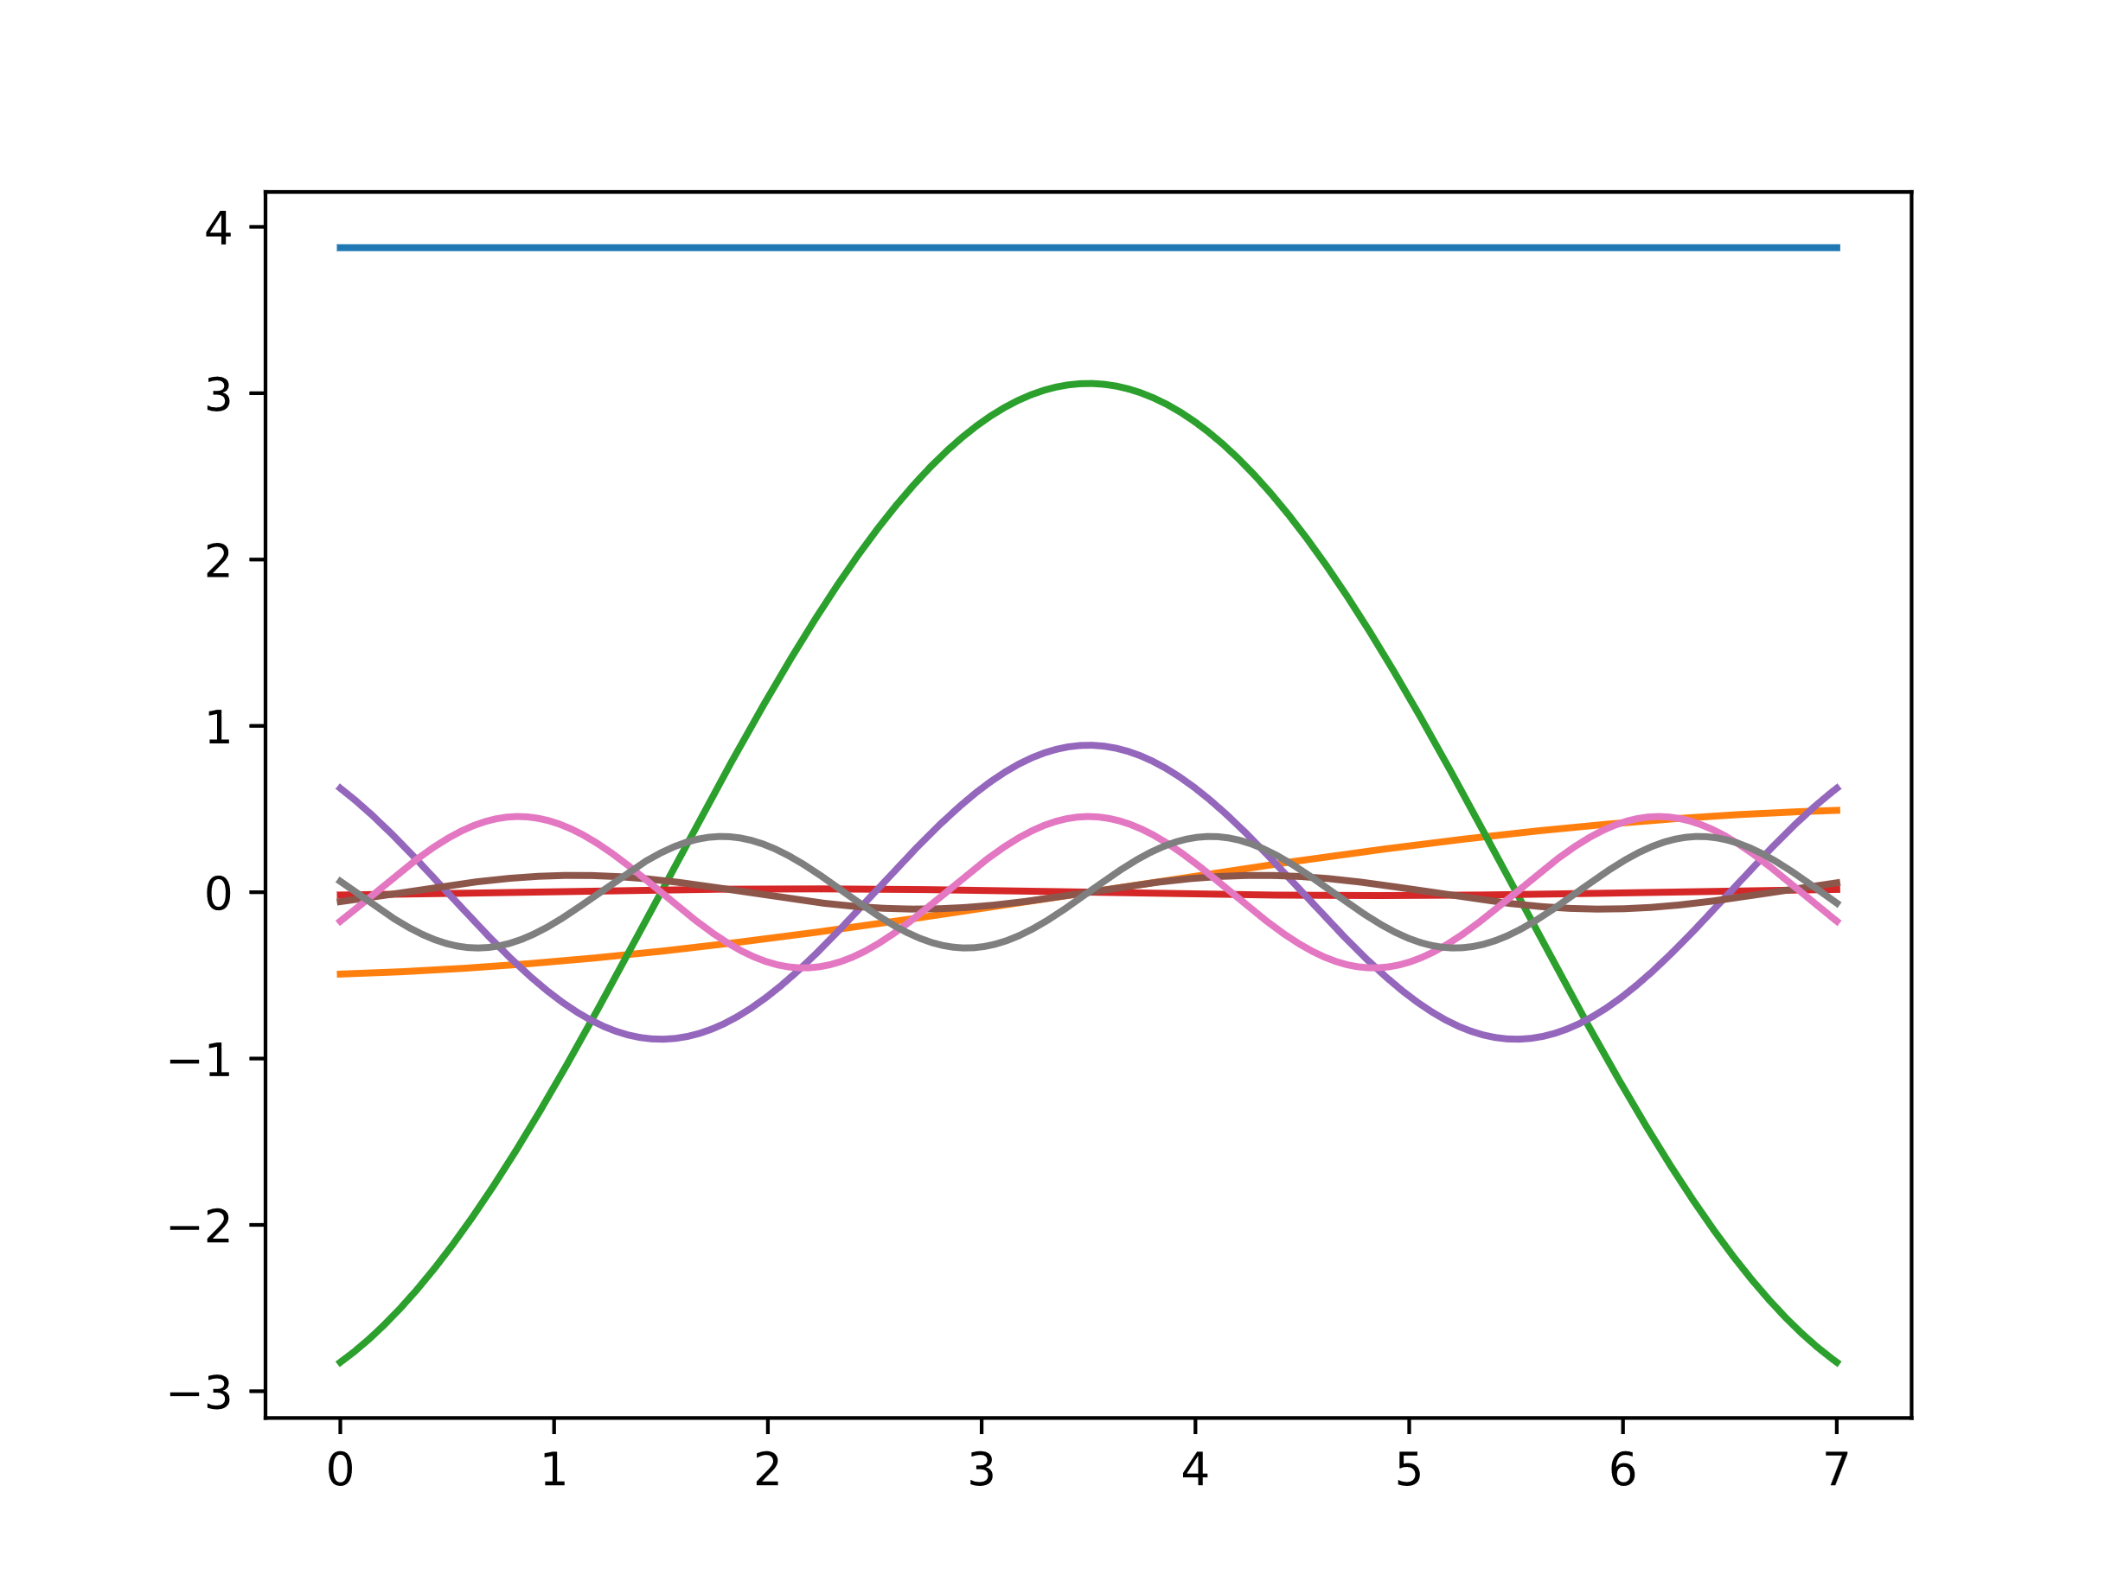
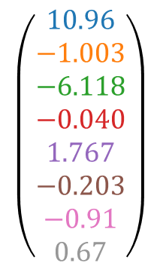
$$\left(\begin{matrix}10.96 \\ −1.003 \\ −6.118 \\ −0.040 \\ 1.767 \\ −0.203 \\ −0.91 \\ 0.67\end{matrix}\right)$$

Slide 38
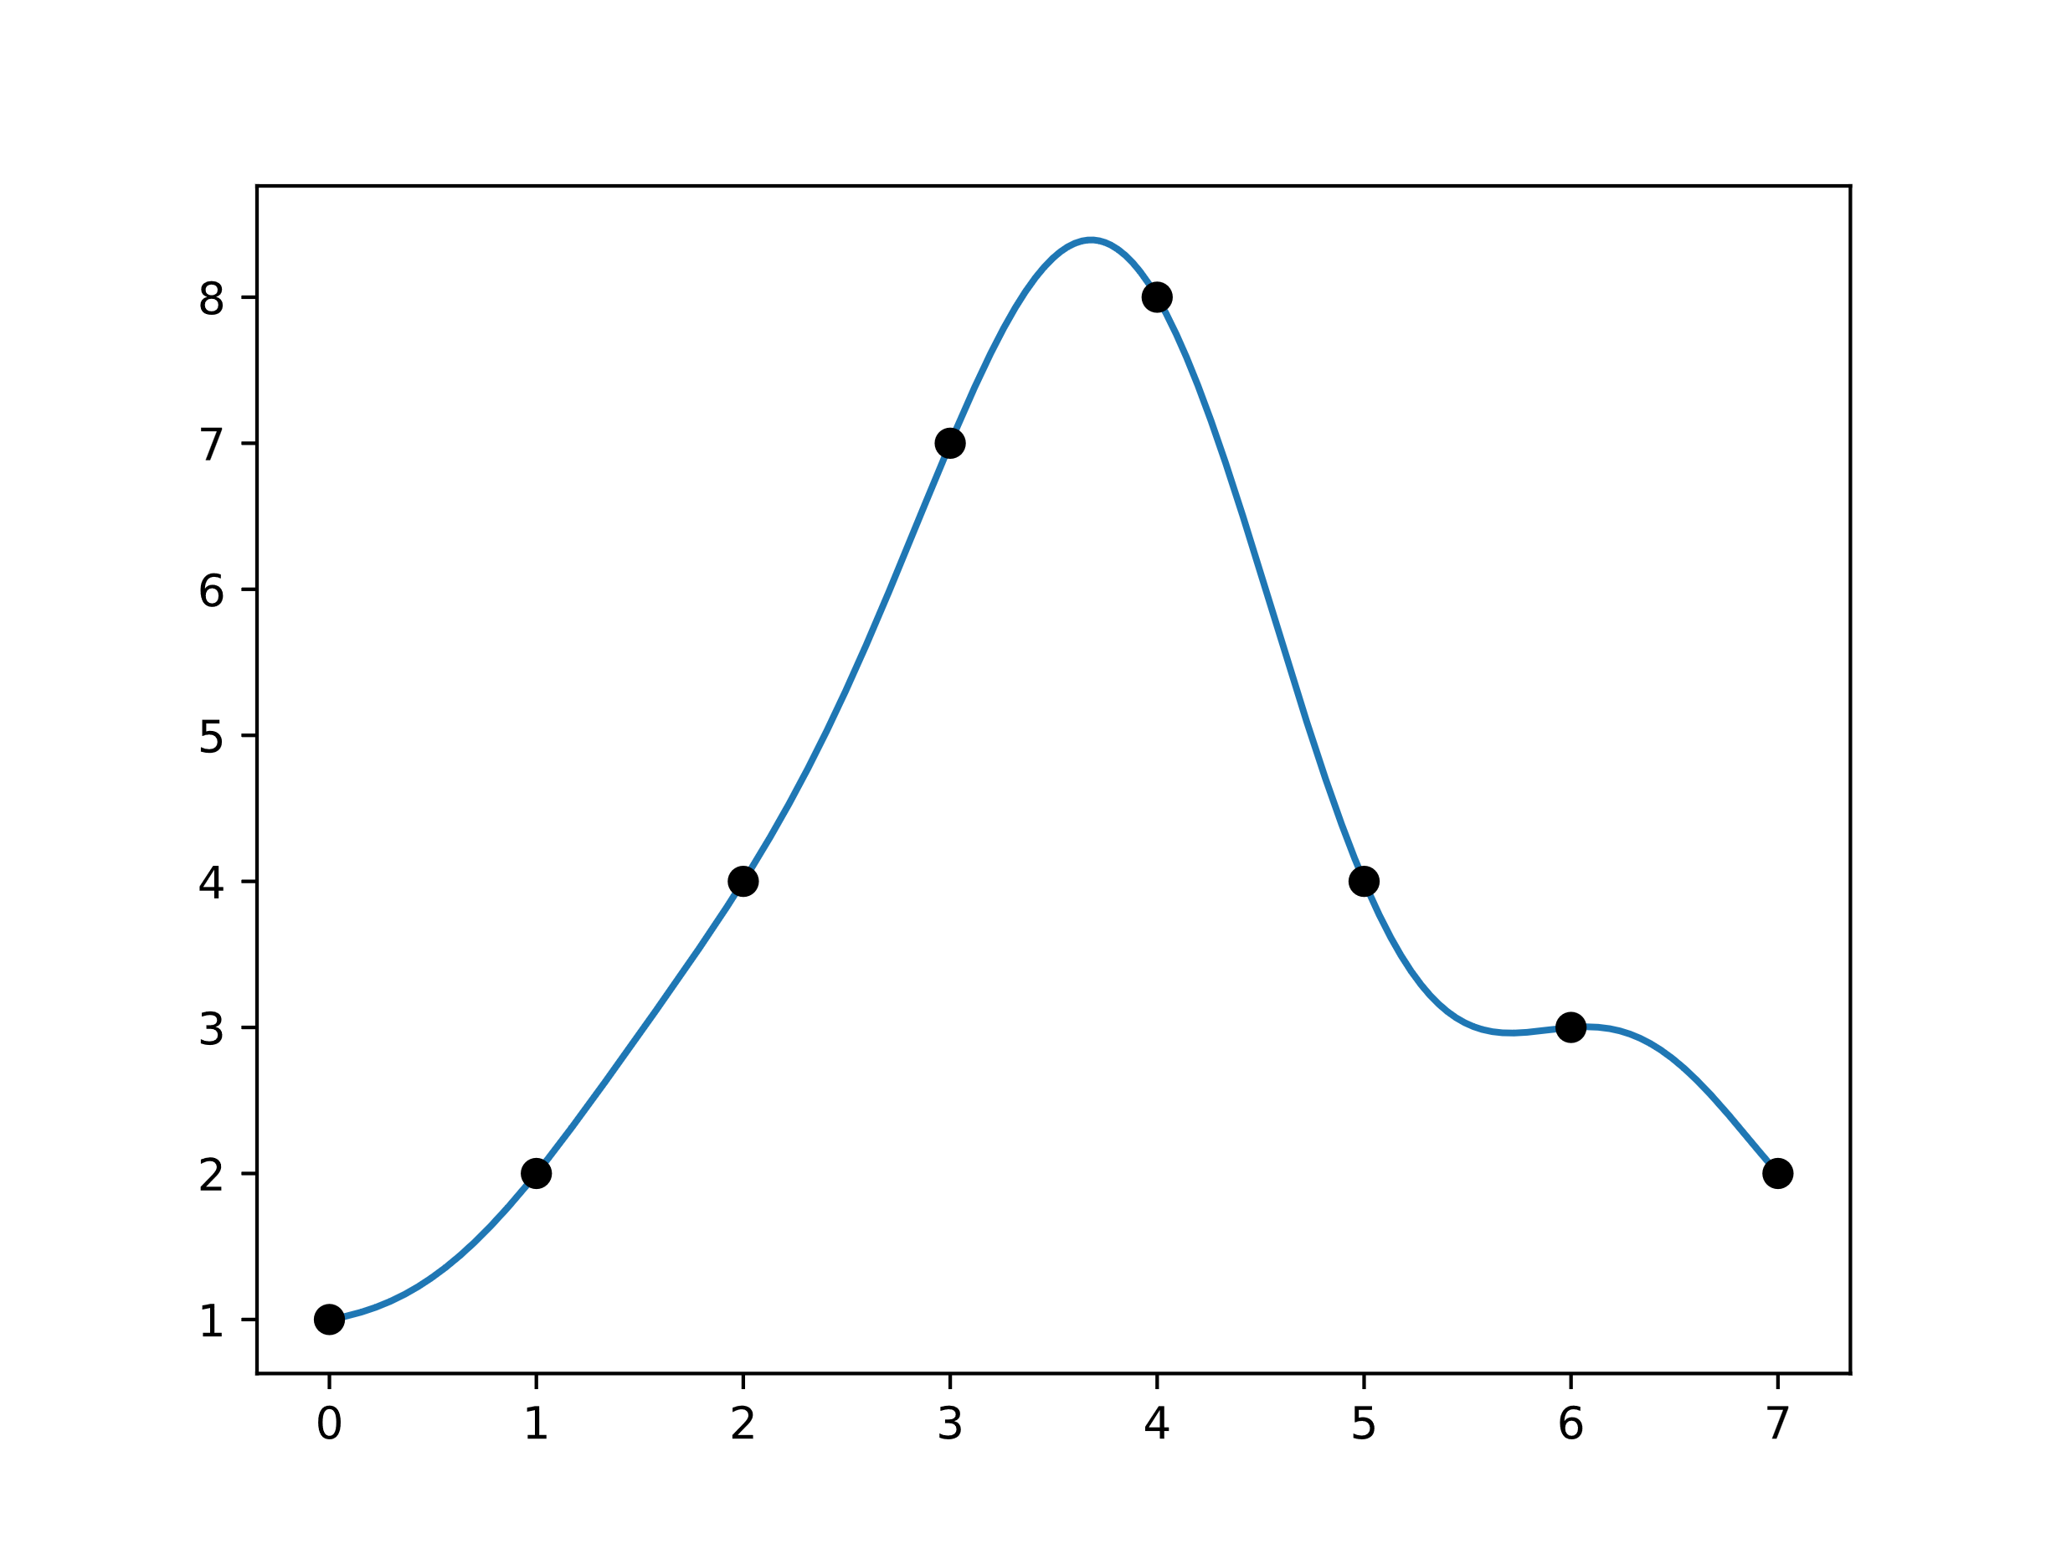
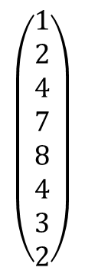
$$\left(\begin{matrix}1 \\ 2 \\ 4 \\ 7 \\ 8 \\ 4 \\ 3 \\ 2\end{matrix}\right)$$

Slide 39
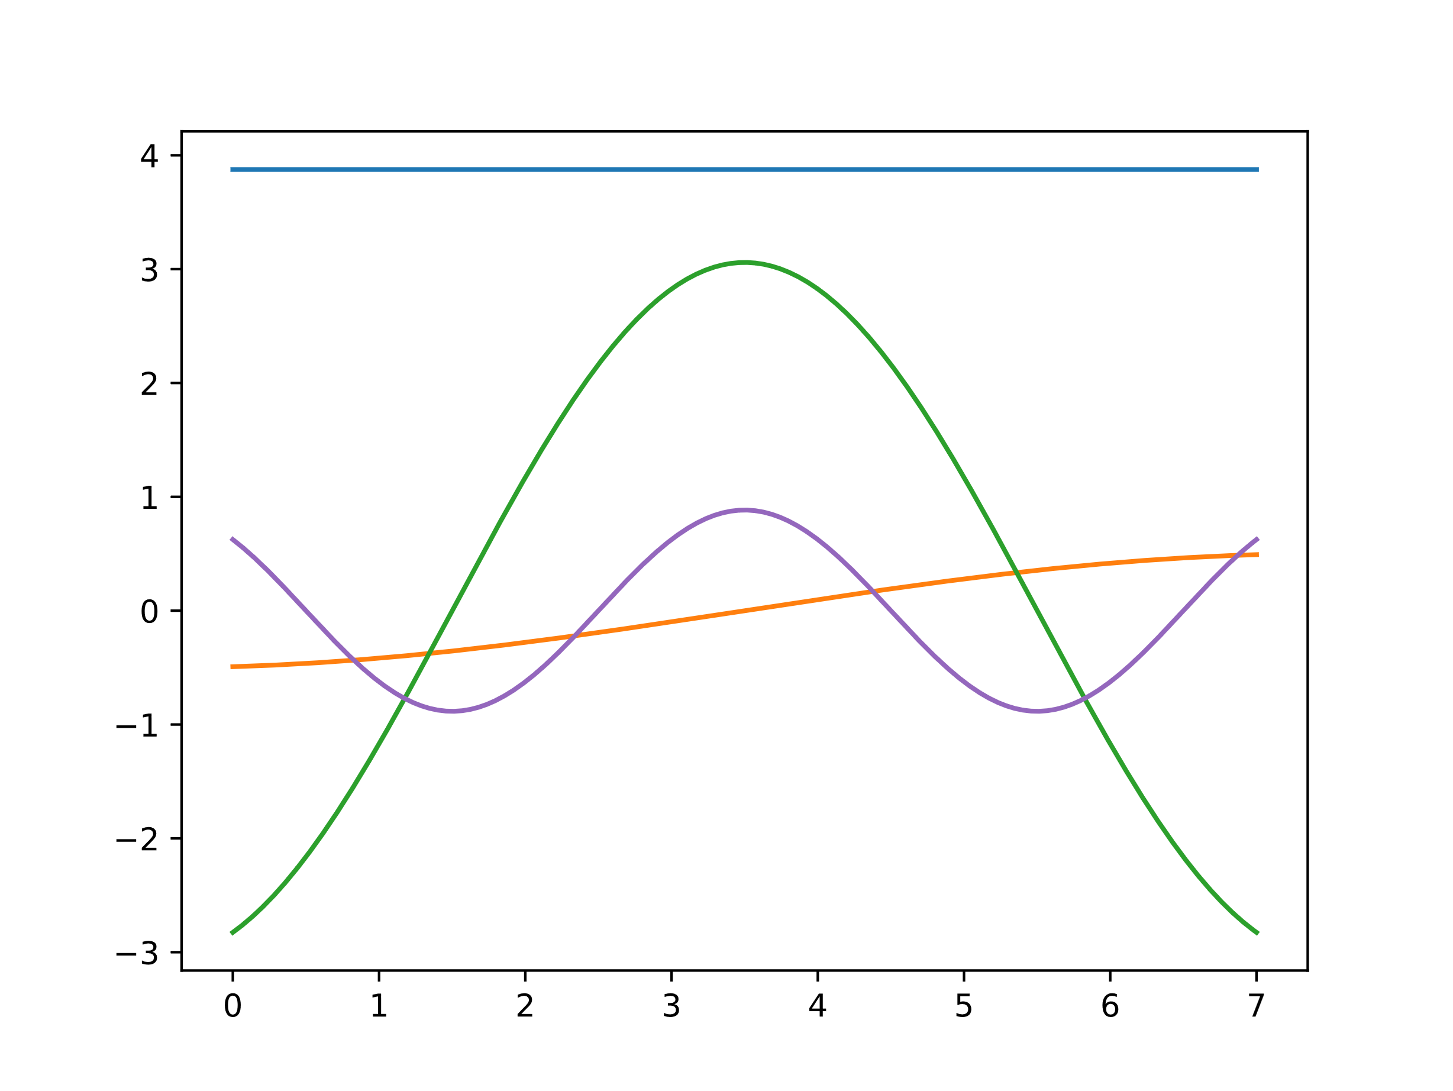
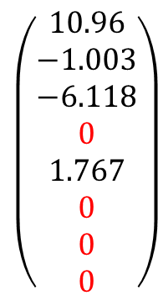
$$\left(\begin{matrix}10.96 \\ −1.003 \\ −6.118 \\ 0 \\ 1.767 \\ 0 \\ 0 \\ 0\end{matrix}\right)$$

Slide 40
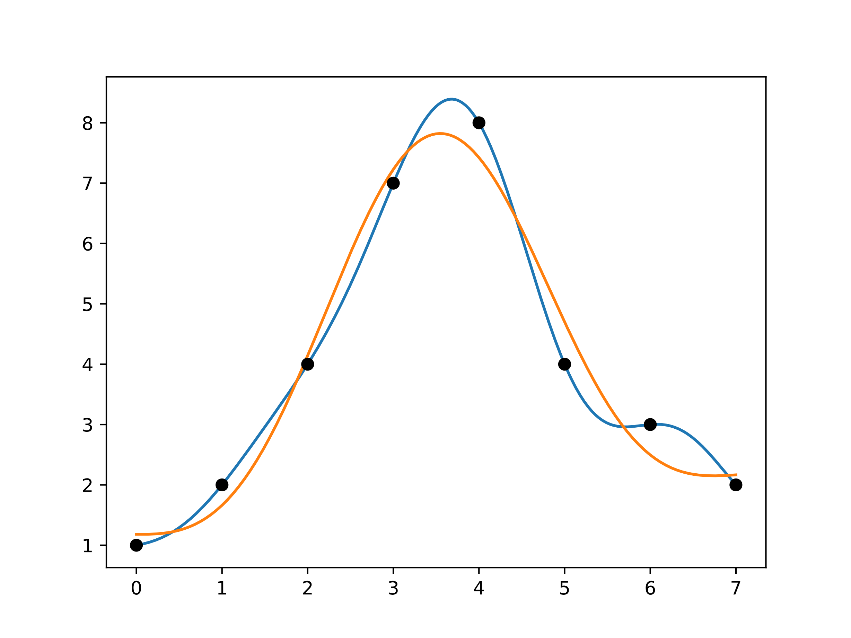
Notes:
Transformation an sich keine Kompression!! Mit dem zusatz natürlich verlustbehaftet, die Transformation ist vorbereitung auf Kompression.

Slide 41
Warum?

Slide 42
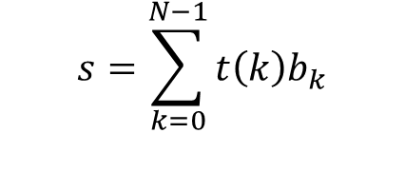

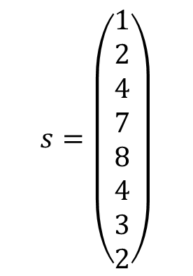

$$s=\begin{aligned}\left(\begin{matrix}1 \\ 2 \\ 4 \\ 7 \\ 8 \\ 4 \\ 3 \\ 2\end{matrix}\right)\end{aligned}$$
$$s={\left(s_{0},…,s_{N−1}\right)}^{T}$$
$$s=\sum_{k=0}^{N−1}{t\left(k\right)b_{k}}$$
$$s=\begin{aligned}\left(\begin{matrix}1 & 2 & 4 & 7 & 8 & 4 & 3 & 2 \\ 2 & & & & & & & \\ 4 & & & & & & & \\ 7 & & & & & & & \\ 8 & & & & & & & \\ 4 & & & & & & & \\ 3 & & & & & & & \\ 2 & & & & & & & \end{matrix}\right)\end{aligned}$$

Slide 43

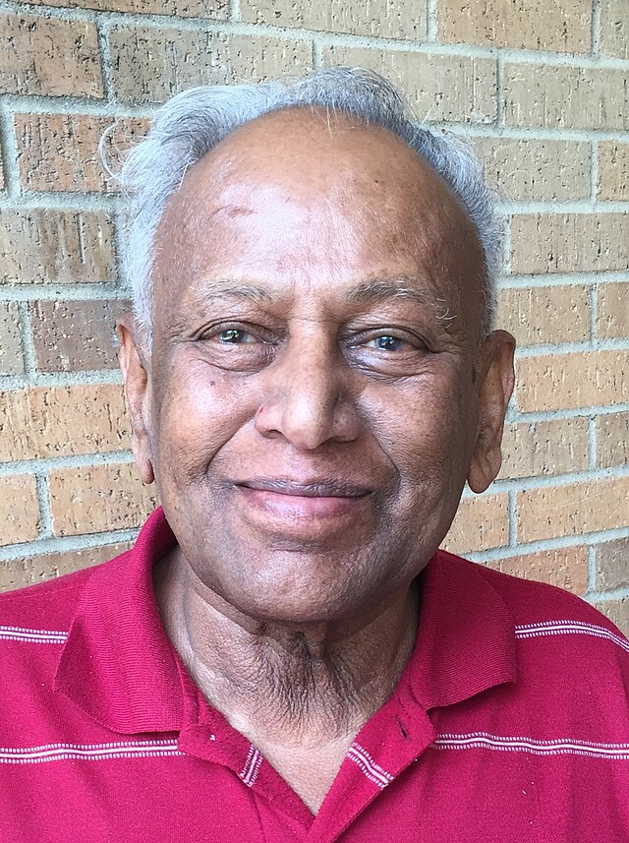
Notes:
Ans Ende packen, 3 min Ehrung für diese beiden!

