Slide 1

Ontology Engineering: from Cognitive Science to the Semantic Web
Maria Teresa Pazienza
University of Roma Tor Vergata, Italy

Slide 2
Role of natural language

Slide 3
Computational lexicons and natural language technologies
Computational lexicons provide a word knowledge that is comprehensible to machines
There is an esplicit representation
Word meaning is related to both its morphology and syntax
It is possible to create multilingual lexical links

Slide 4
Computational lexicons and natural language technologies
Computational lexicons are collections of lexical entries in a specific language
A lexical entry may correspond to a
lemma: dog, fine, house
flexed form : eats, eated, dogs, houses
For lemma based lexicons, each lexical entry may collect a variable amount of information

Slide 5
Computational lexicons and natural language technologies
Orthographic form
Categorial information (parts of discourse): N, V, P, ….
A few morphological info: gender, number, person, etc.
Information on selectional properties (subcategorization)
Information on lemma meaning (lexical semantics)

Slide 6
Computational lexicons and natural language technologies
A language processing system is composed, at least, by the following components
phrase/text
results
Syntactic analyzer/parser
Morphologic analyzer
Computational
lexicon

Slide 7
Ontologies and computational lexicons
Access to
Content
HLT
Semantic Web
Ontologies
Computational
Lexicons
?

Slide 8
Ontologies
“An ontology is an explicit specification of a conceptualization” (Gruber, 1993)
“it includes vocabulary, semantic links, a few simple inference rules and logics ” (Hendler, 2001)

Slide 9
“Linguistic” ontologies
Systems of symbols representing concepts as they are coded by linguistic expressions (lexical units, terms, ...)
  They specify semantic classes by grouping terms with similar meaning
  A language for semantic representation is used
car, van, truck
VEHICLE
ARTIFACT
dog, cat, horse
OBJECT
MAMMAL
ANIMAL
beach
BEACH
LOCATION
ENTITY
spiaggia
piano concert, rock concert
CONCERT
EVENT

Slide 10
“Linguistic” ontologies
Monolingual vs multilingual
General purpose vs domain specific
Tipes of content
  (Morpho)syntactic
  Semantic
  Mixed
  Terminological

Slide 11
Syntactic computational lexicons
Lexical information is represented into subcategorization frames (ComLex, PAROLE ecc.)
Syntactic frames express:
  A number of arguments
  Related syntactic categories (PP, NP, ecc.)
  Lexical constraints on arguments (ie. PP must have a preposition as first element)
  A functional role for each argument (Subj, Obj, ecc.)
hit [V: (Subj: NP) (Objd: NP)]
answer [N: (Obji: PP_to)]

Slide 12
Semantic computational lexicons
They represent the meaning of a word
  By distinguishing different word senses
  By expressing inferences (being a human => being an animate)
  By representing similarities, relatedness ecc. (es. bank, current account, money are concepts that are related in a financial context)

Slide 13
Semantic computational lexicons
Based on:
Conceptual nets
  WordNet (Miller, Fellbaum et al.)
  EuroWordNet (Vossen et al.)
  ..
Frames
  Mikrokosmos (Nirenburg, Mahesh et al.)
  FrameNet (Fillmore et al.)
  ..
Hybrid
  SIMPLE (Calzolari, Lenci et al.)
  ..

Slide 14
Semantic lexicons
Generally lexicons are alphabetically organized.
Mainly they reproduce the same structure of dictionaries as they publish infos just starting by words (starting from the lemma, ecc.)
It is possible to organize a lexicon on different bases, for example, on conceptual bases.

Slide 15
Words and concepts
words, ie. ‘dog, ‘eat, etc. express concepts.
Dogs are mammals
The phrase has among its constituents the words “dog”, “mammal”…
the proposition has among its constituents the concepts dog, mammal
Concepts may be considered a sort of constituents of the meaning (that is what we wish to communicate).
To understand propositions we must understand all concepts expressed by their constituents

Slide 16
Polysemy and synonymy
A given word, (ex. “bank”) may have different senses, that is may express more than one concept in different contexts; it is called polysemyc
bank = institution where people can keep their money, etc..
bank = raised ground along the edge of a river or lake, etc

Slide 17
Polysemy and synonymy
On the contrary, the same concept may be expressed by different words (synonyms)
house, residence, flat, …
Both synonymy and polysemy are not properties in a total approach, they are context dependent
These properties may be helpful for doing inference

Slide 18
Hyperonym and hyponym
A robin is (is-a) a bird, a bird is (is-a) an animal, an animal is (is-a) a living being…
robin is-a bird is-a animal is-a living being…
The concept robin is subordinate to the concept bird.
The concept bird is superordinate to the concept robin.
The word “robin” is a hyponym of the word “bird”
The word “bird” is a hyperonym of the word “robin”
These properties may be helpful for doing inference

Slide 19
Lexical concepts
A lexical concept is a concept that, in a specific language, may be expressed in a simple way (a word, a complex word, etc.).
house is a lexical concept
house made of glass, is not a lexical concept

Slide 20
Lexical concepts representation
A lexical concept may be represented as a set of synonym words (synset) that express that concept.
{automobile, car}
It is possible to relate synsets (representations of lexical concepts) by means of hyponyms and hyperonyms.
Criteria for inserting two words in the same synset:
A mother tongue person may substitute a word with the other in the highest number of contexts

Slide 21
{automobile, car} is-a
{vehicle} is-a
{transportation means }
……………..
{transportation means}
Is-a
{vehicle}
Is-a
{automobile,car}

Slide 22
WordNet (WN)
WordNet (WN) has been developed at the University of Princeton by George Miller research group as a model of mental lexicon. Def. by C. Fellbaum:
… a semantic dictionary designed as a net, to represent words and concepts as in interrelated system; it seems consistent with the evidence with which persons speacking organize their own mental lexicons…
It is a semantic network where concepts are defined in terms of relations with other concepts
In WordNet, words are structured in 15 different hierarchies. The root of each of them corresponds to a sort of semantic primitive.
{activity}, {animal}, {artifact}, {attribute}, {body}, {cognition, knowledge}, {communication}, {event}, ……

Slide 23
Hierarchies
activity
communication
……………………………………
……………………………………

Slide 24
WordNet (WN)
WordNet (WN) is a lexical database for English language
high coverage for English lexical entries (N, V, Adg, Adv)
information on lexical and semantic relations among entries
synonymy (automobile, car)
hyponymy - a kind of - (ambulance, automobile)
meronymy – has part – (hand, fingers)
antonymy (day, night)

Slide 25
WordNet WN
Each word can have different senses (identified by numbers) identifying a specific synset, that is composed by synonyms terms (i.e. <living form, organism, being, living object>).
With such a structure it is possible to explicit the glossa correspondent to a specific word sense (as in a conventional dictionary), as well as the semantic relations in which the glossa is involved.

Slide 26
WordNet (WN) structure
WN structural fundamental element is the
synset = synonym set
A synset is equivalent to a concept
A concept is expressed by a synset
Ex. Senses of “car” (synsets to which “car” belongs)
{car, auto, automobile, machine, motorcar}
{car, railcar, railway car, railroad car}
{cable car, car}
{car, gondola}
{car, elevator car}

Slide 27
WordNet (WN) structure
Separate tables (files) for different syntactic categories (N, V, Adg, Adv)
Links among words and synsets as well as among synsets (that represent syntactic relations)
Ex. {persons, individuals, humans }
a kind of {organism, being}
a kind of {living thing, animate thing}
a kind of {object, physical object}
a kind of {entity, physical thing}

Slide 28
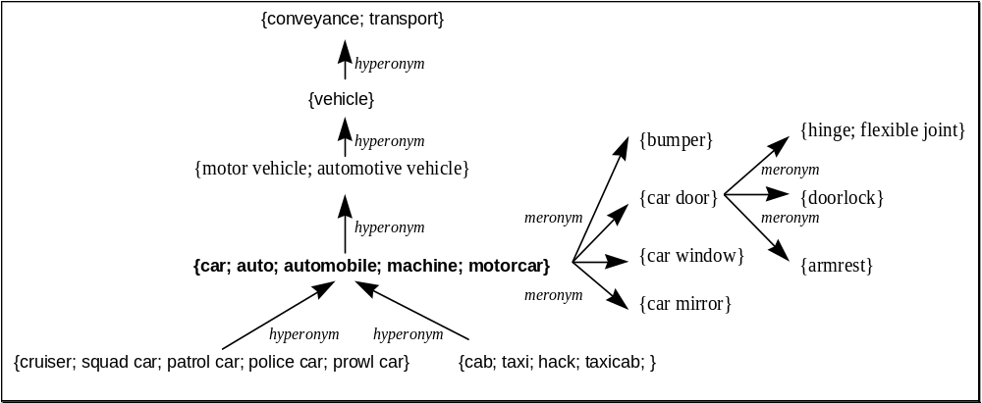
WordNet structure

Slide 29
WordNet WN
(not updated values)

Slide 30
WordNet WN
The word ``bass'' has 8 senses in WordNet
bass - (the lowest part of the musical range)
bass, bass part - (the lowest part in polyphonic music)
bass, basso - (an adult male singer with the lowest voice)
sea bass, bass - (flesh of lean-fleshed saltwater fish of the family Serranidae)
freshwater bass, bass - (any of various North American lean-fleshed freshwater fishes especially of the genus Micropterus)
bass, bass voice, basso - (the lowest adult male singing voice)
bass - (the member with the lowest range of a family of musical instruments)
bass -(nontechnical name for any of numerous edible marine and
freshwater spiny-finned fishes)

Slide 31
Hierarchies in WordNet

Slide 32
WordNet WN
Synsets are organized hierarchically by means of hyperonymy and hyponymy relations
Further semantic relations exist between synsets (role, part-of, cause); thanks them a very rich and complex semantic network has been realized.
By using the semantic structure of WordNet, each one can build a personalized cognitive view starting by a word.

Slide 33
WordNet WN
WN configures in two different aspects:
Lexicon describing different word senses
Ontology describing semantic relations between concepts.
WN has been initially created for English; then versions for further languages have been developed: Dutch, Spanish, Italian, Basc, ….
EuroWordNet multilingual database (Vossen)

Slide 34
WordNet WN
The Wordnet more relevant aspect is the notion of synset; through a synset it is possible to define a sense (as well a concept )
For example: table as a verb to indicate defer
  > {postpone, hold over, table, shelve, set back, defer, remit, put off}
For WordNet, the meaning of this sense of table is just this list.

Slide 35
WordNet WN domain independent lexical relations (among entries, senses, set of synonyms),

Slide 36
WordNet WN
A few problems:
There is a confusion between concepts and individuals (lack of expressivity: with the relation INSTANCE-OF it is not possible to distinguish between subsumption concept-concept and instantiation individual-concept)
Confusion between object-level and meta-level (i.e.: the concept Abstraction includes either abstract entities as Set, Time, Space, or abstractions and meta-level concepts as Attribute, Relation, Quantity)
Confusion between different levels of generality (i.e. entities are both types and roles)

