Slide 1
Big Data Quality Identity in Linked Data
Maria Teresa PAZIENZA
a.a. 2017-18
«when owl:sameAs isn’t the Same…»
H.Halpin, P.J. Hayes, J.P.McCusker, D.L. McGuinnes, H.S. Thompson

Slide 2
Introduction
The problem of «identity» is an outstanding and well known issue in artificial intelligence.
In the web of linked data is the first time the problem is encountered by different individuals attempting to independently knit their knowledge representation together using the same standardized language.
owl:sameAs in linked data tend to be mutually incompatible and almost always violate the strict logical semantics of identity demanded by owl:sameAs

Slide 3
What is Identity?
The problem of identity lies not within
Linked Data per se;
it is a long-standing and well-known issue in philosophy:
the problem of identity and reference.
Owl:sameAs
construct semantics is defined as stating that
«two URI references actually
refer to the same thing and
share all the same properties »

Slide 4
What is Identity on the web?
Owl:sameAs can be considered just one type of
«identity link»
a link that declares two items/individuals to be identical in some fashion or otherwise closely related
identity links define two individuals to be identical or otherwise closely related between diverse and heterogeneous data-sets.
It is unrealistic to assume everybody will use the same name to refer to individuals. In fact it would require some grand design which is contrary to the spirit of the web. (Ex: prof. Pazienza, mother of the bride, … )

Slide 5
Leibnitz law
If x is not identical to y, then there must be some property that they do not share.
If x and y share all properties (i.e. they are indiscernable) then they are identical

Slide 6
Different temporal spatial coordinates
Is Tim Berners-Lee as an adult the same as
Tim Berners-Lee of five minutes ago?
Or as a child?
Or if he lost his arm?
In the engineering discipline of knowledge representation we can never enumerate all possible properties.
As a solution we can have some properties as those necessary for identity, an explicit theory of identity criteria.
Two kind of properties:
intrinsic to the identity
extrinsic /purely relative to other things

Slide 7
Theory of identity
Theories of identity could be based on different criteria: some theories subsume weaker or stronger ones, but others are simply incommensurable.
Problems arise with respect to comparing values or asserted properties; ex.
Vague values: 2 inches are the same as 5 cm?
Contradictory properties:
Morning Star refers to Venus-
Evening Star refers to Venus;
may we consider true the equality among the two stars?

Slide 8
Logical analisys of identity
Inference:
When someone says two things are the same, the two things share all the same properties ;
so every property of one thing can be inferred to be a property of the other.
The question is:
does such a definition of identity work in
a decentralized environment
such as the Web of Linked Data?
The real problem with the use of URI as identifiers and Owl:sameAs is a problem of context and the implicit import of properties.

Slide 9
Varieties of identity
A possible solution: the agent’s claim, i.e.
The statement of identity is not necessarily true, but only stated by a particular agent
Then different agents may accept different identity statements and so have different inferences;
once an agent accepts an identity claim, the agent is bound to all its valid inferences
This issue comes into play when different agents describe the world at different levels of granurality.

Slide 10
Varieties of identity
A possible solution: weaker notion of being similar, i.e.
Two different things share some but not all properties in their given incomplete descriprion
A wine glass and a coffee-cup are similar as regards holding liquids, but they hold entirely different kinds of liquid usually and are different shapes;
so Leibnitz’s Law would not hold obviously as they are different things.
Condivisione di proprietà di livelli più alti dell’ontologia

Slide 11
Varieties of identity
A possible solution: related relationship, i.e.
When two different things share no properties in common in a given description but are nonetheless closely aligned in some fashion
Complex, structured, yet hard to-specify relationships between things that are «kind of close to identity», such as the relation between a quantity and a measurent of a quantity, or the use of a drug in a clinical trial and the drug itself
As on some trivial level «everithing is related», there are degrees of relatedness.
There is a family of heterogeneous and semi-structured relationships that should be studied more carefully and empirically observed before any hasty judgements are made

Slide 12
The similarity ontology
It has been proposed a number of new relationships of identity based on permutation around each of the properties of transitivity, symmetry and reflexivety: the Similarity Ontology.
We can use these properties to make inferences about the relationship in a certain domain-specific cases, while one would not thereby necessarily be claiming that any two objects having this new kind of relationship would share properties.

Slide 13
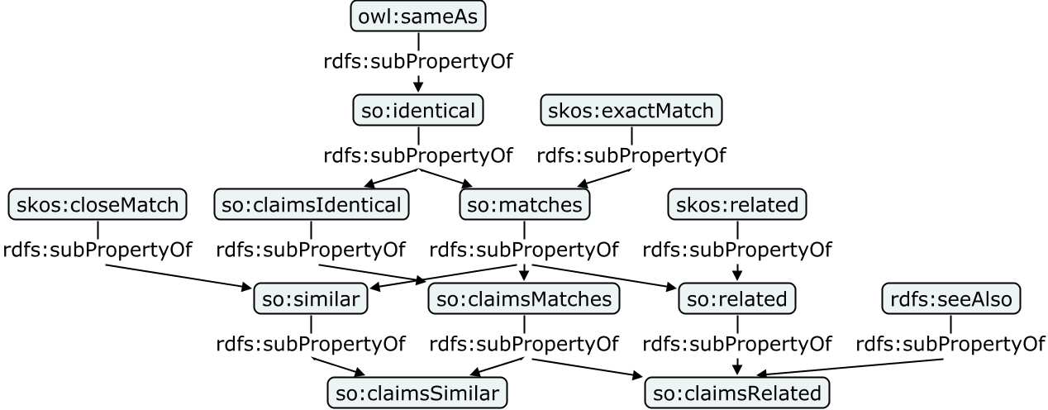
Sub-property relationships between the properties of the Similarity Ontology and existing properties from OWL, RDFS, and SKOS

Slide 14
Inference (with Similarity Onotology)
A particular property or set of properties are isomorphic across a particular kind of similarity.
This kind of entailment can be performed through introduction of a property chain introduced in OWL2, to express
«same relevant property as»
It is much more structured than a vague notion of matching and similarity

