Slide 1
Open Information Extraction
Matthias Huck and Alexander Fraser
Center for Information and Language Processing
LMU Munich
18 January 2017

Slide 2
Introduction
Reminder:
We know how to:
Recognize named entities in natural language text
Extract binary relations between named entities
We have an application scenario:
Relations can be stored in a knowledge base
And be used in question answering or spoken dialogue systems
But so far, there are limitations, most notably:
We have dealt with narrow domains (such as geographical location, food, plant seed development)
The sets of entity types and relations were closed and manually defined
Open IE aims at:
Not being limited to any single domain
Not being limited to pre-defined entity types and relations

Slide 3
Open IE: Task Definition
We want to find any relation that is expressed in large data sets.
Cannot resort to specialized domain knowledge
Cannot think of all possible relation types beforehand
Should rather not force all possible arguments into a rigid set of entity types
We want to scale to billions of documents that are heterogeneous wrt. domains, quality, credibility.
Which relations are correct?
Which are uninformative or incoherent?
Which are redundant?

Slide 4
Open Relation Extraction: Example
Hudson was born in Hampstead, which is a suburb of London
(Hudson, was born in, Hampstead)
(Hampstead, is a suburb of, London)
[Fader et al.. Identifying Relations for Open Information Extraction. Proc. of EMNLP, Edinburgh, Scotland, UK, July 2011.]

Slide 5
Open Relation Extraction: Basic Approach
Learn a general model of how (arbitrary) relations are expressed in a particular language.
Neither relation names nor argument types known in advance
Bootstrap with heuristics or distant supervision
Train a (sequence) classifier (often with unlexicalized features)

Slide 6
CHALLENGES
Synonym resolution
Disambiguation
Vagaries of natural language
Entities with same name
Different names for entitites
Entity linking
Fake news
Temporal and spatial aspects
Fact consistency checks
…

Slide 7
Synonym Resolution
The same entity may be referred to by a variety of names.
Michael Jackson; Jacko; The King of Pop; . . .
The same fact may be expressed in a variety of ways.
IBM built Watson - IBM created Watson--IBM invented Watson
. . .
Dookie is a record by Green Day
Dookie is an album by Green Day
. . .
RESOLVER identifies synonymous relations and objects
[Yates and Etzioni. Unsupervised Resolution of Objects and Relations on the Web. Proc. of the NAACL, Rochester, NY, USA, April 2007.]
[Etzioni et al.. Open Information Extraction from the Web. Communications of the ACM, vol. 51 no. 12, Dec. 2008.]

Slide 8
Disambiguation
The same string may refer to different entities
(especially across different domains).
Watson, the founder of IBM; Watson, the computer system – Watson, Sherlock Holmes' friend (entity linking)
mouse, the animal; mouse, the input device
1984, the year; 1984, the book
Paris, France; Paris, Texas
[Etzioni et al.. Open Information Extraction from the Web. Communications of the ACM, vol. 51 no. 12, Dec. 2008.]

Slide 9
Vagaries of Natural Language
pronoun resolution
metaphor
anaphora
complex or ungrammatical sentences
irony, sarcasm
. . .
[Etzioni et al.. Open Information Extraction from the Web. Communications of the ACM, vol. 51 no. 12, Dec. 2008.]

Slide 10
Entity Names: three Main Problems
1-Entities with Same Name
Same type of entities share names
Kevin Smith, John Smith, Springfield (The Springfields were a British pop-folk vocal trio who had success in the early 1960s in the UK, US and Ireland. They included singer Dusty Springfield and her brother, record producer Tom Springfield, along with Tim Feild, who was replaced by Mike Hurst.), …
Things named after each other
Clinton, Washington, Paris, Amazon, Princeton, Kingston, …
Partial Reference
First names of people, Location instead of team name, Nick names

Slide 11
Entity Names: three Main Problems(2)
2-Different Names for Entities
Nick Names
Bam Bam (Steve Bannon consigliere di Trump), Drumpf (Donald Trump), … …
Typos/Misspellings
Baarak, Barak, Barrack, …
Inconsistent References
MSFT, APPL, GOOG…

Slide 12
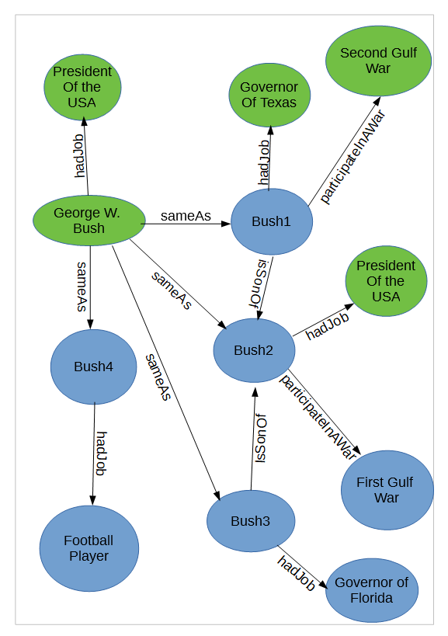
Entity Names: three Main Problems(3)
3- Entity linking

Slide 13
Incorrect Information
Nowadays referred to as “fake news”.
Elvis killed JFK
Rate the reliability of an extracted relation.
The relation extractor may have made an error (cf. the confidence function)
Occurrance frequencies over the whole corpus can give an indication
Credibility of the source of a document
[Kasneci et al.. The YAGO-NAGA Approach to Knowledge Discovery. ACM SIGMOD Record Volume 37 Issue 4, Dec. 2008.
https://suchanek.name/work/publications/sigmodrec2008.pdf]
[Etzioni et al.. Open Information Extraction from the Web. Communications of the ACM, vol. 51 no. 12, Dec. 2008.]

Slide 14
Fact Consistency Checks
Avoid contradictory facts within the knowledge base
Elvis died in 460 AD cannot refer to Elvis Presley
if we already knows that Elvis Presley was born in 1935
born(X,Y) ^ died(X,Z) ) Y < Z
appears(A,P,B) ^ R(A,B) ) expresses(P,R)
appears(A,P,B) ^ expresses(P,R) ) R(A,B)
means(“Elvis”,Elvis_Presley, 0.8)
means(“Elvis”,Elvis_Costello, 0.2)
Implemented in the SOFIE IE system, which aims to extend the YAGO knowledge base
[Suchanek. Information Extraction for Ontology Learning. Book chapter in Völker and Lehman: Perspectives on OntologyLearning, 2014. https://suchanek.name/work/publications/ontologybookchapter.pdf]

Slide 15
Temporal and Spatial Aspects
Time
The capital city of the Federal Republic of Germany?
Bonn (in 1981). Berlin (in 2016).
Plato has not met with Tsipras
Space
An elephant does not fit into a coffee mug
Trees don’t travel
Somebody who pays in GBP is probably located in Britain
Time and Space
Plato has never seen a kangaroo

Slide 16
Summary: Open IE
Discovering relations without a closed set of pre-defined relation types
Open-domain
Learning from the whole Web
Distant supervision / bootstrapping to get started
Attention to detail required to avoid pitfalls
The system should benefit from the sheer size of the data
It should learn more by itself when being run perpetually, and becomes more reliable

