Slide 1
Big Data Quality Identity in Linked Data
Maria Teresa PAZIENZA
a.a. 2018-19
«when owl:sameAs isn’t the Same…»
H.Halpin, P.J. Hayes, J.P.McCusker, D.L. McGuinnes, H.S. Thompson

Slide 2
Introduction
The problem of «identity» is an outstanding and well known issue in artificial intelligence.
In the web of linked data is the first time the problem is encountered by different individuals attempting to independently knit their knowledge representation together using the same standardized language.
owl:sameAs in linked data tend to be mutually incompatible and almost always violate the strict logical semantics of identity demanded by owl:sameAs

Slide 3
What is Identity?
The problem of identity lies not within
Linked Data per se;
it is a long-standing and well-known issue in philosophy:
the problem of identity and reference.
Owl:sameAs construct semantics is defined as stating that
«two URI references actually
refer to the same thing and
share all the same properties »

Slide 4
What is Identity on the web?
Owl:sameAs can be considered just one type of
«identity link»
a link that declares two items/individuals to be identical in some fashion or otherwise closely related
identity links define two individuals to be identical or otherwise closely related between diverse and heterogeneous data-sets.
It is unrealistic to assume everybody will use the same name to refer to individuals. In fact it would require some grand design which is contrary to the spirit of the web. (Ex: prof. Pazienza, mother of the bride, … )

Slide 5
Leibnitz law
a)
If x is not identical to y,
then there must be some property that they do not share.
b)
If x and y share all properties (i.e. they are indiscernible)
then they are identical

Slide 6
Different temporal spatial coordinates
Is Tim Berners-Lee as an adult the same as
Tim Berners-Lee of five minutes ago?
Or as a child?
Or if he lost his arm?
In the engineering discipline of knowledge representation we can never enumerate all possible properties.
As a solution we can have some properties as those necessary for identity, an explicit theory of identity criteria.
Two kind of properties:
intrinsic to the identity
extrinsic /purely relative to other things

Slide 7
Theory of identity
Theories of identity could be based on different criteria: some theories subsume weaker or stronger ones, but others are simply incommensurable.
Problems arise with respect to comparing values or asserted properties; ex.
Vague values: 2 inches are the same as 5 cm?
Contradictory properties:
Morning Star refers to Venus-
Evening Star refers to Venus;
may we consider true the equality among the two stars?

Slide 8
Logical analisys of identity
Inference:
When someone says two things are the same, the two things share all the same properties ;
so every property of one thing can be inferred to be a property of the other.
The question is:
does such a definition of identity work in
a decentralized environment
such as the Web of Linked Data?
The real problem with the use of URI as identifiers and Owl:sameAs is a problem of context and the implicit import of properties.

Slide 9
Varieties of identity
A possible solution: the agent’s claim, i.e.
The statement of identity is not necessarily true, but only stated by a particular agent
Then different agents may accept different identity statements and so have different inferences;
once an agent accepts an identity claim, the agent is bound to all its valid inferences
This issue comes into play when different agents describe the world at different levels of granurality.

Slide 10
Varieties of identity
A possible solution: weaker notion of being similar, i.e.
Two different things share some -but not all -properties in their given incomplete descriprion
A wine glass and a coffee-cup are similar as regards holding liquids, but they hold entirely different kinds of liquid usually and are different shapes;
so Leibnitz’s Law would not hold obviously as they are different things.
Condivisione di proprietà di livelli più alti dell’ontologia

Slide 11
Varieties of identity
A possible solution: related relationship, i.e.
When two different things share no properties in common in a given description but are nonetheless closely aligned in some fashion
Complex, structured, yet hard to-specify relationships between things that are «kind of close to identity», such as the relation between a quantity and a measurent of a quantity, or the use of a drug in a clinical trial and the drug itself
As on some trivial level «everything is related», there are degrees of relatedness.
There is a family of heterogeneous and semi-structured relationships that should be studied more carefully and empirically observed before any hasty judgements are made

Slide 12
The similarity ontology
It has been proposed a number of new relationships of identity based on permutation around each of the properties of transitivity, symmetry and reflexivety: the Similarity Ontology.
We can use these properties to make inferences about the relationship in a certain domain-specific cases, while one would not thereby necessarily be claiming that any two objects having this new kind of relationship would share properties.

Slide 13
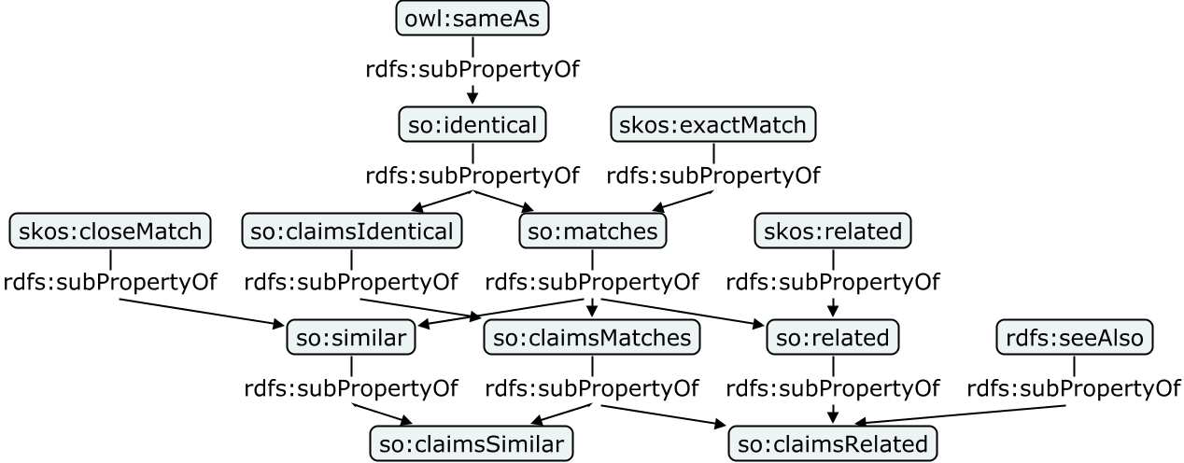
Sub-property relationships between the properties of the Similarity Ontology and existing properties from OWL, RDFS, and SKOS

Slide 14
Inference (with Similarity Onotology)
A particular property or set of properties are isomorphic across a particular kind of similarity.
This kind of entailment can be performed through introduction of a property chain introduced in OWL2, to express
«same relevant property as»
It is much more structured than a vague notion of matching and similarity

Slide 15
Linked Data quality
Linked Data quality can be measured along several dimensions, including
accessibility, interlinking, performance, syntactic validity or completeness
In each of these dimensions, we can define a number of concrete metrics, which can be used to precisely and objectively measure a certain indicator for linked data quality.
Additionally, domain specific quality metrics can be defined

Slide 16
Linked Data quality
Ensuring data quality in Linked Open Data is a complex process as it consists of structured information supported by models, ontologies and vocabularies and contains queryable endpoints and links.

Slide 17
Objective linked data quality classification
The basic idea behind Linked Data is that its usefulness increases when it is more interlinked with other datasets. Tim Berners-Lee defined four main principles for publishing data that can ensure a certain level of uniformity reflecting directly data’s usability
Make the data available on the Web: assign URIs to identify things.
Make the data machine readable: use HTTP URIs so that looking up these names is easy.
Use publishing standards: when the lookup is done provide useful information using standards like RDF.
Link your data: include links to other resources to enable users to discover more things

Slide 18
Objective linked data quality classification
Building on previous principles, we group the quality attributes into four main categories:
Quality of the entities: quality indicators that focus on the data at the instance level.
Quality of the dataset: quality indicators at the dataset level.
Quality of the semantic model: quality indicators that focus on the semantic models, vocabularies and ontologies.
Quality of the linking process: quality indicators that focus on the inbound and outbound links between datasets.

Slide 19
Modeling Quality
Reusing existing ontologies is a common practice that Linked Data publishers are always trying to adopt.
However, ontologies and vocabularies development is often a long error-prone process especially when many contributors are working consecutively or collaboratively. This can introduce deficiencies such as redundant concepts or conflicting relationships.
Getting to choose the right ontology or vocabulary is vital to ensure modeling correctness and consistency.

Slide 20
Dataset Quality
Considering the large amount of available datasets in the Linked Open Data, users have a hard time trying to identify appropriate datasets that suit certain tasks.
The most adopted approaches are based on link assessment.
Provenance-based approaches and entity-based approaches are also used to compute not only dataset rankings, but also rankings on the entity level.

