Slide 1
IDRA
A framework for ontology Learning FROM Big Data
Ing. Roberto Enea
Senior Software Engineer
@SecureAuth

Slide 2
Summary
IDRA (Inductive Deductive Reasoning Architecture): General Framework for Ontology Learning
Challenge
Architecture and Data Model (LOM)
Components
Kevin: an IDRA Use Case to collect user data in order to highlight risk factors for Social Engineering Attack Susceptibility
Facebook Crawling
Evaluation Criteria

Slide 3
ETL (Extract Transform Load)
The main result of the ETL process is to give a new and useful semantics to data.
Examples in Identity and Access Governance
Abandoned Accounts
Orphan Accounts

Slide 4
ETL from Web Challenge
Managing Data Evolution
Change of perspectives: not only documents but sources
Managing Volume
New data storage approaches are needed
Managing Uncertainty

Slide 5

Managing Uncertainty
two different kinds of uncertainty: objective and subjective.
An objective uncertain data is something that is inherently uncertain. As an example, we could mention the daily weather forecast where the chance of rain is expressed with a given probability.
The subjective uncertain data represents facts that are inherently true or false, but their value is hard to be defined because of data noise.
Our aim is to reduce subjective uncertainty of extracted facts in order to embed them in the learning ontology

Slide 6
Managing Uncertainty
Our approach can be summarized by the following features:
Use of a value in the range of [0,1000] to represent the level of uncertainty of an axiom (RDF statement) coming from the ontology learning process. The value depends on:
The algorithms used to extract the statement
The sources’ reliability
A dedicated infrastructure to manage the LOM (Learning Ontology Model) including management of the confidence level (the confidence level is not included in the learned ontology)
Providing a tool for running SPARQL what-if queries to the user, in order to let him investigate and validate uncertain statements using an interrogative model approach

Slide 7
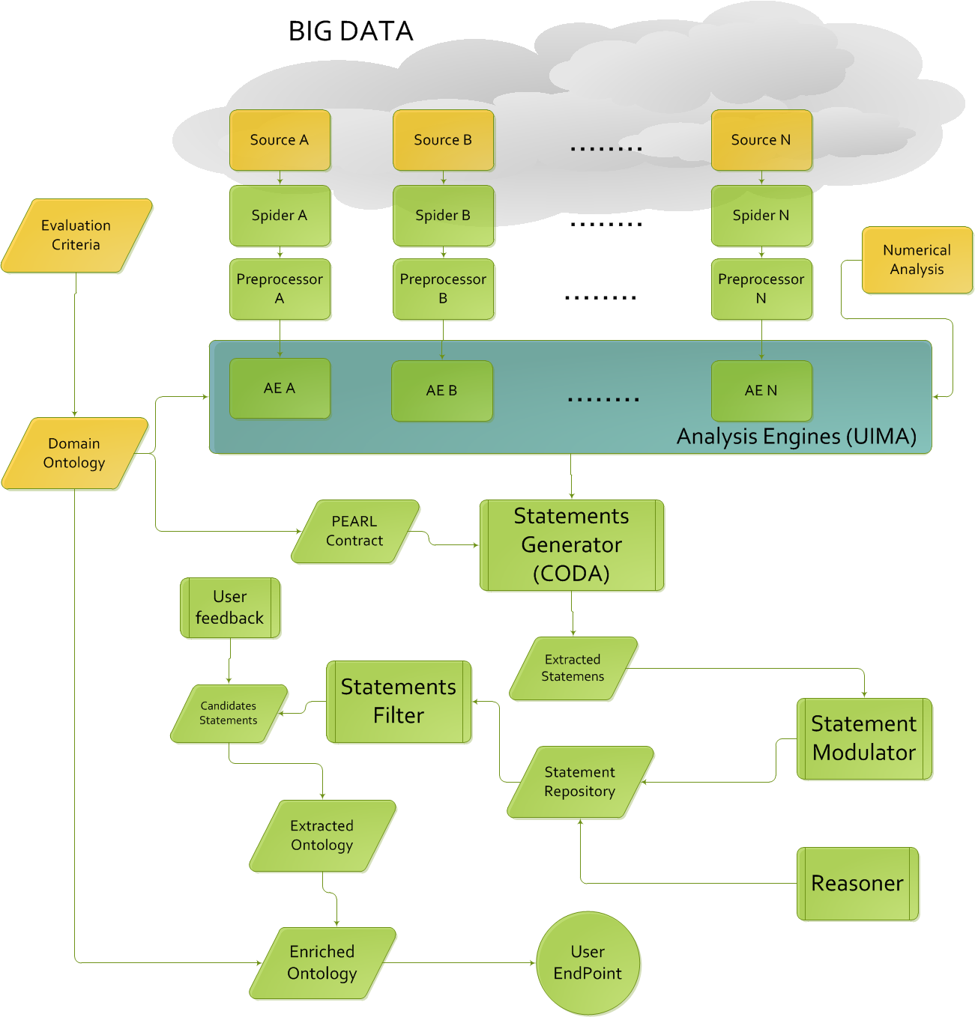
IDRA Concept

Slide 8
Structural Components
Statements Generator: The module implementing the statements generation.
Statements Repository: the repository storing the LOM
Statements Modulator: This module update the confidence level of the incoming triples
Analysis tools (query What if, Reasoner)

Slide 9
Domain dependent components
Domain Ontology: the ontology including the initial ontology and inference rules
Analysis Engines (UIMA annotators): the set of annotators specific for each source monitored
Projection Rules: the rules used to map the annotation to the domain ontology. It is used by CODA to generate the triples
Inference Rules: the set of rules to infer the required categorization on data
Crawler: the module dedicated to data extraction. It is strictly related to the source monitored.

Slide 10



IDRA Architecture
Statements Generator FB
Statements Generator Wiki
LAM
(Learned Axioms Manager)
Statements Generator RG

Slide 11
Statements Generator
REST Interface
Sources
Crawler
Analysis Engine
(UIMA Annotator)
CODA
Triples
Domain Ontology
Projection
Rules

Slide 12
Learned Axiom Manager
REST Interface
Domain
Ontology
Triples
Statements
Modulator
SPARQL
Parser
Reasoner
Inference
Rules
Repository

Slide 13
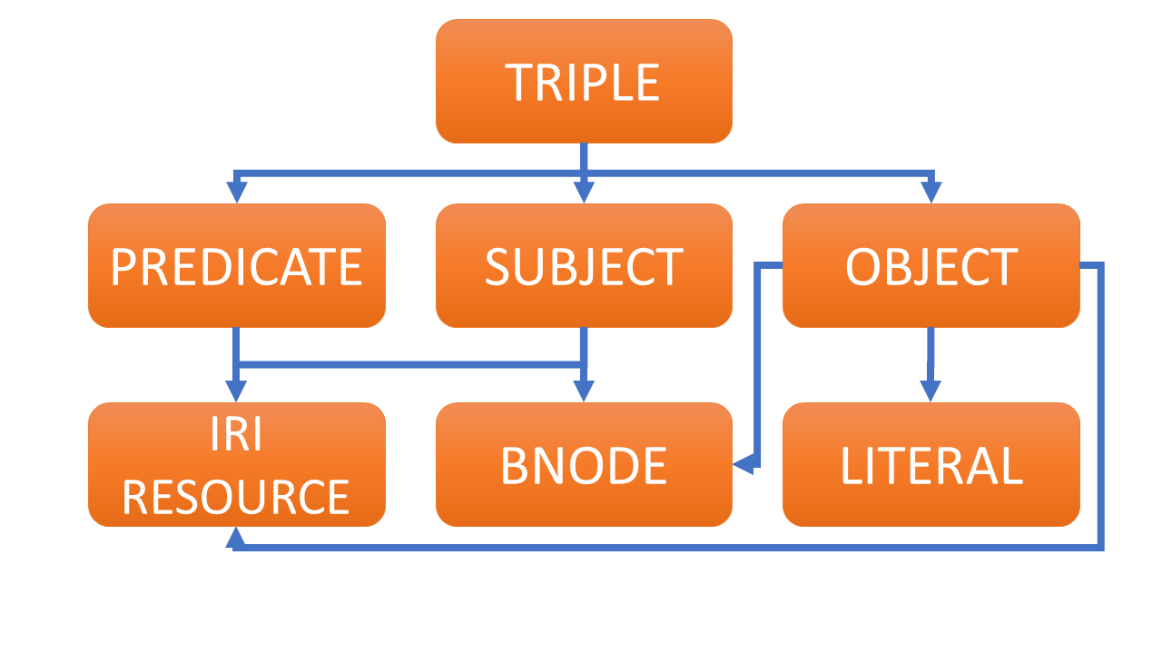
LOM Data Model
The main entity of the model is the Triple.
It contains some important attributes required for the managing of uncertain statements:
the confidence level
the number of occurrences
the source
If a single instance of a triple is extracted from the analyzed documents the SM will assign to the triple the same confidence level coming from the SG, otherwise it will calculate the average of the confidence level increasing the number of occurrences.
The source indicates the original corpus the statement has been extracted from.

Slide 14
In-Memory graph DBs
Based on Binary Matrices used as Adjacency matrices to store Relationships between entities
All the indexes are stored in memory
Persistence is used just from not frequently accessed properties

Slide 15
In-Memory graph DBs
Adjacency matrices make the indirect relationship computation easy
Facebook Profile
Places
 | X | Y | Z
a
b
c
d
e
Friends
 | A | B | C
f
g
h
i
l
m
n
 | f | g | h | i | l | m | n
X
Y
Z
Users
Facebook Profile
Friends

Slide 16
In-Memory graph DBs
In order to compute the relationships between the Users and the places where their friends live,
It is enough to compute the Boolean matrix product of the three matrices above
Places
 | A | B | C
f
g
h
i
l
m
n
 | X | Y | Z
a
b
c
d
e
 | A | B | C
a
b
c
d
e
 | f | g | h | i | l | m | n
X
Y
Z
Users

Slide 17
In-Memory graph DBs
Hierarchy navigation
 | a | b | c | d | e | f | g | h
a
b
c
d
e
f
g
h
a
c
 | a | b | c | d | e | f | g | h
a
b
c
d
e
f
g
h
b
d
e
g
f
h

Slide 18
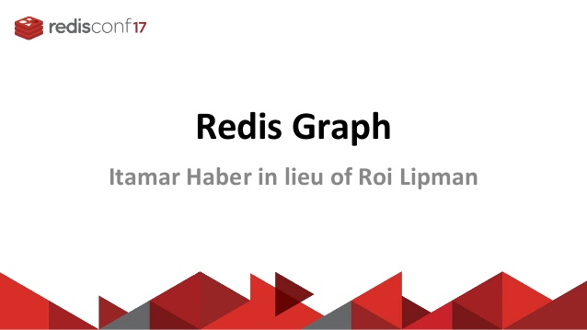

In-Memory graph DBs OS

Slide 19
Use case: Kevin
Detection system of people at risk of SE Attacks.
Sources: main social networks
Domain ontology: based on common HR Db entities
Inference rules coming from: Samar Muslah Albladi and George R. S. Weir, «User characteristics that influence judgment of social engineering attacks in social Networks»

Slide 20
Facebook Crawling
In order to overcome several blocking systems adopted by Facebook to avoid crawling I considered to use:
Selenium: A java library for Web UI Automation, usually used by QA Engineers
Several Agents (fake profiles with no friends to not influence Facebook search)
Random delays between actions to simulate human behavior

Slide 21
Projection Rules Strategy
The confidence level is evaluated using the edit distance between the field extracted and the
corresponding information in HR Profile.
It is applied to the hasFacebook profile relationships, while the relationships between Facebook
profile and its attributes have the maximum cl
HR Profile
CL=1000
Job
Facebook
Profile
CL[0, 1000]
Education
Company

Slide 22
Inference Rules
Rule name | Rule Description
Identifiable | Person(?x) ^ kevin-ontology:hasFacebookProfile(?x, ?y) -> kevin-ontology:Identifiable(?x)
HighInformationDisseminator | kevin-ontology:Person(?x) ^ kevin-ontology:FacebookProfile(?y) ^ kevin-ontology:hasFacebookProfile(?x, ?y) ^ kevin-ontology:hasJob(?y, ?z) ^ kevin-ontology:livingPlace(?y, ?l) ^ kevin-ontology:spouse(?y, ?h) ^ kevin-ontology:studied(?y, ?d) ^ kevin-ontology:studiedAt(?y, ?m) ^ kevin-ontology:workFor(?y, ?u) -> kevin-ontology:HighInformationDisseminator(?x)
VerySusceptibleToSEA | kevin-ontology:Identifiable(?x) ^ kevin-ontology:HighInformationDisseminator(?x) -> kevin-ontology:VerySusceptibleToSEA(?x)
MediumInformationDisseminator | kevin-ontology:Person(?x) ^ kevin-ontology:FacebookProfile(?y) ^ kevin-ontology:hasFacebookProfile(?x, ?y) ^ kevin-ontology:livingPlace(?y, ?l) ^ kevin-ontology:studiedAt(?y, ?m) ^ kevin-ontology:workFor(?y, ?u) -> kevin-ontology:MediumInformationDisseminator(?x)
ModeratelySusceptibleToSEA | kevin-ontology:MediumInformationDisseminator(?x) ^ kevin-ontology:Identifiable(?x) -> kevin-ontology:ModeratelySusceptibleToSEA(?x)

Slide 23
Inference Rules
The inference Rules are expressed in SWRL language because:
It is flexible (a lot of built-in function that let the user implement advanced rules)
It starts from OWA
It is embedded inside the ontology in OWL format
The extended specification (built in functions) is supported by few reasoners

Slide 24
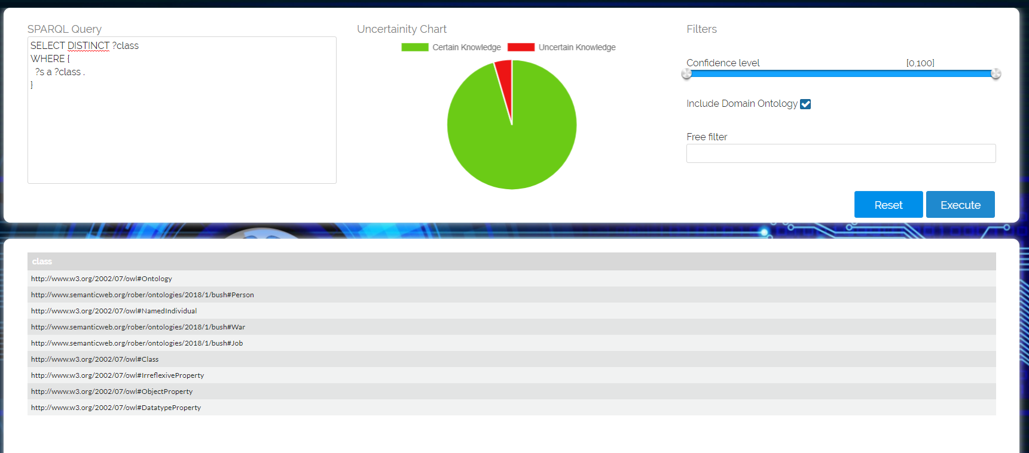
Demo

Slide 25

Q&A

